Slide 1

Progress and next steps
2 February 2017 this version is the minutes of the meeting
J. J. John on behalf of the team

Slide 2
Agenda
Discuss progress and steps for next week:
  ABCN’ emulator
  firmware - SACI
  readout software
  CHESS-2-to-FMC adaptor board
  Other CHESS-2 hardware
  CHESS-2 mini-module
  TWiki page for CHESS and its test hardware: https://twiki.cern.ch/twiki/bin/view/Atlas/CHESSStripTestChip

Slide 3
ABCN’ firmware status
  Atlys firmware / CHESS-2 analogue test status:
  Working on stimulating pixels with sources and (after next week) with a laser.
  DAC voltage issues resolved – was a wire-bonding issue (missed a pad, disconnected)
  We collectively haven’t been able to
    see charge injection working – may have issue with this circuit
    see a recognisable pulse on the analogue outputs – but the load presented to the analogue outputs may just be too high.
    (well, we see a pulse on the outputs when sending in a large charge injection pulse, but it appears to be cross-talk or ground bounce, not charge injection)
  Hervé has had success working with the digital output of the test array, where we mux one of 512 pixels’ comparator outputs onto a digital output.
    We’ll pursue that.

Slide 4
ABCN’ firmware status, continued
  Nexys Video firmware and software status:
  .

Slide 5
ABCN’ firmware status – from last week
  Just so we can go over these suggestions, as a reminder for discussion:
  One possibility is that ISE optimised away some connections.
    Under Synthesize, look at View Technology Schematics. This shows what circuitry is left after optimisation, so you’d see if the SACI outputs reach the FPGA pins.
  For the SACI clock issue:
    In the latest ocb_saci.vhd from Matt (in ITSDAQ svn), saci_clk comes from:
      saci_clk <= not(tog_saci_clk_i) and saci_clk_en;
    tog_saci_clk_i is connected to tog_i(T_4MHz), ultimately from ticks_gen.vhd. You could check that this line is toggling.
    saci_clk_en is generated by the main state machine prc_async_machine. In the usual sequence, it becomes ‘1’ in state PayloadWordX (and remains ‘1’ until SendReply is reached).
    So it could help to monitor the current and next state of both the main state machine and the serialiser-deserialiser state machine with ChipScope . Perhaps the state machines are not starting up, or never reaching PayloadWordX in any case.
    If the expected states aren’t reached, can then look at the inputs to see why.

Slide 6
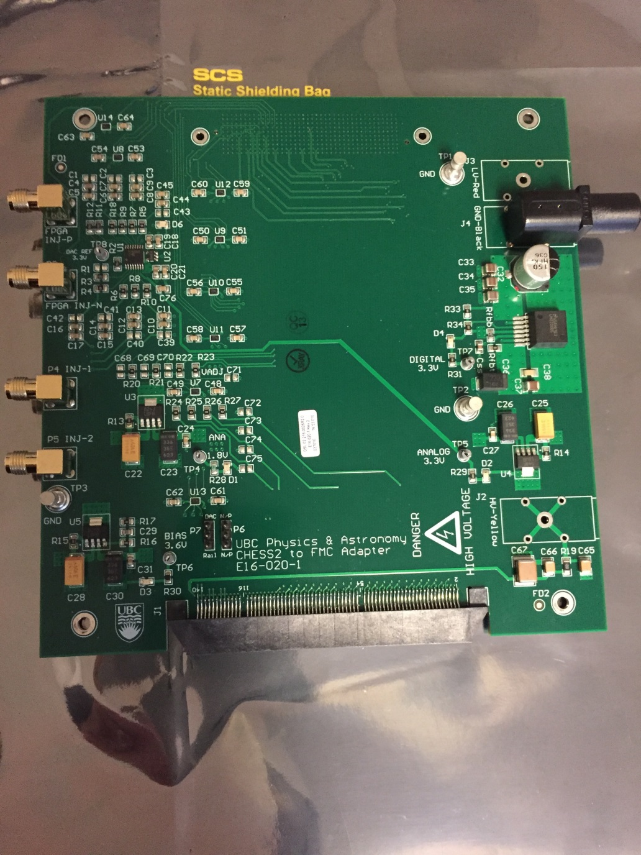
CHESS-2-to-FMC adaptor board status
  Current status:
  .

Slide 7
CHESS-2 other hardware
  Current status:
  Similar to last week: digital testing is proceeding well except for the charge injection.
  Su Dong wanted a clearer status about charge injection before sending out hardware.
CHESS-2 mini-module
More details of the connector:
    The connector is the ITSDAQ standard 0.05" Samtec connector FTSH-125-01-F-DV
    This is organised as 13 signal pairs and 12 ground pairs, alternating, for constant impedance and to minimise cross-talk. The signal pairs are:
      1 x bunch crossing clock BCO
      1 x command COM
      1 x request line L1R
      8 x data
      2 x spare lines
    Next: go over data out requirements.

