Slide 1

Progress and next steps
2 February 2017 this version is the minutes of the meeting
J. J. John on behalf of the team

Slide 2
Agenda
Discuss progress and steps for next week:
  ABCN’ emulator
  firmware - SACI
  readout software
  CHESS-2-to-FMC adaptor board
  CHESS-2 digital hardware
  CHESS-2 mini-module
  ABC130*/HCC* news
  TWiki page for CHESS and its test hardware: https://twiki.cern.ch/twiki/bin/view/Atlas/CHESSStripTestChip

Slide 3
ABCN’ firmware status
  Atlys firmware / CHESS-2 analogue test status:
  Several of us are working in parallel on the analogue testing: Hervé in Santa Cruz, Kestutis in Glasgow and Todd and Jaya John in Oxford. See Hervé’s update (Tuesday)
  Not working yet – have not yet seen:
    charge injection– may have issue with this circuit (since also not seen with digital system)
    a recognisable pulse on the analogue outputs – but the load presented to the analogue outputs may be too high.
  Working:
    DAC voltage issues on Oxford analogue daughterboard resolved – was a wire-bonding issue (missed a pad, disconnected)
    Hervé has had success working with the digital output of the test array, where we mux one of 512 pixels’ comparator outputs onto a digital output.
  Next steps:
    stimulate pixels with sources and lasers (Oxford system available after next week)
    isolate analogue output lines from the daughterboard traces and motherboard
    more work with digital output of test array

Slide 4
ABCN’ firmware status, continued
  Nexys Video firmware and software status:
  Will be continuing with ChipScope later this week.
  See suggestions from last week on next slide.

Slide 5
Nexys Video next steps – from last week
  As a reminder:
  One possibility is that ISE optimised away some connections.
    Under Synthesize, look at View Technology Schematics. This shows what circuitry is left after optimisation, so you’d see if the SACI outputs reach the FPGA pins.
    Inserting a ChipScope at the main level should could also clarify this.
  For the SACI clock issue:
    In the latest ocb_saci.vhd from Matt (in ITSDAQ svn), saci_clk comes from:
      saci_clk <= not(tog_saci_clk_i) and saci_clk_en;
    tog_saci_clk_i is connected to tog_i(T_4MHz), ultimately from ticks_gen.vhd. You could check that this line is toggling.
    saci_clk_en is generated by the main state machine prc_async_machine. In the usual sequence, it becomes ‘1’ in state PayloadWordX (and remains ‘1’ until SendReply is reached).
    So it could help to monitor the current and next state of both the main state machine and the serialiser-deserialiser state machine with ChipScope. Perhaps the state machines are not starting up, or never reaching PayloadWordX in any case.
    If the expected states aren’t reached, can then look at the inputs to see why.

Slide 6
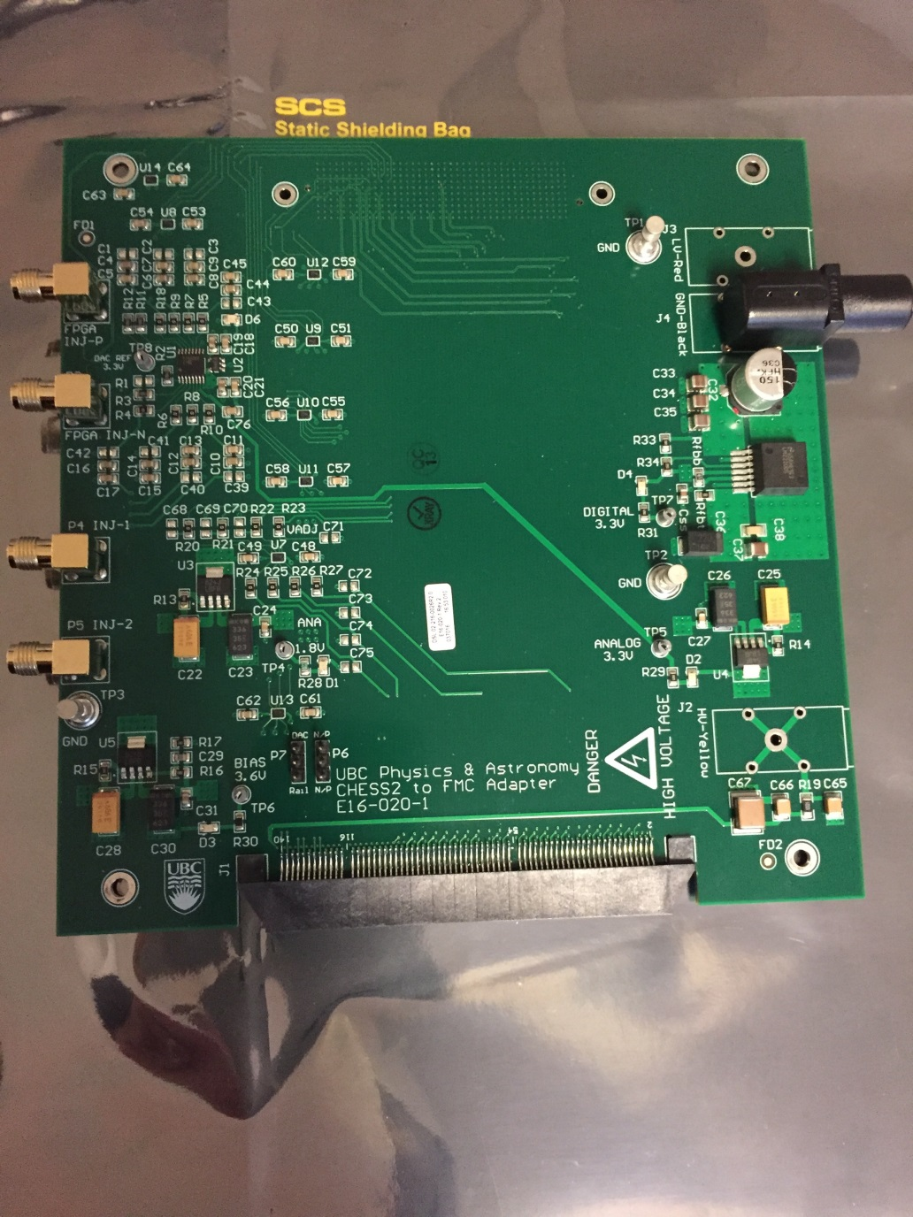
CHESS-2-to-FMC adaptor board status
  Current status:
  No problems seen with the power, shifters and DAC elements during low level testing.
  Power connectors have arrived and will be added soon.

Slide 7
CHESS-2 digital hardware
  Current status:
  Digital testing is proceeding well except for the charge injection.
  Su Dong wanted a clearer status about charge injection, in case the carrier board needed changes to enable it to work, before sending out hardware.
  The daughterboard layout is being revised for the BL & BLR connections and to ease the wire-bonding. This is to make bonds more perpendicular to chip edge, though it is challenging to change as the signal layers are packed with traces.
  Jaya John estimates it might be roughly +1 week of layout changes and Su Dong said ~2 weeks to manufacture, so subject to confirmation, probably ~3 weeks away from having revised bare boards.
  There are 5 first-revision carrier boards in all, but Jaya John wasn’t sure how many first-revision daughterboards there are.
  If at UBC, you see you are 1-2 weeks away from wanting a digital daughterboard, let Su Dong know.

Slide 8
CHESS-2 mini-module
More details of the connector:
    The connector is the ITSDAQ standard 0.05" Samtec connector FTSH-125-01-F-DV
    This is organised as 13 signal pairs and 12 ground pairs, alternating, for constant impedance and to minimise cross-talk. The signal pairs are:
      1 x bunch crossing clock BCO
      1 x command COM
      1 x request line L1R
      8 x data
      2 x spare lines
    Next: go over data out requirements.
    Jaya John to look over data out lines needed and draft a proposal for the connectors.

Slide 9
ABC130*/HCC* news
Paul let us know:
    The HCC* specs are nearly complete.
      The command protocol is still evolving. It is expected to settle by end of February.
    The data format for ABC* to HCC* has changed to fixed length from variable length.
    Paul would be happy to present a summary of changes in this meeting in the future.
    After the March ATLAS Upgrade Week could be a good point, as we usually have a push to update the specs for AUWs.

