Slide 1

Progress and next steps
9 February 2017 this version is the minutes of the meeting
J. J. John on behalf of the team

Slide 2
Agenda
Discuss progress and steps for next week:
  ABCN’ emulator
  firmware - SACI
  readout software
  CHESS-2-to-FMC adaptor board
  CHESS-2 digital hardware
  CHESS-2 mini-module
  ABC130*/HCC* news
  TWiki page for CHESS and its test hardware: https://twiki.cern.ch/twiki/bin/view/Atlas/CHESSStripTestChip

Slide 3
ABCN’ firmware status
  Atlys firmware / CHESS-2 analogue test status:
  Firmware: still using va113, all well.
    Will want to extend: add capability to read in 2 SACI response lines at some point.
  Analogue system testing: have now got the digital output of the test array working in Oxford with an external clock: 40MHz from a pulse generator.
    Doing some initial tests of the 512 pixels.
    Working to understand the clocking needs of the test array – what amplitude and when can the clock start up, with respect to powering up CHESS-2.
  Next steps:
    stimulate pixels with sources and lasers (Oxford system available after next week)
    isolate analogue output lines from the daughterboard traces and motherboard

Slide 4
ABCN’ firmware status, continued
  Nexys Video firmware and software status:
  .

Slide 5
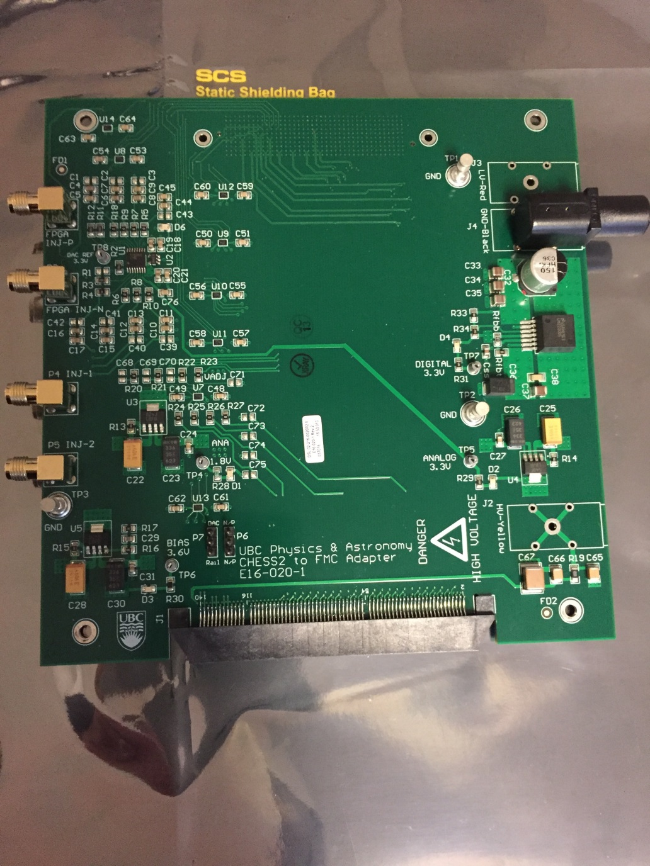
CHESS-2-to-FMC adaptor board status
  Current status:
  .

Slide 6
CHESS-2 digital hardware
  Current status:
  Issue seen with unexpectedly high HV current when the low voltage supplies are on.
  This is not seen on the analogue test system.
    Analogue system: HV bias to bottom and test arrays only. LV to bottom and test arrays but bottom array readout/LVDS interface disabled.
    Digital system: HV and LV supplied to all 3 arrays.
  Investigating at SLAC… could be due to N-wells at different points on the sensor being at different voltages, could create N-P-N junction with P-doped substrate, hence current flow?
  Production:
    Working on order for 20 more carrier boards.

Slide 7
Back-up slides

Slide 8
Nexys Video suggestions
  As a reminder:
  One possibility is that ISE optimised away some connections.
    Under Synthesize, look at View Technology Schematics. This shows what circuitry is left after optimisation, so you’d see if the SACI outputs reach the FPGA pins.
    Inserting a ChipScope at the main level should could also clarify this.
  For the SACI clock issue:
    In the latest ocb_saci.vhd from Matt (in ITSDAQ svn), saci_clk comes from:
      saci_clk <= not(tog_saci_clk_i) and saci_clk_en;
    tog_saci_clk_i is connected to tog_i(T_4MHz), ultimately from ticks_gen.vhd. You could check that this line is toggling.
    saci_clk_en is generated by the main state machine prc_async_machine. In the usual sequence, it becomes ‘1’ in state PayloadWordX (and remains ‘1’ until SendReply is reached).
    So it could help to monitor the current and next state of both the main state machine and the serialiser-deserialiser state machine with ChipScope. Perhaps the state machines are not starting up, or never reaching PayloadWordX in any case.
    If the expected states aren’t reached, can then look at the inputs to see why.

Slide 9
CHESS-2 mini-module
More details of the connector:
    The connector is the ITSDAQ standard 0.05" Samtec connector FTSH-125-01-F-DV
    This is organised as 13 signal pairs and 12 ground pairs, alternating, for constant impedance and to minimise cross-talk. The signal pairs are:
      1 x bunch crossing clock pair - BCO
      1 x command pair - COM
      1 x request pair - L1R
      8 x data pairs
      2 x spare pairs (could also be used as 4 single-ended lines in firmware)
    Next: go over data out requirements.
    Jaya John to look over data out lines needed and draft a proposal for the connectors.

Slide 10
ABC130*/HCC* news
.

