Slide 1

Progress and next steps
16 February 2017 this version is the minutes of the meeting
J. J. John on behalf of the team

Slide 2
Agenda
Discuss progress and steps for next week:
  ABCN’ emulator
  firmware - SACI
  readout software
  CHESS-2-to-FMC adaptor board
  CHESS-2 digital hardware
  CHESS-2 mini-module
  ABC130*/HCC* news
  TWiki page for CHESS and its test hardware: https://twiki.cern.ch/twiki/bin/view/Atlas/CHESSStripTestChip

Slide 3
ABCN’ firmware status
  Atlys firmware / CHESS-2 analogue test status:
  Firmware: still using va113, all well.
  Analogue system testing:
    Found some erroneous wire-bonds – had intended to disable a digital/LVDS test structure but caused excess current draw on the low voltage supplies.
    Hervé saw big improvements after removing those wire-bonds, including analogue output pulses. These pulses go away if you turn off the CHESS-2 pixel amplifiers via internal bias DAC settings.
  Next steps:
    Reproduce this in Oxford.
    Various distribution work for the analogue hardware.

Slide 4
ABCN’ firmware status, continued
  Nexys Video firmware and software status:
  .

Slide 5
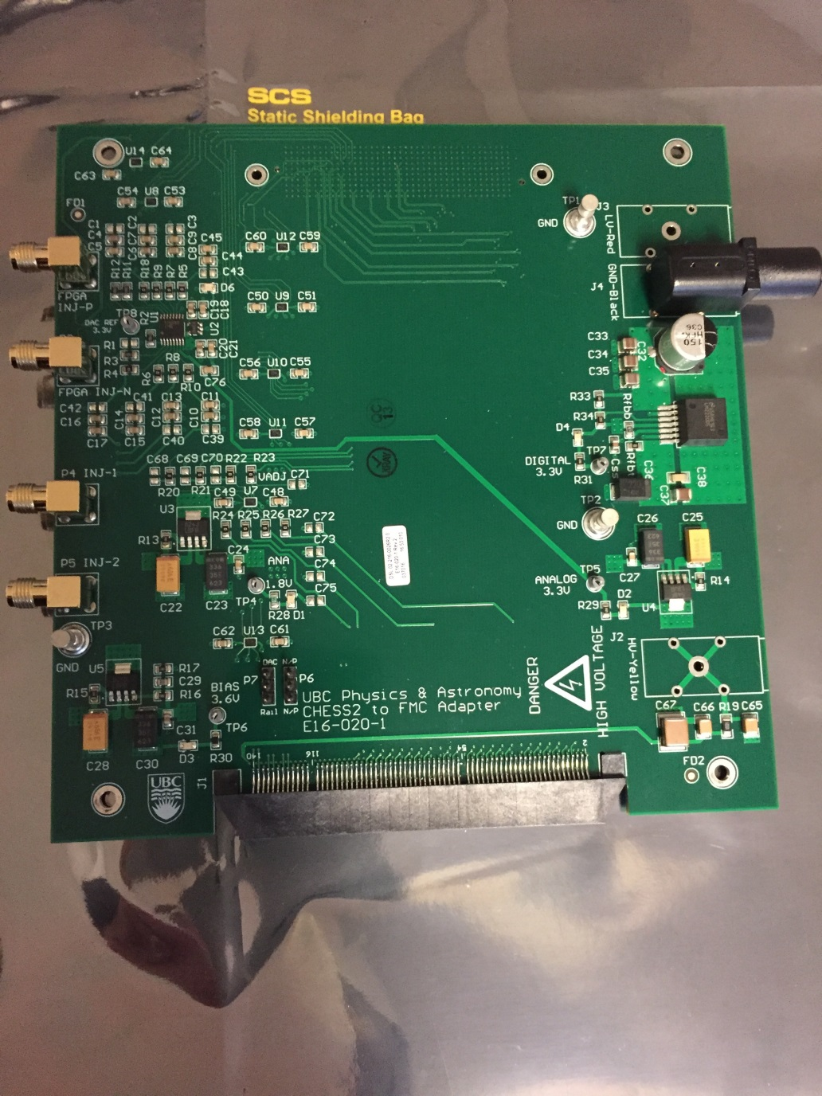
CHESS-2-to-FMC adaptor board status
  Current status:
  .

Slide 6
CHESS-2 digital hardware
  Current status:
  Continuing on layout revisions of digital daughterboard to ease the wire-bonding.
  The second batch of carrier boards are being manufactured.

