Slide 1

Progress and next steps
16 February 2017 this version is the minutes of the meeting
J. J. John on behalf of the team

Slide 2
Agenda
Discuss progress and steps for next week:
  ABCN’ emulator
  firmware - SACI
  readout software
  CHESS-2-to-FMC adaptor board
  CHESS-2 digital hardware
  CHESS-2 mini-module
  ABC130*/HCC* news
  TWiki page for CHESS and its test hardware: https://twiki.cern.ch/twiki/bin/view/Atlas/CHESSStripTestChip

Slide 3
ABCN’ firmware status
  Atlys firmware / CHESS-2 analogue test status:
  Firmware: still using va113, all well.
  Analogue system testing:
    Found some erroneous wire-bonds – had intended to disable a digital/LVDS test structure but caused excess current draw on the low voltage supplies.
    Hervé saw big improvements after removing those wire-bonds, including analogue output pulses via charge injection. These pulses go away if you turn off the CHESS-2 pixel amplifiers via internal bias DAC settings.
    Working on analogue outputs again in Oxford, with a laser pointer, varying the internal current DAC settings. Seeing small pulses on the analogue outputs, which go away when the internal bias DACs are disabled.
  Next steps:
    Continue exploring DAC space.
    Various distribution work for the analogue hardware.

Slide 4
ABCN’ firmware status, continued
  Nexys Video firmware and software status:
  Found one issue with DIO instantiation, fixed.
  Now, static values of SACI signals observed, as expected.
  Will test SACI commands (dynamic behaviour) once Robin is back, next week.
  Wojtek will add SPI to the DIO to be able to programme the external DAC chip on the adaptor board.

Slide 5
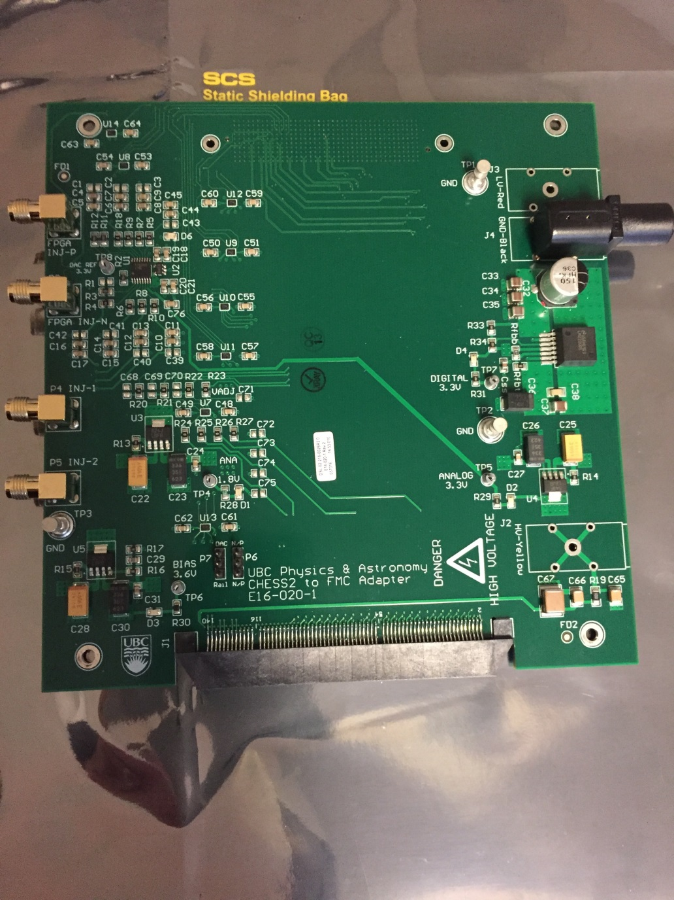
CHESS-2-to-FMC adaptor board status
  Current status:
  Boards functional.
  Will test DACs once SPI added to DIO of firmware.
  Reminder:
    20 bare boards made
    10 assembled and tested for power supplies and level shifters
    1 tested including DACs via SPI from a microcontroller
  Will see further about distribution and finances with Colin once the SPI is tested and basics tested with CHESS-2 connected: e.g. register reads and writes.

Slide 6
CHESS-2 digital hardware
  Current status:
  Continuing on layout revisions of digital daughterboard to ease the wire-bonding.
  The second batch of carrier boards are being manufactured.
ABC* / HCC*
  Current status:
  Interfaces still evolving. Can probably talk about them again in another 1-2 months.

