Slide 1
Progress and next steps 23 February 2017 this version is the minutes of the meeting
J. J. John on behalf of the team

Slide 2
Agenda
Discuss progress and steps for next week:
ABCN’ emulator
firmware - SACI
readout software
CHESS-2-to-FMC adaptor board
CHESS-2 digital hardware
CHESS-2 mini-module
ABC130*/HCC* news
TWiki page for CHESS and its test hardware: https://twiki.cern.ch/twiki/bin/view/Atlas/CHESSStripTestChip

Slide 3
ABCN’ firmware status
Atlys firmware / CHESS-2 analogue test status:
Firmware: still using va113, all well.
Analogue system testing:
Kestutis is mapping out the 512-pixel test array’s sensitivity variations.

Slide 4
ABCN’ firmware status, continued
Nexys Video firmware and software status:
.

Slide 5
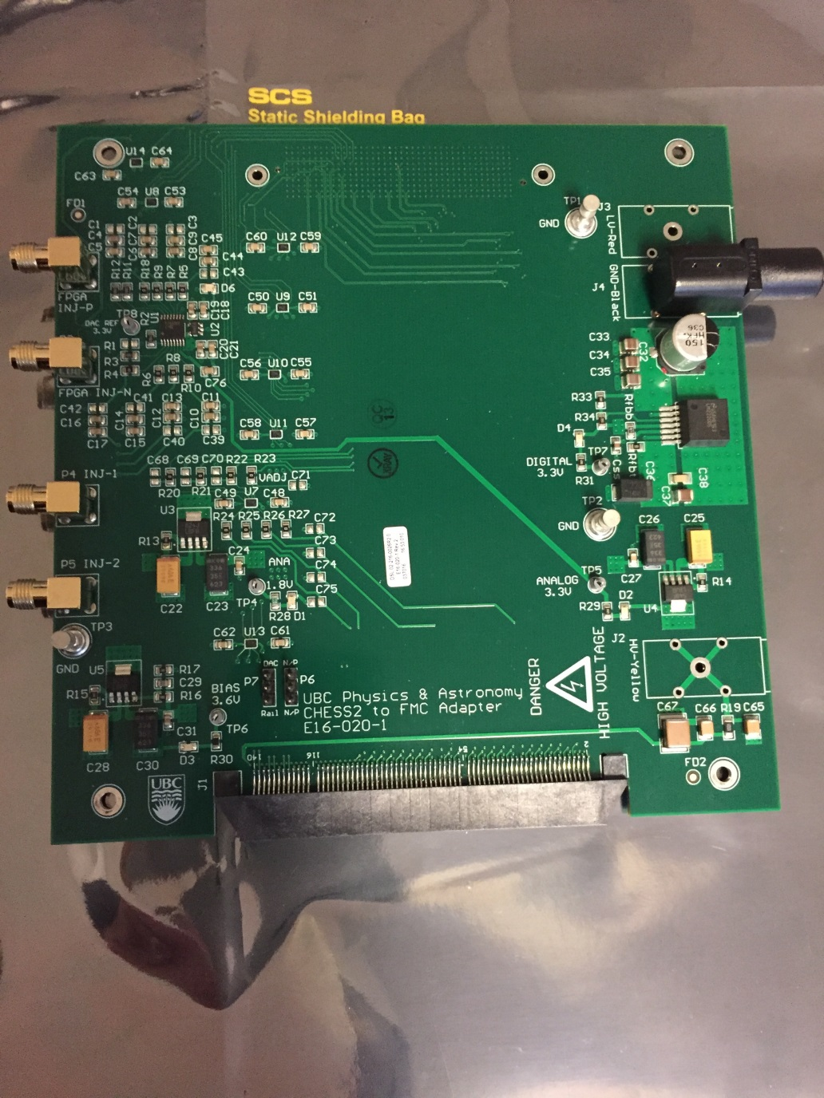
CHESS-2-to-FMC adaptor board status
Current status:
.

Slide 6
CHESS-2 digital hardware
Current status:
No update this week.
ABC* / HCC*
Current status:
Laura Gonella (Birmingham) presented a talk on the ABC* and HCC* at the Trento workshop this week which is a very useful summary of the current state of the designs: link

