Slide 1
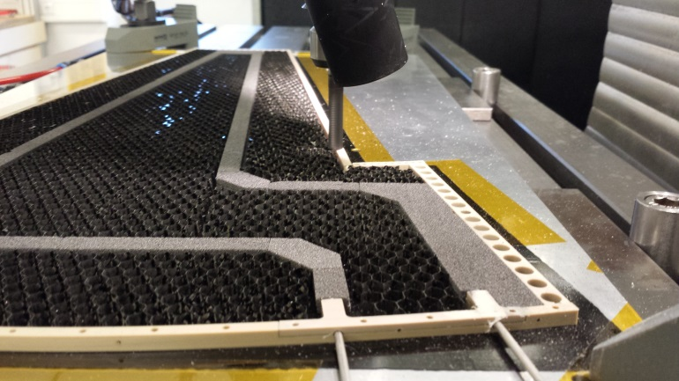
Petal cores and module-on-core mounting
Sergio Díez (DESY), Bernd Stelzer (TRIUMF)
Endcap production preparation meeting
March 3rd, 2017
DESY Zeuthen
Core concept, manufacture steps, infrastructure
Production flow for cores at DESY
Specs and QC
Module-on-core concept
Module-on-core specs and QC

Slide 2
Petal core concept
Staves and petals require low-mass cores with embedded cooling pipes, good thermal performances, resistance to deformations, flat structure
Carbon composites: tremendously flexible class of materials, reasonable Xo, good thermal properties, variable CTE
Carbon fiber “sheets” consist of filaments or woven layers impregnated with epoxy.
By arranging layers in various lay-ups and configurations, a great variety of components can be created with enhanced mechanical and thermal properties

Slide 3
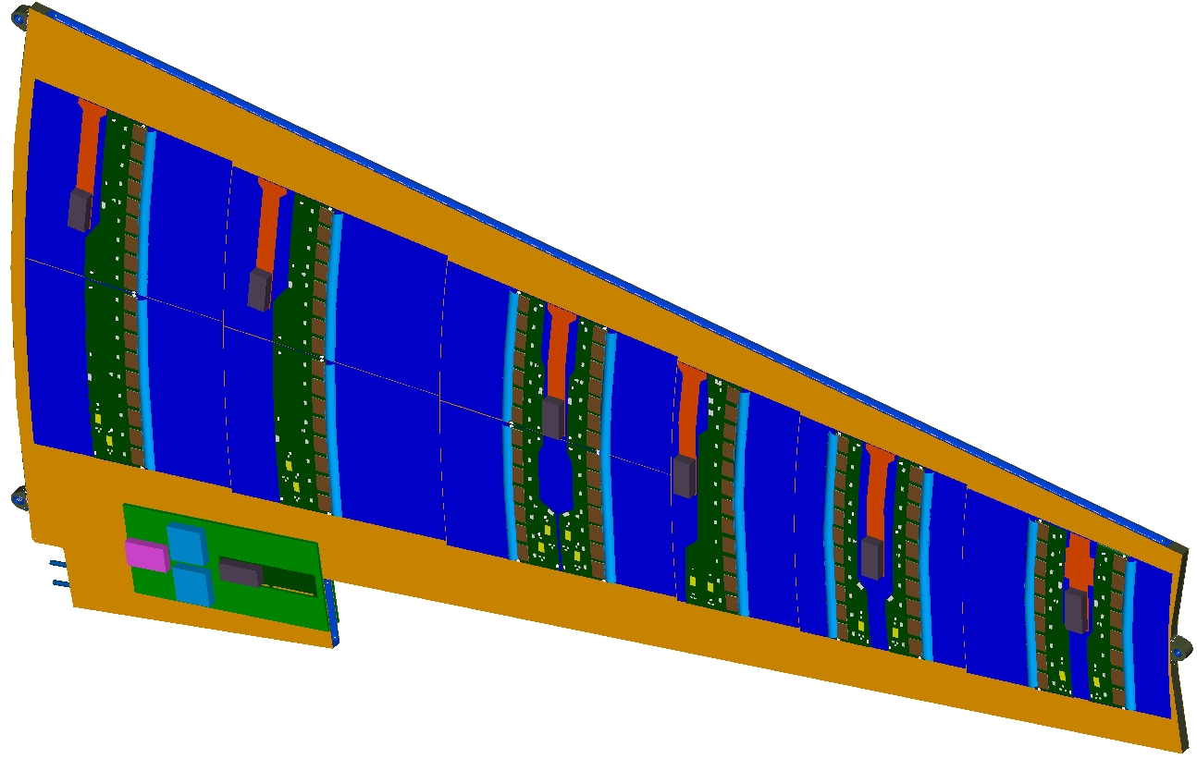
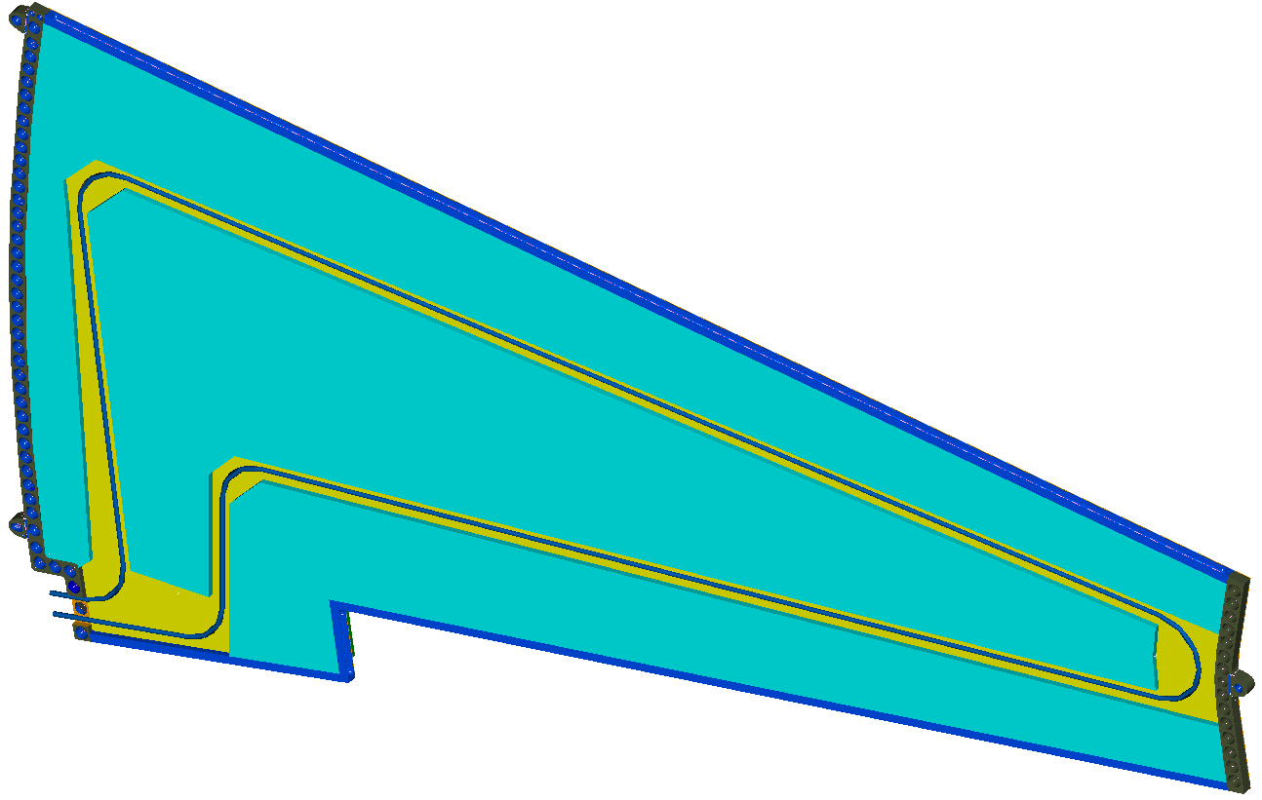
Latest petal core design (Feb 2017)
5.0 mm core thickness (from surface of bus tape to surface of bus tape)
Cut-out at the EoP region to allow rapid bending of the pipe
Electrical break outside the core structure
Pipe inlet and outlet next to each other, no PL in between
Through-holes at PLs
5 mm oversized hole at unconstrained PL
Latest CAD model here

Slide 4
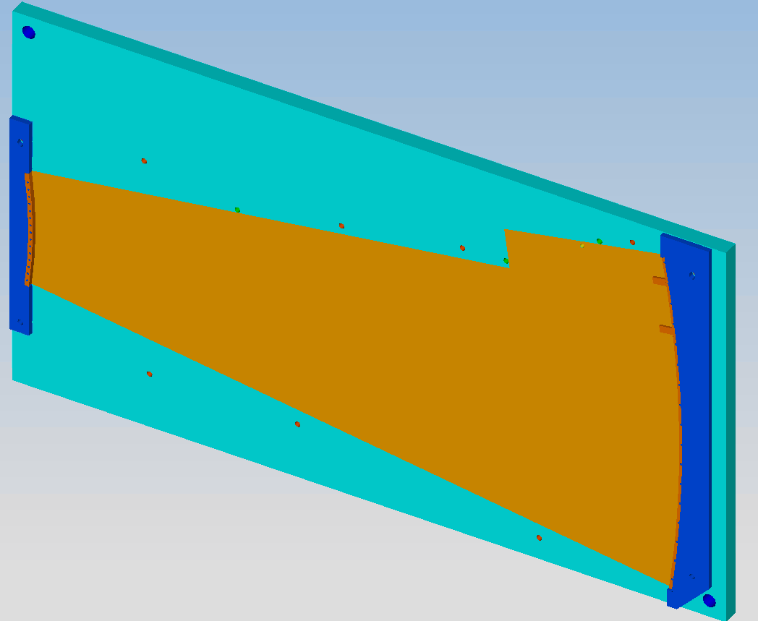
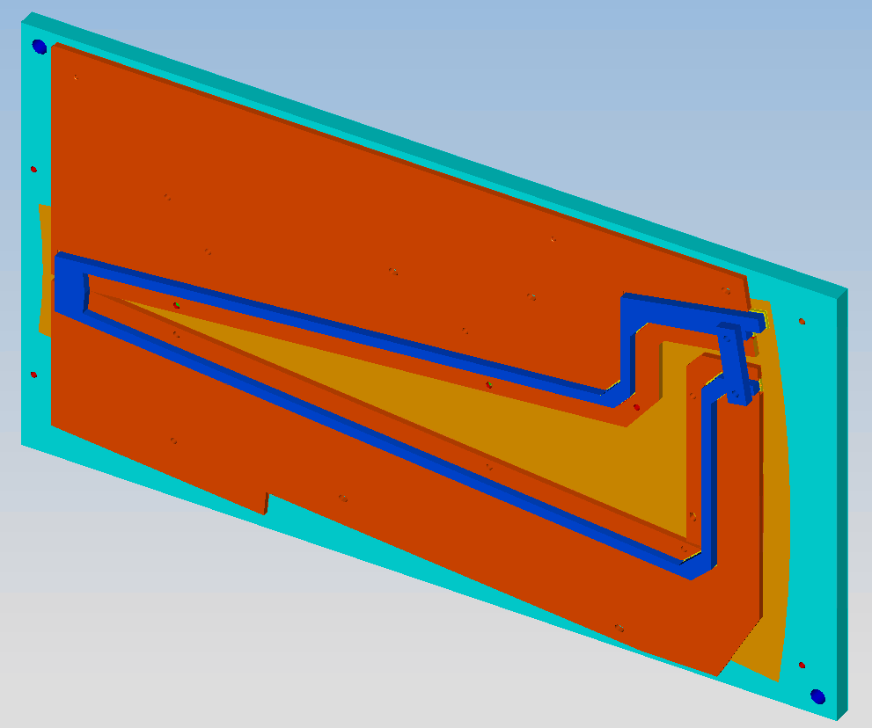
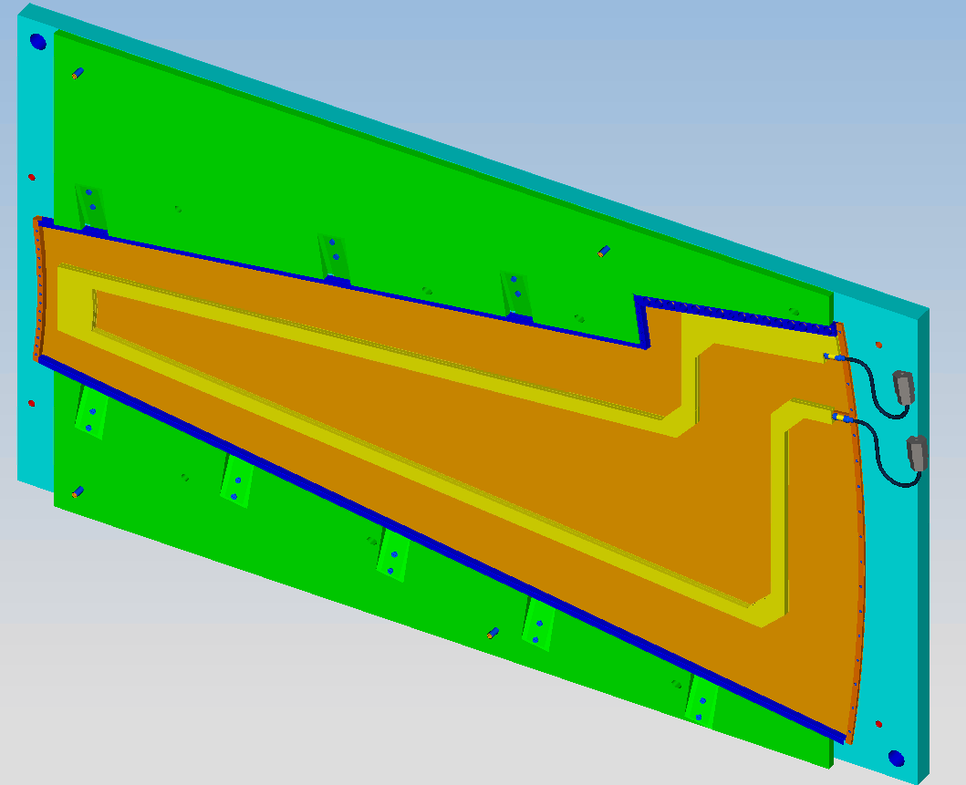
Core manufacture tools
Core manufacture performed with precision tools tools in order to obtain
Required accuracy
Repeatability
High throughput
Toolset in constant evolution, along with core layout
Converging on a final design
Expect only minor changes in the design from now on (although I have been making this statement for more than 2 years...)

Slide 5
Current manufacture steps + infrastructure
Step # | Description | Infrastructure
1 | Cutting and co-curing of 0-90-0 facesheets + bus tapes | Pattern cutter, Autoclave
2 | Cutting of full set of glue masks for core manufacture | Pattern cutter
3 | Pipe bending and brazing of StSt pipe fittings | Large vacuum brazing oven, pipe bender
4 | Machining of top and bottom closeouts with petal locators | CNC milling machine
5 | Gluing of top and bottom closeouts on bottom facesheet | Core tools
6 | Machining of graphite (Allcomp) foam | CNC milling machine
7 | Gluing of cooling loop (foam to pipe) | Core tools
8 | Gluing of cooling loop (loop to bottom facesheet) | Core tools
9 | Machining of carbon fiber C-channels | CNC compatible with CF materials
10 | Gluing of carbon fiber C-channels | Core tools
11 | Cutting of carbon fiber honeycomb to shape | Pattern cutter
12 | Gluing of carbon fiber honeycomb | Core tools
13 | Milling of core surface | Milling machine compatible with CF
14 | Gluing of top facesheet | Core tools
15 | Precise machining of petal locators | Large range CNC (> 600 x 350 mm)

Slide 6
Rough FTE time estimates per core
Step # | Description | Infrastructure
1 | Cutting and co-curing of 0-90-0 facesheets + bus tapes | Pattern cutter, Autoclave
2 | Cutting of full set of glue masks for core manufacture | Pattern cutter
3 | Pipe bending and brazing of StSt pipe fittings | Large vacuum brazing oven, pipe bender
4 | Machining of top and bottom closeouts with petal locators | CNC milling machine
5 | Gluing of top and bottom closeouts on bottom facesheet | Core tools
6 | Machining of graphite (Allcomp) foam | CNC milling machine
7 | Gluing of cooling loop (foam to pipe) | Core tools
8 | Gluing of cooling loop (loop to bottom facesheet) | Core tools
9 | Machining of carbon fiber C-channels | CNC compatible with CF materials
10 | Gluing of carbon fiber C-channels | Core tools
11 | Cutting of carbon fiber honeycomb to shape | Pattern cutter
12 | Gluing of carbon fiber honeycomb | Core tools
13 | Milling of core surface | Milling machine compatible with CF
14 | Gluing of top facesheet | Core tools
15 | Precise machining of petal locators | Large range CNC (> 600 x 350 mm)
1-2 hours work ½ day work Full day work > 1 day work

Slide 7
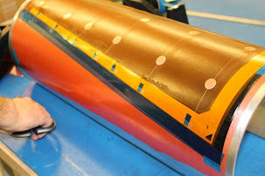
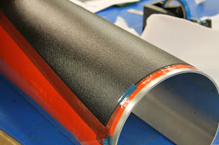
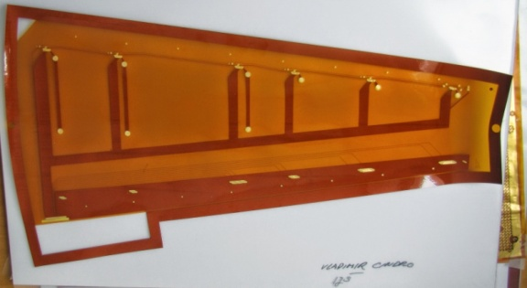
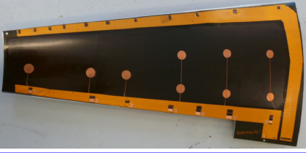
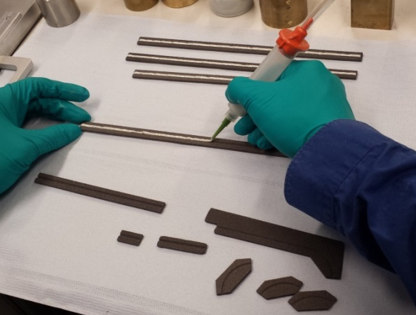
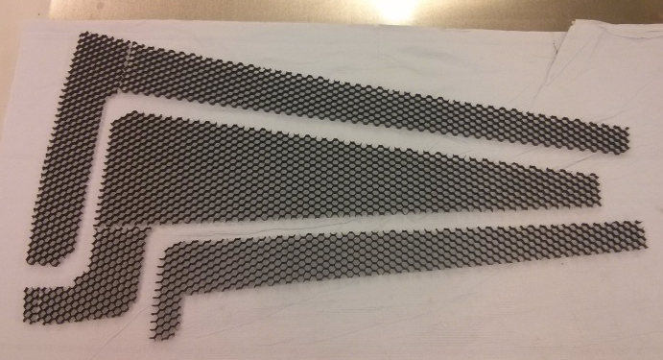
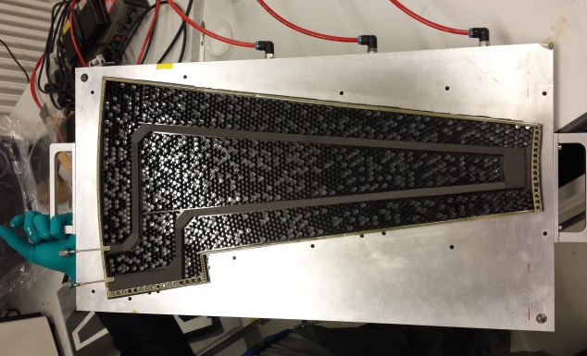
Some pics
Co-curing of facesheets + bus tapes
Bus tape before and after co-curing
Gluing of pipe to foam
Cooling loop
Honeycomb cut to shape
Milling of petal surface
Petal ready for second facesheet

Slide 8
Remarks
At the moment, DESY Hamburg is performing every single step on this list (with the exception of the currently co-cured bus tapes, performed at Liverpool, but planned at DESY once our autoclave is operational)
Parallelization of work is definitely needed (see next slides)
Machined parts could be (should be) manufactured in industry
It will help if some institutes help in producing some of these parts
Or even better: produce cores!

Slide 9
Core production flow at DESY
Industry
Industry
JSI Ljubljana
Industry
Industry
Industry
Industry
Carbon-fiber honeycomb
Carbon-fiber pre-pregs
Petal bus tapes
Titanium pipes
Carbon fiber foam
Thermoplastic materials
Pultruded carbon fiber rods
Reception tests
Pipe bending
Pipe connectors and E breaks vacuum brazing
Facesheets + bus tape co-curing
Connectivity test
Machining of foam
Cooling loop assembly
Pressure and He leak tests
Petal locators and closeouts machining
Petal assembly
Machining of C-channels
DESY Workshops
Petal core assembly
Final precision PL machining
Transport to Geb. 26
43a
Carbon fiber lab

Slide 10
DESY HH ITk Schedule
 | 2017 |  | 2018 |  |  |  | 2019 |  |  |  | 2020 |  |  |  | 2021 |  |  |  | 2022 |  |  |  | 2023 |  |  |  | 2024
Cores (422)
Modules (XXX)
EoS boards (XXX)
Petals (100)
EC integration
EC commissioning (DESY)
EC transport, installation, and commissioning (CERN)
Pre-production readiness
Throughput:
~4 cores per week over 2 years
Contingency: extend production time by ~6 months?
Pre-production
Production

Slide 11
Specs and QC
Quality control steps
Ti pipes: Pressure and He leak testing after bending and brazing
Machined parts (C-channels, closeouts, Allcomp): Optical tests with SmartScope
Bus tapes: Impedance and BERT tests before co-curing, after co-curing, after core build
Completed cores:
Geometrical
Overall Flatness
Local flatness
Delamination tests
Parallelism?
Torsional strength?
Thermal/combined
IR tests (-30 C, CO2 dual-phase)
Thermal cycling
Some of the test stands under development at the moment, SmartScope CNC 670 a key equipment for this
Expect core (and module-on-core) specs by March AUW

Slide 12
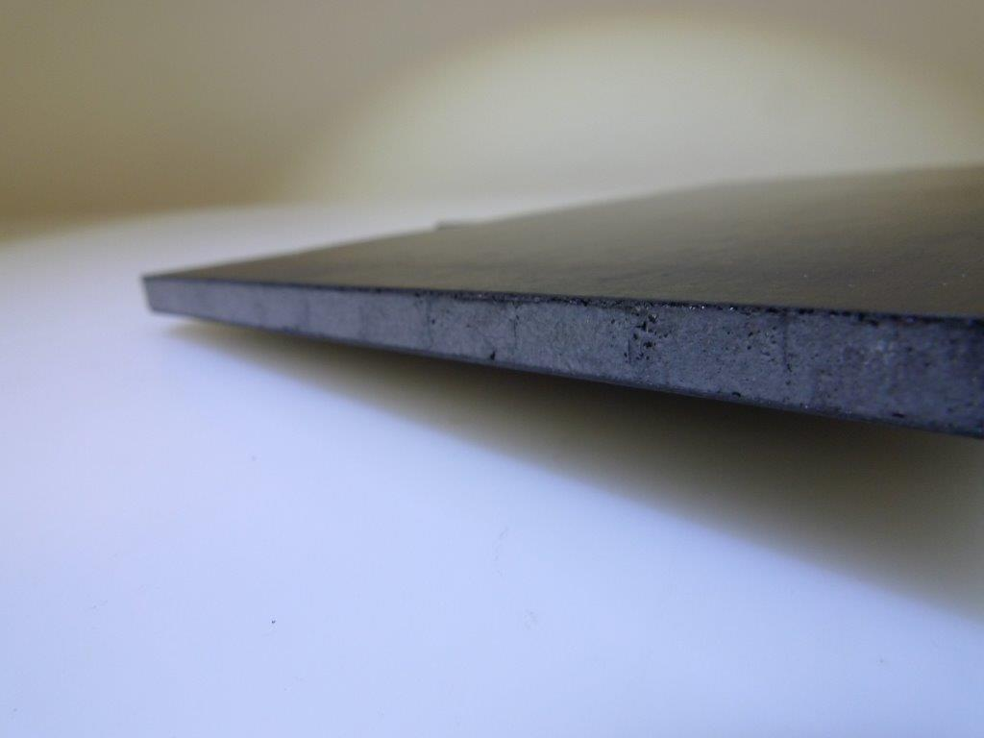
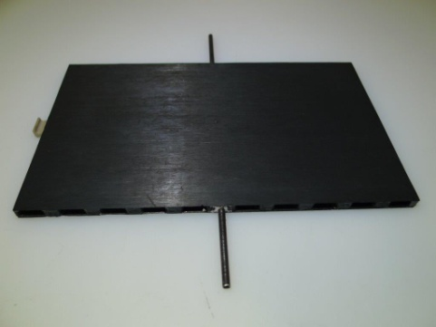
Industrial approach: Scientifica
Scientifica.es
IFIC-Valencia is trying to qualify this company for petal core production
Progress on this has been heavily delayed due to lack of titanium pipes (don’t get me started)
However, they already have all the materials for building their first petal, including co-cured v1 bus tapes (many thanks Luise P., Peter C., Tim J.)
They want to try an alternative way of connecting to the pipe with injected, T conductive foam
They will need co-cured bus tapes anyway (DESY HH), probably also brazed Ti pipes
Expect some results in the near future
At this stage, the idea is that they produce a prototype petal that we should “qualify” in order to decide if we leave petal core production to industry (DESY should help with this)

Slide 13
Available cores and summary
R&D on petal core manufacture is being carried out by DESY HH
4 cores produced so far
1 thermo-mechanical petal
1 full core at DESY for mechanical studies
2 dummy cores (no pipes) devoted to module-on-core studies
2 more cores underway
With pipes, without bus tapes
1 standard core, 1 “thin” core (5.0 mm thick)
Machining of all the core components is dragging us down really badly
Investigation of outsourcing machining to industry ongoing
Quite likely for COs and C-channels
Very unlikely for Allcomp foam and core milling
DESY will most likely not be able to produce all the cores for both endcaps, especially considering the commitment on other areas too
Industrial approach with Scientifica followed up by Valencia, DESY is getting involved on this
Any other volunteers within the community welcome

Slide 14
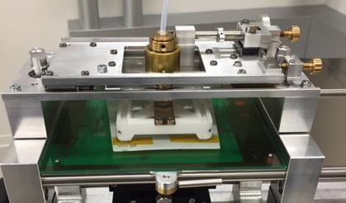
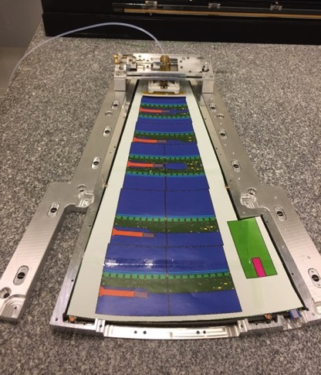
EC module-on-core (I)
Active EC Sites:
DESY, Freiburg, Valencia, Vancouver
Requirements: Accurate placement of modules on petal core and good cooling connection, tools include:
Robotic x-y-z gantry (optical survey, glue deposition?)
Generic module loading station
Module loading bridges (x-y translation, rotation)
Petal metrology (vision CMM or laser range finder)
Assembly frames:
Outer frame mounted to gantry table, supports bridge
Inner frame holds petal (also during bonding and shipping?)
Common Procedure:
Survey petal locators to determine petal reference frame
Load EC module from loading station onto bridge
Survey module fiducials and (iteratively) position module
Apply glue pattern of SE4445
Place module – cure glue, held in place by bridge – repeat 9 times
Perform post-mounting petal metrology survey
Wire bonding to bus-tape and EoS + electrical acceptance test
Common tooling on sharepoint

Slide 15
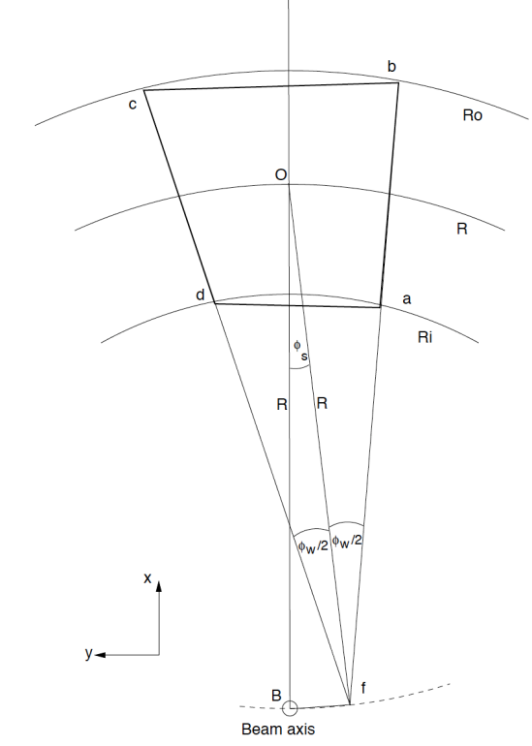
EC module-on-core (II)
Specifications (similar to barrel)
Components
Local flatness of core ±25µm
Module bow between -50µm and +150µm (negative means center above edges)
(Bus-tape) pads within 100µm in y and 300µm in x
Equipment:
Repeatability of gantry position <20µm in all directions
Out of plane metrology accuracy <10µm
Performance Target:
Placement of modules with a lateral accuracy of ±50µm (i.e. no point between 2 modules closer than 400 µm)
Average distance between sensor and core is 150µm (to ensure good cooling contact)
Details of Checks/QC/QA:
Components in the loading process shall be checked on reception
Perform a electrical acceptance test using GBT link (QC)
Thermal cycling of loaded petal (QA only)?
Module loading specifications being defined. Draft: (Google doc)
https://cds.cern.ch/record/1514636

Slide 16
Backup

Slide 17
Petal Coordinate System
The back side is a 180 degree rotation of this around the X axis
Note: R0 has been designed with -4 mrad (The decision to go for 3.5 mrad came a bit later)

Slide 18
Sensor Coordinate System
Beam reference frame with a sensor placed at the desired radius R from the beam-line and rotated by the stereo angle. The Sensor-frame is centred at O; the Strip-frame is centred at f .

Slide 19
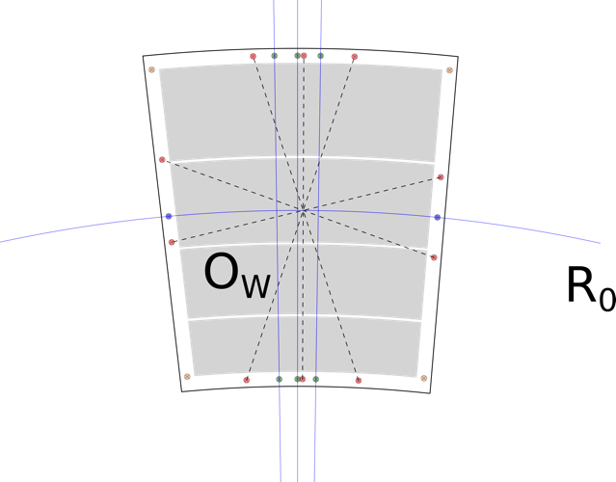
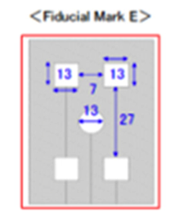
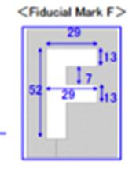
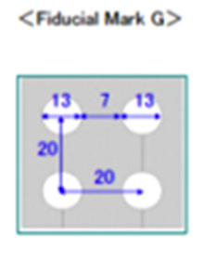
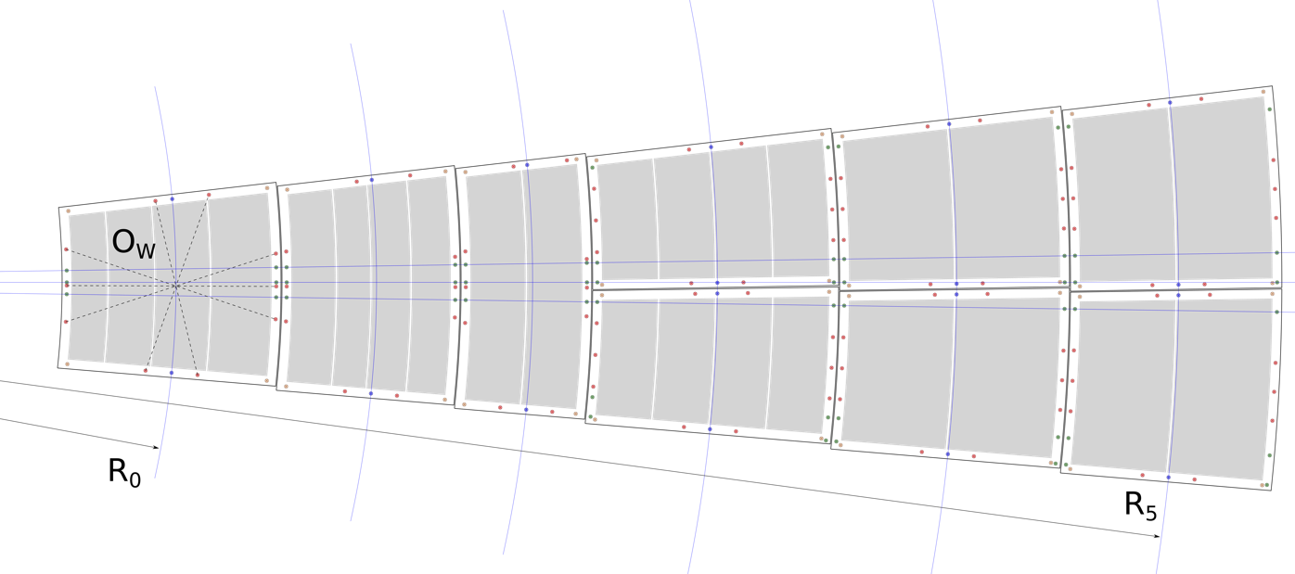
Modules on Petal
Green markers are for the angles (markE)
Brown markers give the corners of the sensor (F)
Blue markers tell about the radius (E)
Red markers help defining Ow (G)
Sensors are placed by positioning the centre of the wafer (Ow) at a given radius ( and angle)

Slide 20
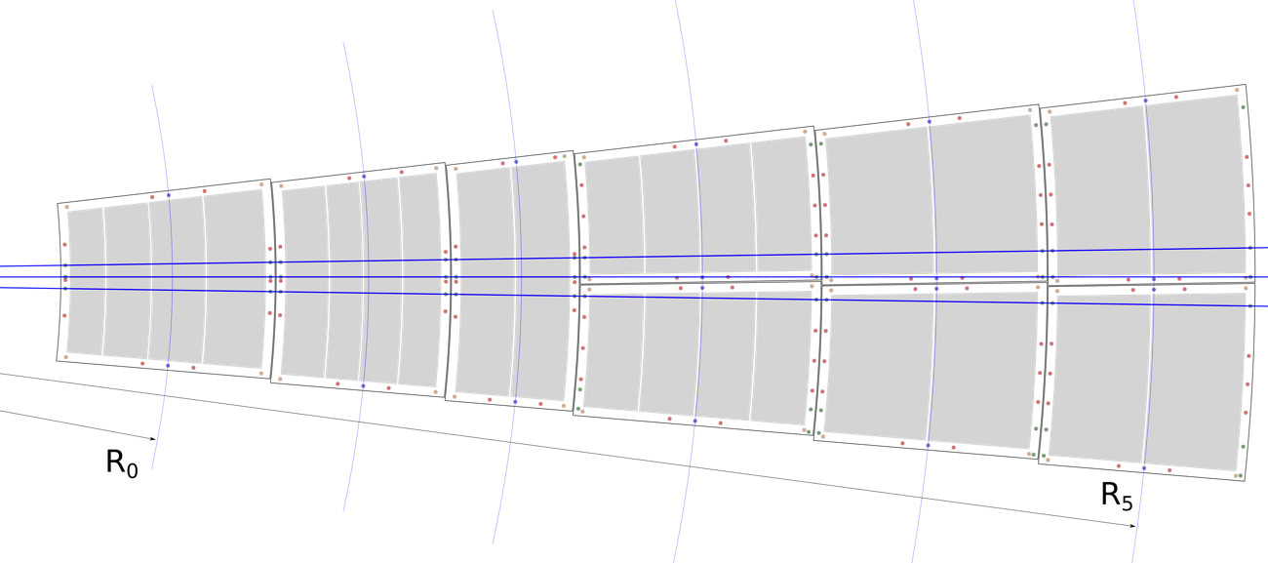
Modules on Petal
Crossing point at (0,0), ie, interaction point.
The angle (which accommodates the 3.5 mrad and the rotation in the outer rings) can be defined by 3 lines (blue) that cross at the origin (interaction point).

Slide 21
