Slide 1
Fermi-LAT & NuSTAR as
Stellar Axionscopes
Maurizio Giannotti,
Barry University (FL)
13th Patras Workshop
on Axions, WIMPs and WISPs,
May 14-19,
Thessaloniki, Greece

Slide 2
Summary
  Hunting for stellar axions with spaceborne x-ray and γ–ray detectors
  The potential of the current instruments (Fermi, NuSTAR)
  Is the future going to be brighter?

Slide 3
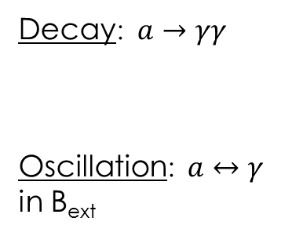
The Hunt for Stellar Axions
Production
Detection
Non thermal (e.g., nuclear transitions)
e.g. CUORE…
See talk by F. Avignone
Stars are ALPs factories:
Thermal E~T (or m_{a}, if m_{a} >>T).
CAST, IAXO…
See talk by I. Irastorza
and by M. Karuza+L. Micelli
Decay:$a→γγ$
Oscillation: $a↔γ$
in B_{ext}
Nuclear Bremsstrahlung (g_{aN})
Primakoff (g_{aγ})
Compton (g_{ae})
Electron Bremsstrahlung (g_{ae})
γ
ω_{a} ~ keV to several MeV
x- or γ–ray photons

Slide 4
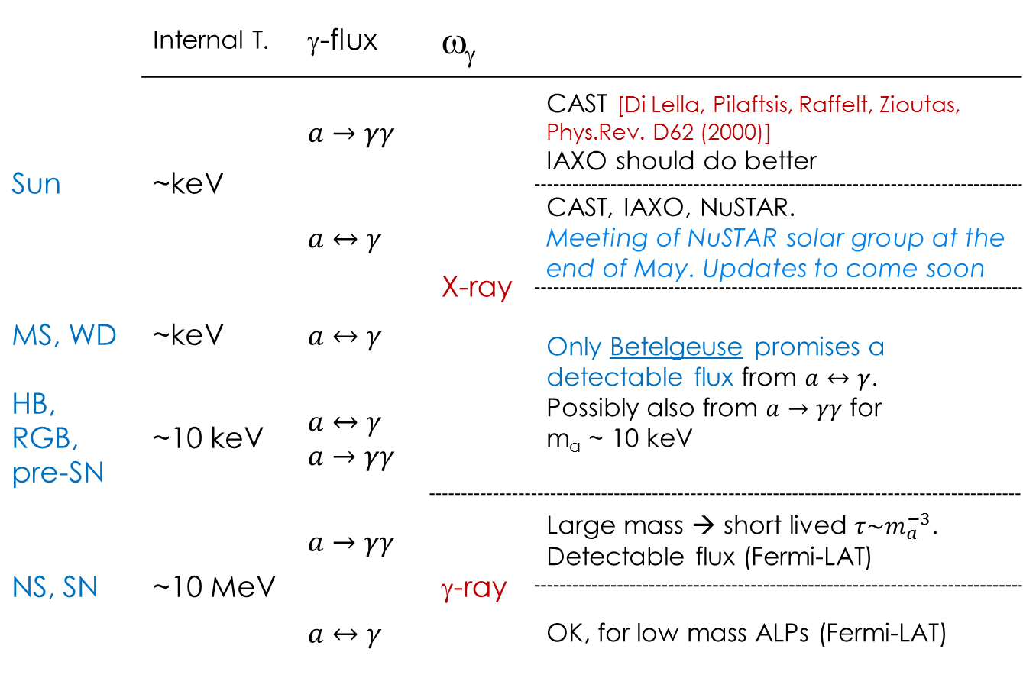
Fermi and NuSTAR as stellar axionscopes
 | Internal T. | γ-flux | ω_{γ}
Sun | ~keV | $$a→γγ$$ | X-ray | CAST [Di Lella, Pilaftsis, Raffelt, Zioutas, Phys.Rev. D62 (2000)] IAXO should do better
 |  | $$a↔γ$$ |  | CAST, IAXO, NuSTAR. Meeting of NuSTAR solar group at the end of May. Updates to come soon
MS, WD | ~keV | $$a↔γ$$ |  | Only Betelgeuse promises a detectable flux from $a↔γ$. Possibly also from $a→γγ$ for m_{a} ~ 10 keV
HB, RGB, pre-SN | ~10 keV | $$a↔γ$$ $$a→γγ$$
NS, SN | ~10 MeV | $$a→γγ$$ | γ-ray | Large mass → short lived $τ\sim m_{a}^{−3}$. Detectable flux (Fermi-LAT)
 |  | $$a↔γ$$ |  | OK, for low mass ALPs (Fermi-LAT)
NuSTAR
Fermi

Slide 5
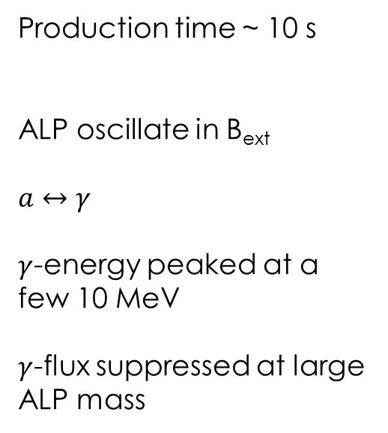
Light ALPs from SN
ALPs are produced through Primakoff! Partial degeneracy and effective mass is taken into account
Production time ~ 10 s
ALP oscillate in B_{ext}
$a↔$ $γ$
$γ$-energy peaked at a few 10 MeV
$γ$-flux suppressed at large ALP mass
Payez, C. Evoli, T. Fischer, M. G., A. Mirizzi, A. Ringwald, JCAP 1502 (2015)

Slide 6
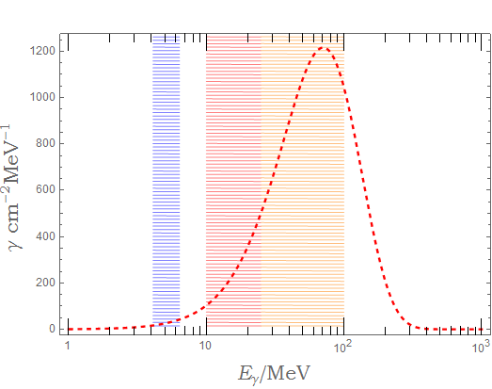
The past: SMM and SN 1987A
At the time of the SN1987A explosion, the Gamma-Ray Spectrometer (GRS) on the Solar Maximum Mission (SMM) was operative.
No photon excess at the time of the neutrino burst in any of the three energy bands of the GRS instrument
3 upper limits on the observed fluence (at 3σ) during the neutrino burst duration
0.9 γ cm⁻²
0.4 γ cm⁻²
0.6 γ cm⁻²
Several uncertainties related to the instrument which are not easily quantifiable
Payez, C. Evoli, T. Fischer, M. G., A. Mirizzi, A. Ringwald, JCAP 1502 (2015)

Slide 7
SMM and SN 1987A
The best constraint on ALP–photon conversion comes from the highest energy bin [25, 100] MeV
J. Brockway, E. Carlson, G. Raffelt, Phys. Lett. B 383, 439 (1996)
J. Grifols, E. Masso, R. Toldra, Phys. Rev. Lett. 77, 2372 (1996)
A. Payez, C. Evoli, T. Fischer, M. G., A. Mirizzi, A. Ringwald, JCAP 1502 (2015).
Reported bound is for 18 M⊙ progenitor and
Jansson and Farrar model for the Galactic magnetic field
R. Jansson, G. R. Farrar, Astrophys. J. 757, 14 (2012)
A. Payez, C. Evoli, T. Fischer, M. G., A. Mirizzi, A. Ringwald, JCAP 1502 (2015).

Slide 8
SMM and SN 1987A
The best constraint on ALP–photon conversion comes from the highest energy bin [25, 100] MeV
J. Brockway, E. Carlson, G. Raffelt, Phys. Lett. B 383, 439 (1996)
J. Grifols, E. Masso, R. Toldra, Phys. Rev. Lett. 77, 2372 (1996)
A. Payez, C. Evoli, T. Fischer, M. G., A. Mirizzi, A. Ringwald, JCAP 1502 (2015).
Reported bound is for 18 M⊙ progenitor and
Jansson and Farrar model for the Galactic magnetic field
R. Jansson, G. R. Farrar, Astrophys. J. 757, 14 (2012)
A. Payez, C. Evoli, T. Fischer, M. G., A. Mirizzi, A. Ringwald, JCAP 1502 (2015).

Slide 9
The present: Fermi-LAT
Fermi Large Area Telescope (Fermi-LAT),
Launch: June 11, 2008.
Detection through pair production. Especially sensitive above 1 GeV.

Slide 10
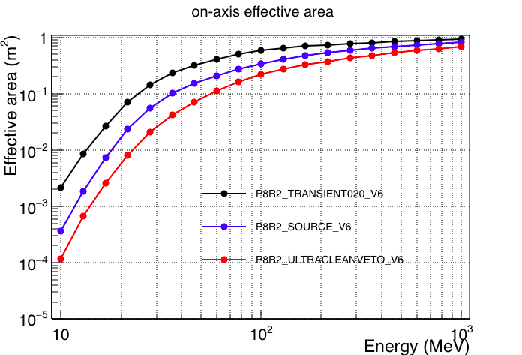
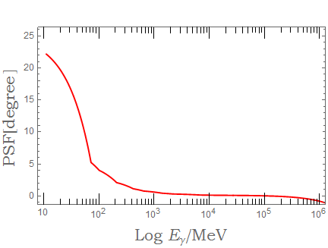
The present: Fermi-LAT
Pass 8: W. Atwood et al. arXiv:1303.3514
M. Ackermann et al. Astrophys.J.Suppl. 203 (2012)
Current event level analysis: Pass 8
Energy range | 20 MeV - over 300 GeV
Effective Area | 1 m² for E > 1 GeV 0.3 m² @ 50 MeV
Point Spread Function (PSF) | 0.8° @ 1 GeV 11° @ 50 MeV

Slide 11
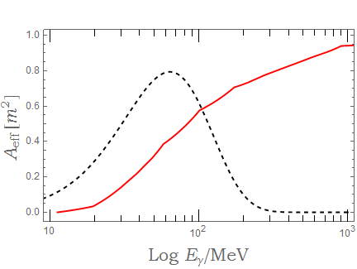
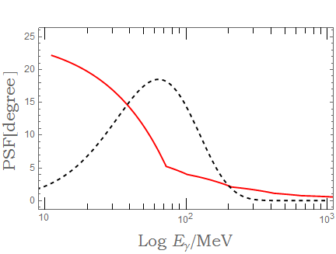
The present: Fermi-LAT
Fermi-LAT
Fermi-LAT
γ-flux
(arbitrary normalization)
γ-flux
(arbitrary normalization)
Fermi-LAT averaged over the expected SN spectrum 50 MeV<E<500 MeV
GRS on the SMM,
10 MeV<E<100 MeV
<A_{eff}>~5500 cm²
F_{γ} 10⁻³ γ cm⁻²
M. Meyer , M. G., A. Mirizzi, J. Conrad, M. A. Sánchez-Conde, Phys.Rev.Lett. 118 (2017)
<
~
<A_{eff}> <100 cm²
F_{γ} 0.6 γ cm⁻²
D. J. Forrest et. al., Solar Phys. 65, 15 (1980)
<
~

Slide 12
The present: Fermi-LAT
Fermi-LAT
Fermi-LAT
γ-flux
(arbitrary normalization)
γ-flux
(arbitrary normalization)
Fermi-LAT averaged over the expected SN spectrum 50 MeV<E<500 MeV
GRS on the SMM,
10 MeV<E<100 MeV
<A_{eff}>~5500 cm²
F_{γ} 10⁻³ γ cm⁻²
factor of ~5
improvement on g_{aγ}
<
~
<A_{eff}> <100 cm²
F_{γ} 0.6 γ cm⁻²
<
~

Slide 13
Fermi-LAT as SN axionscope
Background from actual data (not simulations)
Bins of 20 s (different sizes don’t change results considerably) in a GTI of 1500s
10⁻¹⁰
Most of the uncertainty is on the magnetic field. Shown case of Jansson-Farrar model.
R. Jansson, G. R. Farrar, Astrophys. J. 757, 14 (2012)
The Pshirkov model would give stronger bounds
g_{aγ} (GeV⁻¹)
10⁻¹¹
10⁻¹²
10⁻¹³
10⁻¹⁰
10⁻⁹
10⁻⁸
10⁻⁷
10⁻⁶
m_{a} (eV)
M. Meyer , M. G., A. Mirizzi, J. Conrad, M. A. Sánchez-Conde, Phys.Rev.Lett. 118 (2017)

Slide 14
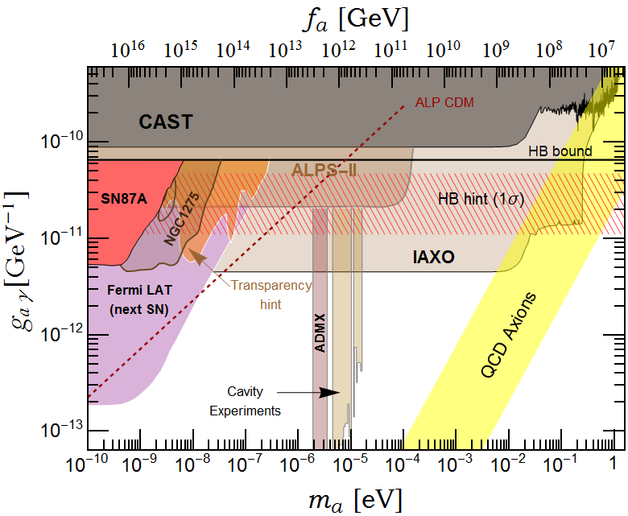
Fermi-LAT and the Next galactic SN
Excellent potential to probe a very interesting region of the ALP parameter space!
M. Meyer , M. G., A. Mirizzi, J. Conrad, M. A. Sánchez-Conde, Phys.Rev.Lett. 118 (2017)

Slide 15
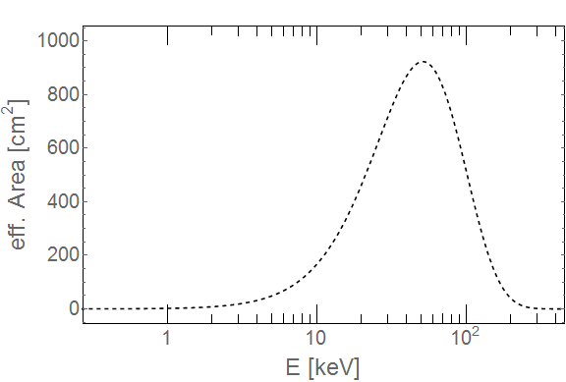
Waiting for the next SN: Betelgeuse and NuSTAR
Betelgeuse is a supergiant with internal temperature about 10 keV. Modeling this star is one of the main difficulties.
Additionally, Betelgeuse is a fast rotating star.
E. Carlson, PLB 344, (1995)
Jan Eike von Seggern, Ph.D. dissertation (2014)
M.G., B. Grefensette, O. Straniero, A. Mirizzi, In preparation
Expected photon flux (arbitrary normalization)
ALPs are created through Primakoff and the photon flux is expected to be peaked at a few 10 keV.

Slide 16
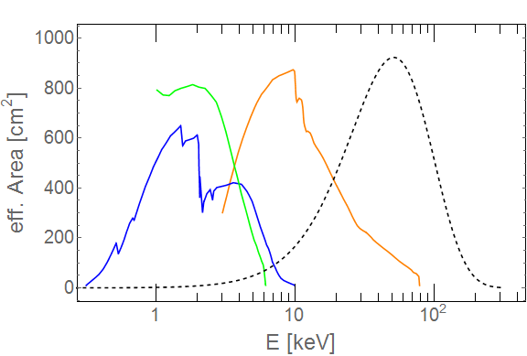
Waiting for the next SN: Betelgeuse and NuSTAR
Betelgeuse is a supergiant with internal temperature about 10 keV. Modeling this star is one of the main difficulties.
Additionally, Betelgeuse is a fast rotating star.
E. Carlson, PLB 344, (1995)
Jan Eike von Seggern, Ph.D. dissertation (2014)
M.G., B. Grefensette, O. Straniero, A. Mirizzi, In preparation
ALPs are created through Primakoff and the photon flux is expected to be peaked at a few 10 keV.
NuSTAR is the favorite X-ray telescope
XMM
NuSTAR
γ-flux
Chandra

Slide 17
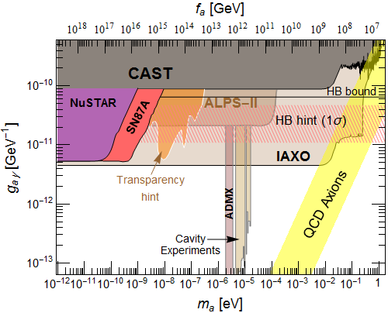
Betelgeuse and NuSTAR
M.G., B. Grefensette, O. Straniero, A. Mirizzi, In preparation
A more complete study within the newly formed NuSTAR dark matter analysis group is in preparation
Preliminary
NuSTAR has the potential to explore couplings down to
g_{aγ}= a few 10⁻¹² GeV⁻¹.
NuSTAR has potential to probe part of the region excluded by SN87A
potential

Slide 18
What about massive ALPs
QCD axions outside the QCD axion band!!
In theory of large extradimensions, there could be a light axion, which solves the strong CP, and a tower of KK-modes whose mass has (mostly) geometrical origin.
Mass could also be generated through interaction with a hidden sector (e.g. mirror world)→ heavy/weakly interacting axions solve strong CP
K. Dienes, E. Dudas, T. Gherghetta, Phys.Rev. D62 (2000)
L. Di Lella, A. Pilaftsis, G. Raffelt, K. Zioutas, Phys.Rev. D62 (2000)
K. Dienes, J. Kost, B. Thomas, arXiv:1612.08950
…
Z. Berezhiani, L. Gianfagna, M. G., Phys.Lett. B500 (2001)
L. Gianfagna, M. G., F.Nesti, JHEP 0410 (2004)
Axion decay time into photons decreases with the cubic power of m_{a}
We could observe photons from axions decay. No need for B!

Slide 19
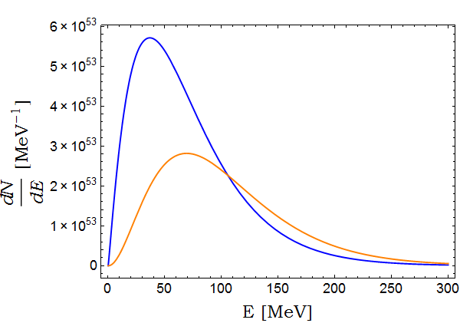
ALPs Production
If ALPs are KK-modes of a QCD axion or mirror-world axions, they do interact with nuclei and can be produced through nuclear bremsstrahlung, very efficient in SN and NS!
a
N
N
N
N
γ
a
Bremsstrahlung
Corresponds to f_{a}~10¹⁰ GeV
Primakoff x 10⁸

Slide 20
Massive axions from SN
α
M.G., L. Duffy, R. Nita, JCAP (2011)
J. Jaeckel, P.C. Malta, J. Redondo (2017)
t_{γ}
βt_{a}
axions
secondary photons
SN
θ
primary photons
d_{SN}
Earth
Axion production integrated over the explosion time (~10 s)
Eliminate axions which decay inside the star
Photons from axion decay between
t_{a} and t_{a}+dt_{a}.
Flux of secondary photons with energy dω_{γ} in time interval dt and direction interval dcos θ
NOTE: KK or mirror axions could also decay into e⁺e, very efficient for m_{a}>2m_{e}

Slide 21
Massive axions from SN
Interactions with photons only
J. Jaeckel, P.C. Malta, J. Redondo (2017)
α
t_{γ}
βt_{a}
axions
secondary photons
SN
θ
primary photons
d_{SN}
Earth
The secondary photons (from the axion decay) can be considerably delayed with respect to the primary photons because:
axions are slower
the path is longer
The delay time can be large
J. Jaeckel, P.C. Malta, J. Redondo (2017)

Slide 22
Massive axions from SN
Interactions with photons only
J. Jaeckel, P.C. Malta, J. Redondo (2017)
α
t_{γ}
βt_{a}
axions
secondary photons
SN
θ
primary photons
d_{SN}
Earth
From SN 1987A
The secondary photons (from the axion decay) can be considerably delayed with respect to the primary photons because:
axions are slower
the path is longer
The delay time can be large
and the source may appear to be not punctiform
J. Jaeckel, P.C. Malta, J. Redondo (2017)

Slide 23
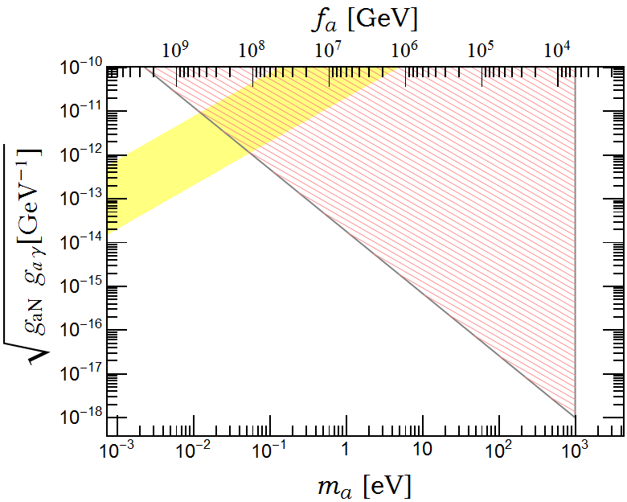
Massive ALPs from SN and NS
Analysis carried out for SN
interaction with photons only
full angular analysis
complete analysis of time delay
and NS
nuclear bremsstrahlung, for m_{a}<2m_{e}
forward decay only (relativistic)
J. Jaeckel, P.C. Malta, J. Redondo (2017)
B. Berenji, J. Gaskins, M. Meyer Phys.Rev. D93 (2016)
QCD
excluded
Includes interactions with nucleons
Interacts with photons only

Slide 24
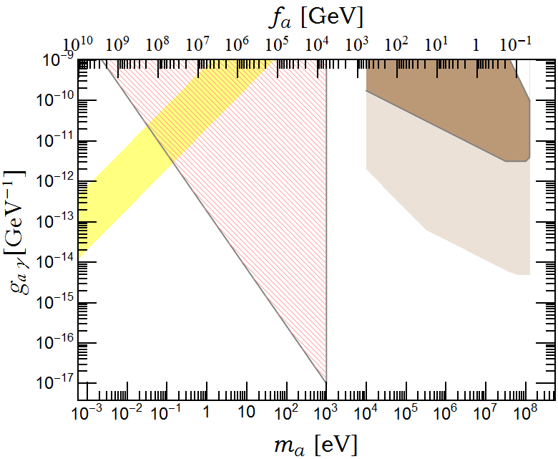
Massive ALPs from SN and NS
Assuming QCD axion coupling we can translate in the g_{aγ}-m_{a} plane
B. Berenji, J. Gaskins, M. Meyer Phys.Rev. D93 (2016)
J. Jaeckel, P.C. Malta, J. Redondo (2017)
NOTE: very slow (γ<1.2) ALPs cannot escape the gravitational field and gravitate around the NS before they decay. They could contribute to very late photons from Betelgeuse.
SN1987A
NS
QCD
Betelgeuse
Includes interactions with nucleons
Interacts with photons only
Similar idea for KK gravitons in
S. Hannestad, G. Raffelt:
Phys.Rev.Lett. 87 (2001)
Phys.Rev.Lett. 88 (2002)
Phys.Rev. D67 (2003)

Slide 25
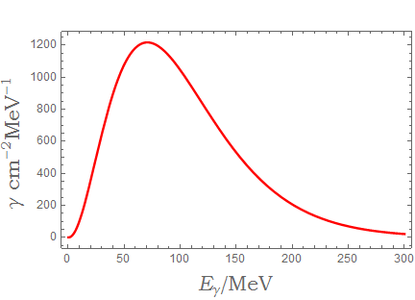
The future… will it be brighter ?
Renewed interest in exploring the ~MeV universe and an effort to build instruments sensitive in the energy range
from a few10² keV to a few 10² MeV
using a combination of Compton and pair-production detection and with strategies to improve pair-production events at lower energy.
e-ASTROGAM Energy range ~0.3 MeV to ~3 GeV, with
PSF ≲ 3° at 50 MeV
PANGU Energy range of
~10 MeV to ~1GeV, with
PSF ≲ 2° at 50 MeV
ComPair Energy range
~200 keV to ~500 MeV, with
PSF ≲ 3° at 50 MeV

Slide 26
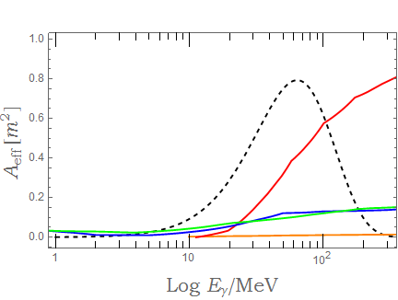
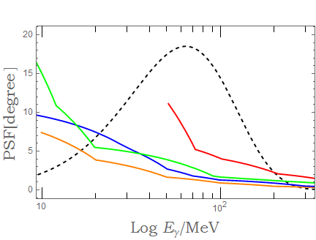
The future… will it be brighter ?
Fermi-LAT
e-ASTROGAM
ComPair
PANGU
γ-flux
 | energy | <A_{eff}> | <PSF>
Fermi-LAT | 50 – 500 MeV | ~ 5500 cm² | ~ 4.7º
e-Astrogam | 10 – 300 MeV | ~ 1220 cm² | ~ 2.1º
ComPair | 10 – 300 MeV | ~ 1145 cm² | ~ 2.6º
Pangu | 10 – 300 MeV | ~ 100 cm² | ~ 1.3º
Averaged over the expected SN spectrum

Slide 27
The future… will it be brighter ?
Fermi-LAT
e-ASTROGAM
ComPair
PANGU
γ-flux
A simple integration over the effective area gives a higher number of events for Fermi-LAT than from the next generation of gamma ray detectors!!
However, the reduced PSF lowers the background. Altogether, the limits on axion-photon coupling from SN would be essentially unchanged with these new instruments!

Slide 28
Conclusions and perspectives
In the case of a galactic SN, Fermi-LAT would be a considerable improvement with respect to the SMM and would shed light on a very interesting region hinted by cooling anomalies and transparency.
NuSTAR has the potential to explore a controversial region and strengthen the current SN1987 bound on g_{aγ} (m_{a}<10⁻¹⁰ eV) from Betelgeuse observations.
If Betelgeuse goes SN, Fermi-LAT has also the potential to explore ALP models with masses up to ~0.1GeV and very small couplings
The currently planned next generation gamma-ray detectors are not likely to improve on SN ALPs with respect to Fermi-LAT.

Slide 29
Thanks

Slide 30
Additional slides

Slide 31
Axions/ALPs from NS
Assumption: ALPs interact with nucleons and photons as standard axions. However, the mass is not related to the coupling. Example, KK modes of the axion field or mirror axions.
B. Berenji, J. Gaskins, M. Meyer Phys.Rev. D93 (2016)
They can be produced in NS through nuclear Bremsstrahlung.
Afterwards they decay and can be observed with Fermi-LAT.
Analysis of 4 NS, with d < 0.4 kpc, Galactic latitude such that |b| > 15◦, in order to avoid contamination from diffuse emission from the Galactic plane.
Mass is kept small enough so decay is essentially forward.
QCD
excluded

Slide 32
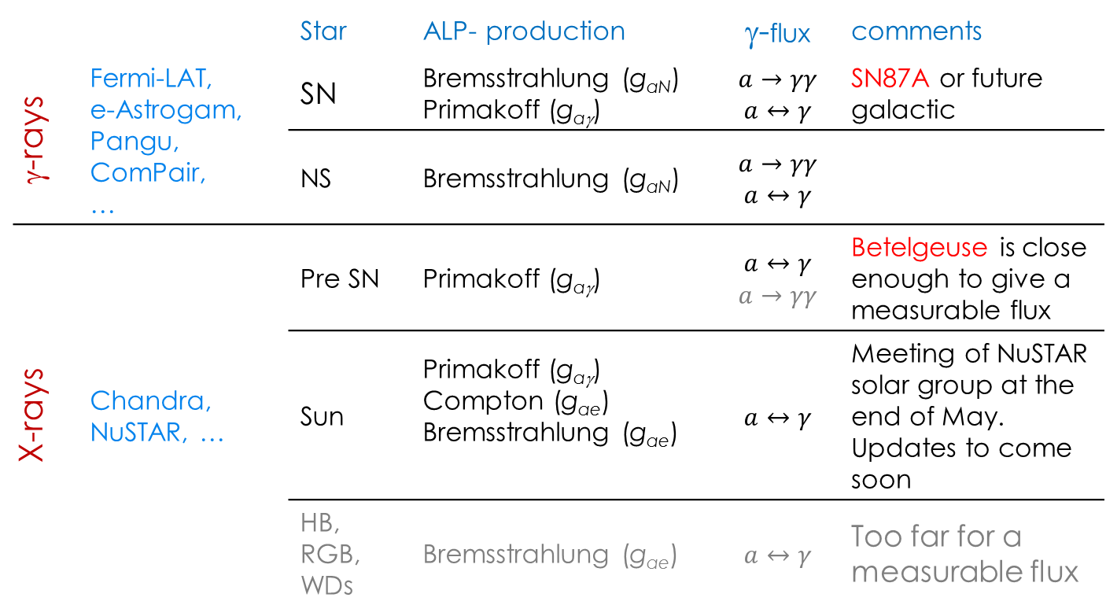
Spaceborne X- and γ–ray detectors as stellar axionscopes
 |  | Star | ALP- production | γ-flux | comments
γ-rays | Fermi-LAT, e-Astrogam, Pangu, ComPair, … | SN | Bremsstrahlung (g_{aN}) Primakoff (g_{aγ}) | $$a→γγ$$ $$a↔γ$$ | SN87A or future galactic
 |  | NS | Bremsstrahlung (g_{aN}) | $$a→γγ$$ $$a↔γ$$
X-rays | Chandra, NuSTAR, … | Pre SN | Primakoff (g_{aγ}) | $$a↔γ$$ $$a→γγ$$ | Betelgeuse is close enough to give a measurable flux
 |  | Sun | Primakoff (g_{aγ}) Compton (g_{ae}) Bremsstrahlung (g_{ae}) | $$a↔γ$$ | Meeting of NuSTAR solar group at the end of May. Updates to come soon
 |  | HB, RGB, WDs | Bremsstrahlung (g_{ae}) | $$a↔γ$$ | Too far for a measurable flux

Slide 33
Next galactic SN

Slide 34
Next galactic SN

Slide 35
Next galactic SN

Slide 37
