Slide 1
Searching for ALPs with NGC1275 Nicholas Jennings Rudolf Peierls Centre for Theoretical Physics, University of Oxford
13th Patras Workshop on Axions, WIMPs and WISPs
Thessaloniki, Greece, 15-19 May 2017

Slide 2
Searching for ALPs with NGC1275
Based on astro-ph/1605.01034 with M. Berg, J. Conlon, F. Day, S. Krippendorf, A. Powell and M. Rummel.
Similar analysis by Wouters and Brun (1304.0989) but with a less luminous AGN (Hydra A) than NGC1275 ($\sim$1% of data used here).
More recently M. Marsh et al (1703.07354) looking at M87.
Fermi-LAT analysis of NGC1275 (1603.06978) and H.E.S.S. (PKS 2155-304, 1311.3148).

Slide 3
Axion-Like Particles
Light pseudo-scalars arising from the breaking of a U(1) symmetry at a high scale.
Well motivated from string theory: always arise in the Large Volume Scenario.
ALPs couple to electromagnetism via the Lagrangian term:
$$\frac{a}{M}E∙B=a g_{aγγ}E∙B$$
In magnetic fields leads to photon-ALP inverconversion.

Slide 4
Photon-ALP oscillations
Probability of photon-ALP conversion (for $m_{a}≲{10}^{−12}eV$):
$$P_{γ→a}= \frac{1}{2}\frac{Θ^{2}}{1+Θ^{2}}\sin^{2}\left(Δ\sqrt{1+Θ^{2}}\right)$$
$Θ=0.28\left(\frac{B_{⊥}}{1μG}\right)\left(\frac{ω}{1 keV}\right)\left(\frac{{10}^{−3}{cm}^{−3}}{n_{e}}\right)\left(\frac{{10}^{11}GeV}{M}\right)$ $Δ=0.54\left(\frac{n_{e}}{{10}^{−3}{cm}^{−3}}\right)\left(\frac{L}{10kpc}\right)\left(\frac{1 keV}{ω}\right)$
In magnetic fields leads to photon-ALP oscillations at X-ray energies.

Slide 5
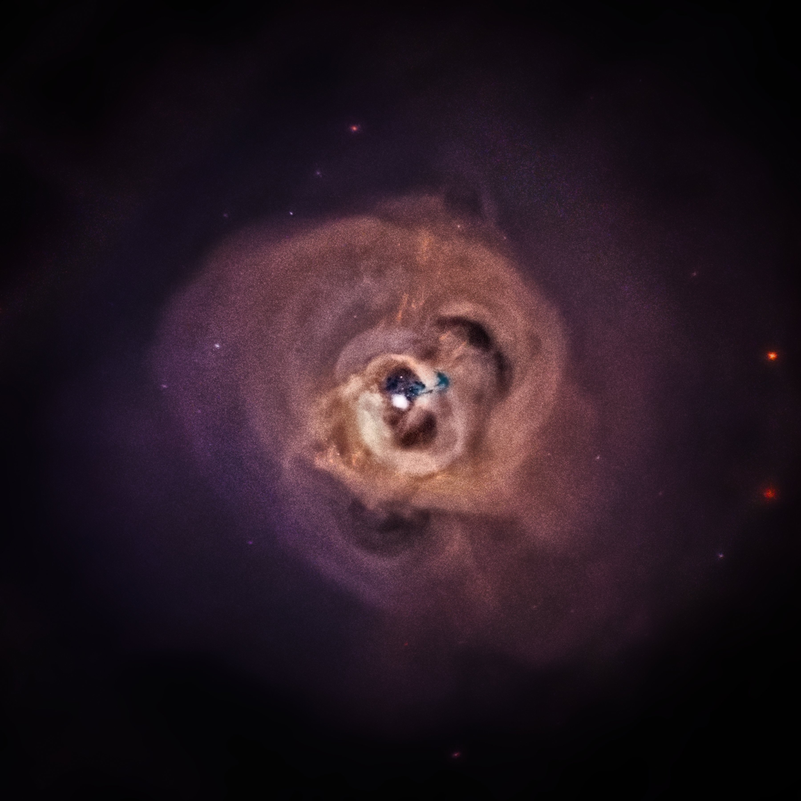
Perseus Cluster
Magnetic field approximately 1 Mpc across.
Coherence lengths 3.5-10 kpc.
Magnetic field strength estimated at 10-25 $μ$G at the centre [astro-ph/0602622], and 1-10 $μ$G across the cluster.
Very efficient converter of photons to ALPs.

Slide 6
NGC 1275
Central galaxy of Perseus, with an AGN unobscured in our direction.
Basic components to X-ray spectrum are:
Power-law.
Reflection spectrum (incident photons illuminate accretion disc, resulting in fluorescent emission) – in practice manifest as neutral Fe K$α$line at 6.4 keV.
Thermal soft excess (origin not entirely known).

Slide 7
Photon survival probability in Perseus
100 domains, lengths: 3.5-10 kpc (total: 620kpc), $B_{0}=15 μG$

Slide 8
Photon survival probability in Perseus
Convolved with Gaussian FWHM (150 eV)

Slide 9
The data
Chandra satellite: 1 Ms with ACIS-S in 2002 and 2004, 500 ks with ACIS-I in 2009.
We subtract source spectrum from nearby cluster emission background and fit spectrum with absorbed power-law.
Total counts:
230000 for 2009 ACIS-I ‘edge-of-chip’ observations
242000 for 2009 ACIS-I ‘midway’ observations
183000 for 2002-4 ACIS-S on-axis observations
On-axis
Midway
Edge

Slide 10
Complete extraction for ACIS-I edge
At 2.0–2.2 keV: five data points in a row 3-5 sigma high
At 3.4–3.5 keV: two data points low, 4.5, 2.6 sigma

Slide 11
Pile-up contamination
If two or more photons arrive during the detector read-out time (3.1s), they are registered as one photon.
Two ways to ameliorate this:
Discard central pixels with highest flux.
Model pile-up effects with jdpileup model.

Slide 12
Extraction for ACIS-I edge excluding centre

Slide 13
ACIS-I midway excluding centre

Slide 14
Extraction for ACIS-S with pileup model

Slide 15
Features
Excess at 2-2.2 keV:
Overwhelming statistical significance, however at an effective area edge.
No numerical package was able to model this excess directly.
Dip at 3.5 keV:
Significant at 4-sigma.
Possible connection to 3.5 keV line (Bulbul 14, Boyarsky 14).
See 1608.01684 for an analysis of the consistency of this result with other 3.5 keV analyses.

Slide 16
Bounds calculation – Magnetic Field Model
$$B(r)∝ {n_{e}(r)}^{0.7}$$
$$n_{e}\left(r\right)= \frac{3.9 ×{10}^{−2}}{{\left[1+{\left(\frac{r}{80 kpc}\right)}^{2}\right]}^{1.8}}+\frac{4.05 ×{10}^{−3}}{{\left[1+{\left(\frac{r}{280 kpc}\right)}^{2}\right]}^{0.87}}{cm}^{−3}$$
Domain lengths drawn randomly from a Pareto distribution between 3.5 kpc and 10 kpc.
Power spectrum index n=2.8 based on analysis of cool-core cluster A2199 done in 1201.4119.

Slide 17
Bounds calculation
Compare 2 models for the spectrum:
Model 0: $F_{0}\left(E\right)={AE}^{−γ}×e^{−n_{H}σ\left(E\right)}$
Model 1: $F_{0}\left(E,B\right)={AE}^{−γ}×e^{−n_{H}σ\left(E\right)}×P_{γ→γ}\left(E,B,M\right)$
Procedure:
Fit data to Model 0.
Calculate $P_{γ→γ}$ for 50 random magnetic field configurations.
For each mag. field config. generate 10 fake data sets from Model 1.
Fit Model 0 to each of the 500 fake data sets.
If ${χ_{1}}^{2}<{χ_{0}}^{2}$ for less than 5% of configs, Model 1 excluded at 95% confidence.

Slide 18
Bounds calculation
Based on a central magnetic field value of $B_{0}=25 μ$G, at 95% confidence:
$g_{aγγ}≲1.5 × {10}^{−12}{ GeV}^{−1}$
What if 2.0-2.2keV excess were caused by ALP-photon oscillations?
Would correspond to $g_{aγγ}≃1 × {10}^{−12}{ GeV}^{−1}$.

Slide 19
New bounds
Image credit: Gray Rybka

Slide 20
New bounds
Image credit: Gray Rybka

Slide 21
Other Point Sources
Analysis of other good point sources recently done in 1704.05256.
Best sources for constraining ALPs:
2E3140: $g_{aγγ}≲1.5 × {10}^{−12}{ GeV}^{−1}$
NGC3862: $g_{aγγ}≲2.4 × {10}^{−12}{ GeV}^{−1}$

Slide 22
New Satellite - Athena
Athena X-ray Observatory due to launch in 2028.
Energy resolution of 2.5 eV will resolve ALP-induced oscillations far better than Chandra.
Detailed analysis of projected bounds from Athena coming very soon (1705.XXXXX):
Improvement of around an order of magnitude over Chandra observations!
Assuming no modulations detected.

Slide 23
Conclusions
NGC1275 provides the best current bounds on ultralight ALP-photon interactions.
Other point sources competitive: good for cross-checking
Going forward, Athena promises to vastly improve current bounds.

Slide 24
Extra slides

Slide 25
Extra slides – 3C 273

Slide 26
Quick summary of systematics
Pileup – but magnitude of excess is the same across different spectra on different instruments with widely differing levels of pileup.
Effective area miscalibration – but excess is not present in the background spectra.
Missubtraction of cluster background – O(10%) features survive for SNR of up to 60:1.
Miscalibration of gain in high-flux regions – but feature consistent at varying levels of flux. Also Fe K$α$line at 6.4 keV as expected.
Atomic lines – none in the right region.

