Slide 1



Axions and ALPs: a very short introduction
David J. E. Marsh
Phys. Rep. 643, 1 (2016)

Slide 2
QCD axion: the edge of discovery?

Slide 3
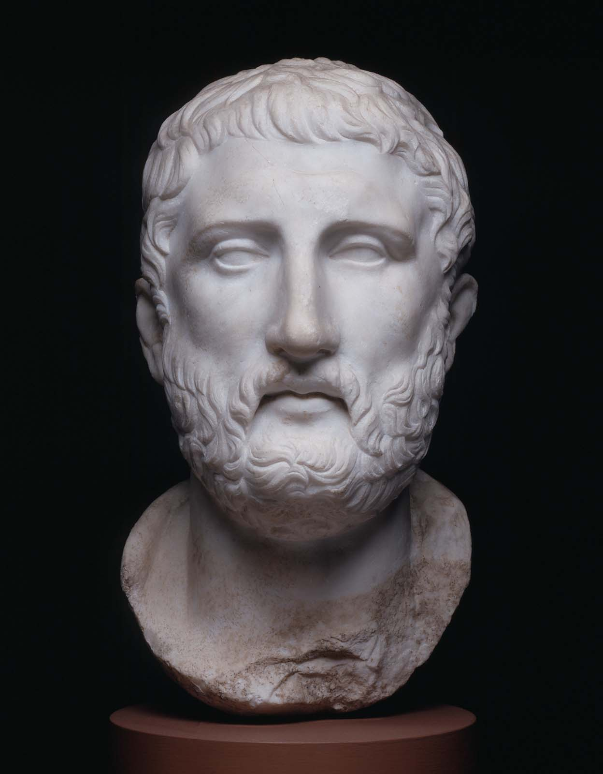
Axion Theory
and Models

Slide 4
The QCD Axion
PQ: Peccei & Quinn (1977)
WW: Wilczek (1978); Weinberg (1978)
Introduced by PQWW to solve the strong CP problem.
QCD “topological term”
e.g. Crewther et al (1979)
Neutron EDM is measured small → θ has a fine tuning problem.
90% C.L. Pendlebury et al (2015)
Axial current anomaly. Bell & Jackiw (1969)
Solution: introduce global chiral U(1) with SSB: θ is dynamical.

Slide 5
The QCD Axion
KSVZ: Kim (1978); Shifman, Vainshstein, Zakharov (1980)
DFSZ: Dine, Fischler, Srednicki (1981); Zhitnitsky (1980)
Complex PQ field SSB potential defines the axion decay constant, f_{a}:
Once coupled to the θ-term the axion has a potential (ChPT not DIG):
Vafa-Witten theorem: minimum must conserve CP → solved problem.

Slide 6
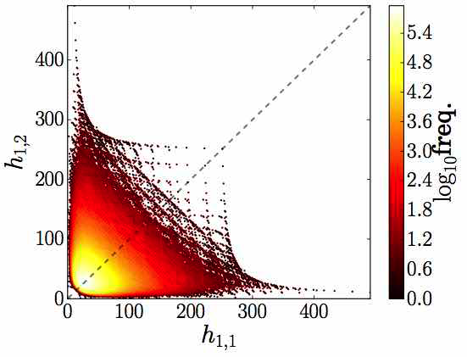
Axions in String Theory
e.g. Svrcek & Witten (2006);
Arvanitaki et al (2010)
Axions are the CP-odd KK zero modes of p-form fields.
a is integral of A on closed cycles → # of axions fixed by topology.
ω=harmonic basis, dω=0
Gauge invariance of F → shift symmetry for a.

Slide 7
Axions in String Theory
Grimm & Louis (2004); Hocker & Louis (2005)
Cicoli et al (2012); Ringwald (2012)
Example: Type-IIB orientifolds. Consider the C₄-form (b₄=h_{1,1}~30).
Kinetic terms from the Kahler potential. Moduli σ → size of cycles.
Canonically normalise
Masses come from D7-brane gauge group instantons (7 wraps 4):
Diagonalise

Slide 8
The (Multi)-Axion Effective Action
For non-canonical fields, before chiral symmetry breaking:
General kinetic term, with alignment.
General instanton potential, with phases.
All possible shift-symmetric couplings to SM fields.
Kinetic terms/charges see e.g. Bachlechner et al (2014)

Slide 9
The (Multi)-Axion Effective Action
For non-canonical fields, after chiral symmetry breaking:
Masses and c^{EM} shift & EDM coupling if non-zero c^{QCD}.
Coupling to quarks → coupling to nucleons.
Couplings see e.g. Graham & Rajendran (2013)

Slide 10
The (Multi)-Axion Effective Action
Canonical fields, after expanding potential:
Generic results for mass and kinetic term from random matrix theory
Kinetic term and potential determine phase, mass, field range, & ints.
General interaction Largrangian has all available terms.
Other axions/instantons can affect solution to strong CP problem.
Planckian problem for QCD axion, see e.g. March-Russell & Kamionkowski (1992)
Notes:
I am mostly going to consider the case of a single axion field, but please bear in mind the complications. Especially around the “decay constant” and initial conditions.

Slide 11
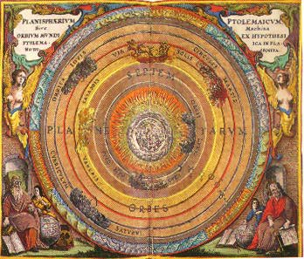
Axion Cosmology

Slide 12
Production of Axions
Populations of axions can be hot or cold, particles or coherent fields.
Vacuum realignment: cold field.
Decay of defect: cold particles (later interactions → condense).
Decay of parent (e.g. modulus): hot particles.
Thermal bath: hot particles.
Coherent effects on Earth and in galaxies from λ_{dB}.
Uncertainty on relic abundance → QCD axion DM for low f_{a}.
``Cosmic Axion Background’’, N_{eff} bounds and conversion.
``Neutrino-like’’ constraints, m_{a}<(few) eV. Negligible for QCD axion with stellar bounds.

Slide 13
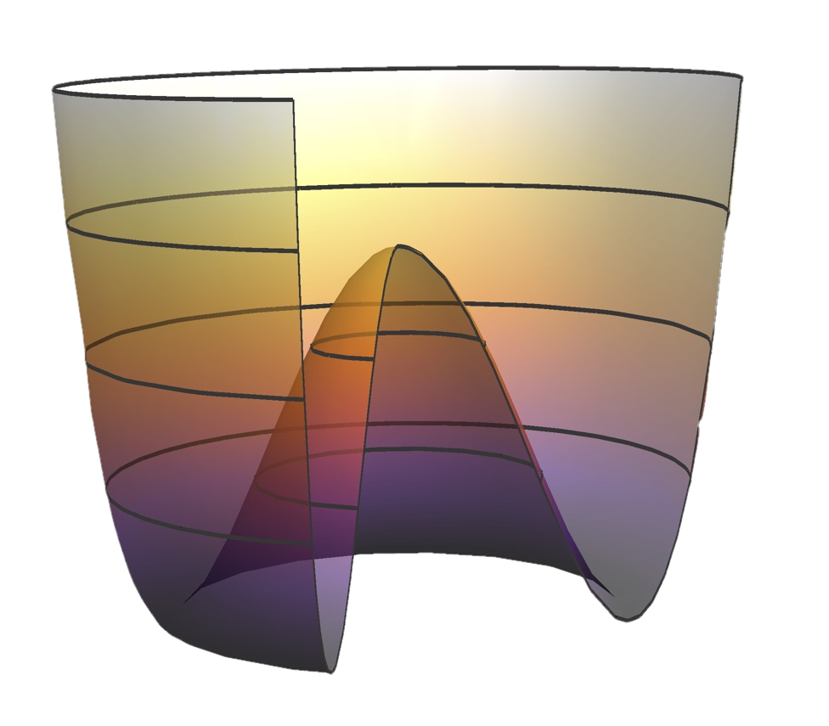
Symmetry Breaking in Cosmology
Temperature determines the PQ vev:
The axion is born:
Crucial role is played by inflation:
From r<0.07, BICEP2 (2016)
Before SSB Phase transition relics: strings, DWs, miniclusters.
After SSB Cold condensate, no relics. Isocurvature perturbations.

Slide 14
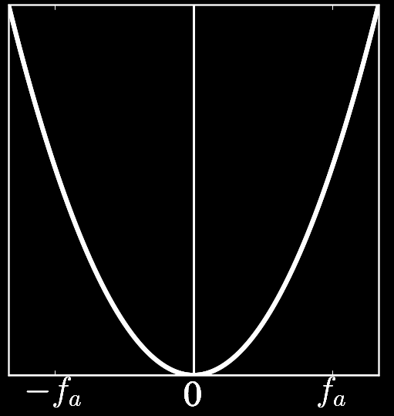
Vacuum Realignment: Inflation and DE
Axion acquires mass*, evolves according to Klein-Gordon:
Axion is “frozen” by Hubble friction term.
Light axions can be inflatons/DE.
Problem is field range.
(* I am ignoring T-dependence and anharmonicities)

Slide 15
Vacuum Realignment: Production of DM
Axion acquires mass, evolves according to Klein-Gordon:
Field oscillates & damps.
WKB (or exact) →
Osc. scalar ~ matter
(above the Jeans/ de Broglie scale)
QCD axion: Preskill Wise & Wilczek; Abbott & Sikivie; Dine & Fischler (1983); also Turner (1983)

Slide 16
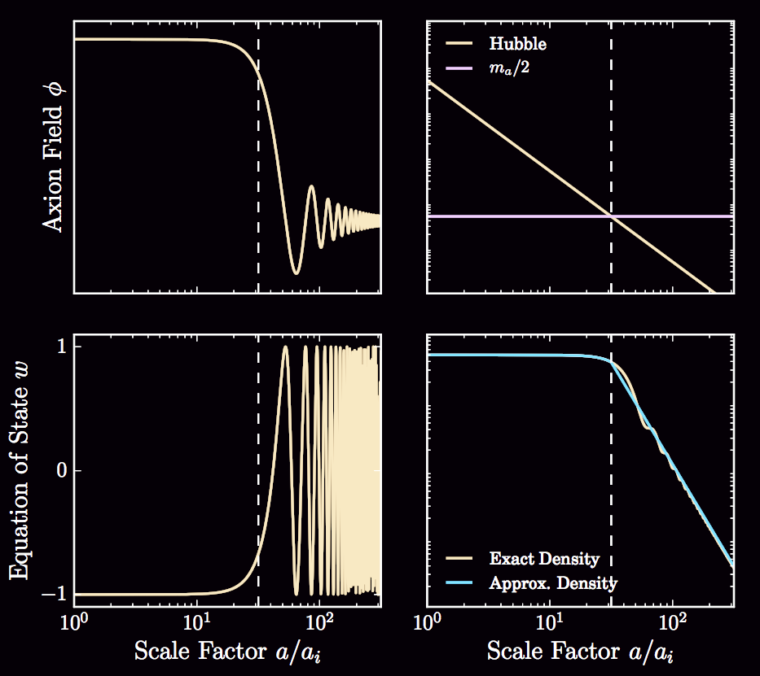
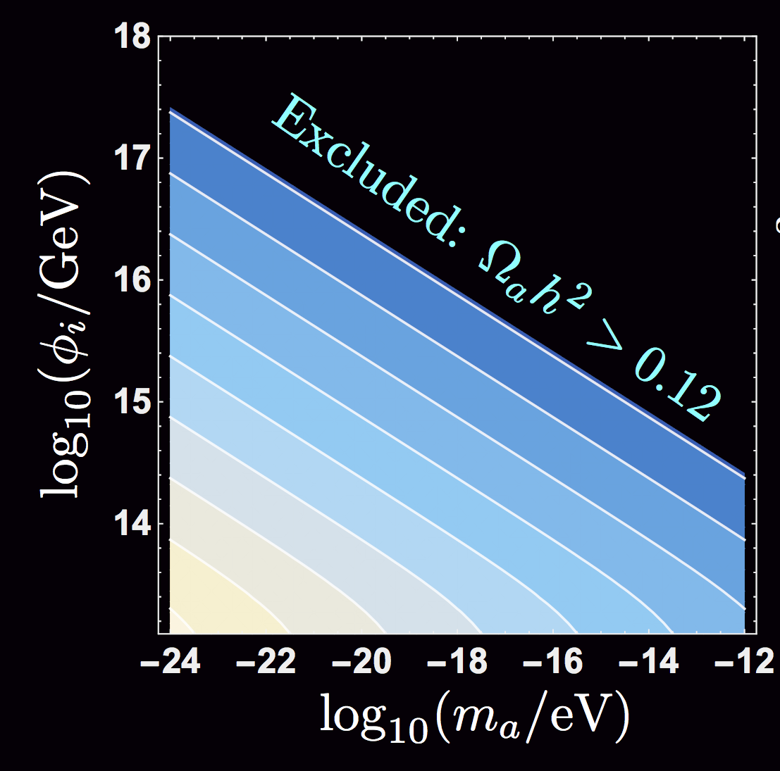
Vacuum Realignment: Production of DM
>1% DM
Field range + mass → relic density.
Light axions → f_{a} ~ M_{GUT} –M_{pl}
Anthropic bound m_{a}~10⁻¹⁸ eV
Notes:
Note that inflation/DE needs large field range, while DM needs small field range. Tension?
Best way to explore this is with statistics and random matrix models. See Stott et al.

Slide 17
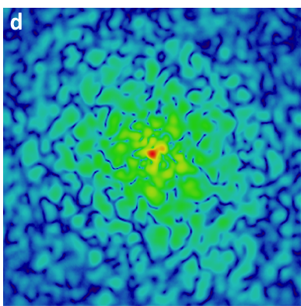
When Axions Aren’t CDM
Basic QM: axion field is coherent below the de Broglie wavelength.
Origin: gradient energy in the Klein-Gordon eq. → pressure.
DM searches and coherence effects:
Velocity ~ 200 km s⁻¹
“axion wind” from grads.
Axion star/soliton.
Cosmology: structure formation, and “axion stars”.
Non-rel: Schrodinger-Poisson.
Linear perts: sound speed.
Quasi-particles/coherence length.
ULAs: coherence time ~10⁶ years.
Length ~ kpc.
Sims: see talk by Jens Niemeyer
Fig: Schive et al (2014)

Slide 18
QCD Axion DM: low f_{a}, high H_{I}
When SSB occurs after inflation → bound on mass from Ω_{a}h²=0.12
Anharmonicities in V (fit):
Average θ fixed (many volumes):
T-evolution of m_{a} (QCD):
Thermal history (up to TeV):
Decays of defects (N_{DW}=1):
Lyth (1992)
Tensor r<0.07 → SSB before inflation
Wantz & Shellard (2009)
Kawasaki et al (2015)
Dashed: c=a=1; Solid: c=2.1, a=2.48; Borsanyi et al Lattice n=3.34
Notes:
Solid is \alpha=2.48, c=2.1, dashed is \alpha=c=1.

Slide 19
Crucial Epochs and Energies
SSB. Thermal. Compare f_{a}~T. Early Universe. Before or after inflation?
QCD: from stellar cooling.
String theory: LVS.
SSB is model dependent.
QCD: from black hole spins.
String theory: WGC & GUTs.
SSB must be before inflation.
Oscillations. Non-thermal. Compare m_{a}~H. Relic abundance. Late time.
Inflation.
BBN → define ULAs.
Linear scales → precision.
Equality → axion DM
Today → axion DE

Slide 20
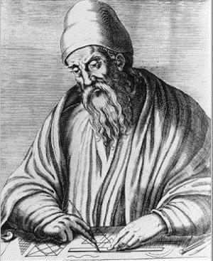
Constraints on Axions

Slide 21
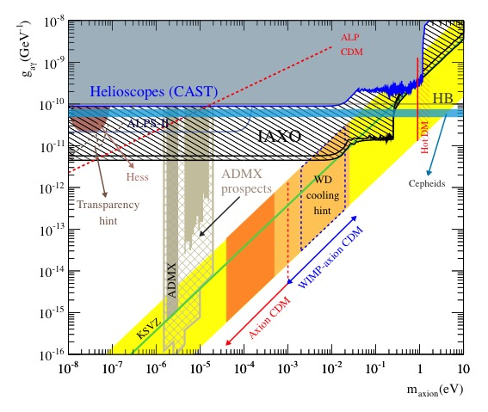
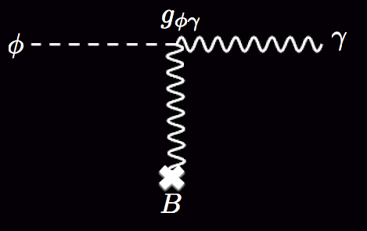
Axion-Photon Conversion
Sikivie (1983); van Bibber et al (1987)
Magnetic field, Primakoff process.
Mainstay of many axion searches.
GAMBIT update: see talk by Sebastian Hoof
From Carosi et al (2013)

Slide 22
Decays of Heavy Axions
Ellis et al (1992); Masso & Toldra (1995)
Milea et al (2015)
Lifetime for decay to photons:
Decay in equilibrium
CMB Anisotropies: heating changes N_{eff} and baryon abundance.
BBN: light element abundances Y_{p} (He) and D/H from expansion rate
Spectral distortions: CMB black body spectrum (COBE).
Decay out of equilibrium
Notes:
Vertical lines of constant decay time: in equilibrium decays.
Horizontal lines: out of equilibrium

Slide 23
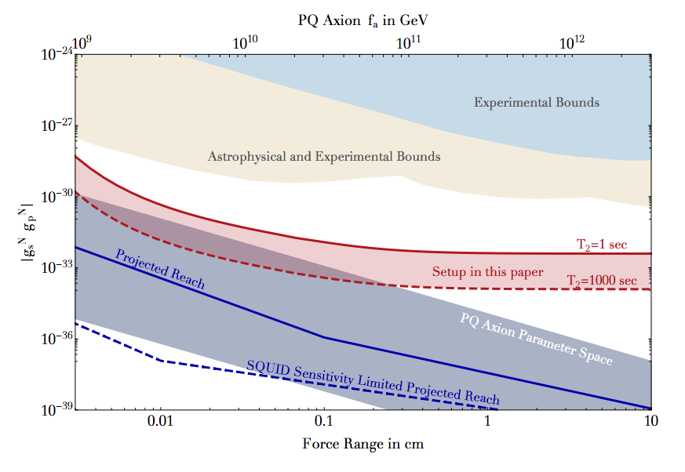
Axion Mediated Forces
Moody & Wilczek (1984)
Raffelt (2012); Arvanitaki & Geraci (2014)
Not a standard “fifth force”: axions couple to spin → dipole force.
Lab constraints weak:
CP-violation → monopole potential
→ ARIADNE proposal.

Slide 24
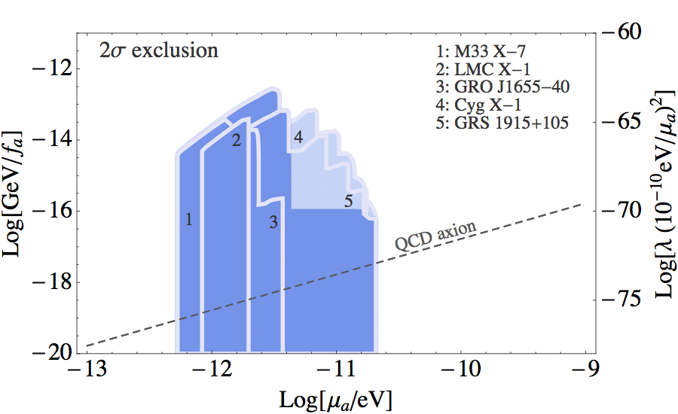
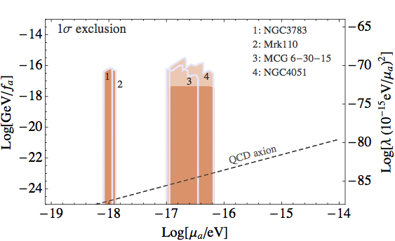
Black Hole Superradiance
Brito et al (2015); Arvanitaki & Dubovsky (2010); Arvanitaki et al (2014)
Most generic constraint on light bosons. Predict gaps in (M,J) plane.
“Gravitational atom”: Light bosons → bigger BH.
Stable orbits → potential barrier → “mirror” for extracting spin.
Stellar mass BH: f_{a}~M_{pl} QCD axion
SMBH: super-Planckian or ULA.

Slide 25
Axion Inflation and DE
Inflation: Freese et al (1990)
DE: Hill & Ross (1988); Friemann et al (1995)
For m<H and ρ~M_{pl}²H² scalar field can drive accelerated expansion.
Axions: mass protected from corrections (natural). But need φ~f_{a}~M_{pl}.
Note: f here is NOT defined by the coupling to EDM, but in potential.
Single field in string theory large f constrained by “WGC”.
Getting around the field range:
“Hilltop”: tune the initial angle to nearly π. Natural with N~O(20).
“N-flation”: variant of assisted. Pythagoras in field space. N~O(100’s).
“Alignment”: cancellation in V and/or K. Rotate to canonical basis.
“Monodromy”: lift V. Potential branches from complex plane.
Notes:
Basis dependent. No unique “f” in complex models.

Slide 26
Ultralight Axions and Fuzzy DM
Hu et al (2000); DJEM+(2013+); Hui et al (2016)
50%
Predict no faint galaxies
100%
CDM
10⁻²³
10-22
JWST
50%
w=-1 → Silk damping + ISW.
CMB absolute lower bound m_{a}>10⁻²⁴ eV, mixed DM at ~ 1%.
Jeans scale → less structure.
High-z galaxies/Lyman-a: ma>10⁻²²⁻²¹ eV. Need sims.
Constraints on ULA couplings: See talk by Michal Rawlik
ULAs and GWs: see talk by ArataAoki.

Slide 27
Thank You

Slide 28
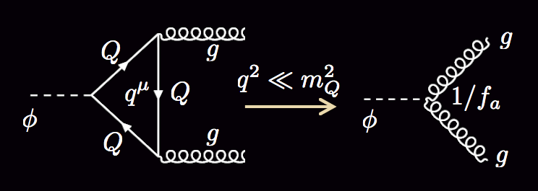
The QCD Axion
KSVZ: Kim (1978); Shifman, Vainshstein, Zakharov (1980)
DFSZ: Dine, Fischler, Srednicki (1981); Zhitnitsky (1980)
Good: vacuum energy depends on θ due to “instantons”.
e.g. Coleman’s book
Bad: topologically distinct vacua prevent transition:
e.g. Callan et al (1978)
Consider KSVZ model. Heavy quark charged under U(1) → couple axion to θ-term.
Axial coupling → spin structure

