Slide 1
Looking for low-mass WIMPS with TREX-DM
Theopisti Dafni, Universidad de Zaragoza
On behalf of the TREX-DM project
tdafni@unizar.es

Slide 2
Outlook
Low-mass WIMPs
Gas TPCs with mM for the WIMP search
The TREX-DM project

Slide 3
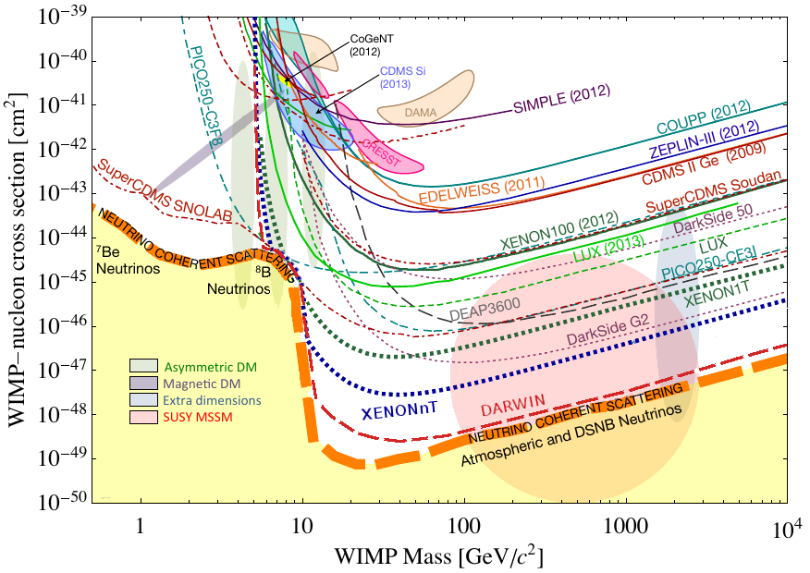
The WIMP hunt
Plot from arXiv:1310.8327
Dark Matter experiments focus on ~50-200 GeV WIMPs
  Heavy nuclei target
  Large target masses
  Low background:
    Radiopurity control
    Electron/nuclear recoil discrimination
      high threshold
What if mass <10 GeV?
  Many Dark Matter experiments have moved
  their attention to the low- mass range,
  but might not be adequate for this region
“Low mass” WIMP race
“Mainstream” WIMP race

Slide 4
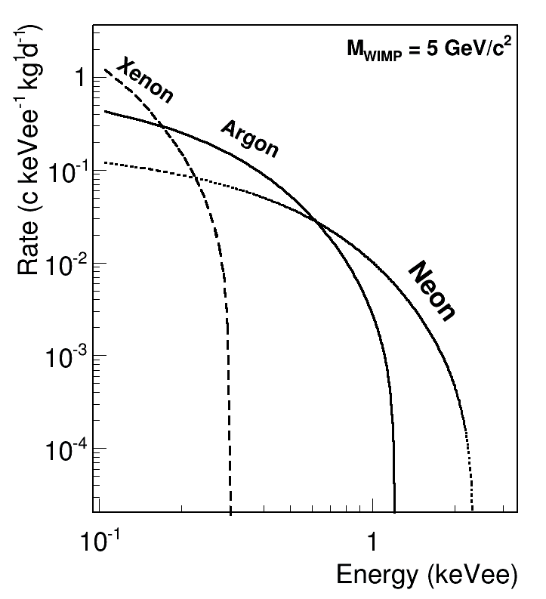
TREX-DM: motivation
What if mass <10 GeV?
  Low A target material
  Low Energy threshold (< 1 keV)
A HPTPC for low-mass WIMPs?
  Low thresholds achievable
  Flexibility in target nuclei
    (low A in particular: Ne, Ar..)
  Rich topological information
  Complex:
  No Electron/nuclear recoil discrimination
  Scaling up in masses?
  Quenching factor at keV energies
We propose TREX-DM: a gas TPC equipped with mM to look for low-mass WIMPs in the LSC

Slide 5
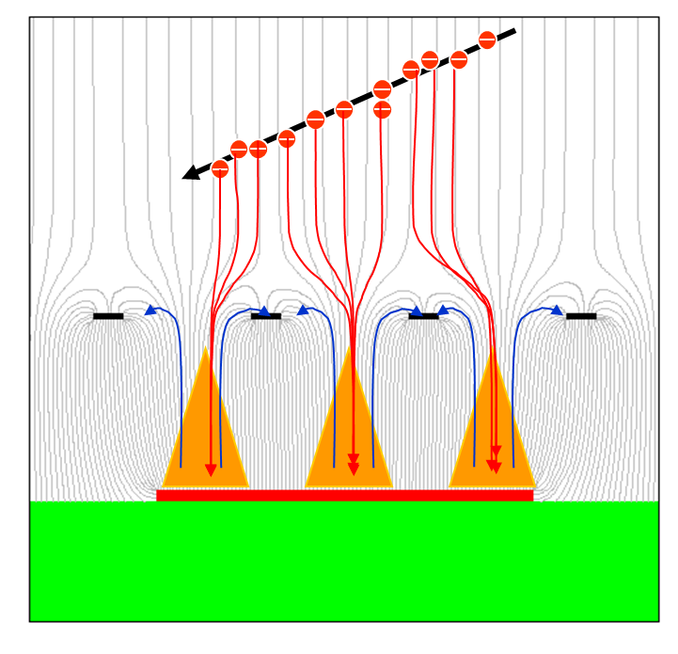
The Micromegas detector
Principle of operation
Consolidated structures:
good performance is systematically achieved
Simple, high granularity, large surfaces
Technologies
  Classical : CAST, COMPASS, ATLAS
  BULK: Robust, mature, very large areas available (T2K, CLAS-12, nTOF, MIMAC)
  microbulk: Higher homogeneity, lightweight, radiopure (CAST, nTOF)
Drift Field (~10²kV/cm)
Amp. Field
~10⁴kV/cm
Readout plane + mesh all in one
Micromesh
5µm copper
Kapton 50 µm
CERN+CEA+UNIZAR development
Readout pads

Slide 6
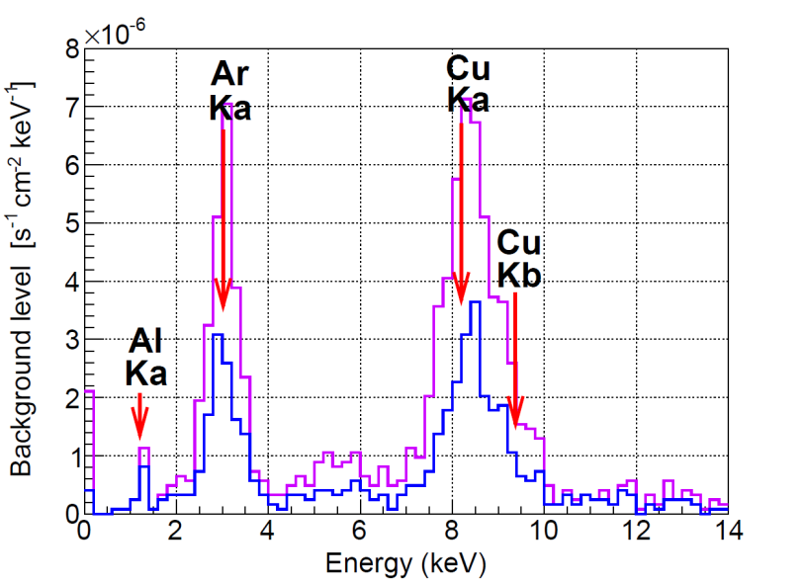
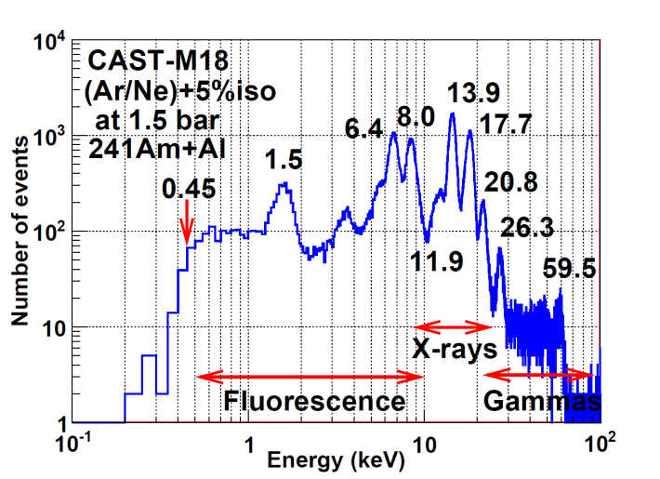
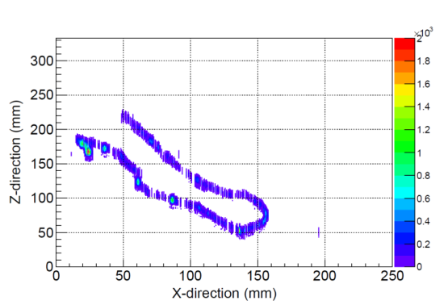
TPCs with Micromegas
Important features for Rare event searches
  Consolidated structure and manufacture
    good performance systematically obtained
  Low intrinsic radioactivity
    made out of Kapton and copper
  Radioactivity control
    Component screening, material study → cleaner elements
  Good energy resolution
  Low energy threshold
    < 0.5keV already achieved, could be improved
  Topological information
    high power to discriminate x-ray signals from background
  Scaling-up
    already proven to be feasible and effective
electron

Slide 7
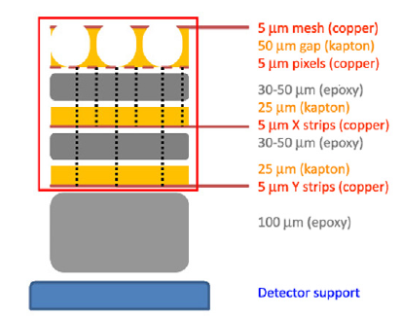
Micromegas: radioactivity
Ultra-low Radioactivity: important to determine quantity, nature and origin of the contamination
Microbulks are mostly Cu & Kapton : potentially very clean
Several samples measured with HPGe at LSC
“BiPo” method: upper limits on U and Th factor
(x100 lower, unpublished)
U & Th levels below ~0.1 µBq/cm²
negligible contribution (and still upper bounds)
40K quantified activity ~ 60 µBq/cm² *
Contamination probably from the treatment of the
materials used: identification & alternatives

Slide 8
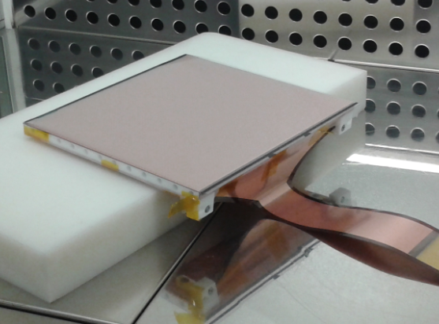
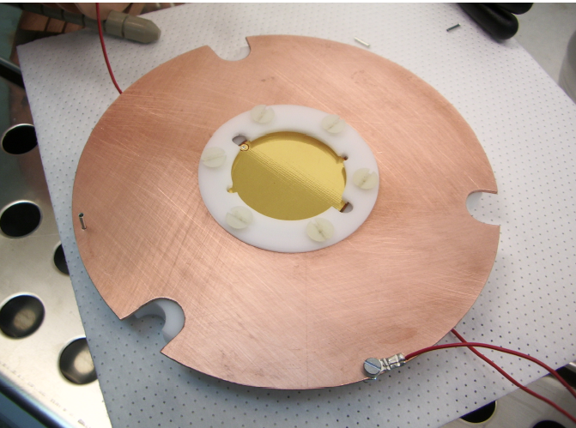
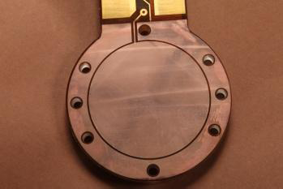
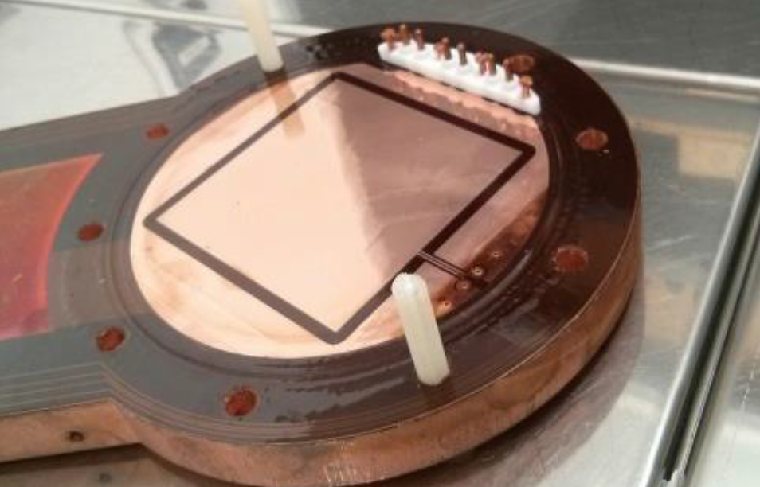
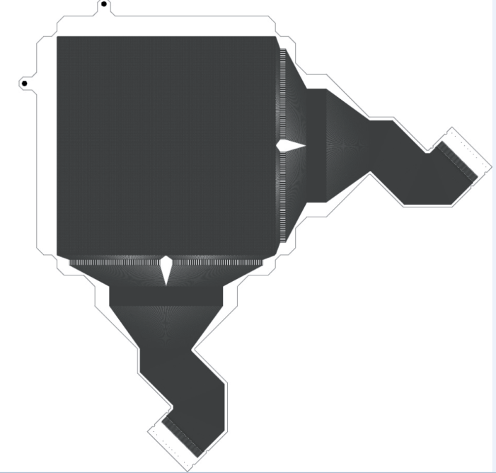
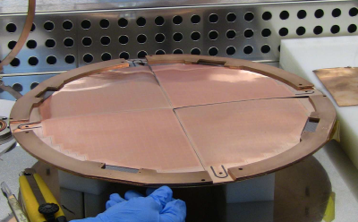
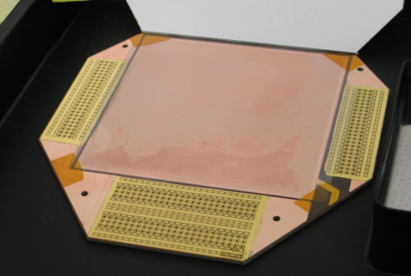
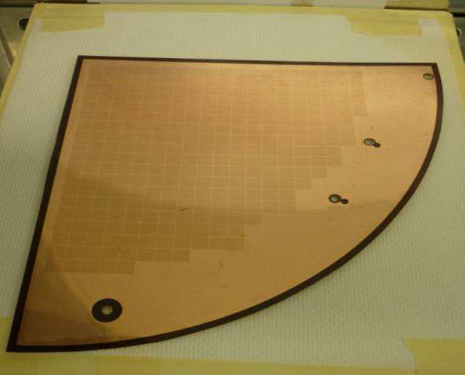
Micromegas scaling up
Microbulk technology:
radiopurity, granularity, scaling-up
excellent performance and prospects for rare-event searches
20 x 20 cm²
Largest single microbulk so far
3 cm
Non-segmented
6 x 6 cm²
~150 strips
15 cm radius
300 Pixels
25 x 25 cm²
TREX-DM in fabrication
10 x 10 cm2
12 x 12 Pixels
tessellation
∅ 30 cm

Slide 9
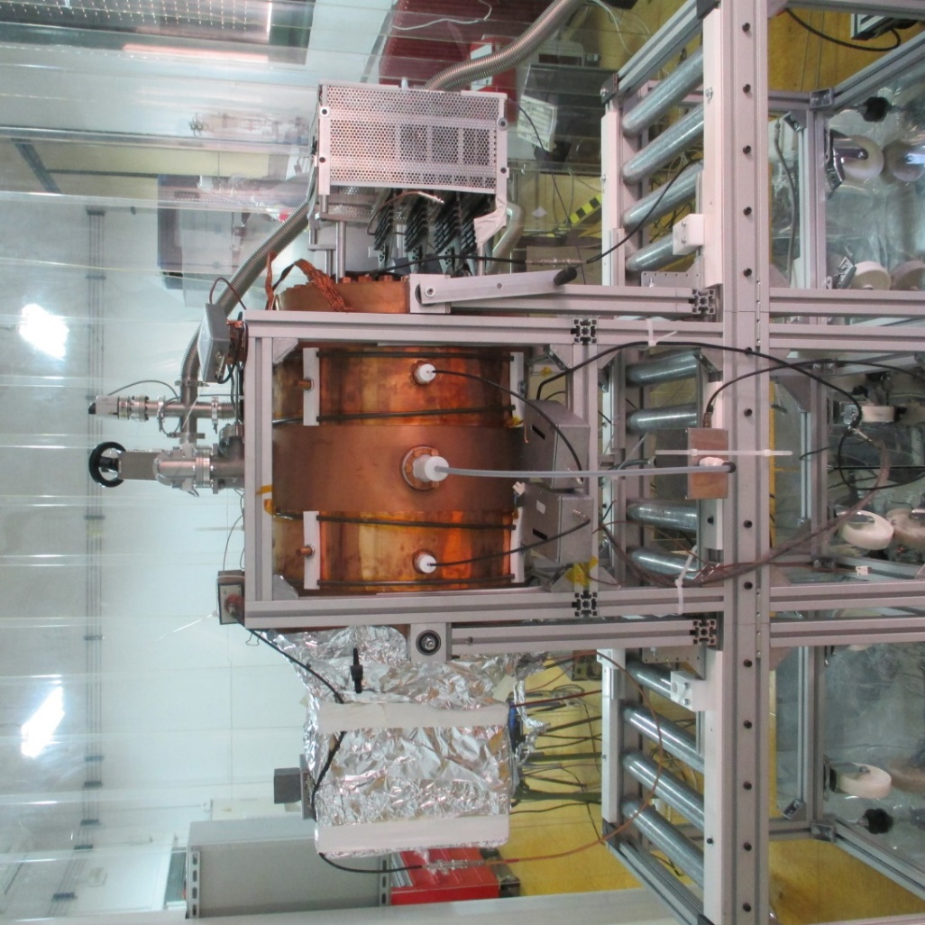
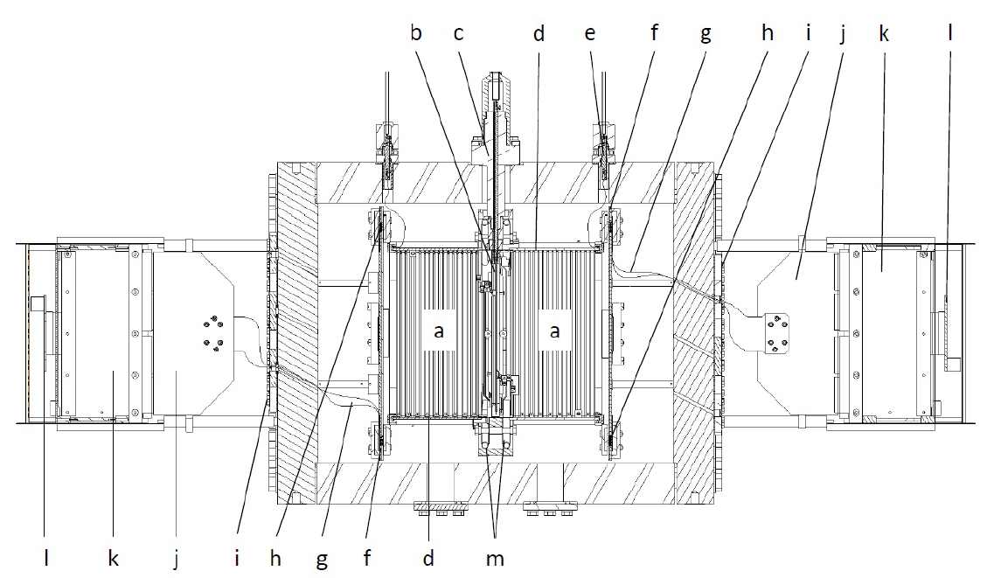
TREX-DM: first steps
Goals : 0.3kg Ar, ~0.160kg Ne at 10 bar
  low energy threshold (< 1 keV)
  low background level (~1 keV⁻¹ kg⁻¹ day⁻¹).
  operation at HP: NOT focused on directionality
Proof of concept, not fully radiopure.
  Built and commissioned at lab:
  Systematic screening of all components
  Bulk MM tested in Ar at HP
  Validation of the simulation chain.
Two active volumes: 19cm x 20cm x 20cm.
Field cage: kapton & Cu, covered by Teflon
Bulk MM: 20x20cm², 2D anode plane (2x432 strips)
Central cathode: mylar, isolated by Teflon
AFTER-based electronics (update to AGET with auto-trigger?)
Signals extracted by flat cables

Slide 10
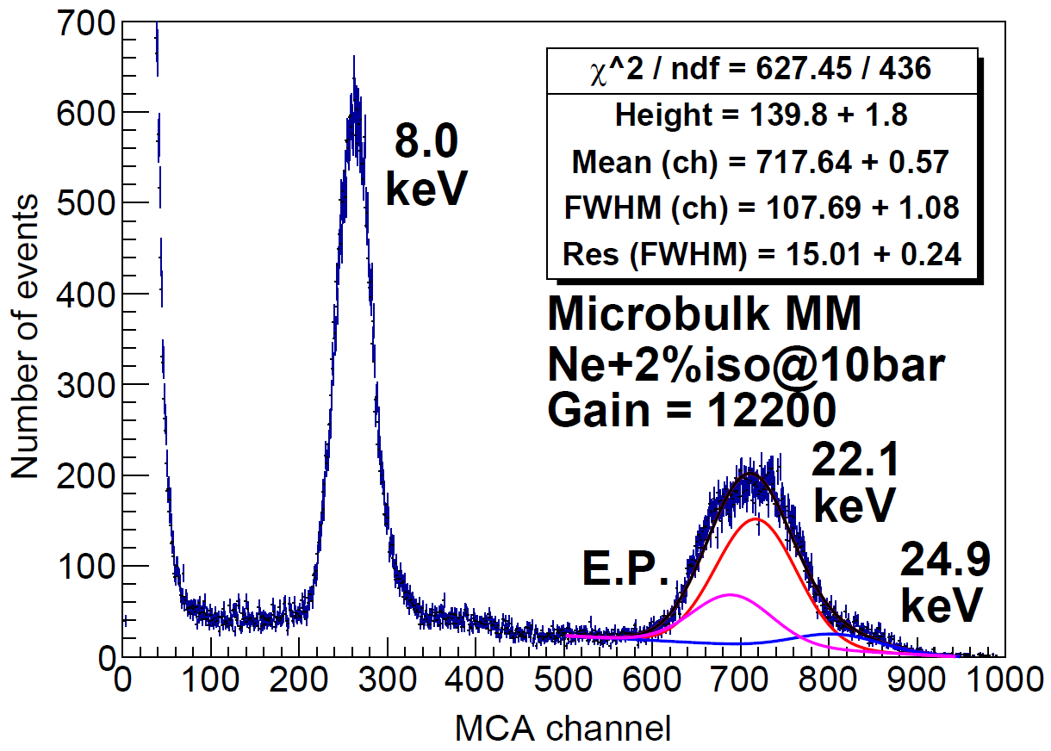
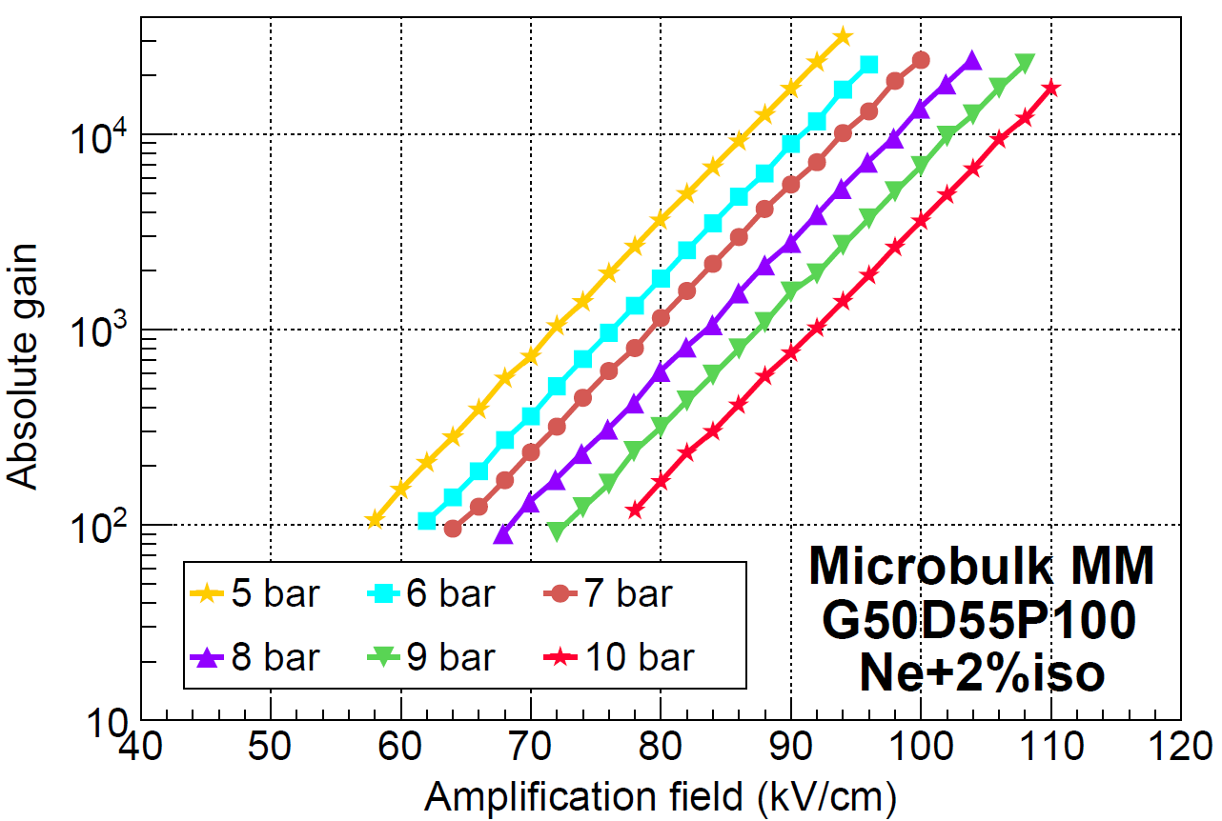
TREX-DM: Gas studies
Ne-2%iC₄H₁₀ @ 10 bar
Operating in non-flammable gases simplifies installation underground
Characterized microbulks in Ar-1%iC₄H₁₀ and Ne-2%iC₄H₁₀
Source: 109Cd (21keV)
Pressures: 1-10 bar.
Excellent behaviour in terms of gain: > 2000 and > 20000 respectively
Good behavior in terms of energy resolution:
some degradation at higher P as expected

Slide 11
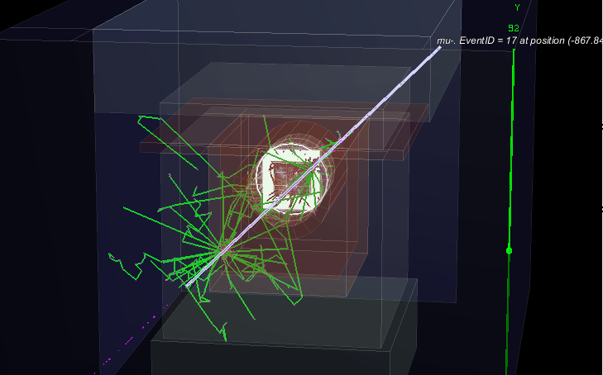
RESTSoft
Dedicated software developed by the UNIZAR group, ROOT-based
REST 2.1.5
RestG4: interface with GEANT4
    Event generation, Physics processes, GDML for geometries
REST
    Charge amplification, generic readout description, hits, electronics response
Framework ready to perform the Data analysis
Complete simulation of the detector response

Slide 12
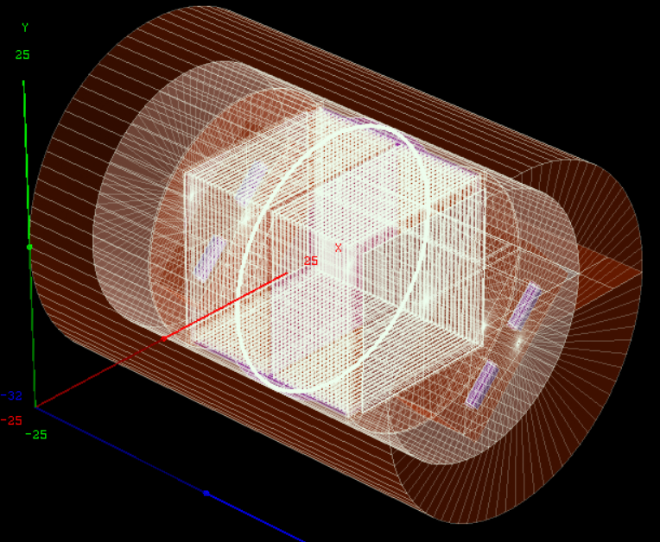
TREX-DM: Background model
Background model
  Studies for Ar-2% iC₄H_{10 and} Ne-2% iC₄H₁₀
Successfull validation against the experimental data
REST 2.1.5
Based on extensive radioactivity measurements of all the components
Expected background: 1 - 10 c keV⁻¹ kg^{-1s} d⁻¹
  intrinsic radioactivity
  Cosmogenic activation (60Co, 3H)
  Radon-related
  External backgrounds: muons, gamma, neutrons

Slide 13
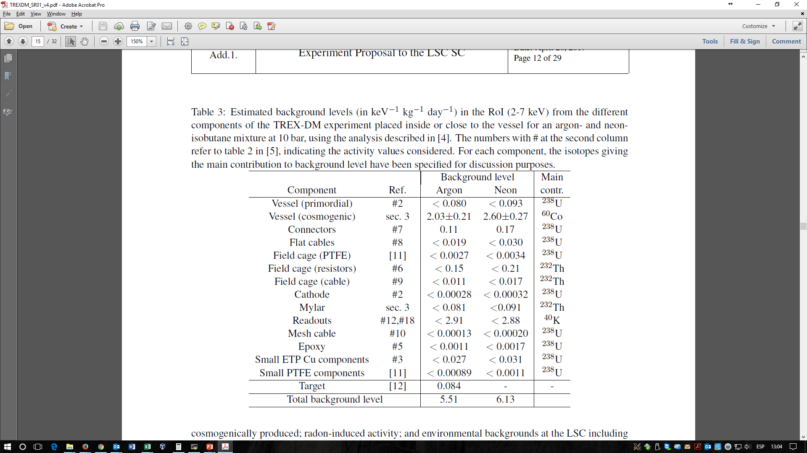
Background components
Possible contribution from mM: 40K
Measurements x25 less exist, still checking
Other important contribution:
Cu vessel cosmogenically activated.
New vessel might be needed for the upgrade

Slide 14
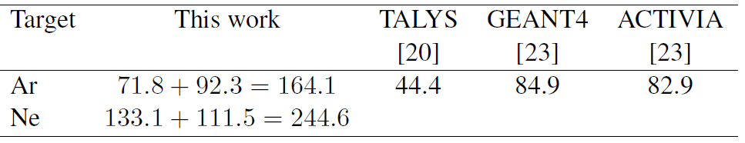
Cosmogenic
In Copper
A piece of copper with the same history as the vessel was measured and the activation was derived.
The vessel (due to the mass) shows an important contribution (60Co).
In Gas (3H)
It could have a significant contribution (signal indistinguishable from DM) but probably liquefaction eliminates it, as liquid TPCs report no mention of it.
iC4H10: probably free of 3H because of underground origin.
Assuming activation to saturation:

Slide 15
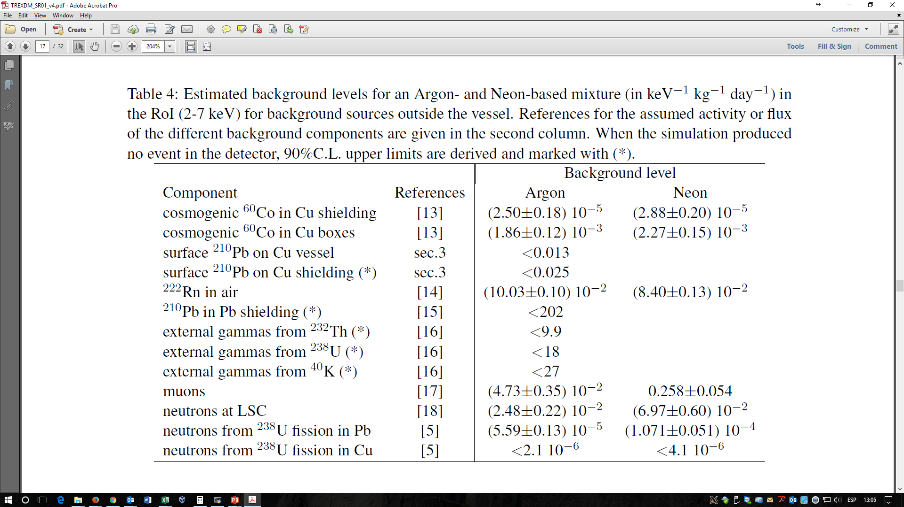
Background External sources
* Still working on statistics…
Cosmogenic
Rn-induced
LSC
environmental
Includes induced neutrons
More neutrón sources –like (α, n) reactions- are considered, all negligible contributions

Slide 16
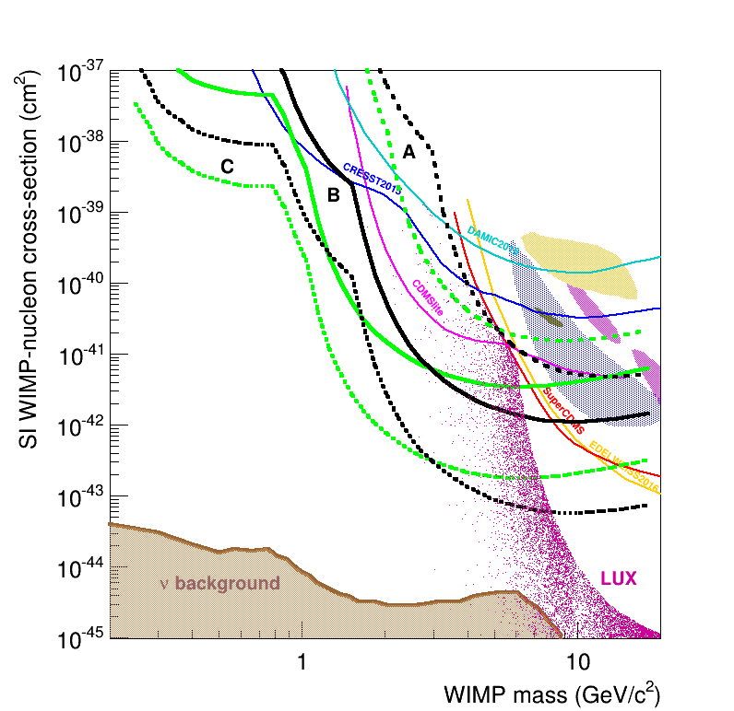
TREX-DM: projection
Physics potential and prospects
  Ne-2% iC₄H₁₀ and Ar-1% iC₄H₁₀ , 10 bar
A:
10 c keV⁻¹ kg⁻¹ d⁻¹ , 0.4 keVee, 0.3 kg· year
B:
1 c keV⁻¹ kg⁻¹ d⁻¹ , 0.1 keVee, 0.3 kg· ear
C:
0.1 c keV⁻¹ kg⁻¹ d⁻¹ , 0.1 keVee, 10 kg· year

Slide 17
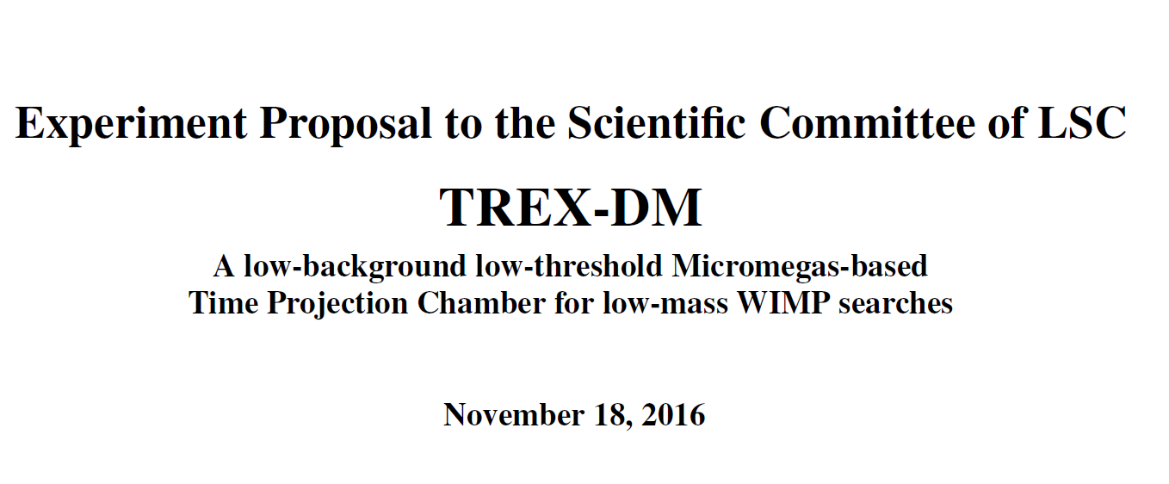
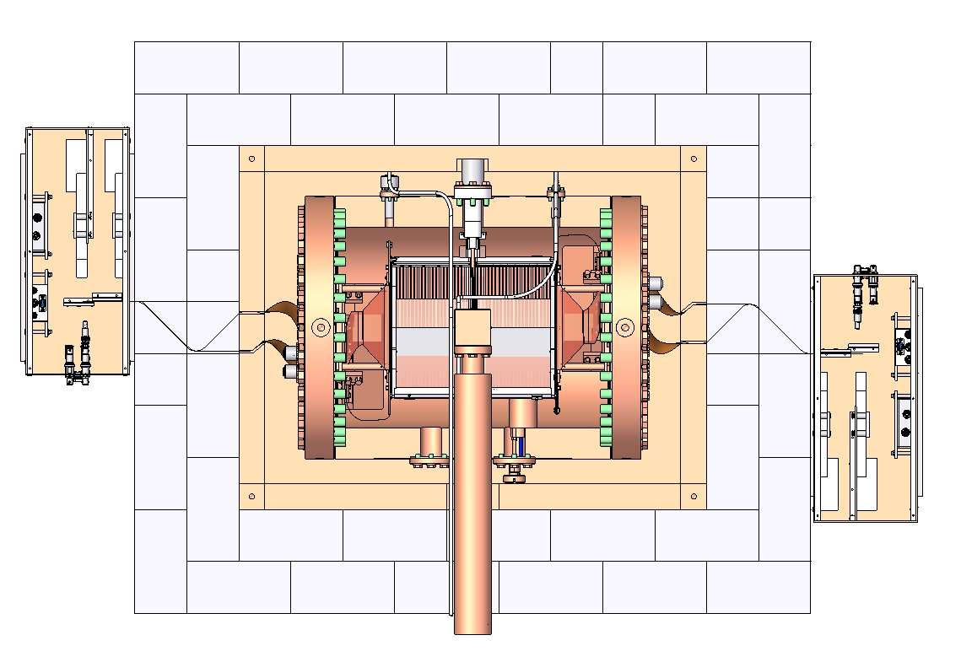
TREX-DM: next steps
Experiment accepted by LSC Dec 2016
Estimated timeline:
  Preparation and commissioning at LSC: ~1 year
  Physics Run in LSC: ~2 years
Detector improvements: radiopure version
  Shielding
  Components
  Readout planes
  DAQ
  …
Aspects on moving Underground
  Services and installation
  Documentation
  Layout
  Gas type operation
  …

Slide 18
TREX-DM: next steps (II)
Operation Underground
Commissioning phase: through 2017
Tentative Data-taking programme:
  Ne-2% iC₄H₁₀ at 1-10 bar: 1 year (2018)
  Evaluation of data
  Possible updates of setup
  Restart-Data taking:
  possibility of depleted ³⁹Ar at 10bar

Slide 19
Summary and Conclusions
Gas TPCs with Micromegas planes have the potential to make excellent detectors for rare-event searches
low background levels and thresholds, low radioactivity, scaling up possibilities, topological information of events
Still some challenges to be addressed: keep characteristics over large areas, quenching factor
The TREX-DM experiment
Challenge: low energy threshold over a large area at High Pressure
Prospects: Background levels ~ 1 count keV⁻¹ kg⁻¹ day⁻¹
Energy threshold ~0.4keVee down to 0.1keVee
TREX-DM will provide valuable insight for the low-mass region:
Very few detectors currently sensitive in the sub-keV region
Little known of sources of background
Unique detector of its kind:
    complements field
potential for innovation
Potential to be sensitive to areas beyond the current bounds at the prototype level

Slide 20
end

Slide 21
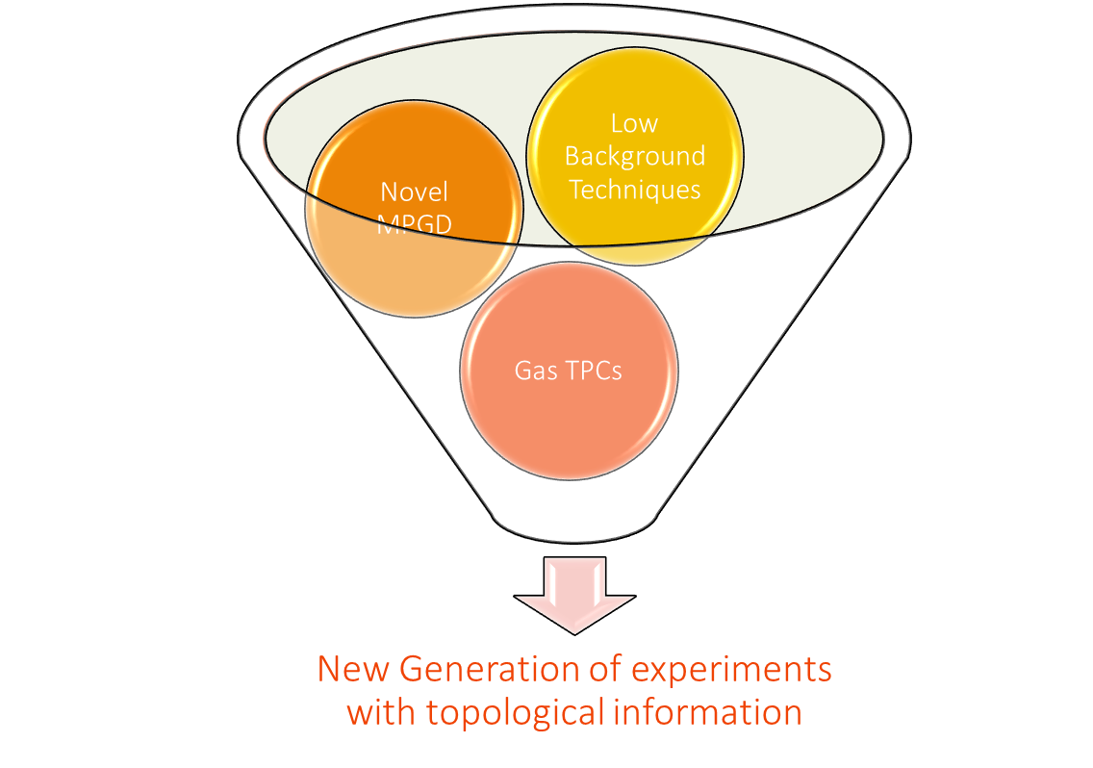

The T-REX project
Rare Event Searches (axions, WIMPs, ν):
  low radioactivity
  low background
  low threshold
  scalability
topology can be the key
Gas TPCs offer high potential
T-REX: merge MPGDs (Micromegas)
+ low background techniques
Focus on R&D and small scale prototyping

Slide 22
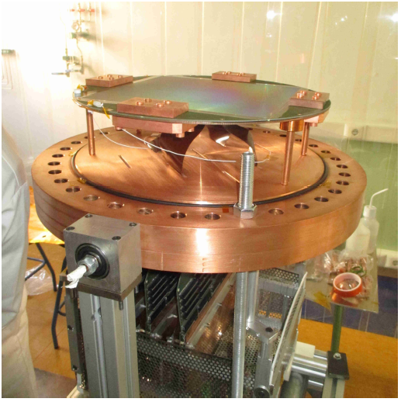
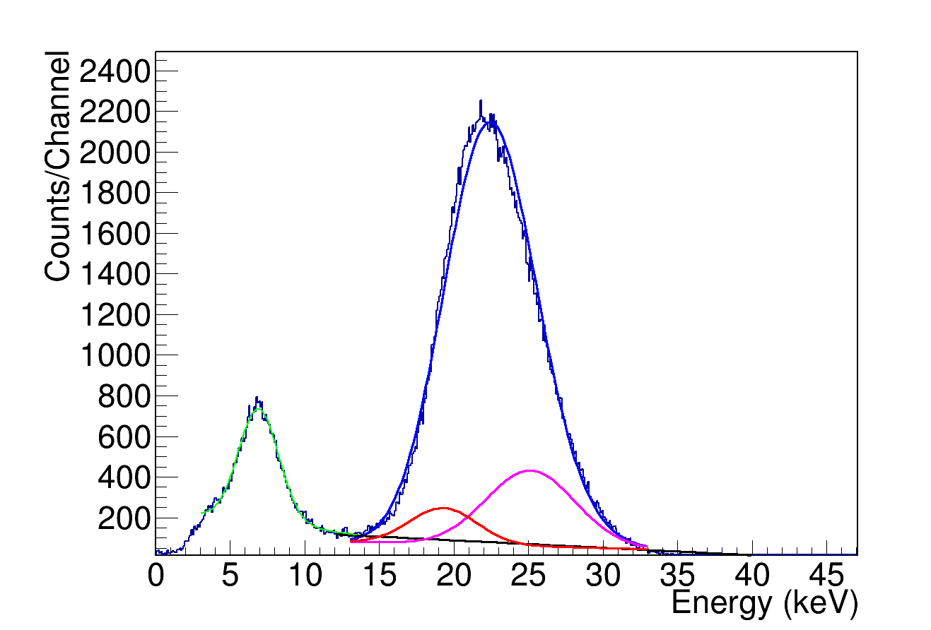
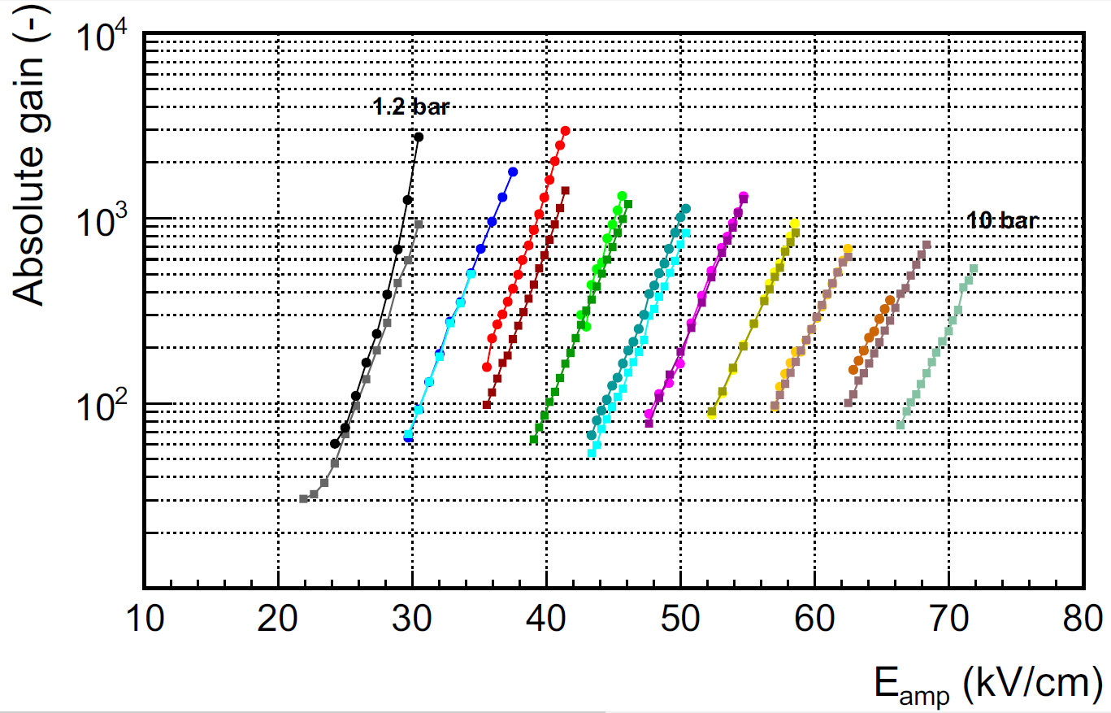
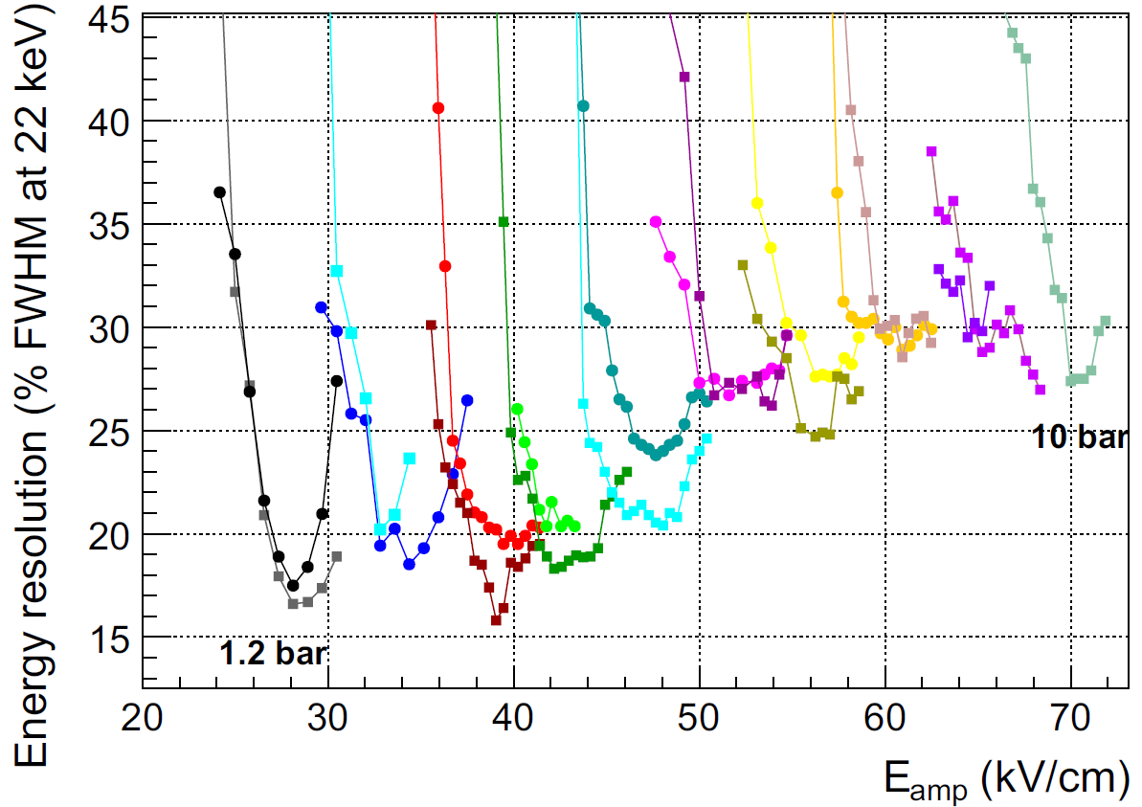
TREX-DM: Bulk readouts
Bulk detectors characterized in Ar+2%iso up to 10 bar.
Results limited by noise, low quencher quantity
Degradation of performance with pressure:
Gain: 3 x 10³ (1.2 bar) -> 5 x 10² (10 bar).
Threshold: 1.0 keV →6.0 keV.
Resolution: 16% FWHM -> 27% FWHM.
Ar+2%iC₄H₁₀
Typical spectrum ¹⁰⁹Cd

Slide 23
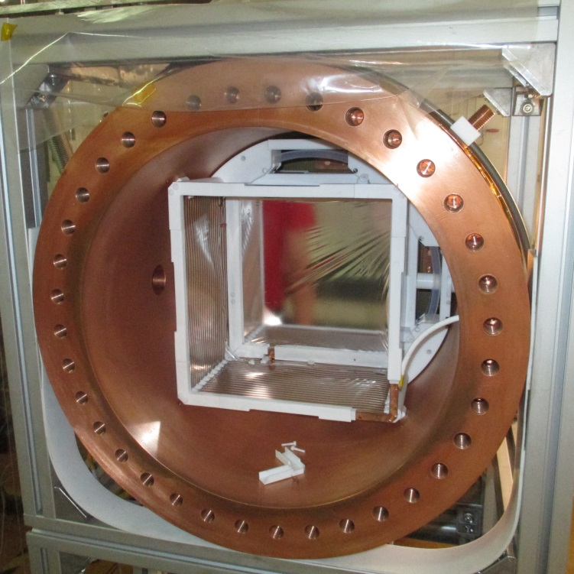
Drift cage & mechanical support
Cathode
Drift fields: 50 – 200 V/cm/bar.
Central cathode of mylar.
Field cage: copper-polyimide printed circuit + resistors.
Each field cage ends a copper ring.
Field cage
Last ring

Slide 24
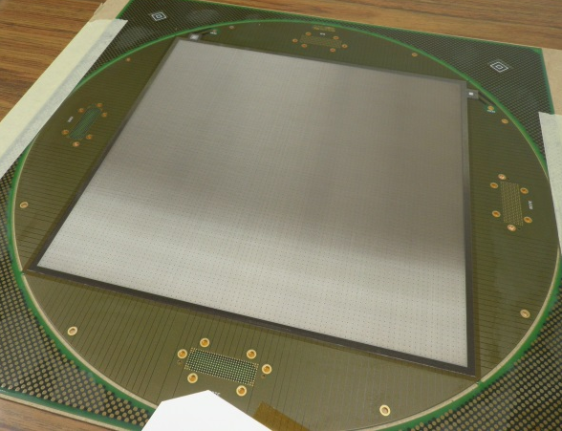
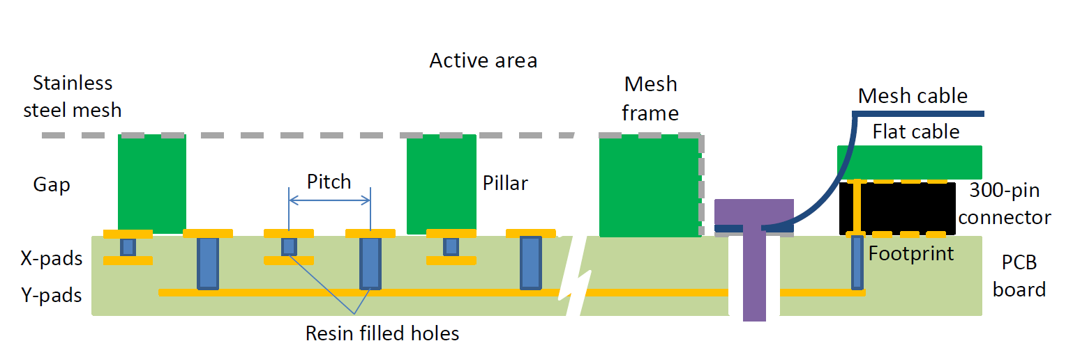
Micromegas readout planes
Bulk @ IRFU/Saclay.
PCB @ Somacis.
Area: 25.2 x 25.2 cm².
Squared pads 332 μm, pitch 583 μm.
Interconnected to 432 strips/direction.

Slide 25
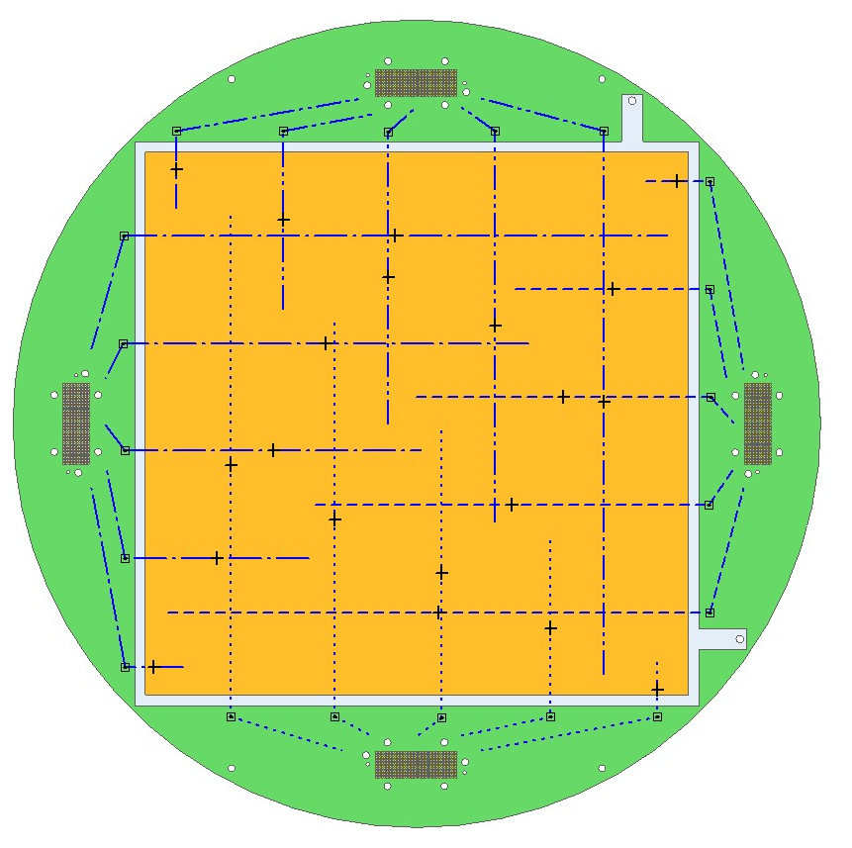
Micromegas readout planes
Y detector Strips
North Connection
Electronics
Footprints
432 strips/direction.
Routing to 4 footprints.
Connector print of 300 pads: 288 or 144 used.
X detector Strips
West Connection
X detector Strips
East Connection
Electronics
Footprints
Mesh connector
Y detector Strips
South Connection

Slide 26
Mesh & strip signal extraction
Readout plane
Connector
4 connector print by readout.
Flat cable: connector -> interface card.
Interface card -> Front-end Cards (FECs).
AFTER-based electronics
Flat cable

Slide 27
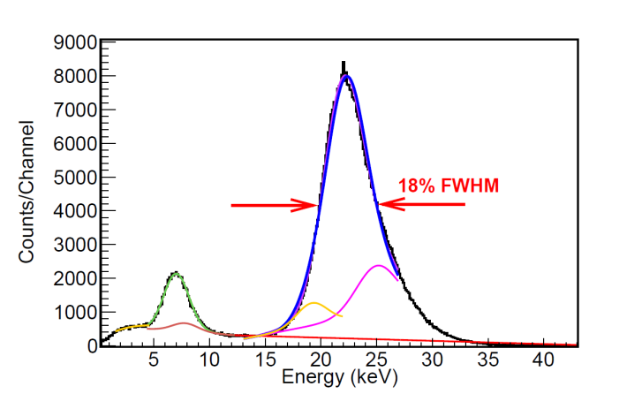
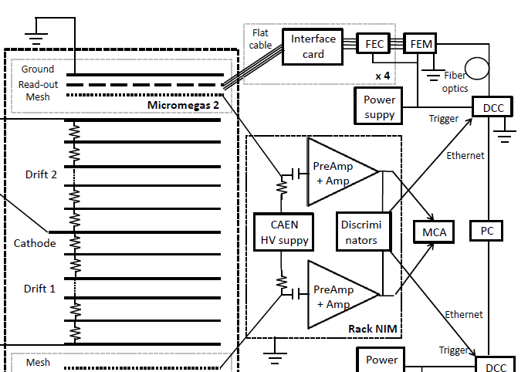
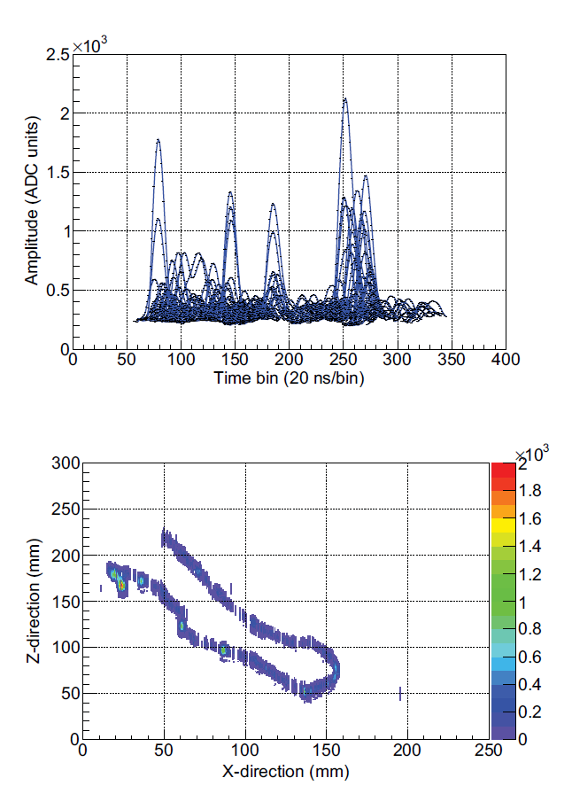
Readout electronics
Mesh:
Preamplifier + amplifier -> Spectrum or Trigger.
Strips:
4 FECs -> 1 FEM -> 1 DCC -> Computer.

Slide 28
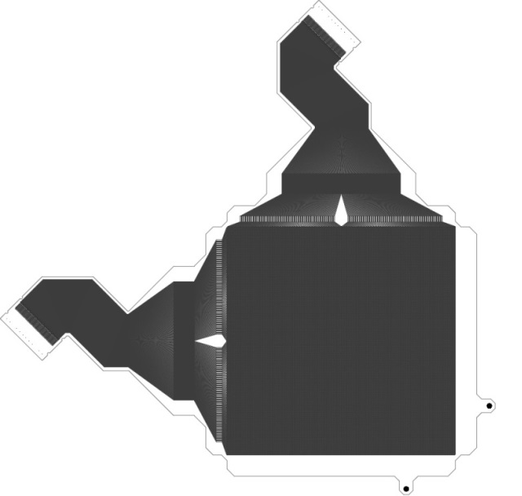
Radiopure readout planes
25 x 25 cm² microbulk in fabrication
20 x 20 cm² microbulk
Area = 25 x 25 cm², pitch = 1 mm.
Baseline: Microbulk (CERN). But also bulk (Somacis & IRFU/Saclay).
Radiopure materials: copper & polyimide (kapton).
Readout glued on a radiopure copper support.
Signals extracted via a flexible part.

Slide 29
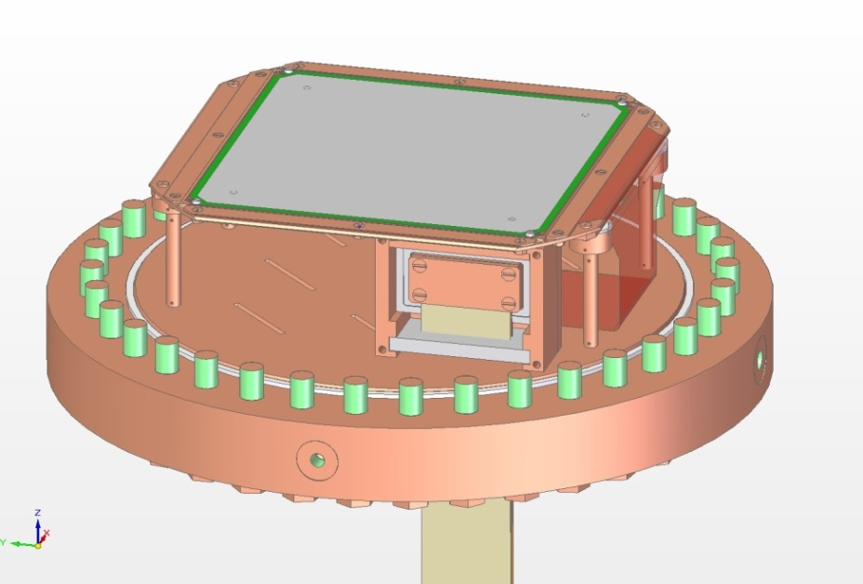
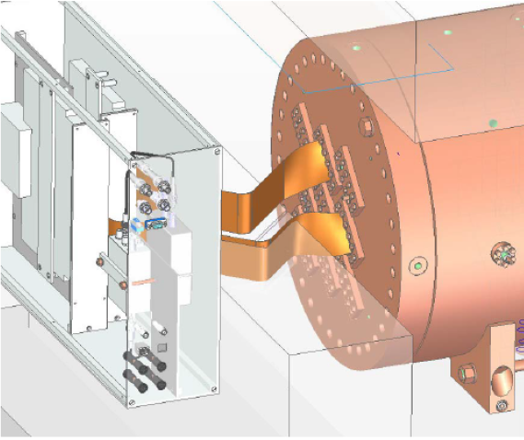
Signal extraction
Conceptual Design of TREX-DM readout
The same signal extraction strategy as in the actual detector.
The readout flexible part brings the signals far from the active area, so that the connectors could be shielded.
Flat cables go out the vessel, cross the lead shielding & reach DAQ.

Slide 30
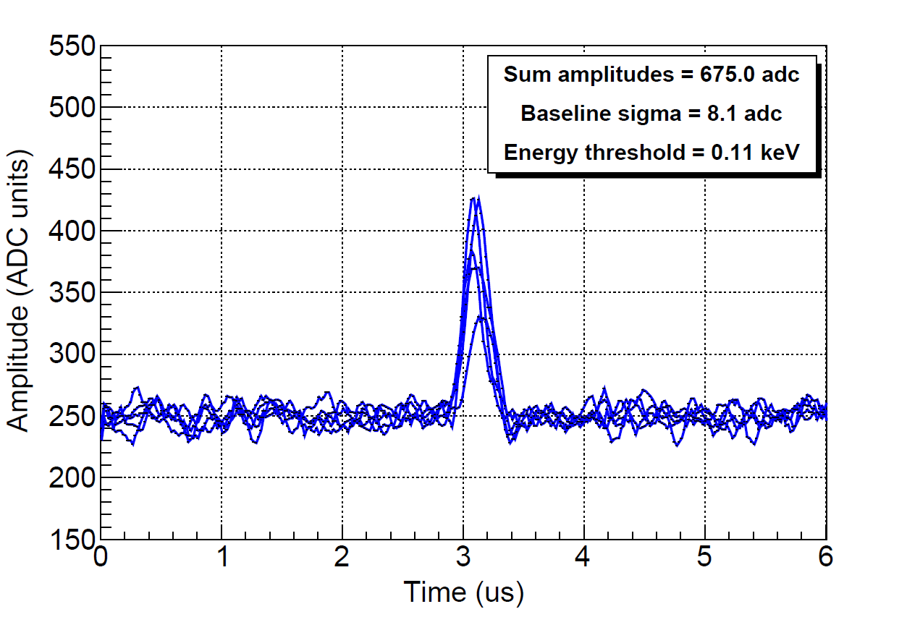
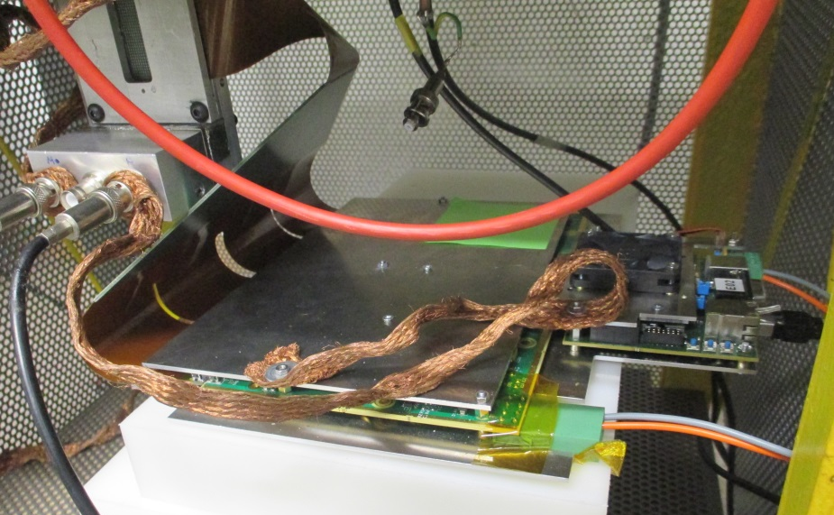
AGET-based front-end electronics
1 keV event
FEC-AGET
FEM
Auto-trigger capabilities for strips.
A factor ~10 lower energy threshold (0.1 keV) expected.
Capacitance: strips ~0.2 nF, mesh ~6 nF.
Layout: front-end (FEC-AGET), FEM (FEMINOS) & trigger module (TCM).
Being tested within T-REX.

Slide 31
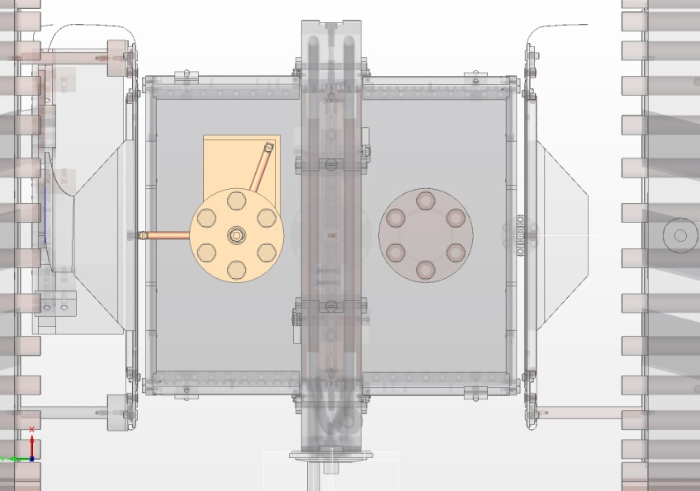
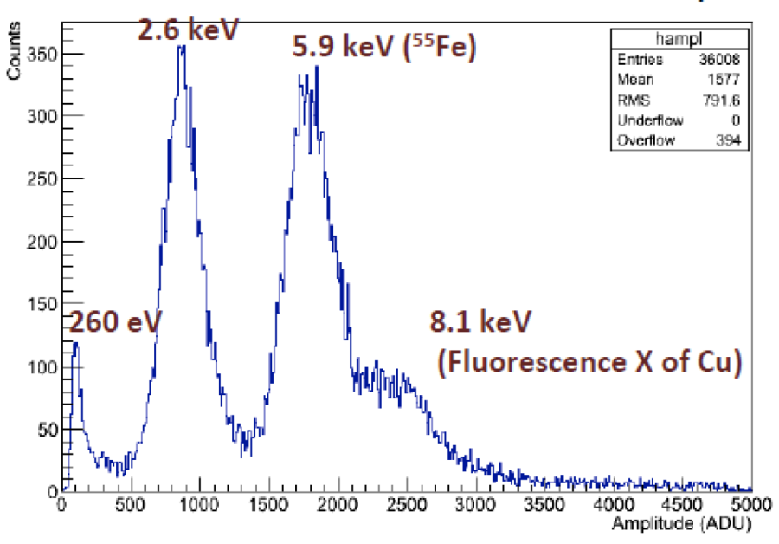
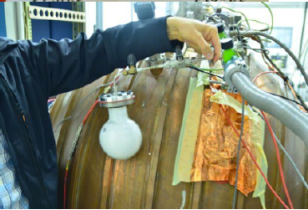
Calibration system
SEDINE experiment
Movable ⁵⁵Fe source
An extra x-ray line at lower energy is needed.
No extra system & Neon fluorescence @ 0.85 keV.
Movable ⁵⁵Fe source -> 5.9 keV x-rays.
³⁷Ar source -> 0.26 & 2.6 keV x-rays.
³⁷Ar source
Calcium salt irradiated by fast neutrons

Slide 32
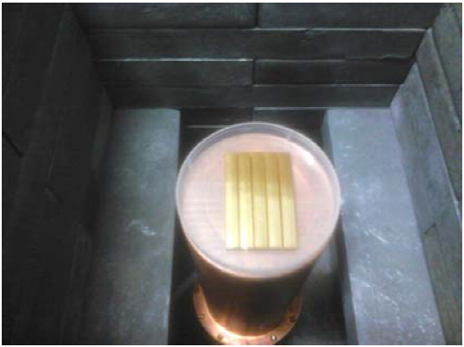
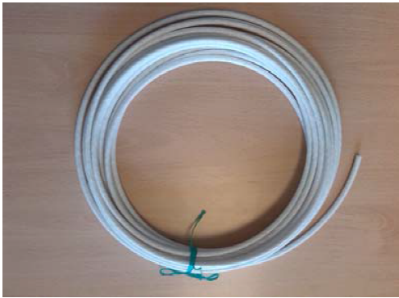
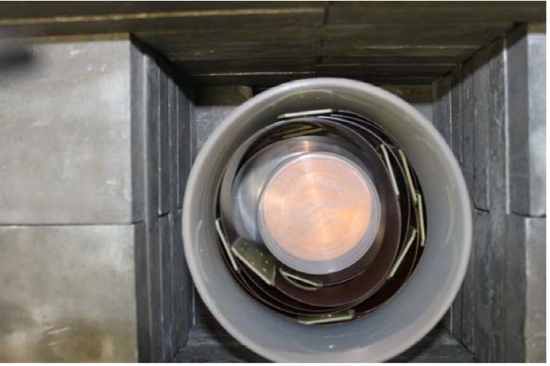

A material screening program
Mainly based on a germanium gamma-ray spectrometry at LSC.
Most of components have been measured.
Found radiopure versions of the micromegas readout planes, flat cables and connectors. To be used at LSC version.
Measured activities are used to scale simulation results.
Connectors
Signal cables
Calibration tube
Flat cables

Slide 33
Background Internal components

Slide 34
Background External sources

Slide 35

Neutrons

Slide 36

TPC for rare event searches
The potential they offer is very high:
  Target gas flexibility
  Possibility for very low threshold
  High granularity readout
  Rich topological information
But they are also rather complex
  Scaling up in masses
  Background at low energies
  for WIMPs: No electron/nuclear recoil discrimination
  Realistic threshold?
  Radioactivity
These issues have been partially addressed within T-REX

