Slide 1
Constraints to axion physics
from Globular Clusters.
An update
Oscar Straniero Italian National Institute of Astrophysics and INFN LNGS (Italy). Member of the LUNA collaboration.
Inma Dominguez University of Granada (Spain).
Maurizio Giannotti Physical Sciences, Barry University (USA).
Alessandro Mirizzi University of Bari and INFN Bari (taly).

Slide 2
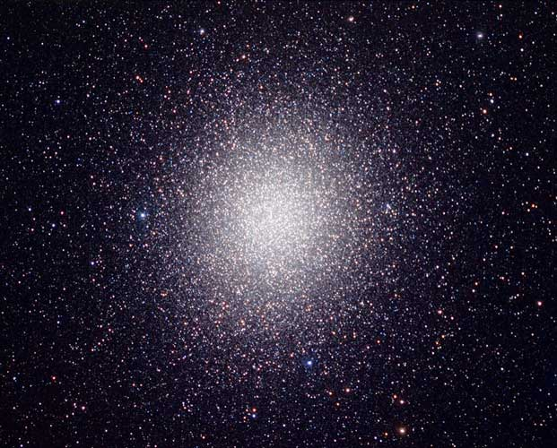
Globular Clusters
GCs are building blocks of any kind of galaxy. They are found in giant spirals (such as the MW or M31), ellipticals (M87) as well as in Dwarfs Spheroidals or irregular galaxies (e.g. Magellanic Clouds).
Hundreds of GCs populate the galactic halo and bulge. They are old (~13 Gyr) and contain up to 10⁷ stars gravitationally bound.
Most of their stars are nearly coeval. However, there exists a growing amount of observational evidences showing that they host multiple stellar populations, characterized by diverse chemical compositions. In a few extreme cases, multiple photometric sequences have been distinguished.

Slide 3
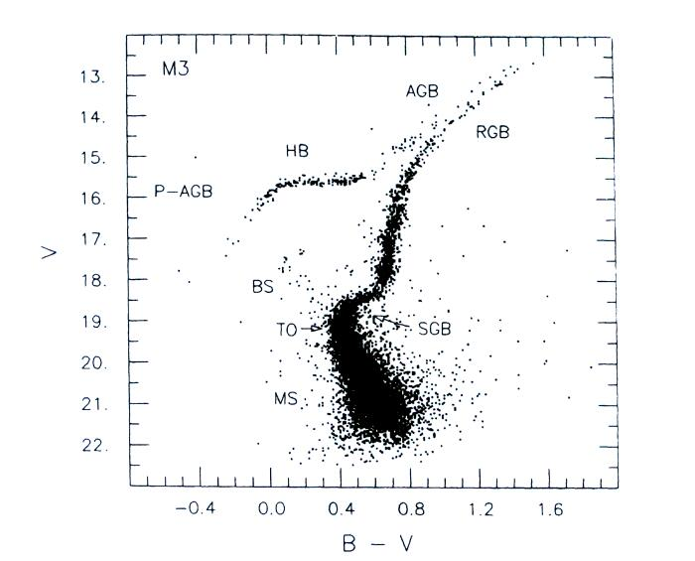
GC Color-Magnitude diagram
The number of stars observed in a given portion of the CM diagram is proportional to the time spent by a star in this region.
Bremsstrahlung
Primakoff
Compton
Bremsstrahlung

Slide 4
Observables and axions
Luminosity of the RGB tip Bremsstrahlung
RGB Luminosity Function Bremsstrahlung
Luminosity of the ZAHB Bremsstrahlung
R=N_{HB}/N_{RGB} Compton+Primakoff/Bremsstrahlung
RR-Lyrae mass pulsation properties Bremsstrahlung
R2=N_{AGB}/N_{HB} Compton+Primakoff/Bremsstrahlung

Slide 5
Our method, step by step!
Basic ingredients (theory): Evolutionary tracks (L,Teff) of GC stars calculated under different assumptions about the axion production by thermal processes (rates from Raffelt & Weiss 1994 + Nakagawa et al. 1998).
A few hundreds tracks are needed to account for variations of various parameters, e.g. mass, composition (Y and Z) and axions coupling constants (g13 & g10)

Slide 6
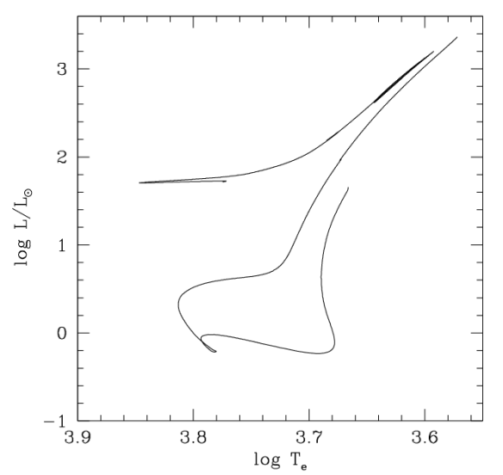
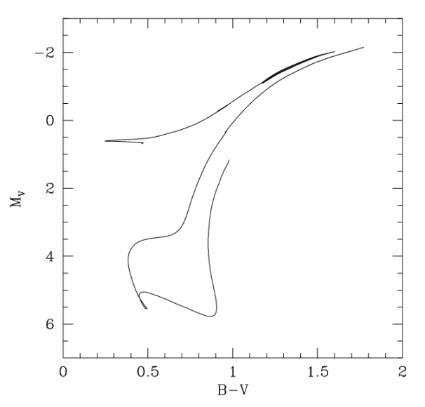
from tracks to synthetic CM diagrams
M_{bol}=4.75+2.5log(L/L_{ꙩ})
+
Models of stellar atmospheres needed
mass distribution and photometric errors: MONTECARLO
≠
Distance
+
Interstellar Absorption
V
Age=12.8 Gyr

Slide 7
The tip of the Red Giant Branch
Viaux et al. (2014) already exploited this observable and found g13 < 4 (95% C.L.). They used single mass evolutionary tracks compared to (I,V-I) CM diagrams of M5.
However RGB stars near the tip mostly emit in the near-IR ( λ>1 μm, I,J,H,K bands). By means of multicolor IR photometry we may get the RGB M_{bol} directly. Collecting optical and IR data, Valenti et al. 2004 provided RGB tip M_{bol} for several GCs.
We use these observations coupled to our synthetic CM diagrams to estimate the probability to find stars in the brightest portion of the RGB. Indeed, the evolutionary timescale is quite fast near the tip so that the observed RGB tip may not coincide with the brightest point of the theoretical track.

Slide 8
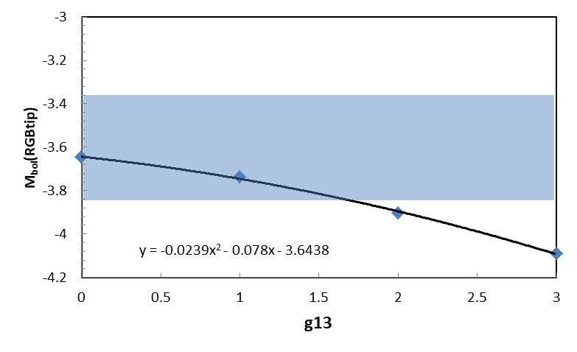
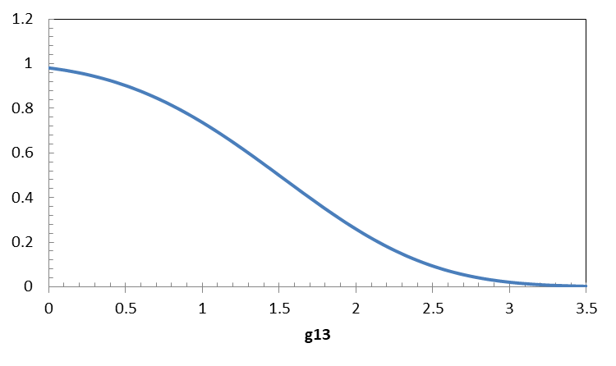
Constraint from RGB tip: the case of M3
IR observations of M3:
M_{ex} = 3.61± 0.24
Error budget:
exp+dist | ± 0.24
Y/Z | ± 0.015
theory | ± 0.05
Likelihood function:
95%
Result: g13 < 2.3 (95% C.L.)

Slide 9
The Zero Age Horizontal Branch
If Bremsstrahlung axions are produced in the core of RGB stars , the core mass at the beginning of the HB phase should be larger than expected when this process is neglected.
Since the larger the core mass the brighter the star (Paczynsky 1967), brighter HB are expected in case of a non-negligible axion-electron coupling.
So, the ZAHB luminosity is another observable suited to constrain g13.
Such a constraint has never been exploited so far. Synthetic CM diagrams are needed to model the spread in luminosity of HB stars and determine the true ZAHB level..
ZAHB

Slide 10
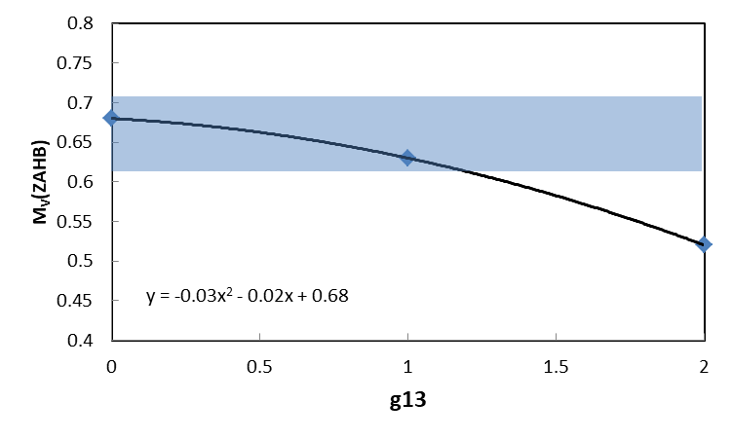
Zero Age Horizontal Branch
M3 (Ferraro et al. 1999): V_{ZHAB} = 15.68±0.05
M_{V} = V + (M-m)_{V}
distance modolus = 15.02±0.05

Slide 11
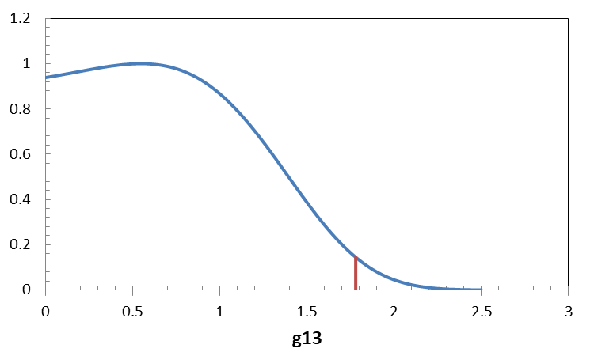
Likelihood for V_{ZAHB}
Error budget:
V_{ex} | ± 0.05
distance | ± 0.05
V->bol | ± 0.03
Z | ± 0.02
Y | ± 0.006
95%
Likelihood function:
Best fit: g13 = 0.54 ; 95% C.L.: g13 < 1.78

Slide 12
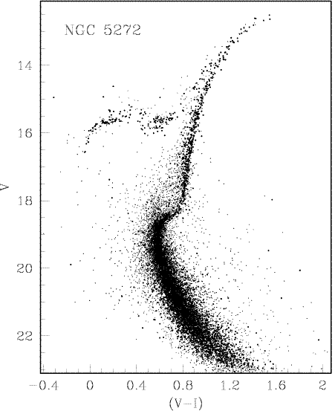
R=N_{HB}/N_{RGB} parameter
The number of stars observed in a given portion of the CM diagram is proportional to the time spent by a star in this region, e.g.:
R does not depend on metallicity, distance, light absorption and age.
R depends on Y (!!)
AGB
HB
39 GCs (from the Salaris et al 2004 catalog)
RGB
R
MS
<R> = 1.39±0.03

Slide 13
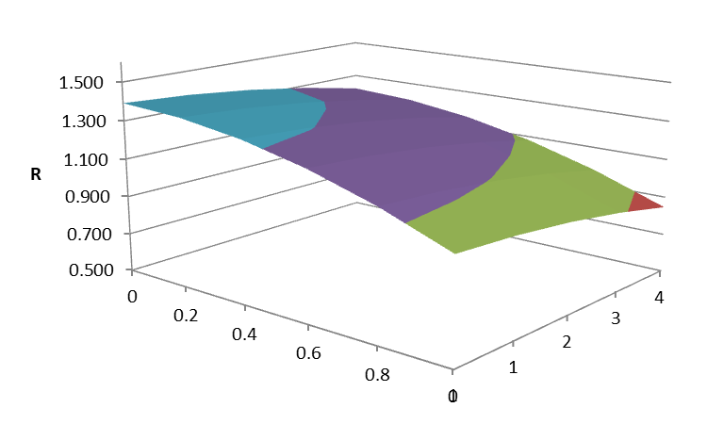
Primakoff-Bremsstrahlung-Compton, all together
He mass fraction (Y)
g10
g13
Y=0.2551±0.0022
Izotov et al. 2014 MNRAS

Slide 14
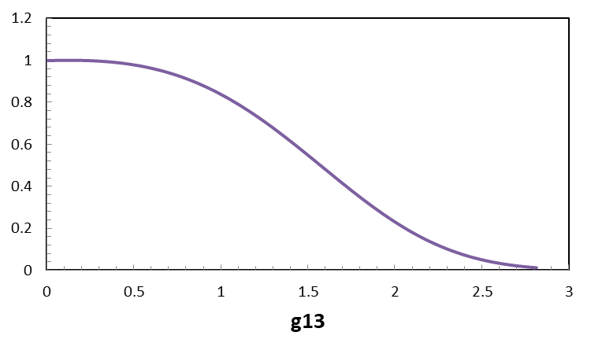
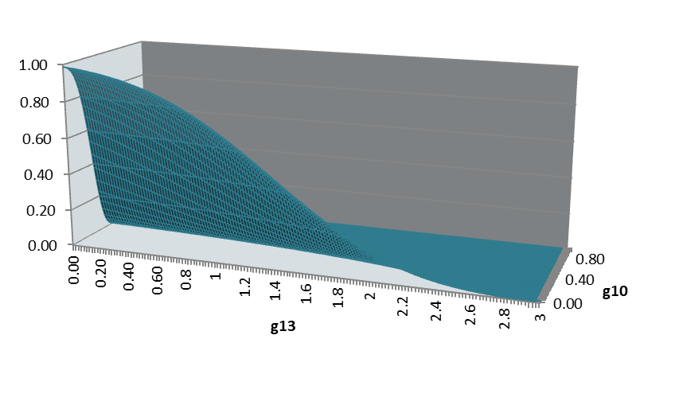
Likelihood function:
Error budget:
R_{ex} | ±0.03
Y | ±0.015
R_{th} | ±0.04
g13
g10

Slide 15
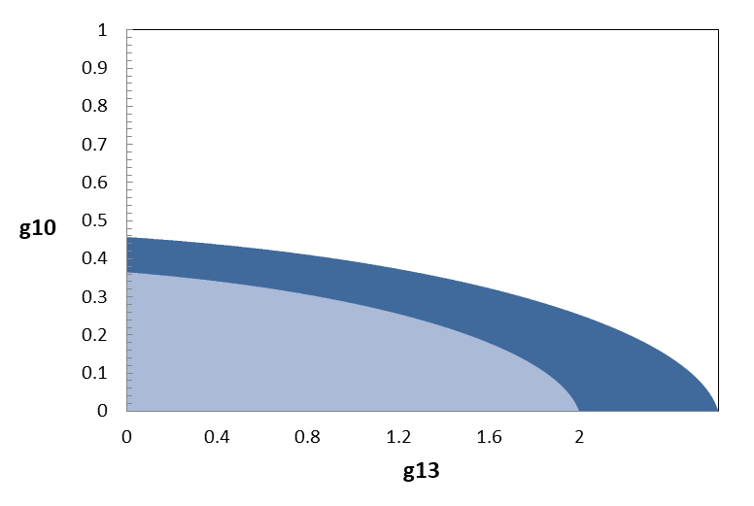
g10 < 0.46 95% C.L.
g13 < 2.61 95% C.L.
75%
95%

Slide 16
Summary:
Basing on synthetic CM diagrams, we have developed a more accurate method to constrain axion physics by means of GCs photometric observations.
From the RGB tip luminosity we obtain (M3 only) g13<2.3 (95%)
From the ZAHB luminosity we obtain (M3 only) g13<1.78 (95%)
g10<0.5
From R parameters we obtain (95%)
g13<2.6
but latter result depends on the assumed He abundance …. and there is a (longstanding) debate on that issue

