Slide 1
SASE1 Tunnel Closing
Sandor Brockhauser
CAS
Schenefeld, 20/01/2016

Slide 2
XTD2/XTD9 Components – naming convention
Domain/Type/Member
Scope_ComponentGroup_Component[-Suffix]/Type/Member
6 _ 6 _ 9(6) - 2 / 6 /24(16) => max 58 characters including predefined separators
SA1_XTD2_SRA vs. SA1_XTD2_PSLIT
FXE_XTD2_CRL vs. SA1_XTD2_CRL
SPB_XTD9_SHUT

Slide 3
Goal
Prioritisation
1 – Enable remote control of all devices within XTD2/XTD9 from Karabo 2 but no DOOCS/TINE integration: XTD2_UND, XTD[2,9]_XGM, XTD2_IMGTR, XS3_SHUT, [FXE,SPB]_XTD9_SHUT
2 – (a) Make the control interface easier to use ; (b) Connect devices to DAQ system
CAS provides commissioning scenes for each equipment for each component
Component responsible shall
provide all Karabo names for each(!) controllable equipment inside
provide all default Karabo(!) configuration parameters for the equipments
inform when a component is ready to be tested and organise the tests
CAS shall request computing resources (servers in SASE1 balcony room) from ITDM early enough

Slide 4
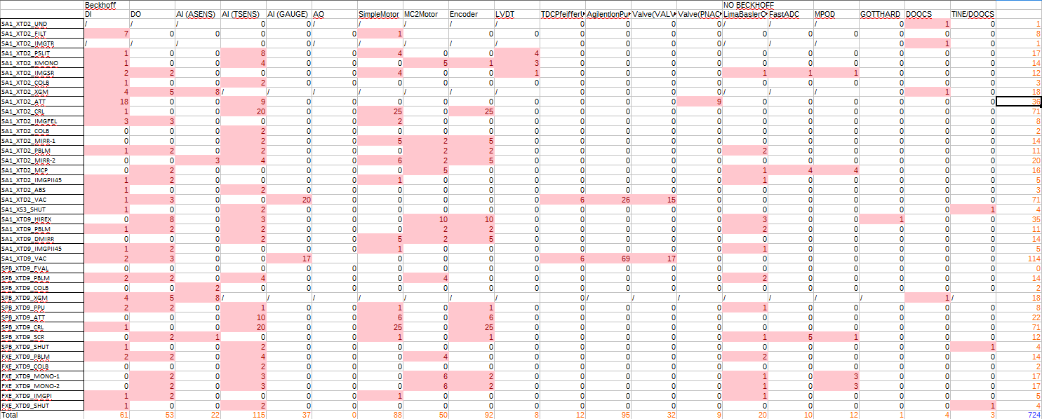
XTD2/XTD9 Components, Equipment Types and Equipments

Slide 5
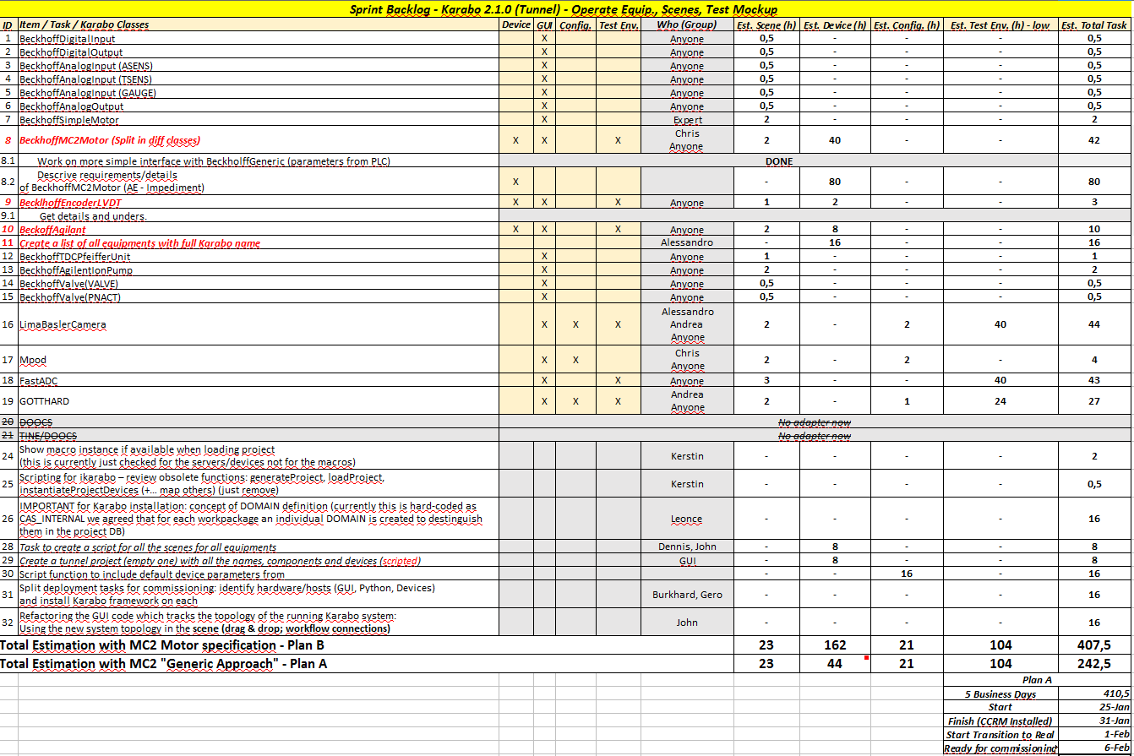

Slide 6
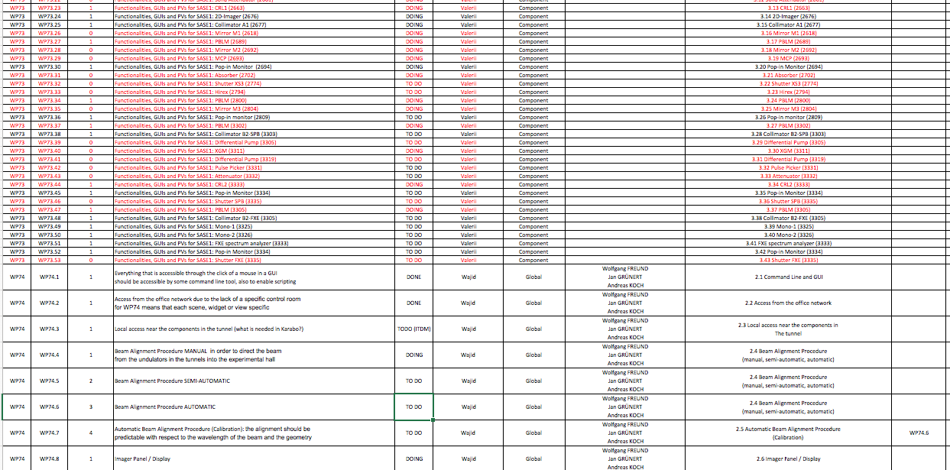
Full Backlog - https://docs.xfel.eu/share/page/site/daqControls/document-details?nodeRef=workspace://SpacesStore/2ada3564-e01f-409a-8c32-fd31ea4eff09

Slide 7
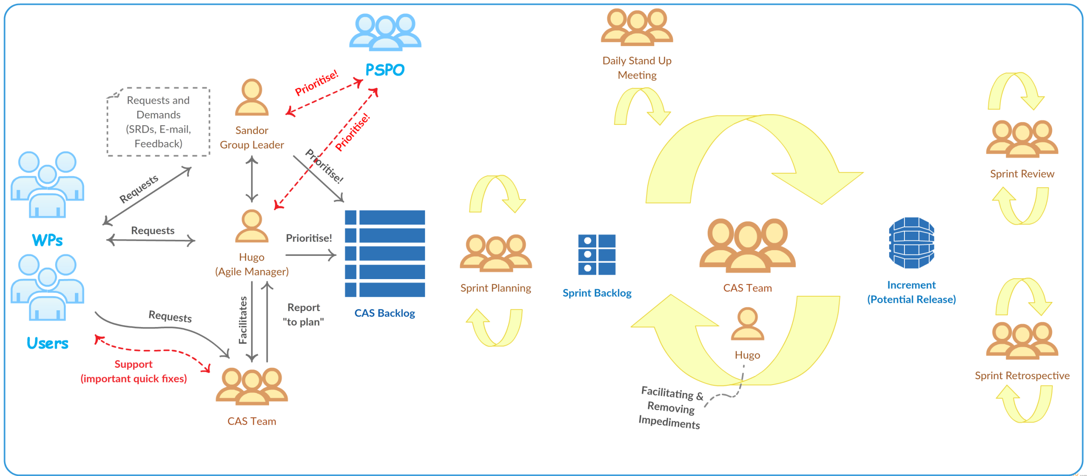
Agile Process in CAS

