Slide 1
Alignment with beam halo tracks
Andrea Parenti (DESY)
CMS Hamburg/DESY Meeting
03/06/2009

Slide 2
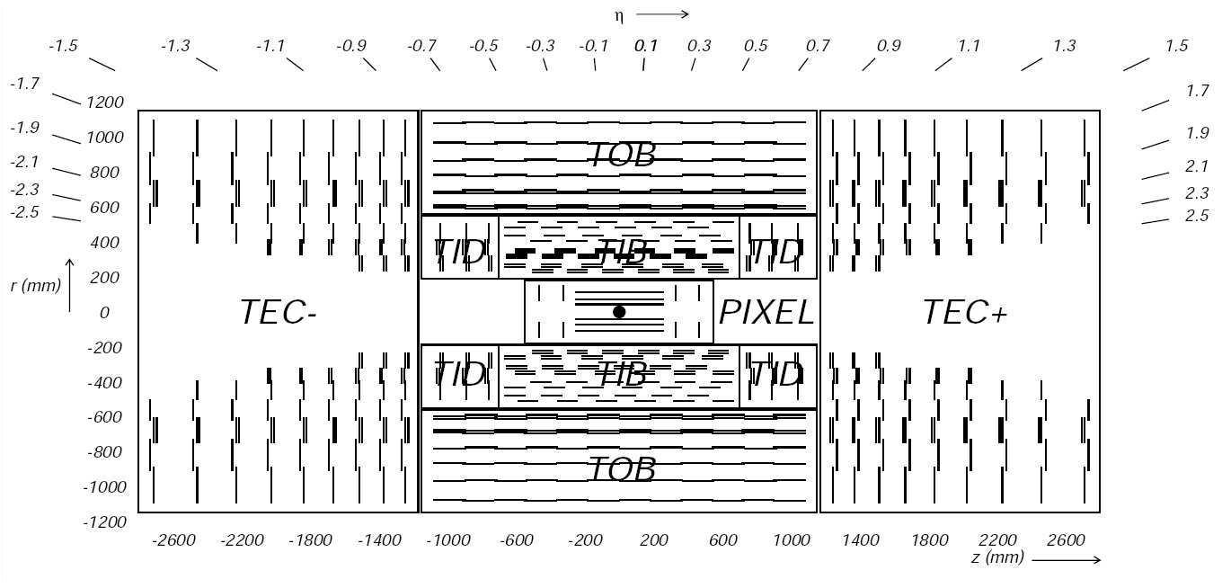
The CMS tracker
In this talk I will focus on alignment of the endcaps: TEC & TID
Tracker Endcaps:
9 disks, 4-7 rings
Tracker Inner Disks:
3 disks, 3 rings

Slide 3
Track based alignment: samples
High pT muons (Z, W decays):
  small multiple scattering
  will become available after collisions start
Cosmic muons:
  already available
  ok for barrel, not very useful for endcaps
Minimum bias:
  high-rate, available since first collisions
Beam Halo muons:
  already available with single beams, high-rate
  useful for end-caps (~ horizontal tracks)
...

Slide 4
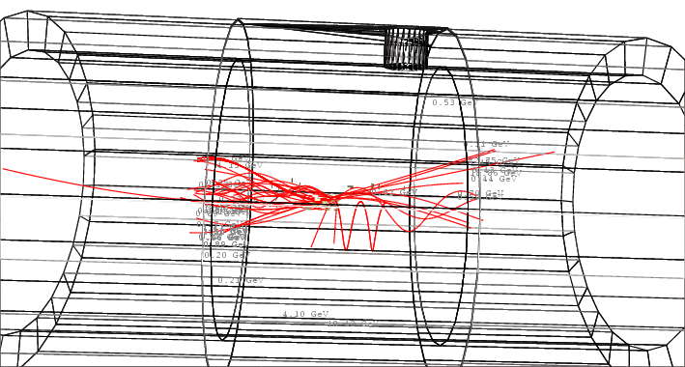
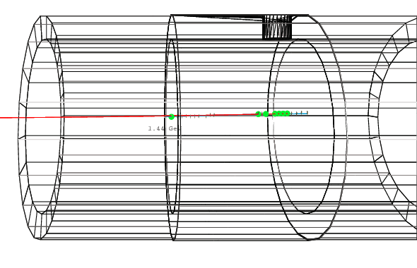
Beam Halo (BH) events
Simulation of a beam halo event in CMS detector:
The event contains a muon plus low momentum hadrons
We must apply cleaning cuts to select good tracks
A beam halo event, with no hadrons simulated

Slide 5
Alignment with beam halo
Based on 60k beam halo Monte Carlo events
  larger sample will be available soon
After requirements on minimum # of hits and chi2 of track fit, 30k good tracks are left for the endcap alignment
Due to the small number of usable tracks, only alignment of high-level structures has been studies
  TID rings: 18 subdetectors x 3 parameters
  TEC disks: 14 subdetectors x 3 parameters (2 disks are fixed to avoid global displacements or deformations)
An initial misalignment is applied (in the so-called 10pb scenario)
  TID rings: 185 mm (u,v), 850 mrad (g)
  TEC disks: 70 mm (u,v), 30 mrad (g)

Slide 6
Alignment with BH + Minimum Bias
Also Minimum Bias (MB) events will be abundant since the beginning
Expected similar rate as Beam Halo... using 175k events
Tighter track selection (pT>1.5 GeV, # of track hits)
After that, # of selected tracks: 300k (10x beam halo tracks)
Selected tracks are then used to evaluate alignment parameters

Slide 7
Alignment: TEC results
Minimum bias tracks only
u/v/γ residuals after realignment:
Min. Bias + Beam Halo
<Δu> = 9 μm
<Δv> = 11 μm
<Δγ> = 30 μrad
<Δu> = 2 μm
<Δv> = 10 μm
<Δγ> = 4 μrad

Slide 8
Alignment: TID results
Minimum bias tracks only
u/v/γ residuals after realignment:
Min. Bias + Beam Halo
<Δu> = 13 μm
<Δv> = 13 μm
<Δγ> = 140 μrad
<Δu> = 7 μm
<Δv> = 2 μm
<Δγ> = 13 μrad

Slide 9
Comparison of the results
TID: BH+MB results are much better than BH and MB only (especially for angular parameter)
TEC: results are dominated by BH but anyway the angular parameter benefits from combination with MB

Slide 10
Conclusions
A study of the alignment of high-level structures in the tracker endcap has been done with MC events.
Minimum bias and beam halo have been used (mixed according to the expected rate).
Beam Halo events improve a lot alignment of endcaps with respect to minimum bias only.
Now waiting for bigger BH MC sample in order to study effect on smaller-level structures

Slide 11
Backup Slides

Slide 12
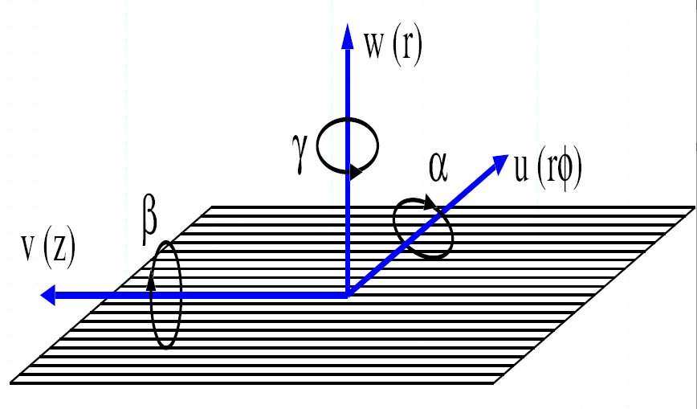
Alignment Parameters

Slide 13
Initial geometry and parameters
Alignment is done of High level structures: 'TIDRingsLayers13,110001', 'TrackerTECDiskLayers11,cc000c', 'TrackerTECDiskLayers24,110001', 'TrackerTECDiskLayers55,cc000c', 'TrackerTECDiskLayers69,110001'
Start from ideal geometry + custom misalignent
  TIDRings & TECDisks as in 10pbScenario
    TIDRings: 185 mm (u,v), 850 mrad (g)
    TECDisks: 70 mm (u,v), 30 mrad (g)
  no misalignment applied on smaller structures, and on the barrel sub-detectors

Slide 14
Alignment with beam halo
Based on 20X beam halo Monte Carlo
  the available statistics is limited: ~60k events
Track collection: ALCARECOTkAlBeamHalo
Track selection:
  ptMin = 0.
  etaMin = -999. / etaMax = +999.
  nHitMin = 6 / nHitMin2D = 2
  chi2nMax = 50.
  minMultiplicity = 1
Nb. of selected tracks: ~31200

Slide 15
Alignment with BH: TEC results
Initial and remaining misalignment:
Correlation of remaining and initial misalignment:

Slide 16
Alignment with BH: TID results

Slide 17
Alignment with Minimum Bias
Based on 20X Monte Carlo
  expected similar rate as Beam Halo... using 175k events from CSA08 MC
Track collection: ALCARECOTkAlMinBias
Track selection:
  ptMin = 1.5
  etaMin = -10. / etaMax = +10.
  nHitMin = 8 / nHitMin2D = 2
  chi2nMax = 50.
  minMultiplicity = 1
Nb. of selected tracks: ~302200 (10x beam halo tracks)

Slide 18
Alignment with MB: TEC results

Slide 19
Alignment with MB: TID results

