Slide 1
Reducing Rn in Big Cavities
Concept by Ken McFarlane

Slide 2
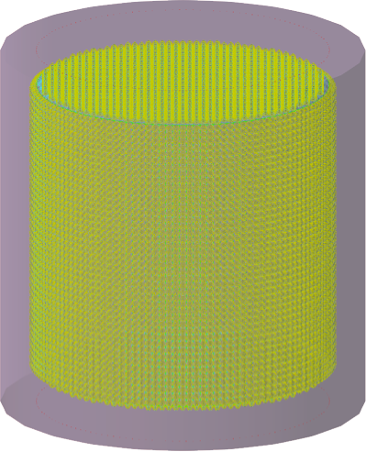
The Problem
60m
60m

Slide 3
The Problem
Rn in gas volume above water level
Usually mitigated by big cover gas system
60m
60m

Slide 4
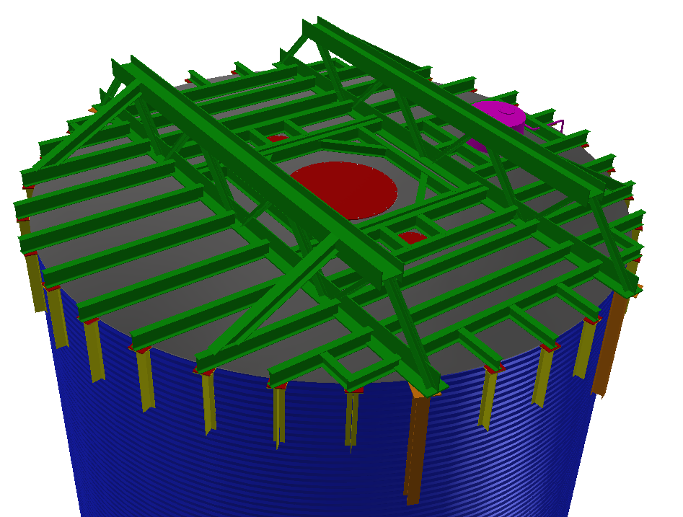
Overfilled Tank Concept
Deck Penetrations Concept
Water Shield Tank Perspective View

Slide 5
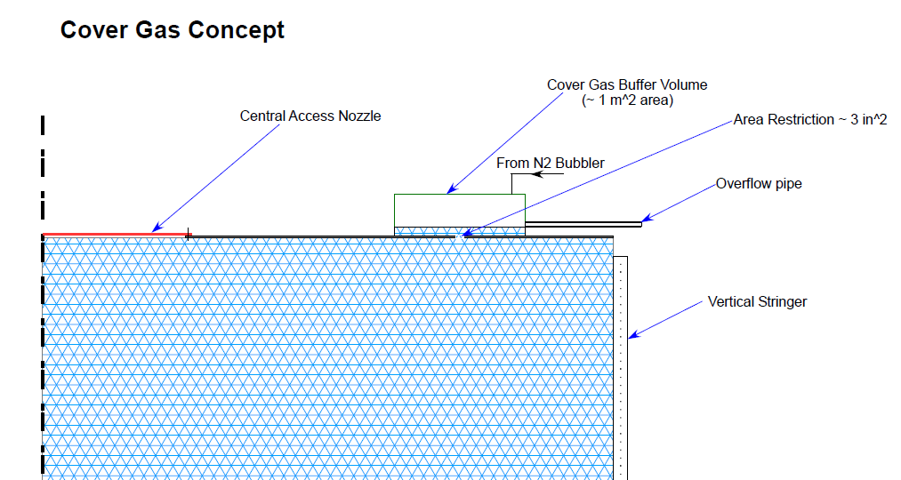
Water Shield Tank Concept

Slide 6
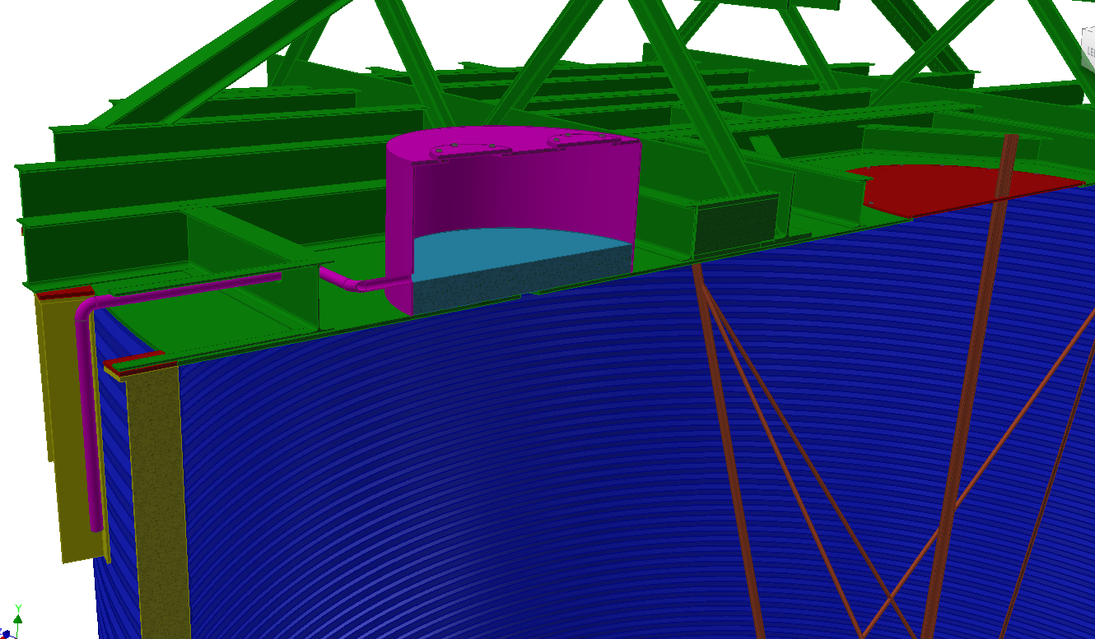
Tank Water Level

Slide 7
Benefit of Overfilled Water Shield Tank
  Exposure to Rn is reduced from a surface area of many m² (area of tank liquid surface) to diffusion through liquid cracks.
  N2 Flushing volume reduced several orders of magnitude.
  Gross leak in any deck seal would be apparent with water accumulation.
  Small leaks on deck seals lead to potential Rn diffusion through leak, however, this is a long path with expected time for Rn to decay
  Additional free board height of tank is not required

