Slide 1
Opportunities for an ANNIE Run 3
R.Svoboda, DESY, March 27-29 2017

Slide 2
THEIA Long Baseline Physics Options
Common R&D
What % scintillation light?
Stability
Material compatibility
Ability to manufacture
Ability to keep optically clean
COST
What % scintillation light?
COST
LAPPDs
Fast, inexpensive PMTs
New analysis techniques and
reconstruction
Understanding of the role
of measuring neutron yield
and spectrum could play
Understanding of the role
of hadronic activity
could play
Water based
Liquid Scintillator
Oil based
Liquid Scintillator

Slide 3
ANNIE Run 2
Common R&D
What % scintillation light?
Stability
Material compatibility
Ability to manufacture
Ability to keep optically clean
COST
What % scintillation light?
COST
LAPPDs
Fast, inexpensive PMTs
New analysis techniques and
reconstruction
Understanding of the role
of measuring neutron yield
and spectrum could play
Understanding of the role
of hadronic activity
could play
Water based
Liquid Scintillator
Oil based
Liquid Scintillator

Slide 4
ANNIE Run 3
Common R&D
What % scintillation light?
Stability
Material compatibility
Ability to manufacture
Ability to keep optically clean
COST
What % scintillation light?
COST
LAPPDs (more)
Fast, inexpensive PMTs
New analysis techniques and
reconstruction (more)
Understanding of the role
of measuring neutron yield
and spectrum could play
Understanding of the role
of hadronic activity
could play
Water based
Liquid Scintillator
Oil based
Liquid Scintillator

Slide 5
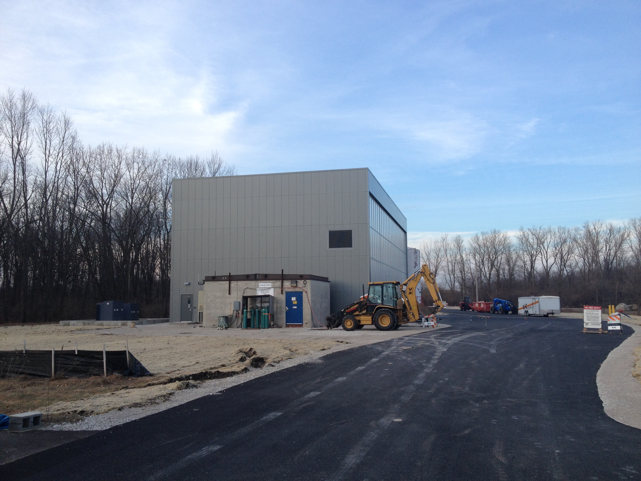
ANNIE Hall next to SBND Hall

Slide 6
ANNIE Run 2 Proposal
Refurbish and install PMT’s from LUX (20 10” Hamamatsu), WATCHBOY (50 10” Hamamatsu), and LBNE (27 11” ETEL HQE) to allow detection of neutron capture on Gadolinium
60 (40) additional 8” (10”) PMTs may also be needed
Electronics and HV for the additional PMTs
Muon Range Detector refurbishment (need plastic scintillator and small PMTs)
New electronics for MRD and FACC highly desirable
Presentation to FNAL Program Advisory Committee July 2017

Slide 7
ANNIE Run 2 and THEIA
Gadolinium loaded water target allows measuring neutron yield as a function of Q² This is critical to rejection of proton decay and Diffuse SN neutrino backgrounds
First test of reconstruction techniques using a small number of LAPPD’s
Booster Neutrino Beam provides source of 1 GeV muon neutrinos and anti-neutrinos, allowing development of neutrino sign discrimination techniques using neutron yield
ANNIE is a “sandbox” for the LBNF part of the THEIA program
If you are thinking about THEIA R&D for LBNF this is an optimal time to participate in the Run 2 proposal, as nothing is yet set in stone, and the chances of success with the FNAL PAC are very good

Slide 8
Importance of Vertex Resolution
ANNIE Run 2
MRD
μ⁻
ν_{μ}
hadrons
neutron
capture

Slide 9
MRD
μ⁻
t₀
ν_{μ}

Slide 10
Cherenkov timing equation
PMT
(0,0)
θ_{C}
Muon track
t=t₀
Vertex

Slide 11
Cherenkov timing equation
PMT
(0,0)
θ_{C}
Muon track
t=t₀
Vertex

Slide 12
Cherenkov timing equation
PMT
(0,0)
How to break
this unpleasant
symmetry?
θ_{C}
Muon track
t=t₀’
Vertex

Slide 13
Issues for vertex resolution
If Cherenkov light only, then must image the ring edge to determine correct t₀ for timing. Need many pixels to do this precisely, as in Super-K.
For ANNIE with LAPPD’s the lateral timing will constrain the direction and perpendicular vertex uncertainty very well, but the uncertainty parallel to the track will still be an issue
One possibility is to have a Water-based Liquid Scintillator target

Slide 14

Add scintillation light from vertex and fast timing to break the t₀ symmetry
LAPPD
(0,0)
θ_{C}
Muon track
t=t₀’
Vertex

Slide 15
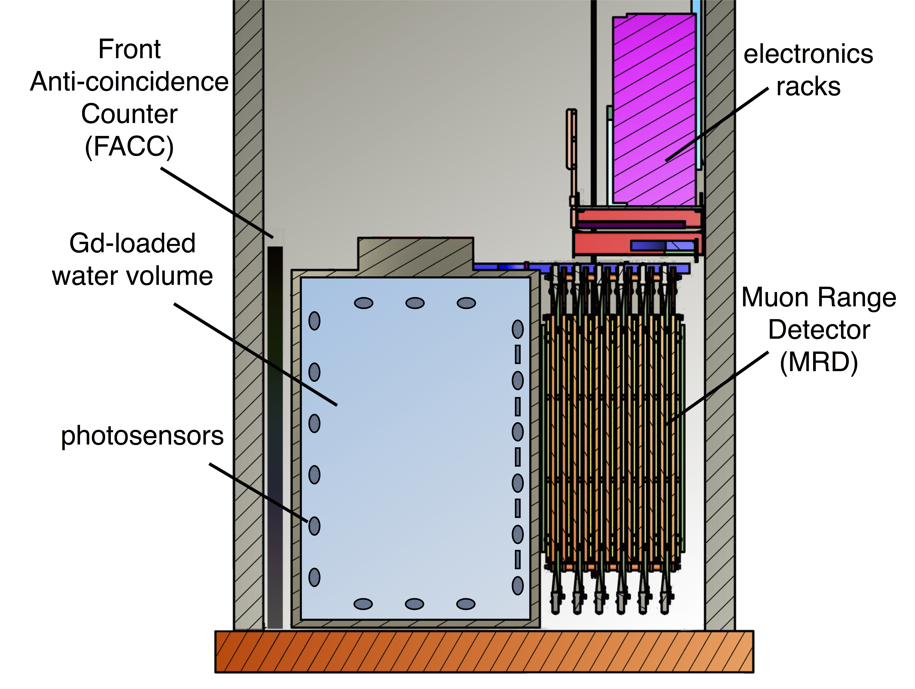
RUN 3A:
The addition of a WbLS target to ANNIE plus more LAPPD’s would greatly extend usefulness to THEIA
Cost would be low and time scale would be quick
more LAPPDs
UVT acrylic tank

Slide 16
MRD
μ⁻
t₀
ν_{μ}
WbLS

Slide 17
Additional
LAPPDs
scintillation
photons
t₀
Vertex constrained by
leading edge of
scintillation photon
timing in addition to
forward Cherenkov
timing
WbLS

Slide 18
Additional
LAPPDs
t₀
Vertex downstream of
the target has no WbLS
signal – only Cherenkov
WbLS

Slide 19
Additional
LAPPDs
scintillation
photons
Vertex upstream of
the target has a leading
edge scintillation signal
out of time with the
Cherenkov signal
t₀
WbLS

Slide 20
ANNIE RUN 3A
costs are only additional LAPPD’s and holder, UVT acrylic vessel, and WbLS (about one ton) – perhaps less than $200k?
ANNIE Run 1 already set to handle 100 liter NCV, this would be about a factor of two larger target in linear dimensions
Only need additional electronics for the additional LAPPD’s
Time to implement driven by LAPPD deployment and WbLS manufacturing time
I would suggest a separate proposal to FNAL PAC and DOE following Run 2 proposal submission – but maybe good to mention in Run 2 proposal? TBD
After this one can think of other possibilities if needed…

Slide 21
ANNIE RUN 3B?
Perhaps fill ANNIE completely with WbLS or ObLS?
material compatibility
recirculation design and prototyping
carbon target studies if ObLS
test a small balloon?
fast PMTs?
Advanced LAPPD housing
Once the “sandbox” is in place, very inexpensive to operate and available to THEIA R&D

