Slide 1

Liquid Scintillator Characterization and Development of Detector Monitoring Systems at TUM
Hans Th. J. Steiger
Technische Universität München
Lehrstuhl für experimentelle Astroteilchenphysik
DESY, Hamburg 23.03.2017

Slide 2
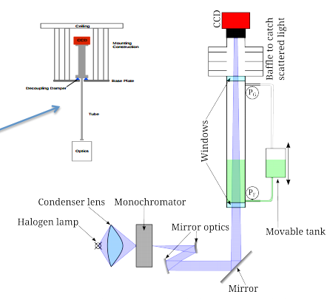
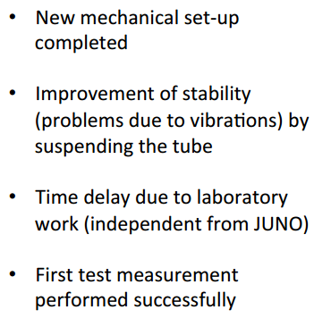
PALM – Precision Attenuation Length Measurement
Sabrina Prummer, PhD Student at TUM

Slide 3
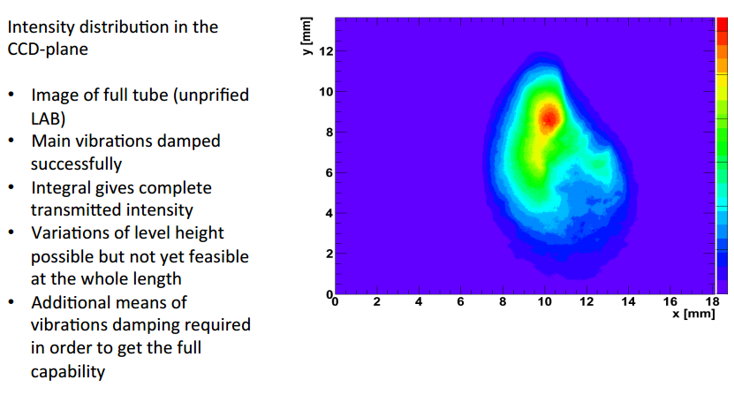
First Test Measurements
Sabrina Prummer, PhD Student at TUM

Slide 4
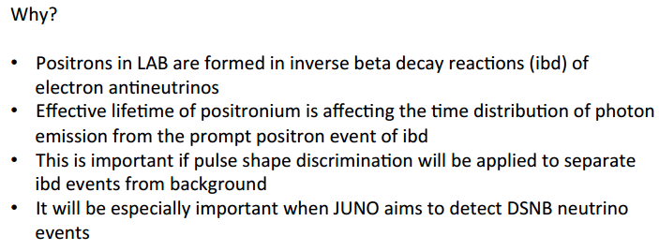
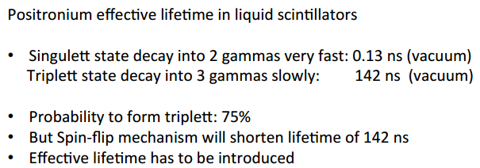
PoLiDe – Positronium Lifetime Determination

Slide 5
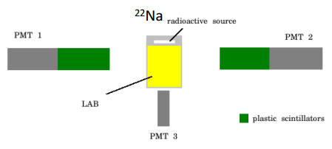
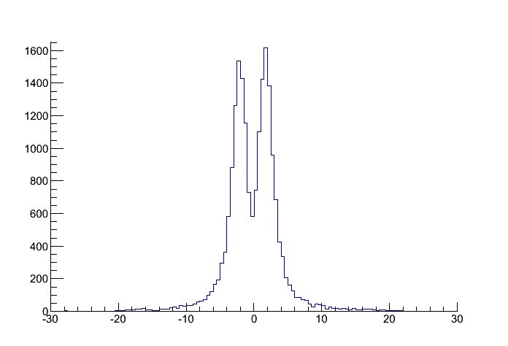
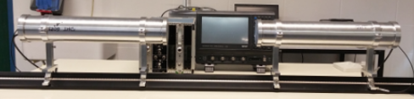
PoLiDe – Positronium Lifetime Determination
Schematics of the Setup:
Coincidence Trigger / Tests
Counts / (0.5 ns)
¹³⁷Cs
Coincidences in the two plastic scintillator detectors are used as trigger signals
Time difference [ns]
Backscattering of γ‘s on one detector and redetection in the other
H. Steiger, S. Prummer, M. Schwarz, P. Landgraf, M. Tippmann

Slide 6

Monte-Carlo Simulation of the Setup
Simulation of the setup with Geant4
Investigation & optimization of:
  Geometry
  Offline event discrimination
Liquid Scintillator
²²Na Source
Copper Vessel
Thin layer of highly reflecting Aluminum
Saint Gobain BC-400
3-inch PMT
3-inch PMT

Slide 7
Monte-Carlo Simulation of the Setup
Identify “good” events with the following properties:
  Positron hits LAB and annihilates there
  Both plastic scintillators are hit by a 511 keV gamma
  No 511 keV gamma hits both plastic scintillators
  The additionally produced 1275 keV gamma (from ²²Na source) does not hit any scintillator
Identify different “fake” triple events:
  Positron scintillates in LAB but leaves it before annihilation
  The 1275 keV gamma hits one or more scintillators
  One 511 keV gamma hits both plastic scintillators
  Other fake events due to the three gammas
3-inch PMT
1-inch PMT
Integral [V ns]
Integral [V ns]
Mario Schwarz, Master Student at TUM

Slide 8
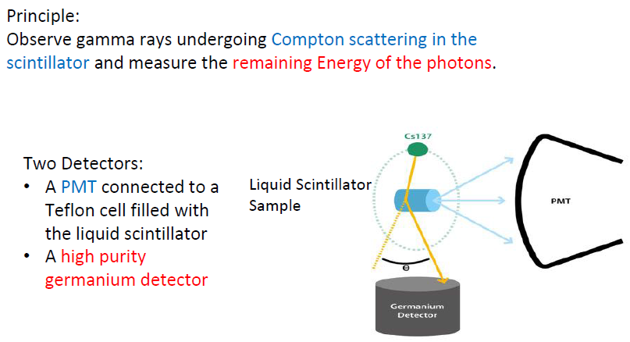
Measuring the Non-Linearity of the Liquid Scintillator
Konstantin Schweizer, Tobias Drohmann†

Slide 9
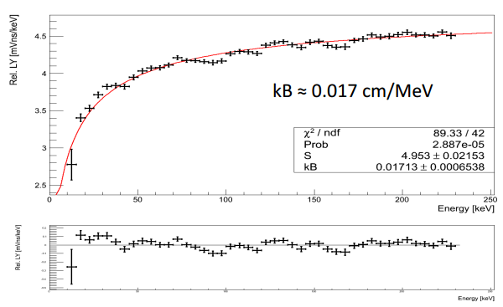
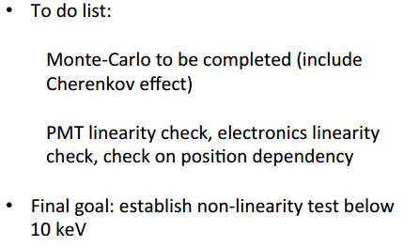
Measuring the Non-Linearity of the Liquid Scintillator
PRELIMINARY

Slide 10
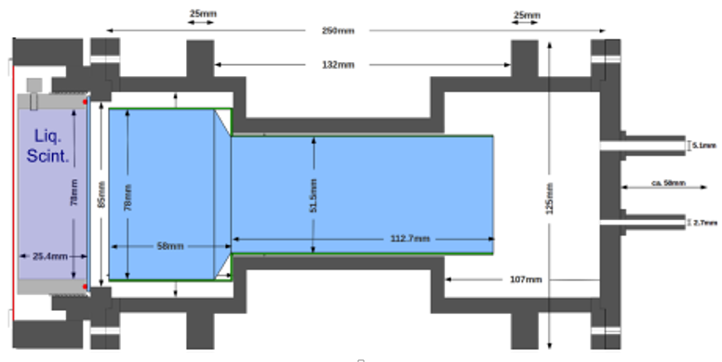
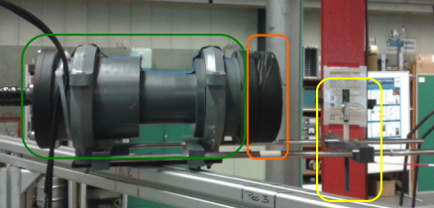
Quenching Factor Measurements for PSD in Liquid Scintillators
The Detector Setup:
Cross-section of the LS detector
Holder for calib. source
LS Cell
PMT Dark Box

Slide 11
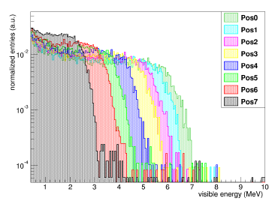
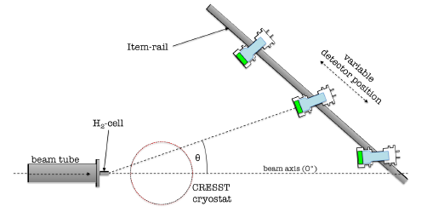
Quenching Factor Measurements for PSD in Liquid Scintillators
Setup at the n-facility at the MLL-accelerator
n-energy visible in the detector measured in different positions
The setup allows a variation of the initial n-energy by measuring in different off-axis positions
Energy dependence of the QF for LAB + 3g/l PPO + 20mg/l bisMSB was already measured
MLL neutron source is a unique facility for investigations with pulsed neutron beams
Vinzenz Zimmer, PhD Thesis

Slide 12
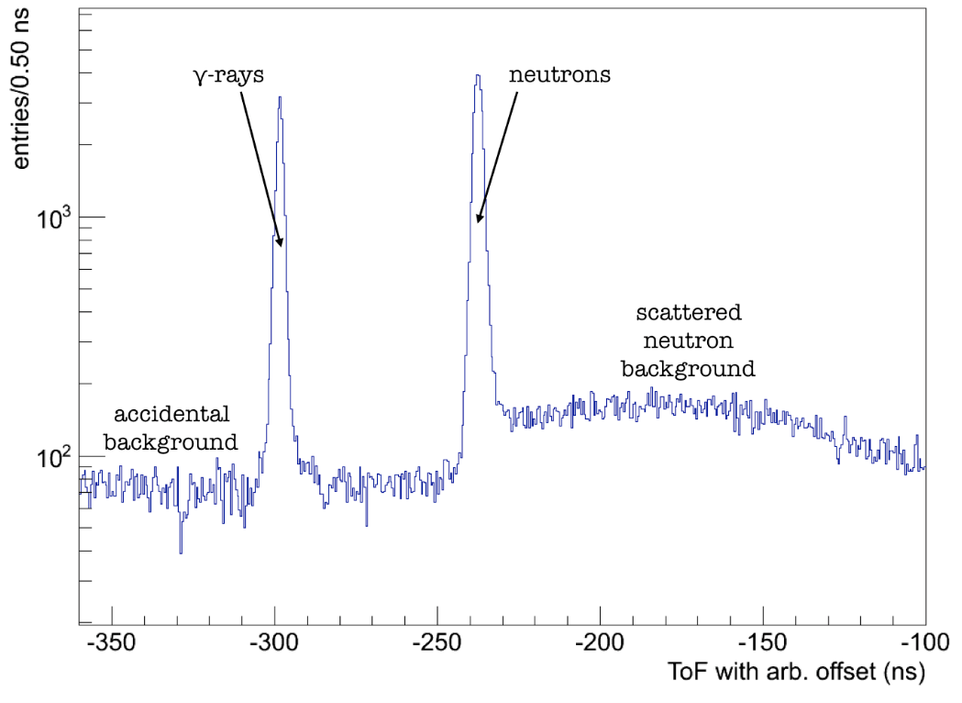
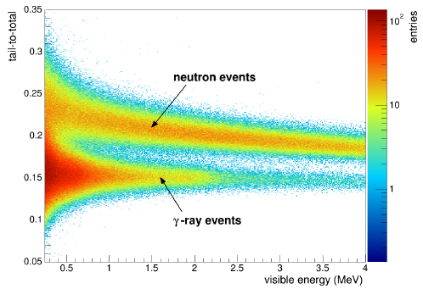
PSD Results from the Setup
LAB + 3g/l PPO + 20mg/l bisMSB
t_{t} = 28.5ns
Pulsed neutron beam at 11 MeV
LAB scintillator exhibits excellent PSD behavior
Similar results from B. von Krosigk et al., Eur.Phys.J. C73 (2013) 4, 2390
Vinzenz Zimmer, PhD Thesis

Slide 13
Detector Monitoring Systems – Filling Level Measurement System and Slow Control

Slide 14
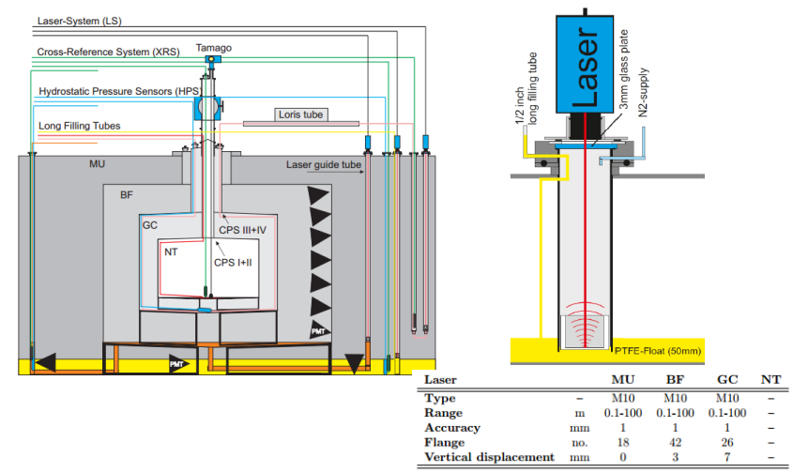
Level Measurement (Experiences from Double Chooz)

Slide 15
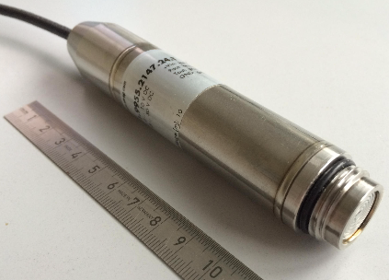
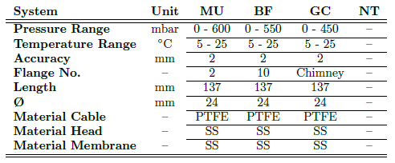
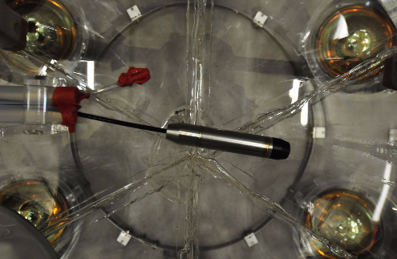
Hydrostatic Pressure Sensors (HPSs)
Picture of a hydrostatic pressure sensor (HPS) . The housing is completely made of stainless steel and the supply cable is coated with PTFE.
HPS installed in the Gamma Catcher. The sensor is glued to the bottom center of the acrylic vessel.

Slide 16
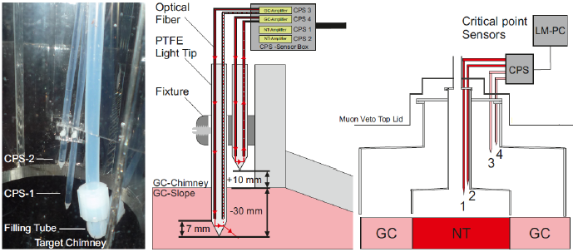
Critical Point Sensors (CPS)
CPS positioned between the main body and the chimney of the acrylic vessels.
Installation details and dimensions of the sensor-tip
Overview of the CPS-installation in gamma catcher and target and its connection
The CPSs are composed of two optical fibers leading to an optical cone.
An amplifier sends light through one of the fibers into the optical cone, the light is totally reflected and sent back via the second fiber to the amplifier.
When the cone is submerged, the refractive index around the cone changes (from air to liquid) and the light is not totally reflected anymore.

Slide 17
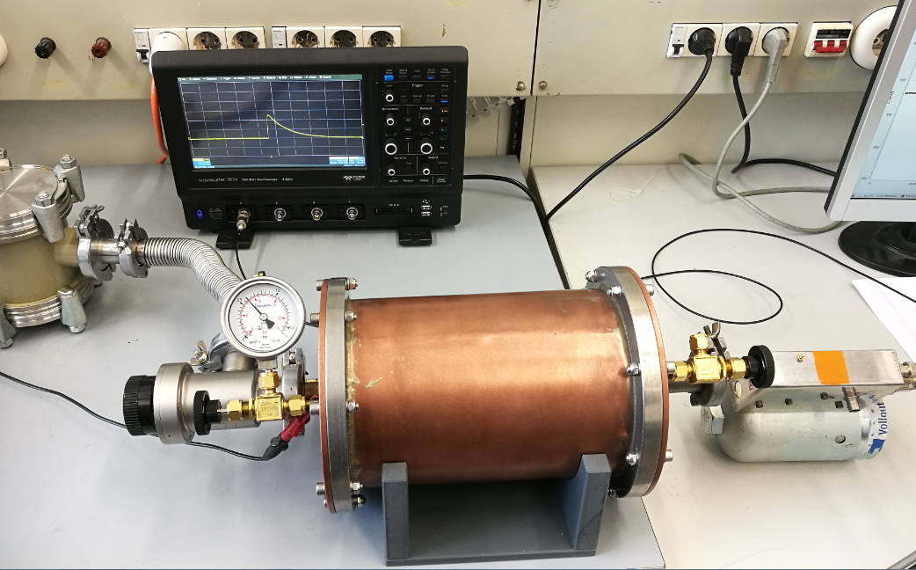
Development of a Monitoring System for the Radon Concentration in gaseous Nitrogen
Inhouse produced preamplifier
To vakuum pump
To ADC and HV source
Vacuum vessel with ²²⁶Ra source
Main Valve
Counter tube
Length: 25.4 cm Diameter: 15.24 cm
Counting gas filling valve

Slide 18
Thank you for your attention!

Slide 19

Questions?

