Slide 1
71th Section Coordination Meeting XHEXP1
27.1.2017

Slide 2
Agenda
SASE1-3 Status Updates (G. Wellenreuther & A. Violante)

Slide 3
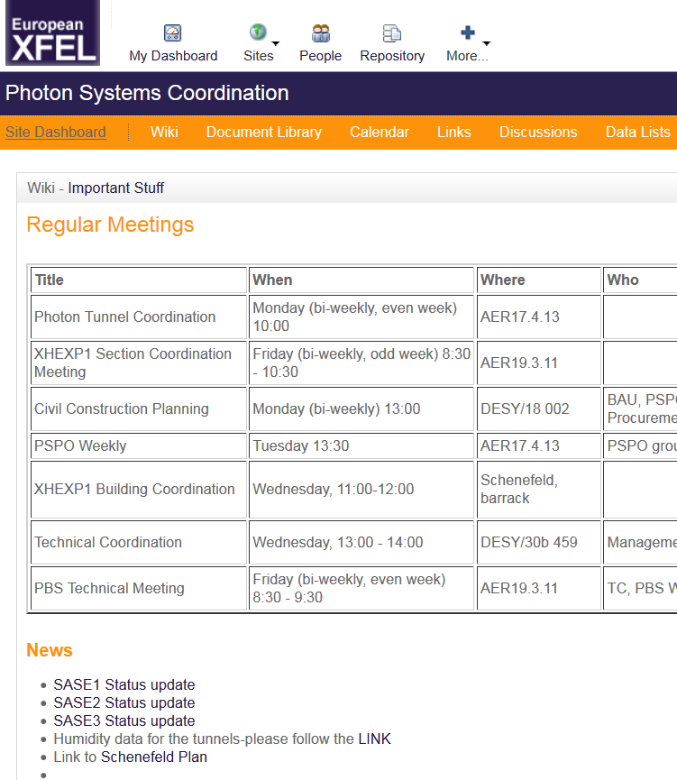
SASE1-3 status update
Summarize most recent and current time-critical tasks / dates for each SASE individually.
At least weekly updated.
In Alfresco:
Document Library/Planning
SASE1 Status update
SASE2 Status update
SASE3 Status update

Slide 4
SASE1

Slide 5
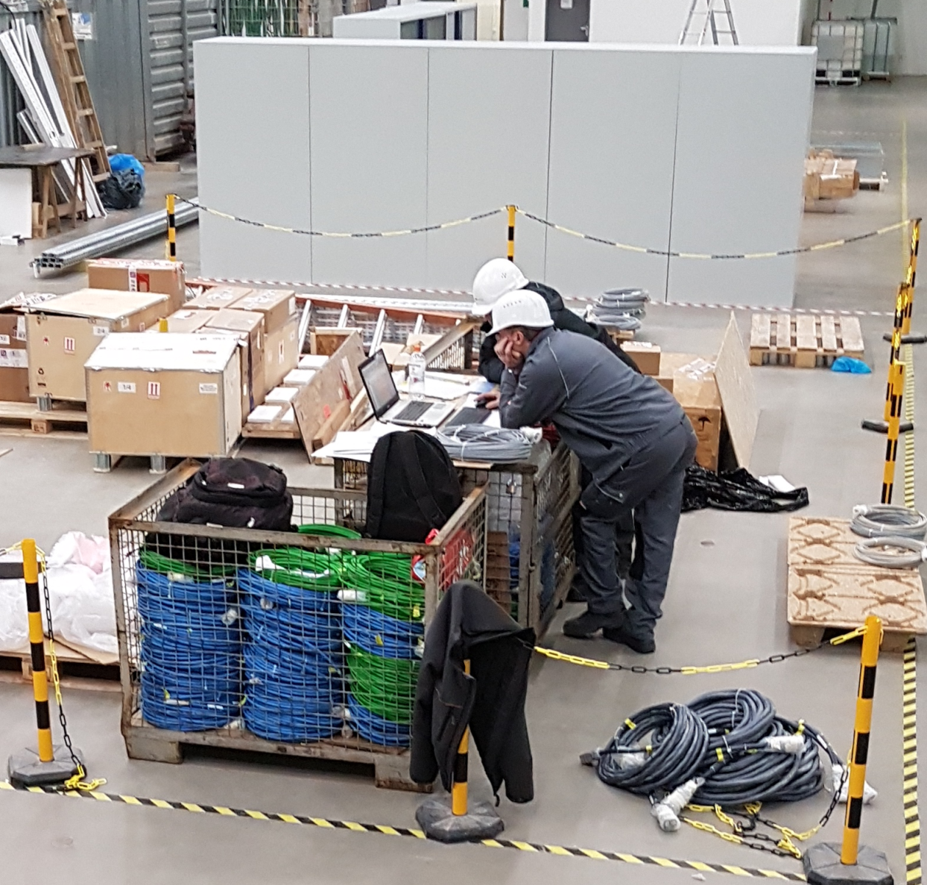
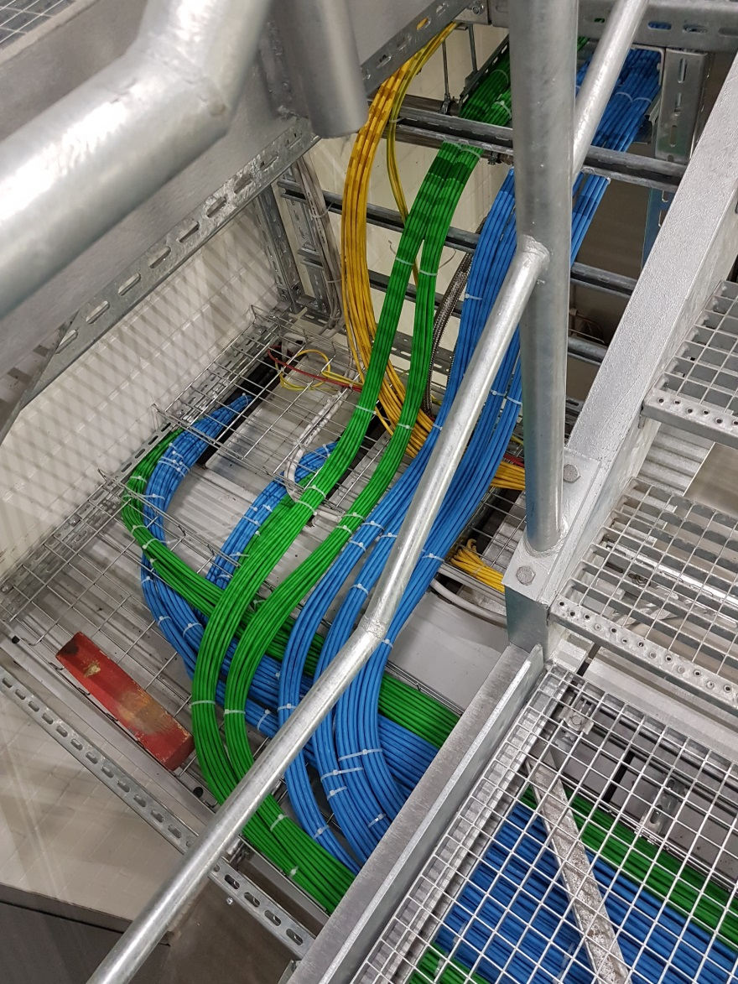
25.1.: New cables have arrived for SPB optics… and been put into place.

Slide 6
Final acceptance tests (VOB-Abnahmen)
Elektro Hartmann: Final acceptance test 15.12., removal of defects extended to 31.1. (be aware of potential power cuts on 30th and 31st).
Vater (Phase I cabling): Final documentation 27.1.
➔ VOB-Abnahme shifted from 26.1. → 7.2.
Dräger (Gases): Final documentation 27.1. ➔ VOB-Abnahme mid. of Feb.
Jeske (Sanitary): Final documentation 24.1. ➔ VOB-Abnahme mid. of Feb.
A+S (Fire saf.): Final tests, have to hand in their documentation ASAP
➔ VOB-Abnahme ca. end of Feb.
Engie (AC):
  Central AC device + exhaust air system: 1st week of February
  Walkthrough control rooms: 2nd week of February
  Curtains C.01 + D.09 + Cooling water installations: 3rd week of February
  Measurements C.01, D.02, D.05, D.09: Beg. of March
➔ VOB-Abnahme ca. mid of March
Instruments are expected to check their installations now, and inform TS (Tobias Bartsch) and PSPO about any remaining open issues.
Gewerk / Firma | Dokumentation | Abnahme/ Begehung | Mängelbehebung
Elekro/ EL.Hartmann | 08.12.2016 | 15.12.2016 | 25.01.2017
IT / Vater KNS | bei 27.01.2017 | 07.02.2017
Gase / Dräger ANSY | bei 27.01.2017 | Mitte Feb.
Sanitär / Jeske | 24.01.2017 | Mitte Feb.
BMA / A&S |  | End Feb.
Zentralklimagerät / Engie |  | KW5
SASE-Abluft |  | KW5
Kontrollräume / Engie |  | KW6
Kälteanlage |  | KW7
D02; C01; D05; D09 Messung |  | Anf. März
Anschluss Digestorium D12 |  | Ende März 2017
Liefertermin Vorhänge C01, D09 |  | ~KW7

Slide 7
SASE3

Slide 8
SASE2

Slide 9
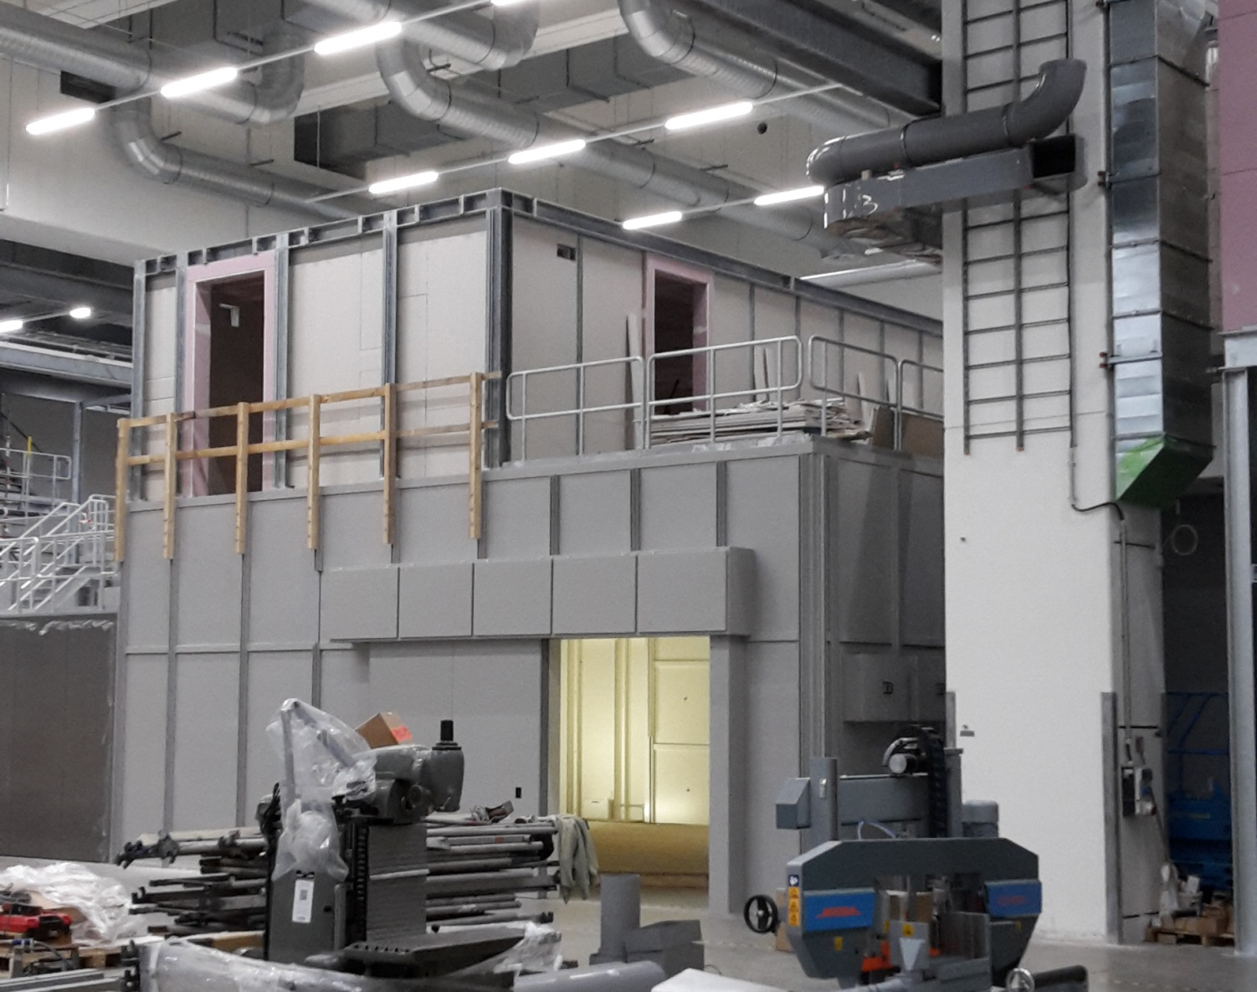
11.1.: Engie is active in SASE2…

Slide 10
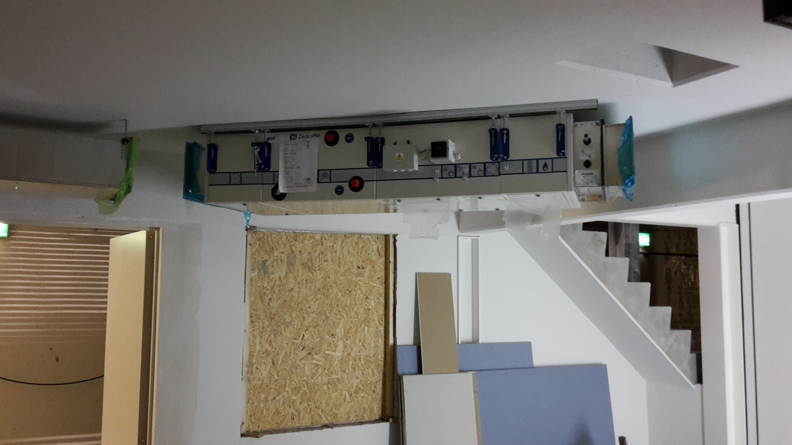
26.1.: AC in HED-Control has been installed

Slide 11
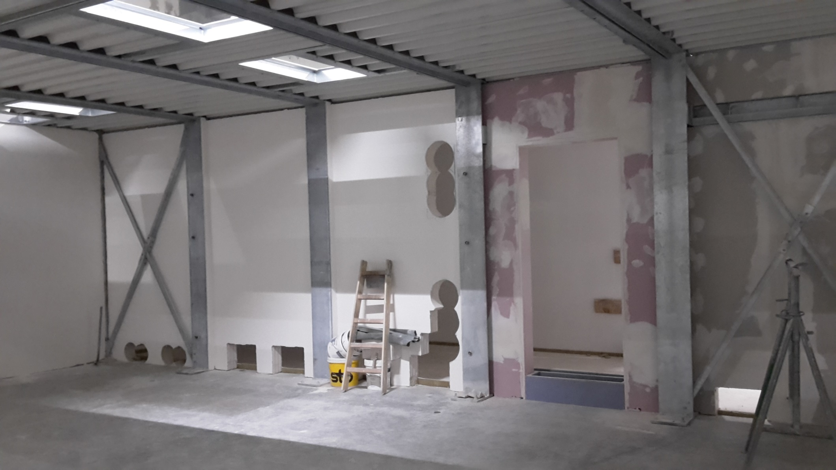
26.1.: Cut-outs for cabling in A.23

Slide 12
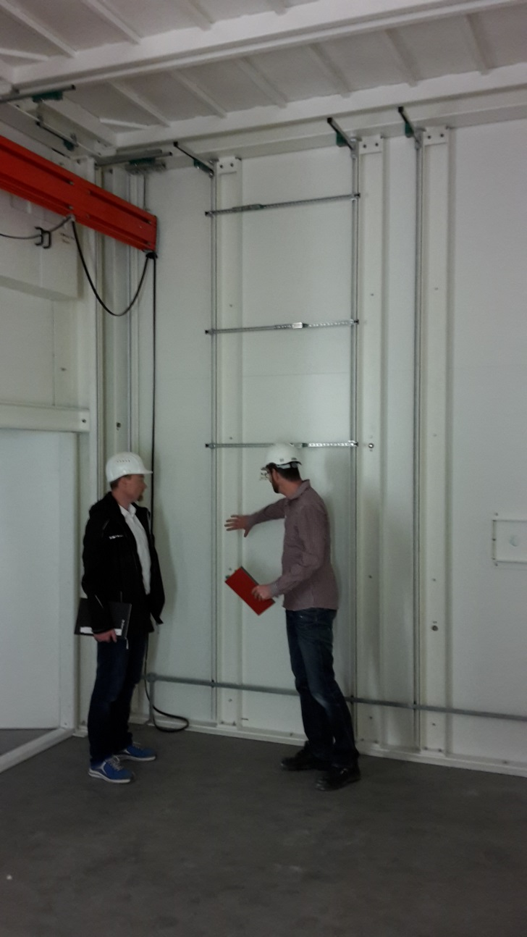
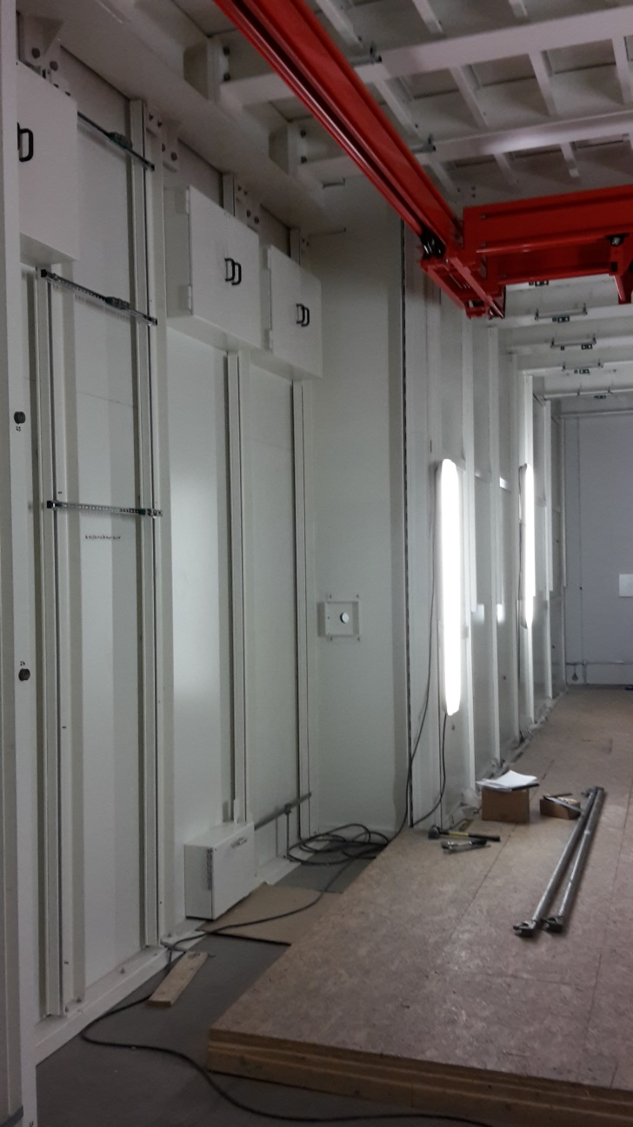
26.1.: Gas installations by Dräger started

Slide 13
TC/XHEXP1 + SASE1 Readiness
SASE1 Readiness should nominally start at 9:00, thereby removing the artificial break inbetween.
In case the TC / XHEXP1-meeting takes longer people will have to wait a little (but the topics are connected)

Slide 14
Upcoming Dates & Meetings
Today, 9:30: SASE1 Readiness (was „Vacuum Controls Commissioning Task Force and Tunnel Coordination”)
Today 8-15:00: Test of the smoke extraction system in XHEXP1 – no access in this timeframe.
If you need access afterwards, contact M. Prollius or C. Schulz
30.1.+31.1.: Last „repairs“ by Elektro Hartmann
3.2., 8:30: Regular TC-Meeting
3.2., 9:30: SASE1 Readiness
10.2., 8:30: XHEXP1 Meeting
10.2., 9:30: SASE1 Readiness

