Slide 1
Consistency of documentation for tunnel electronics
Patrick Geßler
AE
SASE1 Readiness Meeting, 2017-02-10

Slide 2




Correct Workflow
Hardware Parameters
OR
Interlock
Definition

Slide 3
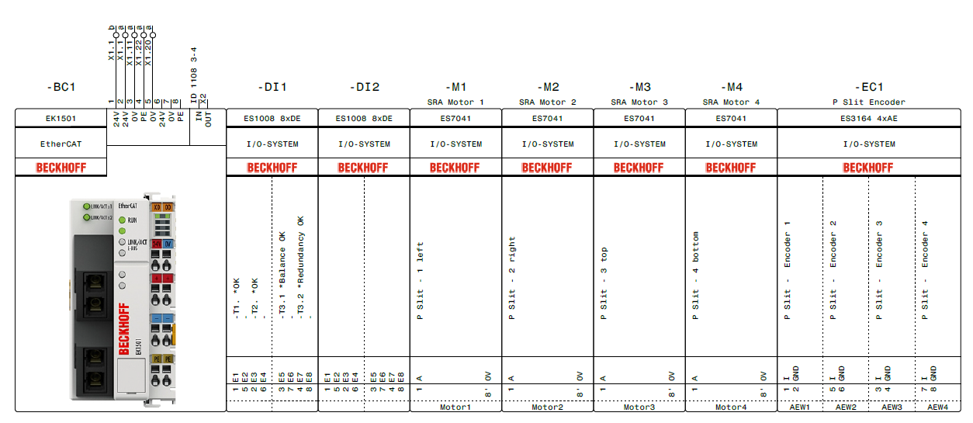
Current situations

Slide 4
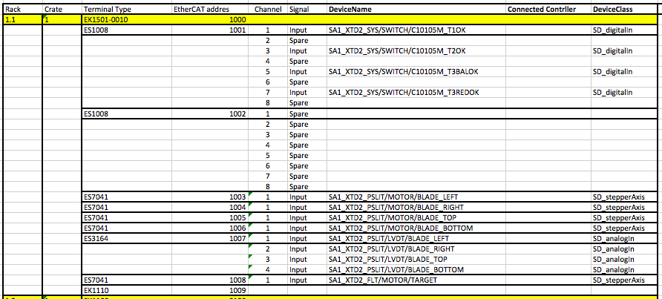
Current situations

Slide 5
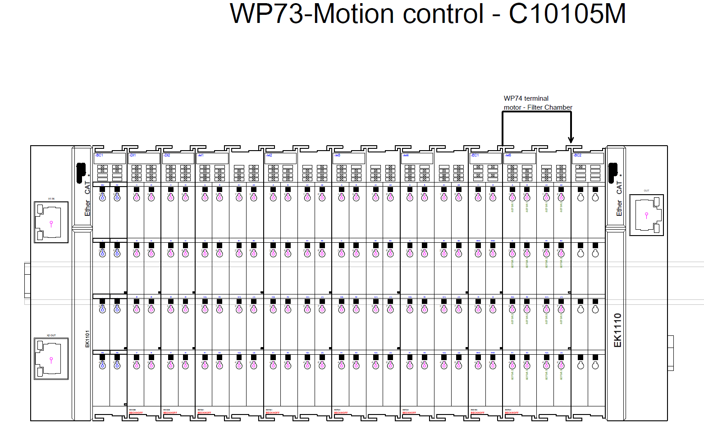
Current situations

Slide 6
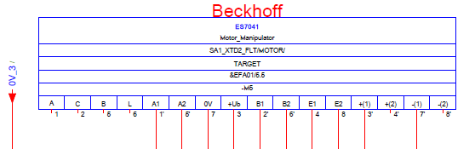
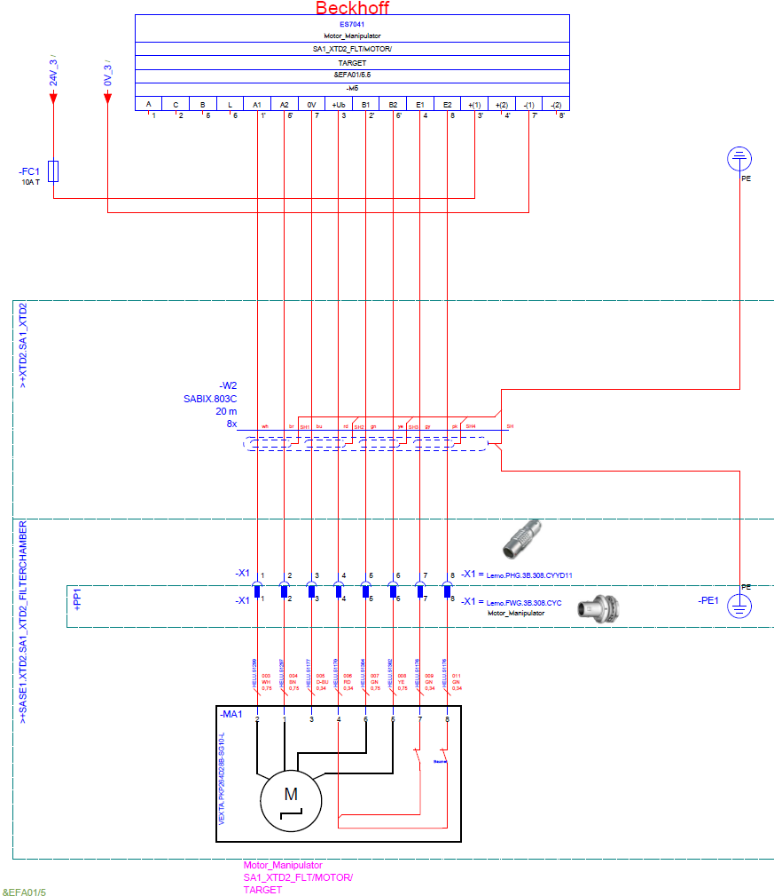
Current situations

