Slide 1
XGM – progress week 6 / 2017
Dr. Jan Grünert
X-ray Photon Diagnostics
Group Leader
Hamburg, February 10th, 2017
Contains information by K.Tiedtke / F.Jastrow from DESY-FS-FL-D and from WP74 team

Slide 2
XGM - Progress (w6)
RGA check of new resistors at DESY test chamber: RGA is OK
HV tests in GMD test-chamber at FLASH2 with new resistors: OK
XGM01 was opened tuesday in HERA-S clean room, and resistors were exchanged.
RGA test of HERA XGM is OK.
HV tests OK.
Pulse tests OK.
→ A suitable solution for the problem was found :-)

Slide 3
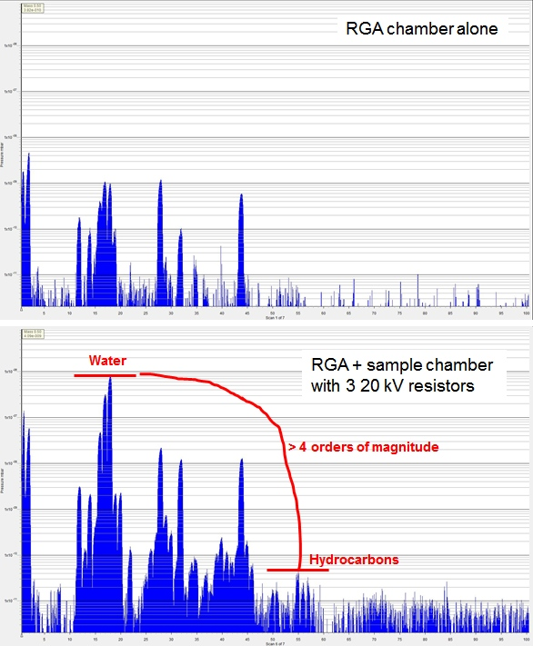
RGA of new resistors: ok

Slide 4
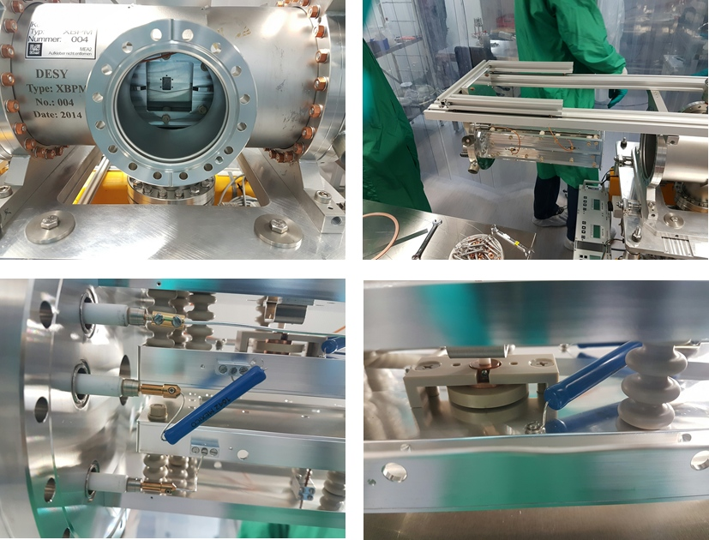
Repair of XGM01 @ HERA-S
Extractor Tool
Removal of commercial multiplier
New resistor at feedthrough
New resistor near e1

Slide 5
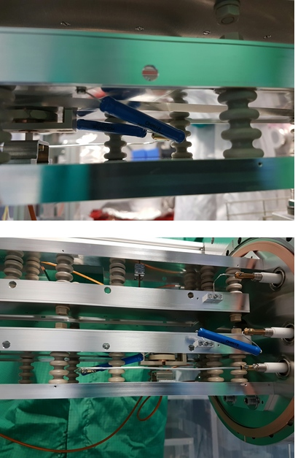
Detail view of electrodes
Resistors to the
split electrodes
full view of all electrodes
in an XGMD

Slide 6
XGM – more on progress (w6)
XGM_XTD2
Connected ~50% of the XGM/Beckhoff vacuum cables
Determined some issues with other 50% cables (connectors not fitting, cable not working, documentation inconsistent)
Received all hoses / fittings for the GasSupply_XGM_XTD2 (will be connected when XTD2_XGM has to be opened)
XGM_XTD9
Finished the pressurized air piping (copper)
Installed the Keithleys and SRG controller

Slide 7
XGM - Plan week 7
Planning for exchange of resistors at XGM@XTD2:
Involved groups: XFEL VAC, DESY-Tiedke, Survey, and WP74
Planning ongoing, to be done as soon as possible
Other XGM tasks:
XGM@XTD2: local Beckhoff test, including Gas-Supply
XGM@XTD9: wiring of vacuum-to-Beckhoff, installation of wiring terminals (2x) on girder, cables from girder terminals to rack
Both: test of serial communication from DOOCS to Keithleys/SRG/RVC300/HV-crate

