Slide 1
Chess2 measurements

Slide 2
Status
-CHESS2 amplifiers don’t seem to produce an output pulse.
-CHESS2 amplifier are internally and externally biased.
Injection
IFB
RowENB
RAMWrEn
3.3
ColENB
1.8
Load
Th
Casc
1/2/4/8
In
InSF
Comp
Baseline

Slide 3
Chess2 internal bias
- Chess2 uses internal current source to control all 4096 pixels of an array.
Current attenuator
32 steps of 2dB.
current
out
to cells
Prog. res.
4 values

Slide 4
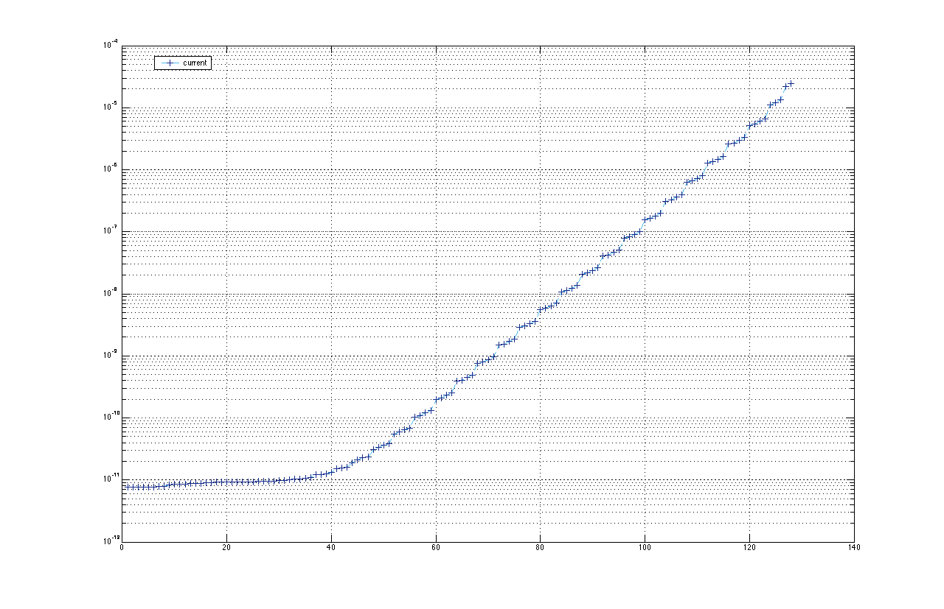
Cuurent (A)
Logarithmic behavior
desirable for feedback
current adjustment
Here 0 current.
7bit adjustable

Slide 5
Status
- CHESS2 on the Oxford motherboard seems to be running hot.
- Motherboard only current = 0.149mA
- Function implemented that turns off:
  Amplifier
  Comparator
  DACs
- We should see current on the motherboard ~ 0.149mA
- We measure 0.462mA ???

Slide 6
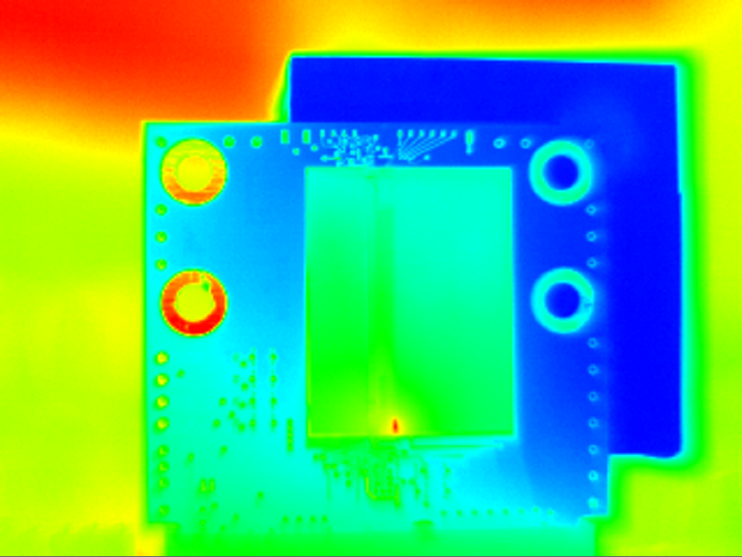
Thermal imaging of CHESS2

Slide 7
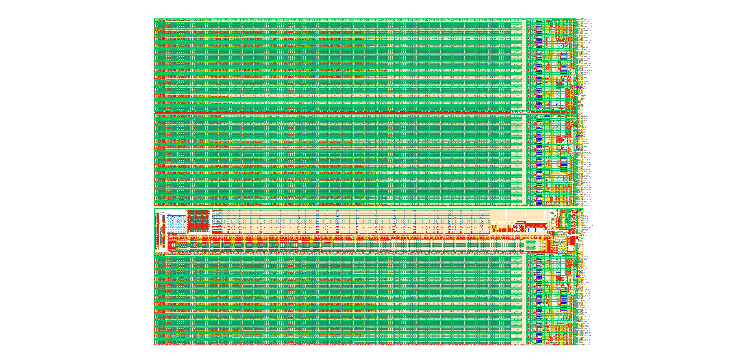

Slide 8
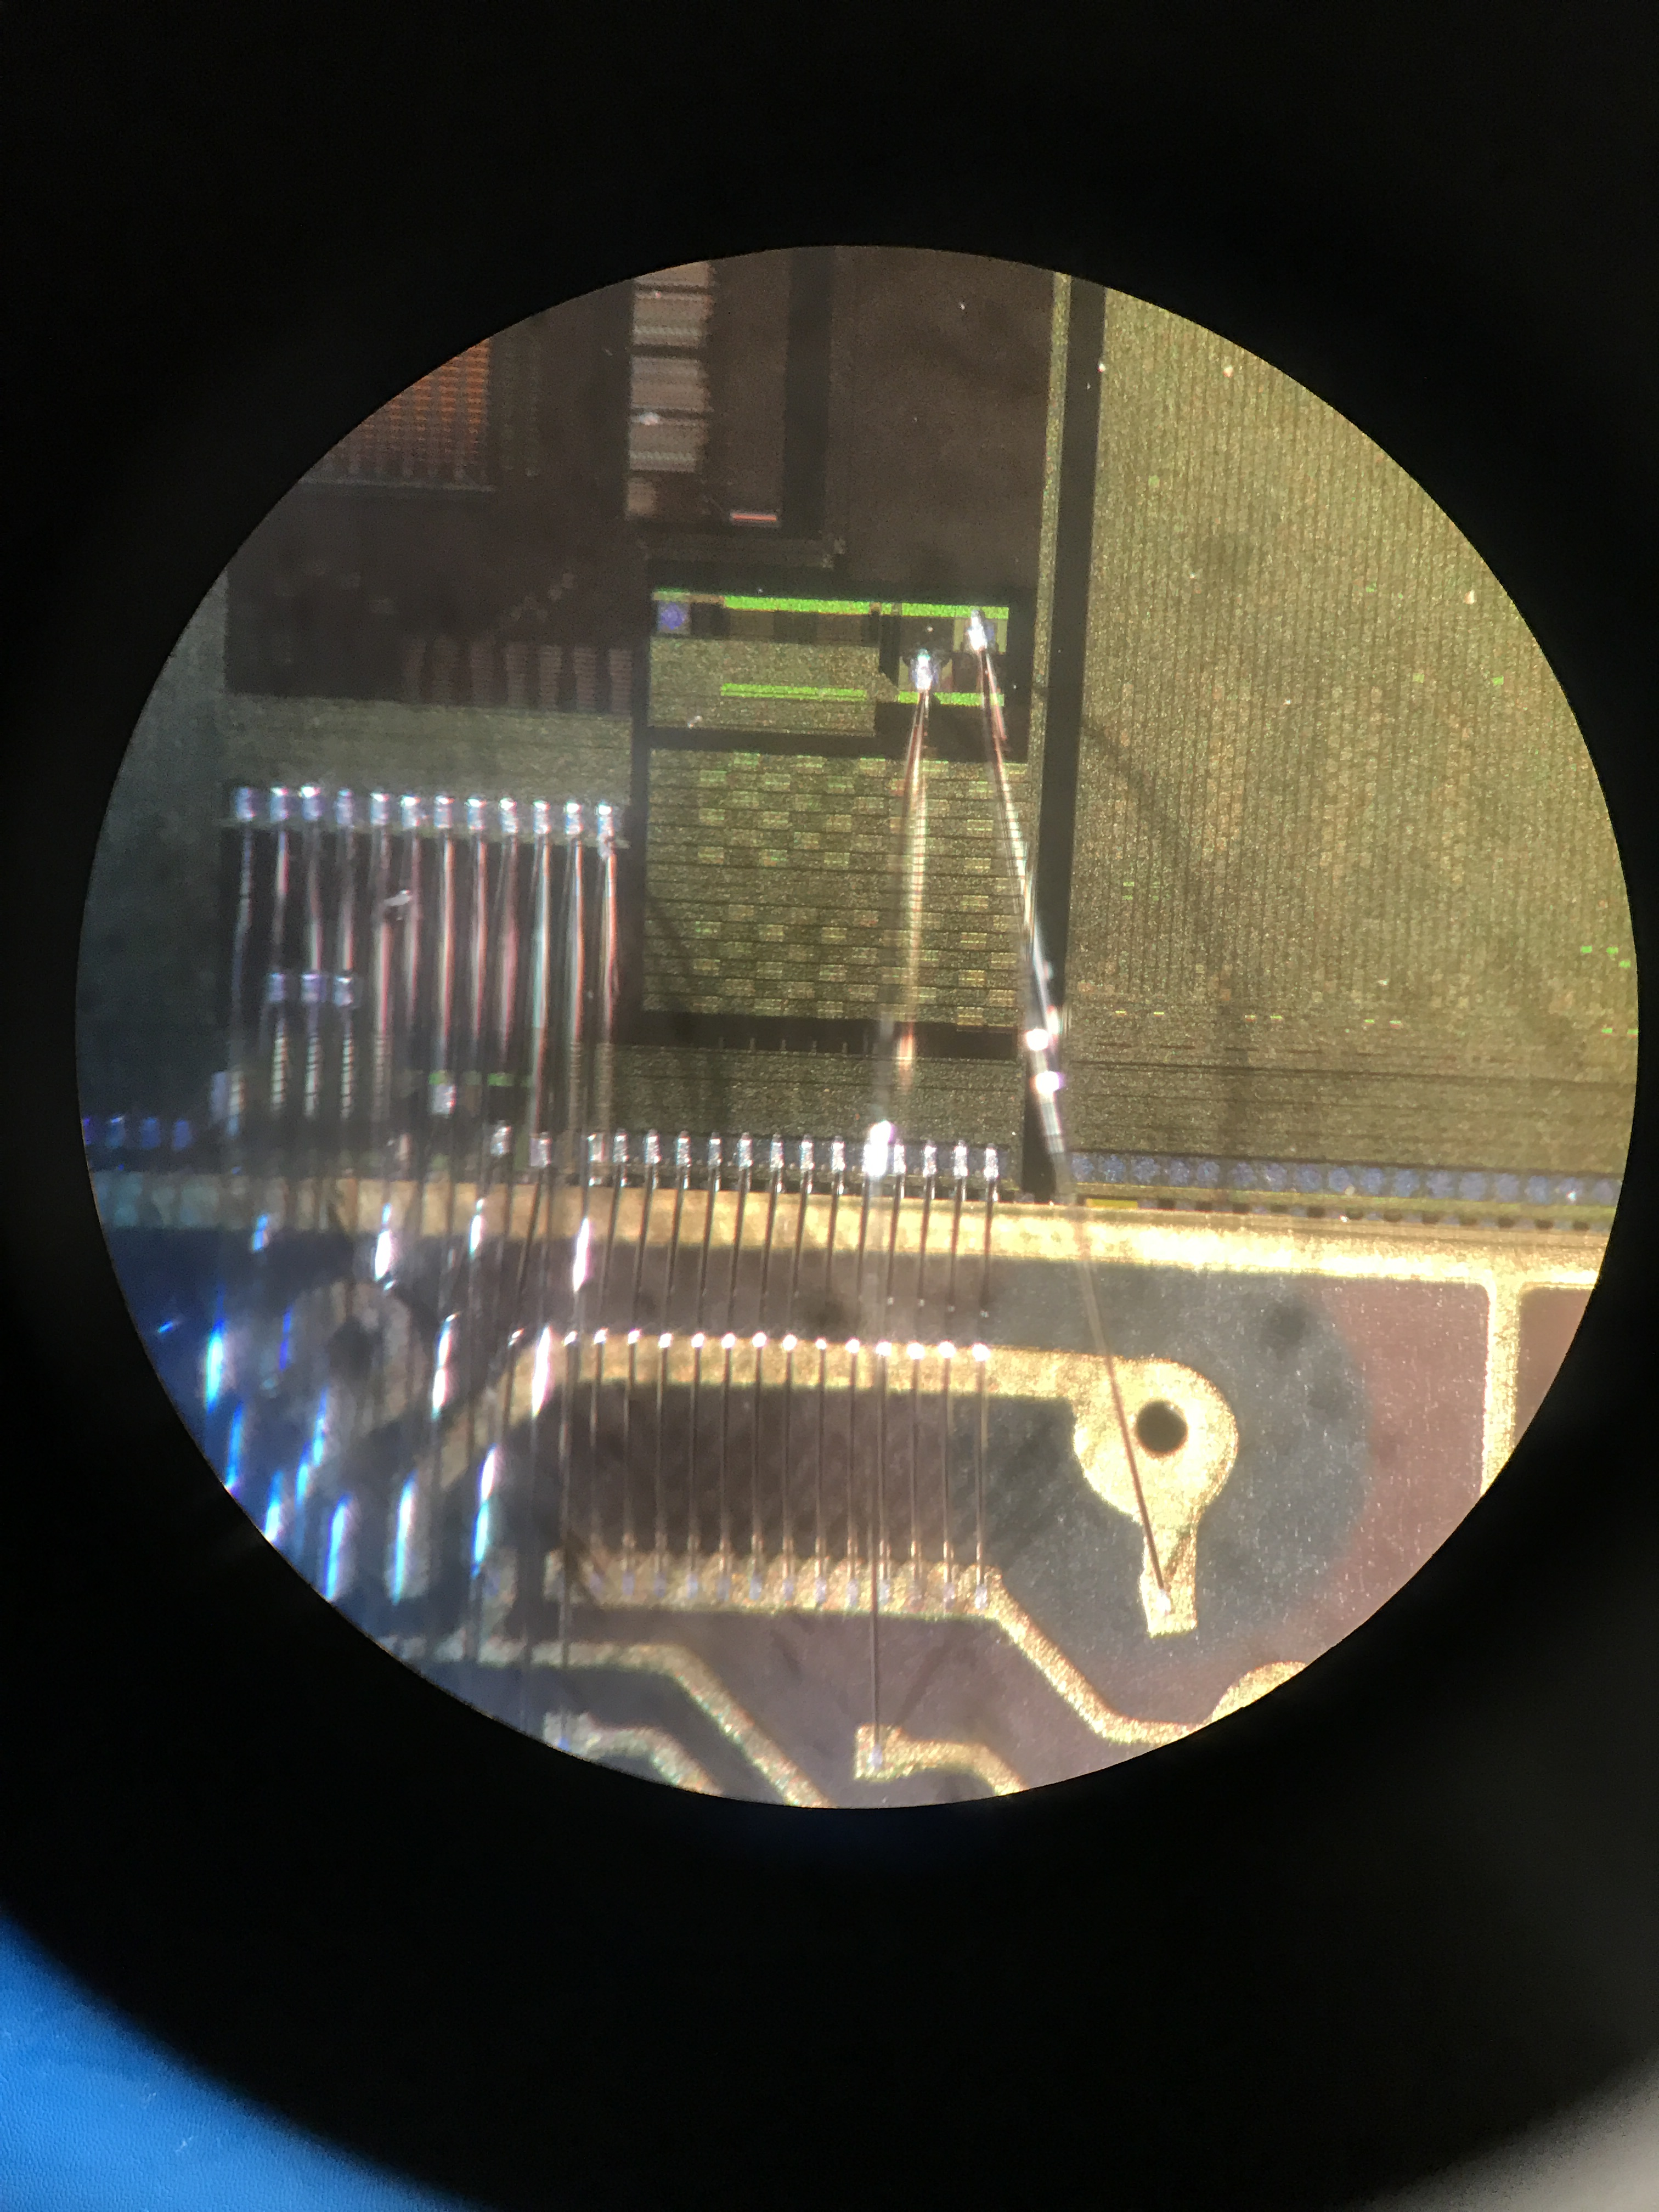
vdd pad of bottom array was grounded

Slide 9
vdd pad of bottom array was grounded

Slide 10
Status
- Done late last night – didn’t want to try pulling the wirebong
- Forest we will pull the wire and make sure the hot spot disappears

Slide 11
Further investigation
- The SLAC chip seems to be running hot too. We will look at it with the IR cam as well.
- Before this finding I had measured completely the current of the amplifier iN.
- Every other current source was shut off
Injection
IFB
RowENB
RAMWrEn
3.3
ColENB
1.8
Load
Th
Casc
1/2/4/8
In
InSF
Comp
Baseline

Slide 12
Bias current measurement
- In the test array (the one that we are looking at on the Oxford setup) the 512 test pixel bias is shared with the bottom array.
- We have 4096 + 512 – 4608 times the current.

Slide 13
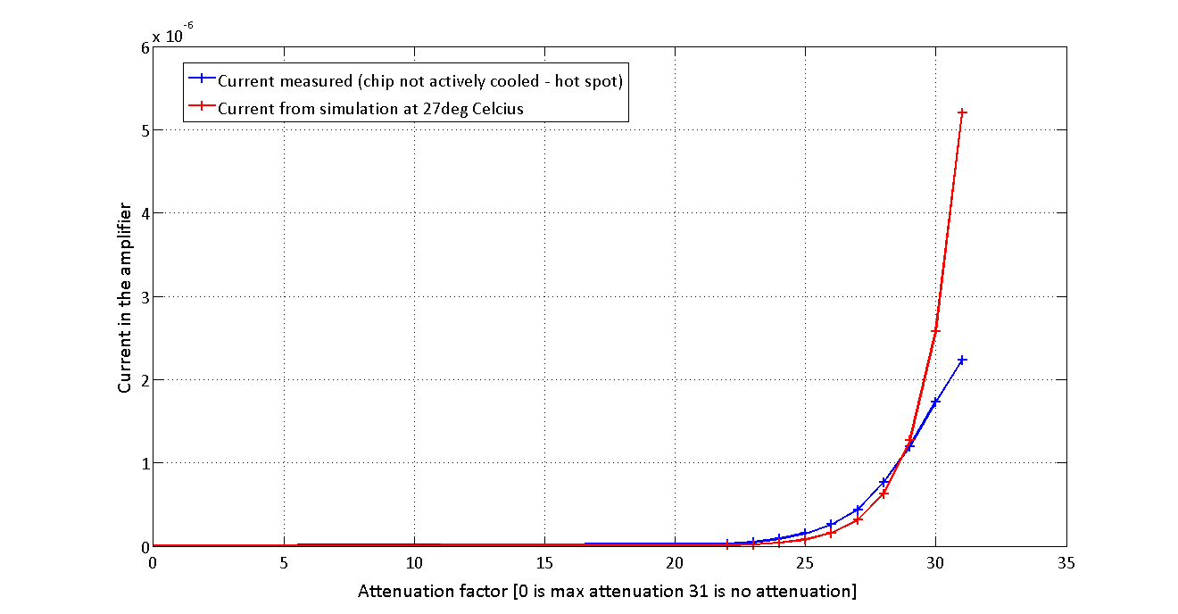
Measurement results

Slide 14
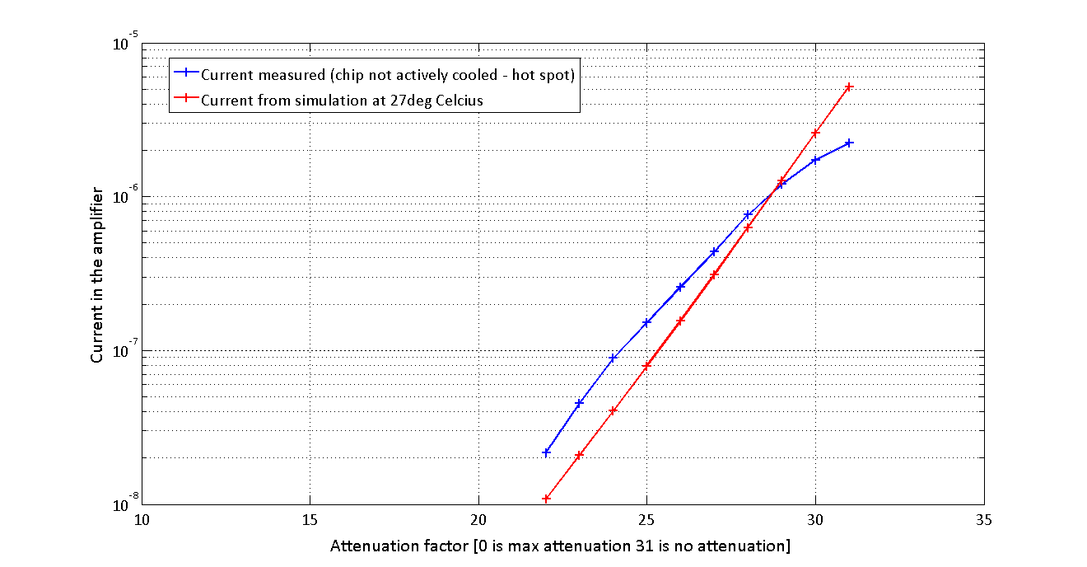
In log scale

Slide 15
About the current
- The current source is not temperature compensated.
- With more heat than expected in the chip we are underbiasing the amplifiers.
- Will remove hot spot
- Put some cooling capabilities on the back side of the chip to control precisely the temperature.
- More test results to come.

Slide 16
More information
- There is indeed an error in the CHESS2 datasheet about the amount of charge injected.
- Comparison of the big arrays of nwells between Chess1 and Chess2 (For Igor):
 | Chess1 | Chess2
Nwell width | 24.3u | 24.3u
Nwell length | 148.175u | 90.2u
Individual Nwell area | 148.175ux24.3u | 90.2ux24.3u
Number of rows | 44 | 32
Number of columns | 10 | 12
Total Nwell area | 1.58mm2 | 0.84mm2
Total big array size | 1.985mm x 2.029mm | 1.283mm x 1.263mm

