Slide 1
Searching for missing charge in irradiated CHESS2 large passive array
Top TCT with IR: non uniformity seen (see talks by B. Hiti), could be related to the missing charge
https://indico.desy.de/materialDisplay.py?contribId=3&sessionId=0&materialId=slides&confId=16774
Top TCT with red laser to check the surface: more uniform than with IR ➔ doesn’t explain the effect

Slide 2
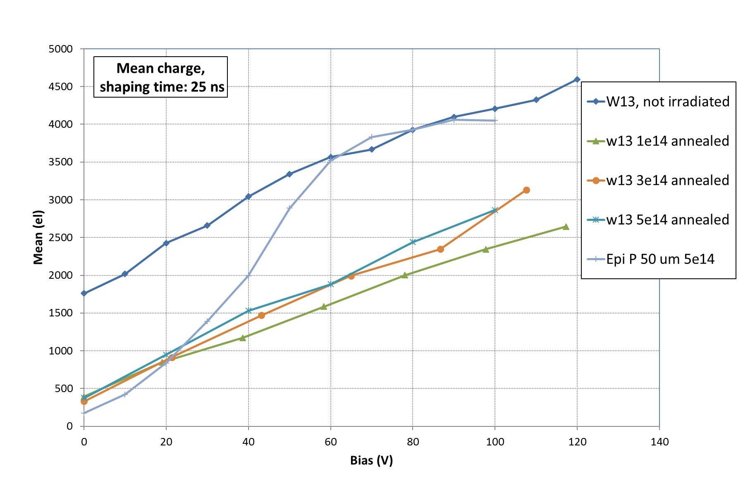
Cross check the measurement system with irradiated p-type 50 um thick epi diode
→ active thickness similar to CHESS but:
  higher resistivity of depleted epitaxal layer
  lower resistivity of the substrate bellow the epi layer
W13 (200 Ohmcm) chosen because depleted depth at 100 V near 50 um
from E-TCT we would expect over 5000 electrons in CHESS2 after 5e14

Slide 3
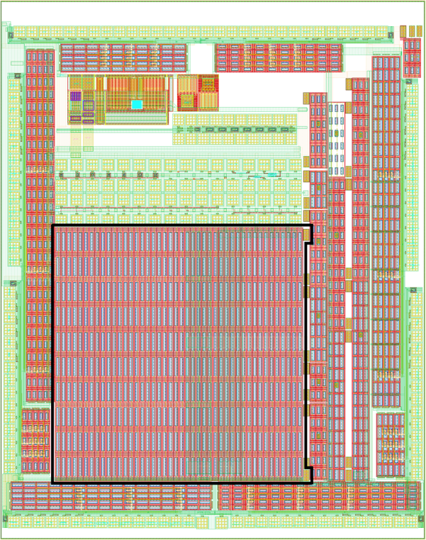
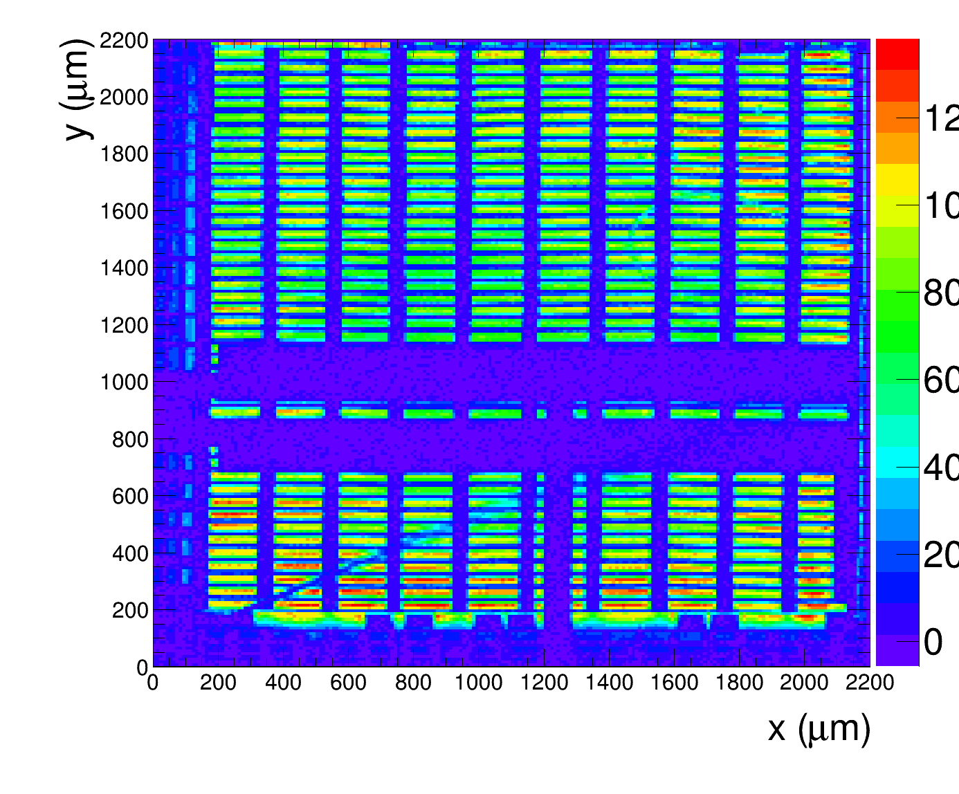
TOP TCT with CHESS1 (2e15) large pixel array
Chess1, 20 Ohm-cm, irradiated with 2e15 n/cm2
45 um x 200 um pixles, 40 % diode area fraction
2x2 mm2 array
Top TCT, IR, Charge in 25 ns

Slide 4
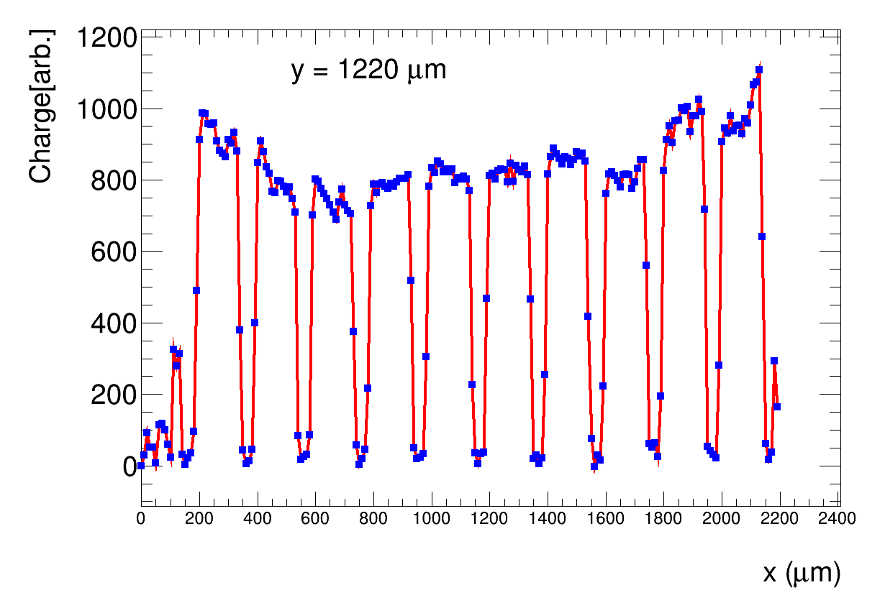
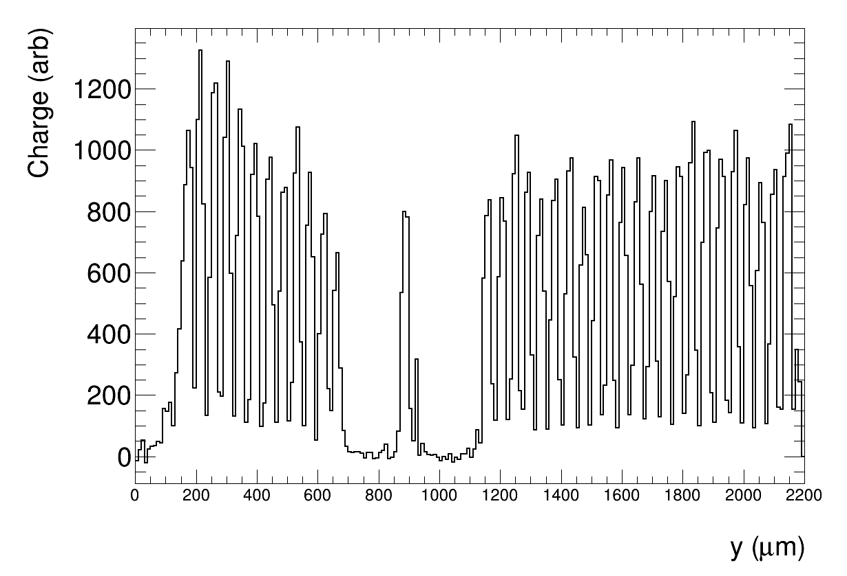
X = 1450
Collected charge more uniform across the device than CHESS2

Slide 5
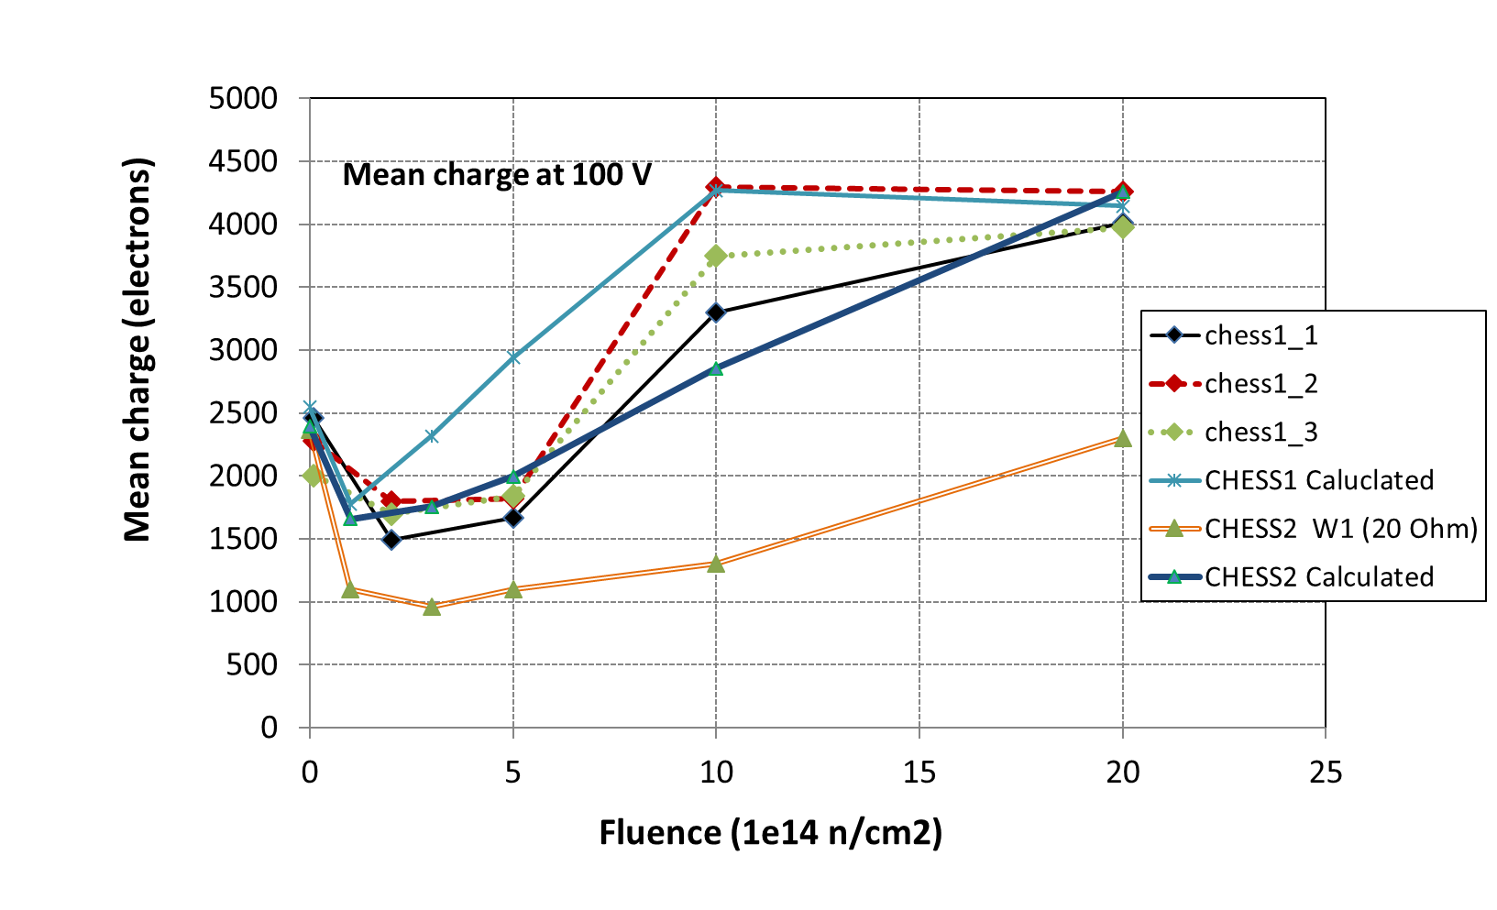
Comparison with simple calculations (planar pad diode approximation, uniform Neff measured with E-TCT)
Calculations in better agreement with measurements for CHESS1

Slide 6
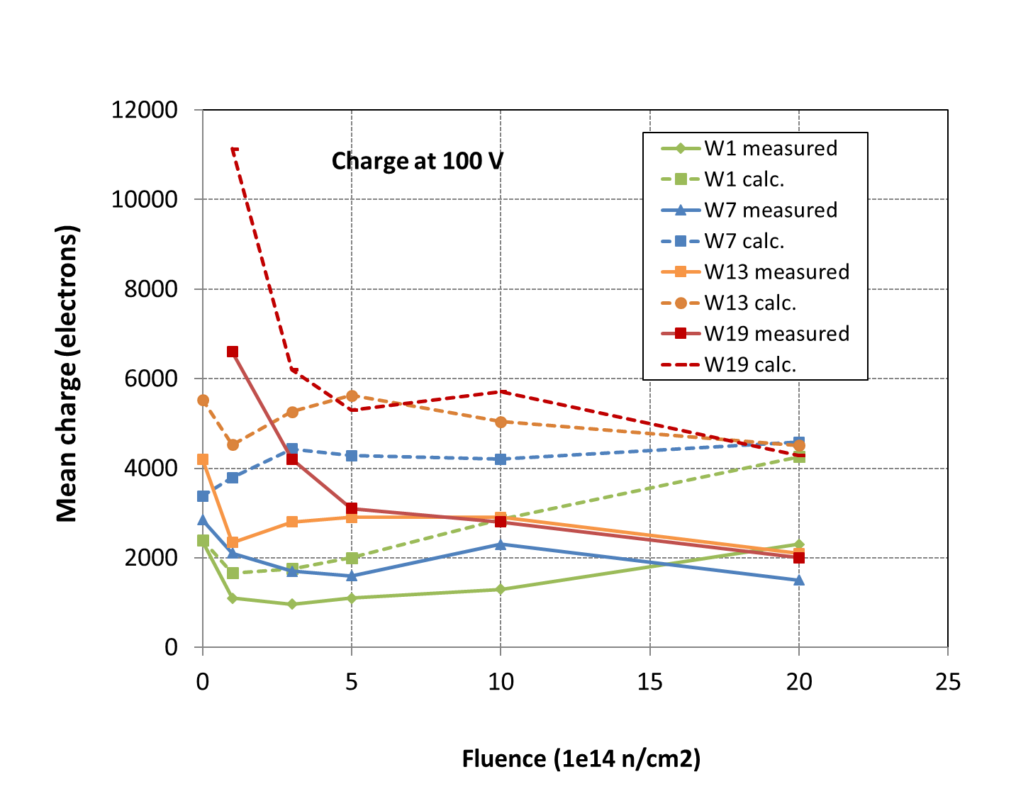
difference between measured and expected seen for all resistivites
best agreement before irradiation

Slide 7
In calculations we take simple one dimensional approximation (pad detector) with electric and weighting field
extending to the same depth.
We know that in partially depleted pad detectors after irradiation the border of weighting field moves to the
back side electrode because of increased Ohmic resistivity of silicon. Because of this the charge released
in depleted part does not travel over whole weighting field and this reduces the collected charge by factor d/D
maybe differences between weighting and electric field are the reason for smaller charge in irradiated chess2
  why we don’t see the same effect in chess1?
Warning: weighting and electric field in HVCMOS much more complicated than in pad detectors!
d
E = U/d
Ew = 1/D
D
Search continues…..

