Slide 1
Laser development for gravitational wave detectors
State of the art and the future
Michael Steinke on behalf of LZH/AEI team
03.05.2017

Slide 2
LZH Facts
Non-university, non-profit research
center in Hannover
Founded in 1986 at University
Built in 1991,extensions in 1997/2008
Staff of 180 people (w/o students)
Turnover ~18M€ per year
~3M€ basic funds
Total area ~ 10,000 m²
Shop floor ~ 1,400 m²
Clean room 300 m²
28 Labs

Slide 3
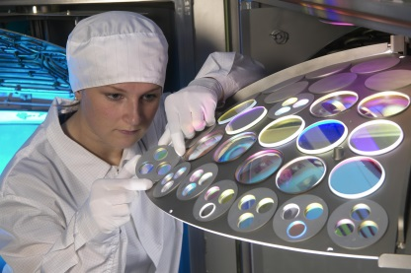
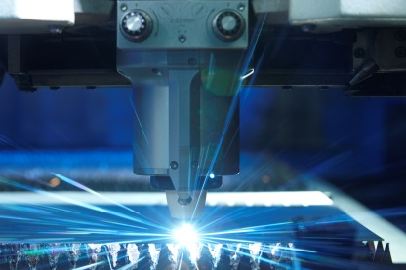
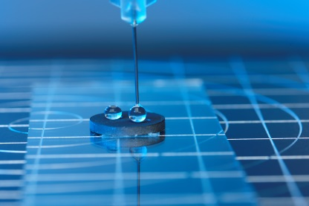
LZH Research focus
OPTICAL COMPONENTS AND SYSTEMS
Optical Coating Technology
Fiber Components
Lasers
OPTICAL PRODUCTION TECHNOLOGIES
From nano to macro:
Precise Surface Processing
Generative Processes
Joining and Cutting of Metals
Processing of Non-Metals
BIOMEDICAL PHOTONICS
Biomedical Engineering
Laser Medicine
Biophotonics

Slide 4
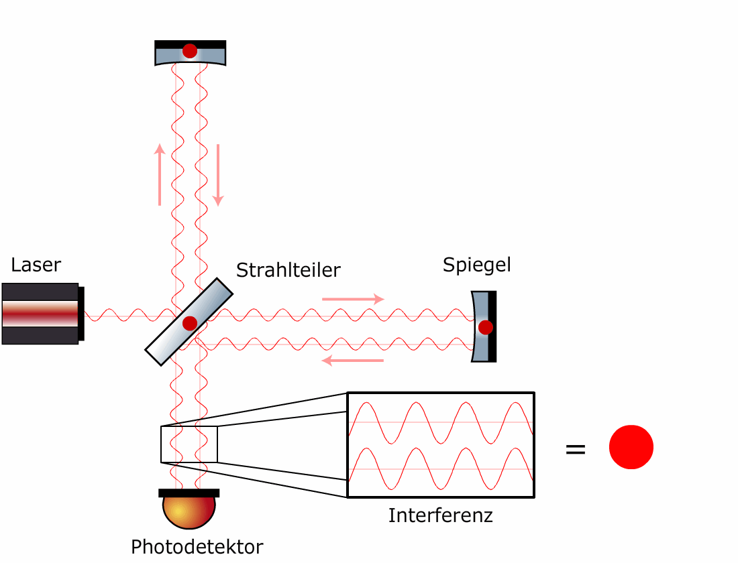
How to measure Gravitational Waves?
Interferometric gravitational wave detectors
Michelson type
Suspended (free falling) mirrors
Gravitational wave causes phase shift between the interferometer arms
Beamsplitter
Mirror
The mirrors do not really move locally, but the effect is the same and it is easier to imagine the physics
Interference
Photodetector

Slide 5
Current Detector network

Slide 6
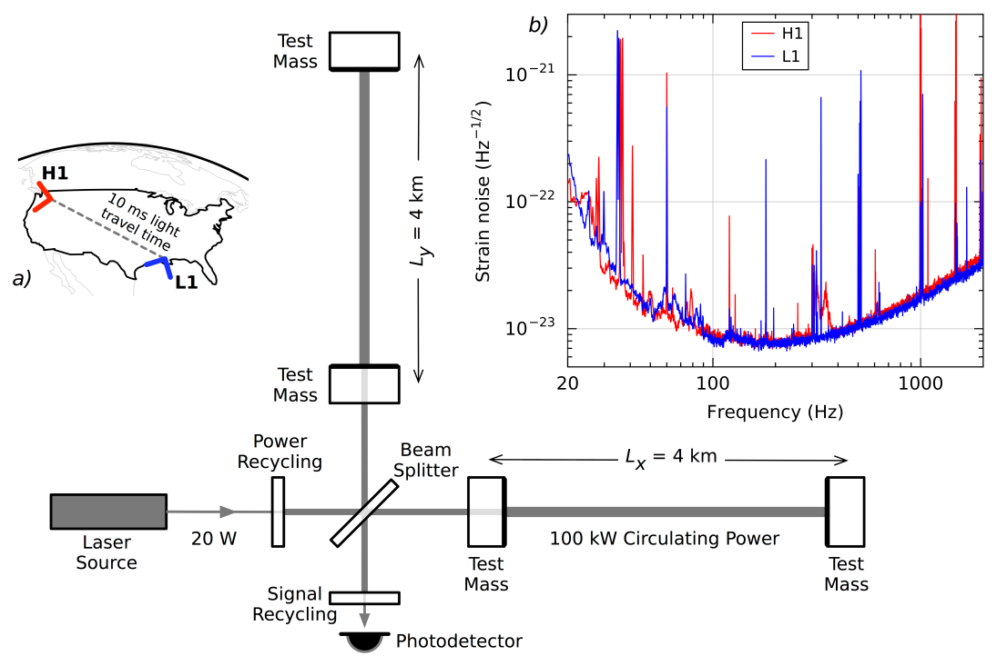
Requirements on the laser sources
Fundamental mode (TEM₀₀) operation
Linear polarization (PER >100:1)
Good frequency and amplitude stability
High output power (shot-noise scales with $1/\sqrt{P}$)
Single-frequency operation (kHz)
High reliability (24/7 operation)
Easy maintenance
Requirements very challenging and unique

Slide 7
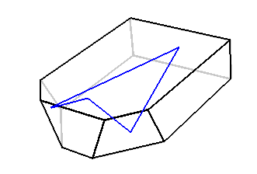
Non planer ring oscillator (NPRO)
Output
beam
Pump
Light
3 x 8 x 12 mm
Output power: 2 W
Beam quality (M²_{x,y}): < 1.1
Line width: 1 kHz / 100ms
⇨ Output power limited to 2W

Slide 8
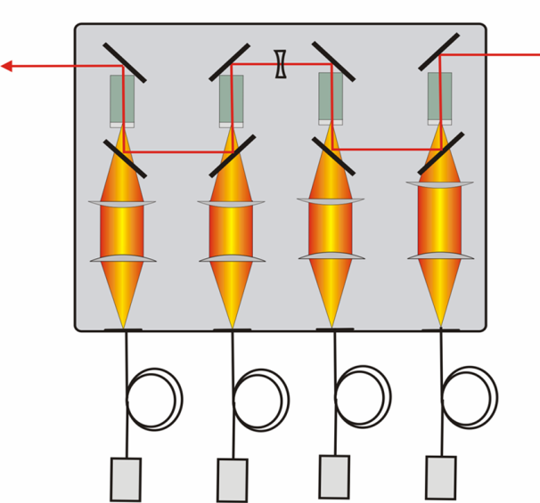
Solid-state laser technology
Solution: Solid-state (rare-erath doped crystals) laser technology to amplify NPRO
Amplifier configuration
Injection locked laser configuration
Amplified
output
Pump diodes
From seed
From seed
Amplified
output
Pump diodes

Slide 9
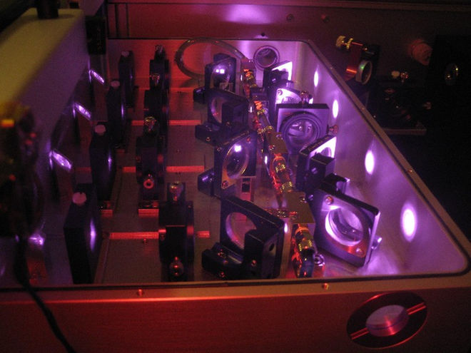
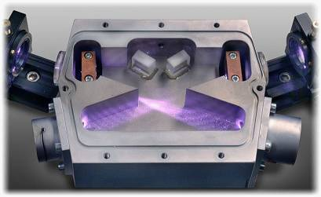
GEO and VIRGO laser systems
GEO:
GEO:
NPRO seed
35W Nd:YVO₄ amplifier stage
VIRGO:
NPRO seed
20W Nd:YAG injection locked stage
60W Nd:YVO₄ amplifier stage (same as GEO)
VIRGO (injection locked stage):

Slide 10
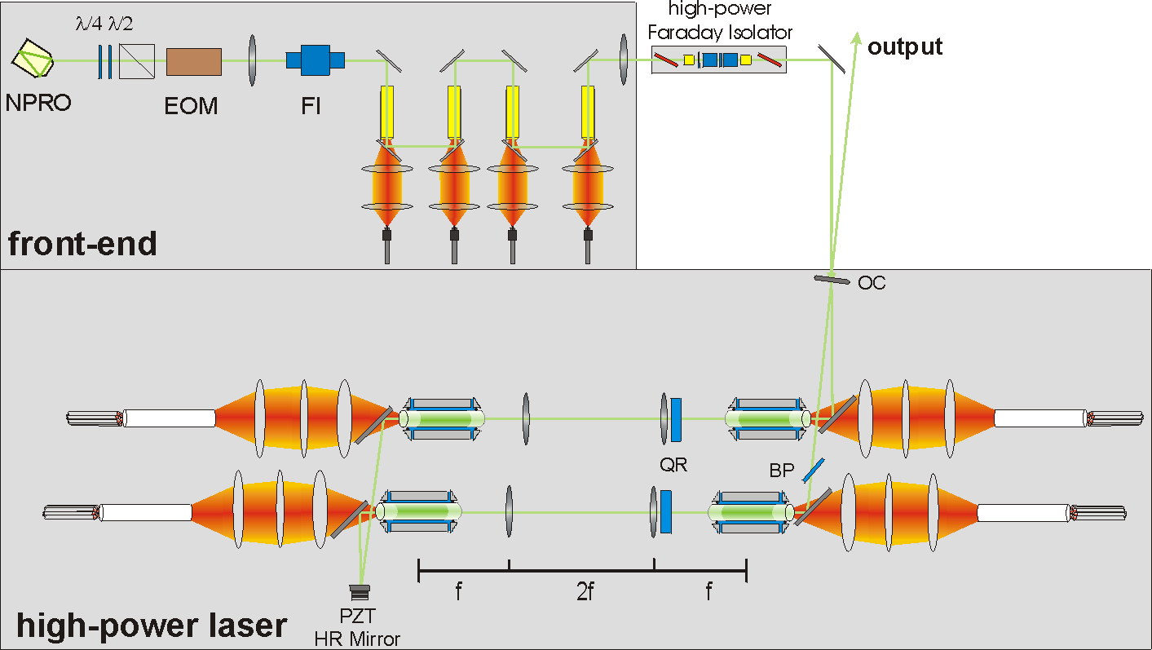
LIGO laser systems
Nd:YVO₄ amplifier stage similar to GEO system
Nd:YAG Injection locked high-power stage with four laser heads

Slide 11
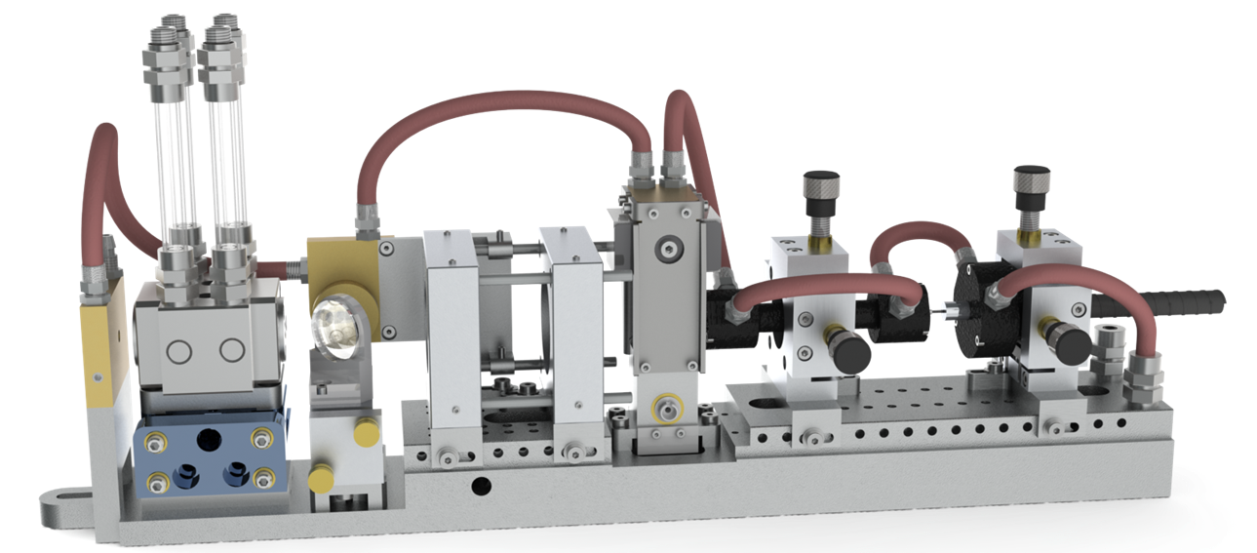
Laser head design
1. Water cooled base
2. Pump source: fiber bundle of 7 fibers
3. Pump light homogenizer
4. Pump light diagnostics: Power & Spectrum
5. Pump light imaging optics
6. 45° dichroic mirror
7. Pump light beam dump
8. Water cooled pump chamber for
Nd:YAG laser crystal
9. ASE beam dump
7
8
6
5
4
3
2
9
1

Slide 12
Transverse mode control – laser setup
One major issue
How to design resonator such that it is stable for pure TEM₀₀ mode?
Note: need to include thermal lensing in design
Setup for investigation on transverse mode behavior: 2 head system

Slide 13
Transverse mode control – resonator design
symmetric resonator with short distances

Slide 14
Transverse mode control – resonator design
symmetric resonator with long distances

Slide 15
Transverse mode control – resonator design
slightly asymmetric resonator with long distances

Slide 16
Transverse mode control – resonator design
strongly asymmetric resonator

Slide 17
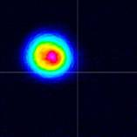
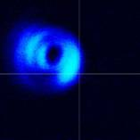
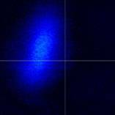
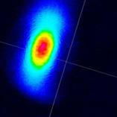
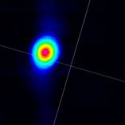
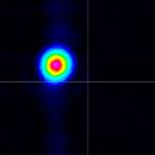
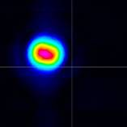
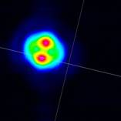
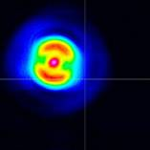
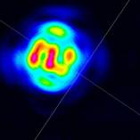
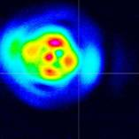
Transverse mode control

Slide 18
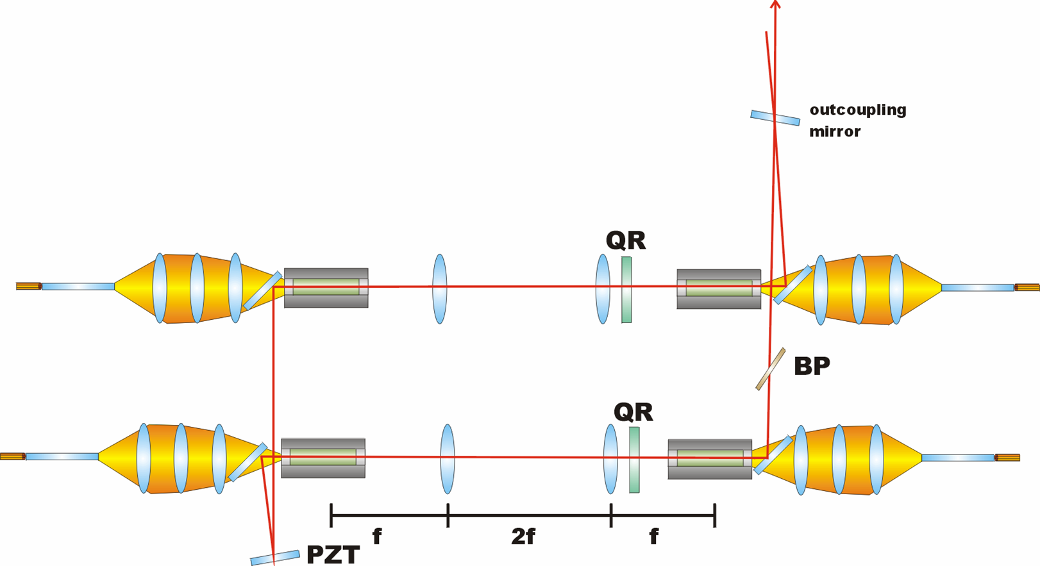
Power scaling: 2 heads → 4 heads
“Just” double the resonator: 2 heads → 4 laser heads

Slide 19
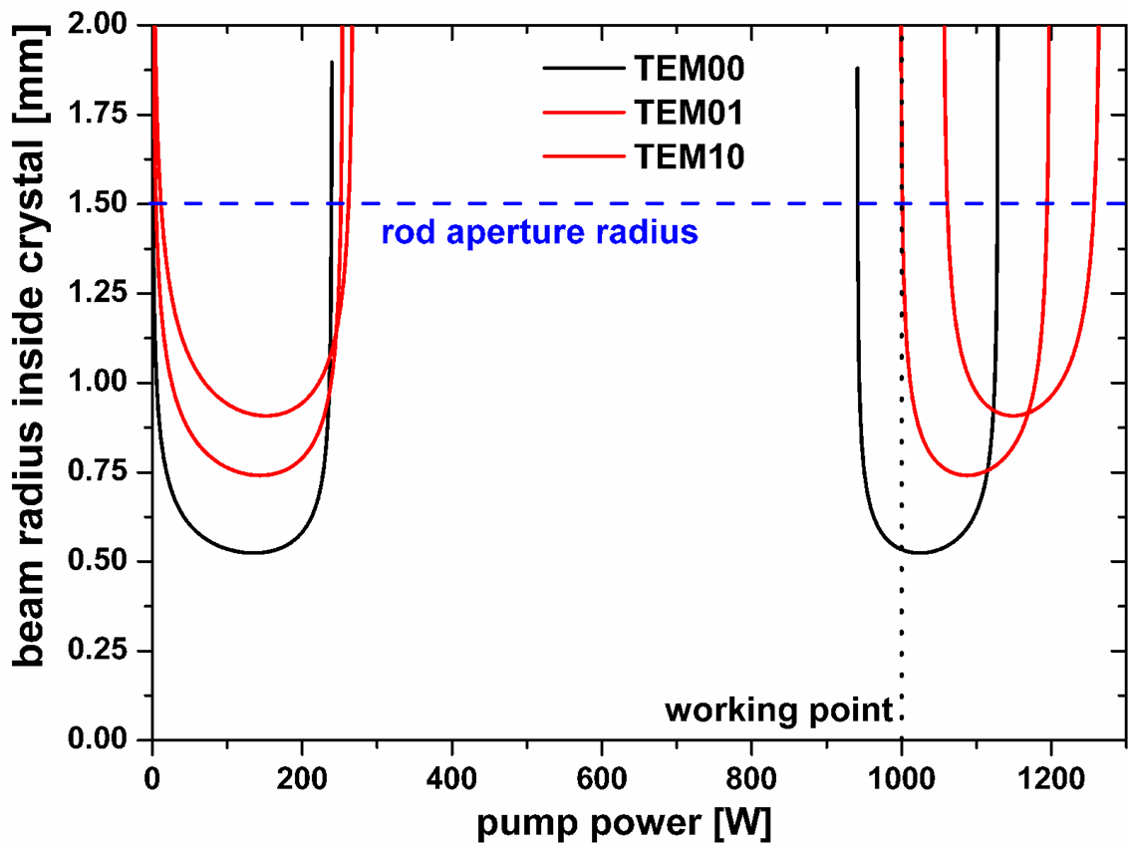
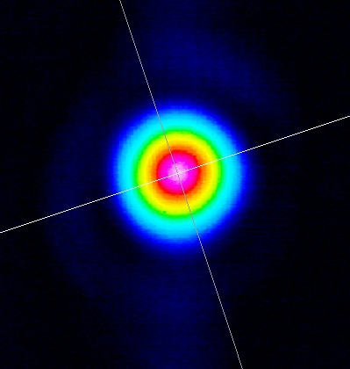
Transverse mode control – 4 head cavity design
Beam profile at ~165W:

Slide 20
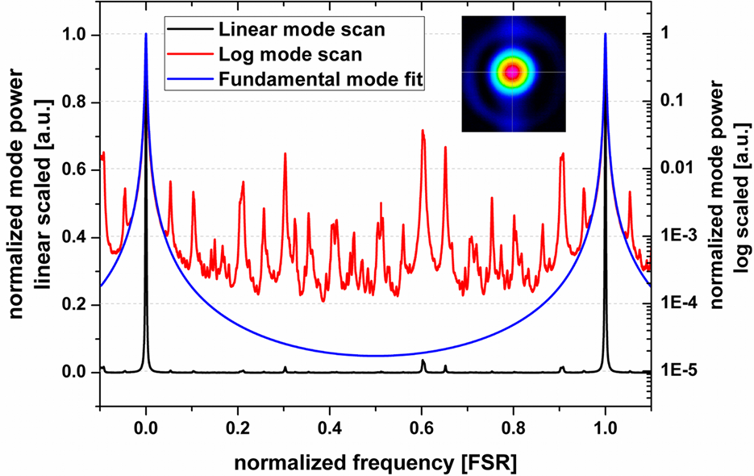
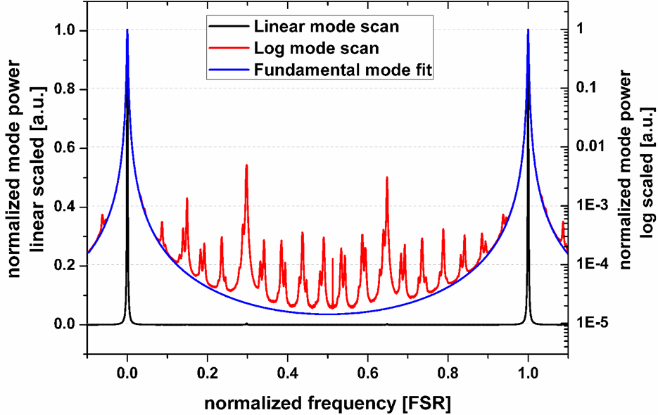
Beam quality
After high power oscillator
After high power mode-cleaner
> 88 % in TEM₀₀ mode @ 220 W of output power from the oscillator
< 2 % in higher order modes
Transmitted output power after HPPMC > 165 W

Slide 21
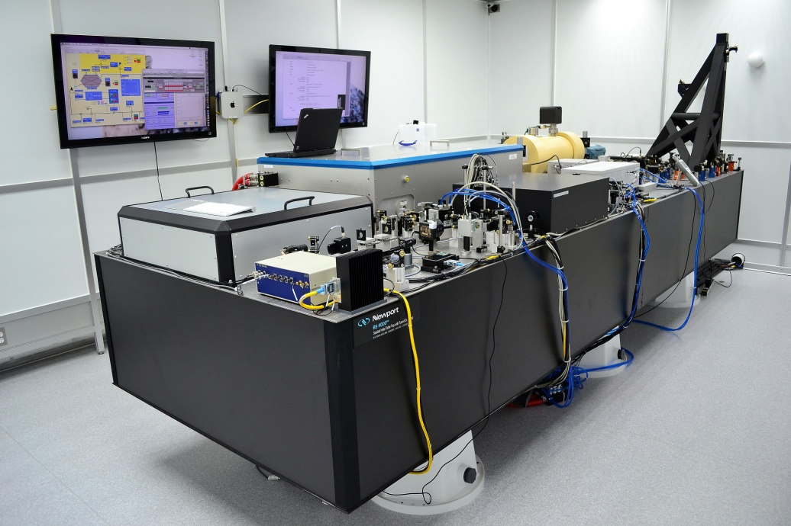
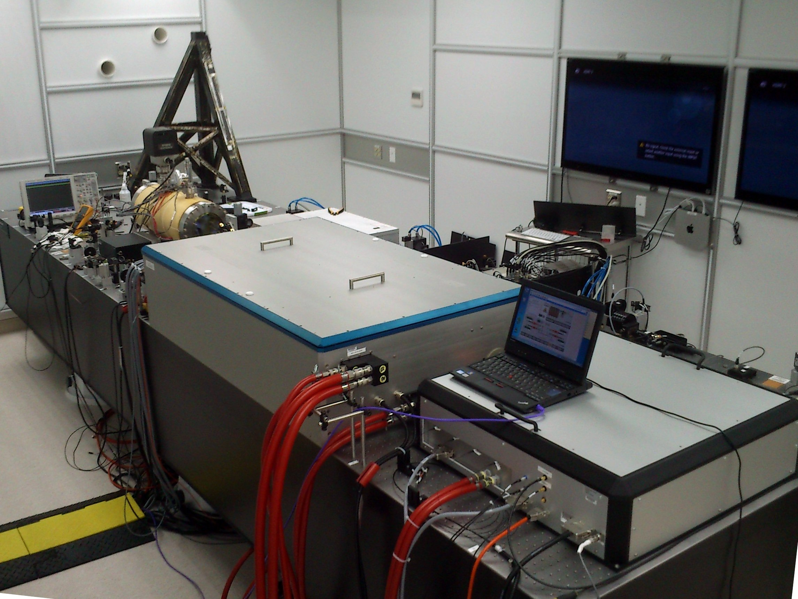
State of the art Ligo laser systems
~165W in TEM₀₀ mode
kHz linewidth (single-frequency operation)
PER ???
Two laser systems have been installed in Livingston & Hanford
A third system is waiting for installation in LIGO India

Slide 22
State of the art
Lessons learnt regarding the injection locked laser concept
Not that easy to operate and maintain
Shows significant pointing
It has a working point
…. not used during LIGO detection runs…...
LIGO and VIRGO thinking about 100W-class amplifiers
Low single-pass gain
Thermal lenses also part of design
Complex & bulky
100W seems realistic
Cryogenic detectors will require lasers with wavelength >1.4µm
Do we want to stick to solid-state technology for 3rd generation GWDs?
Isn't there a promising (better) alternative?

Slide 23
Fiber technology
Became very promising over last two decades
Supported by commercial applications (in particular laser processing)
Still very active in terms of research
Advantages | Disadvantages
Wave-guiding High gain levels Amplifiers already promising | Long interaction lengths Non-linear effects Amplified spontaneous emission
No thermal lens | Modal instabilities
Beam quality given by design | Can’t freely chose fiber design (limited by technology and non-linear effects)

Slide 24
Fiber technology
Research:
Ongoing at 1µm, 1.5µm and 2µm
Lot of optical concepts
Optical performance seems promising
Tight requirements of GWDs
on reliability
Which concepts to use?

Slide 25
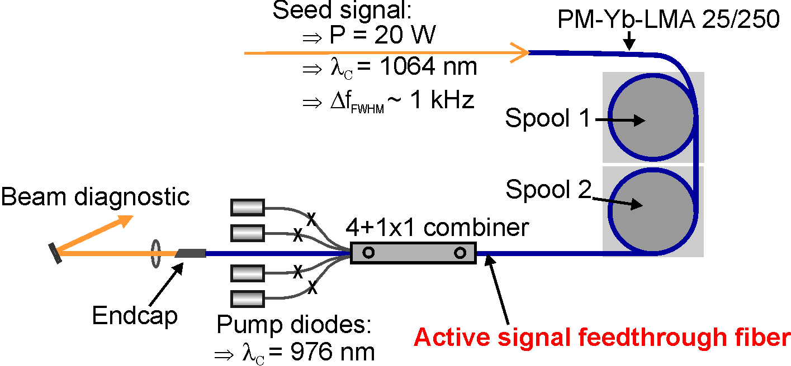
Fiber prototype at 1064nm
Seed source: NPRO with 2W output power
Fiber based single-mode 20W pre-amplifier
Two fiber spools for external thermal management of the active fiber
Home-built integrated 4+1x1 fiber combiner for counter pumping
Pump fibers directly fused to the active polarization maintaining fiber

Slide 26
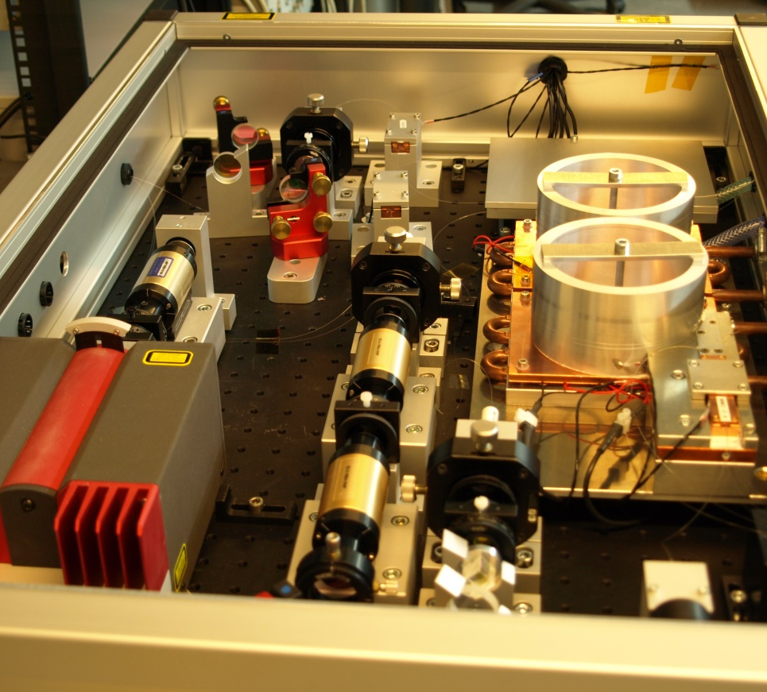
Fiber prototype at 1064nm
Pre-amplifier: 30W
Main amplifier: 200W
PER: 18dB
TEM₀₀ content: >90%
Successfully long-term (600h) tested at 120W
Problems with pump combiner at higher power levels
Functional prototype
Successful verification of (optical) concepts
Next step → engineering prototype
Pre-Amplifier
NPRO
Main-Amplifier

Slide 27
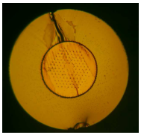
Fiber prototype at 1550nm
State of the art at 1550nm
Max. 55W in TEM₀₀ mode
Specialty fibers (non-PM)
Not monolithic
Our goal (together with AEI)
100W
Monolithic
No specialty fibers & PM fibers
Functional/engineering prototype
Promising result*
200W
Monolithic with commercial double-clad fibers (non-PM)
„Good“ beam quality, no SBS
* Proc. SPIE 9728, Fiber Lasers XIII: Technology, Systems, and Applications, 97282L (March 11, 2016); doi:10.1117/12.2212480

Slide 28
Fiber prototype at 1550nm
Simple (and all-fiber) architecture
Er/Yb codoped active fiber
Home-built fiber components

Slide 29
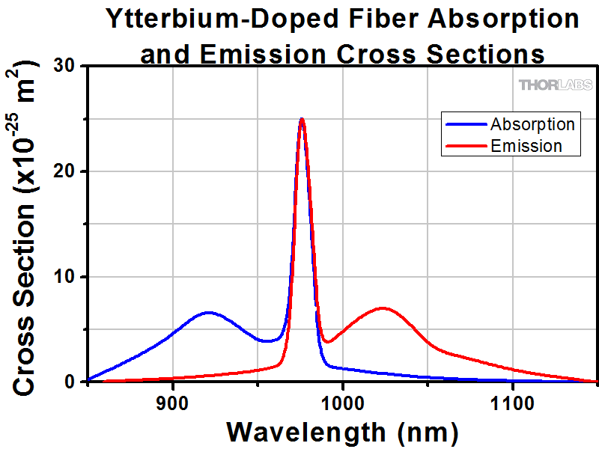
Fiber prototype at 1550nm
Pumping scheme
At 940nm (off-resonant)
Supresses saturation of Yb-to-Er energy transfer
Longer fiber required → SBS issue!?
Suppression of SBS
Backward pumping
Large mode area (LMA) fiber
25µm core, 300µm cladding
Commercially available (non-PM and PM)
Excitation of FM via mode field adapter
Use coiling-induced losses of HOMs

Slide 30
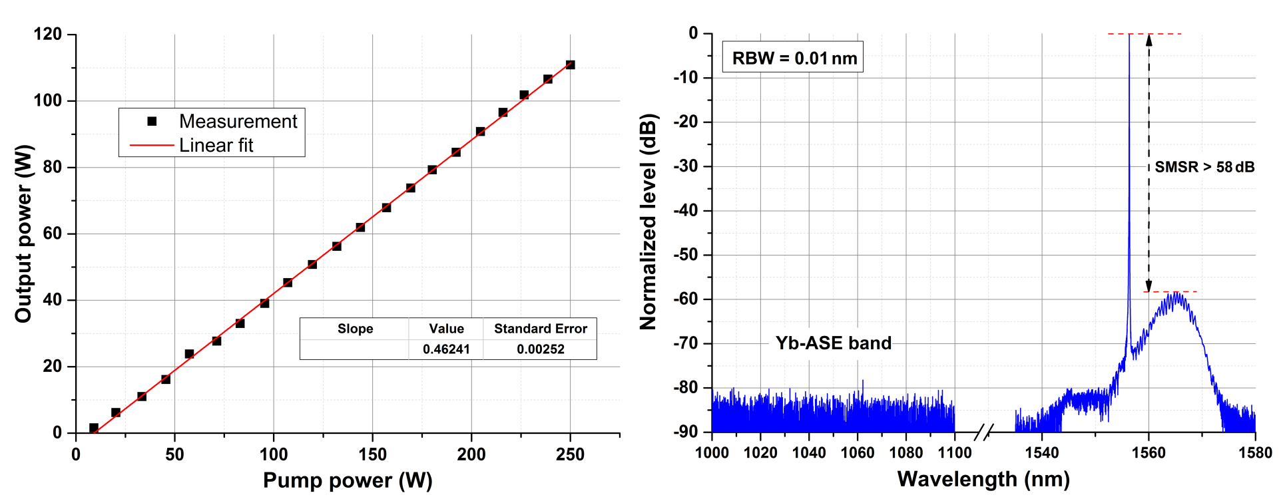
Fiber prototype at 1550nm
Linear slope up to 111W
No Yb-band ASE and good suppression (~60dB) of Er-band ASE
Output power limited by pump power

Slide 31
Fiber prototype at 1550nm
SBS-free
<1% power fluctuation on 1 hour scale
Polarization stable (~13dB) after warm-up time
Next upgrade: Active spool temperature stabilization and PM fibers

Slide 32
Fiber prototype at 1550nm
98.4% TEM₀₀ content at output power of 10W
97.3% TEM₀₀ content at output power of 55W
94.8% TEM₀₀ content at output power of 111W
In combination with measured PER: 100W in linearly polarized TEM₀₀ mode

Slide 33
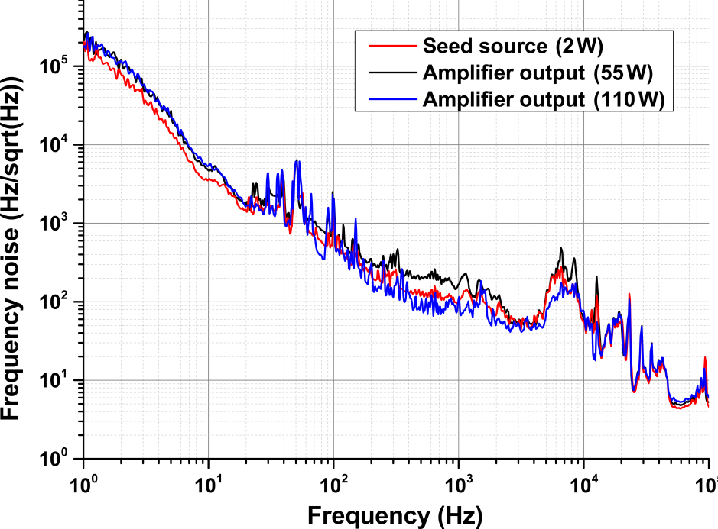
Fiber prototype at 1550nm
Frequency noise of amplifier determined by seed
Calculated linewidth
20kHz (100ms/10Hz)
1064nm NPRO: 1kHz (100ms/10Hz)
Interfaces for external stabilization
Fast actuator: Piezo
Slow actuator: Temperature
(Similar to NPRO)
External EOMs (for PDH stabilization) available at 1550nm

Slide 34
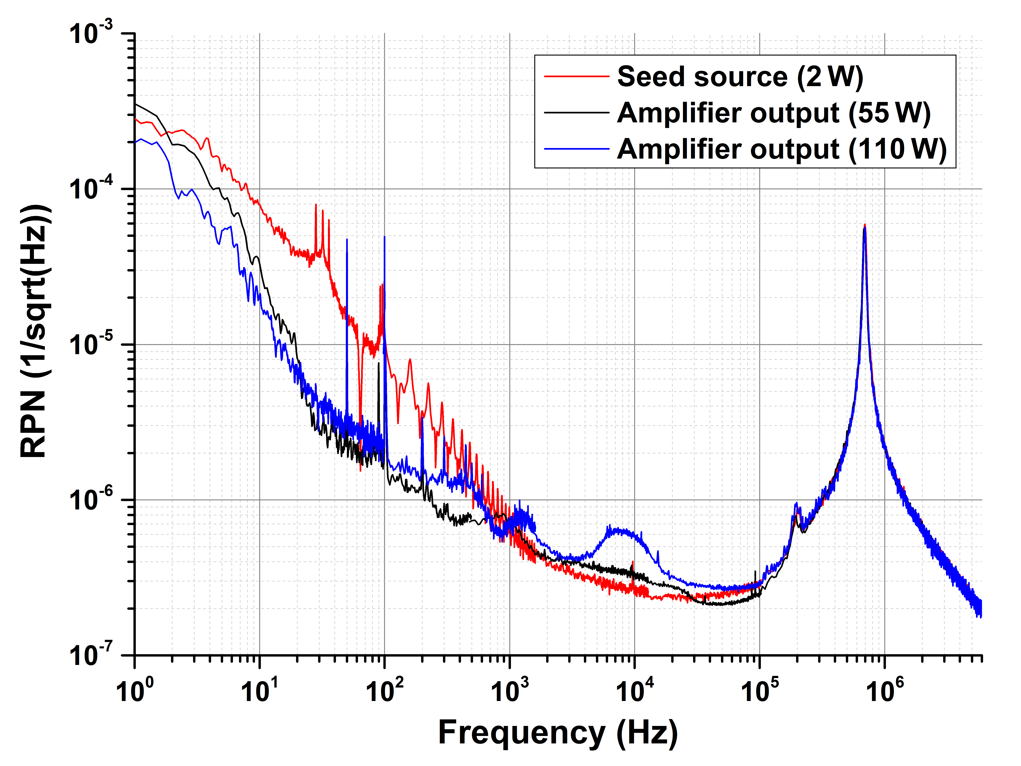
Fiber prototype at 1550nm
Frequencies >1kHz
Determined by seed
Except “resonance” around 10kHz at 110W
Frequencies <1kHz
Most probably determined by seed and pump
Stabilization via feedback to pumps feasible
Low-pass transfer function
Cut-off frequency given by effective lifetime → 1-10kHz

Slide 35
Fiber prototype at 1550nm
Where we are
100W lab/function prototype at 1550nm
Next steps (towards function/engineering prototype)
Upgrade to PM fibers
Design/development of pre-amplifier
Minor upgrades of optical concepts (e.g. optimization of fiber length)
Engineering
Mechanical, electrical, cooling etc. concepts
Optimization of fiber components
Take profit of experiences at 1064nm (and aLIGO system)
Further power scaling (200W is realistic)

Slide 36
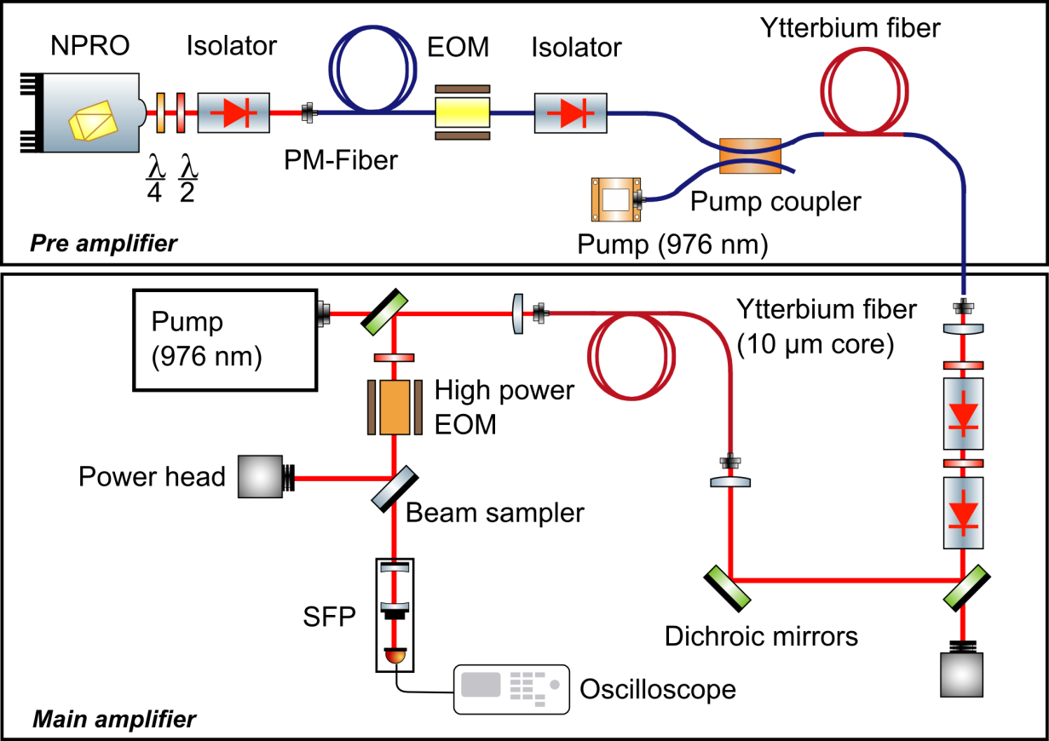
SBS Suppression schemes
Side band modulation with fiber coupled EOM
5W pre-amplifier
Demodulation with high power EOM

Slide 37
SBS Suppression schemes
SBS threshold increased from 60 W to 88 W ➔ factor 1.5
Limited by SBS and pump brightness

Slide 38
SBS Suppression schemes
SBS threshold increased from 60 W to 88 W ➔ factor 1.5
Limited by SBS and pump brightness

Slide 39
Coherent combination
Use fiber coupled splitters / combiners
Use knowledge gained from dynamics considerations → Control differential phase by tuning the pump power!
Differential pump power control:
Tunes phase
Leaves combined power unchanged (in 1st order)

Slide 40
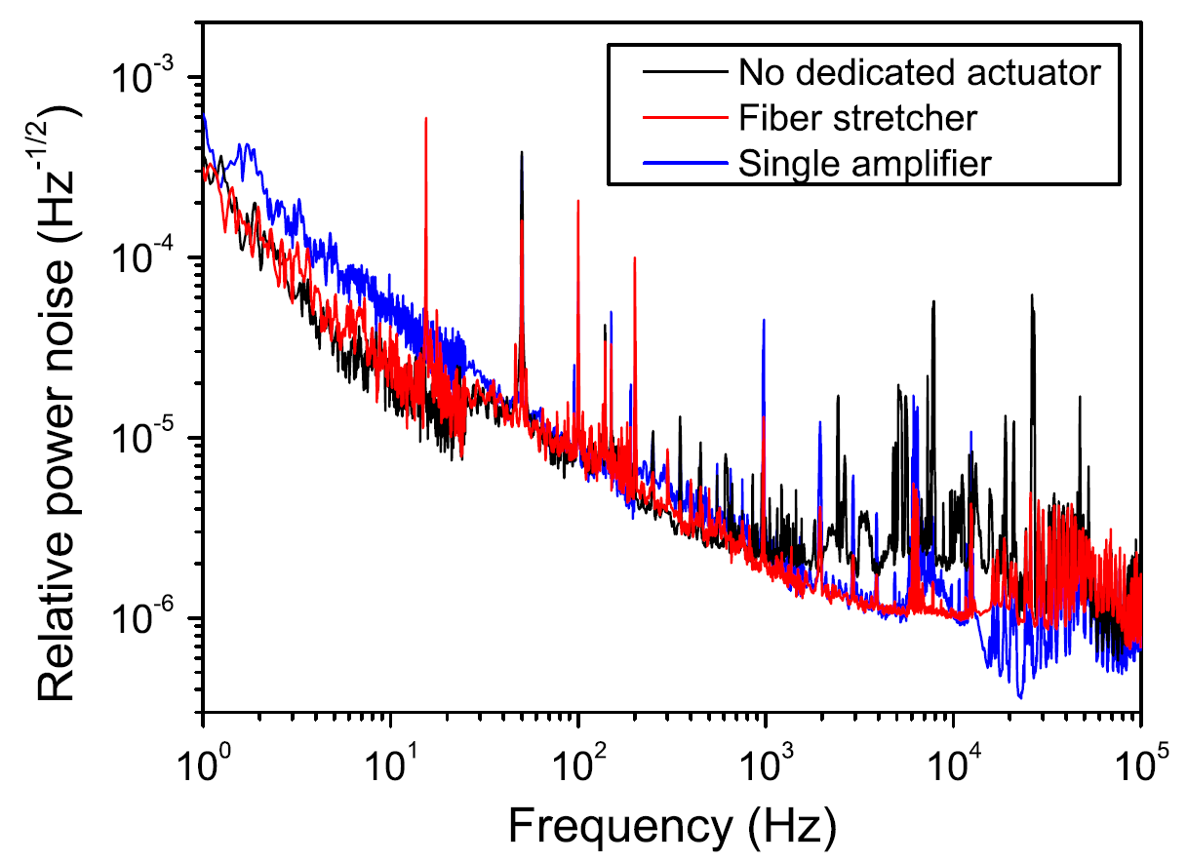
Coherent combination
Max CBC output power: 25 W
CBC efficiency: > 95 %
Stable locking for > 0.5 h
For long term operation additional long-range actuator needed (e.g. thermal control)
Control loop unity gain frequency: ~1 kHz
Limited by laser diode power supply
No power noise degradation due to locking scheme
Beam quality determined by single-mode fiber: > 97% in TEM₀₀

Slide 41
THANKs FOR YOUR ATTENTION

Slide 42
Challenges aLIGO solid state system
Complexity
How to simplify complexity? How to simplify alignment of laser to point of operation?
How to simplify repair & maintenance?
Pointing
Where does it come from?
Inherent feature of free-space scheme (coupling of mechanical noise)
Coupling of thermal lensing with external perturbations
How to suppress it? Can we counteract it (stabilization)?
Will it be better with an amplifier (instead of injection-locked laser) configuration?
What about solid-state technology if we aim for longer wavelengths (1550nm or 2000nm)?

Slide 43
Challenges fiber technology
Fiber design
Good point: We will have a fiber draw tower in Hannover soon ☺
Are non-standard (step-index) fibers an alternative for monolithic systems?
How to push the limits of standard step-index fibers?
Single-mode behavior
Photo-darkening
Fiber components
Degradation under high-power operation
Reliability
What is the best (most reliable) way to suppress SBS? Where are the limitations?
Will we ever encounter modal instabilities? How to counteract them?

Slide 44
Limitations of fiber amplifiers - MI
Modal instabilities (MI)
Threshold-like onset of modal instabilities in high-power fiber amplifiers
Beating of modes  inversion grating  temperature grating  refractive index grating  stimulated/driven energy transfer between modes
Hot topic regarding the power scaling of fiber amplifiers at 1.0µm
Eidam et al., Optics express 19 (14) 2011

Slide 45
Further challenges
Which seeder technology to use at longer wavelengths?
No NPROs available
External cavity laser diodes seem to be promising
Fiber lasers are ok but have larger linewidths
Whispering gallery mode lasers with very narrow linewidth (but expensive)
No real experiences with single-frequency fiber amplifiers at around 2000nm (optical specs are fine but long-term stability etc.)
Funding?

Slide 46
Prospects and challenges: Power scaling @ 2.0µm
Fiber technology at ~2.0µm is evolving significantly (driven by commercial interests)
Suitable coating materials (for high power operation)?
What about photodarkening (modal instabilities)?
What about single-frequency seed sources at ~2.0µm?
Fiber lasers (e.g. from NP Photonics or AdValue Photonics)
Whispering gallery mode lasers (e.g. from OEwaves)
What about their noise levels etc.? Are they already appropriate?
photonics-usa.com

Slide 47
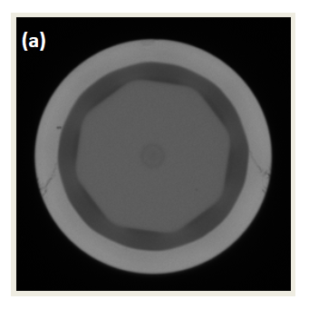
Going beyond 2µm
Holmium (Ho³⁺) emits efficiently around ~2.1µm
So far, no demonstration of single-frequency fiber amplifiers
Record CW output power: 407W* (monolithic fiber laser, cladding-pumped)
Drawbacks**:
Can only be pumped at
~1.9µm (by Thulium-doped lasers/amplifiers)
~1.15µm (Ytterbium-doped laser/amplifiers and/or Raman fiber lasers)
Most high-power demonstrations relied on all-glass fibers
High absorption of polymer coating
Silica absorption increases significantly above ~2.1µm
Experimental slope efficiencies are rather low
Background infrared silica losses, absorption by OH- groups, re-absorption and non-radiative decay processes
* Hemming et al., CLEO 2013, OSA Technical Digest, paper CW1M.1
** Jin et al., Journal of Electronic Science and Technology, 13 (4) 2015

