Slide 1
MEPHISTO PRODUCT LINE – ULTIMATE LOW NOISE LASER PERFORMANCE
Mantas Butkus, Volker Leonhardt

Slide 2
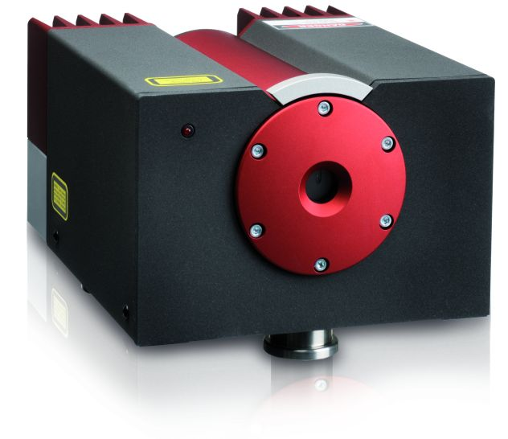
AGENDA
Introduction to Mephisto laser product line:
  Product line & features
  Integration in Coherent’s portfolio
  Manufacturability
Future outlook:
  Methods for power scalability
  Alternative wavelengths

Slide 3
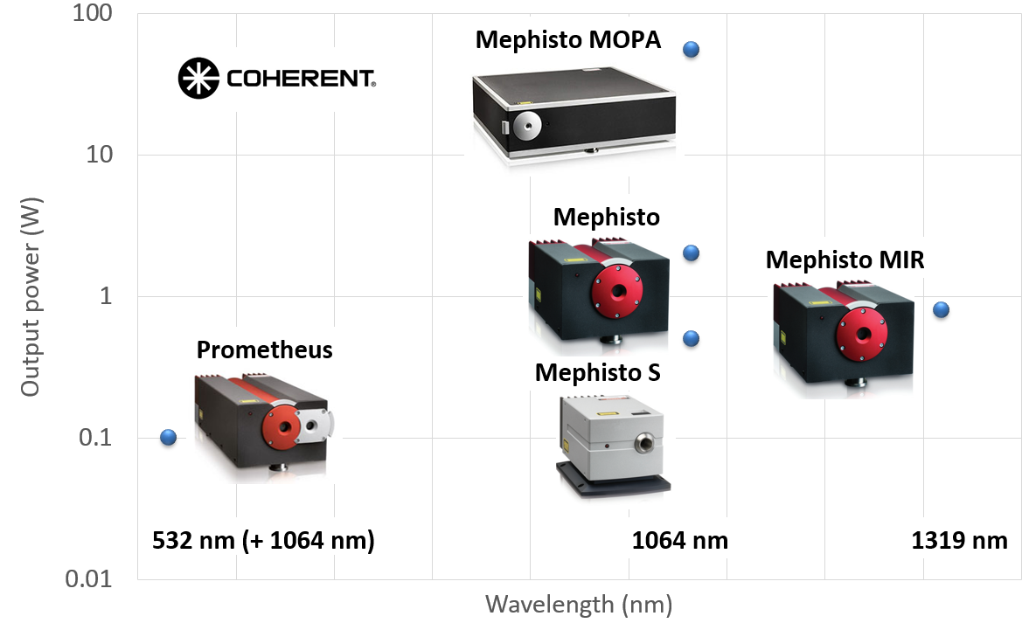
MEPHISTO PRODUCT LINE

Slide 4
MEPHISTO PRODUCT LINE
Mephisto is a family of single frequency solid-state lasers
Based on Nd:YAG crystal in Non-Planar Ring Oscillator (NPRO) configuration
The intrinsic stability is further improved by our Noise Eater technology
1 μm solution for both intensity and frequency stability

Slide 5
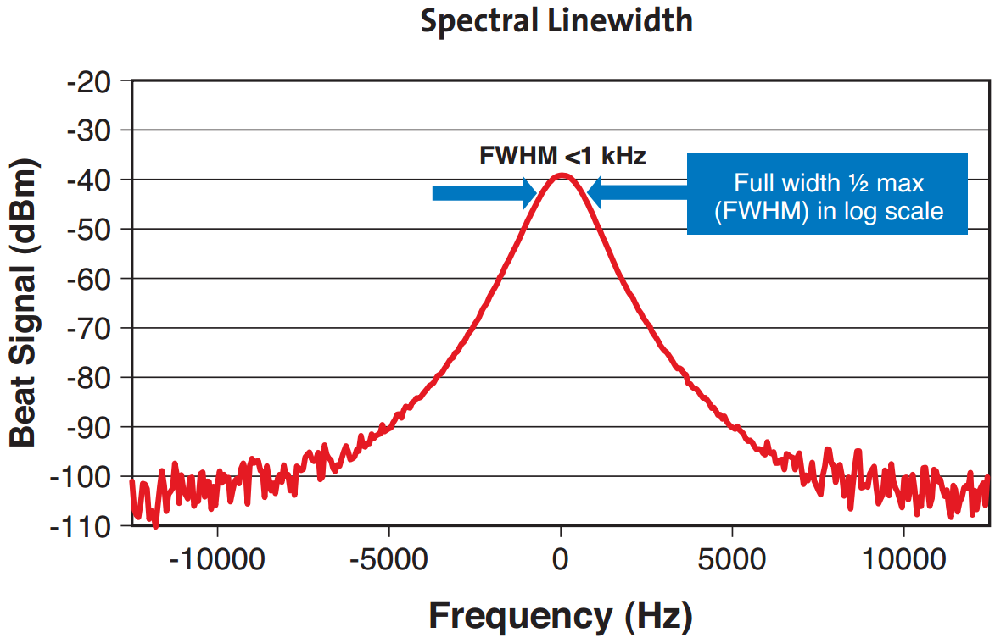
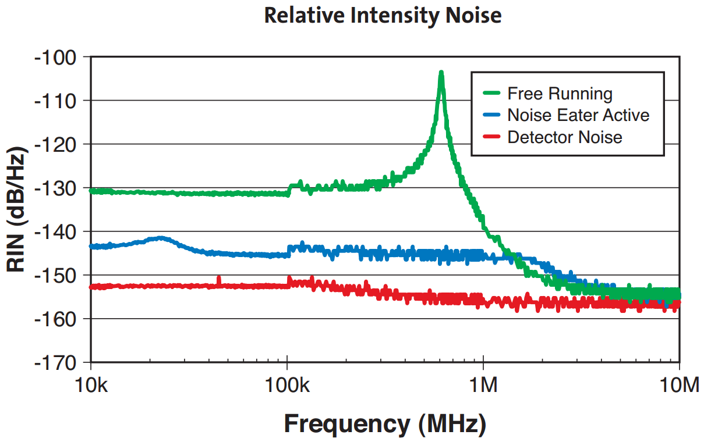
MEPHISTO PRODUCT LINE
Intrinsic 1 kHz linewidth (over 100 ms)
Relative intensity noise <140 dB/Hz

Slide 6
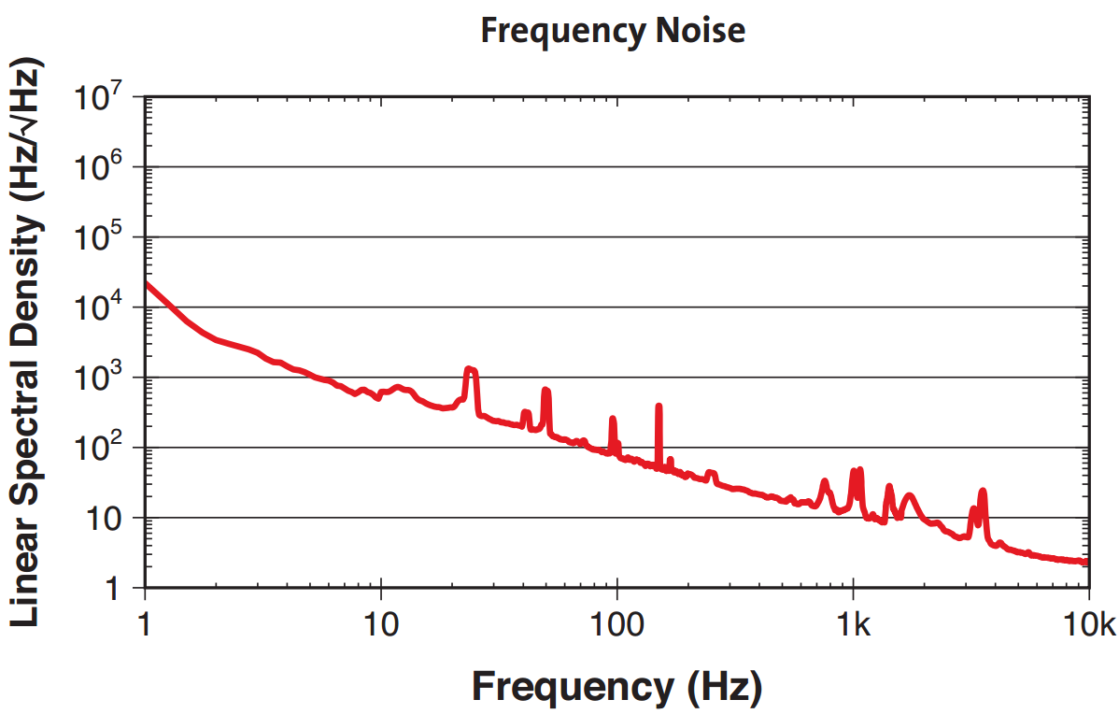
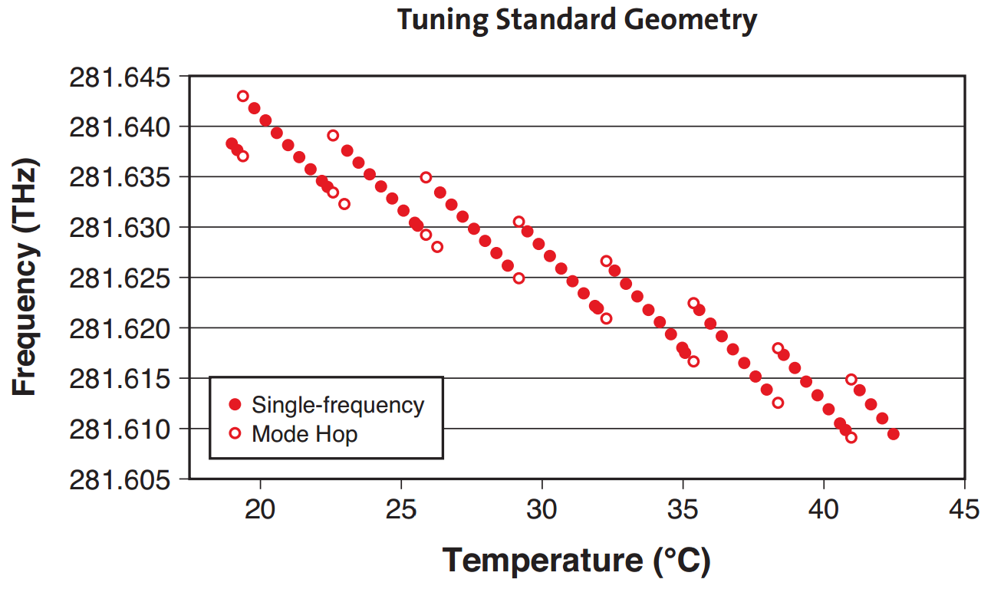
MEPHISTO PRODUCT LINE
Linear spectral density
10⁴*1/f Hz/sqrt(Hz)
Frequency tuning functionality

Slide 7
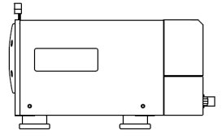
TEMPERATURE AND PZT TUNING
130 MHz (+/- 65 V PZT range)
BNC on head
8 GHz ~ 2.6 K
281.630 THz
Mode hop-free temperature tuning range
281.638 THz
30 GHz ~ 25 K
281.610 THz
Full tuning range with mode hops
281.640 THz
Coherent Confidential. Do Not Copy, Reproduce, or Distribute. | www.coherent.com

Slide 8
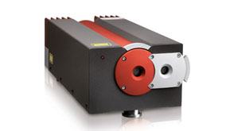
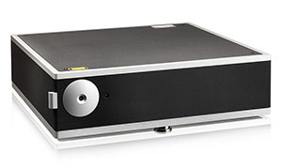

APPLICATIONS
Mephisto:
  Gravitational Waves studies
  Free space optical communications
  Interferometric measurements
  Seeding other sources
Prometheus:
  Laser heterodyning
  Frequency standard
  Interferometric measurments
MOPA:
  Atom trapping
  Quantum optics studies
  Nonlinear optics

Slide 9
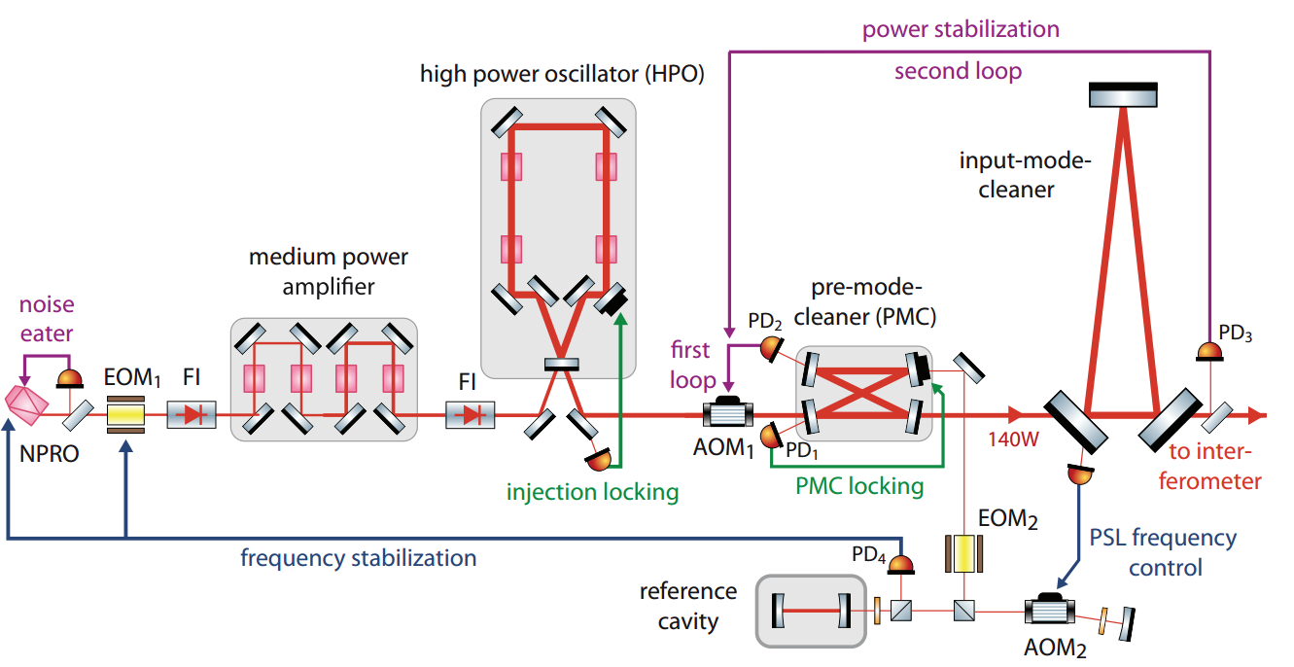
APPLICATIONS
NPRO based lasers remain important part of the Gravitational Waves studies
This includes operational interferometers, lab research, arms stabilization, squeezed light studies, etc.
Kwee P., et al., “Stabilized high-power laser system for the gravitational wave detector advanced LIGO”, Optics Express, pp 10617, Vol. 20, No. 10, 2012

Slide 10
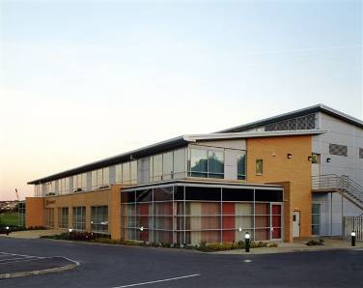
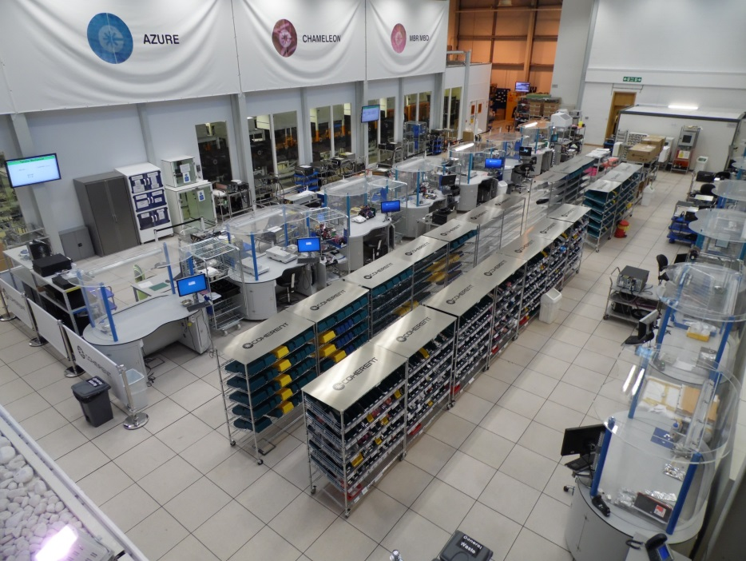
INTEGRATION TO COHERENT
Mephisto production moved from Hannover to Coherent Scotland Ltd in Glasgow in 2015
Coherent Scotland Ltd:
  State-of-the-art facility, ISO (9001, 14001, 18001) certified
  >130 staff, 20 PhD level
  Design (Opto, Elec, Soft, Mech), Manufacturing, Product Management
  Home for a number of industrial and scientific laser

Slide 11
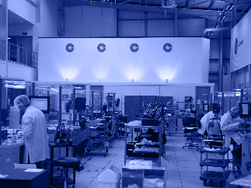

INTEGRATION TO COHERENT
Mephisto now fully integrated in production/sales/service
Excellent on-site technical support
Leverages Coherent vertical integration:
  Full supply ownership of NPRO crystals and pump diodes
1000th Mephisto (all models) unit shipped this year

Slide 12
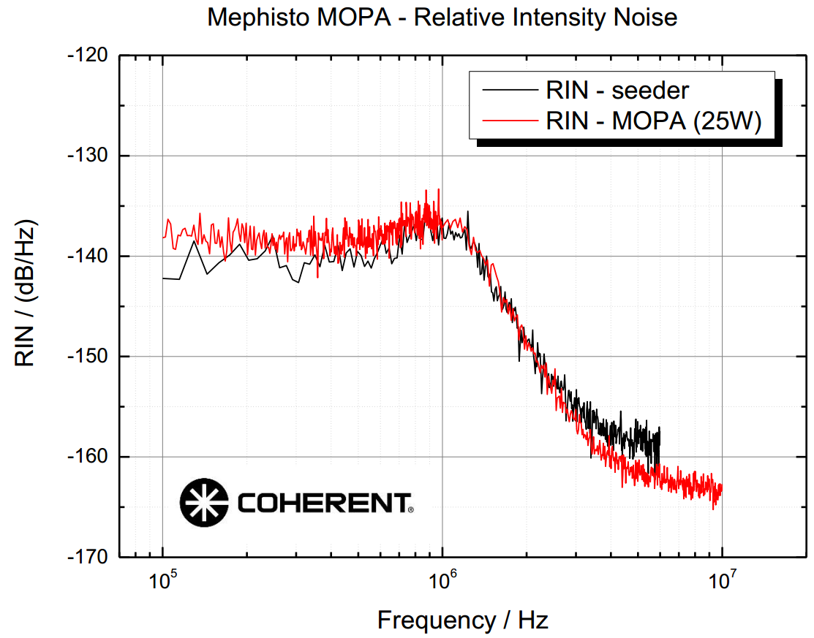
FUTURE OUTLOOK - POWER
Current power scaling is based on solid-state amplification stages
Mephisto-S
FC pump module
YVO_{4 module}
. . .
FC pump module
YVO_{4 module}
Up to 55 watts!

Slide 13
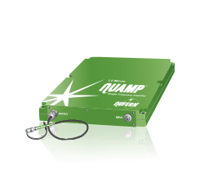

FUTURE OUTLOOK - POWER
Recently fiber technology for power amplification was integrated to Coherent through acquisition of Rofin group (including Nufern)
Nufern amplifiers seeded by Mephisto are used in different applications, especially where multiple high power outputs are required
The technology is currently under review to see if it could add benefits for the roadmap of Mephisto product line

Slide 14
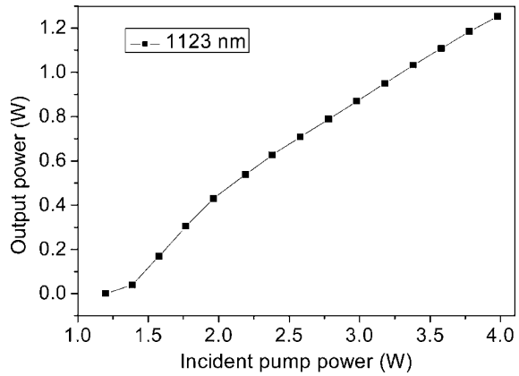
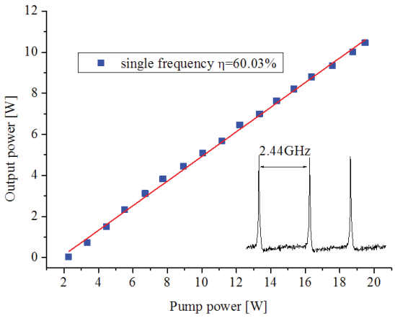
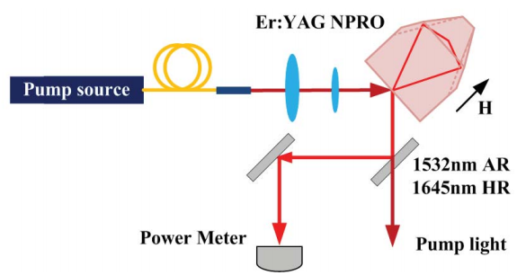
FUTURE OUTLOOK - WAVELENGTH
E. Zang et al., "Single-frequency 1.25 W monolithic lasers at 1123 nm," Opt. Lett. 32, 250-252 (2007)
E. Wang, et al., „A Resonantly Pumped 1645 nm Er:YAG Nonplanar Ring Oscillator With 10.5 W Single Frequency Output“, IEEE Phot. Tech. Letters 25, pp. 955-957 (2013)

Slide 15
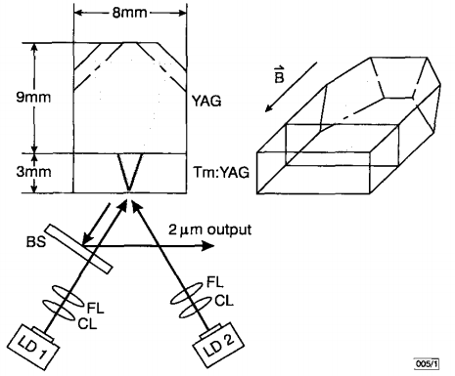
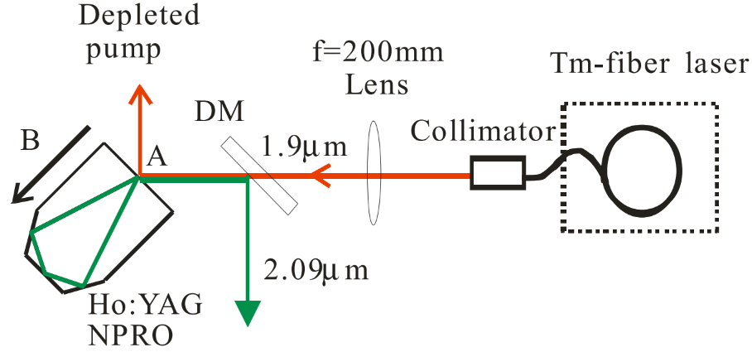
FUTURE OUTLOOK - WAVELENGTH
C. Svelto, I. Freitag, „Room temperature Tm:YAG ring laser with 150mW single-frequency output power at 2.02μm“, Electr. Letters 25, 152 (1999)
B. Yao et al., "7.3 W of single-frequency output power at 2.09 μm from an Ho:YAG monolithic nonplanar ring laser," Opt. Lett. 33, 2161-2163 (2008)

Slide 16
FUTURE OUTLOOK - WAVELENGTH
Wavelength | Crystal | Pump λ | Power | Reference
532 nm | Nd:YAG SHG | 808 nm | 0.1 W | www.coherent.com
1064 nm | Nd:YAG | 808 nm | 2 W (55 W in MOPA) | www.coherent.com
1123 nm | Nd:YAG | 808 nm | 1.25 W | E. Zang, et al., "Single-frequency 1.25 W monolithic lasers at 1123 nm," Opt. Lett. 32, 250-252 (2007)
1319 nm | Nd:YAG | 808 nm | 0.8 W | www.coherent.com
1444 nm | Nd:YAG | 808 nm | 0.5 W | M. Bode, I. Freitag, „Monolithic Nd:YAG ring laser with 0.5 W single-frequency output power at 1.444μm”, CThL4, CLEO Europe (2000)
1645 nm | Er:YAG | 1532 nm | 10.5 W | E. Wang, et al., „A Resonantly Pumped 1645 nm Er:YAG Nonplanar Ring Oscillator With 10.5 W Single Frequency Output“, IEEE Phot. Tech. Letters 25, pp. 955-957 (2013)
2020 nm | Tm:YAG | 784 nm | 0.15 W | C. Svelto, I. Freitag, „Room temperature Tm:YAG ring laser with 150mW single-frequency output power at 2.02μm“, Electr. Letters 25, 152 (1999)
2090 nm | Ho:YAG | 1910 nm | 7.3 W | B. Yao et al., "7.3 W of single-frequency output power at 2.09 μm from an Ho:YAG monolithic nonplanar ring laser," Opt. Lett. 33, 2161-2163 (2008)

Slide 17
SUMMARY
Gravitational Waves research remains one of the keystone applications for NPRO based products due to their stability and functionality
Mephisto product was successfully integrated into Coherent’s scientific lasers portfolio
Extending the functionality of NPRO to different wavelengths up to 2.1 μm was demonstrated in research publications
Coherent is open for discussions about future directions for NPRO based laser products

