Slide 1
XGM – progress week 7 / 2017
Dr. Jan Grünert
X-ray Photon Diagnostics
Group Leader
Hamburg, February 17th, 2017
Contains information from WP74 team
and from K.Tiedtke / F.Jastrow from DESY-FS-FL-D

Slide 2
XGM - Progress (w7)
Repair of XGM@XTD2 (exchange by DESY of resistors in both XGMD-chambers): DONE
Pump-down after repair: 4E-6mbar (Thursday 18h)
Leak check: OK
Started tests of serial communication from DOOCS to Keithleys/SRG/RVC300/HV-crate:
RVC300@XTD2 done
Friday 17-FEB-2017 (now…): XGM@XTD2: local Beckhoff test, including Gas-Supply

Slide 3
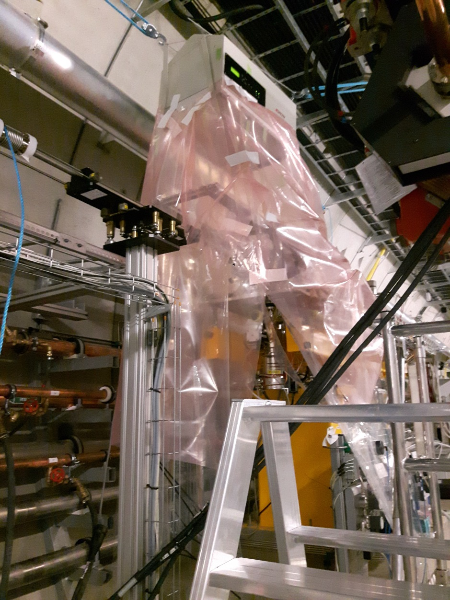
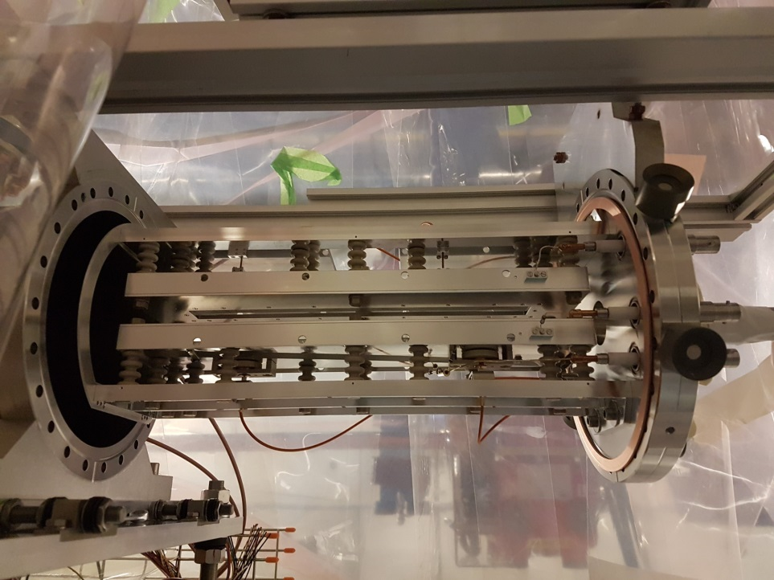
Repair of XGM @ XTD2
Removal of electrodes
Difficult situation at XTD2 on elevated platform

Slide 4
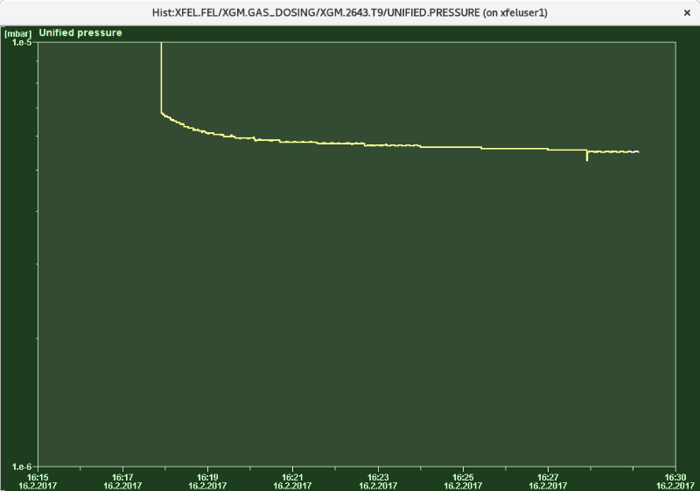
Tests of DOOCS serial control of XGM subcomponents
RVC300 / pressure reading:

Slide 5
XGM - Plan week 8
Planning of Repair XGM@XTD9
XGM@XTD2: finish (?) local Beckhoff test, including Gas-Supply
XGM@XTD9: wiring of vacuum-to-Beckhoff, installation of wiring terminals (2x) on girder, cables from girder terminals to rack
Continue tests of serial communication from DOOCS to Keithleys/SRG/RVC300/HV-crate
Trigger cabling (rack-to-devices) in XTD2+XTD9 (~2-3 days)
Survey&Alignment: 22.2.2017 at XTD2, 23.2.2017 at HERA-S
Grounding : check actual ground connections XTD2+9+10 (24.2.)

Slide 6
WP74 – other devices SASE1– w7
SR-Imager @ XTD2: adjusted (and can now be adjusted in Y, needed additional comp. springs)
MCP @ XTD10: now installed again at final position
Filter chamber @ XTD2
EPS switches rebuilt to NO (also an all other FILT)
Motor and switch tested: moving entire range in < 30sec

