Slide 1

Progress and next steps
23 February 2017 this version is the minutes of the meeting
J. J. John on behalf of the team

Slide 2
Agenda
Discuss progress and steps for next week:
  ABCN’ emulator
  firmware - SACI
  readout software
  CHESS-2-to-FMC adaptor board
  CHESS-2 digital hardware
  CHESS-2 mini-module
  ABC130*/HCC* news
  TWiki page for CHESS and its test hardware: https://twiki.cern.ch/twiki/bin/view/Atlas/CHESSStripTestChip

Slide 3
ABCN’ firmware status
  Atlys firmware / CHESS-2 analogue test status:
  Firmware: still using va113, all well.
  Analogue system testing:
    Kestutis is mapping out the 512-pixel test array’s sensitivity variations.

Slide 4
ABCN’ firmware status, continued
  Nexys Video firmware and software status:
  Robin away at the moment.
  Wojtek wiring up the SPI at the moment.

Slide 5
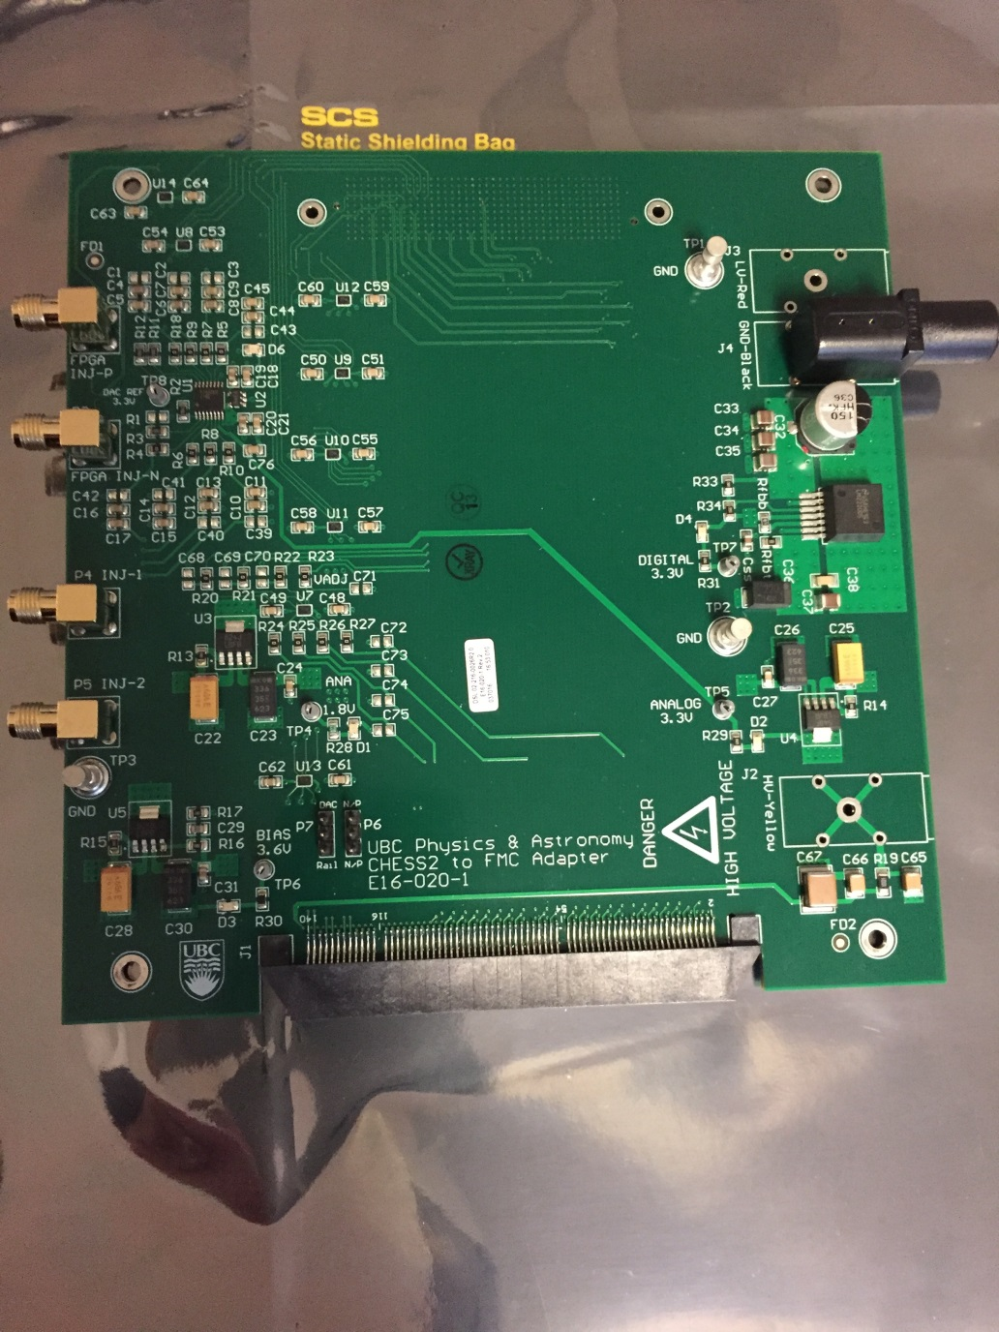
CHESS-2-to-FMC adaptor board status
  Current status:
  No update this week.

Slide 6
CHESS-2 digital hardware
  Current status:
  No update this week.
ABC* / HCC*
  Current status:
  Laura Gonella (Birmingham) presented a talk on the ABC* and HCC* at the Trento workshop this week which is a very useful summary of the current state of the designs: link

