Slide 1

Progress and next steps
2 March 2017 this version is the minutes of the meeting
J. J. John on behalf of the team

Slide 2
Agenda
Discuss progress and steps for next week:
  ABCN’ emulator
  firmware - SACI
  readout software
  CHESS-2-to-FMC adaptor board
  CHESS-2 digital hardware
  CHESS-2 mini-module
  ABC130*/HCC* news
  TWiki page for CHESS and its test hardware: https://twiki.cern.ch/twiki/bin/view/Atlas/CHESSStripTestChip

Slide 3
ABCN’ firmware status
  Atlys firmware / CHESS-2 analogue test status:
  Firmware: still using va113, all well.
  Analogue system testing:
    Kestutis has mapped out the 512-pixel test array’s sensitivity variations.

Slide 4
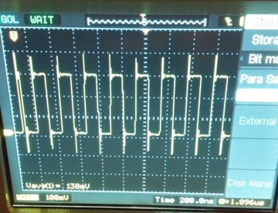
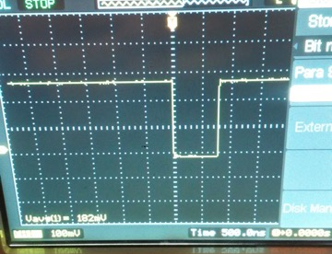
ABCN’ firmware status, continued
  Nexys Video firmware and software status:
  Now able to send SACI commands, probed on hardware:

Slide 5
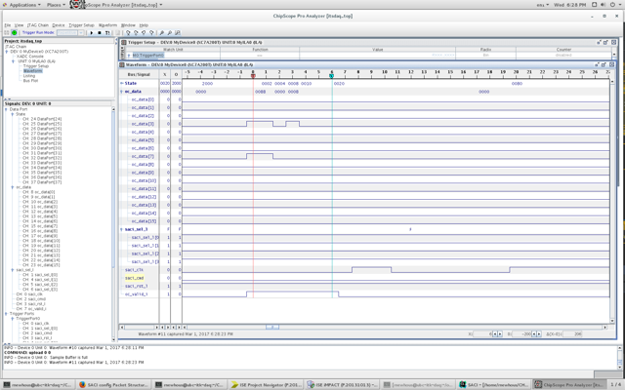
ABCN’ firmware status, continued
  Nexys Video firmware and software status, continued:
  ChipScope screenshot 1:

Slide 6
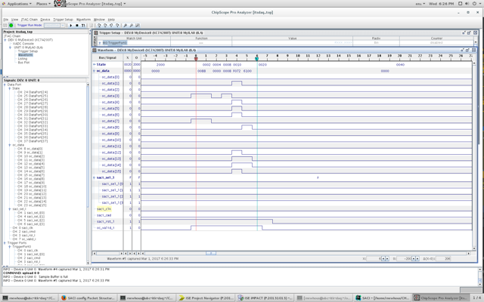
ABCN’ firmware status, continued
  Nexys Video firmware and software status, continued:
  ChipScope screenshot 2:

Slide 7
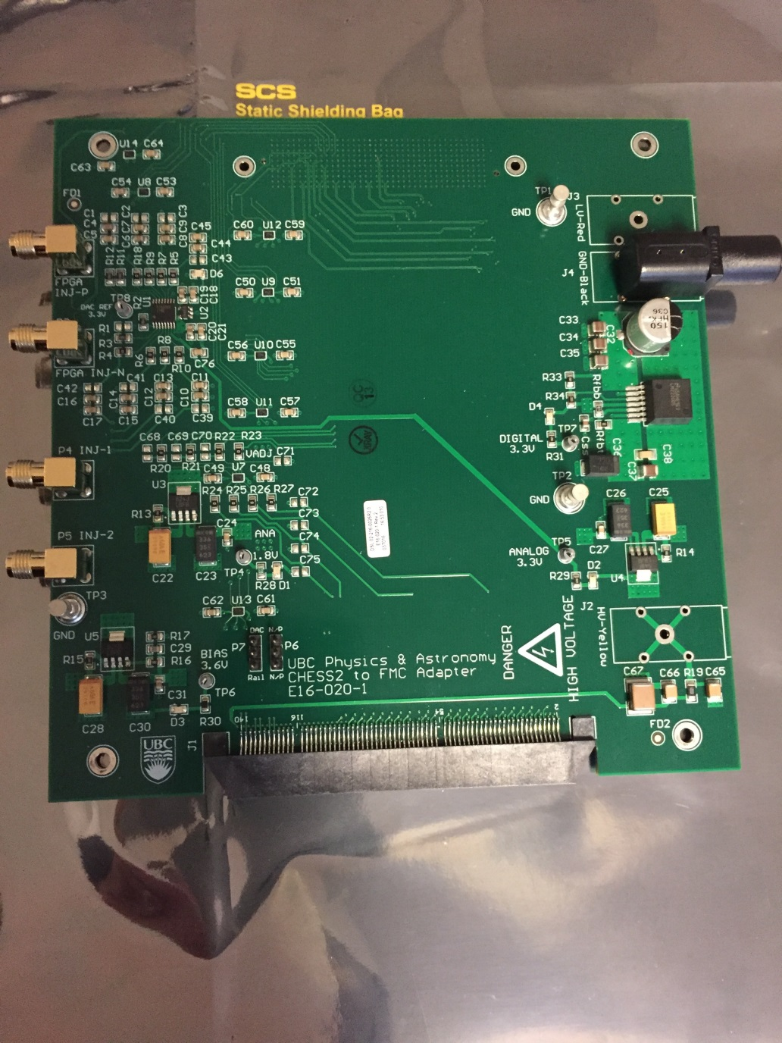
CHESS-2-to-FMC adaptor board status
  Current status:
  .

Slide 8
CHESS-2 digital hardware
  Update from Tuesday’s Strip CMOS meeting from Su Dong:
  Carrier boards:
  Carrier board production completed. Arrived at SLAC on 27 Feb, now testing and preparing the boards.
  Su Dong is currently collecting people’s shipping addresses for the carrier boards.
  Shipping to CERN to collect at ATLAS upgrade week is one possibility, or directly shipping if they are needed sooner.
Daughterboards:
  The digital daughterboard’s revised layout is nearly complete. It should ease the wire-bonding.
  Su Dong will e-mail the group when the files are ready, to review the layout and provide feedback.

