Slide 1

Progress and next steps
2 March 2017 this version is the minutes of the meeting
J. J. John on behalf of the team

Slide 2
Agenda
Discuss progress and steps for next week:
  ABCN’ emulator
  firmware - SACI
  readout software
  CHESS-2-to-FMC adaptor board
  CHESS-2 digital hardware
  CHESS-2 mini-module
  ABC130*/HCC* news
  TWiki page for CHESS and its test hardware: https://twiki.cern.ch/twiki/bin/view/Atlas/CHESSStripTestChip

Slide 3
ABCN’ firmware status
  Atlys firmware / CHESS-2 analogue test status:
  Firmware: still using va113, all well.
  Analogue system testing:
    Kestutis has mapped out the 512-pixel test array’s sensitivity variations.

Slide 4
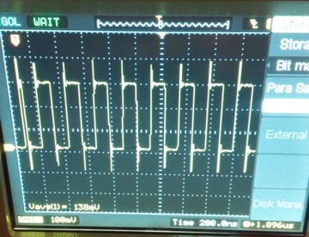
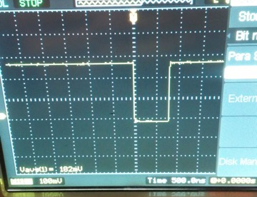
ABCN’ firmware status, continued
  Nexys Video firmware and software status:
  Resolved issues of cores not being generated. The Technology Schematics were useful.
  Now sending SACI commands, probed after FMC connector:
40MHz clock
SACI reset
  Now verifying that SACI commands are sent and interpreted correctly using the configuration software.
  SPI has been implemented in the DIO block.
  After SACI verified, will integrate SPI and try programming the DAC on the adaptor.

Slide 5
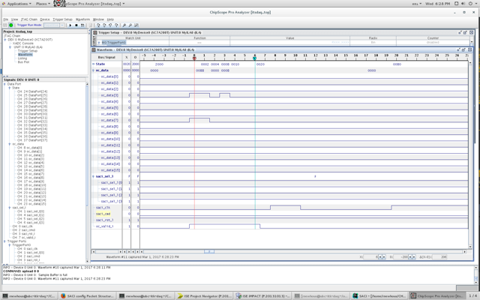
ABCN’ firmware status, continued
  Nexys Video firmware and software status, continued:
  ChipScope screenshot 1, within ocb_saci core:

Slide 6
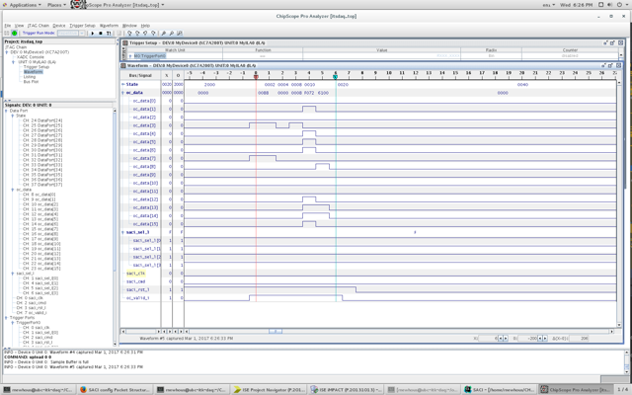
ABCN’ firmware status, continued
  Nexys Video firmware and software status, continued:
  ChipScope screenshot 2, within ocb_saci core, showing parallel SACI data:

Slide 7
CHESS-2 digital hardware
  Update from Tuesday’s Strip CMOS meeting from Su Dong:
  Carrier boards:
  Carrier board production completed. Arrived at SLAC on 27 Feb, now testing and preparing the boards.
  Su Dong is currently collecting people’s shipping addresses for the carrier boards.
  Shipping to CERN to collect at ATLAS upgrade week is one possibility, or directly shipping if they are needed sooner.
Daughterboards:
  The digital daughterboard’s revised layout is nearly complete. It should ease the wire-bonding.
  Su Dong will e-mail the group when the files are ready, to review the layout and provide feedback.
  Wojtek will e-mail Su Dong to say it would be useful to soon have a first-generation daughterboard for working with the adaptor board.

