Slide 1

Progress and next steps
6 April 2017 this version is the minutes of the meeting
J. J. John on behalf of the team

Slide 2
Agenda
Discuss progress and steps for next week:
  ABCN’ emulator
  firmware - SACI
  readout software
  CHESS-2-to-FMC adaptor board
  CHESS-2 digital hardware
  CHESS-2 mini-module
  ABCStar/HCCStar news
  Next meeting – 6 April (skip 30 March)
  TWiki page for CHESS and its test hardware: https://twiki.cern.ch/twiki/bin/view/Atlas/CHESSStripTestChip

Slide 3
ABCN’ firmware status
  Atlys firmware / CHESS-2 analogue test status:
  Ljubljana now working with set-up. Queen Mary (London) briefed. RAL and possibly IHEP Beijing starting soon.
  Had discussion of test issues: working with Hervé and others on these:
    insensitive front end
    excessive HV current draw seen on digital daughterboards
  Nexys Video firmware and software status:
  ..

Slide 4
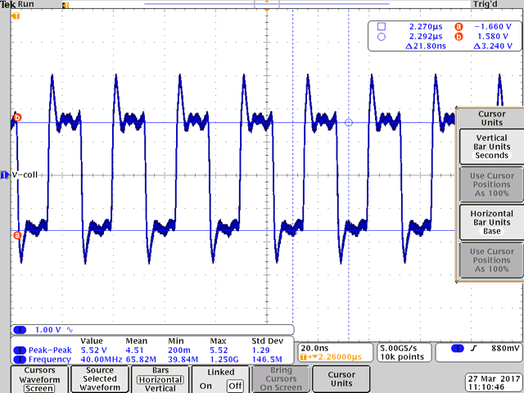
CHESS-2-to-FMC adaptor board
Scope shots from Robin:

Slide 5
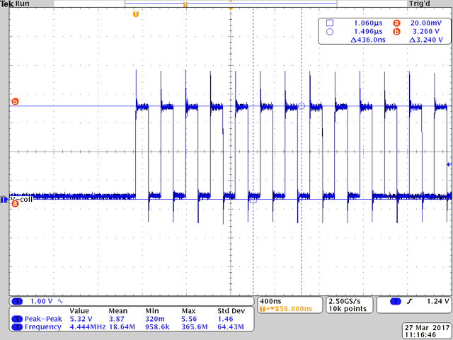
CHESS-2-to-FMC adaptor board
Scope shots from Robin:

Slide 6
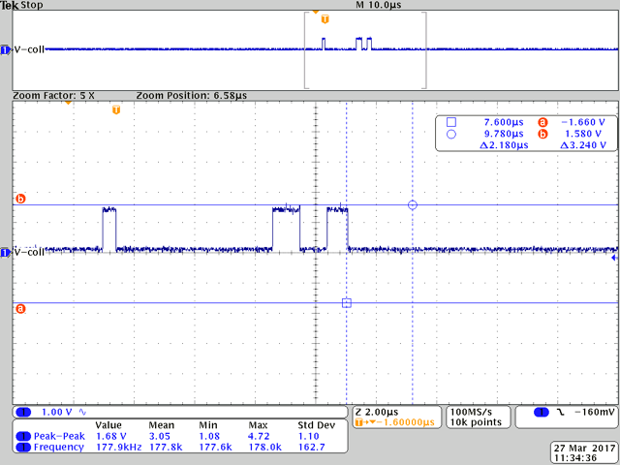
CHESS-2-to-FMC adaptor board
Scope shots from Robin:

Slide 7
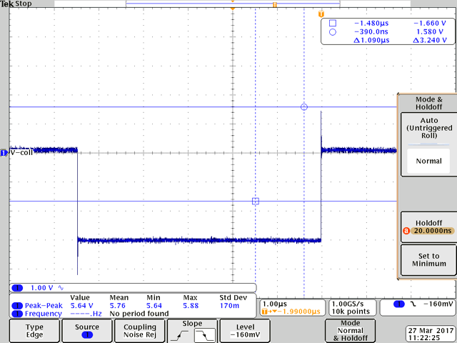
CHESS-2-to-FMC adaptor board
Scope shots from Robin:

Slide 8
CHESS-2 digital hardware
  UBC carrier board?
ABCStar/HCCStar news
  Specs reviewed at ATLAS upgrade week, Tue 28 March, 4-6pm CERN time.
  The ABCStar specification is fairly settled now.

