Slide 1
Progress on Imagers in SASE1
Andreas Koch
WP74
24.2.2017

Slide 2
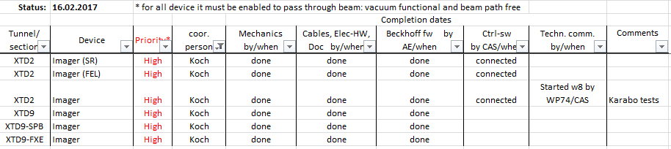
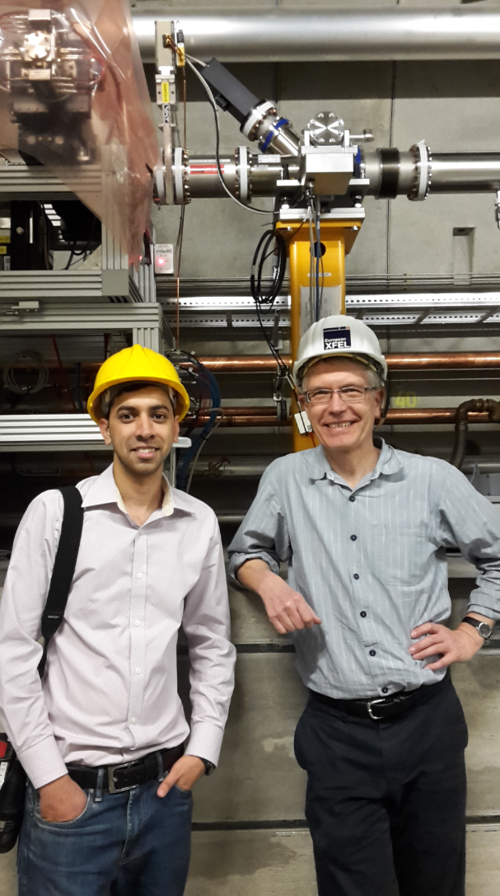
Status installation of Imagers SASE1
This week:
First Karabo test of IMGPII45 in XTD2 !
Installation of cabling of timing signal, finished.
FAT approved of 2x Exit Slit imagers for XTD10, manufactured by IRELEC.
Next week:
Karabo tests XTD2.

