Slide 1
CHESS2 w/300nm Al Backside Deposition:
Diode Leakage Measurements
J. Hasi and J. Segal
February 28, 2017

Slide 2
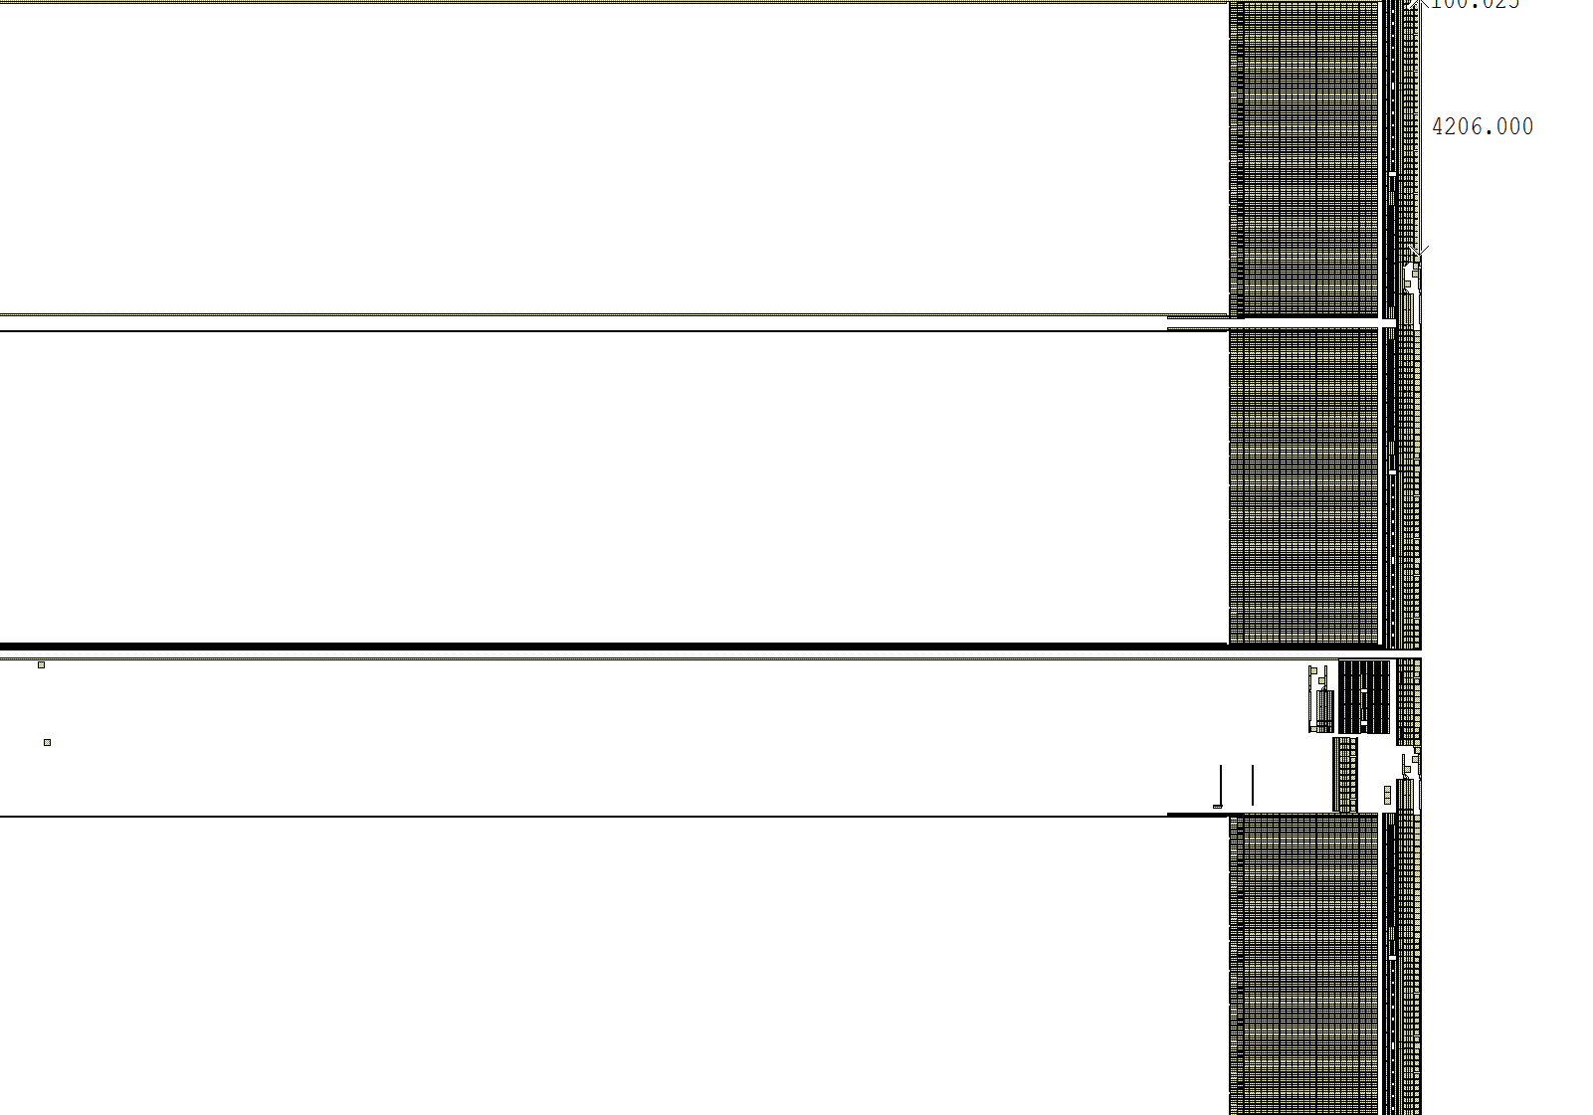
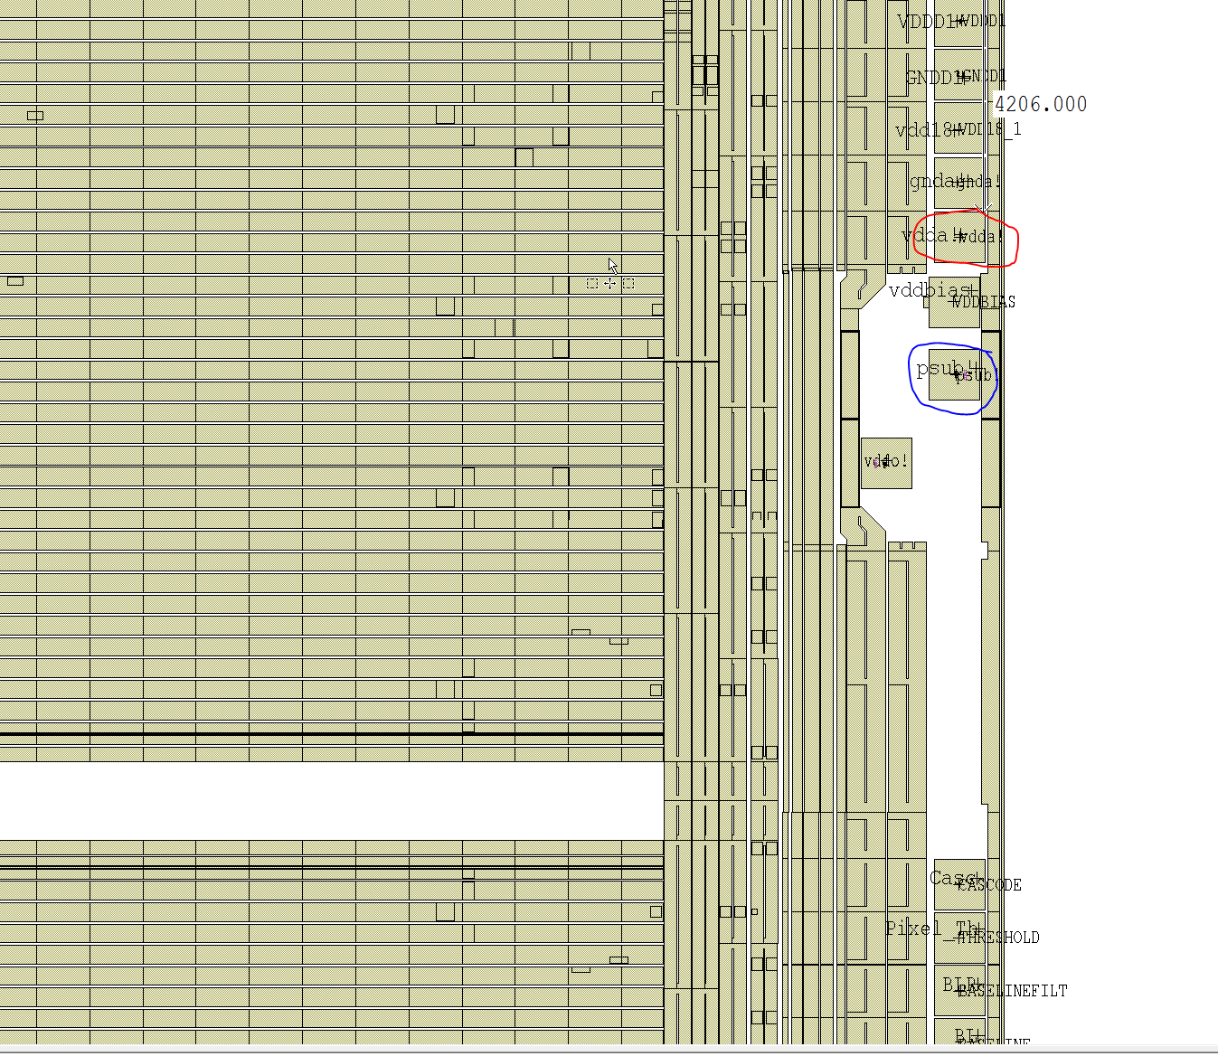
Diode measurement
Measure VDDA to PSUB pad
Or VDDA to metal backside

Slide 3
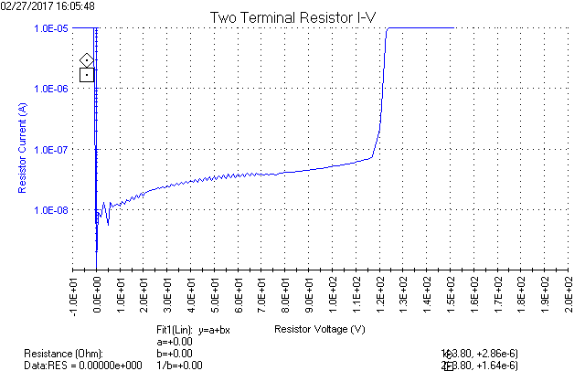
20ohm-cm and 50ohm-cm chips
Sweep VDDA to PSUB pad or to metal backside: Diode breakdown 120-130V

Slide 4
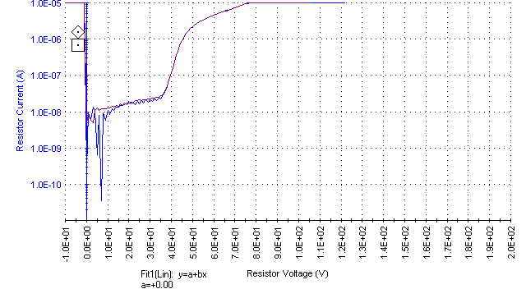
200ohm-cm chip
Sweep VDDA to metal backside, soft breakdown 35V

Slide 5
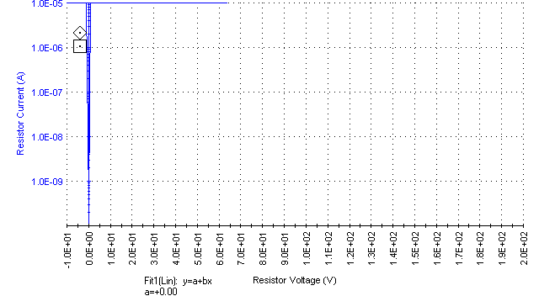
2000+ ohm-cm chip
Sweep VDDA to PSUB pad or to backside, same result: Short
Action: We will test the chips without metal to see if the short was caused by the metal deposition

