Slide 1
CHESS2 Digital Testing
K. Kanisauskas, T. Huffman, J.J John, R. Plackett
ATLAS Strip CMOS Regular Meeting
February 28, 2017

Slide 2
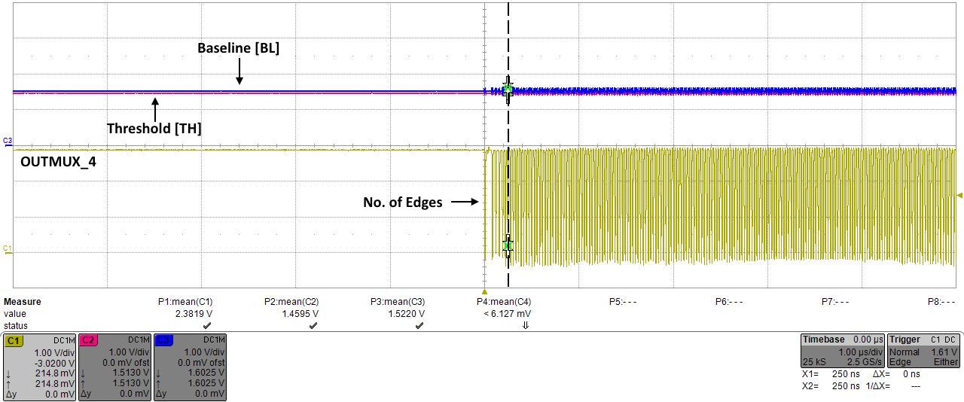
CHESS2 Threshold Scans (1)
A LabView program was made to automate threshold scans for the test array
Threshold scans were done in the range from 1400mV to 1700mV in steps of 5mV, while BL was set to 1600mV (default value)
A number of transitions were recorded at each threshold step
Threshold voltage in this case was regarded as TH value at which max number of transitions occur (within 25us time frame)

Slide 3
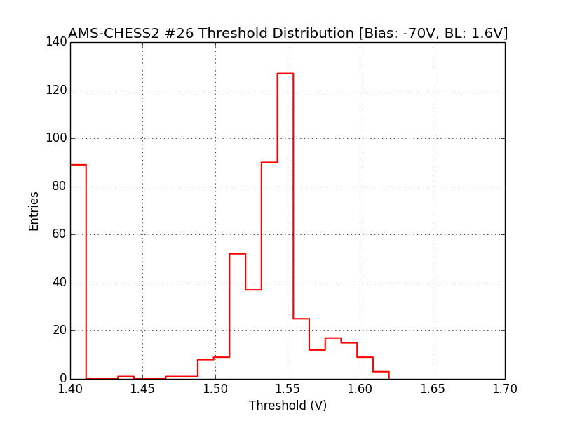
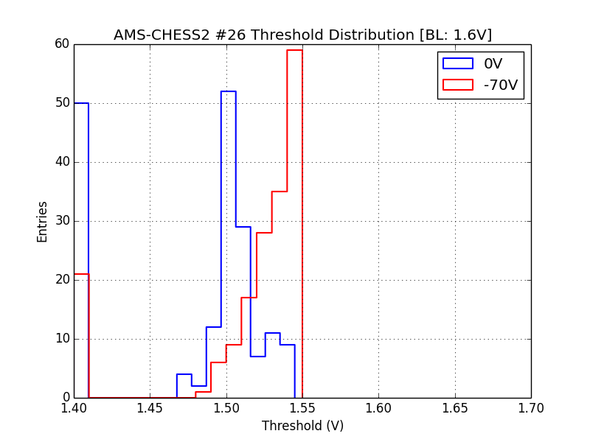
CHESS2 Threshold Scans (2)
512 pixels
11 columns (176 pixels)
DAQ time corresponds to ≈3min per pixel (≈26h for the entire test array)
The results suggest threshold distribution variation with bias voltage
The pixels on the left hand side of the distributions are either off or the transitions occur at very low threshold voltages

