Slide 1
Status Update &
Planning of Migration
AB meeting - 2nd May 2017
Session 1

Slide 2
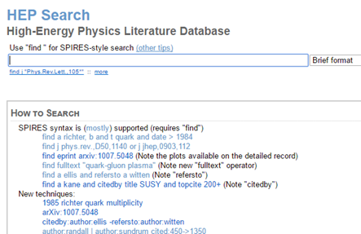
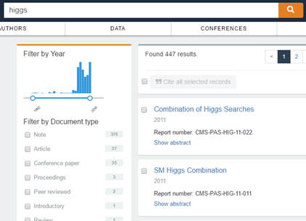
Status Update
From INSPIRE Legacy to INSPIRE Labs

Slide 3
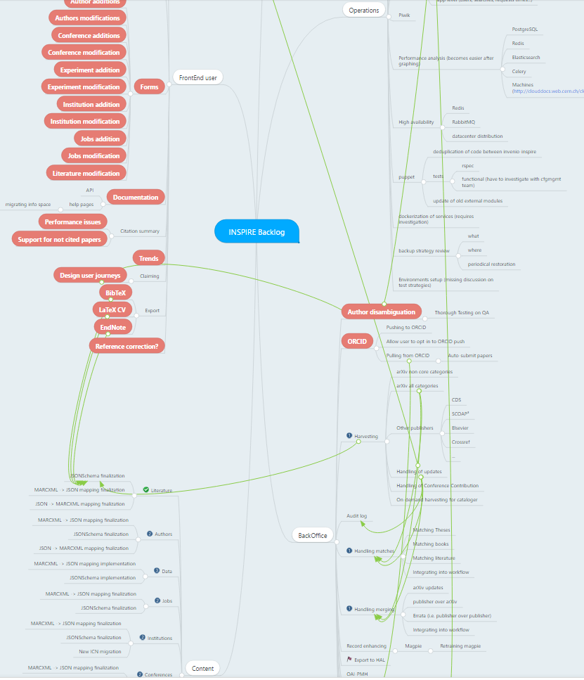

Slide 4
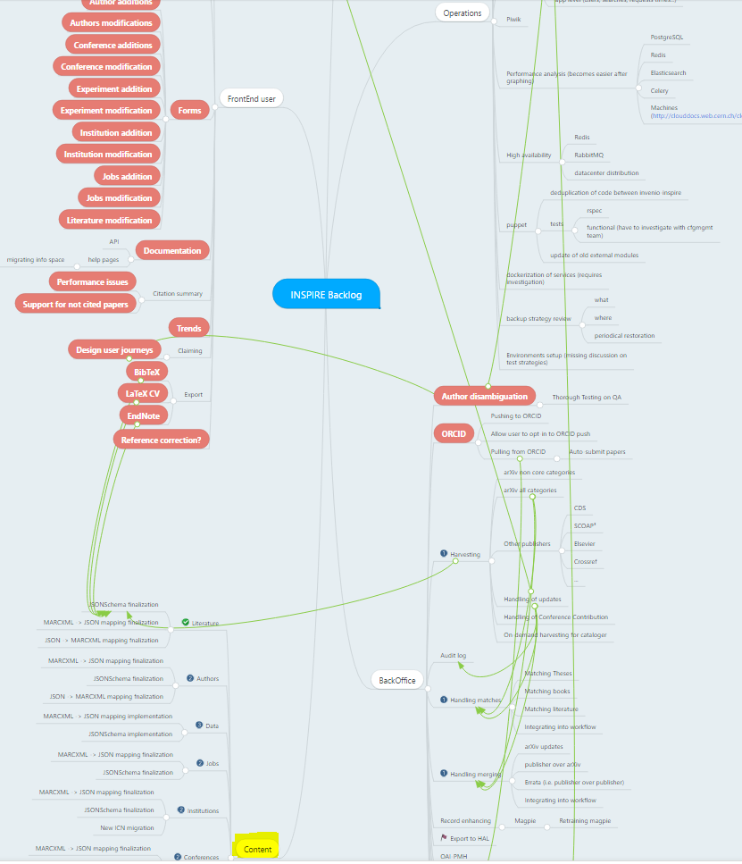

Slide 5
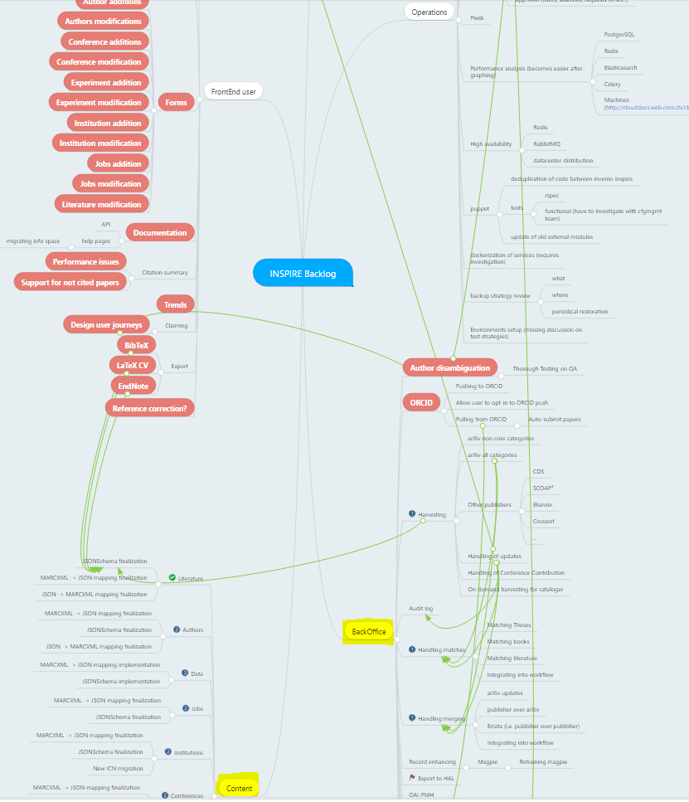

Slide 6
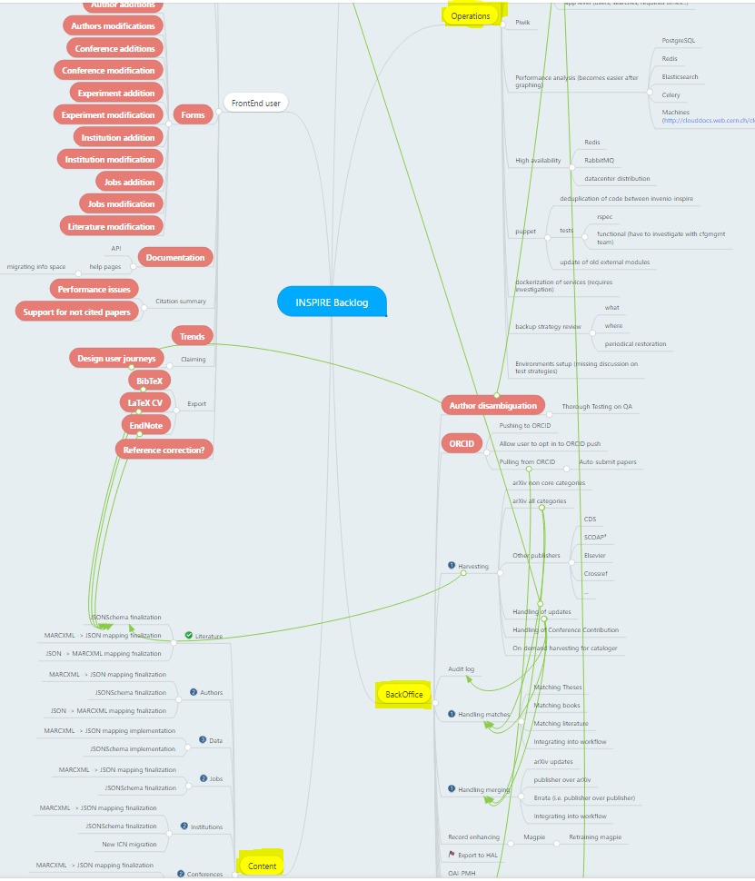

Slide 7
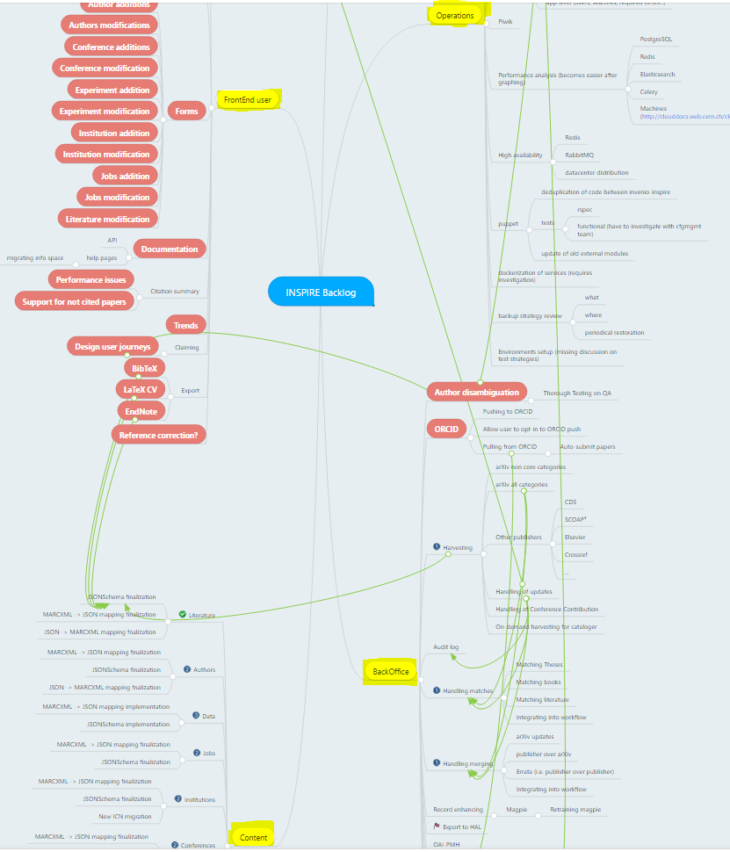

Slide 8
Priority: Curators
Reinforce collaboration
Experience from transition from SPIRES
Service stability
Lessons learnt from release
Users
Curators
Notes:
you explain clearly the spires->inspire problem that back-office tools were underestimated and we were still completing them 4-5 years after the launch
3) that we prize stability and the time/work of those who curate (and even the new partners coming in) and we clean back the house first, then invite people in
The message here is that there's no launch of user-facing urgency, as in the previous case, so we have this time.

Slide 9
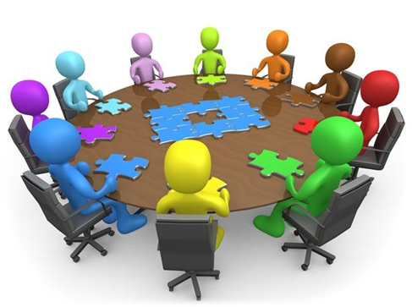
Decision making process
Content standups
Coordination meetings
Policy technical meetings
Technical standups

Slide 10
INSPIRE Labs Roadmap
January 2017 - March 2018
Test
Back Office
Test
Beta Search
Q1 ‘17
Q2 ‘17
Q3 ‘17
Q4 ‘17
Q1 ‘18
Jan-Feb-Mar 2017
Apr-May-June 2017
Jul-Aug-Sep 2017
Oct-Nov-Dec 2017
Jan-Feb-Mar 2018
Establish infrastructure
Launch Back Office
Turn off Legacy

Slide 11
Q1 ’17 Establish Infrastructure

Slide 12
Sensible data model design

Slide 13
Legacy data model: MARC standard
Library of congress standard: meant for traditional libraries
Librarian-friendly, not human-friendly (e.g. first author → “100”)
Poorly adapted to HEP community practices
Merely a convention: no validation
Valid data in nonexistent fields
Invalid data in existing fields
Many relations between records computed at display-time → Inconsistencies

Slide 14
Examples
First author → “100”, other authors → “700”
3 different fields for arXiv preprint info!
035__ $$9arXiv$$aoai:arXiv.org:1704.06539 037__ $$9arXiv$$aarXiv:1704.06539$$cgr-qc 65017 $$2arXiv$$agr-qc 65017 $$2arXiv$$ahep-th
/record/1593916

Slide 15
New data model: custom JSON-schema
Abandon MARC standard
Implement custom data model
Human-friendly
Contents of fields are strictly defined → Better metadata for users → Used more reliably by algorithms
Explicit links between records: better claims, citation counts, ...
https://www.github.com/inspirehep/inspire-schemas

Slide 16
Examples
All authors → “authors”
arxiv_eprints: - value: 1704.06539 categories: - gr-gc - hep-th
/record/1593916

Slide 17
Validation
Valid date
Invalid date

Slide 18
Lots of work for converting & cleaning!

Slide 19
Basic backend tools
Move labs from old Invenio 2 to Invenio 3 infrastructure
User submission forms (literature, authors)
arXiv harvesting (using HEPCrawl)
Machine learning (core-guesser, keyword-guesser, experiment-guesser)
Holding pen interface for curators

Slide 20
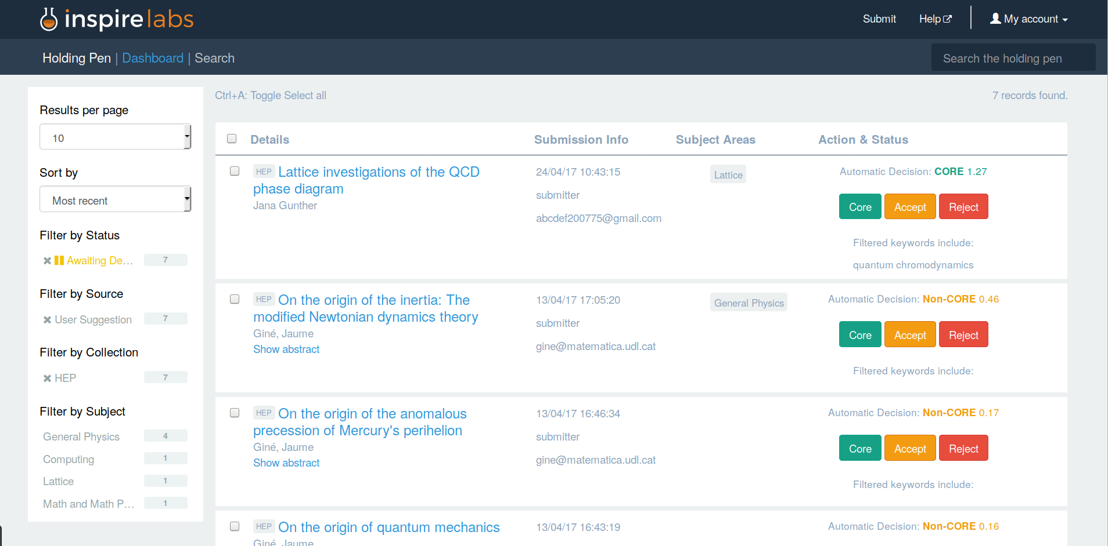
Holding pen

Slide 21
INSPIRE Labs Roadmap
January 2017 - March 2018
Test Back Office
Deliverables
√ Beta Record Editor
Activities
Investigating curator tools
Q1 ‘17
Q2 ‘17
Q3 ‘17
Jan-Feb-Mar 2017
Apr-May-June 2017
Jul-Aug-Sep 2017
Establish infrastructure
Launch Back Office
Deliverables
√ Invenio 3 deployment
√ Holding pen
Deliverables
Launch Record Editor
Activities
√ Harvesting arXiv
Activities
Define user needs for Front End

Slide 22
Q2-Q3 ’17 Finish & Launch Back Office

Slide 23
Data ingestion & enhancement
New submission forms:
books & book chapters
literature updates
Activate other HEPCrawl sources (publishers, repositories)
Better affiliation guessing
Better reference extraction
DESY workflow integration

Slide 24
Several versions:
Matching & merging

Slide 25
Matching
One record from several sources (arXiv, publisher, …)
Matching problem: deciding whether incoming record is the same as existing record
Design: based on lessons from legacy
Needs fine-tuning for robust matches
Benchmark: existing corpus of matched records on legacy
Bonus: also used to match references to cited paper (easy with new data model)

Slide 26
Merging
Two matching records need to be merged
Also: records may have been manually curated
Merging problem: apply update selectively (publisher wins), without losing human work if still relevant
JSON merger: generic tool, need to define merge strategies for every field and all cases (arXiv v2, publisher after arXiv, …)

Slide 27
Record editor
Schema-based
only allows existing fields
validates content
Autocompletes fields → data is valid, saves work
Need to refine UI for efficient curator work
Interface for approval of merging conflicts

Slide 28
INSPIRE Labs Roadmap
January 2017 - March 2018
Test Back Office
Test Beta Search
Deliverables
√ Beta Record Editor
Deliverables
Public beta Search
Author profile prototype
Activities
Investigating curator tools
Activities
Interviewing users
Q1 ‘17
Q2 ‘17
Q3 ‘17
Q4 ‘17
Q1 ‘18
Jan-Feb-Mar 2017
Apr-May-June 2017
Jul-Aug-Sep 2017
Oct-Nov-Dec 2017
Jan-Feb-Mar 2018
Establish infrastructure
Launch Back Office
Turn off Legacy
Deliverables
√ Invenio 3 deployment
√ Holding pen
Deliverables
Launch Record Editor
Deliverables
Launch Search
Launch Authors
Activities
√ Harvesting arXiv
Activities
Define user needs for Front End

Slide 29
Q4 ‘17-Q1 ‘18 Launch Search & Authors

Slide 30
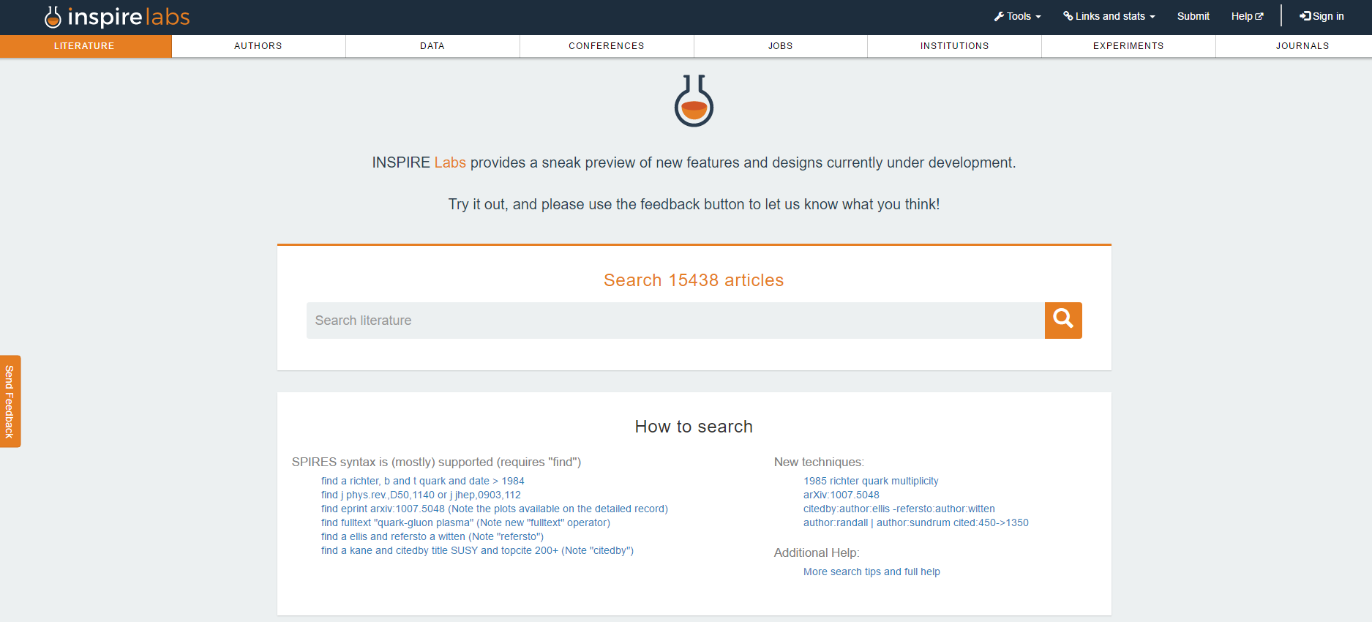

Slide 32
