Slide 1
Typical Responses to Change
The Navigator
who embraces
The Critic
who opposes
The Victim
who panics
The Bystander
who ignores

Slide 2
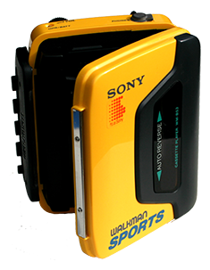
User Feedback - Best Practice
Surveys
Focus Groups
User Testing
Notes:
Surveys: quick feedback but missing contextual information
Focus group: quick decision but might not represent real needs.
legend

Slide 3
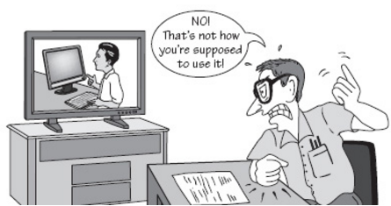
User Testing
Focus on tasks (not assumptions)
Analytics (piwik)

Slide 4
User Testing Strategy



Phase 1
Phase 2
Phase 3
Test Internally
Test with invitation
Test with everyone
All INSPIRE curators, developers and
AB members
3 users per user group
with IHEP/Fermilab/SLAC
Publically available
in Beta

Slide 5
Points to consider + discuss
phasing - when to go to initial public beta release - how many beta releases? - how long is each beta period? - feature set for each release - criteria for release to prod
communication - how to communicate release availability - how/where/when to promote the new interface? - gauging how much traffic to drive to the site at any time
preparing for important discontinuities - citation counting - search behavior - citation display - author profiles - changes to other (non-user) interfaces with the world

