Slide 1
HAL-INSPIRE cooperation
Annette Holtkamp
INSPIRE AB meeting
May 2, 2017

Slide 2
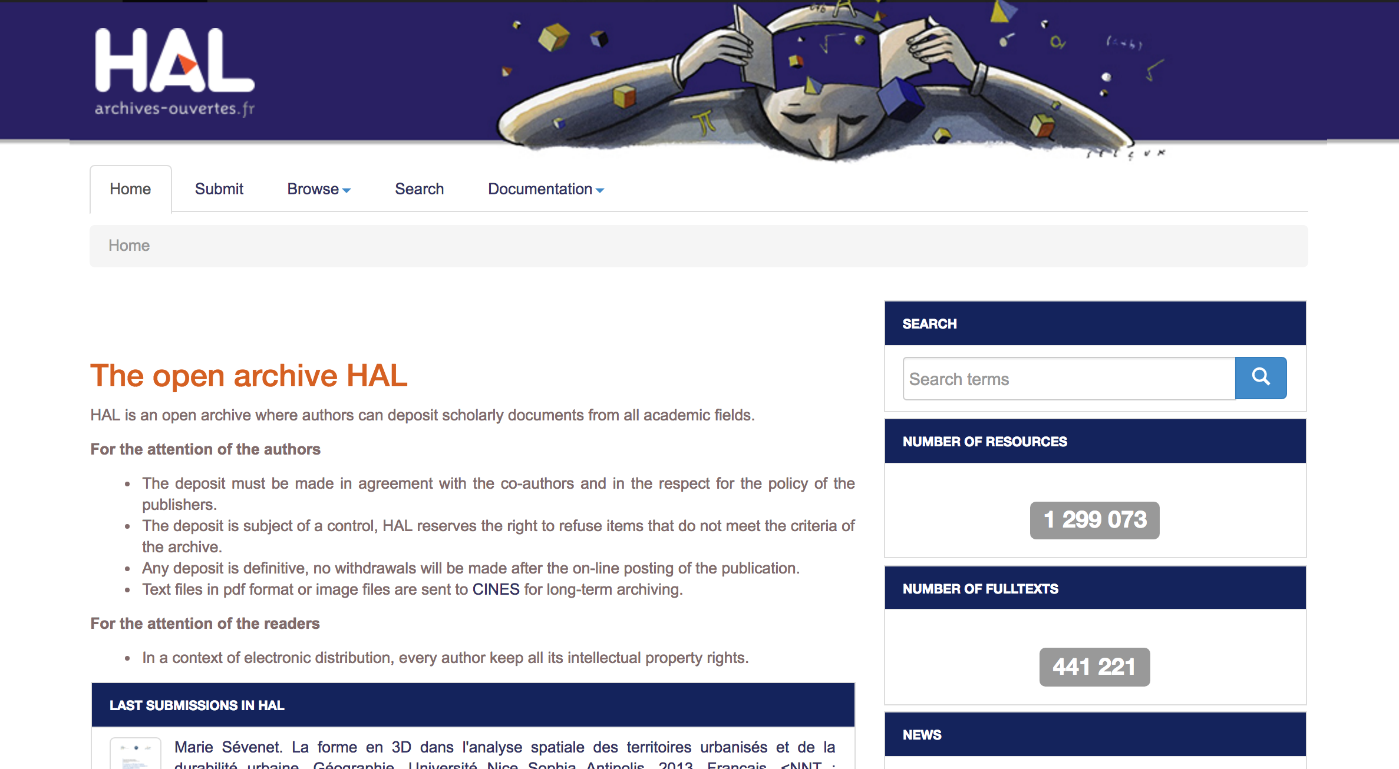
HAL (Hyper Articles en Ligne)
https://hal.archives-ouvertes.fr/

Slide 3
Discussions on cooperation IN2P3/INSPIRE started in 2015
Focus on particle and nuclear physics
Curation on INSPIRE, export to HAL
Summer 2015: 1-week training for 6 librarians
Early 2016: Official CERN/IN2P3 collaboration agreement signed
Mar 2016: CNRS/IN2P3 hired documentalist working fulltime for Inspire

Slide 4
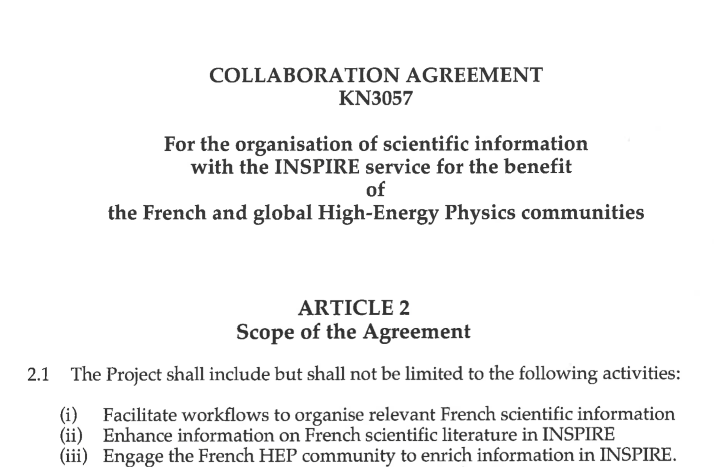

Slide 5
1 CNRS/IN2P3 staff member (100%)
  Record curation
  French institutions
  Authors
  Training + supervision of French cataloguers
  Communication
  Single INSPIRE contact point
9 IN2P3 librarians (<20%)
  Record curation

Slide 6
Scope of work:
Full curation of all records with IN2P3 affiliation
  Currently journal articles only
  Will be extended to arXiv papers
1-4/2017: 1000 records curated
  2000 in total since 2015
Annual projection: > 3000 records
Hidden collection for records outside the scope of INSPIRE
Export to HAL ready to be started

Slide 7
Japan-INSPIRE cooperation
Micha Moskovic
INSPIRE AB meeting
May 2, 2017

Slide 8
Overview
Discussions dating back to 2009, concrete contacts end-2014, official CERN-Japan Collaboration Agreement signed end-2015, real start beginning of 2016
Involves several institutes: KEK, NII, Kyoto U.
Monthly conference calls
One full-time curator from Kyoto U. at CERN March 2016 − February 2017
A new curator should come this year
Focus on Japanese authors and claims

Slide 9
Work of Japanese curator
KAKEN Japanese grant database has researchers (HEP: 2K) and associated papers (90K from HEP authors, not all of them HEP)
Matching them with INSPIRE
  Authors: disambiguation
  Papers: only 7K with DOI
Allowed to make claims based on KAKEN metadata: 4.5K papers
Also general curation work, focus on Japan

