Slide 1




Experimental study of Diffraction Radiation for beam size measurement at ATF2
M. Bergamaschi^{1,2}, A. Aryshev³, P. Karataev¹, K. Kruchinin ¹, R. Kieffer², T. Lefevre², S. Mazzoni², N. Terunuma³
RREPS 2017, Desy, 19th September 2017
John Adams Institute at Royal Holloway, Egham, United Kingdom
CERN European Organisation for Nuclear Research, Geneva, Switzerland
KEK High Energy Accelerator Research Organization, Tsukuba, Japan

Slide 2
Outline
Project Overview
ODRI experiment at ATF2
Synchrotron Radiation Contribution at ATF2
ODRI results at ATF2
Summary

Slide 3
Overview
Motivations and Goals:
Develop a non-invasive transverse profile station for CLIC/ILC beams that can be scaled up
Develop, install and test a combined Optical Transition Radiation (OTR) and Optical Diffraction Radiation Interference (ODRI) emittance station at ATF2 at High Energy Accelerator Research Organisation (KEK)
To optimize sensitivity to smallest beam sizes, we plan to observe ODRI in the visible and far-UV wavelength range, down to approximately 200 nm

Slide 4
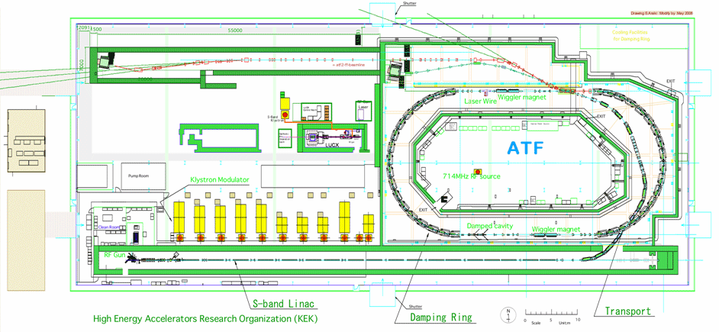
ODRI experiment at KEK ATF2
ODRI experiment location

Slide 5
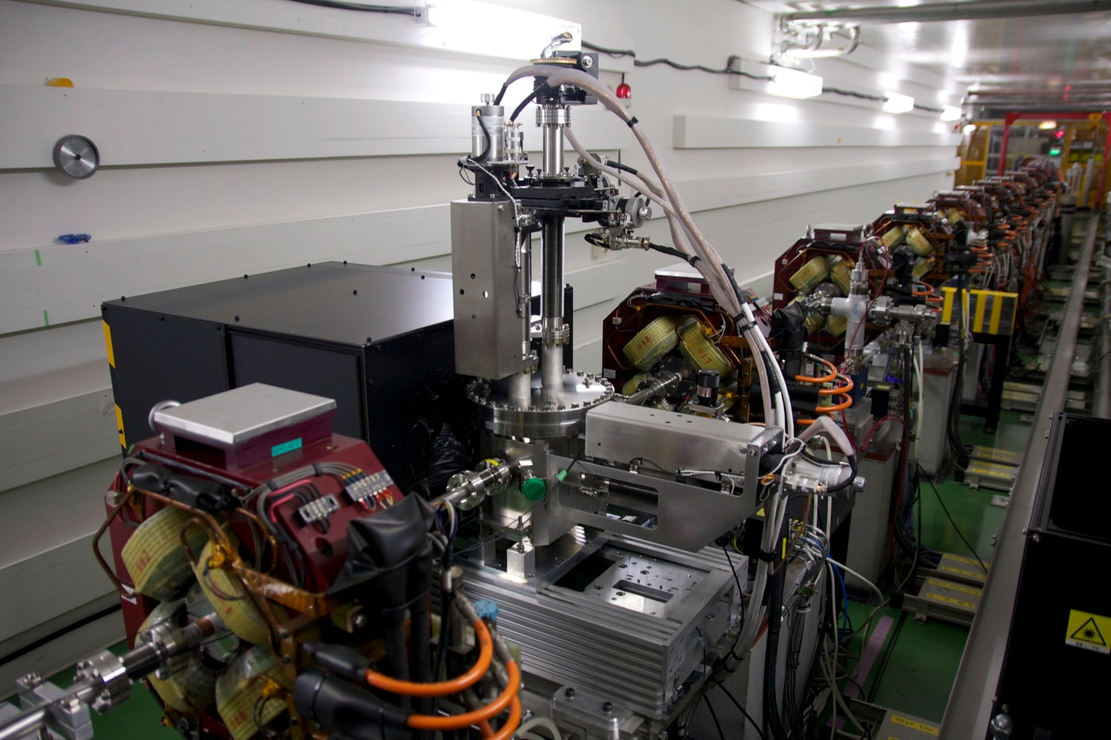
ODRI experiment at KEK ATF2
Experiment installed at ATF2 in February 2016, in the laser-wire previous location where vertical beam can be focused to < 1um
Notes:
Installation in Feb 2016

Slide 6
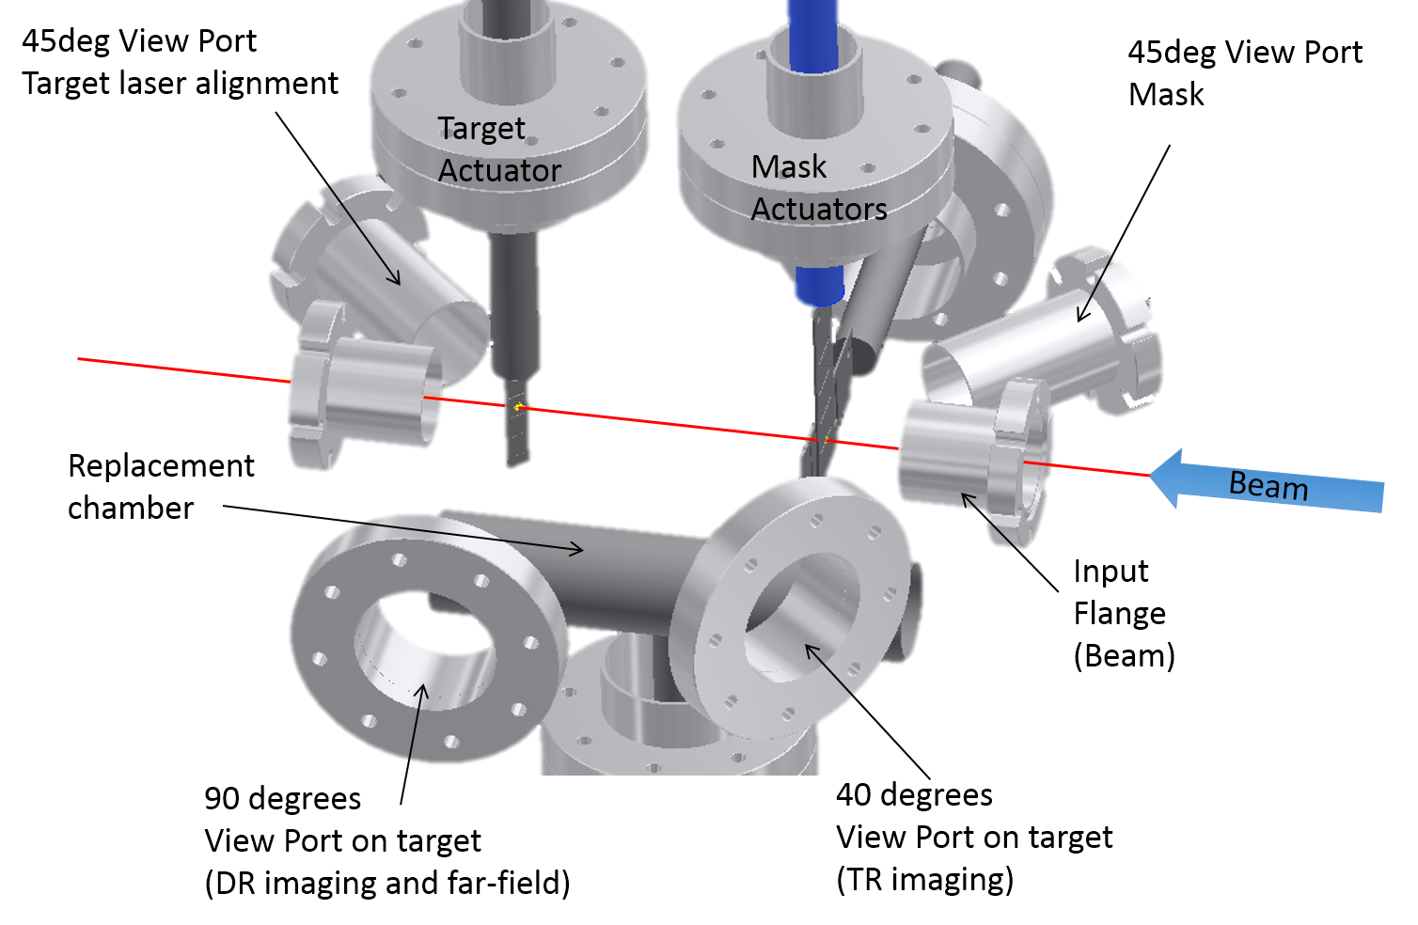
ODRI experiment at KEK ATF2

Slide 7
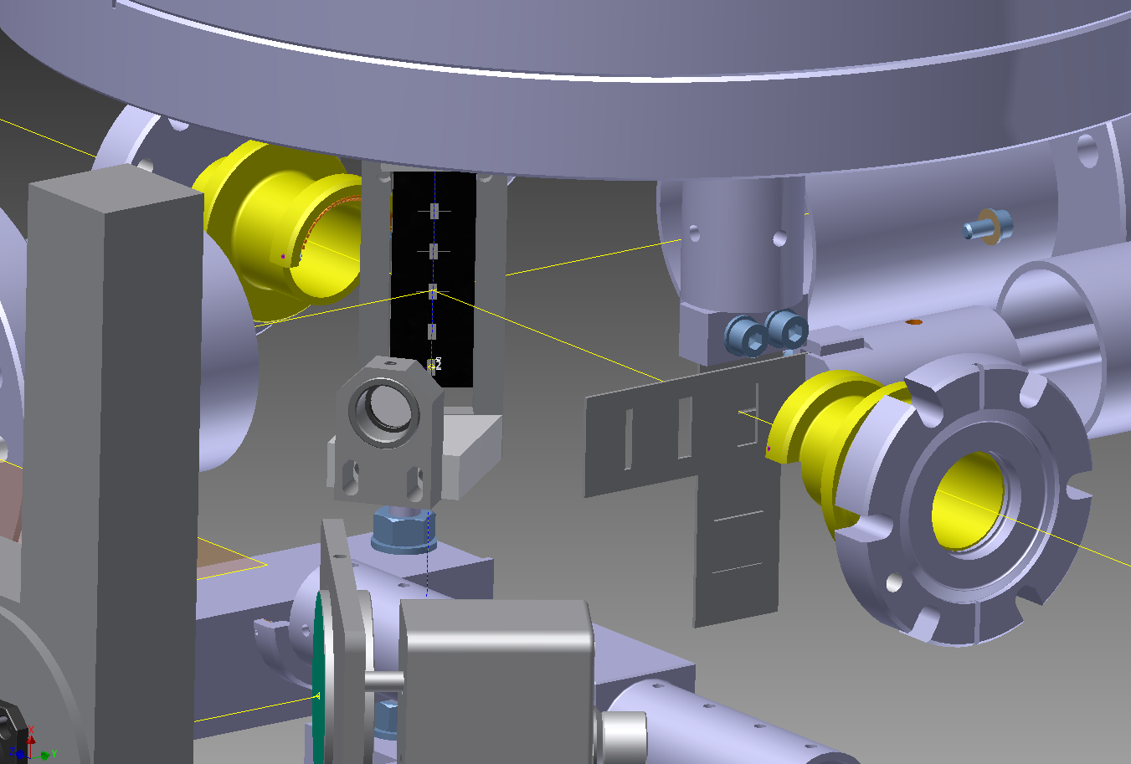
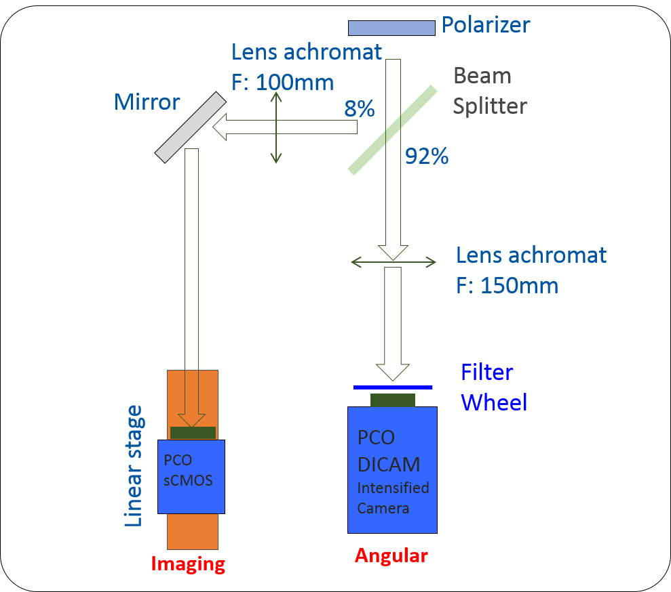
ODRI experiment at ATF2
The target as 4 slits for DR (50 to 201 µm)
A couple of vertical and horizontal mask slits can be inserted 13 cm upstream the target
TARGET
ODR
Masks
e- Beam
Synchronous Imaging and Angular acquisition for position filtering in angular

Slide 8
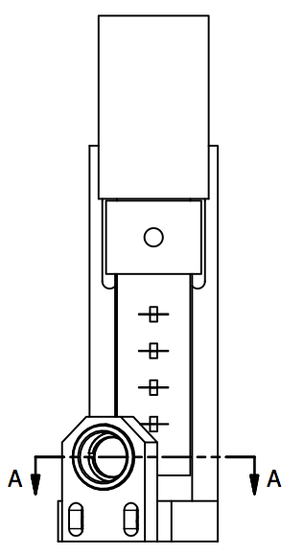
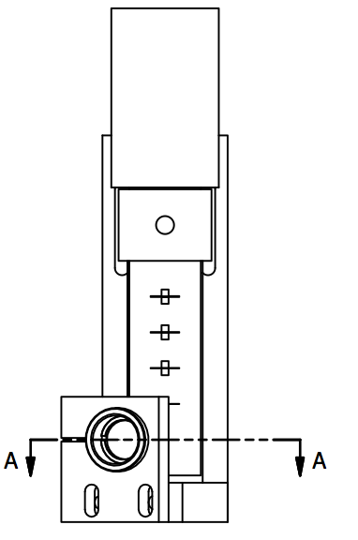
ODRI experiment at ATF2
TARGET
Mirrored areas
6x4mm² around slits
MASK
Fully Mirrored
Slit 1 201.7um
Slit 1 399um
Slit 2 100.6um
Slit 2 198.9um
Slit 3 77.2um
Slit 3 149.2um
Slit 4 49.57um
Slit 4 100um

Slide 9
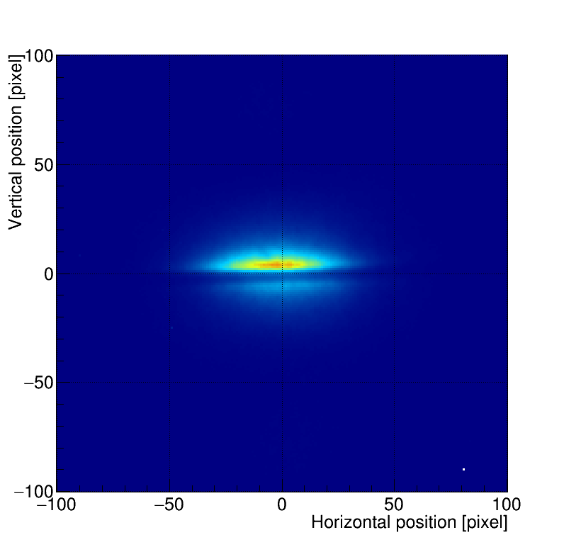
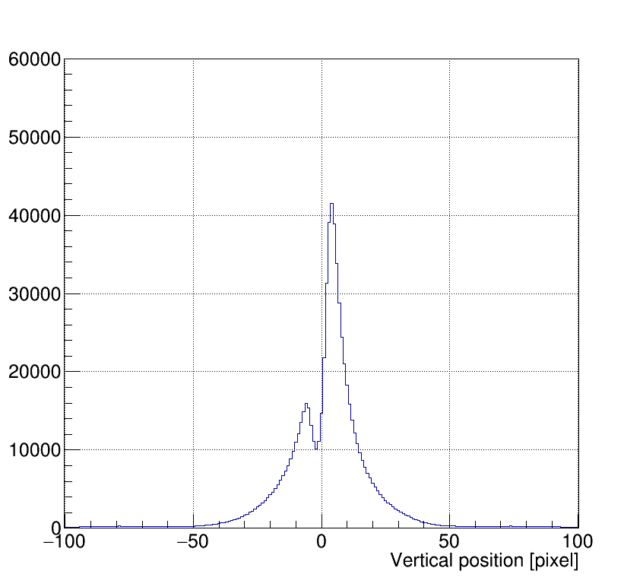
ODR in imaging
There is no visible beam size dependency of the pattern in imaging.
But the vertical position into the slit change the profile asymmetry => Optical Beam Position Monitor (BPM)
Offset

Slide 10
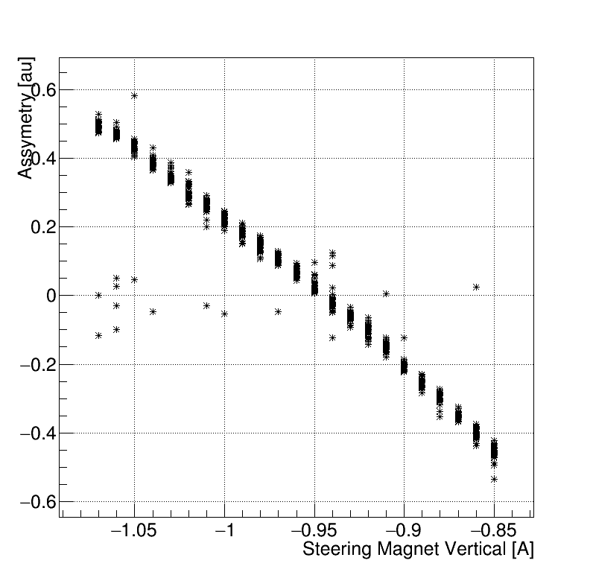
ODR imaging as an optical BPM
Steering -0.85A
Asymmetry = (P_{min}-P_{max})/(P_{max}+P_{min})
P_{max}
Resolution ~1um
P_{min}
Slit: 56um
Beam size: 1 µm
30 shots statistics
Position resolution: about 1 µm
Steering magnet to scan the beam inside the slit
Range 45um

Slide 11
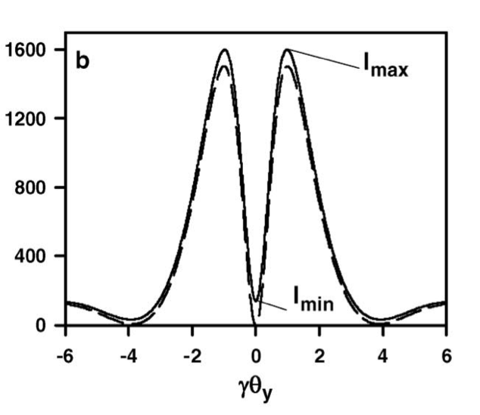
ODR for beam size measurements
The beam size is extracted from the visibility I_{min}/I_{max} of the projected vertical component of the ODR angular distribution
The angular distribution is obtained using a camera located at the back focal plane of an optical lens (effective infinity)
ODR source
Aperture
An horizontal slit is used to measure a vertical beam size.
We use a polarizer to select only the vertically polarized ODR photons and 40nm BW filters to select the wavelength
d
f
Polarizer
Filter
Lens
CCD camera
On focal plane
Angular magnification

Slide 12
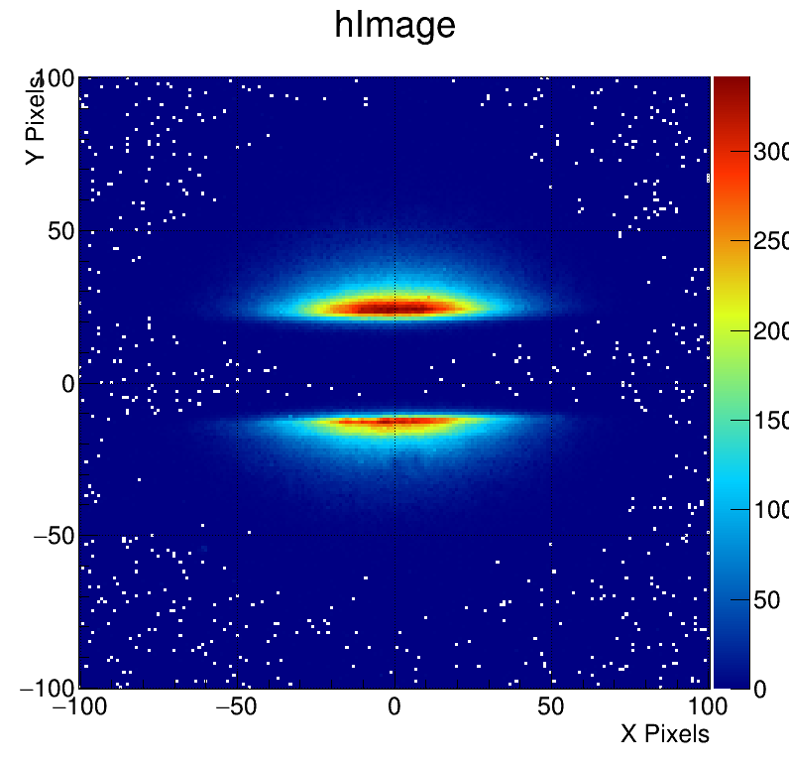
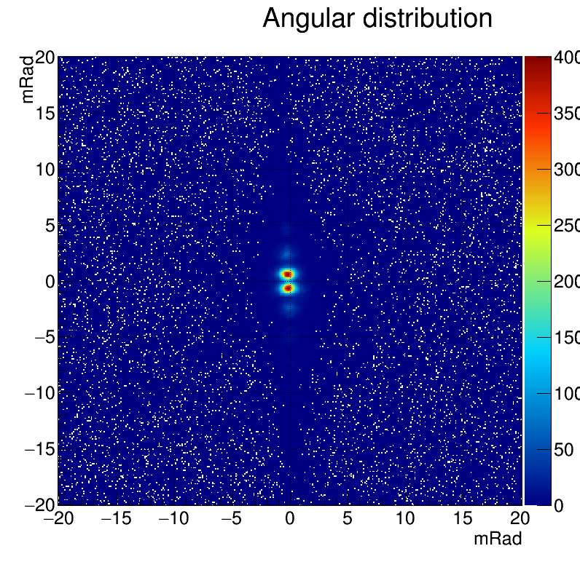
ODRI at ATF2
Direct Image of the ODRI
2D Angular distribution of the ODRI

Slide 13

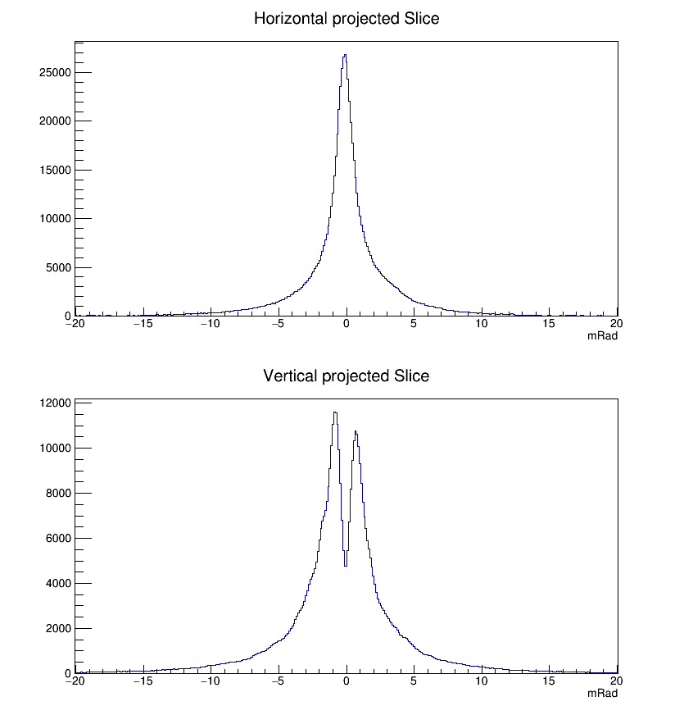
Synchrotron Radiation Contribution at ATF2
Observation of the angular pattern with target in the OTR position with mask inserted to evaluate Synchrotron Radiation Contribution
Minimum too high = high SR Contribution

Slide 14
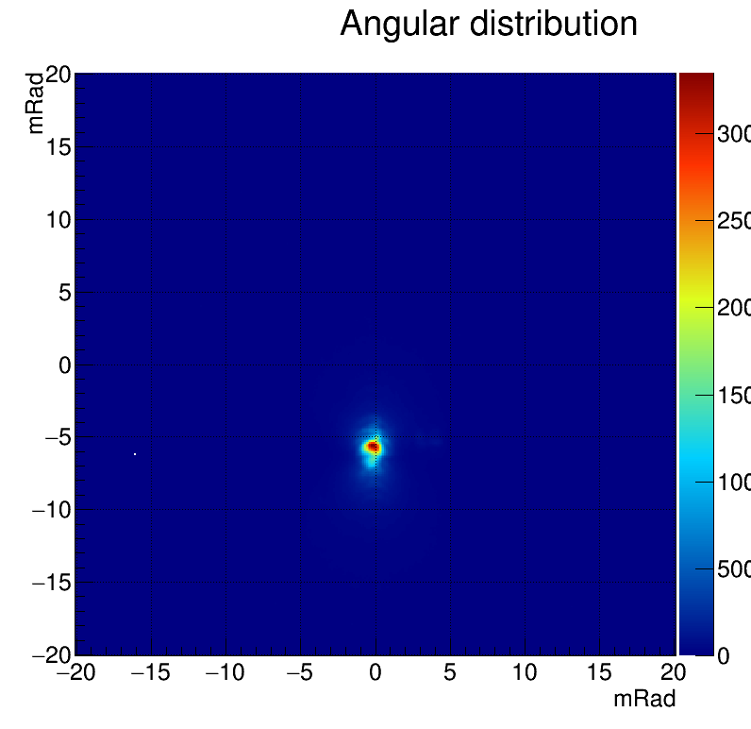
Synchrotron Radiation Contribution at ATF2
OTR Angular pattern with steering magnet off and without mask
Strong Contribution, impossible to evaluate the TR angular pattern

Slide 15

Synchrotron Radiation Contribution at ATF2
Insertion of the mask (582 µm aperture)
Although mask is inserted there is a strong Interference between Synchrotron Radiation and Transition Radiation because beam is not centered in the quadrupole (QM14FF) before the target.

Slide 16

Synchrotron Radiation Contribution at ATF2
No mask present, Alignment of the quadrupole magnet present before the target (QM14FF)
Better profile but peak present in the middle of the pattern due to Synchrotron Radiation generated upstream in the beam-line

Slide 17
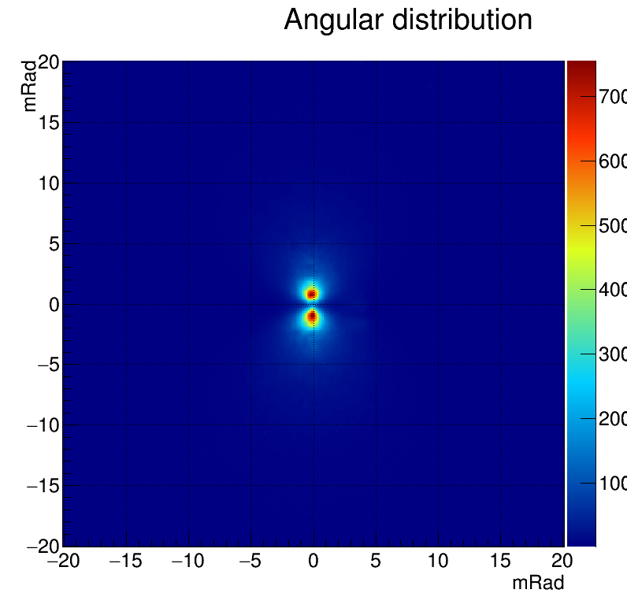
Synchrotron Radiation Contribution at ATF2
Re insertion of the mask (582 µm)
Maximum reduction of the Synchrotron Radiation Contribution

Slide 18
Synchrotron Radiation Contribution at ATF2
Before beam line optimization
After beam line optimization

Slide 19
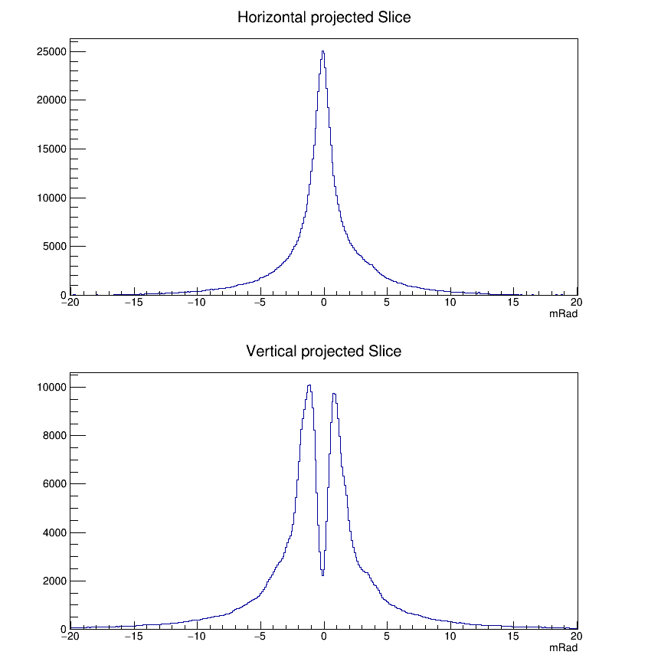
Synchrotron Radiation Contribution at ATF2
Before beam line optimization
After beam line optimization
Lower minimum = lower SR Contribution
Binning limit the minima => bigger angular magnification needed

Slide 20
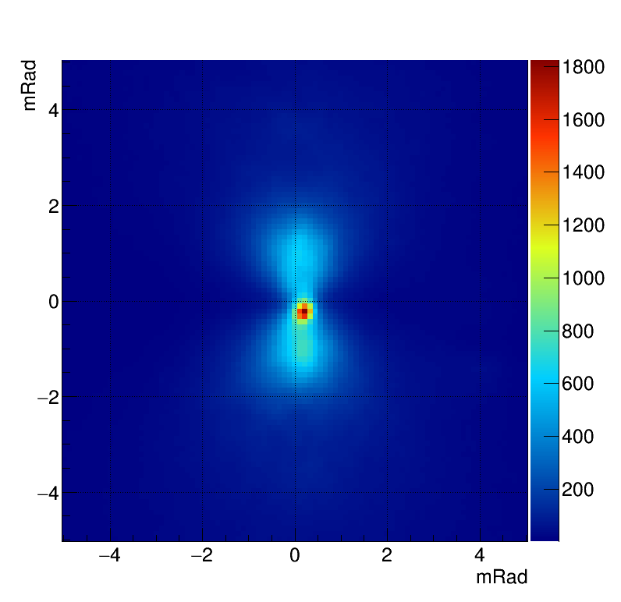
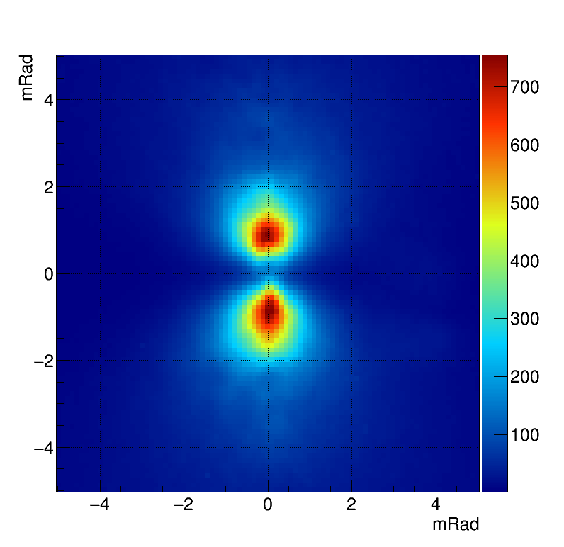
Synchrotron Radiation Contribution at ATF2
TR 2D profile without mask
TR 2D profile with mask

Slide 21
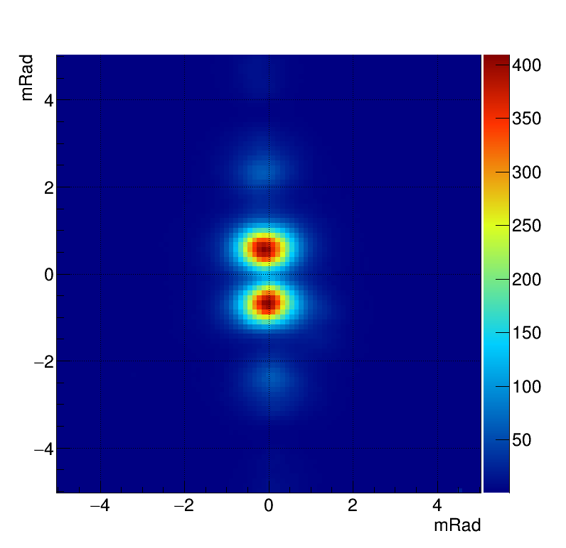

ODRI 2D angular intensity
$λ=450 nm$, beam size = $15.0 µm,$
$$\text{mask} =582.0 µm\text{, }\text{target} =201.7 µm$$

Slide 22
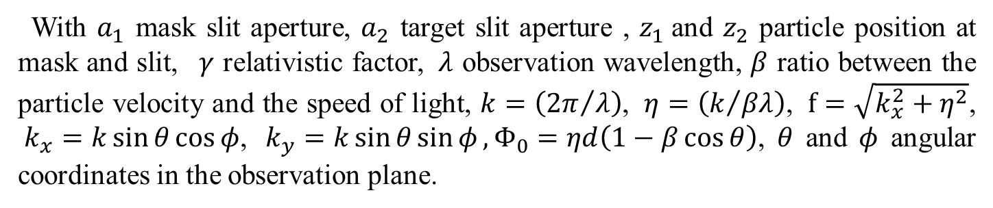
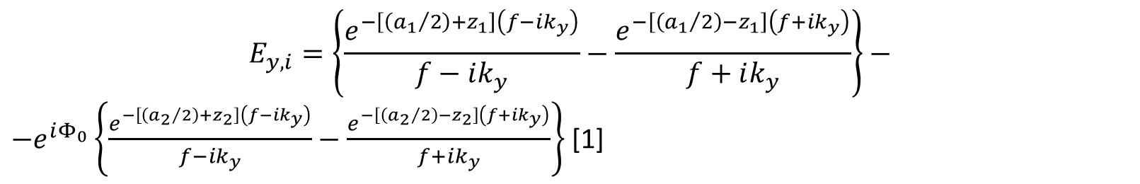
ODRI simulation
$$E_{y,i}=\left\{\frac{e^{−\left[\left({a_{1}}/2\right)+z_{1}\right]\left(f−ik_{y}\right)}}{f−ik_{y}}−\frac{e^{−\left[\left({a_{1}}/2\right)−z_{1}\right]\left(f+ik_{y}\right)}}{f+ik_{y}}\right\}−$$
$−e^{iΦ_{0}}\left\{\frac{e^{−\left[\left({a_{2}}/2\right)+z_{2}\right]\left(f−ik_{y}\right)}}{f−ik_{y}}−\frac{e^{−\left[\left({a_{2}}/2\right)−z_{2}\right]\left(f+ik_{y}\right)}}{f+ik_{y}}\right\}$ [1]
With $a_{1}$ mask slit aperture, $a_{2}$ target slit aperture , $z_{1}$and $z_{2}$ particle position at mask and slit, $γ$ relativistic factor, $λ$ observation wavelength, $β$ ratio between the particle velocity and the speed of light, $k=\left({2π}/λ\right)$, $η=\left(k/{βλ}\right)$, $f=\sqrt{k_{x}^{2}+η^{2}}$, $k_{x}=k\sin{θ}\cos{φ}$, $k_{y}=k\sin{θ\sin{φ}}, Φ_{0}=ηd\left(1−β\cos{θ}\right)$, $θ$ and $φ$ angular coordinates in the observation plane.
[1] A. Cianchi et al., Non-intercepting electron beam size monitor using optical diffraction radiation interference, Phys. Rev. ST Accel. Beams 14,102803 (2011)

Slide 23
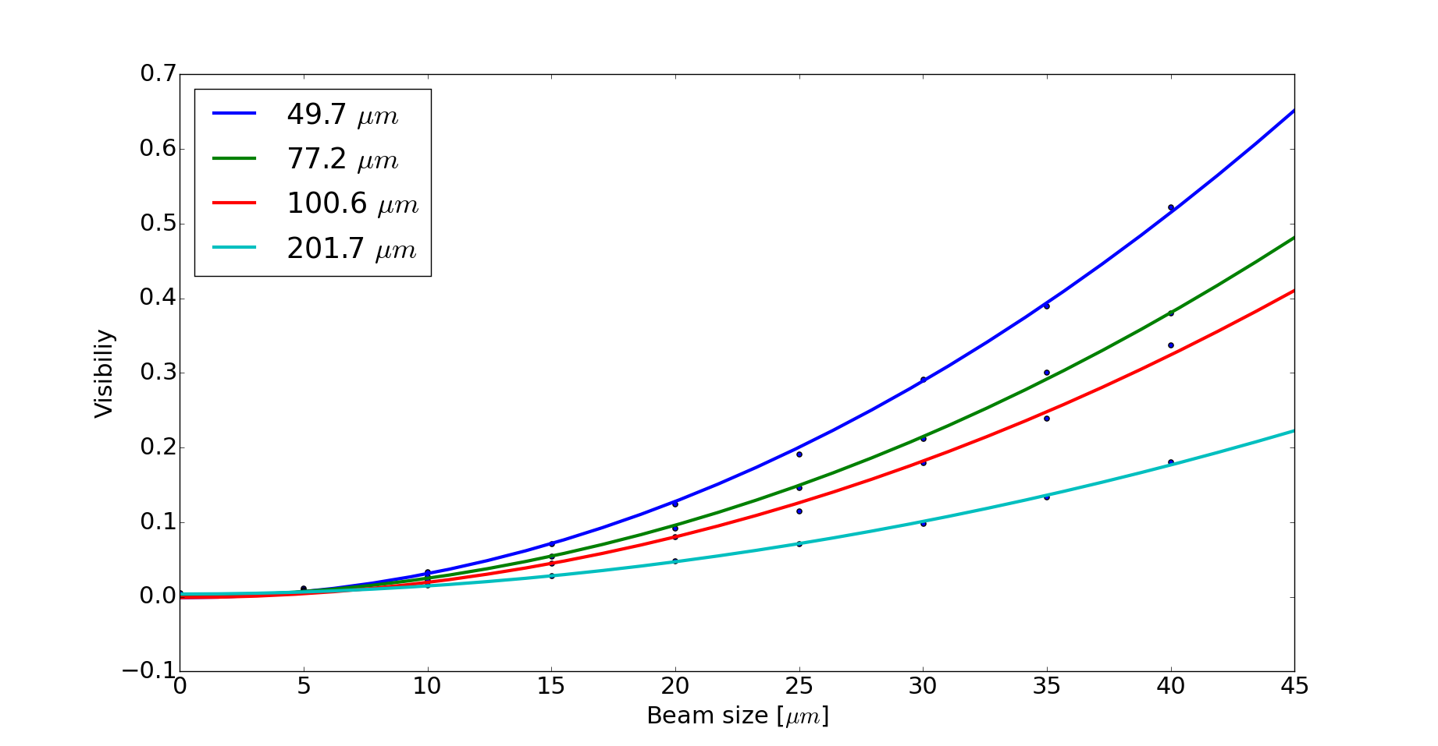
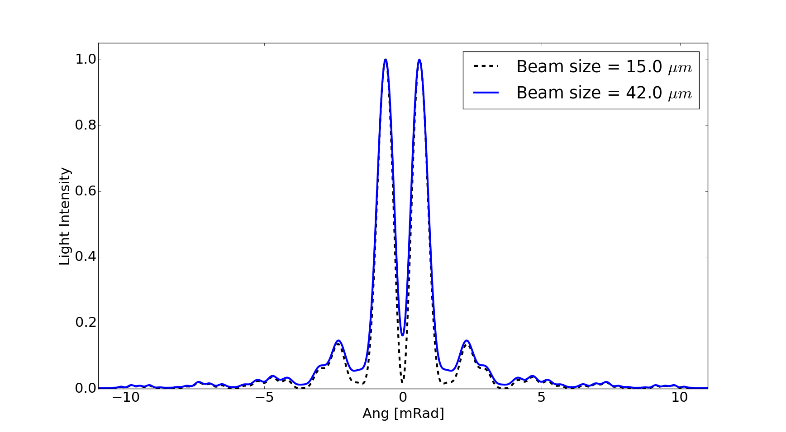




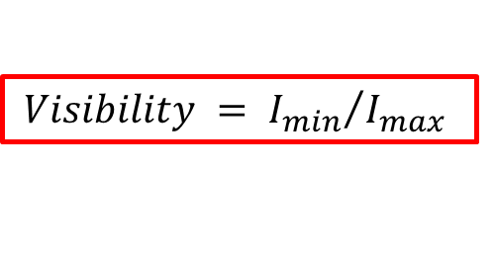

ODRI simulation
$$I=\sum_{i}^{n}{E_{y,i}^{2}}$$
$$n=5000$$
$$d=130 mm$$
Projected Vertical Polarization
Component (PVPC) [2] of DR angular
Intensity for 2 beam sizes
Simulated Visibility vs Gaussian beam size for different target slit sizes
$$I_{max}$$
s$lit size$
$$I_{min}$$
$λ=450 nm$, mask$=582.0 µm$, target $=201.7 µm$
$$Visibility = {I_{min}}/{I_{max}}$$
[2] P. Karataev, et al, Beam Size Measurements with Optical Diffraction Radiation at KEK Accelerator Test Facility, Phys. Rev. Lett. 93, 244802 (2004)

Slide 24
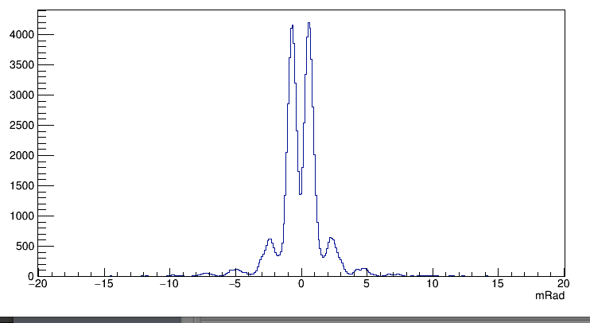
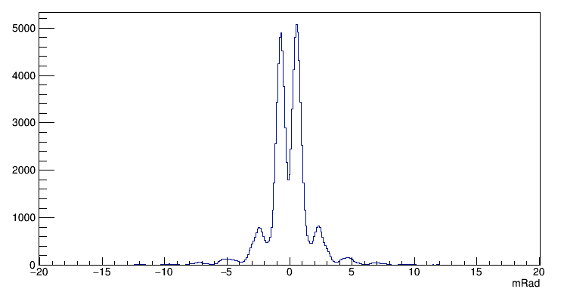
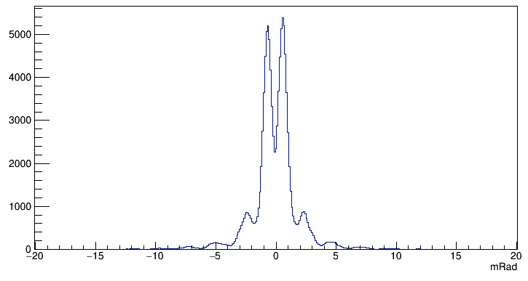
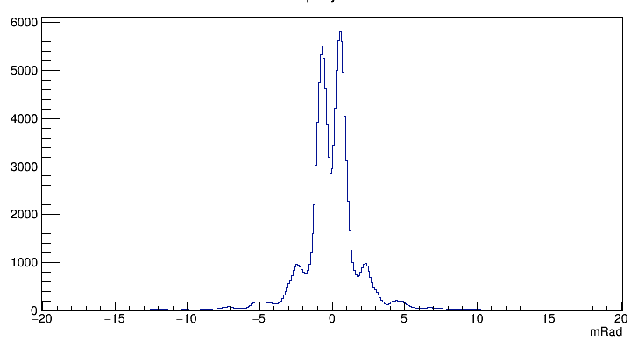
ODRI visibility Quad Scan
PVPC of DR angular intensity for different beam sizes
Quad current 0 (A)
Beam 15 um
Quad current 40 (A)
Beam 24 um
Quad current 80 (A)
Beam 34 um
Quad current 120 (A)
Beam 42 um
Filter:450nm Slit:201.7 µm Mask: 582 µm

Slide 25
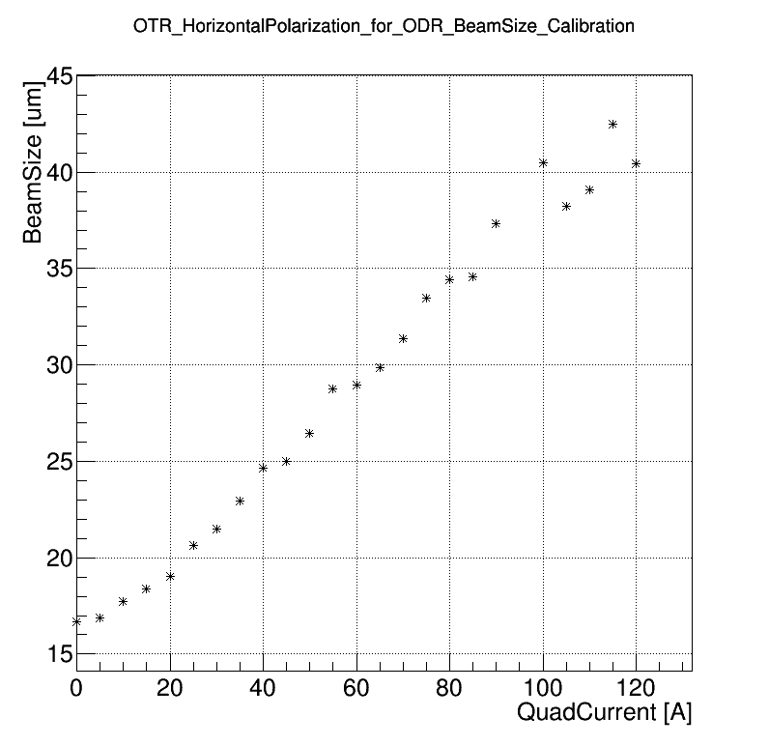
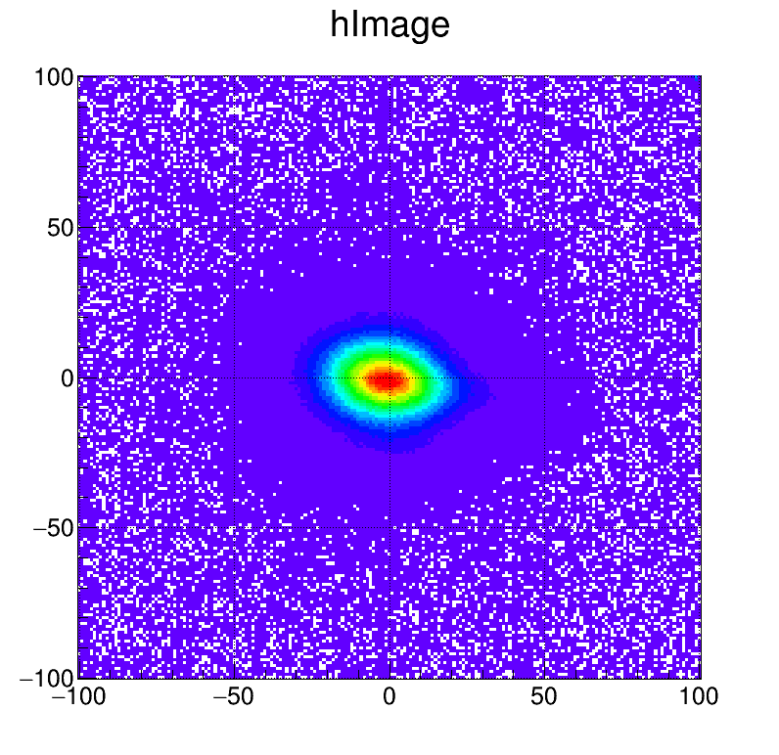
OTR Beam size calibration
The side mirrors of the ODR slit were used to record reference OTR beam size measurement.
This could be done in CLIC/ILC using pilot beam (no target damage).
Then ODR can then be used for full beam charge.

Slide 26
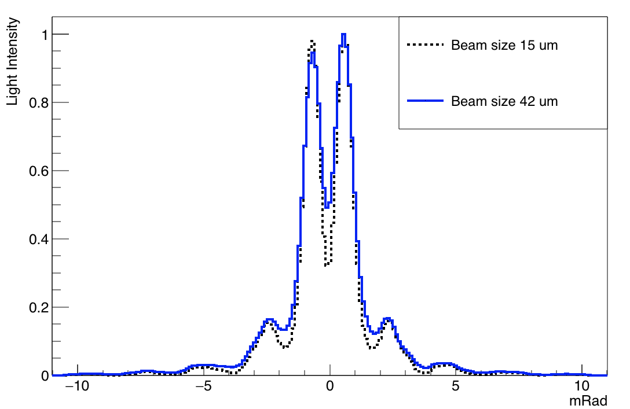
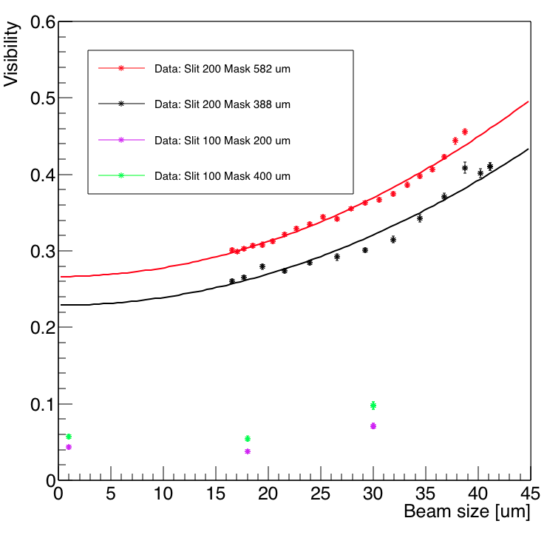
ODRI angular intensity
PVPC of DR angular intensity
for 2 beam sizes
Measured Visibility for different beam sizes and mask/target combination
$λ=450 nm$, $\text{mask} =582.0 µm\text{, }\text{target} =201.7 µm$

Slide 27
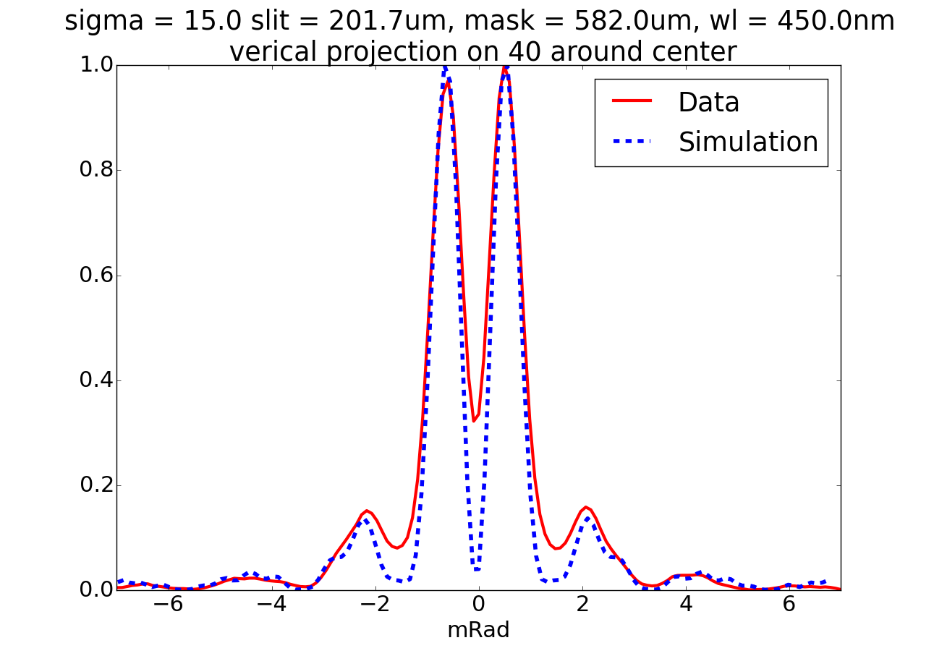
ODR angular data vs simulation
$σ =15 µm\text{,} λ=450 nm$, $\text{mask} =582.0 µm\text{, }\text{target} =201.7 µm$

Slide 28
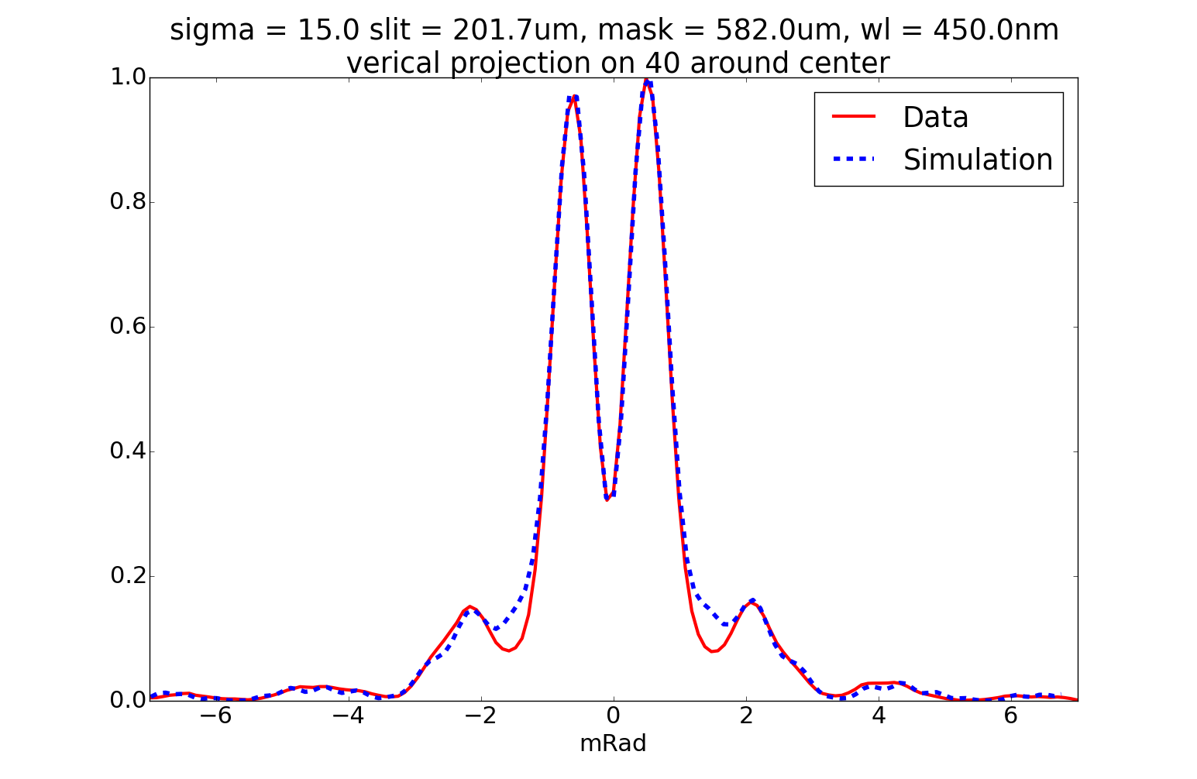
ODR angular data vs simulation
Synchrotron background Gaussian + 6 µm offset in the vertical alignment between slit and mask
$σ =15 µm\text{,} λ=450 nm$, $\text{mask} =582.0 µm\text{, }\text{target} =201.7 µm$

Slide 29
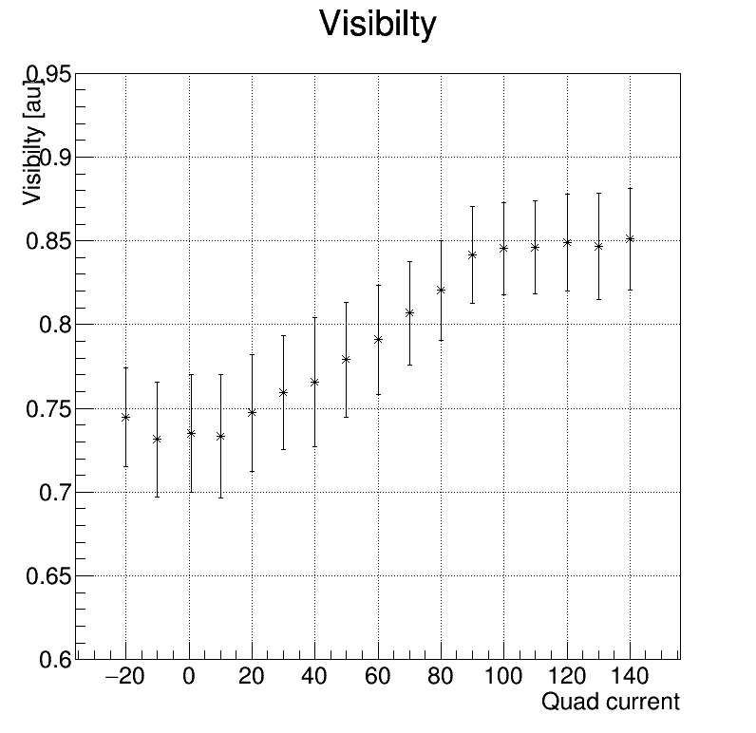
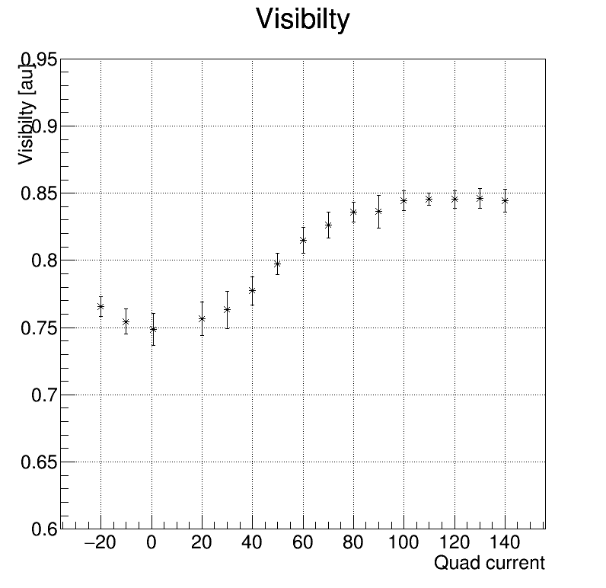
ODR angular data
Last shifts results
200nm Filter
450nm Filter
$$\text{mask} =100 µm\text{, }\text{target} =\text{77.2} µm$$
Minimum beam size around 5 um (not calibrated, OTR PSF)

Slide 30
Summary
Achievements
Imaging the DR source to monitor the position of the beam during angular data acquisition => beam in the slit centre
Sensitivity to beam size of tens of micrometers has been demonstrated, possible to descend to some microns
Beam orbit optimisation needed to minimize SR contribution
Mask contribution to block SR has been observed
Outlook
Better measurement for smaller beam size => bigger angular magnification
Calibration with OTR PSF for micron size beam => improvement of the present imaging optical line

Slide 31
Thank you for your attention!

