Slide 1
Parametric X-ray radiation from crystals with different quality of atomic structure
V.I. Alexeyev^{a,b}, A.N. Eliseyev^{a,b}, E. Irribarra^{c}, V. Karpov ª, I.A. Kishin^{a,b}
A.S. Kubankin^{a,b}, R.M. Nazhmudinov^{a,b}, A.S. Kluev^{b}, P.N. Zhukova^{b}
ª P.N. Lebedev Physical Institute RAS, Moscow, Russia
^{b} Belgorod National Research University, Belgorod, Russia
^{c} Escuela Politécnica Nacional, Quito, Ecuador
2017

Slide 2
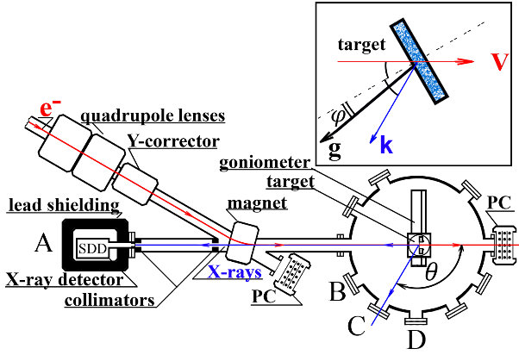
.
7 MeV electron beam

Slide 3
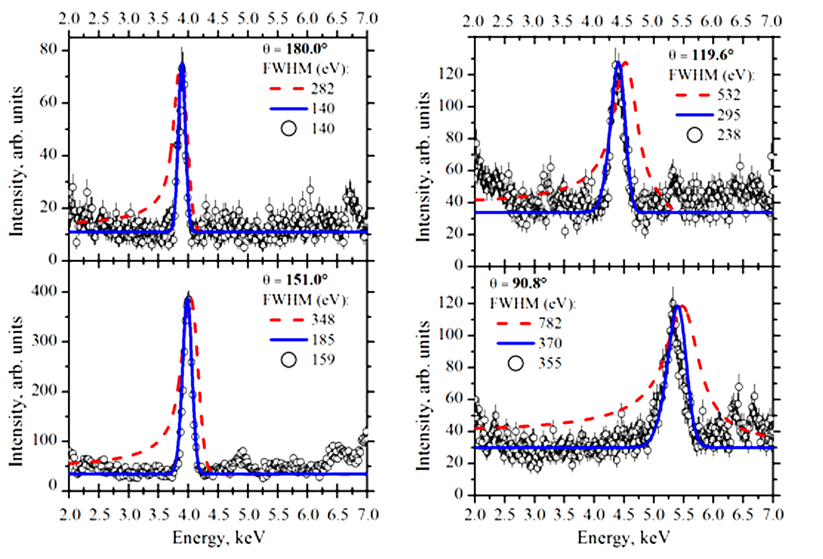
Tungsten foil. Comparison of experimental results with the theory of PXR for
polycrystals (dash line) and theory of PXR for mosaic crystals (solid line).
Four observation angles are presented.

Slide 4
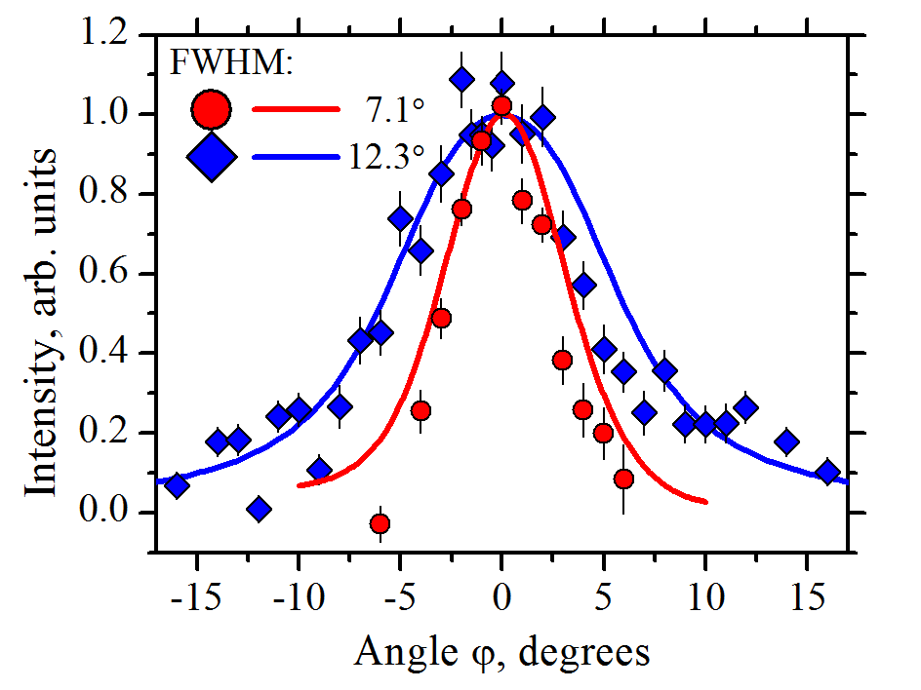
Tungsten foil. Dependence of the PXR yield from (200) plane on the orientation angle
measured for observation angles of 90.8° (circles) and 180.0° (rhombus).
The lines represent the theoretical curves

Slide 5
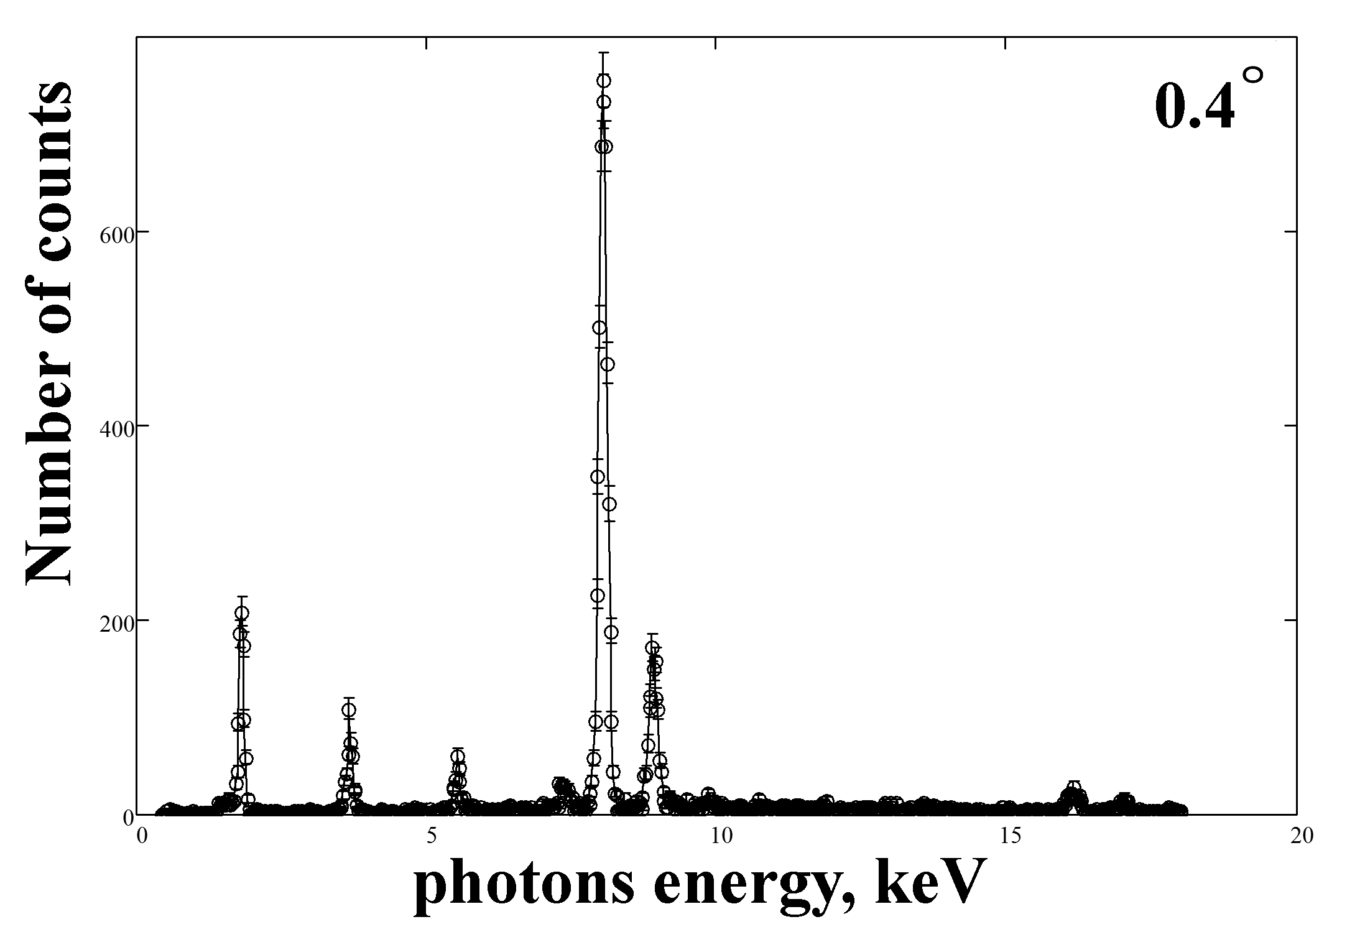
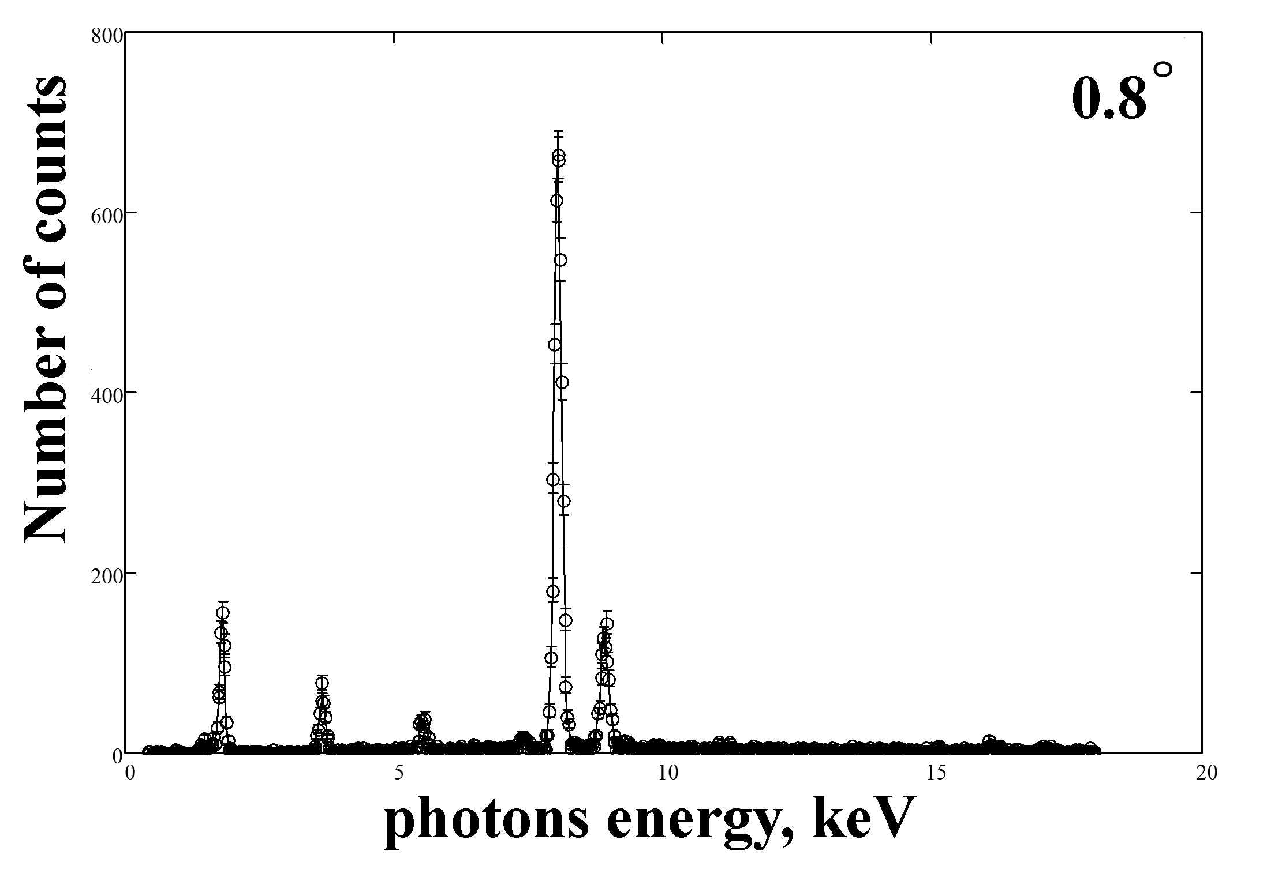
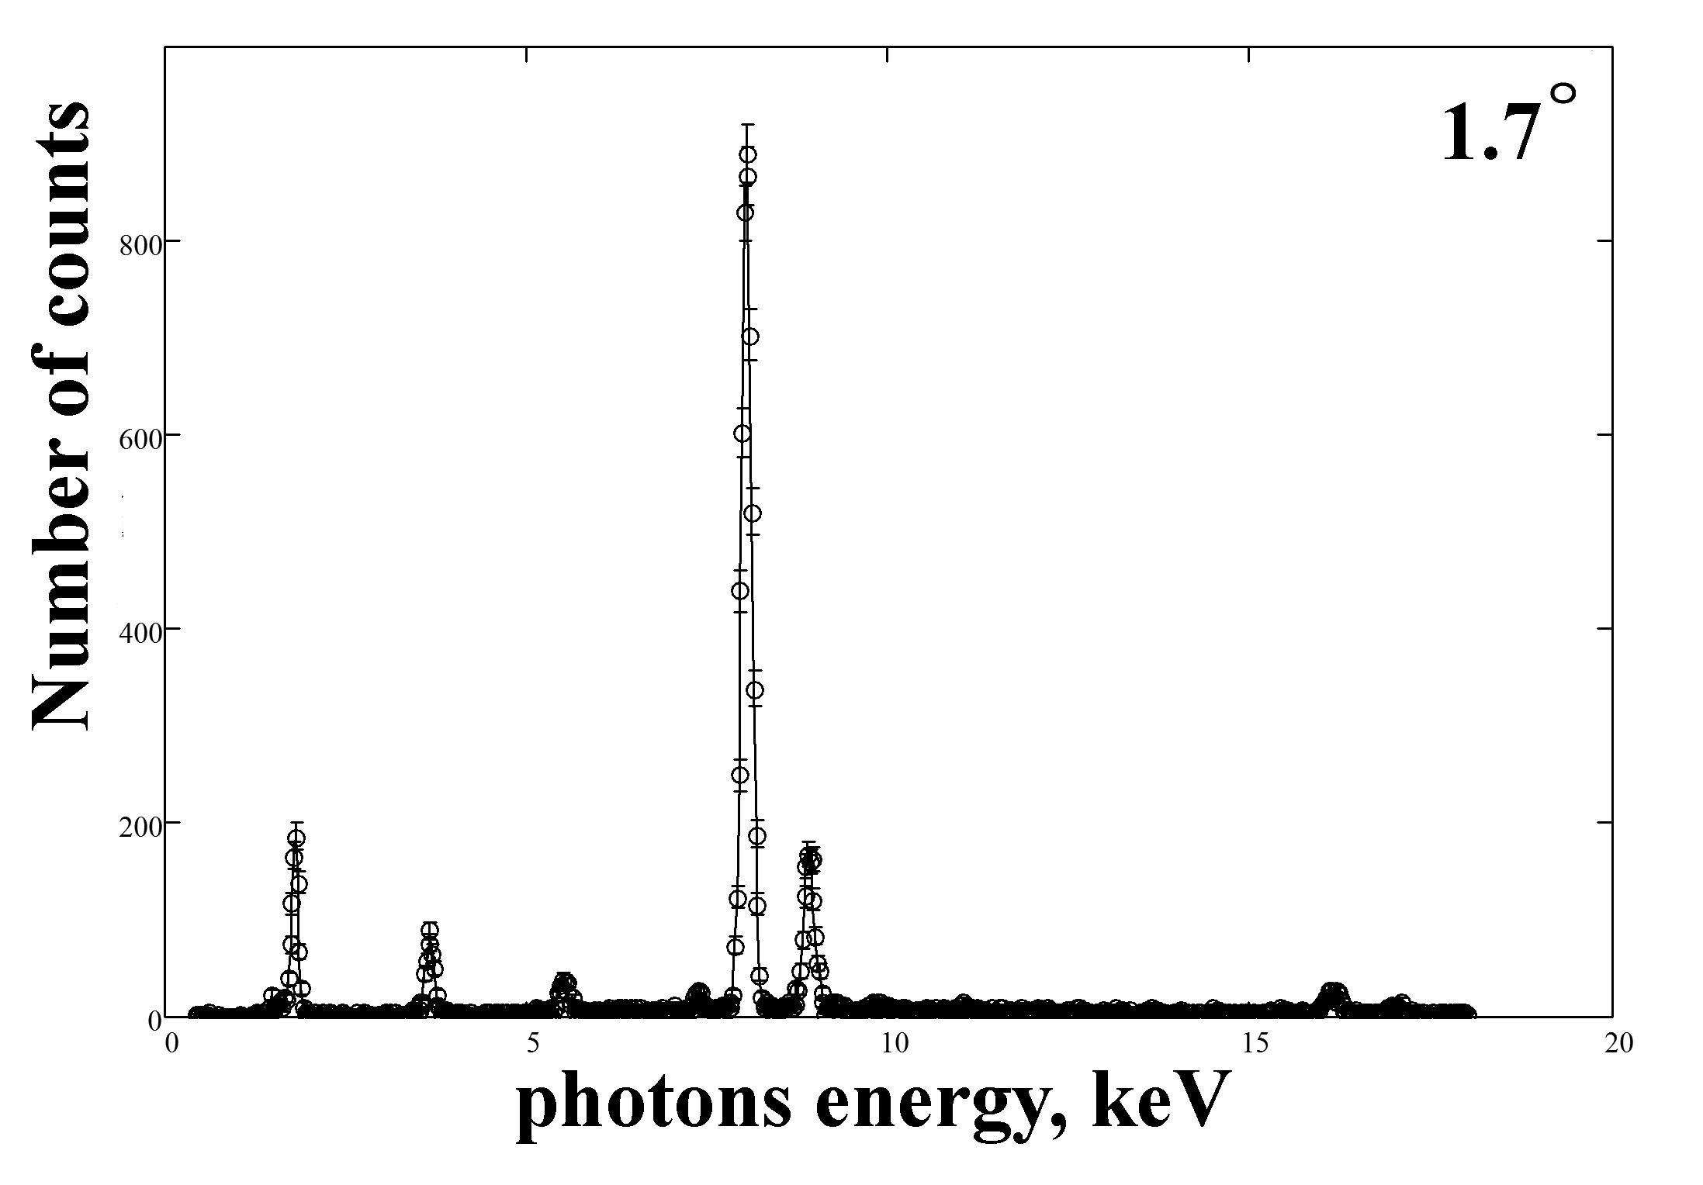
PXR spectra from HOPG with mosaicity 0.4°, 0.8° and 1.7°.

Slide 6
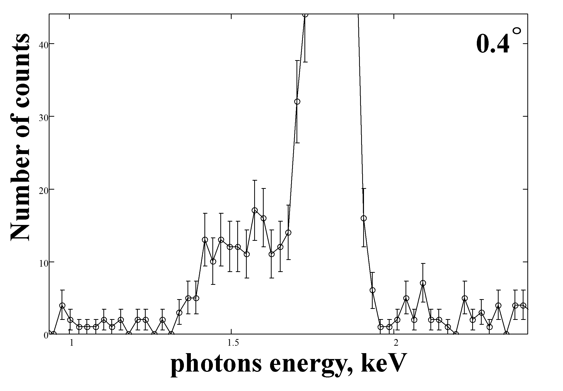
PXR spectra from HOPG with mosaicity 0.4°, 0.8° and 1.7°.

Slide 7
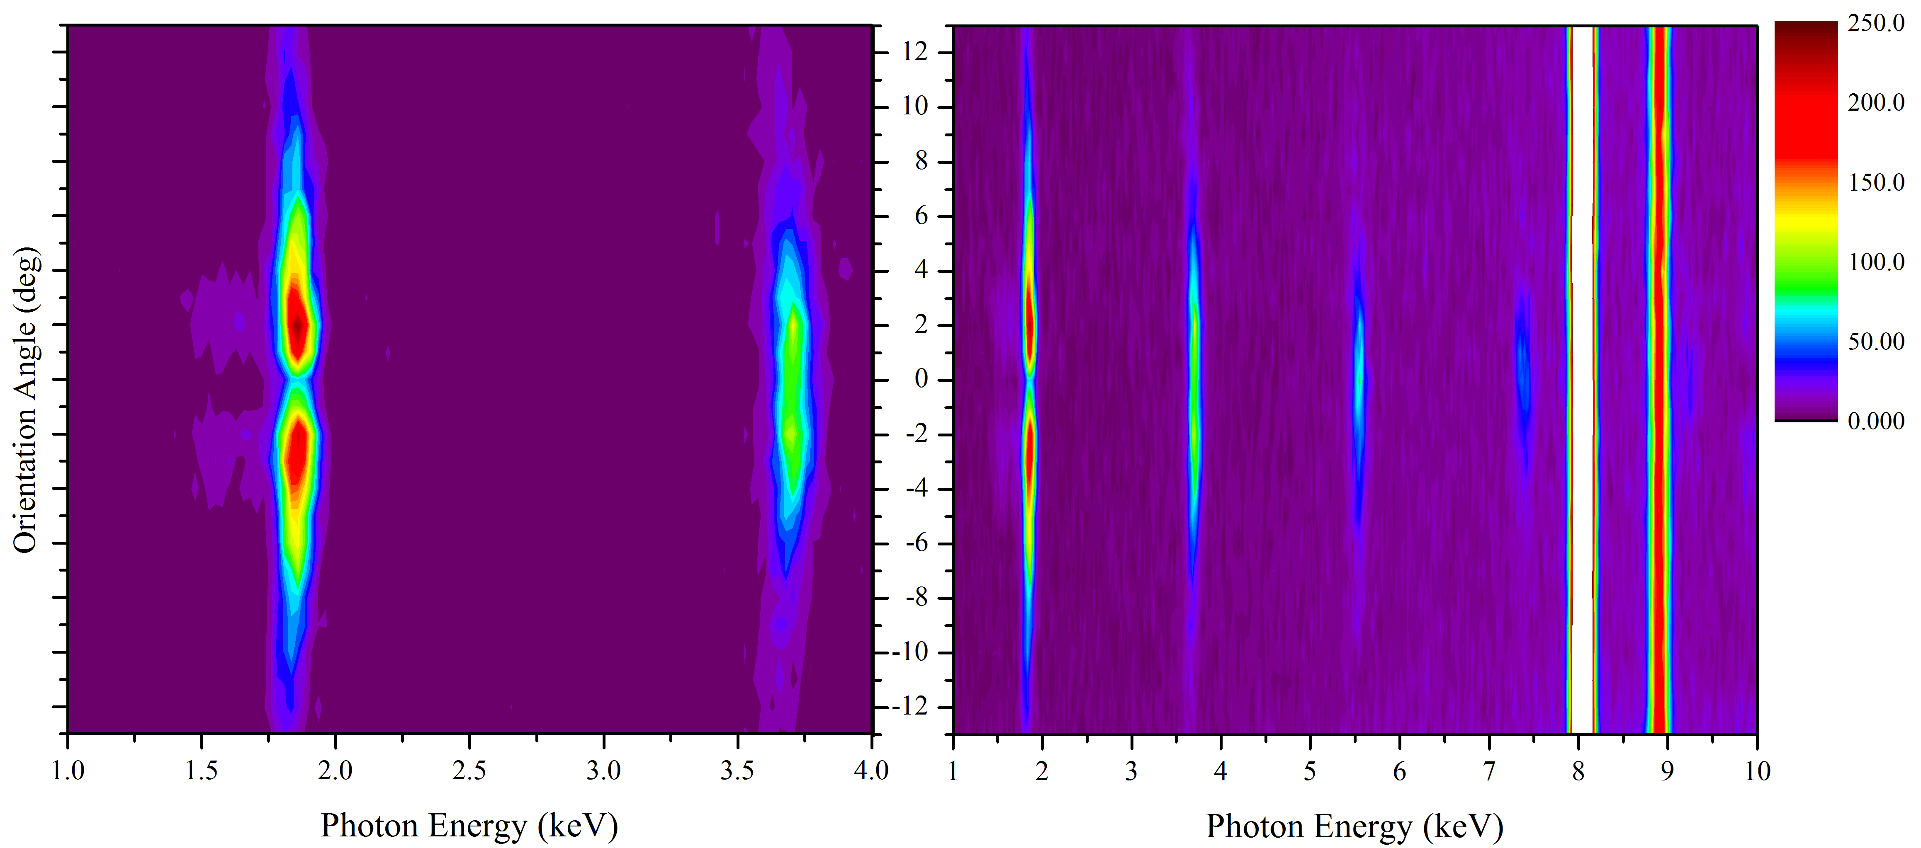
PXR spectra from HOPG with mosaicity 0.4° measured for different orientation
angles of the target relative to the electron beam.

Slide 8
PXR yield dependences for different planes and mosaicity on the orientation angle for the HOPG crystals.
Points 1, 2, 3 and 4 correspond to the first, second, third and forth diffraction orders.

Slide 10
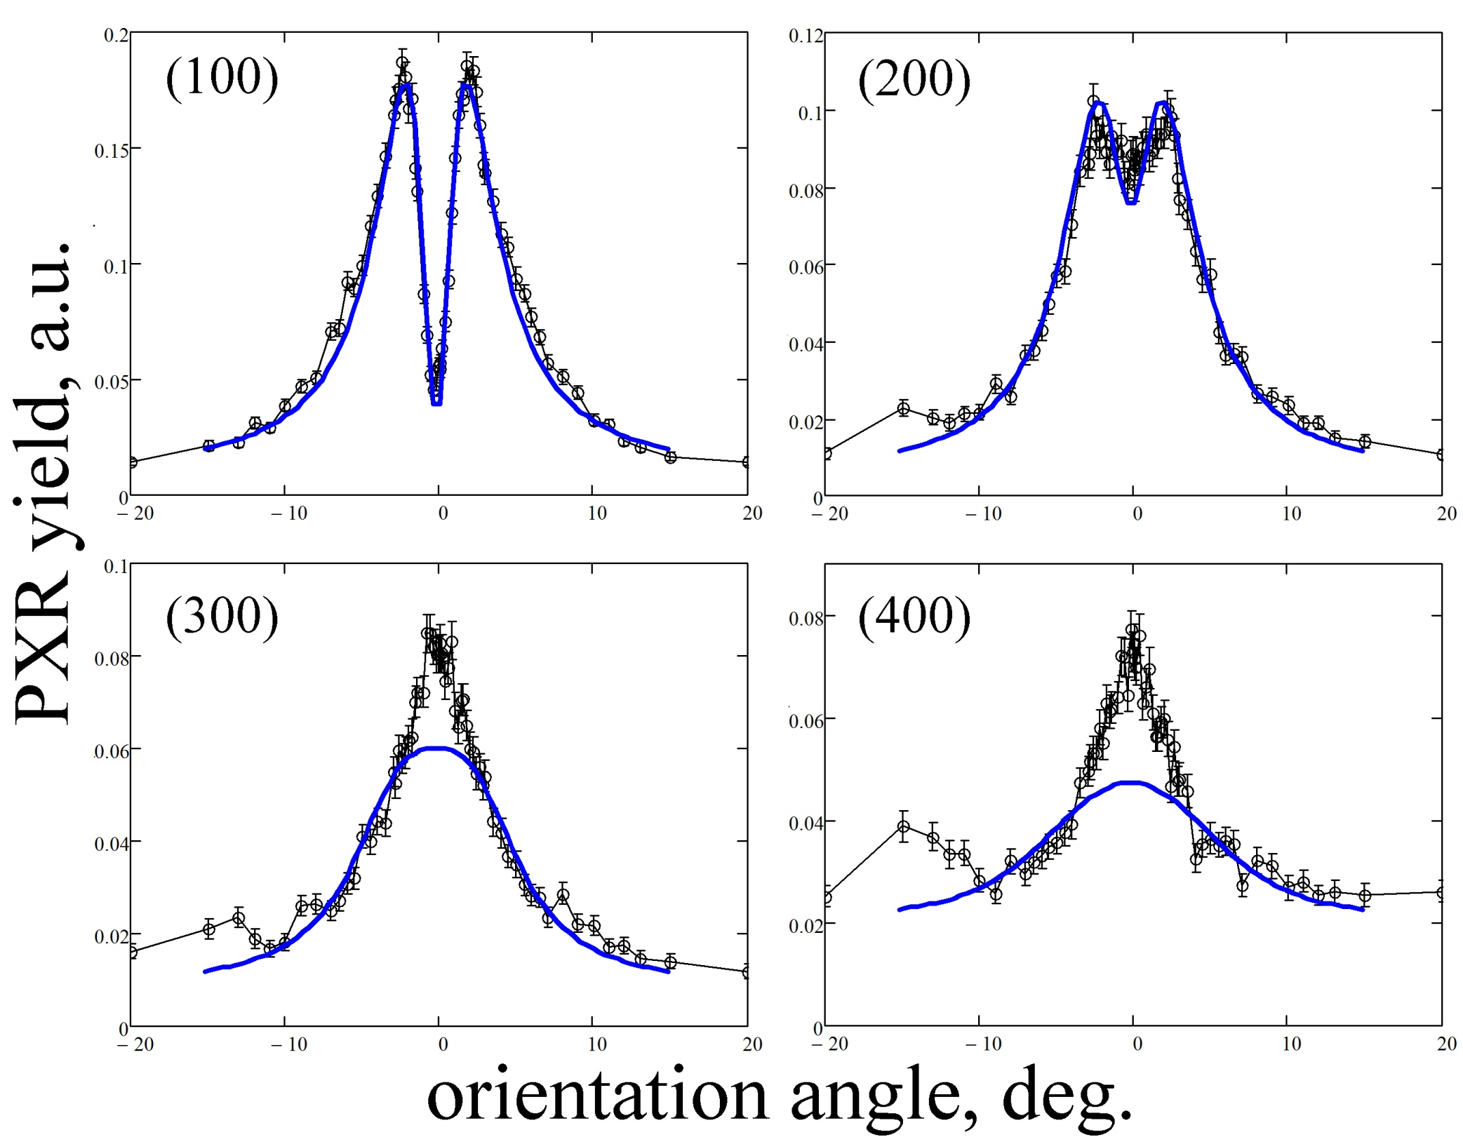
Photoabsorption
length 12 mk
Photoabsorption
length 300 mk
Photoabsorption
length 90 mk
Photoabsorption
Length 800 mk
Comparison of experimental results with the theory of PXR for
mosaic crystals (solid blue line).

Slide 11
Conclusion
Spectra and orientation dependencies of PXR are measured under interaction of 7 MeV electron beam with textured tungsten polycrystalline foil and highly oriented pyrolytic graphite crystals. The results can be summarized as follows:
- The performed calculations show that PXR from textured polycrystals can be described by the kinematical theory of mosaic crystals regarding the texture pattern of the polycrystalline sample as the mosaic parameter. A good agreement between theory and experiment is observed in contrast with the PXR theory for polycrystals.
- PXR orientation dependence is in good accordance with theory for the first two diffraction orders. An additional contribution is observed at angles close to the condition of specular reflection.
- Additional spectral peak which depends on target orientation is observed. The peak nature should be explained.

Slide 12
Thank you for the attention!

