Slide 1
Accelerator research and development at DESY
Large-scale accelerators and accelerator R&D at DESY
Klaus Balewski
XII International Symposium
"RREPS-17“
18.09.2017

Slide 2
Introduction
DESY Mission / Activities
  DESY has committed itself to fundamental research into the structure and functioning of matter. Researchers at DESY explore the microcosm in all its variety – from the interactions of tiny elementary particles and the behaviour of new types of nanomaterials to biomolecular processes that are essential to life.
  Elementary particle physics: Collaboration with CERN; taking part in the large experiments at the LHC or at BELLE II at SUPER KEK-B. Strong and active group in theoretical particel physics. Astro-particle physics in Zeuthen (ICE-Cube, CTA)
  Research with Synchrotron radiation: The light sources at DESY are based on world wide unique particle accelerators that generate extremely intense X-ray radiation. These “supermicroscopes” reveal the atomic details, the behavior of materials and biomolecules and allow research in Physics, Chemistry, Biology, Medicine etc.
  Development, Building and operation of large scale accelerators has been one of DESYs key competences for almost 60 years that makes DESY to one of the world’s leading accelerator centres.
Notes:
HEP – no facilities on side; photon science – large facilities on side; almost sixty years of experience in developing and operation of big acc.

Slide 3
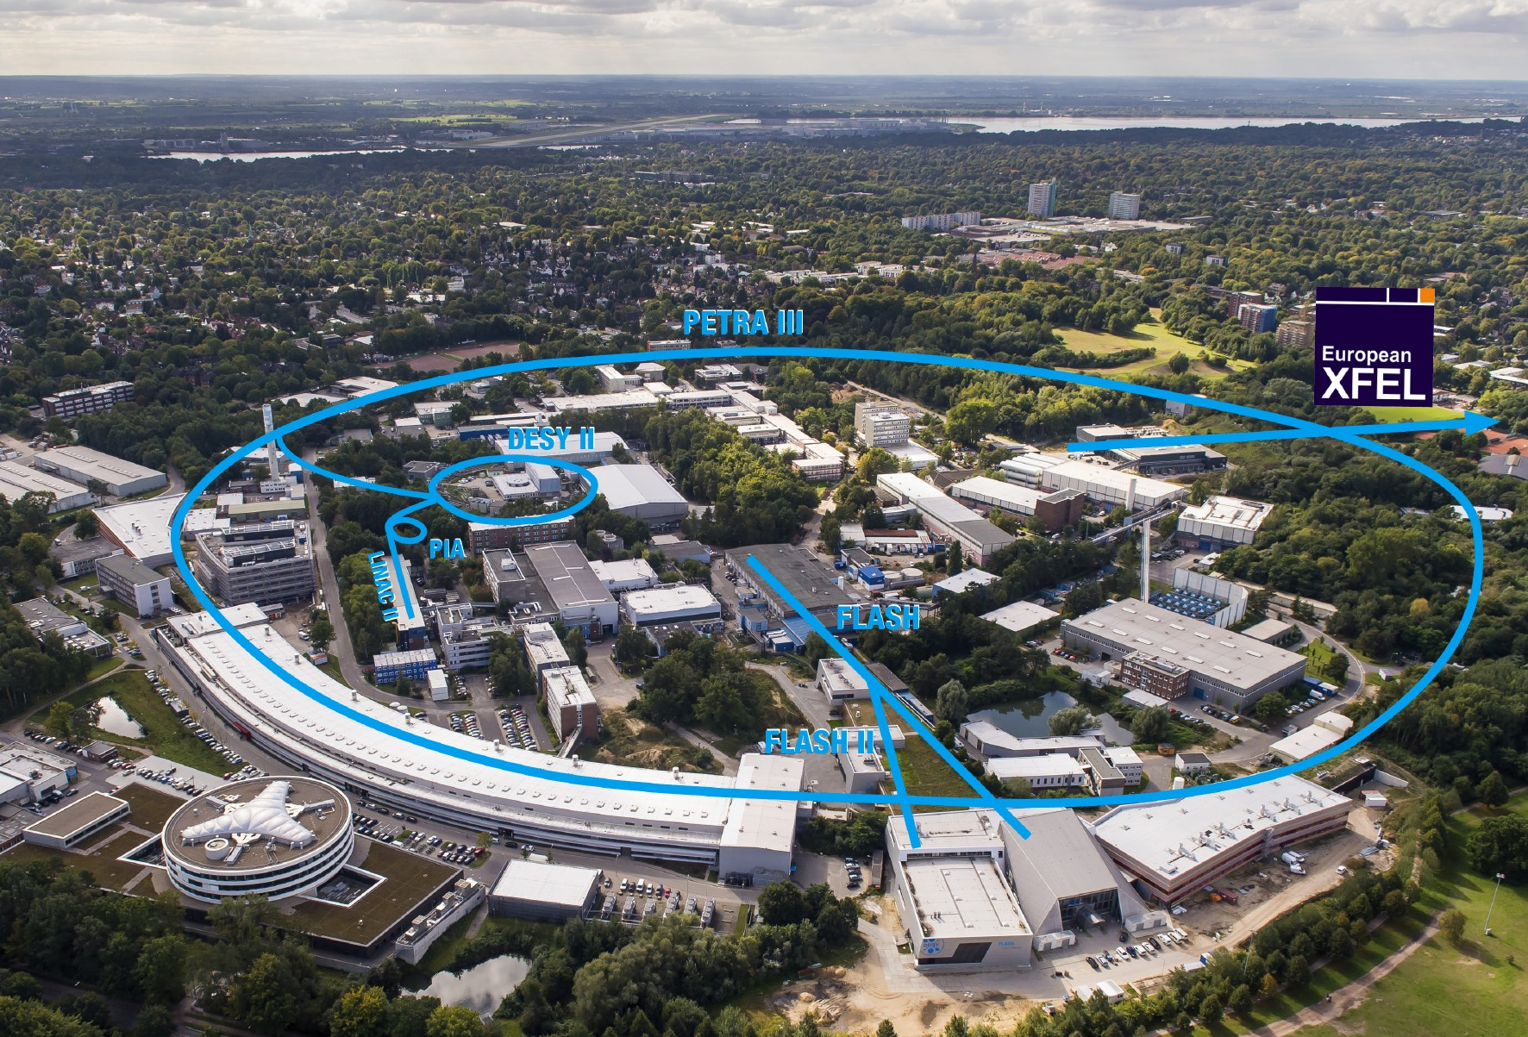
Accelerators at DESY
Notes:
3

Slide 4
PETRA III

Slide 5
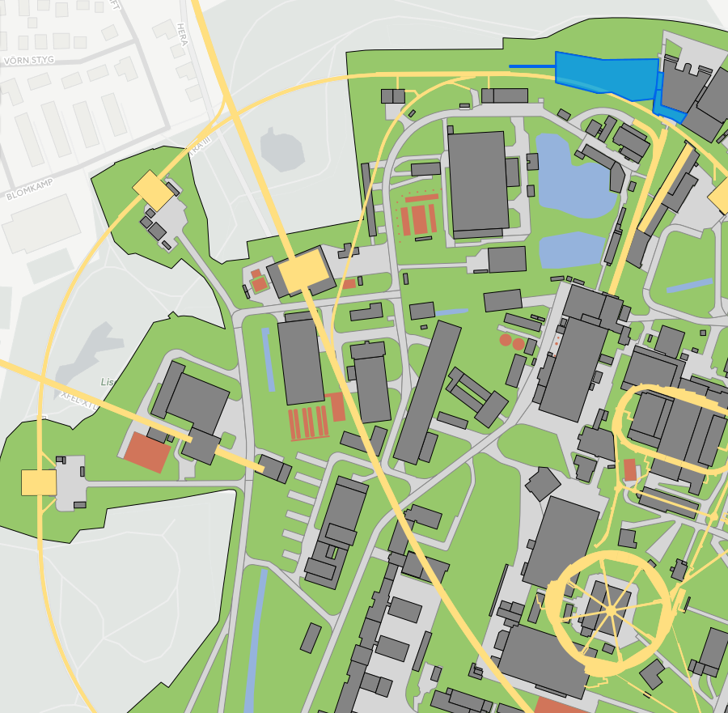
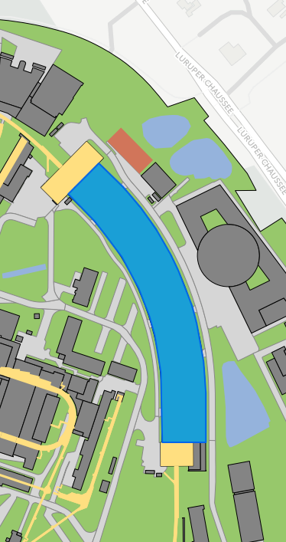
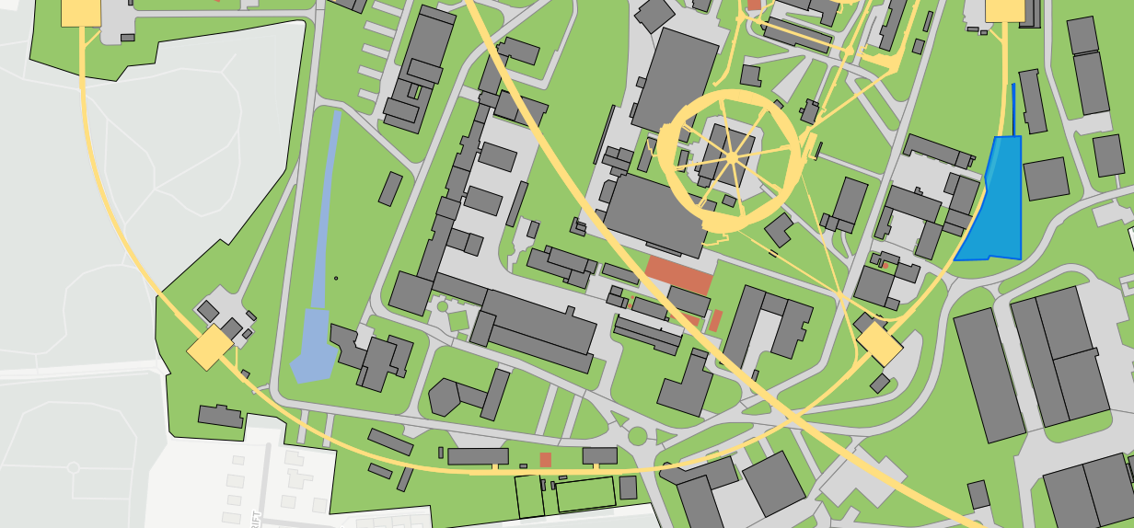
PETRA III: Basic layout and Parameters
Parameters:
circumference: 2304 m (!)
energy: 6 GeV (!)
emittance: 1,2 nmrad (!)
emittance coup.: 1% (10 pmrad!)
current: 100 mA
# bunches: between 40 (192 ns b to b) and 960 (8 ns b to b)
- straight sections: 15
- undulator-beam lines: 24
undulator length: 2, 5, 10 m

Slide 6
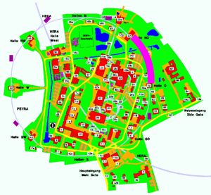
PETRA III :damping wiggler
ε_{x}: 4.5 → 1 nmrad
Damping wiggler sections
Damping wigglers
B = 1.5 T
λ = 0.2 m
h = 0.025 m
L_{tot} = 80 m (2x40m)

Slide 7
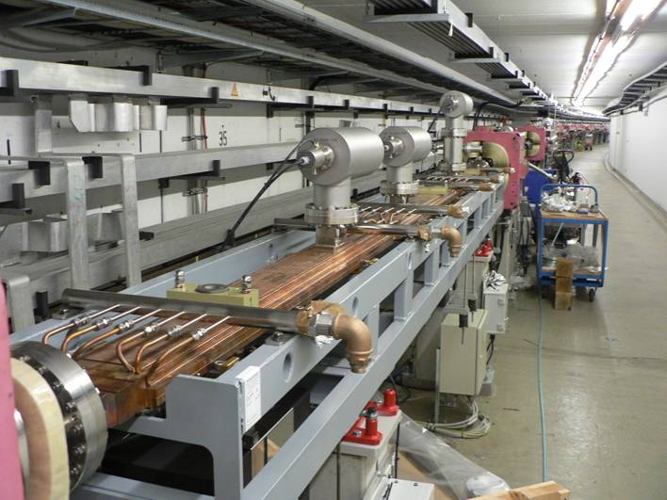
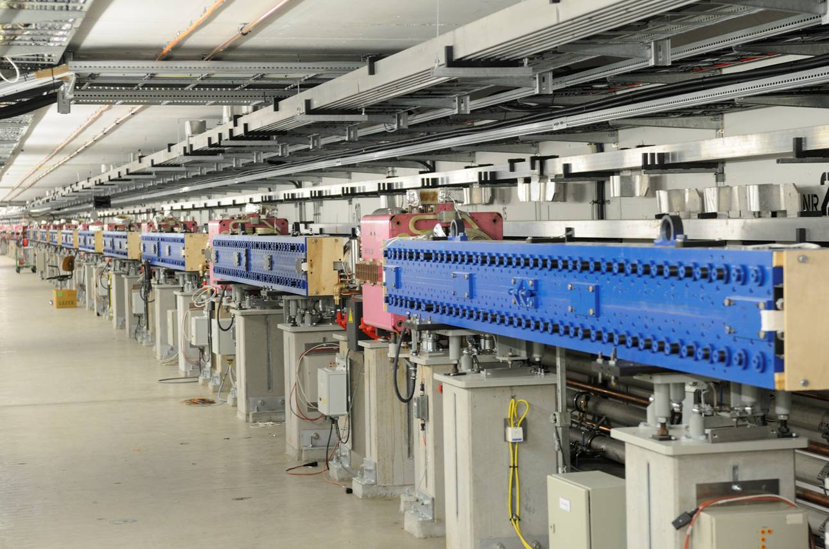
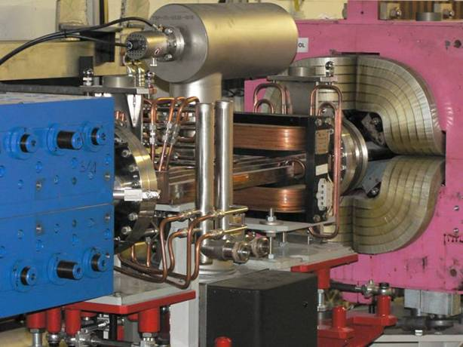
Damping Wiggler Sections (North & West)
220 kW @ 100 mA, ε_{c}=36 keV
Opening angle: 5 mrad horizontal, 0.085 mrad vertical

Slide 8
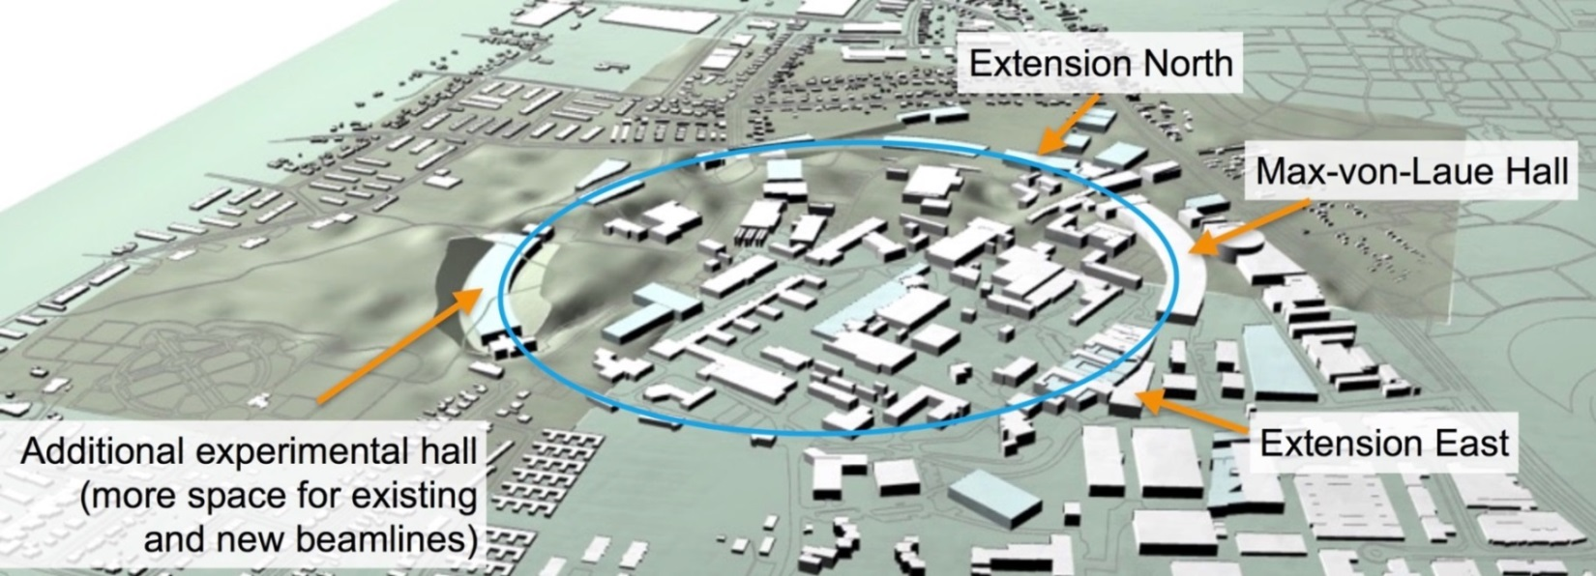
PETRA IV – Upgrade Plans for PETRA
parameters from the application for road map process:
Approach:
Investigate most challenging
design parameters
(6 GeV, 10 pm) !
bare lattice emittance ~ 20 pm
use damping undulators /
wigglers to mitigate IBS
and reduce the emittance
~10 pm (low bunch charge)
PETRA IV Parameter
Energy | 6 GeV (4.5 – 6 GeV)
Current | 100 mA (100 – 200 mA)
Number of bunches | ~ 1000
Emittance horz. | 10 pm rad (10 – 30 pm rad)
vert. | 10 pm rad (10 – 30 pm rad)
Bunch length | ~ 100 ps

Slide 9
FLASH

Slide 10
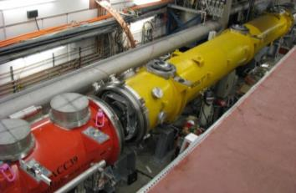
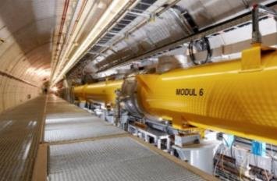
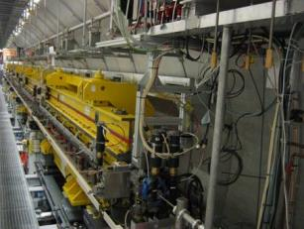
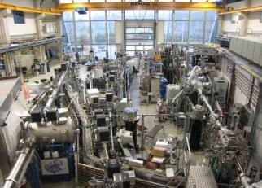
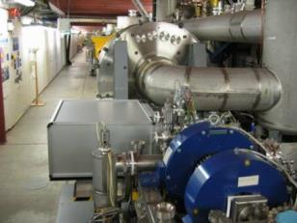
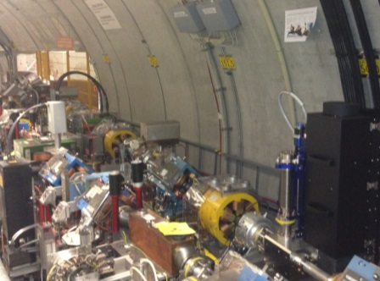
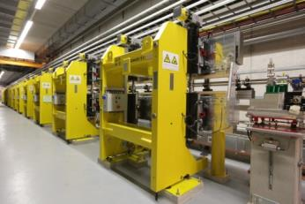
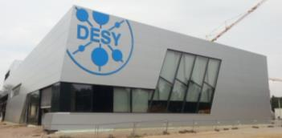
FLASH Layout 2017
3rd harmonic sc module 3.9 GHz
TESLA type superconducting accelerating modules 1.3 GHz
FLASH1 fixed gap undulators
FLASH1 Hall Albert Einstein
315 m
Soft X-ray Undulators
RF Stations
Accelerating Structures
sFLASH
Photon Diagnostics
FLASH1
THz
RF Gun
Bunch Compressors
FLASH2
Lasers
5 MeV
150 MeV
450 MeV
1250 MeV
FLASHForward
Beam Dump
FEL Experiments
Normal conducting 1.3 GHz RF gun
Ce₂Te cathode
Three photocathode lasers
Extraction to FLASH2
FLASH2 variable gap undulators
FLASH2 Hall Kai Siegbahn
Notes:
First Lasing 2000; open for experiments 2005

Slide 11
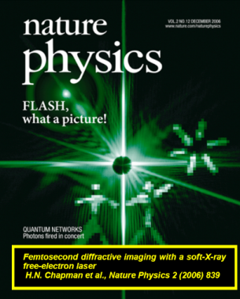
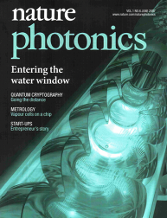
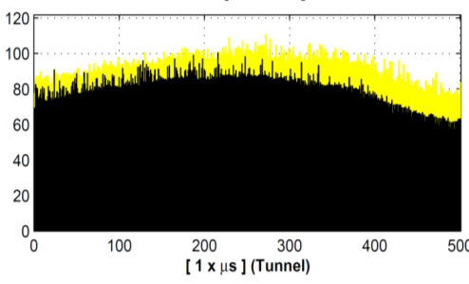
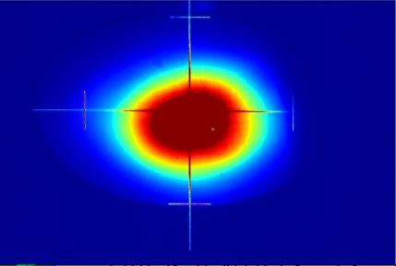
FLASH Parameters
FEL Radiation Parameter FL1 / FL2
Wavelength (fundamental) 4.2 – 51 nm / 4 – 90 nm
Single pulse energy 1 – 500 µJ / 1 – 1000 µJ
Pulse duration (FWHM) < 30 – 200 fs
Peak power 1 – 5 GW
Pulses per second 10 – 5000
Spectral width (FWHM) 0.7 – 2 % / 0.5 – 2 %
Photons per pulse 10¹¹ – 10¹⁴
Peak Brilliance 10²⁸ – 10³¹ B*
* photons/s/mrad²/mm²/0.1%bw
Energy (µJ)
Bunch number
more than 250 publications on photon science at FLASH, many in high impact journals
http://photon-science.desy.de/facilities/flash/publications/scientific_publications

Slide 12
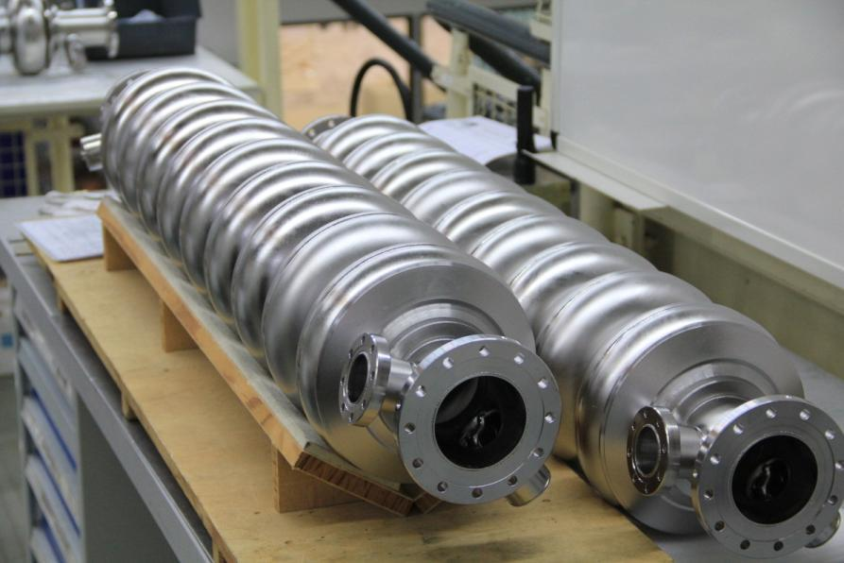
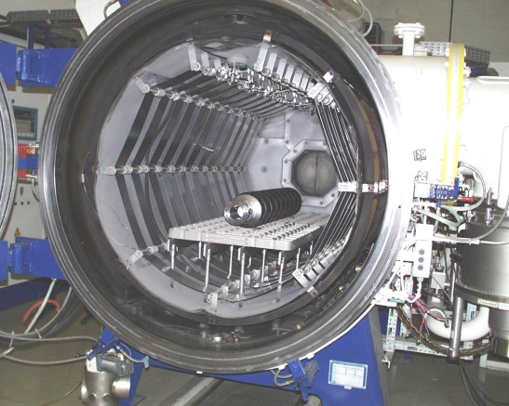
Development of super-conducting rf at DESY
Started in the midd 80-th to design cavities for HERA
Late 80-th turned to linac structures for e-beams with the focus on linear Collider
  Sc rf allows operation with long pulses and even
  cw with large acc. gradients
Test with beam within TTF (first lasing 2000)
Turning TTF into user fac. FLASH (2005)
For XFEL further improvement of technology and knowledge transfer
to industry; industrial frabication of cavities

Slide 13
Simultaneous Operation
Two photon experiments - one at FLASH1 and one at FLASH2 –
are served simultaneously, both with a 10 Hz pulse train repetition rate
Take advantage of superconducting accelerator: long RF pulse (1 ms)
→ long electron bunch train shared between FLASH1 and FLASH2
  fast kicker and Lambertson septum to extract a part of bunch train to FL2
Flexibility for photon experiments
  two undulator beamlines → different wavelengths
  three photocathode lasers → different bunch pattern and bunch charge
  flexible RF-system → different amplitude and phase
  different bunch charge and compression → different pulse durations
FLASH1
bunch train
RF signal
(amplitude, phase)
FLASH2
bunch train
No RF 99 ms
Kicker
Time
800 us
100 ms (10 Hz)

Slide 14
XFEL

Slide 15






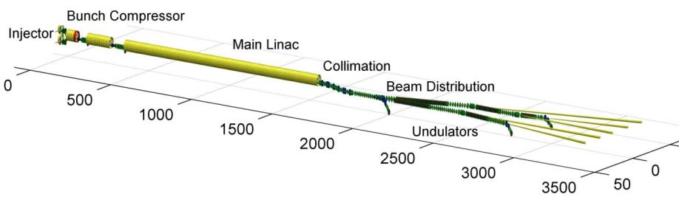











XFEL accelerator consortium – mission completed!
Notes:
Accelerator has been buit within the last 8 years – construction Installation etc.; international consortium

Slide 16
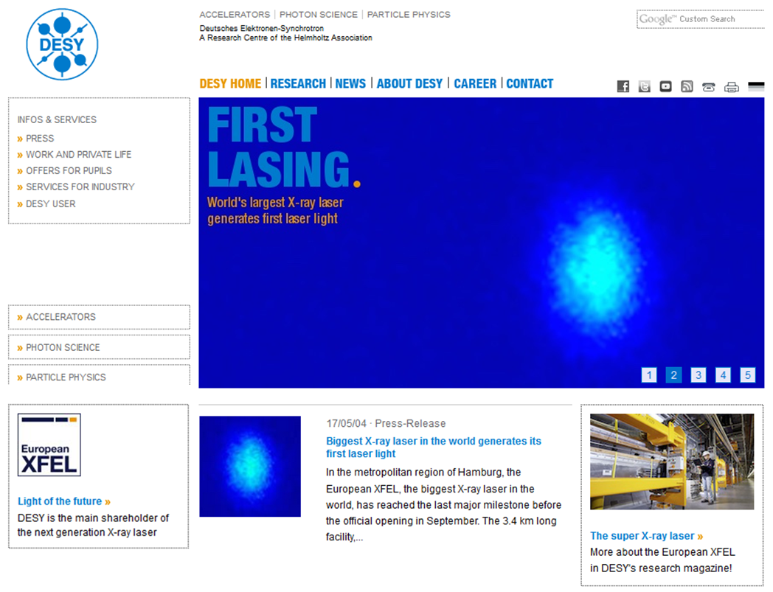
First Lasing (middle of May 2017).

Slide 17
ARD

Slide 18
ARD: Accelerator Research & Development
Develop and investigate new concepts for existing and future accelerators to open new discovery reach for HEP, photon science, other applications
  ST1: Get SRF tech ready for efficient, high-performance CW operation of FEL linacs; high-g pulsed operation will be part of and profit from this R&D for example for ILC
ST3: Advance beam control for ultra-fast science (SINBAD, PITZ, FLASH-R&D)
  Investigate generation, dynamics, characterization of (sub-) fs electron bunches with unprecedented brilliance
  Develop and make usable single fs diagnostics and synchronization
ST4: Develop novel high-gradient acceleration concepts (plasma wakefields, dielectric structures) and demonstrate usability for compact, cost effective facilities (X-ray sources, medical and industrial applications, eventually HEP)

Slide 19
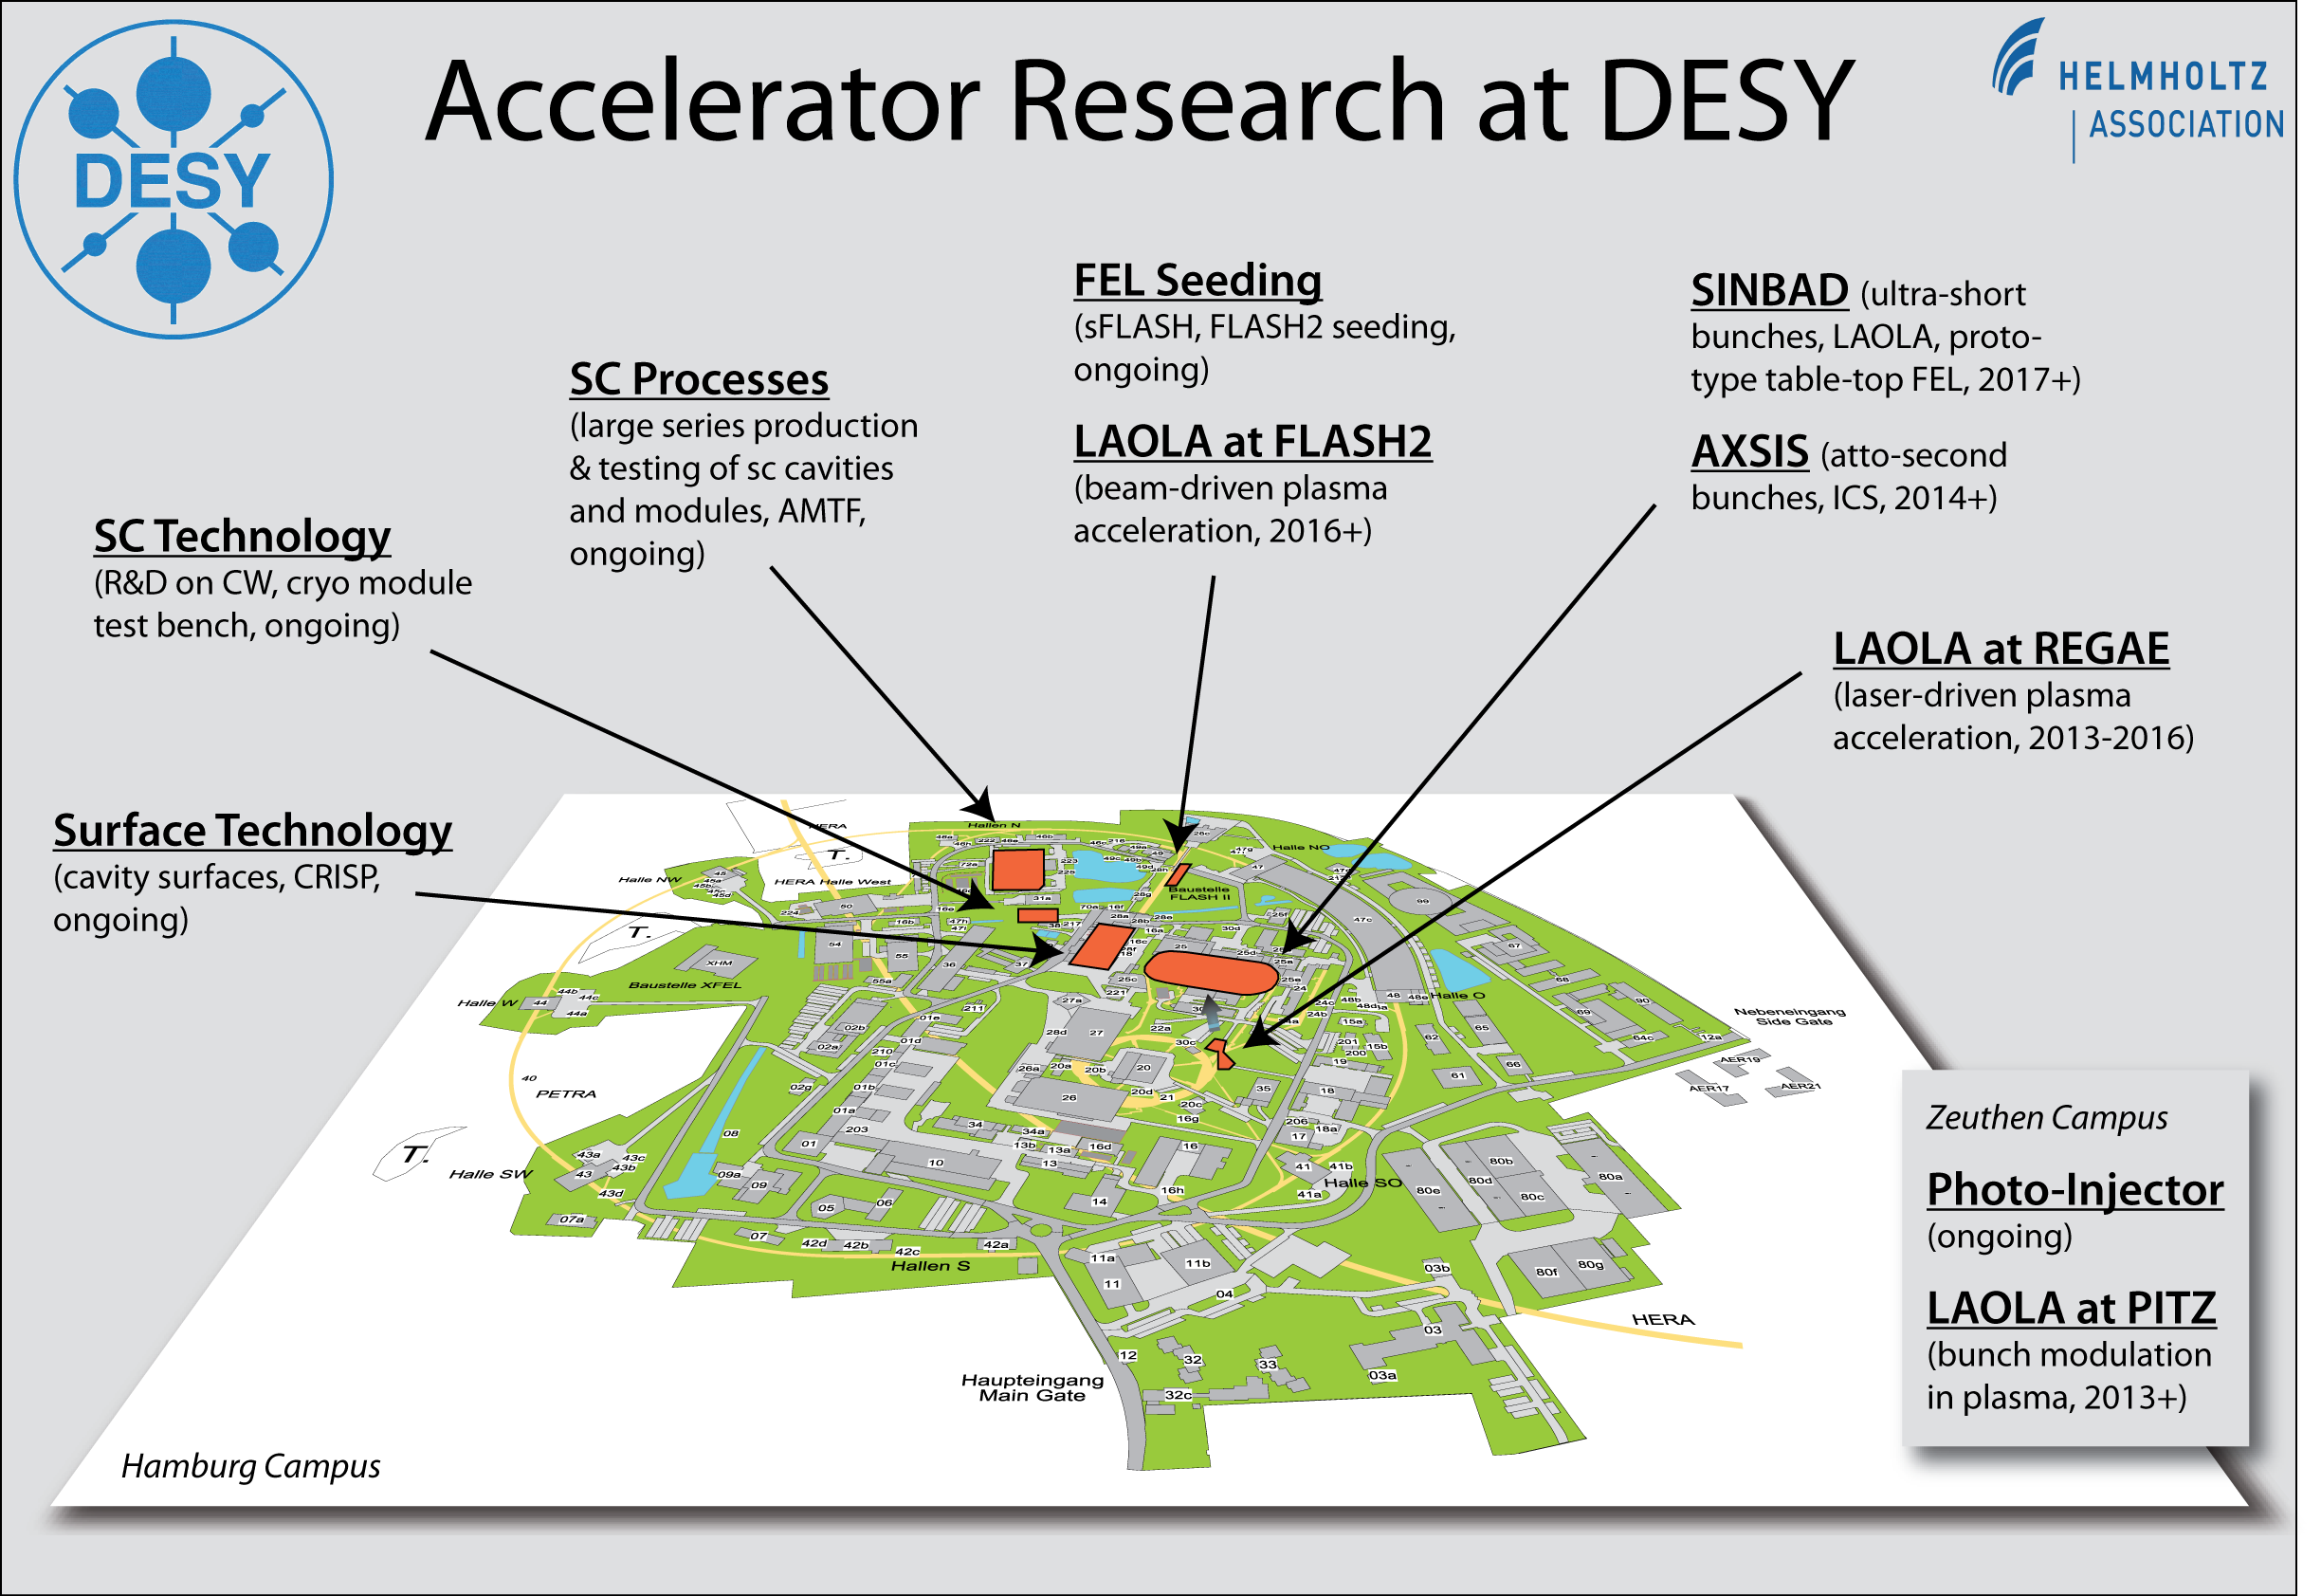
Notes:
LAOLA - Laboratory forLaser and beam driven plasma Acceleration
LAOLA at REGAE has proven proven traped electron acc. & first light from an undulator

Slide 20
Plasma Accelerator: Opportunities and Challenges
Opportunities:
  Very high accelerating fields: GV/cm 3 orders of magnitude higher than conventional rf
  Very compact FELs (short and hopefully cost effective)
  Solution for compact high energy colliders
  Very powerful focusing lens (!)
Challenges:
  Efficient drivers: very power full lasers (PW); stable operation
  Diagnostic for femtosecond or even sub-femtosecond beams with very small emittance
  Control of beam parameters and preservation of small beam dimensions (very tigh tolerances)
  Synchronization stability in the femto-second range
  Staging of plasma cells
Notes:
Length of plasma bubbles a few ten um

Slide 21
Our Novel Accelerator Strategy in One Slide
Exploratory experiments on plasma acceleration at various places at DESY: LAOLA@REGAE, LUX, PITZ, FLASHForward
SINBAD: Dedicated facility for accelerator R&D at DESY.
Aim: Atto-second electron pulses from conventional technology.
Aim: Compact 1 GeV high gradient accelerator with usable beam quality.
Aim: Pilot user experiments.
Options: Dielectric accelerators or plasma accelerators.
ATHENA: Combined program of 6 Helmholtz centers for
laser-driven plasma accelerators with usable beam quality
and new applications.
Aim: 1 GeV compact laser plasma accelerator (e-) with FEL in Hamburg.
Aim: Compact laser hadron accelerator for oncology in Dresden.
Aim: Pilot user operation.
EuPRAXIA: European Plasma Accelerator for the 2020’s.
Aim: 5 GeV compact plasma accelerator (e-).
Aim: User areas for HEP test beams, for FEL and other applications.
Options: Laser-driver is baseline, beam-driver included as option.

Slide 22
Thank you for your attention
Thanks to R. Assmann, R. Brinkmann, S. Schreiber,
R. Wanzenberg, H. Weise, …

