Slide 1
Absorption and Emission of Metamaterial Based One-Dimensional Photonic Crystals
A.R. Mkrtchyan
Institute of Applied Problems of Physics of NAS RA
Yerevan, Armenia
RREPS-2017

Slide 2
Abstract
The features of absorption and emission in metamaterial-based one-dimensional photonic crystals with continuum distribution of the refraction index is investigated. For determining the reflection, transmission, absorption, the field arising in the medium etc. a theory is presented. The case where the medium is periodically inhomogeneous with respect to both the dielectric and magnetic properties is considered. The features of the zone structure, absorption and emission are discussed. At normal light incidence, the medium exhibits the same reflection, transmission and absorption for s- and p- waves; however, as it was shown the modulation of light for these waves is different in the media. It is shown that the absorption suppression effect takes place in the photonic band gap. Near the band edges, the effects of anomalously strong absorption and anomalously weak absorption take place, and this depends on whether the absorption is due to the imaginary part of the dielectric permittivity or the imaginary part of the magnetic permeability. In the presence of periodic inhomogeneity of absorption, these effects are expressed more strongly. They also depend on whether the absorption varies with the real part of the corresponding permeability in-phase or out-of-phase.

Slide 3
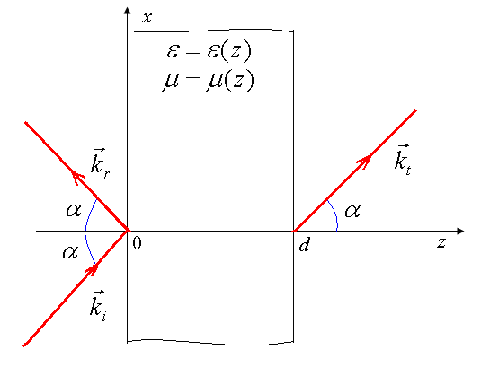
Let us consider light reflection and transmission through a finite layer of a PC. We assume that the medium layer is sandwiched between the planes z = 0 and z = d (d is the layer thickness) and the parameters ε and μ of PC are functions of the z coordinate (medium axis; ε is the dielectric permittivity and μ is the magnetic permeability of the PC layer). Here we consider the following expressions for these parameters:
where Δε and Δμ are the modulation depths of the corresponding parameters and K=2π/Λ , where Λ is the spatial period of the modulation.
Fig.1. The geometry of the problem

Slide 4
In accordance with our modified theory (which obtained after transformation of Maxwell's equations taking into account boundary conditions), the transmission and reflection amplitude coefficients and for the layer that has a refractive index
and borders with the isotropic lossless dielectric with refractive index
on both sides can also be expressed by these functions:

Slide 5
The functions F ^{s,p} and Q ^{s,p} are the solutions of the following system of differential equations:
with the initial conditions
Here

Slide 6
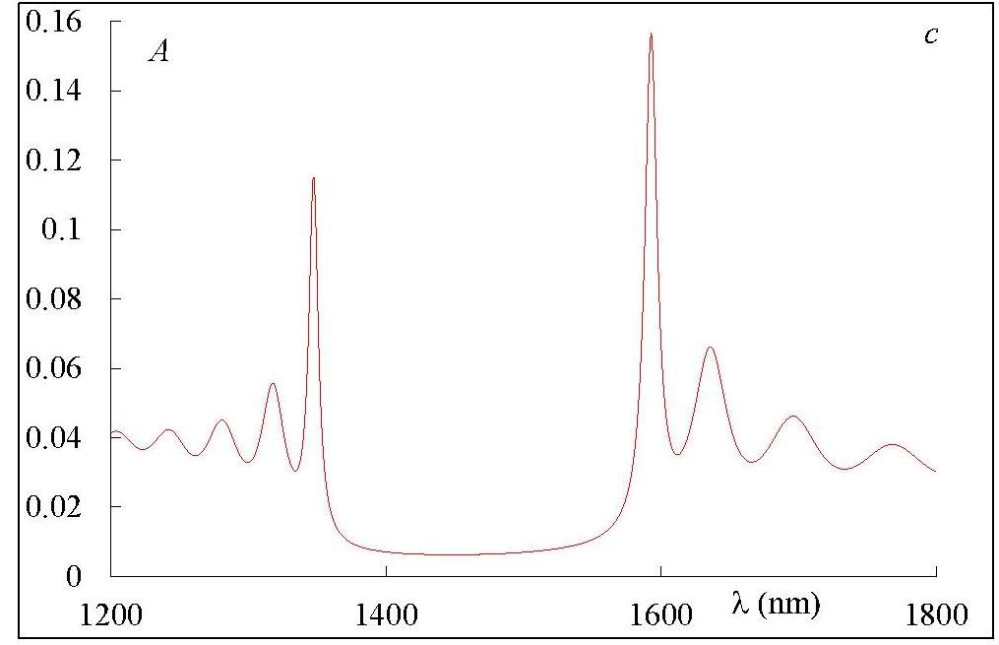
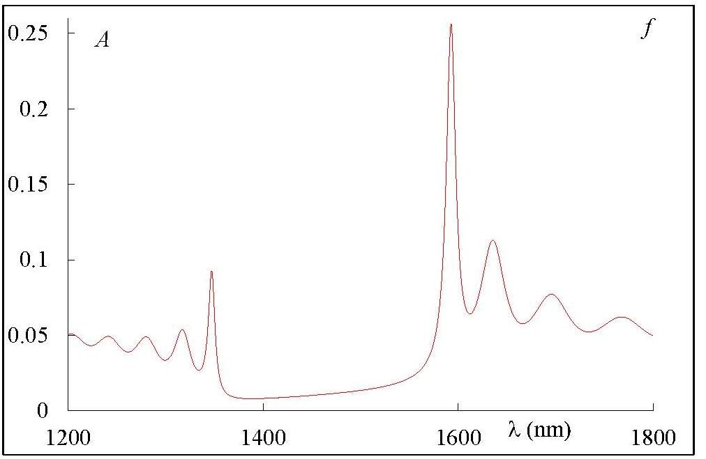
Without metamaterials
With metamaterials
Fig.2. The spectra of absorption at normal light incidence.

Slide 7
$λ=1413nm$, оn this wavelength in PBG the wave in 1D PC is evanescent, it decreases exponentially oscillating, penetrates little into the interior of the medium, and therefore the absorption is small and suppression of absorption takes place.

Slide 8
1. s- polarization
p- polarization
$λ=1347nm$(the first short-wave minimum). Here the envelope of light field oscillations is like sinus in the interval [0; π]. The maximum of this envelope is in the center of PC layer and the two minimums coincide with PC layer boundaries. Then, here the amplitude of the total wave in the center of PC layer is much larger than the one outside the PC layer or for the other wavelengths inside the PC layer. Here the accumulation of radiation in the center of the PC layer takes place. The light energy density in the specimen for this wavelength is maximum and is much larger than that outside the specimen or than that in the specimen but for other wavelengths. That is why the existence of small absorption (small values of Imε(z) (or Imμ(z)) causes the light anomalous strong absorption.

Slide 9
$λ=1335nm$(the first short-wave maximum). Here the envelope is like sinus but in the interval [π/2; 2π] having two maximums and two minimums. The first maximum of this envelop coincides with the left boundary of PC layer, while the second minimum coincides with the right boundary. However, the heights of these maximums are much smaller than the ones at the wavelengths of corresponding reflection minimum. Therefore, as in this case, the energy density in the specimen is small, and strong absorption takes place only in the small region of the medium and the integrated absorption of the radiation received is weak.

Slide 10
1. s- polarization
p- polarization
$λ=1317nm$(d: the second short-wave minimum). Here on the second minimum of the diffraction reflection this envelop already like sinus but in the interval [0; 3π] and with a comparatively small height in envelope maximum. Therefore, on this wavelength anomalous (strong) absorption expresses itself more weakly. At the third minimum, this envelope has three maximums, etc.

Slide 11
Refraction index modulation

Slide 12
Conclusions
We have investigated the peculiarities of the absorption and emission in metamaterial-based 1D PCs with continuum distribution of the refraction index.The absorption effects are revealed and it is shown that the absorption of light by the PC strongly depends whether it is caused by nonzero imaginary part of the dielectric permittivity (i.e., near the ferroelectric resonance) or by nonzero imaginary part of the magnetic permeability (i.e., near the ferromagnetic resonance).The mechanisms of absorption suppression in PBG and the mechanisms of anomalous strong (weak) absorption outside the PBG are revealed. It is shown that the anomalous strong absorption is due to large light energy accumulation. However, it is not the only mechanism. Some of the observed regularities are also observed in chiral photonic crystals (cholesteric liquid crystals, chiral smectics, etc.).

Slide 13
Conclusions
However, if in the latter they are due to the peculiarities of modulation of the amplitude and polarization of the total wave arising in the medium, while, here they are due to the peculiarities of the modulation of the amplitude of the total wave arising in the medium. The obtained results can be used in the design of low-threshold lasers, in systems strongly absorbing light at certain wavelengths and when designing systems with absorption suppression created on the basis of absorbing media, etc.
Let us note that in metamaterial-based 1D PCs these effects can expressed more strongly.
Let us also note, that introducing in the system ferroelectric or ferromagnetic nanoparticles we can essentially control the optical properties of discussed system.
So, choosing corresponding metamaterial we can obtain media with before given properties.
It should be noted that in previous works using metamaterials we can obtain terahertz frequency sources based on difference of the optical and metamaterials generation frequencies.

Slide 14
Thank you for your attention!
International Conference Meghri-17
Organizer committee
and
IAPP NAS Armenia
with Pleasure are Inviting You
to Armenia, October 16 – 22, 2017.
Institute of Applied Problems of Physics of NAS RA, Yerevan, Armenia
Artak Mkrtchyan and Alpik Mkrtchyan

