Slide 1
Laue lens development for hard X-ray and neutron with controllable parameters
V.R. Kocharyan
Institute of Applied Problems of Physics of NAS RA
Yerevan, Armenia
e-mail: vahan2@yandex.ru
RREPS-2017

Slide 2
The reflection of hard X-ray (over 30 keV) and thermal neutron beams from a quartz single crystal was investigated in the Laue geometry under the external influences.
The controllability of X-ray and neutron beam in space and time is analyzed and its parameters are estimated (relative maximum intensity, the angular and energy distribution of obtained beams etc.).
RREPS-2017

Slide 3
DIFFRACTION OF THERMAL NEUTRONS FROM QUARTZ CRYSTAL
UNDER THE EXTERNAL TEMPERATURE GRADIENT
The scattering of thermal neutrons in crystal is described by the Schrödinger equation
where Ψ(r) - is the neutron wave function, V (r) - the interaction potential of neutron in crystal, k and m - the wave number and mass of neutron, correspondingly, and ħ - the Plank constant.
The interaction potential for deformed crystals is as follows:
where Vm -are the Fourier amplitudes of the potential, hm -the vector of reciprocal lattice and r the radius vector, U(r) is a function of atomic displacement in crystal from equilibrium position.
RREPS-2017

Slide 4
The wave function of neutrons in the crystal is described by the Bloch function with variable amplitudes
where Ψn(r) slowly varies in stretches about de Broglie wavelength for neutrons.
After substitution of (V(r)) and (Ψn(r)), and neglect of the second order infinitesimal terms In the two-wave approximation the Schrödinger equation takes the following form:
RREPS-2017

Slide 5
We consider the diffraction of thermal neutrons on X-cut quartz crystal for the symmetric Laue geometry under temperature gradient perpendicular to the reflecting atomic planes (10-11). In this case h has only hx component and, hence, only Ux(x, z) component of displacement function can be considered, and at definite distance from a heating face of crystal Ux may be represented as
where t - is the crystal thickness, R - the radius of curvature of reflecting atomic planes.
Assuming that a plane monochromatic wave is incident on the crystal, the boundary conditions on the front surface of crystal corresponding to z = 0 , will be:
RREPS-2017

Slide 6
Using boundary conditions and displacement function, we finally have for Ψh (z)
where

Slide 7
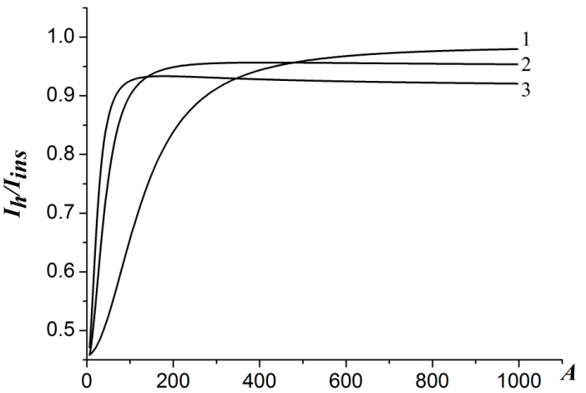
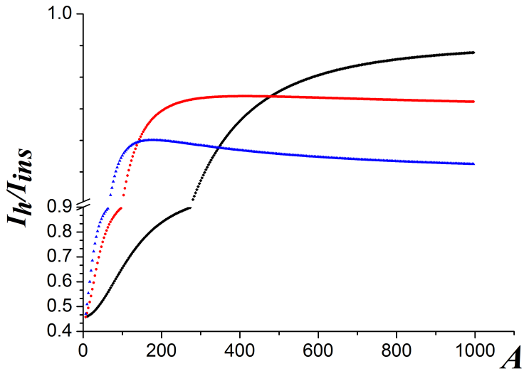
The pumping of neutron beam from the direction of the passage in the direction of reflection
It is seen in the figure that the intensity of reflected beam increases with decreasing curvature in reflecting atomic planes, reaches the maximum value (i.e. the plane monochromatic beam of thermal neutrons fully pumped to the reflection direction), and then slowly decreases.-
Intensity of reflected beam of thermal neutrons with energy of 50 meV vs the deformation parameter of (10 11) reflecting atomic planes for thicknesses of quartz single crystal:
(1) t = 1 cm, (2) t = 3 cm and (3) t = 5 cm.
RREPS-2017

Slide 8
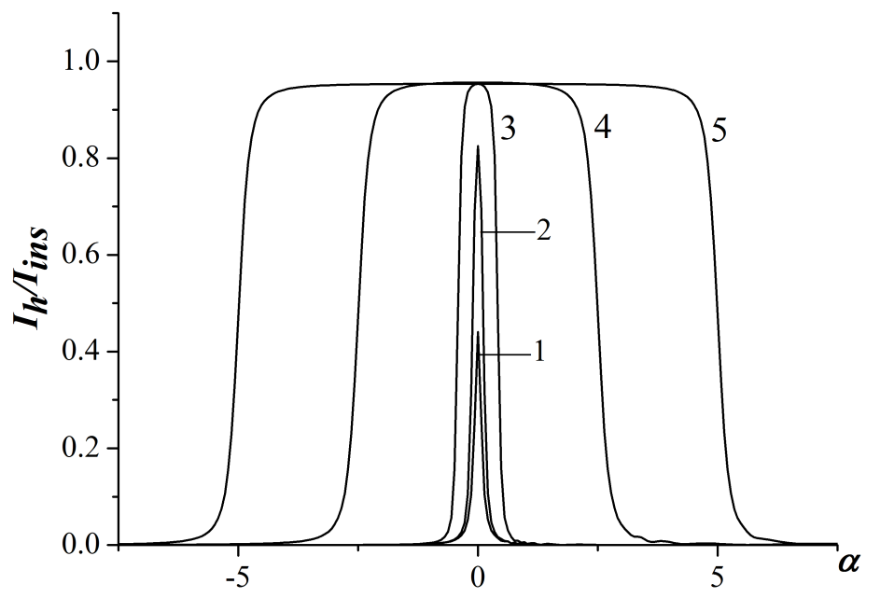
As is seen in the figure, with increasing A (decreasing radius of curvature) the rocking curve is slowly widened, and the maximum value of relative intensity is increased by reaching unity (case of full pumping). The rocking curves abruptly widen as the radius of curvature of reflecting plane further decreases. Later, we will be seen similar behavior in the X-ray beam experiments
Rocking curves of reflecting atomic planes (10 11) of 3 cm thickness quartz single crystal for different values of A parameter: (1) A = 0, (2) A = 70, (3) A = 250, (4) A = 500 and (5) A = 1000.
RREPS-2017

Slide 9
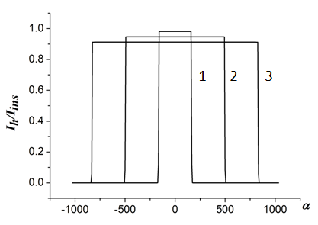
It is seen from the figure that at a certain value of A parameter the thicker is the crystal, the wider is the rocking curve, i.e., the greater is the angular aperture of fully pumped beam of thermal neutrons. For example, 1 cm thickness quartz single crystal, the atomic planes of which have 10m curvature of camber, completely reflects thermal neutrons with angular aperture ~6–7', and 5 cm thickness crystal completely reflects ~30'. When the radius of curvature of reflecting atomic planes (1011) of the quartz single crystal is ~1 m, thermal neutrons fully pumped with angular aperture of ~3°.
Rocking curves of reflecting atomic planes (10 11) of quartz single crystal for the value of A = 10000 (radius of curvature 10m) for thermal neutrons with an energy of 50meV:
(1) t = 1 cm, (2) t = 3 cm, (3) t = 5 cm.
RREPS-2017

Slide 10
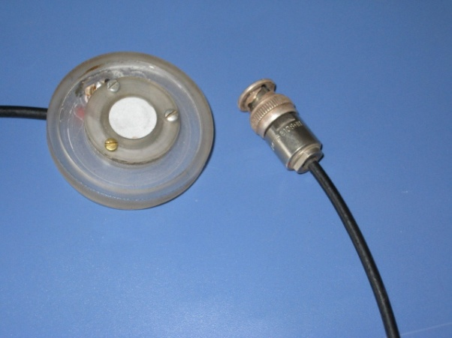
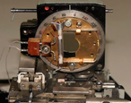
In our institute (IAPP NAS Armenia) it has been experimentally and theoretically shown that with the help of the presence of external acoustic field and temperature gradient in the quartz crystals it is possible to fully pumped X-ray beams from the passing direction to the reflection direction, angular width of fully pumped X-rays is directly proportional to the thickness, to control of the reflected X-rays intensity and the focus location.
RREPS-2017

Slide 11
As the thermal neutrons are absorbed much less as compared with X-rays (the absorption length ~50 cm), one can separate from a primary beam a neutron beam with large spectral and angular with used quartz crystal of several centimetres thickness with a temperature gradient or acoustic field. Taking into account the fact that a thermal neutron De Broglie wavelength is comparable with the wavelength of electromagnetic radiation in the X-ray range, the expected effects for neutrons should be the same as for hard X-rays, for which absorption is also small.
RREPS-2017

Slide 12
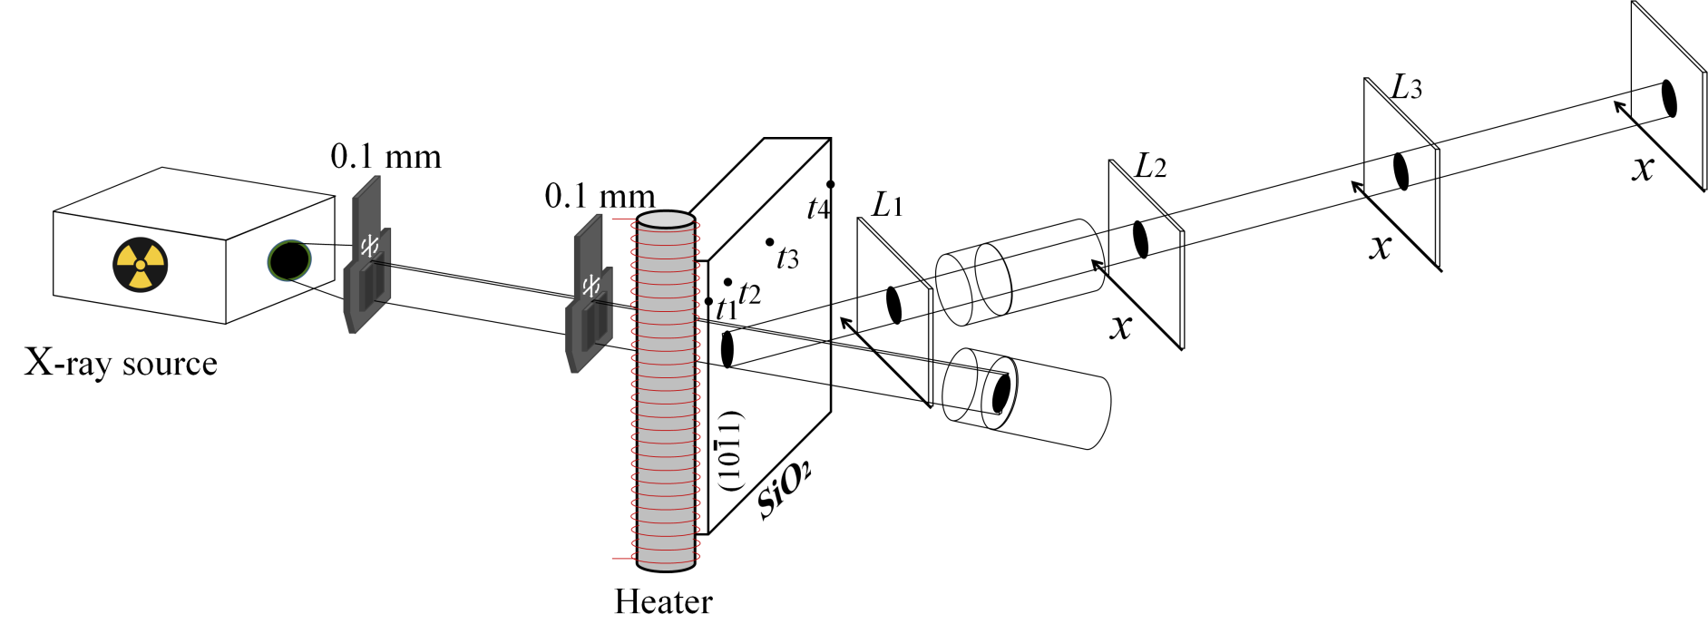
In this work, aiming to obtain basic elements of hard X-ray and neutron optics with controllable parameters, we consider the principles and features of the reflection of hard X-rays from quartz single crystal in Laue geometry under the influence of temperature gradient in the range higher than 30 keV.
In the experiment the white spectrum of X-rays was used, generated from the X-tube Mo BSV-29 with the anode current of 10 mA under the voltage up to 50 kV.
RREPS-2017

Slide 13
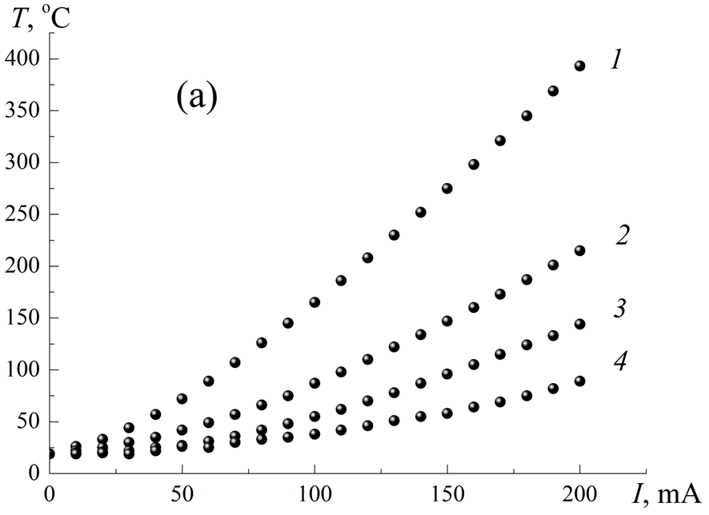
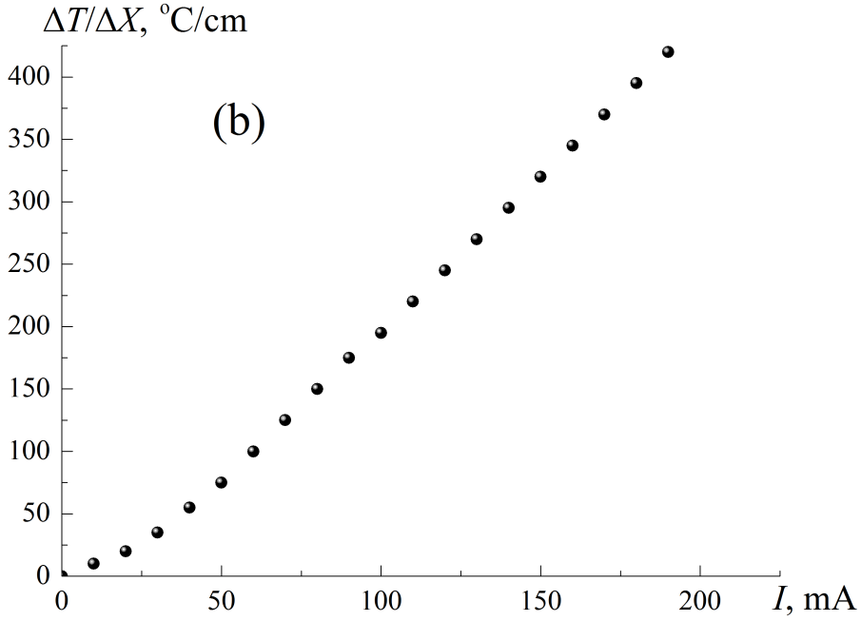
Temperature distribution on the surface of a crystal
a) Dependences of temperature at the points t1 = 0 mm (curve 1), t2 = 4 mm (curve 2), t3 = 15 mm (curve 3) and t4 = 30 mm (curve 4) of the current value of the heater spiral.
b) Dependences of temperature gradient of the current value in the region between the points t1 and t2 , where was incident X-rays.
RREPS-2017

Slide 14
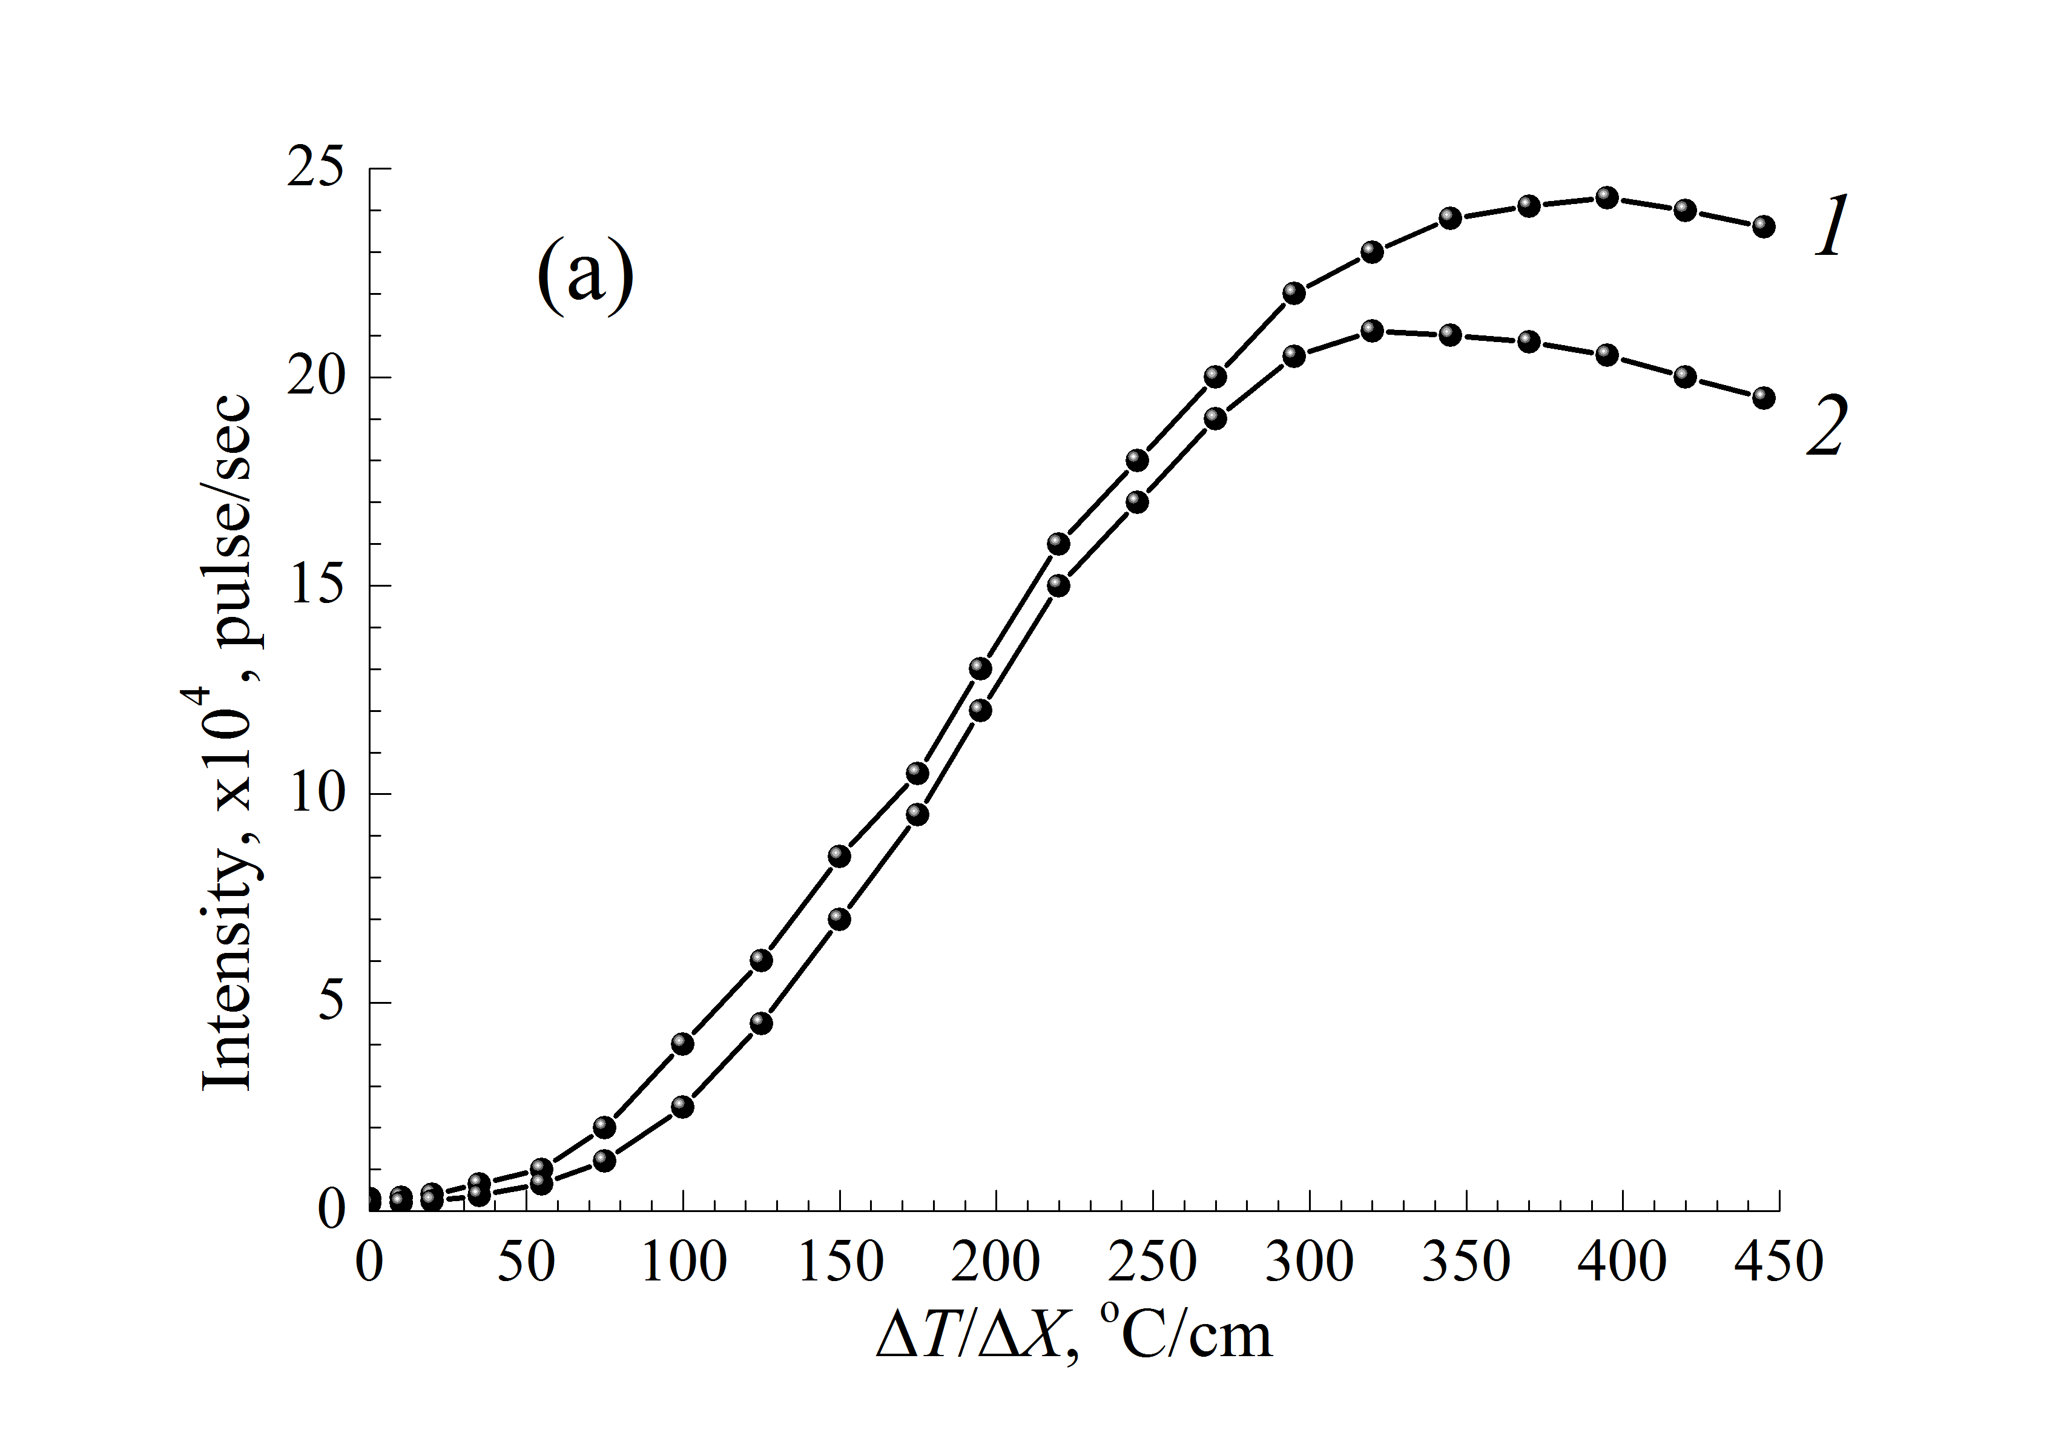
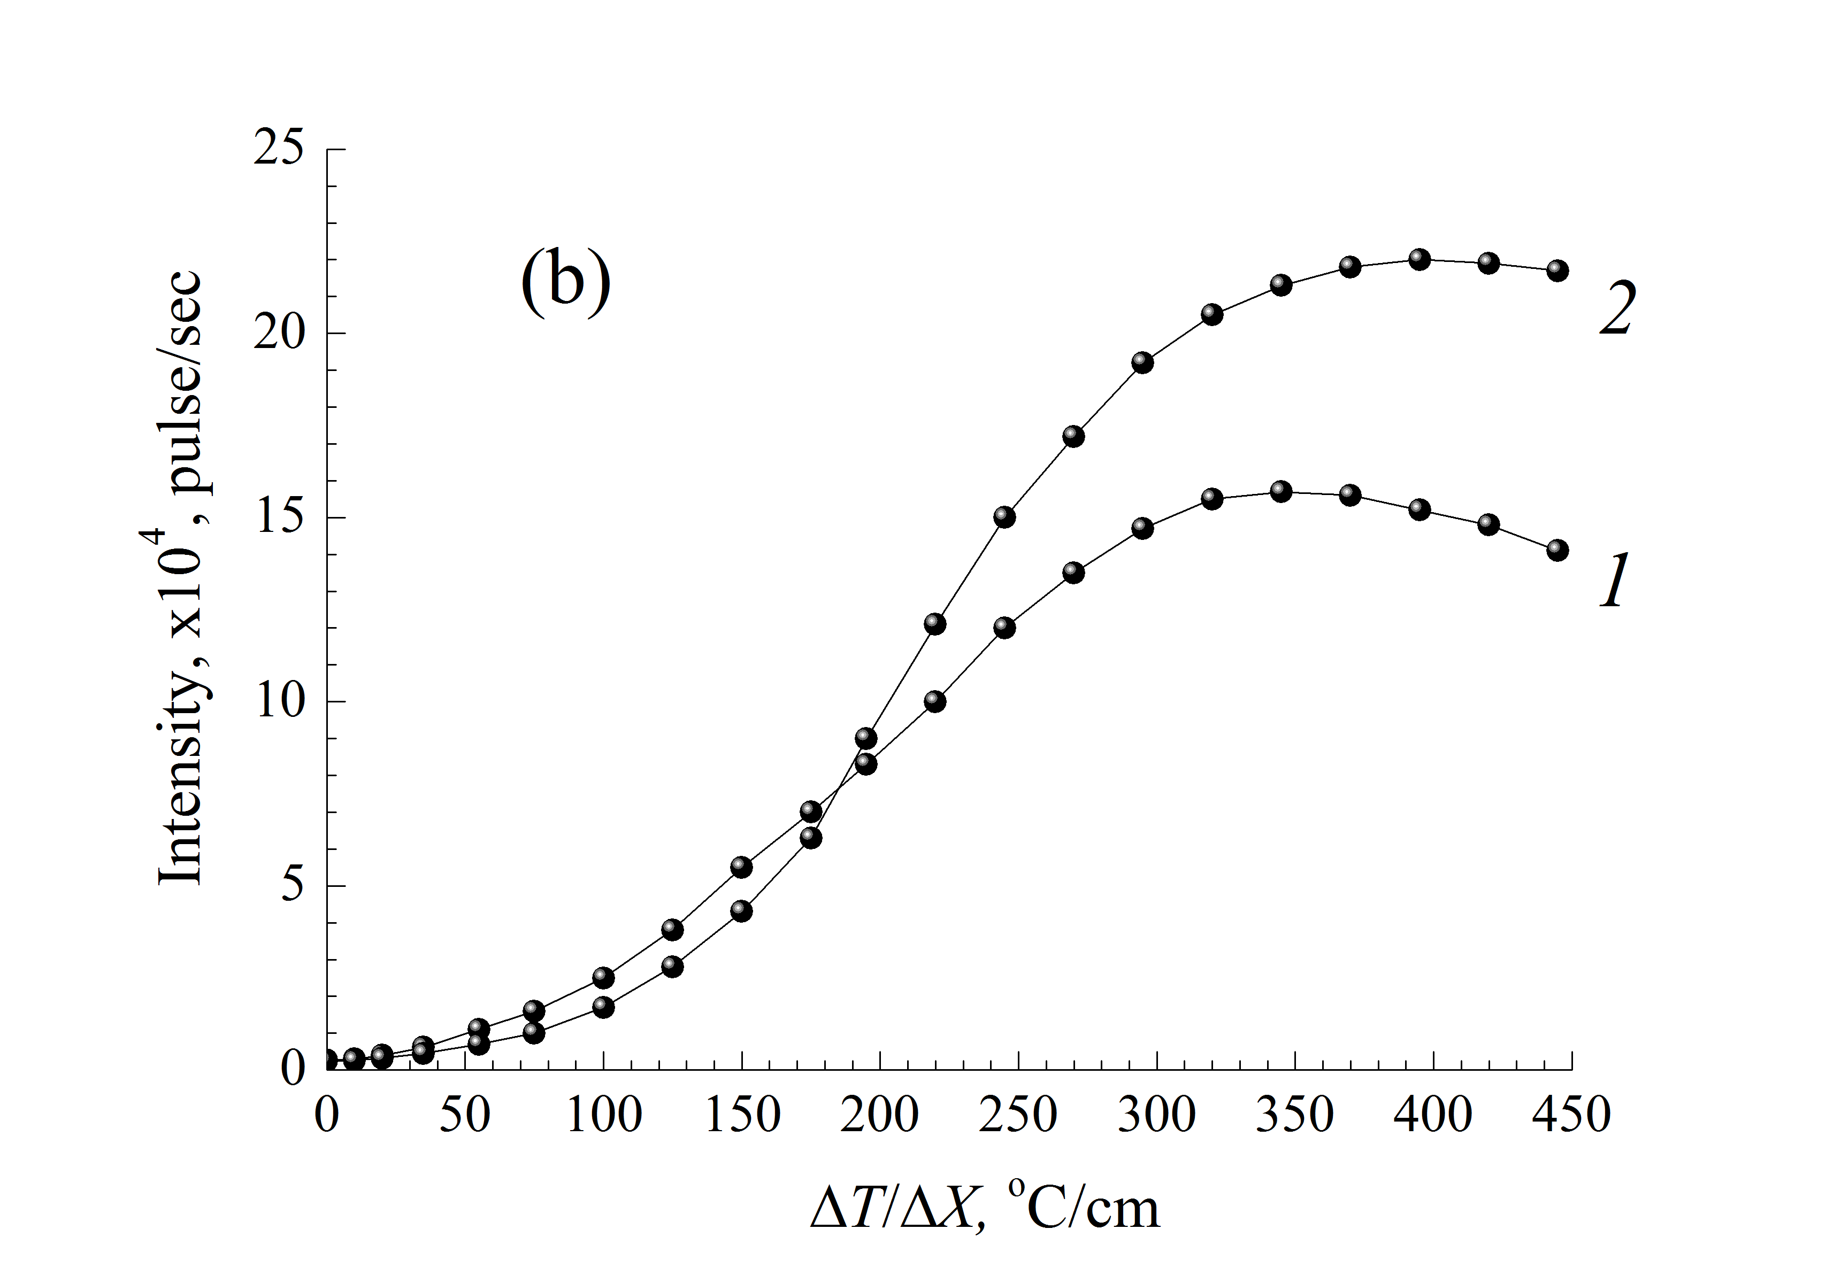
The pumping of hard X-rays from the direction of the passage in the direction of reflection
The dependence of the intensity of the reflected X-rays on the value of temperature gradient. The thickness of a single crystal is 6mm (1) and 9mm (2).
For energy 30keV,
For energy 40keV.
It is seen in the figure that the intensity of reflected beam increases with temperature gradient, reaches the maximum value, and then slowly decreases.
RREPS-2017

Slide 15
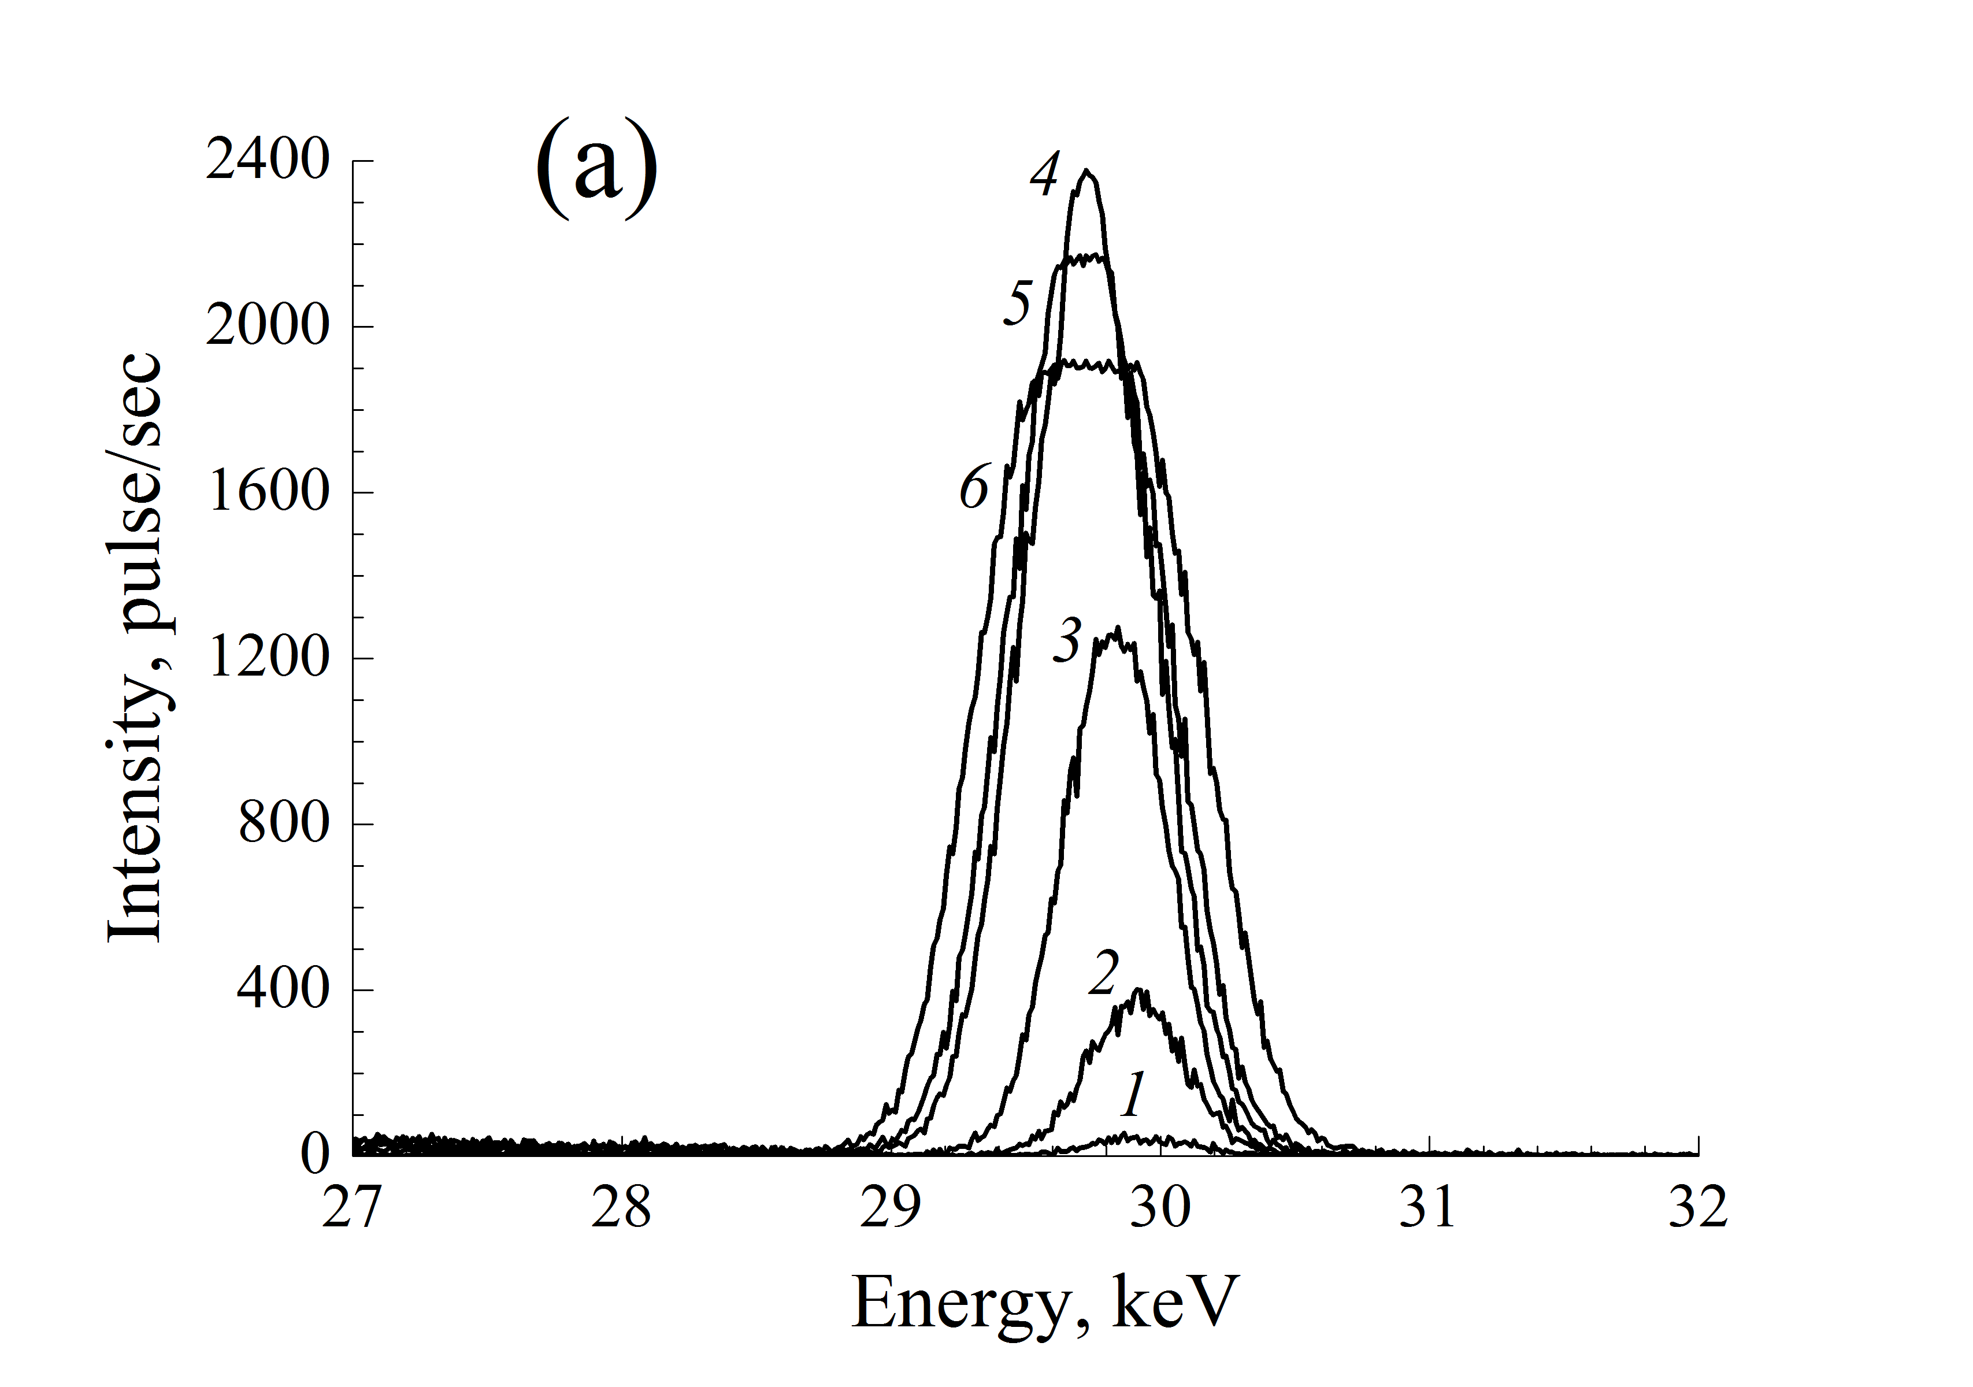
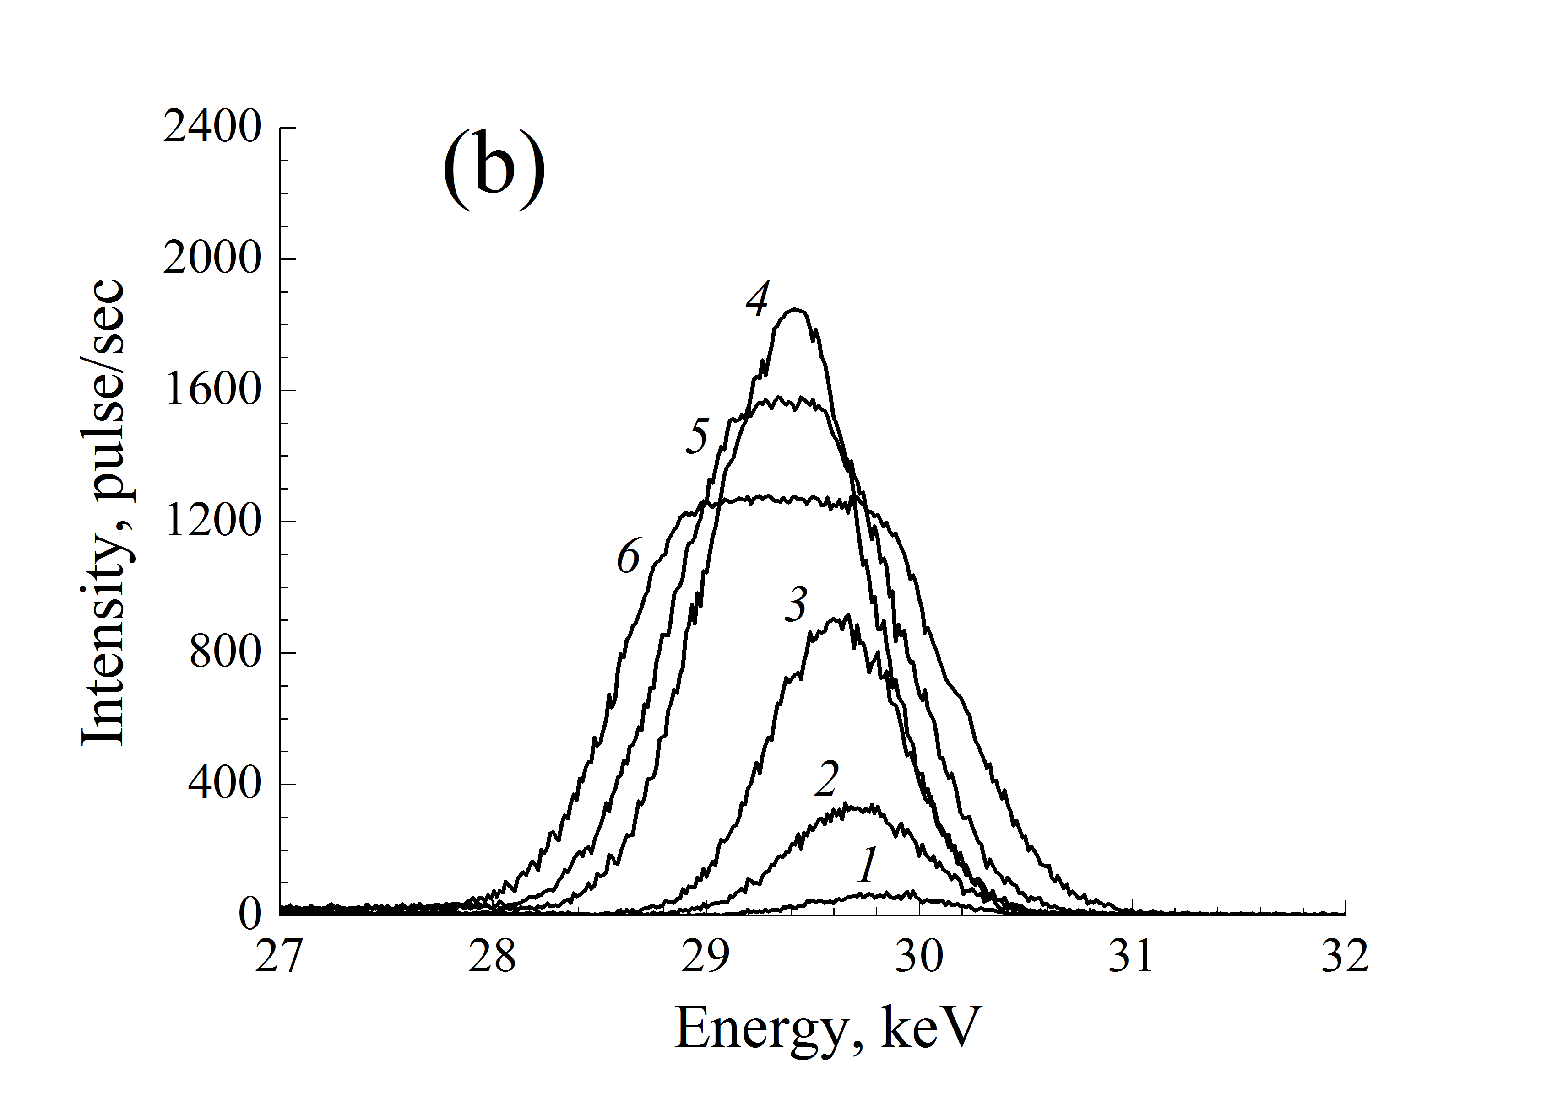
The spectral distribution of the reflected beam
The spectral distribution of the reflected beam from the (10-11) atomic planes of quartz crystals with thicknesses of 6mm (a) and 9mm (b).
1) ߡT/ߡx=0 K/cm, 2) ߡT/ߡx=50 K/cm, 3) ߡT/ߡx=180 K/cm, 4) ߡT/ߡx=270 K/cm, 5) ߡT/ߡx=360 K/cm, 6) ߡT/ߡx=450 K/cm.
The spectra were taken by the XR-100CR detector with a resolution of 270eV at line Am241 17.74 keV. As seen from the figures, depending on the thickness of the quartz crystal it is possible to select from the primary beam of X-rays with a different energy strip and throw it in the direction of reflection. Thus from the spectra of the reflected X-rays seen that with increasing values of the temperature gradient occur multiple increase in the intensity and broadening of the spectrum (that is caused by the curvature of the reflecting atomic planes) and displacement of the spectrum to the direction of low energy (due to the increase in the interplanar distances reflecting atomic planes).
RREPS-2017

Slide 16
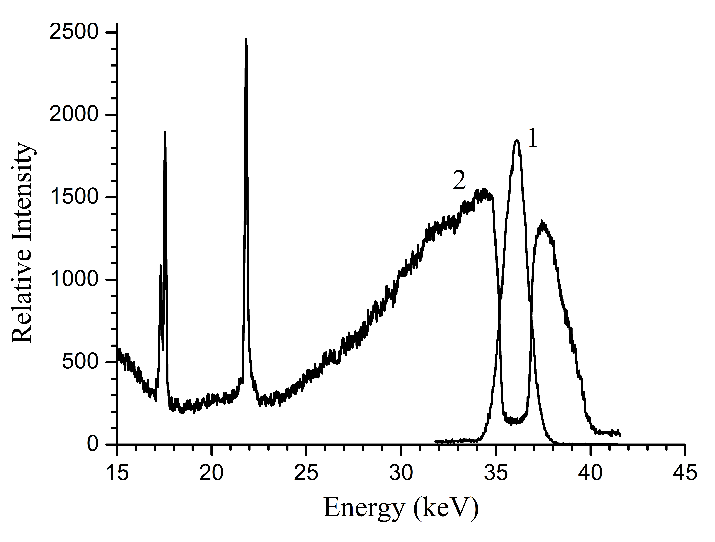
It is seen that for the certain value of temperature gradient the X-rays of ≈2keV width are fully pumped from the passing direction into the reflection direction.
The spectral distribution of the reflected and passing beams from the (10-11) atomic planes of quartz crystals with thicknesses of 10 mm, when ߡT/ߡx=360 K/cm.
RREPS-2017

Slide 17
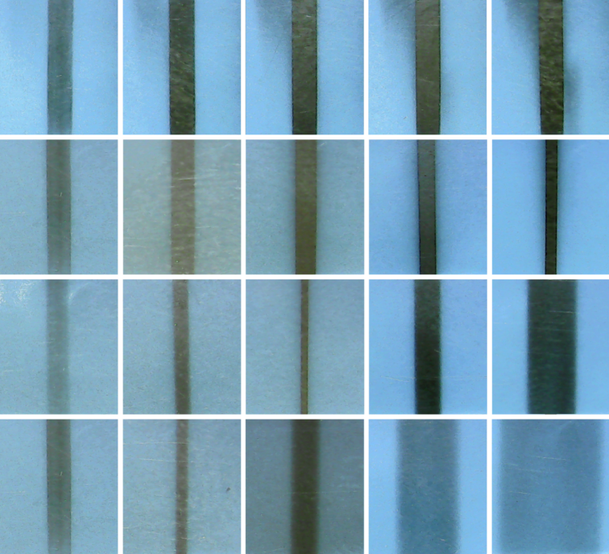
The focus of the reflected X-rays
Experimentally considered the dependence of focus position of the reflected X-rays on the value of the temperature gradient. To find the location of the focus of X-rays at the distances of L1 (4 cm), L2 (35cm), L3 (70cm) and L4 (110cm) from the sample were taken frontal section of the beam with and without influence of a temperature gradient. It is seen that with the increase of temperature gradient the focus of X-rays become closer to the crystal.
0 100 150 200 250 K/cm
L₁
L₂
L₃
The thickness
of the crystal
L₁
6mm
L₂
The thickness
of the crystal
9mm
6mm
L₃
250 K/mm
L₄
-
The frontal section of the reflected X-rays from the reflecting atomic planes (1011) of single crystal quartz with different values of the temperature gradient.
RREPS-2017

Slide 18
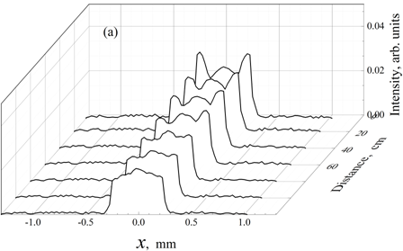
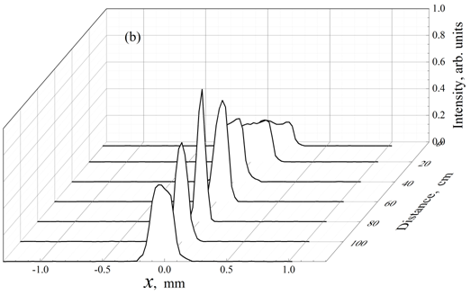
As seen from the figures with the temperature gradient the X-ray focus closer to the crystal and there is a multiply increases of the intensity.
The frontal distribution of the intensity of the reflected X-rays from atomic planes (10-11) of a single quartz crystal of 6 mm thickness at different distances a) without the influence of a temperature gradient
b) under the influence of a temperature gradient of 260ºC/cm.
RREPS-2017

Slide 19
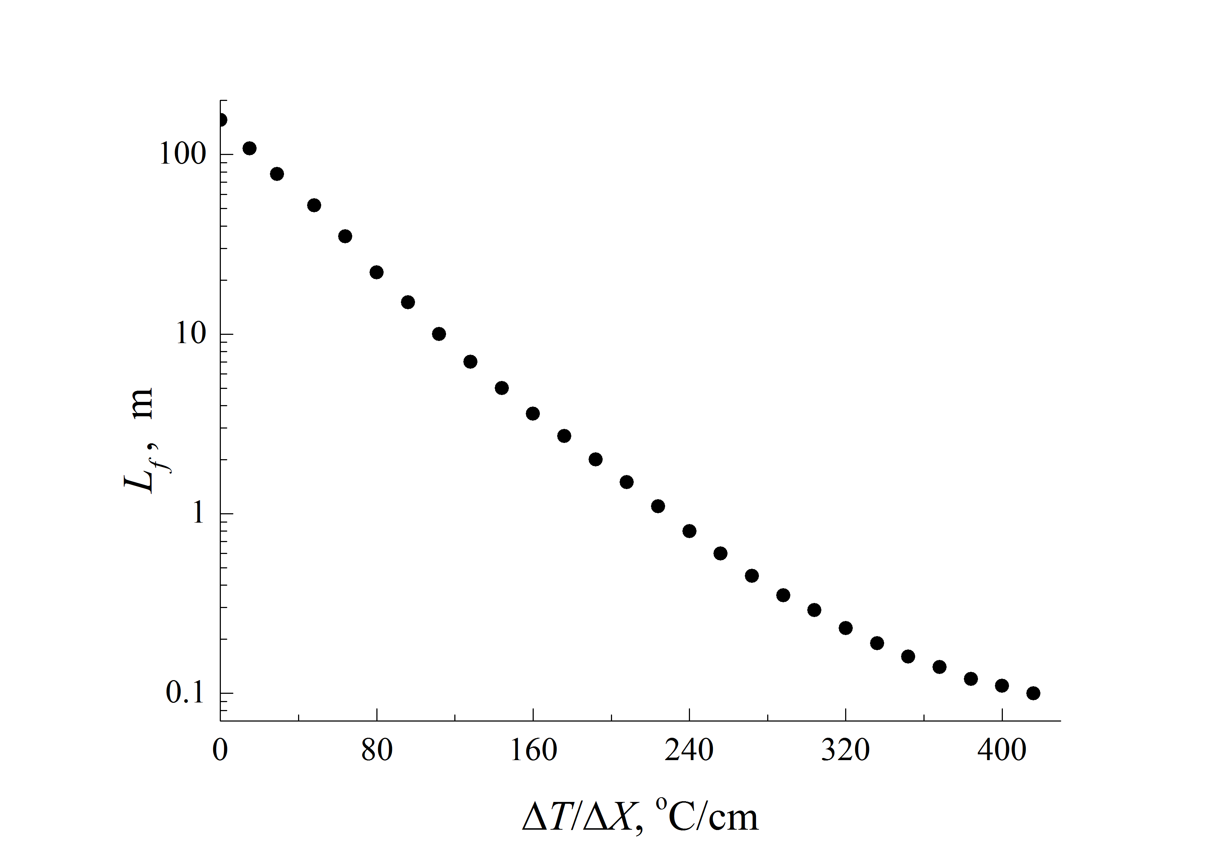
The dependence of the focal length of the reflected beam for the reflecting atomic planes (1011) of single crystal quartz on the value of the temperature gradient.
-
RREPS-2017

Slide 20
Thus, experimentally and theoretically shown, that an increase of the value of the temperature gradient
focus closer to the crystal,
there is a multiple increase of the intensity
with the change in the thickness of a single crystal of quartz it is possible to select from the primary beam of X-rays or thermal neutron beams with a different energy strip and throw it in the direction of reflection.
RREPS-2017

Slide 21
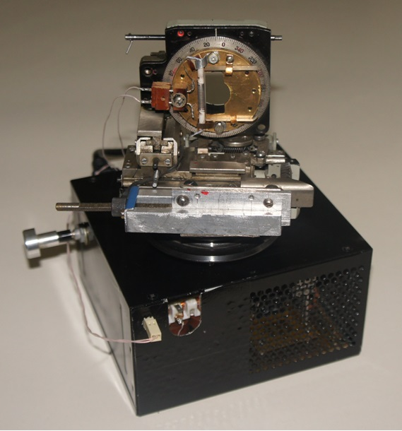
Based on the above research works designed laboratory prototype of the hard X-ray and thermal neutron beam lenses with controlled parameters.
RREPS-2017

Slide 22
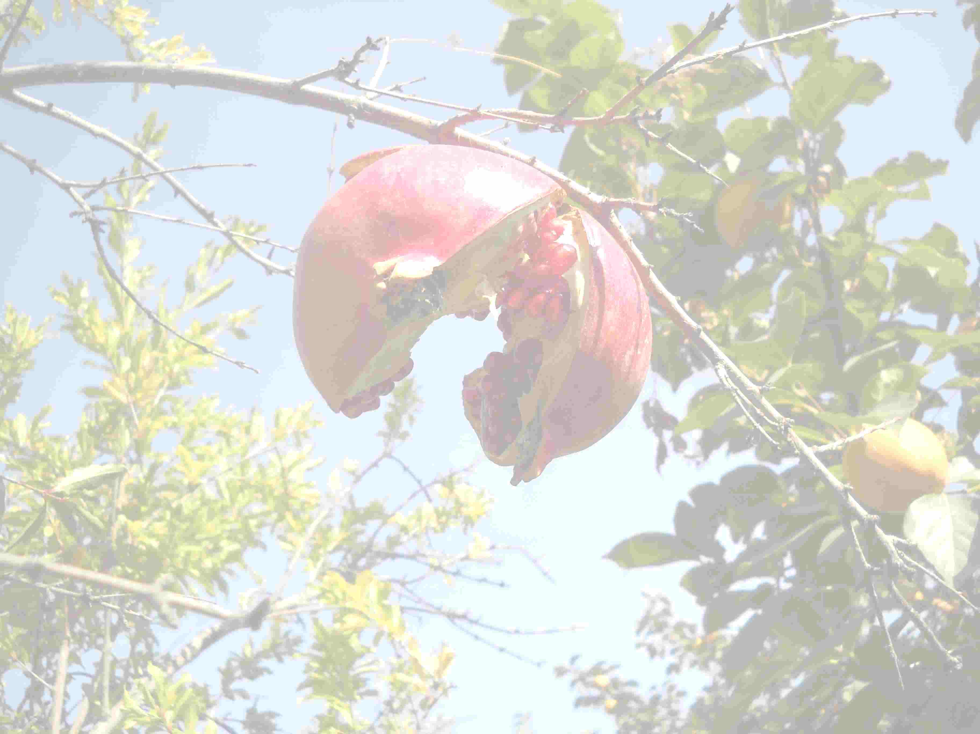
Thank you
for your attention!
Institute of Applied Problems of Physics of NAS RA, Yerevan, Armenia
Vahan2@yandex.ru
RREPS-2017

Slide 23
Thank you for your attention!
International Conference Meghri-17
Organizer committee
and
IAPP NAS Armenia
with Pleasure are Inviting You
to Armenia, October 16 – 22, 2017.
Institute of Applied Problems of Physics of NAS RA, Yerevan, Armenia

