Slide 1



Bunch Imaging and Radiation at the Open End of an Embedded Circular Waveguide
Sergey N. Galyamin
Andrey V. Tyukhtin
Victor V. Vorobev
Saint Petersburg
State University
Thanks to:
Alexander A. Aryshev
KEK

Slide 2
Case with dielectric
Charge density (Gaussian bunch):
Incident field:
Cherenkov radiation frequencies (poles):
Reflected field:
Transmitted field:

Slide 3
Vacuum case
Charge density (Gaussian bunch):
Incident field:
Reflected field:
Transmitted field:
S.N. Galyamin, A.V. Tyukhtin, S. Antipov, and S.S.Baturin, Opt. Express 22, 8902 (2014).
S.N. Galyamin, A.V. Tyukhtin, and V.V. Vorobev, NIMB 402, 144 (2017).
S.N. Galyamin, A.V. Tyukhtin, A.M. Altmark, S.S. Baturin, Proc. RuPAC2016, 518–520.

Slide 4
Vacuum case
Boundary conditions for z = 0

Slide 5
Vacuum case

Slide 6
Vacuum case
Meixner edge condition:

Slide 7
Residue calculus technique: explanation
Given:
R. Mittra, S.W. Lee, Analytical Techniques in the Theory of Guided Waves (Macmillan, 1971)

Slide 8
Vacuum case
TEM

Slide 9
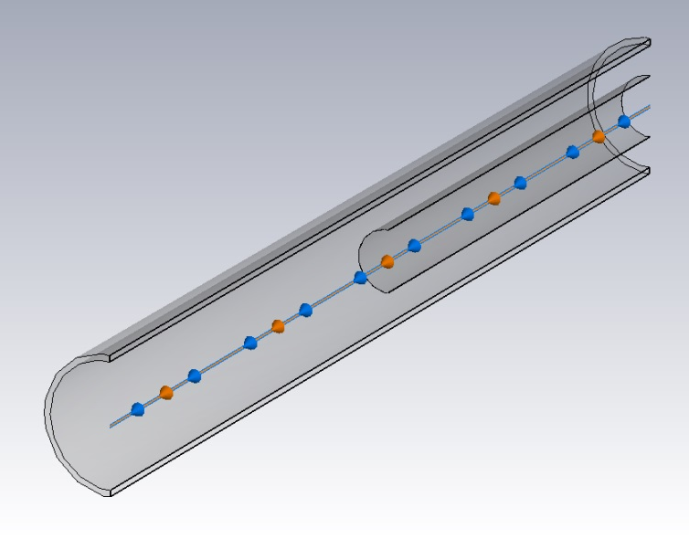
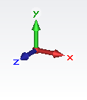
Vacuum case: numerical results and CST simulations
CST Particle studio
z = -1cm, r = 0.35cm.
b = 0.25cm
a = 0.5cm
inner wall 0.001cm
L_{d} = L_{v} = 40cm
Gaussian bunch:
q = 1nC
β = 0.9999 (γ = 70)
σ = 0.5cm
r = 0.35cm.
z = -1cm, -2cm, -3cm, -4cm.
z = 1cm, 2cm, 3cm, 4cm.
BUNCH IMAGING

Slide 10
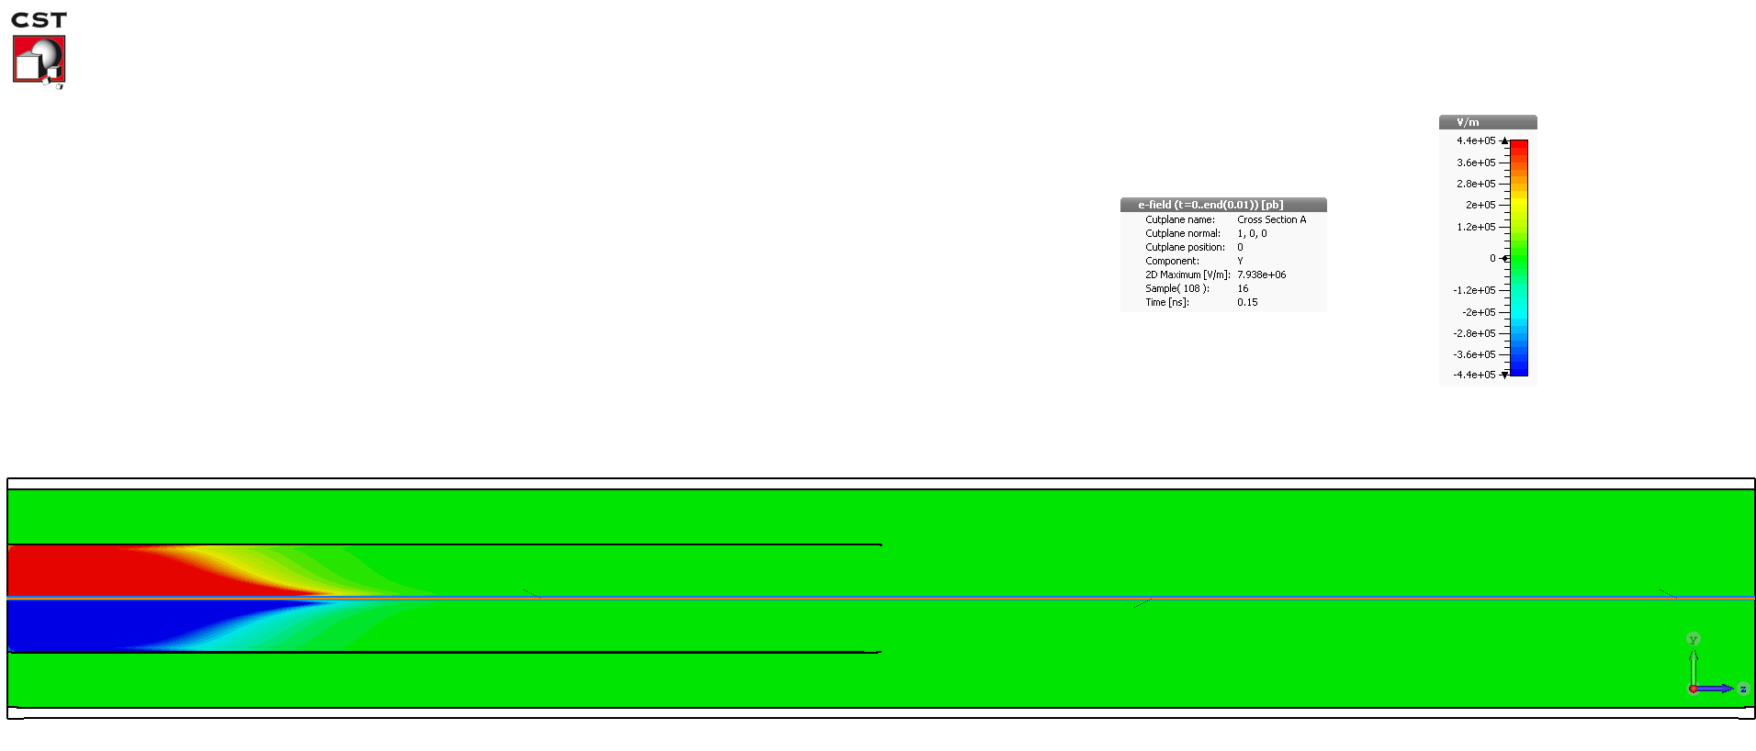
Vacuum case: numerical results and simulations

Slide 11
Waveguide with dielectric filling
Meixner edge condition:
Notes:
The problem statement is the following. We consider the cylindrical frame ro, phi, z. In the plane z=0 the interface between vacuum and uniaxial crystal is placed. A point charge q moves with constant velocity from vacuum into medium, the charge movement rule is the following. We suppose the crystal being nonmagnetic with the plasma frequency dispersion (with losses) of their components. As you can see, this is the classical formulation of the transition radiation problem. The question appears: “What is new here?” However the usual think which is analyzed in this problem is spectral-angle distribution of the radiated energy. But the main goal of this report is to investigate in detail the structure of the EMF with taking into account specific frequency dispersion and small losses.

Slide 12
Waveguide with dielectric filling
Shifted zeros Γ_{p}

Slide 13
Waveguide with dielectric filling: numerical results and simulations
Cherenkov radiation frequencies (poles) in the incident field:
b = 0.25cm
a = 0.5cm
β = 0.9999 (γ = 70)
- zeros of “vacuum problem”
- zeros of “dielectric problem”

Slide 14
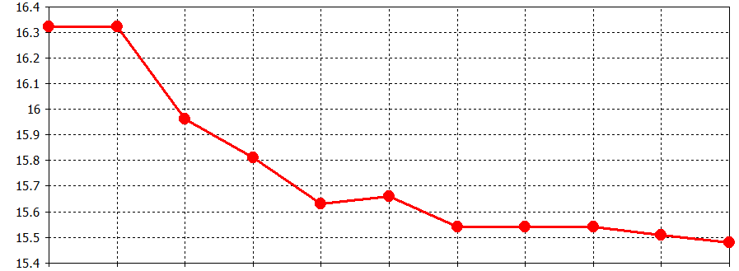
Waveguide with dielectric filling: numerical results and simulations
b = 0.25cm, a = 0.5cm
inner wall 0.001cm
L_{d} = L_{v} = 150cm
Gaussian bunch: q = 1nC
β = 0.9999 (γ = 70)
σ = 0.5cm
r = 0.35cm, z = -1cm, ε = 10
r = 0.125cm, z = -1cm, ε = 10
Analytic / CST | ε = 10 | ε = 2
a = 0.5cm | 15.30 GHz / 15.45 GHz | 45.90 GHz / 46.13 GHz
a = 0.9cm | 15.30 GHz / 15.48 GHz | 45.90 GHz / 46.27 GHz

Slide 15
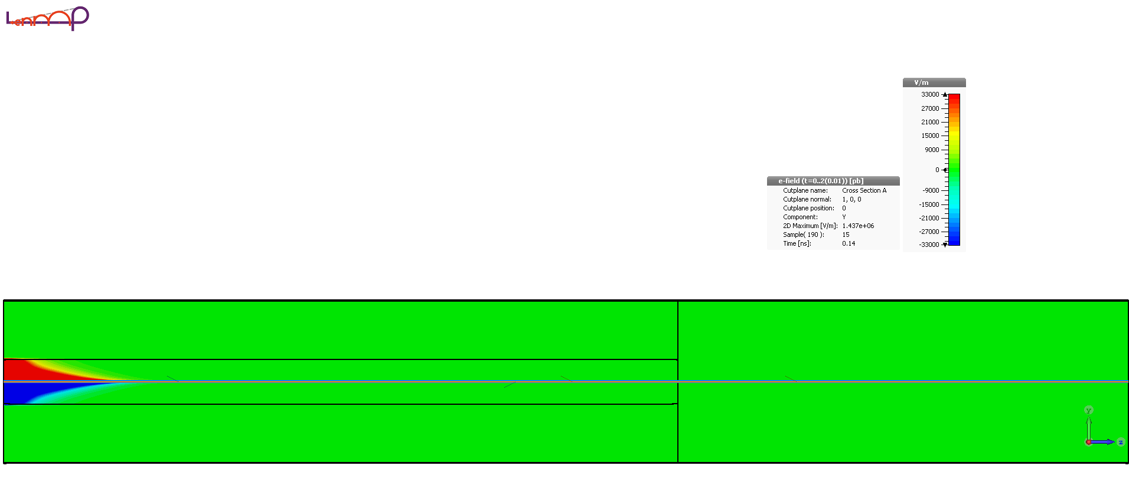
Waveguide with dielectric filling: numerical results and simulations
b = 0.25cm
a = 0.9cm
inner wall 0.001cm
L_{d} = L_{v} = 150cm
Gaussian bunch:
q = 1nC
β = 0.9999 (γ = 70)
σ = 0.5cm
z = 1cm, r = 0.5cm, ε = 10

Slide 16
Thank you for your attention!

