Slide 1
Channeling Experiments with Electrons at the Mainz Microtron MAMI
Hartmut Backe, Werner Lauth, and Thu Nhi Tran Thi¹⁾
Institute for Nuclear Physics
Johannes Gutenberg University of Mainz
¹⁾X-ray Optics Group, ESRF, Grenoble
XII International Symposium RREPS-2017, September 18-22, 2017, DESY Hamburg, Germany

Slide 2
Outline
Motivation
Experiments with a periodically bent silicon (110) crystal at MAMI
Re-analysis of de-channeling length measurements at (111) channeling in a bent silicon single crystal at SLAC with the aid of the Fokker-Planck Equation
Consequences for radiation production with large amplitude undulators
Conclusions

Slide 3
1. Motivation
Is an intense photon source with micro-undulators and electrons feasible?
W. Greiner, A.V. Solov’yov, and A.V. Korol et al.

Slide 4
Micro-Undulator
(110) U₀ = 22 eV
λ_{U} = 9.9 µm
A = 4.64 Å
e⁻
y
375 MeV
x
Coherent undulator radiation emission
R = 6.60 mm
Photon energy

Slide 5
How long remains an electrons in a channel?
(Classical picture)
De-channeling
De-channeling rate λ_{de}
for straight and bent
crystals
Re-channeling
Re-channeling rate λ_{re}

Slide 6
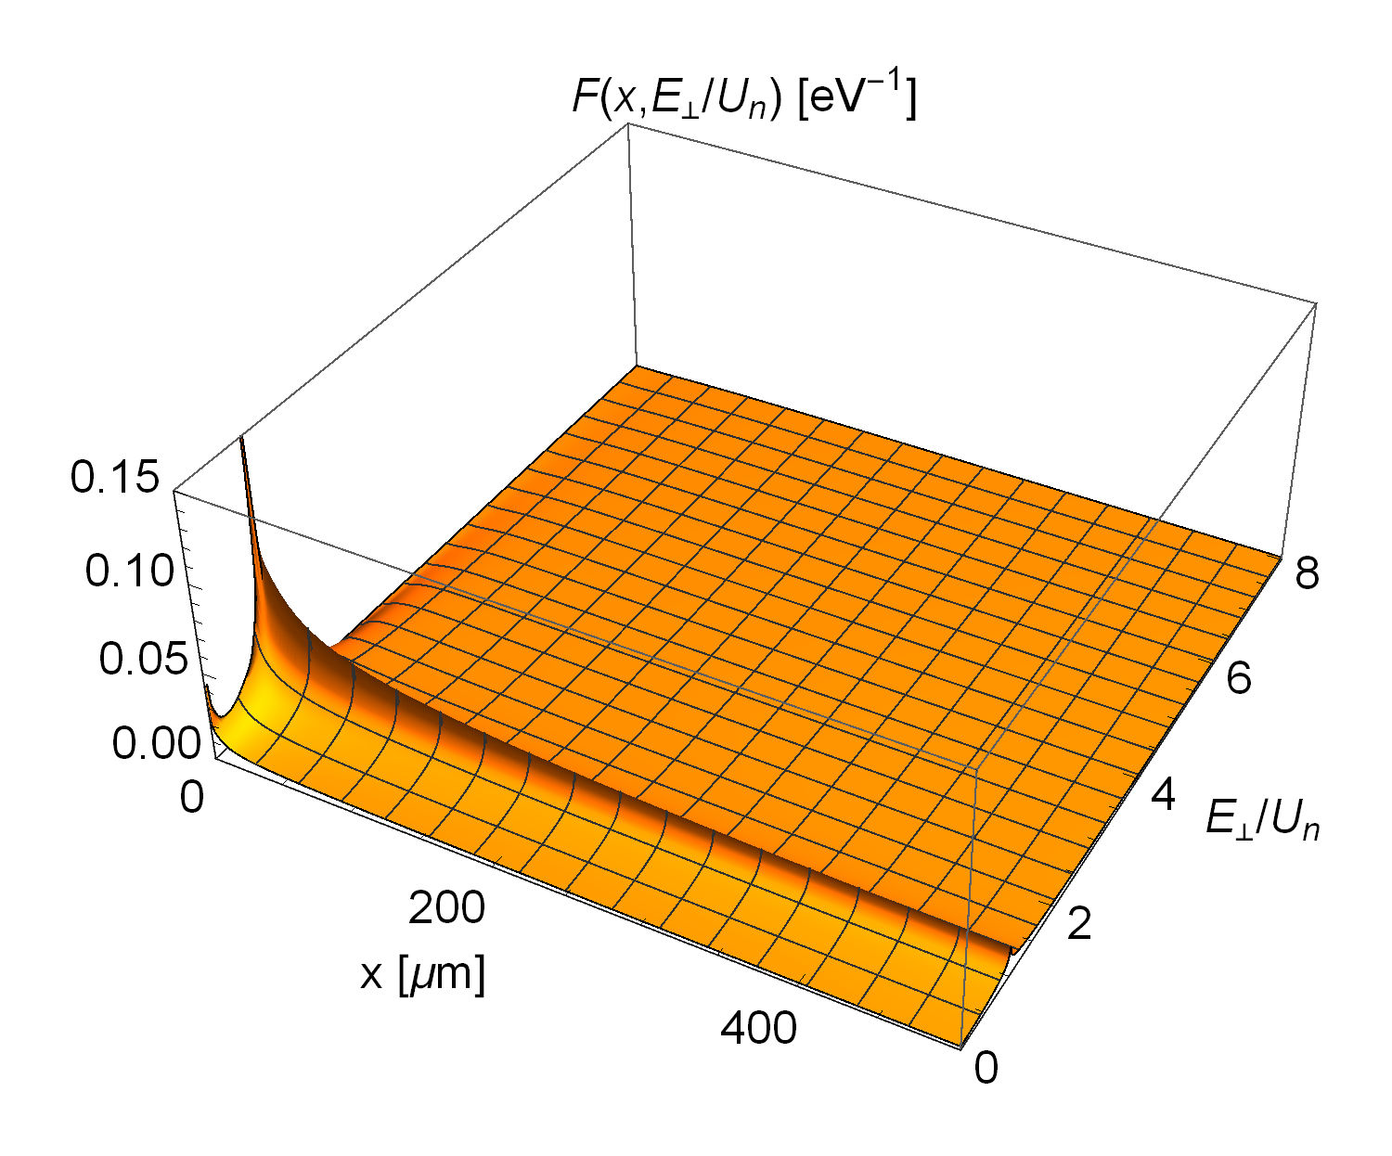
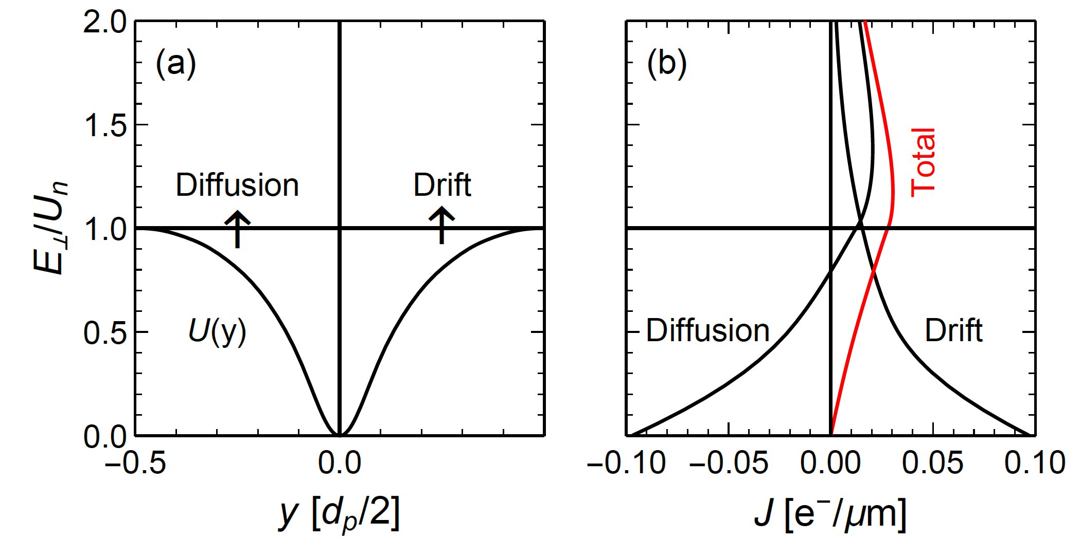
Discussion on the basis of the Fokker-Planck equation
continuity equation with density F and current J
x = c t =5 µm
Transverse Energy
f_{ch}(x)
Crystal Thickness

Slide 7
Transition Rates λ_{de} and λ_{re}
De- and Re-Channeling Lengths L_{de} and L_{re}
Transition rates λ
Channel
occupation
f_{ch} (x)
De-and re-channeling Lengths L

Slide 8
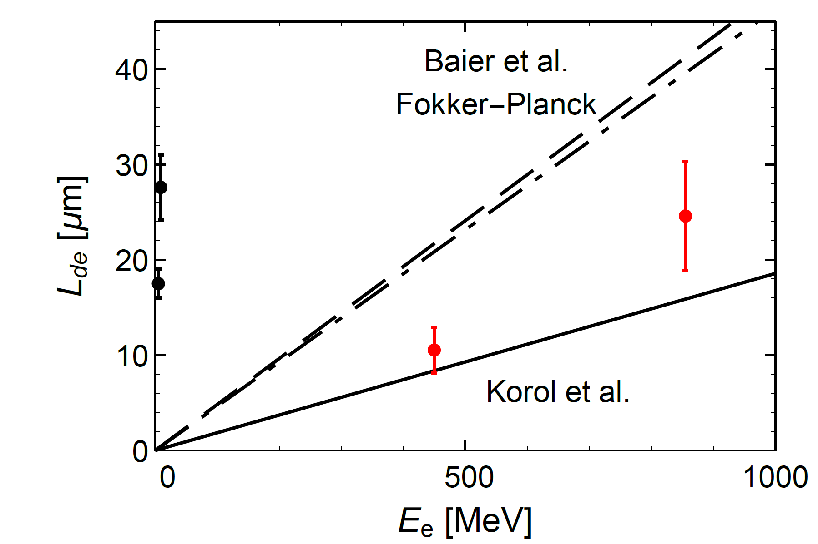
Results for De-channeling Length at Diamond (110)
Baier, Katkov, and Strakhovenko approach, however, with E_{s} = 10.6 MeV instead of 15.0 MeV in formula
MAMI experiment (thickness dependence)
Simulation calculation with MBN
explorer software package

Slide 9
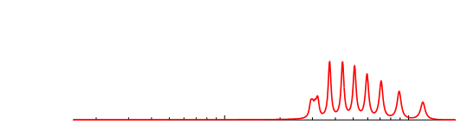
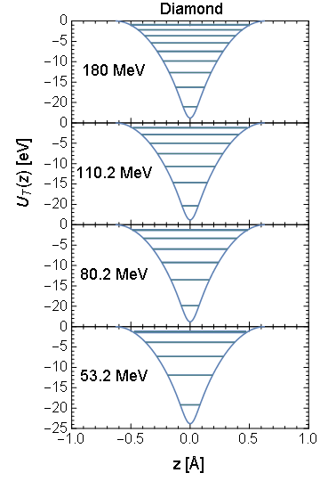
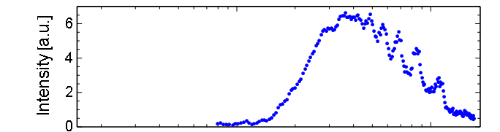
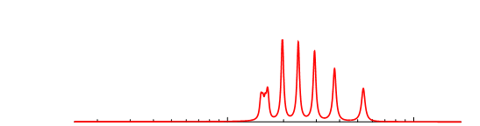
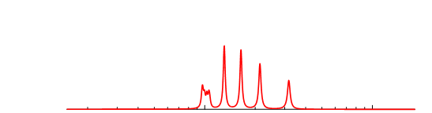
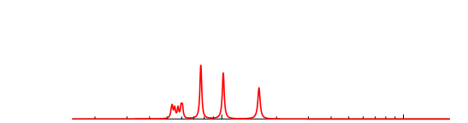
Results: Planar Channeling of Electrons in Diamond
180 MeV e⁻ (MAMI)
40 µm Diamond (110)
M. Gouanere, et al.,
Phys. Rev.
B 38 (1988) 4352

Slide 10
2. Experiments with a periodically bent silicon (110) crystal at MAMI
Large amplitude undulator
H. Backe, et al.,
Nucl. Inst. Meth. in Phys. Res. B 309 (2013) 37 and
Journal of Physics: Conference Series 438 (2013) 012017

Slide 11
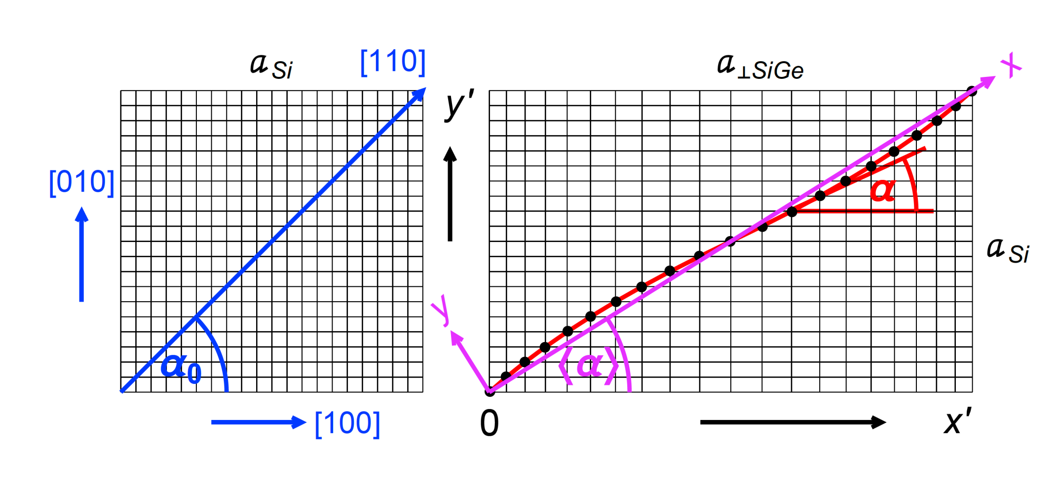
Periodic Graded Composition
Strained Layer Si_{1−x}Ge_{x} Crystals
Substrate
a_{Si} = 5.431 Å
Growing direction
a_{Ge} = 5.658 Å
Notes:
As it was shown by the Aarhus group and Ulrik Uggerhoj, with this method also periodic graded composition strained layers can be produced.

Slide 12
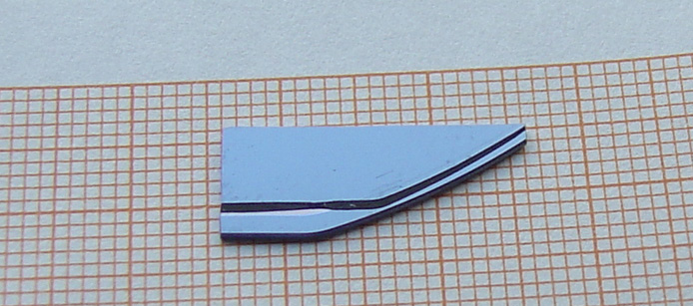
The Aarhus Undulator Crystall
John Lundsgaard Hansen, Arne Nylandsted, Ulrik I. Uggerhøj
MBE-Group
Department of Physics and Astronomy
University of Aarhus
Si_{1-x}Ge_{x} layer
(100) Si substrate
Notes:
The Aarhus group has grown epitaxially a Si_{1-x}Ge_{x} crystal. It has 4 oscillations over 39.6 µm thickness (lambda=9.9 µm). The picture shows a piece of the 4 inch wafer with the substrate and the grown Si_{1-x}Ge_{x} layer on top, visible as a step.

Slide 13
Experimental Setup with 2" Ge(i) Detector
ZnS
Screen
Densimet
Ge
Detector
Camera
Beam Dump
Bore ∅ 4 mm
Ionization
Chamber
185 mm
41.8 ∅
41.8 Length
261 mm
Shielding
Si-detector
Densimet
Bore ∅ 4 mm
Undulator Target
44°
Ge
Detector
41.8 ∅
41.8 Length
8.109 m
0.362 m

Slide 14
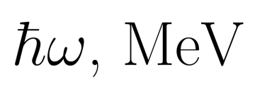
Deconvoluted Difference Spectra
(Off-Channeling Contribution Subtracted)
Beam Energy 375 MeV
Some indication of a
peak at the right energy.
However, line shape is
strongly asymmetric.
Blue:
Plane reference crystal

Slide 15
Synchrotron-like Radiation Emission from Finite Arc Element of Undulator
Observation direction
e⁻
e⁻
Schwinger’s approach

Slide 16
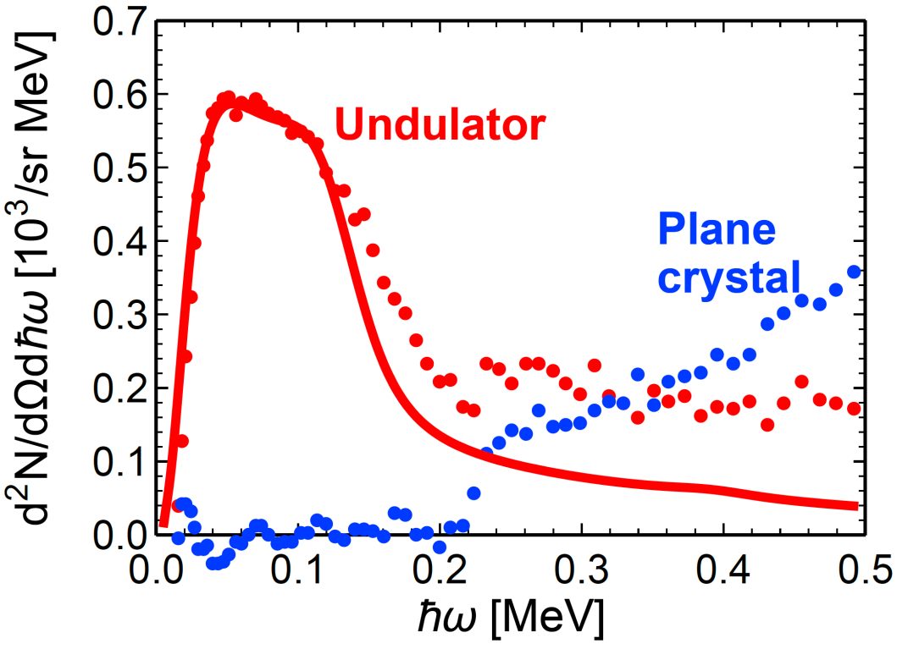
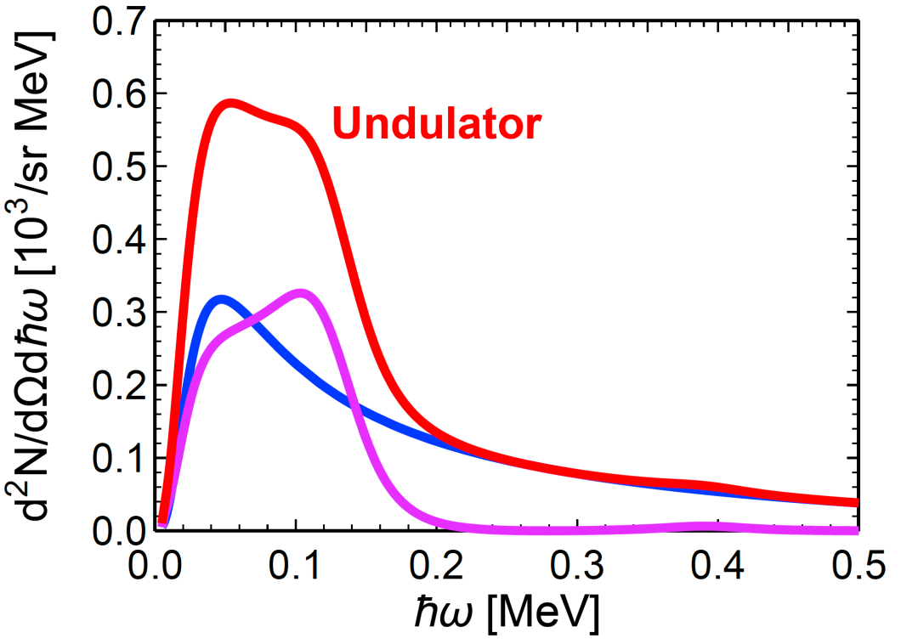
Evidence for Undulator Radiation
Simulation Results at E_{beam} = 375 MeV
Comparison with experiment
Decomposition of calculation
Incoherent:
17 % of full arc
p_{chan} = 97 %
1.2 ω_{p}
Coherent:
L_{coh} = 4.0 µm,
p_{chan} = 3 %
Why is the coherent contribution so small?

Slide 17
3. Re-analysis of de-channeling length measurements at (111) channeling of electrons in bent silicon single crystals at SLAC
T. N. Wistisen, U. I. Uggerhøj, U. Wienands,
T.W. Markiewicz, R. J. Noble, B. C. Benson, T. Smith,
E. Bagli, L. Bandiera, G. Germogli, V. Guidi,
A. Mazzolari, R. Holtzapple, and S. Tucker
Phys. Rev. ST-AB 19, 071001 (2016)

Slide 18
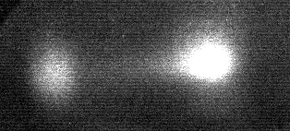
Target Setup with Intensity Distribution on a Luminescence Screen
θ_{e}
Si (111)
R = 0.15 m
Screen
θ₀ = 0
Ejection of
channeled
electrons
Injection
De-channeling
Scattering
t = 60 µm

Slide 19
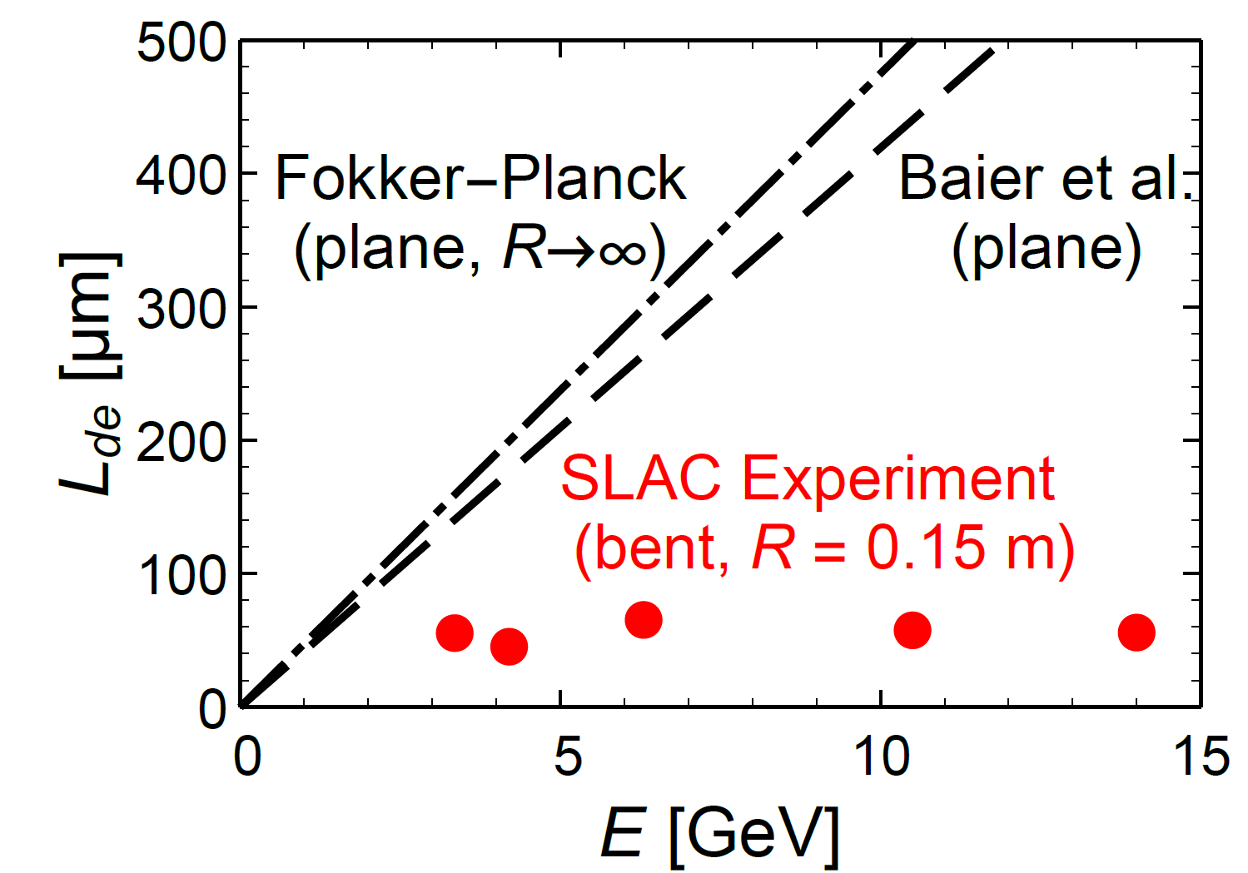
De-channeling Length Measurements at (111) Bent Silicon Single Crystal (SLAC)
T.N. Wistisen et al., Phys. Rev. ST-AB 19, 071001 (2016)

Slide 20
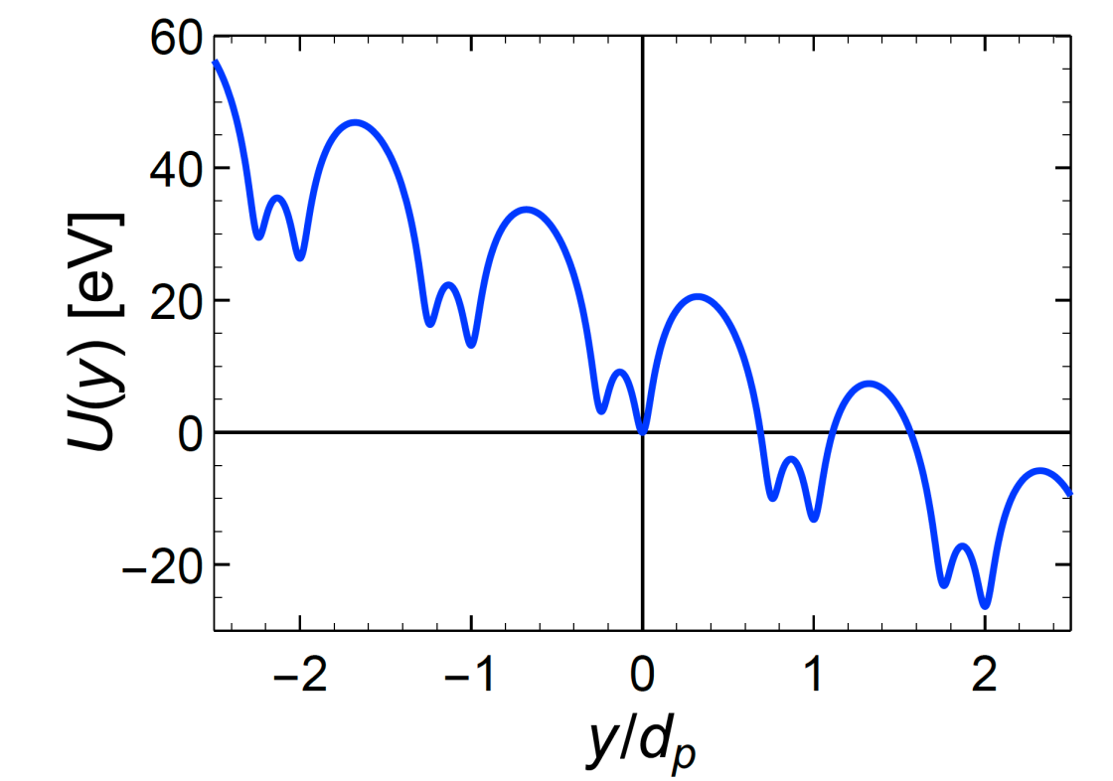
Effect of Centrifugal Forces in Bent Crystals
at R = 0.15 m and pv = 6.3 GeV
Requires introduction of an additional drift term in Fokker-Planck equation
for Si (111):
d_{p} = 3.135 Å

Slide 21
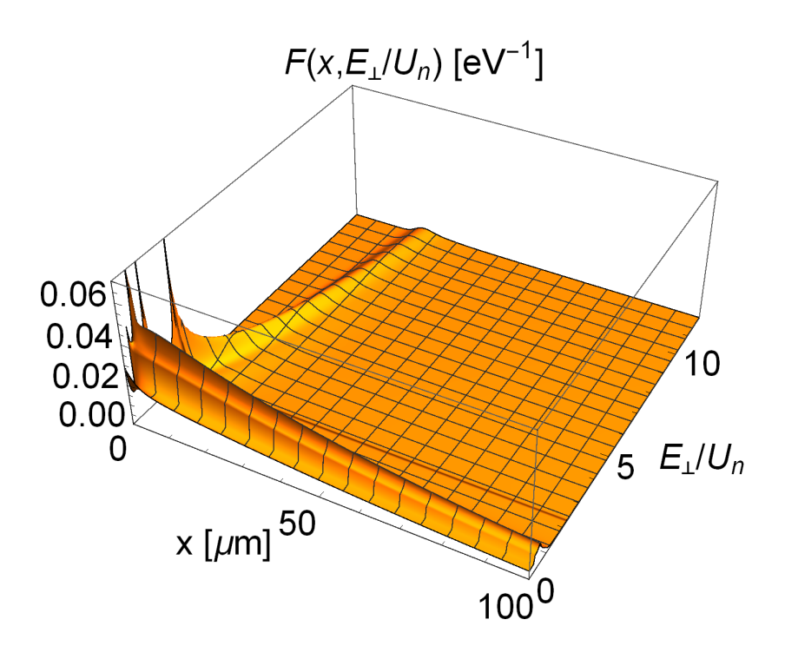
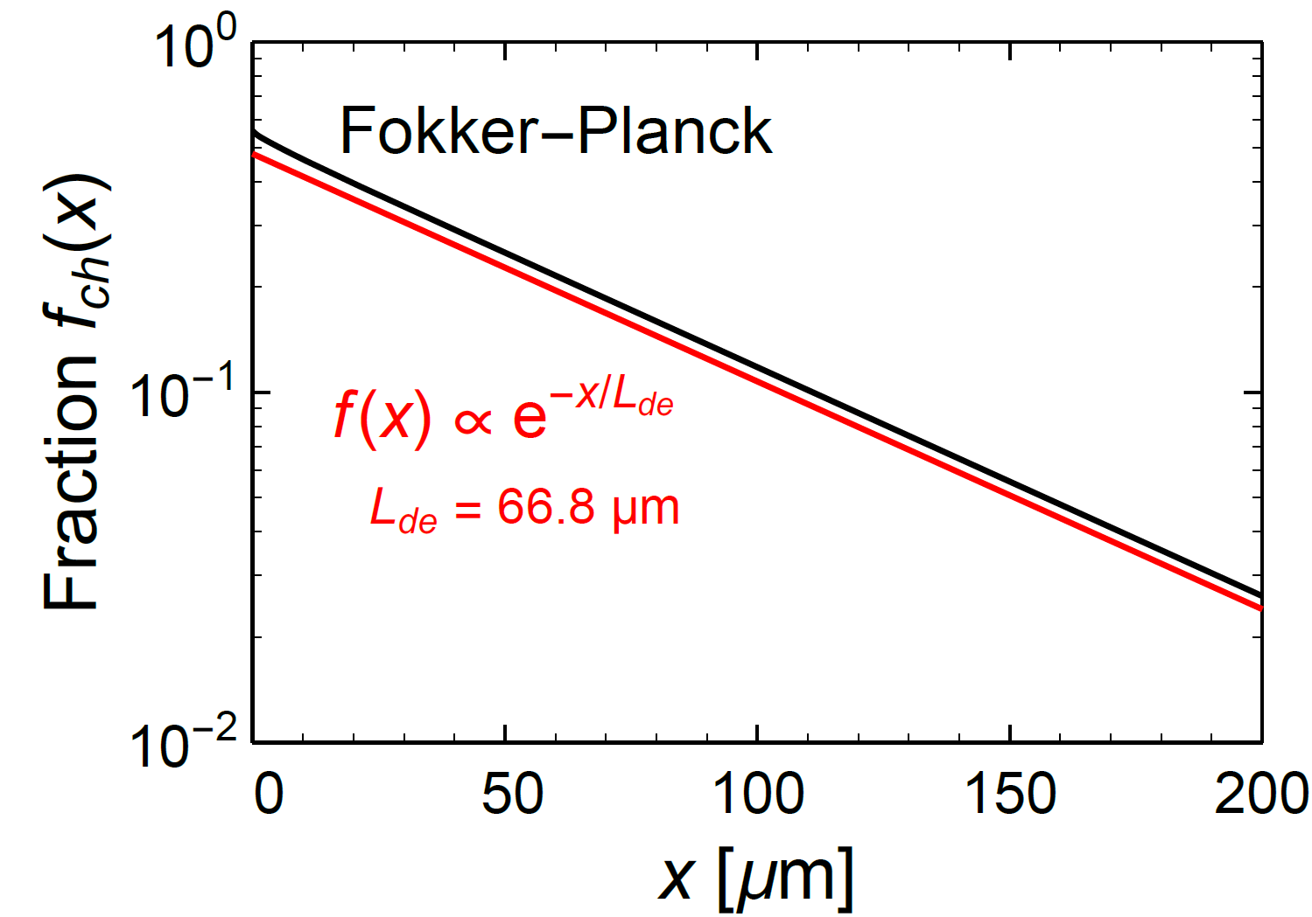
Modification of Fokker-Planck Equation in Bent Crystal
continuity equation
with density F
and current J
Notes:
21

Slide 22
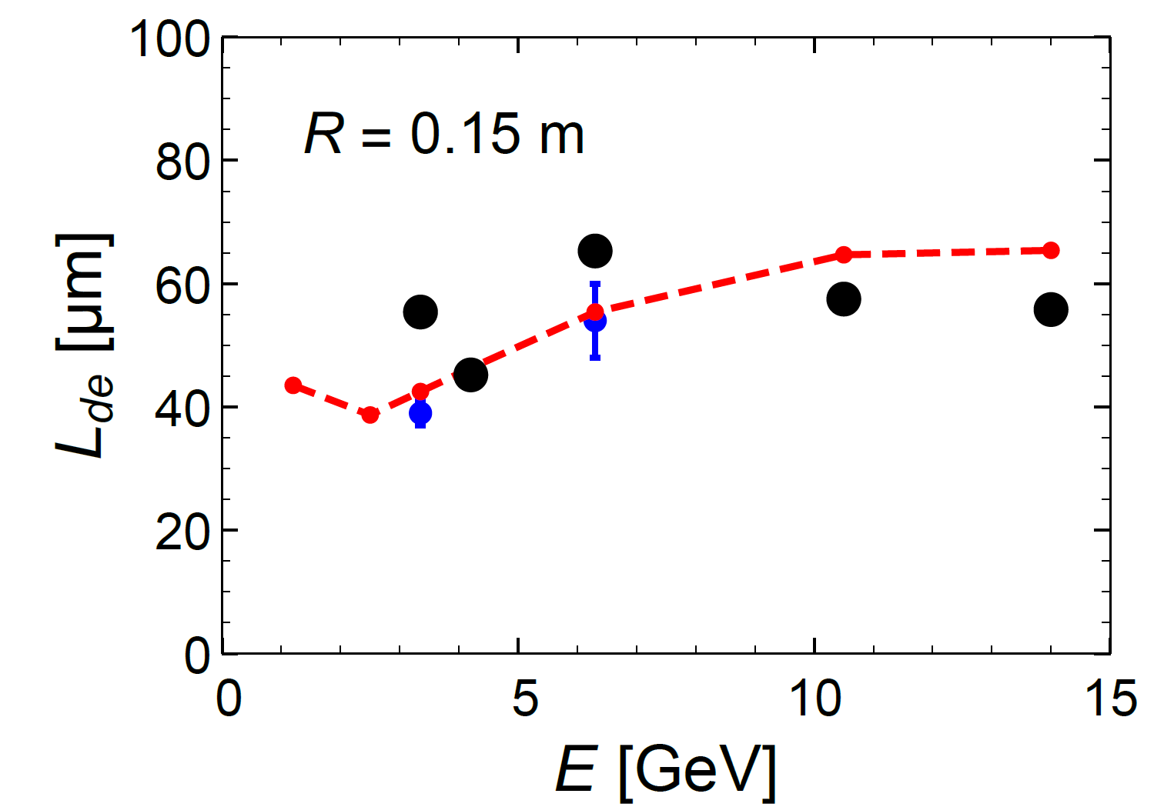
Reanalysis of SCAC De-Channeling Experiment with Modified Fokker-Planck Equation
Bent (111) Silicon single crystal
Fokker-Planck
Simulations with MBN Explorer:
3.35 GeV: 39±2 µm
6.3 GeV: 54±6 µm
G. B. Sushko , A. V. Korol,
A. V. Solov’yov,
NIM B 355 (2015) 39–43
MBN Explorer
SLAC experiment

Slide 23
Apply Modified Fokker-Planck Equation to Si (110) Undulator Experiment at MAMI

Slide 24
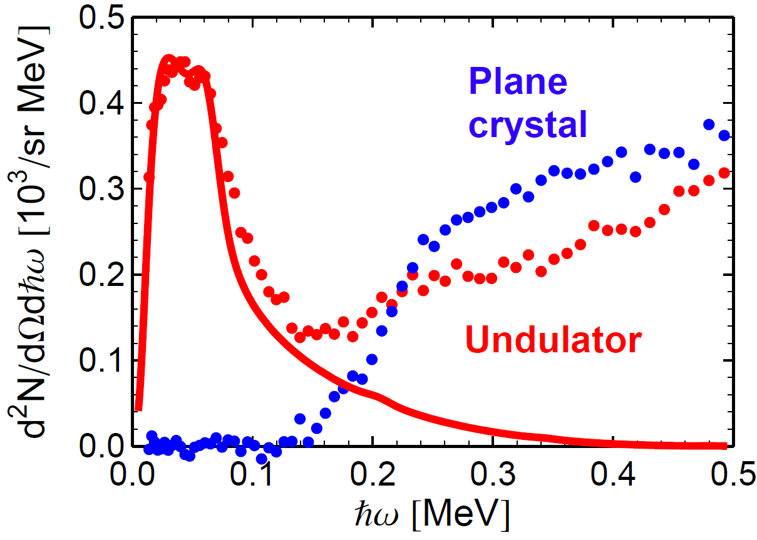
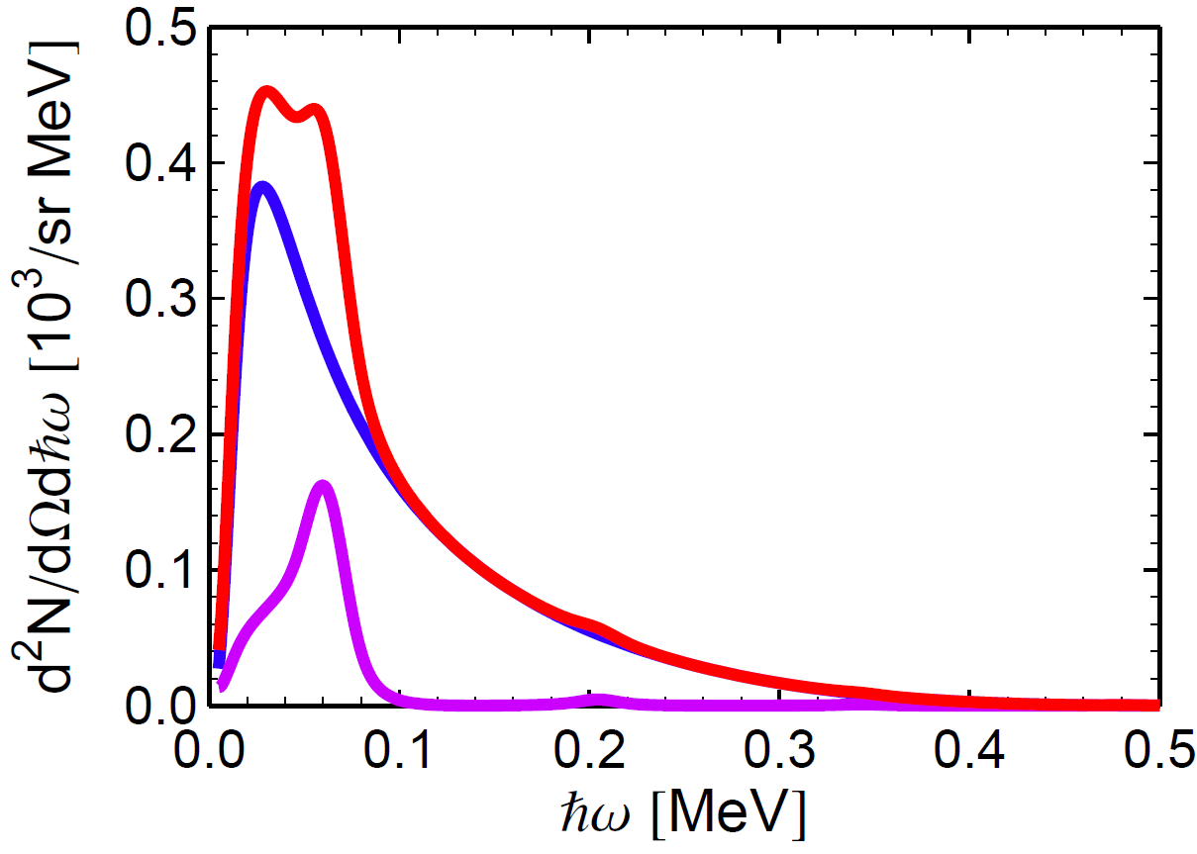
Evidence for Undulator Radiation
Simulation Results at E_{beam} = 270 MeV
Comparison with experiment
Decomposition of calculation
Incoherent:
28 % of full arc
p_{chan} = 98 %
Coherent:
L_{coh} = 6.0 µm,
p_{chan} = 2 %
Why is the coherent contribution so small?

Slide 25
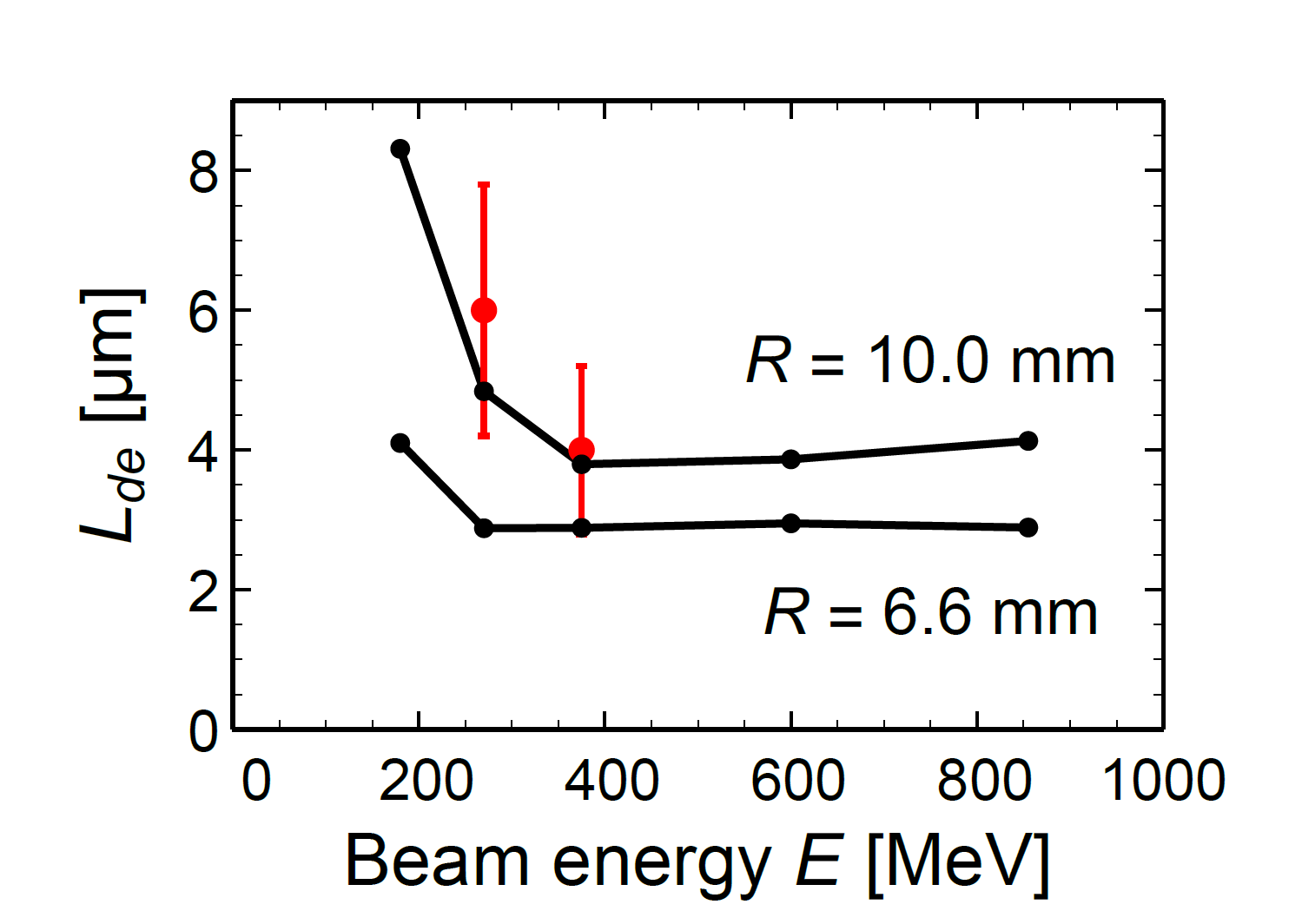
De-channeling Length for Bent Crystal from Modified Fokker-Planck Equation for Si (110) at MAMI Beam Energies
Explanation of strong reduction of the de-channeling length in comparison to a straight crystal:
MAMI experiments

Slide 26
De- and Rechanneling in Undulator Crystal
(110) U₀ = 22 eV
λ_{U} = 9.9 µm
e⁻
z
(1)
(2)
(1)
(2)
(1)
(2)
(1)
x
Coherent undulator radiation emission with coherence length L_{coh} = 4.0 to 6.0 µm
(1) Centrifugal force causes dechanneling
(2) Electron finds proper direction and re-channels
Synchrotron radiation emission from arc elements
(2) → (1) with reduced length. Incoherent since
between (1) → (2) electron loses phase information

Slide 27
4. Consequences for Radiation Production with Large Amplitude Undulators
Considerations on the basis of the Fokker-Planck Equation

Slide 28
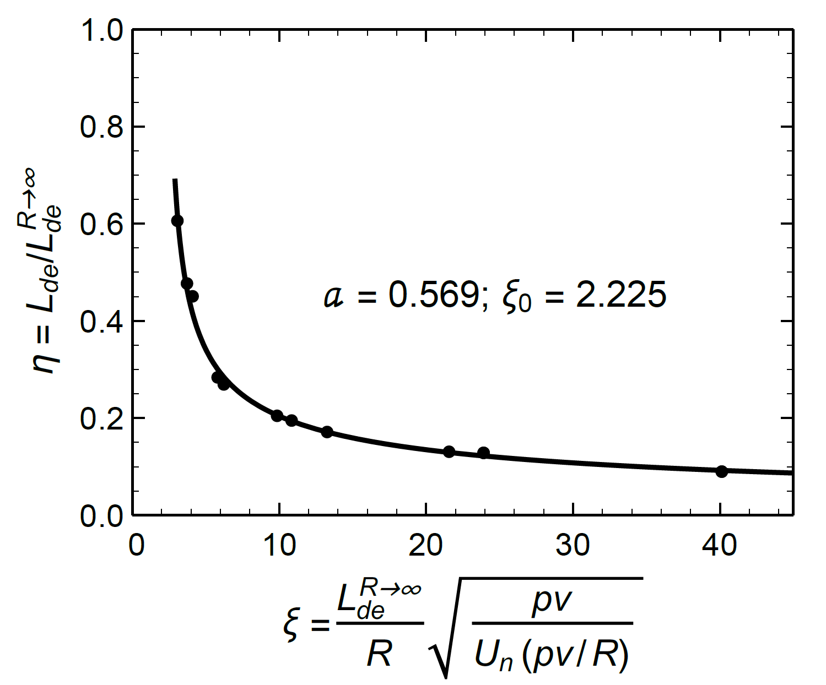
De-channeling Length L_{de}(R,pv) Scaling Law for a Bent Si (110) Crystal
L_{de}(R,pv) is the de-channeling length for a crystal with
bending radius R and momentum pv
Straight crystal according to Fokker-Planck
and Baier, Katkov, and Strakhovenko
approach, however, with E_{s} = 10.6 MeV
instead of 15.0 MeV in formula

Slide 29
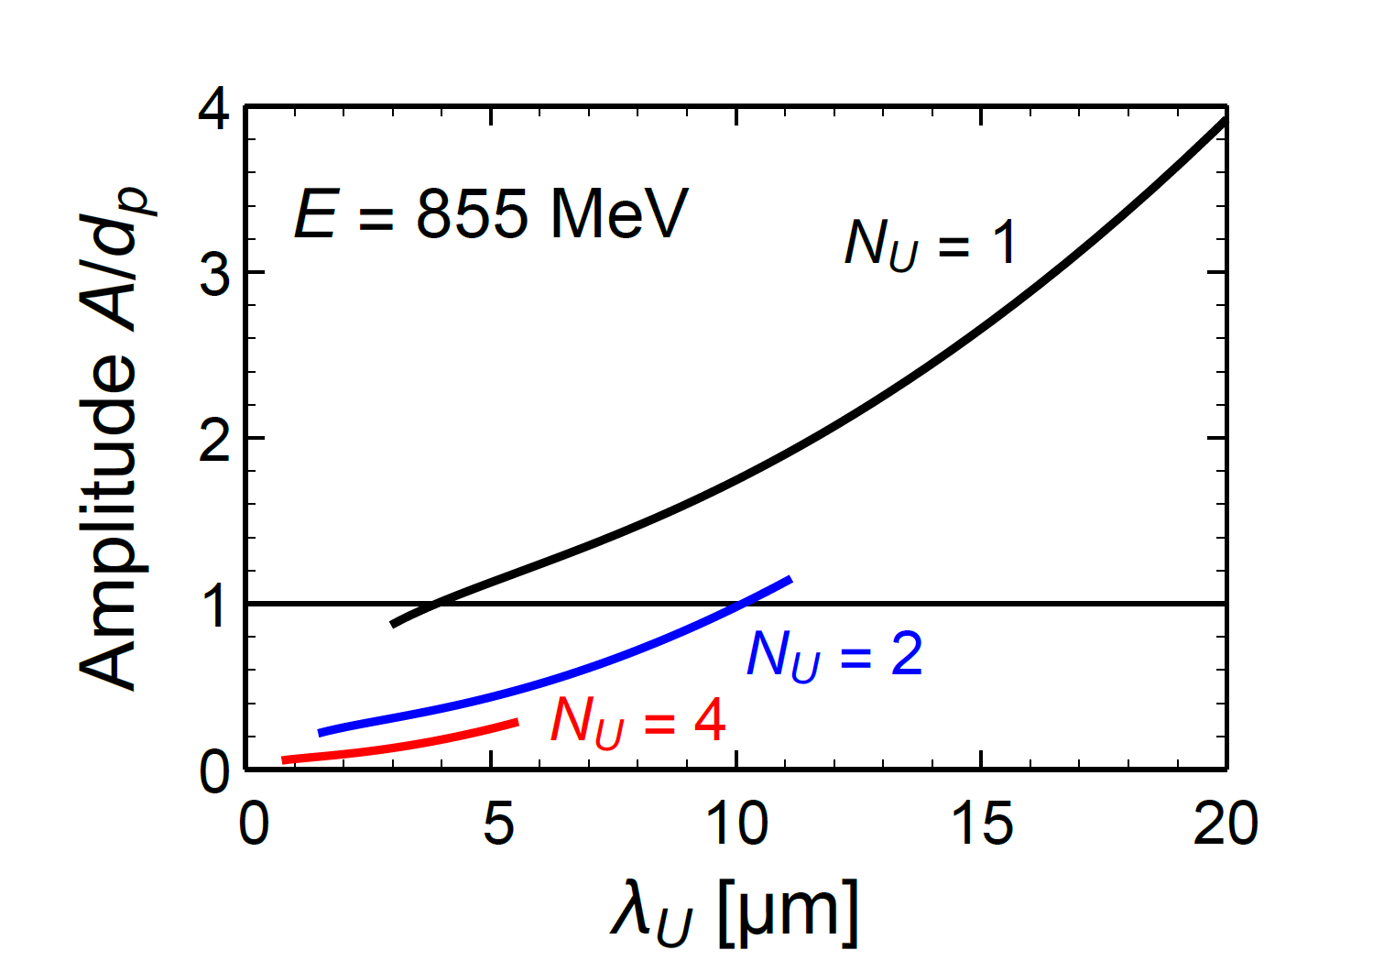
Conditions for
Large Amplitude Undulator Design
N_{U} number of Periods
L_{de} de-channeling length
Half period undulator
A/d_{p} > 1
Large amplitude
domain
A/d_{p} < 1
Small amplitude
Photon energy at 855 MeV

Slide 30
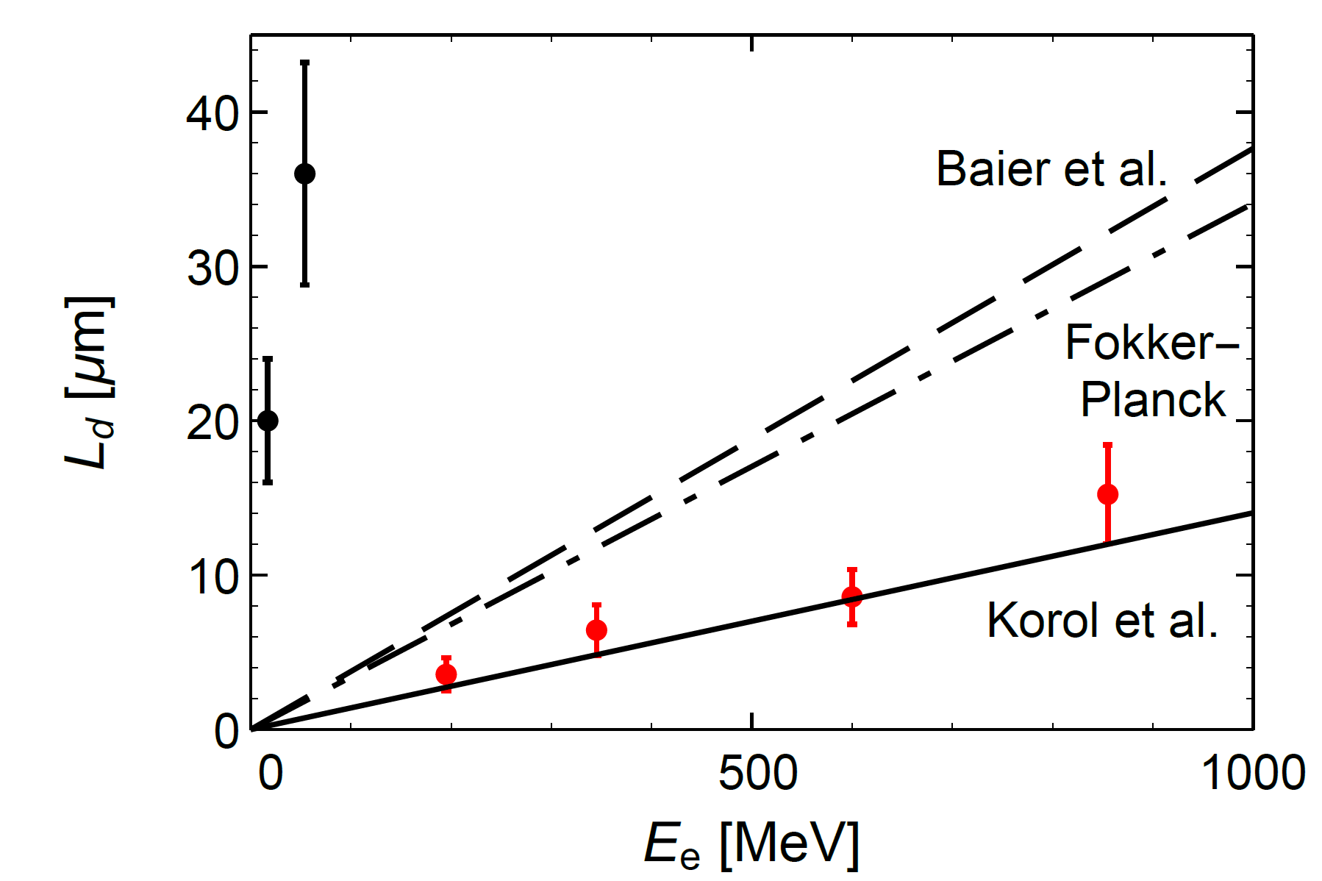
5. Conclusion
1. De-channeling length of straight crystals is probably between the limits given by the Fokker-Planck equation or modified Baier et al. formula (E_{s} =10.6 MeV) and calculations on the basis of the MBN explorer software package of Andrei Korol, Andrey Solov’yov et al., or others.
However, notice: Analysis of experimental de-channeling length is model dependent! Difference λ_{de}(x)- λ_{re}(x) taken from solution of Fokker-Planck equation!
Diamond (110)
Silicon (110)

Slide 31
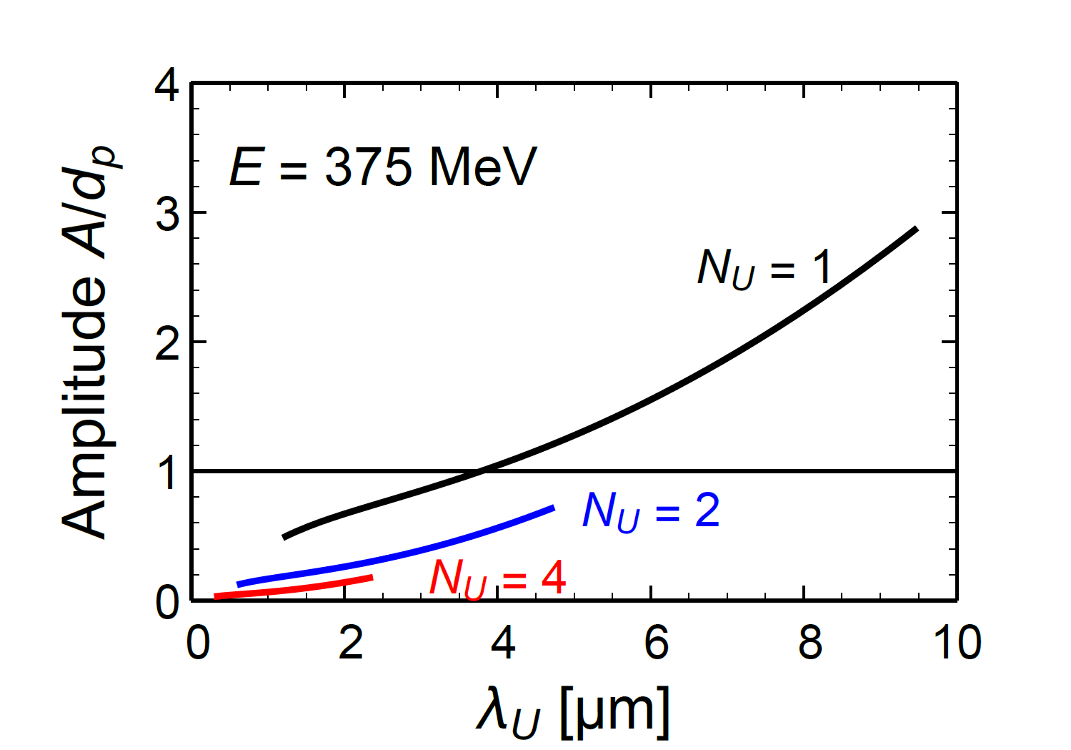
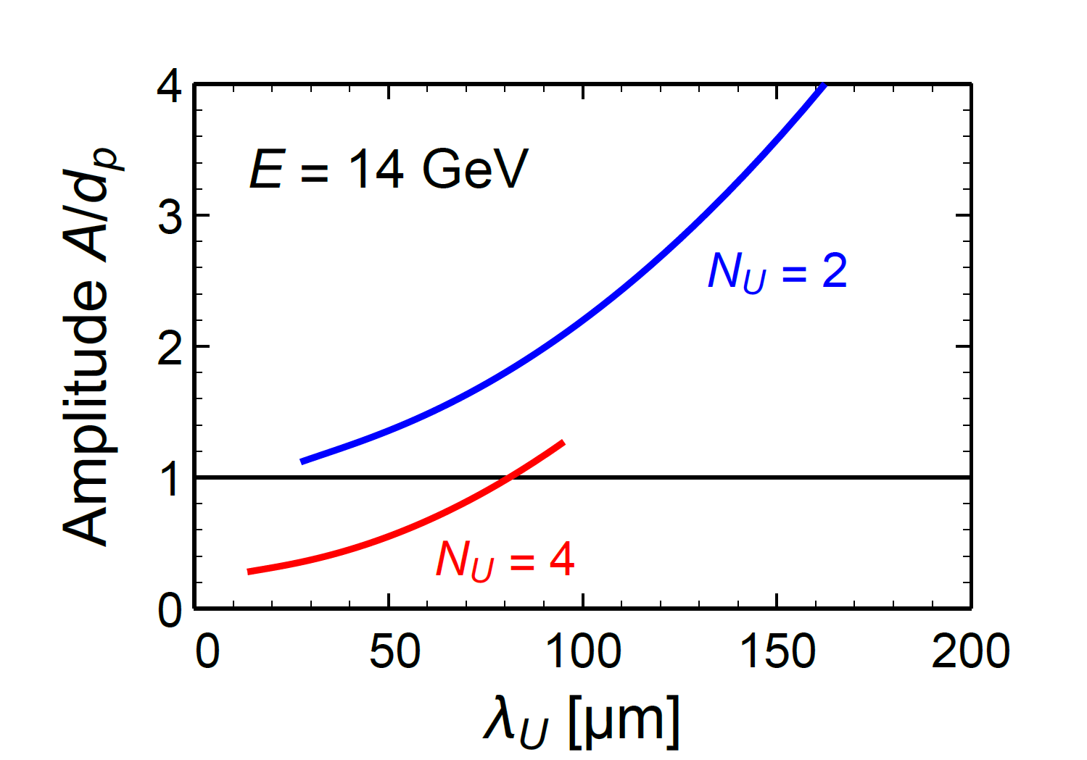
2. Undulator radiation has been observed at MAMI for large and small amplitude graded composition strained layer Si_{1-x}Ge_{x} undulators
3. For a large amplitude undulator the beam energy must be as high as possible. However, synchrotron radiation emission at undulators with many periods may be rather strong as compared with channeling radiation.
4. Certainly, a good positron beam is a better choice than using electrons

Slide 33
6. Remarks on experiments with a small amplitude undulator
Andriy Kostyuk, Phys. Rev. Lett. 110, 115503 (2013)
Andrei V. Korol, et al. Nucl. Instrum. Meth. B 387 (2016) 41–53

Slide 34
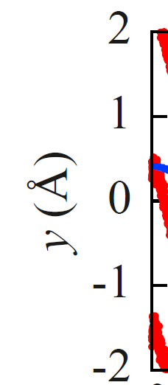
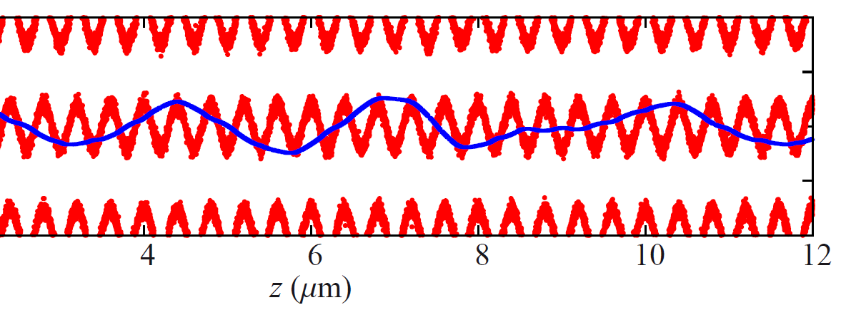
Small Amplitude Undulator
Amplitude 0.4 Å, Period 0.4 µm
Picture taken from A. Kosyuk: arXiv:1303.5034v1 [physics.acc-ph] 20 Mar 2013
Channeling oscillation
The arrows point to the maxima
of the superimposed tiny
modulation due to the undulater
Notes:
Part of Fig. 3 of Kosyuk: arXiv:1303.5034v1 [physics.acc-ph] 20 Mar 2013. The blue curve is modulated with a tiny amplitude having the frequency and being in phase with the undulator (in red).

Slide 35
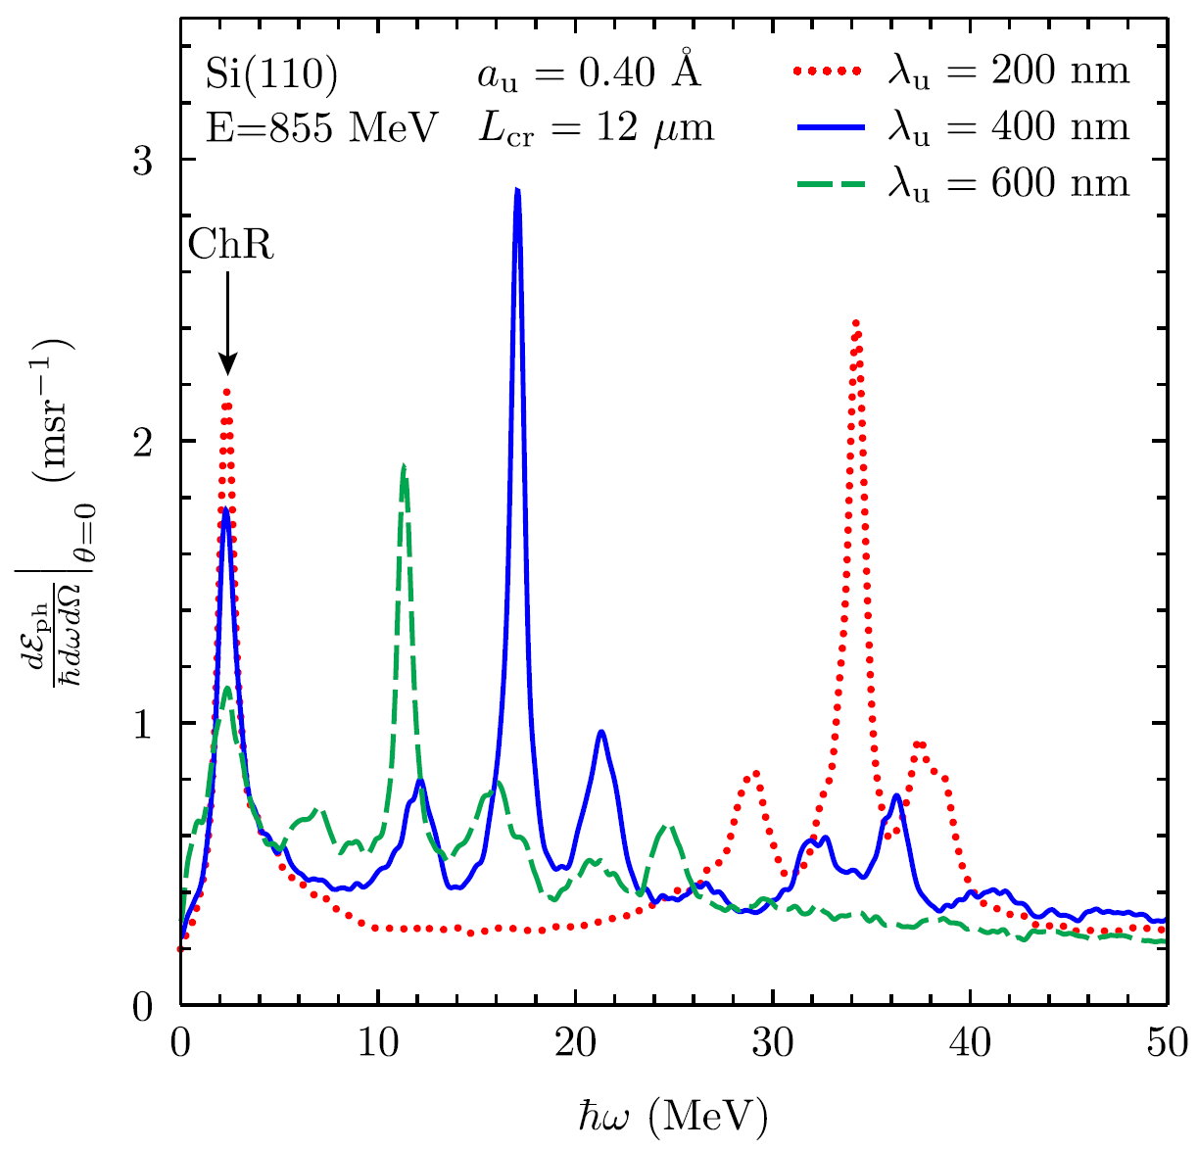
Simulated Spectra for 855 MeV Electrons
Andriy Kostyuk, Phys. Rev. Lett. 110, 115503 (2013)
Silicon (110)
Amplitude: 0.4 Å
Length of undulator: 12 µm
17.4 MeV

Slide 36
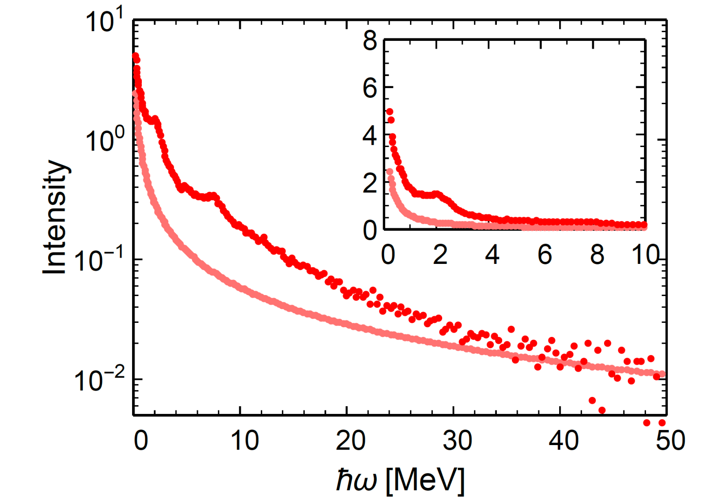
Experimental Small Amplitude Undulator Spectrum (MAMI 600 MeV)
T. N. Wistisen, et al., Phys. Rev. Lett. 112, 254801 (2014)
Silicon undulator in (110) orientation
8.54 MeV
Undulator
Bremsstrahlung
(random orientation)

Slide 37
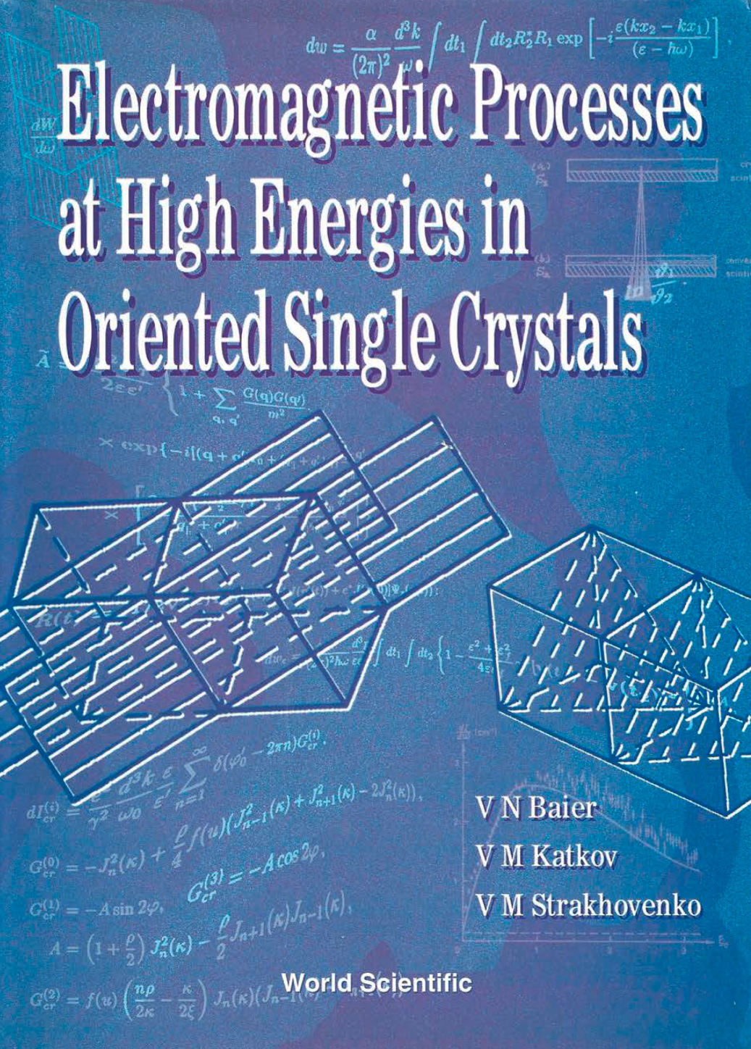
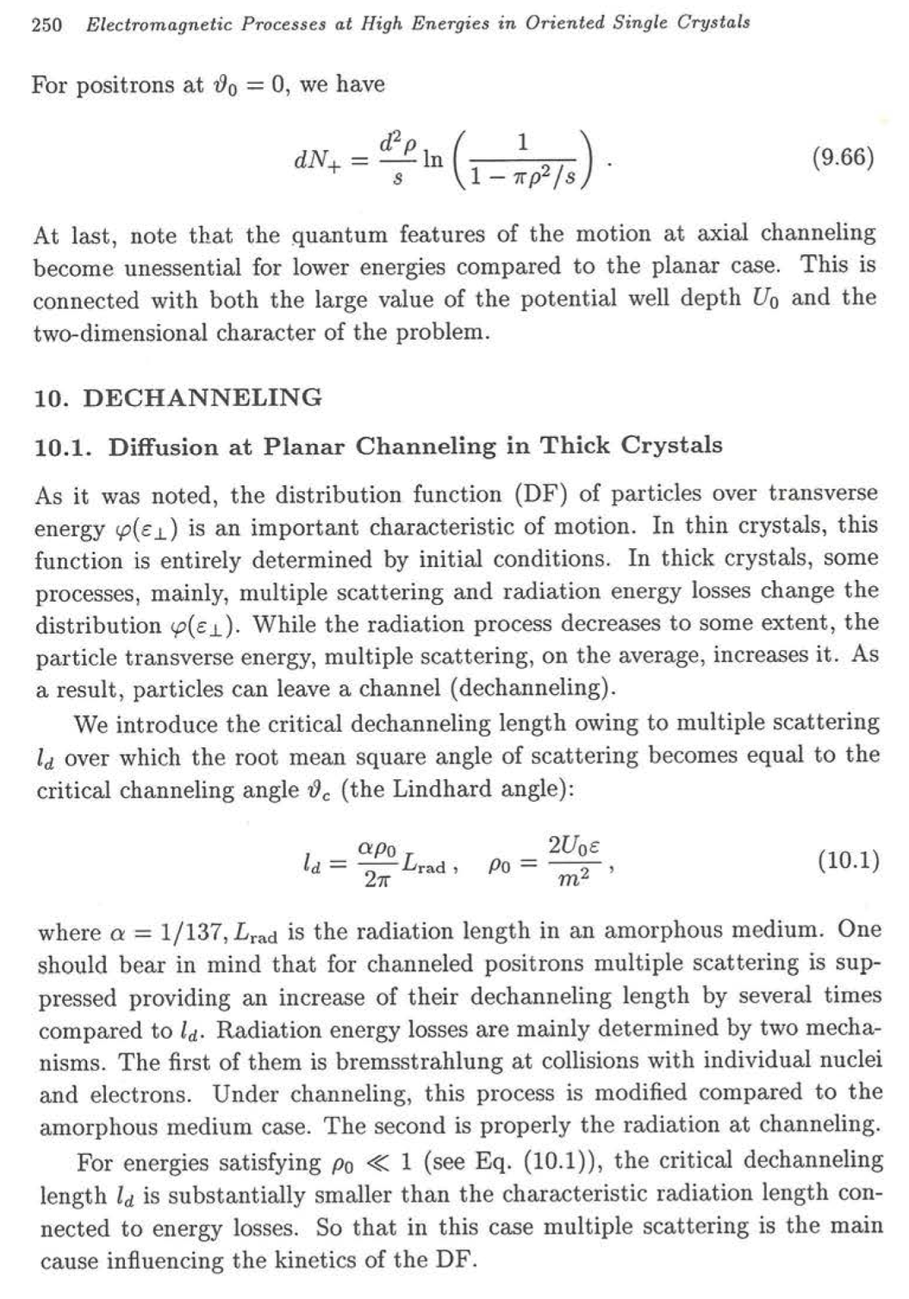

Slide 38
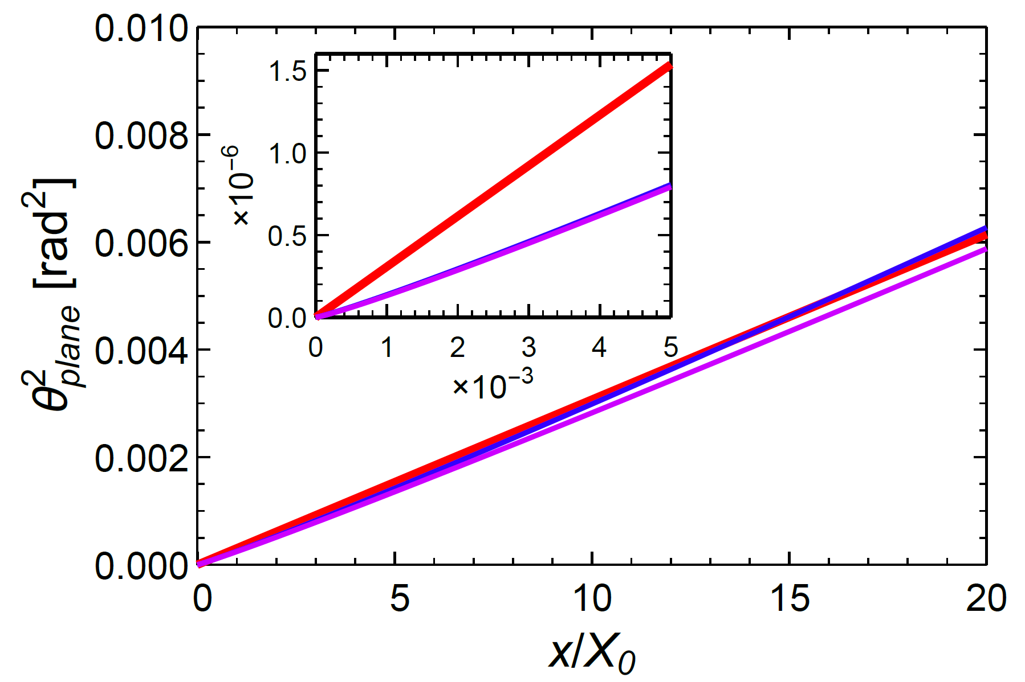
Variance of Scattering Angle according to Baier et al.
Bad approximation
at small thickness
blue:
Particle Data Group
violett:
G.R. Lynch, O.I. Dahl
NIM B58 (1991) 6
Notes:
From Scattering855-corr-2_Ferrara11bDiam1708.nb

Slide 39
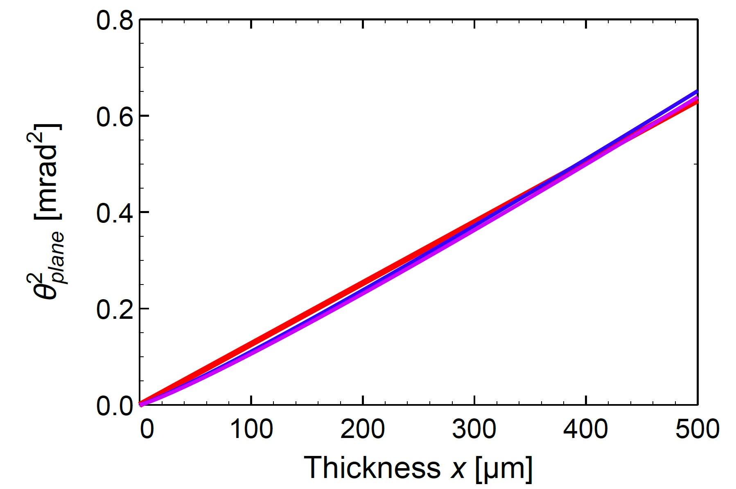
Modified Variance of Scattering Angle at Small Thickness
Baier Katkov approach
blue:
Particle Data Group
violett:
G.R. Lynch, O.I. Dahl
NIM B58 (1991) 6
Notes:
From Scattering855-corr-2_Ferrara11bDiam1708.nb

Slide 40
Fokker-Planck Equation with Normalized Variables
Same equation with normalized variables
Scaling length
is exactly
Normalized variables

Slide 42
H. Backe
W. Lauth
Thu Nhi Tran Thi
K.K. Andersen
Rune Mikkelsen
T. N. Wistisen
S. Yilmaz
J. Lundsgaard Hansen
Ulrik I. Uggerhøj
A. Mazzolari,
E. Bagli
L. Bandiera
V. Guidi
A. Berra, D. Lietti, M. Prest E. Vallazza
D. De Salvado
Institute for Nuclear Physics
University of Mainz
X-ray Optics Group, ESRF, Grenoble
Department of Physics and Astronomy
University of Aarhus
Dipartimento di Fisica e Scienze della Terra
Università di Ferrara
Università dell‘Insubria Como
INFN Sezione di Trieste
INFN Laboratori Nazionali die Legnaro and
Dipartimento di Fisica, Università di Padova

Slide 43
Some references for experimental work
H. Backe, W. Lauth, Nucl. Instr. Meth. in Phys. Res. B 355 (2015) 24-29
H. Backe, D. Krambrich, W. Lauth, K.K. Andersen, J. Lundsgaard Hansen, Ulrik I. Uggerhøj,
Nucl. Inst. Meth. in Phys. Res. B 309 (2013) 37
W. Lauth, H. Backe, P. Kunz, A. Rueda, Int. Jour. Mod. Phys. A 25 (2010) 136
H. Backe, D. Krambrich, W. Lauth, K.K. Andersen, J. Lundsgaard Hansen, Ulrik I. Uggerhøj,
Journal of Physics: Conference Series 438 (2013) 012017
A. Mazzolari, E. Bagli, L. Bandiera, V. Guidi, H. Backe, W. Lauth, V. Tikhomirov, A. Berra,
D. Lietti, M. Prest, E. Vallazza, D. De Salvador, Phys. Rev. Lett. 112 (2014) 135503
T. N. Wistisen, K. K. Andersen, S. Yilmaz, R. Mikkelsen, J. Lundsgaard Hansen,
Ulrik I Uggerhøj, W. Lauth, H. Backe, Phys. Rev. Lett. 112 (2014) 254801
T. N. Wistisen et al., Phys. Rev. ST-AB 19, 071001 (2016)
Support by the European Commission (the PEARL Project within the H2020-MSCA-RISE-2015 call, GA 690991) is gratefully acknowledged.
Many thanks in particular to Andrey V. Solov’yov and Andrei V. Korol for fruitful cooperation and discussions.

