Slide 1
Laser-Wire as a Non-invasive Transverse Beam Emittance Diagnostics for Electrons and H⁻ particles: similarities and differences
Pavel Karataev
John Adams Institute for Accelerator Science
at Royal Holloway, University of London
On Behalf of Laser-Wire Collaboration

Slide 2
Laser-Wire People
BESSY: T. Kamps
DESY : E. Elsen, H. C. Lewin, F. Poirier, S. Schreiber, K. Wittenburg, K. Balewski
JAI@Oxford: B. Foster, N. Delerue (LAL now), L. Corner, M. Newman (CERN), A. Reichold, R. Walczak
JAI@RHUL: S. Boogert, G. Boorman, A. Bosco, P. Karataev, K.Kruchinin (Czech Republic), S. Gibson, L. Nevay, I. Agapov (DESY)
KEK: A. Aryshev, H. Hayano, K. Kubo, N. Terunuma, J. Urakawa
SLAC: A. Brachmann, J. Frisch, M. Woodley, M.Ross
CERN: T. Lefevre, R. Jones, T. Hoffmann, F. Roncarolo, U Raich, E.Bravin
Imperial College: J.K.Pozimski

Slide 3
Two basic principles
Electron beam Laser-Wire
Inverse Compton Scattering Process
H⁻ beam laser Wire
Photo-ionization (neutralization) process

Slide 4
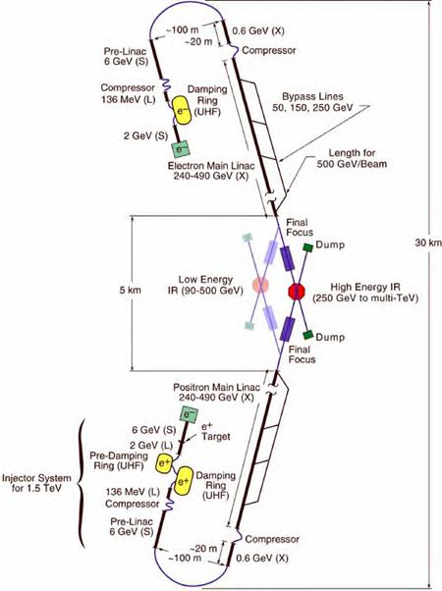
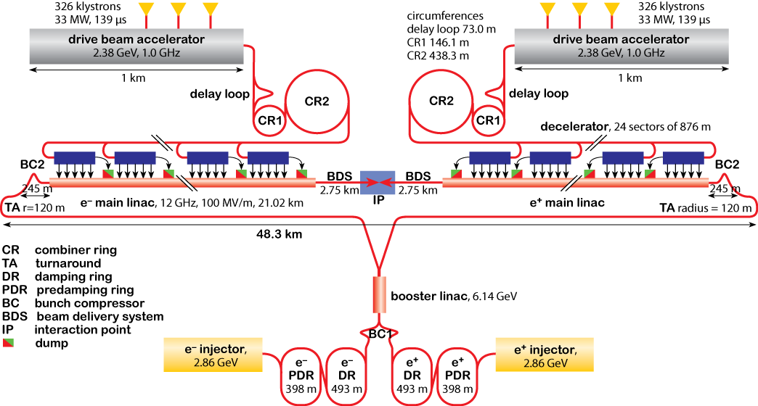
e-beam laser wire for linear colliders
Colliders e⁻/e⁺ high precision machines.
Two main current designs - International Linear
Collider (ILC) and Compact Linear Collider (CLIC).
Extreme focusing/charge/luminosity requirements.
Need high quality non-invasive measurements of beam size, emittance, position, charge, duration, etc.

Slide 5
Laser-Wire Principle

Slide 6
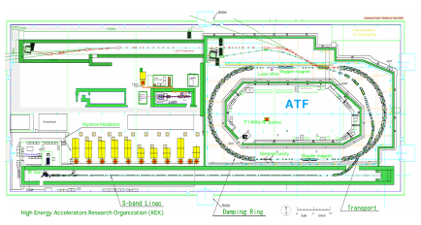
KEK:ATF2 – Accelerator Test Facility
Charge | 1 – 8 x 10⁹ e
Energy | 1.28 GeV
Beam size (LWIP) | 100 x 1 μm
Bunch | 30 ps (3.12Hz, single bunch)
Laser (532nm, Nd:YAG) | 100 mJ, 77 ps

Slide 7
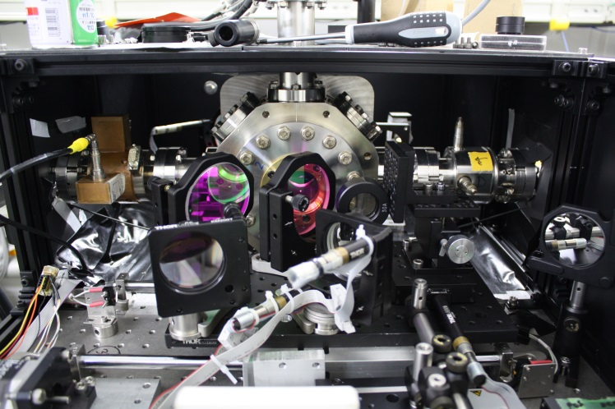
KEK:ATF2 – Accelerator Test Facility
Detector
Laserwire IP
Laser beam transport

Slide 8
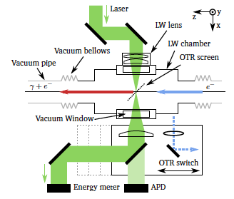
LW interaction region

Slide 9
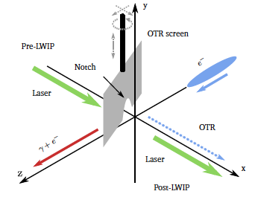
Laser – e-beam collision search

Slide 10
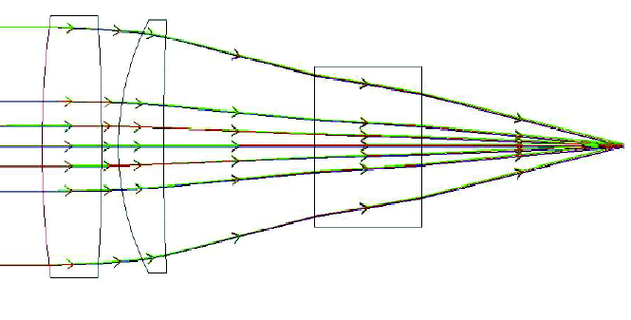
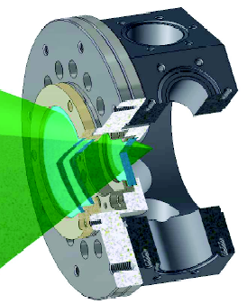
f2 lens design
f2 lens at 50 mm focal distance
Aberration free at 532 nm
Geometrical shadow avoided

Slide 11
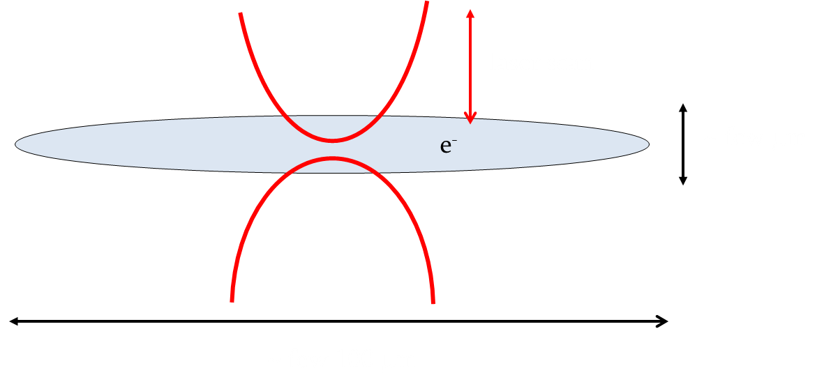
Laser-Wire Layout
2z_{R} ~ 30 – 40 μm.
Vertical direction
scan
Horizontal direction scan

Slide 12
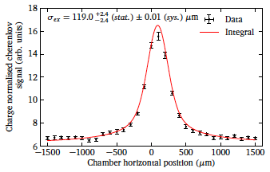
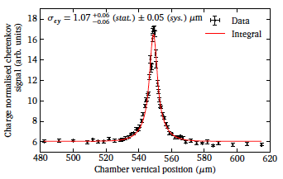
Horizontal and Vertical beam profiles
Horizontal
Vertical

Slide 13
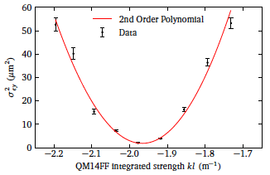
Emittance measurement
Physical beam emittance was 82.56 ± 3.04 pm rad

Slide 14
Performance characteristics
Dynamic range: Defined by the signal to noise ratio and can be adjusted by the laser power
Resolution - determined by the laser waist (Linear Collider requires 1μm, 3.4μm convoluted size achieved at ATF)
Accuracy
Aberration of the lens system (need an aberration free lens)
Laser waist and waist position should be stabilized
Bunch-by-bunch instability
Non-Destructive method
Major candidate for linear collider

Slide 15
H⁻ Laser-wire for proton machines
Large Hadron Collider injection complex
High Luminosity upgrade
Proton beam driven neutron sources
High intensity beam is needed for generating high flux neutrons or neutrino

Slide 16
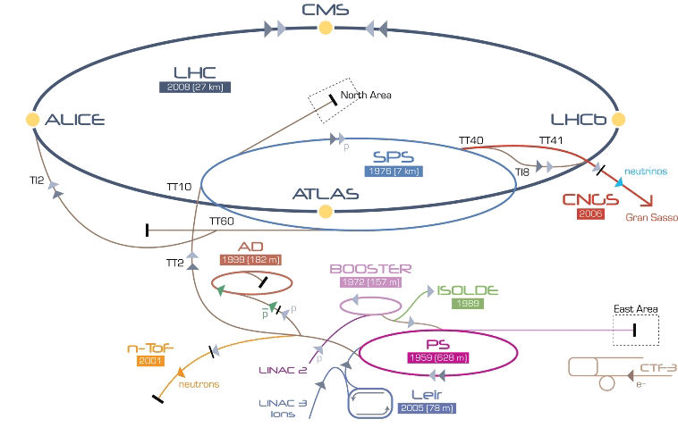
Accelerator Complex at CERN

Slide 17
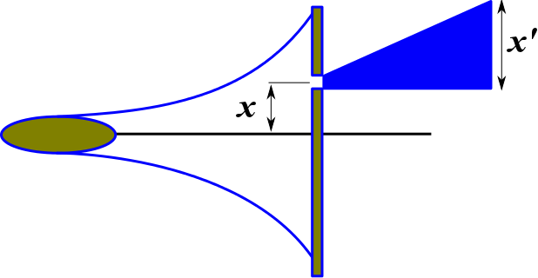
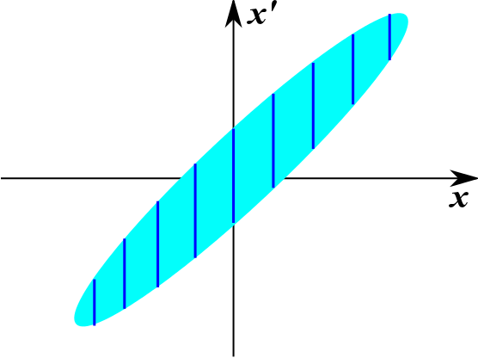
Direct Phase-space measurement principle

Slide 18
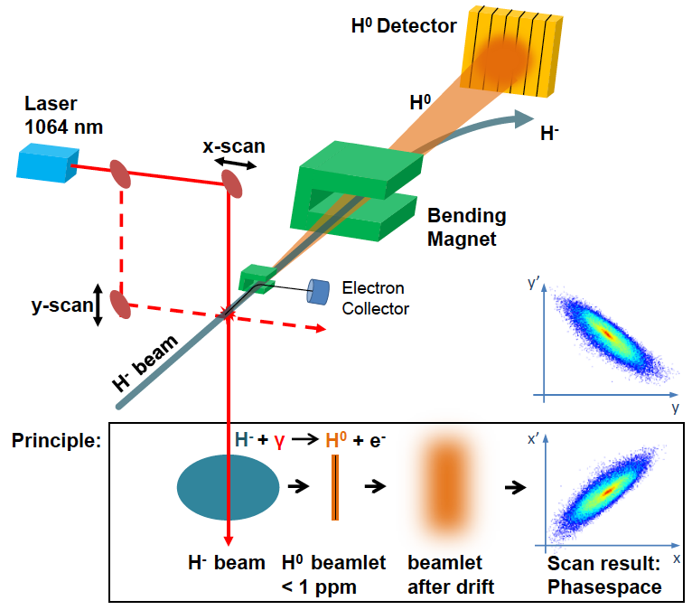
H⁻ Laser-wire principle
Courtesy to T. Hoffman

Slide 19
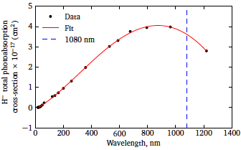
Photo-detachment cross-section
J.T. Broad and W.P. Reinhardt, One- and two-electron photoejection from H⁻: A multichannel
j-matrix calculation. Physical Review A, 14(6):2159–2173, 1976.

Slide 20
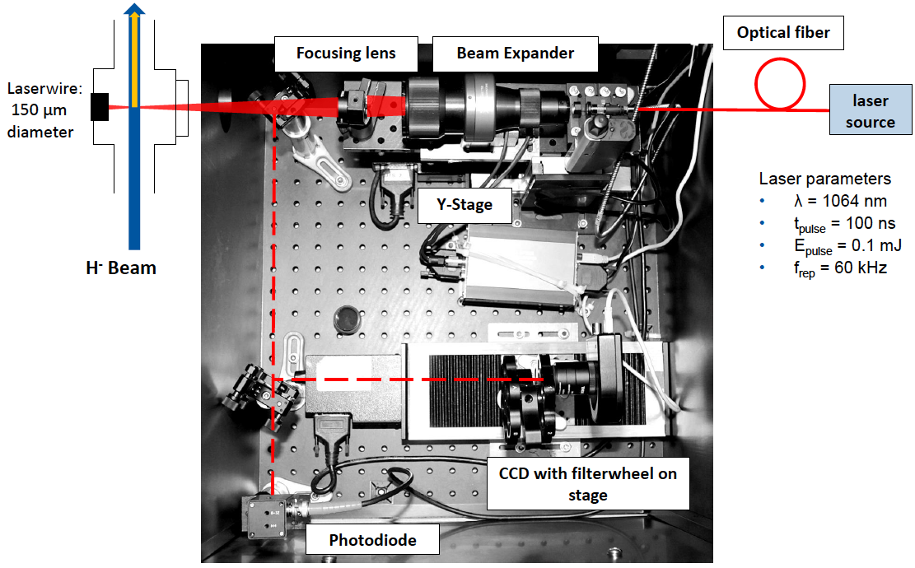
Laser delivery system
Courtesy to T. Hoffman

Slide 21
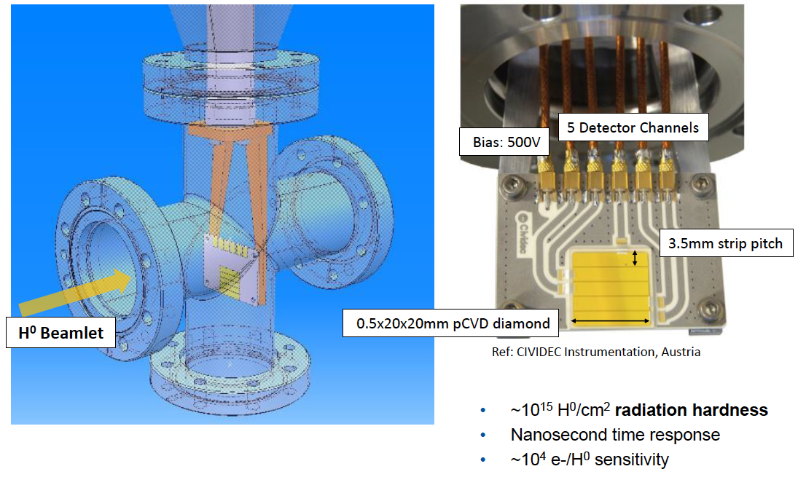
H⁰ Diamond Strip detector
Courtesy to T. Hoffman

Slide 22
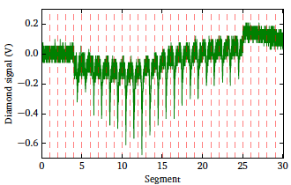
Diamond detector signal

Slide 23
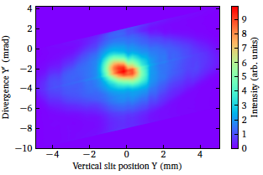
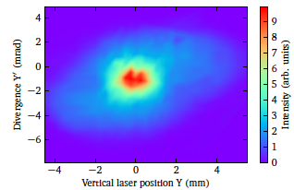
Phase-space measurements
Slit and grid technique
Laser-wire technique

Slide 24
Summary
Electrons
High power
Extreme focusing with aberration free optics
Close to the beam
Pointing stability
Precise positioning system
Strict safety requirements
H⁻ particles
Moderate power
Beam delivery with weak focusing
Could be far-away
Special fast position sensitive detector

