Slide 1



A novel tool in Zemax describing collective optical effects in transition and diffraction radiation
F. Bisesto
LNF-INFN

Slide 2
Outline
Transition Radiation implementation in Zemax
Algorithm and comparison with experiments:
  Coherent radiation
  Incoherent radiation
Conclusions and future perspectives

Slide 3
Zemax optical simulation software
Powerful tool commonly used for lens design and illumination devices (e.g. car headlights).
Provides both geometrical and physical optics analysis.
Scientific appeal: possibility to simulate any optical system with any possible radiation source.

Slide 4
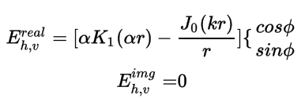
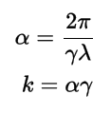

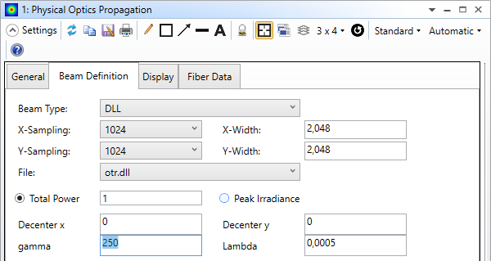
TR electric field implementation in Zemax
A custom dynamic-link library (dll) able to compute the single electron TR field has been written:
Castellano M. et al., NIM A, 435 (1999)
Electron beam energy, spatial position and field wavelength can be chosen.

Slide 5
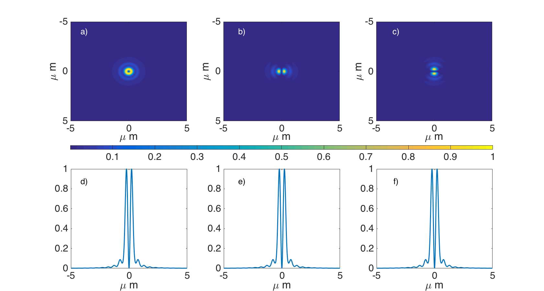
Single electron TR intensity in Zemax
I
I_{h}
I_{v}

Slide 6
How the algorithm works
So far only single electron analysis performed.
Our algorithm takes into account the finite size of the beam and its divergence (i.e. emittance):
  Electron beam parameters (energy, spot size, divergence) can be defined.
  The algorithm simulates the propagation of each TR field.
  The single contributions are summed coherently or incoherently.

Slide 7
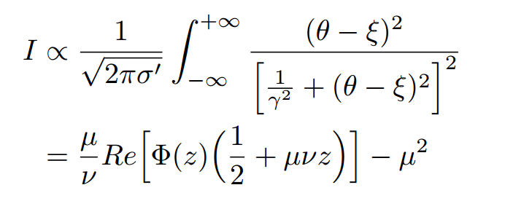
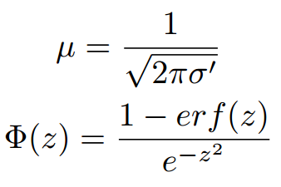
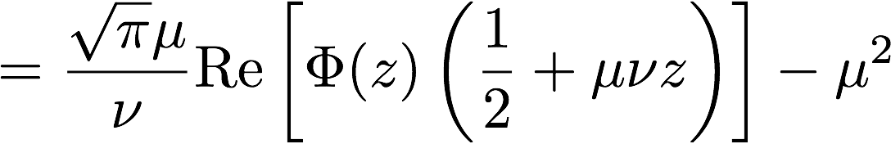


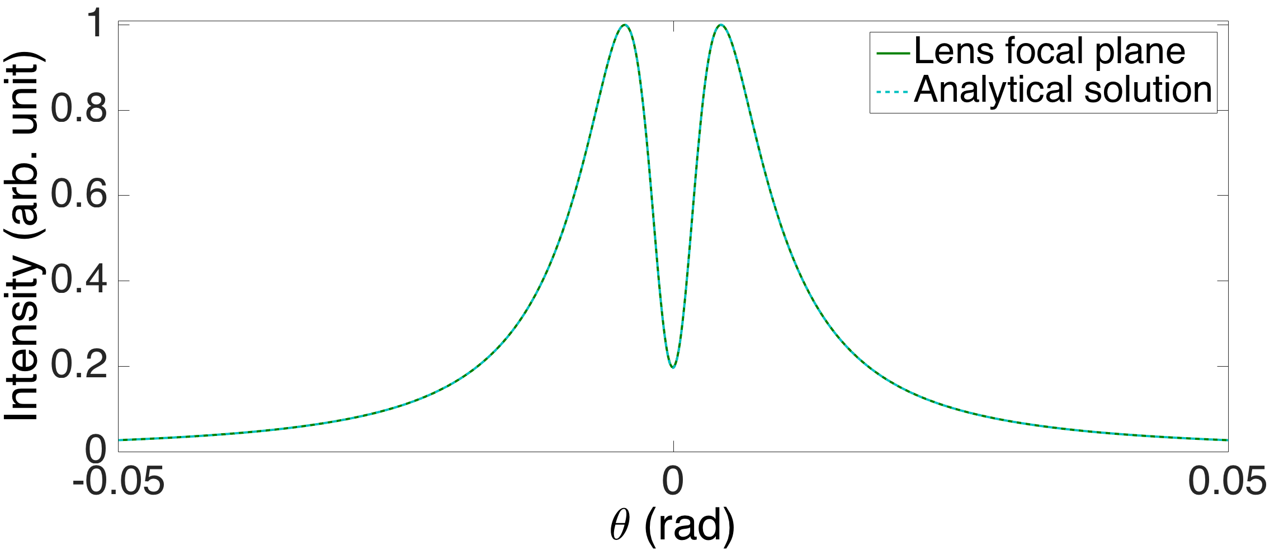
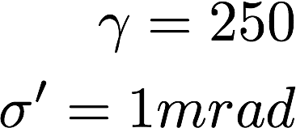
Example: effect of beam divergence
Convolution of single electron contributions
with a Gaussian distribution:
Verzilov V., private communication

Slide 8
Example: effect of beam divergence
Convolution of single electron contributions
with a Gaussian distribution:
Verzilov V., private communication
Effect of beam
divergence

Slide 9
Comparison between simulations and experiments
Simulations have been compared with experimental results:
  THz imaging from CTR (coherent radiation)
  Optical Diffraction Radiation Interference (incoherent radiation)
A special case with microlens array has been studied for an innovative single shot emittance diagnostics.

Slide 10
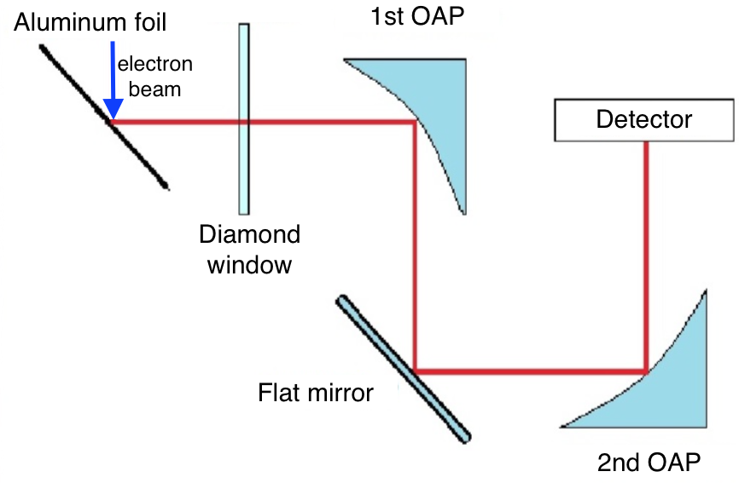
Coherent Radiation: Imaging of THz from CTR
f₁=152mm
Experiment performed at SPARC_LAB Test Facility.
Beam parameters:
Energy = 114 MeV
Spot size = 600 um
Temporal length = 100 fs
Interferential
filter
Giorgianni F. et al., Appl. Sci. 2016, 6(2), 56
f₂=50mm
Giorgianni F. et al., Nat. Comm. 7, 11421 (2016)

Slide 11
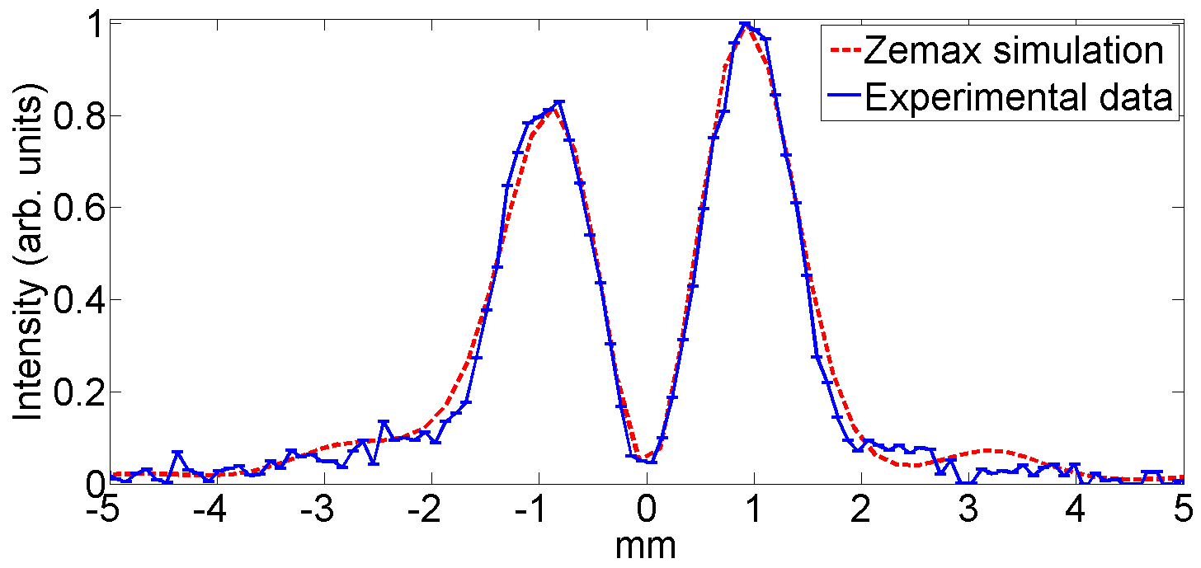
Coherent Radiation: Imaging of THz from CTR
f = 1 THz
It has been found a 8mm diagonal shift between the mirror centers and an angular tilt equals to (−9◦,+9◦).
Giorgianni F. et al., Appl. Sci. 2016, 6(2), 56
Giorgianni F. et al., Nat. Comm. 7, 11421 (2016)

Slide 12
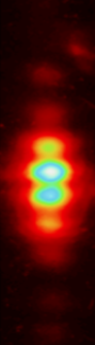
Incoherent Radiation: ODRI Angular Distribution
Experiment performed at FLASH (DESY).
Beam parameters:
𝞬 = 1993
Spot size = 90 um
Beam divergence = 50 urad
1st slit
a=1mm
2nd slit
b=0.5mm
e⁻
Interferential
filter
Polarizer
Flat
mirror
Lens
f=500mm
CCD Camera
Cianchi A. et at., Phys. Rev. ST Accel. Beams 14, 102803 (2011)

Slide 13
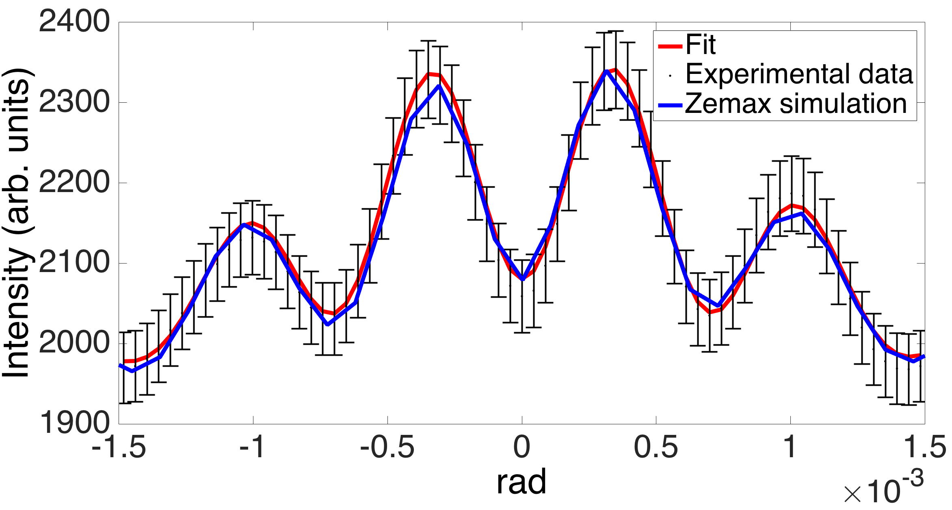
Incoherent Radiation: ODRI Angular Distribution
a=1mm
b=0.57mm
∆a=50um
∆b=-10um
Cianchi A. et at., Phys. Rev. ST Accel. Beams 14, 102803 (2011)

Slide 14
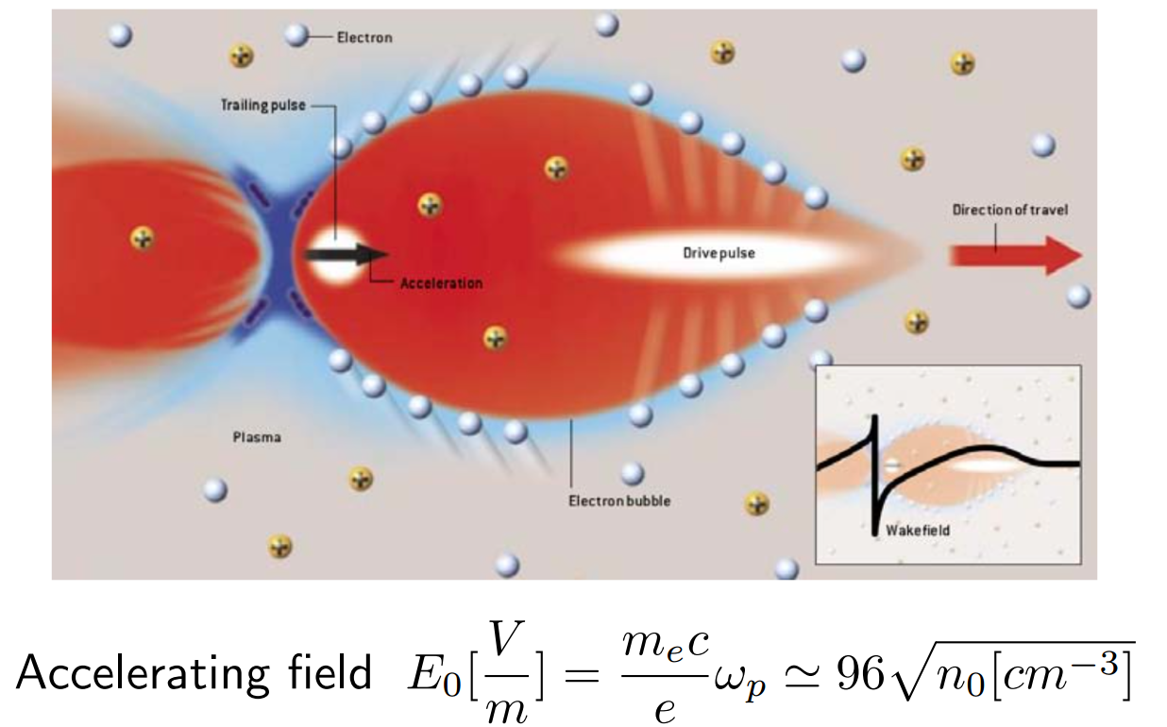
Plasma Acceleration
From 100 MV/m of RF structure (limited by breakdown) to >100GV/m!!!
Notes:
One of the key activity of SPARC_LAB is the plasma acceleration since the high electric field of a plasma are very fascinating for the accelerator world. Indeed, from this equation, it is possibile to reach accelerating gradient greater than 100GV/m, well beyond the limit of RF structure due to breakdown. In this way, it would be possible to build extremely compact accelerators able to reach hundreds of MeV in few mm.

Slide 15
Importance of single shot diagnostics
Electron beams from plasma are still characterized by:
  Relatively large energy spread (~5%);
  Shot-to-shot instabilities.
Therefore, common emittance diagnostics (e.g. quadrupole scan) are almost not useful.
A possible solution comes from Transition Radiation (TR).
Notes:
Nevertheless, electron beams from plasma are still characterized by … Therefore single shot diagnostics are necessary. In particular, the tools commonly used for emittance measurements are almost not useful. A possible solution that we are studying comes from TR

Slide 16
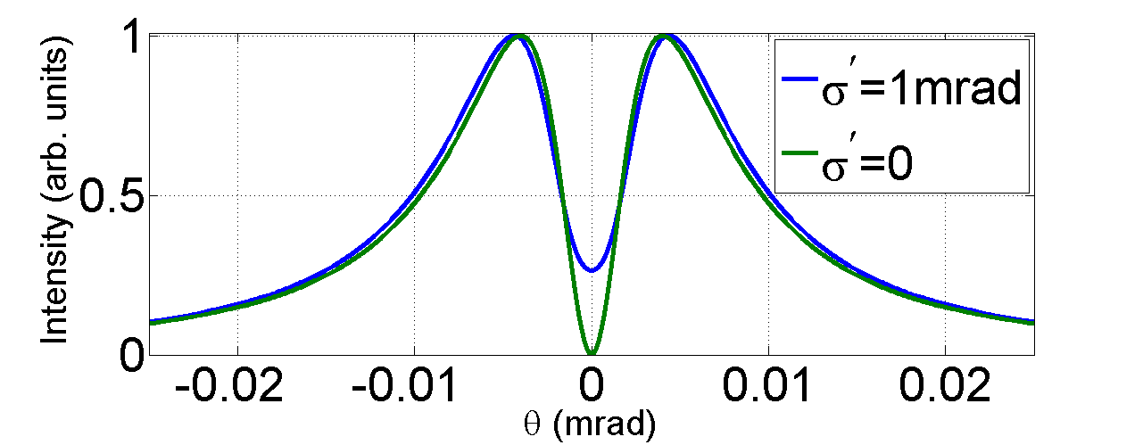
A special case: microlens array for single-shot emittance measurement
The angular distribution of incoherent TR is sensitive to beam divergence: the central minimum is not zero.
Notes:
TR is emitted when a charged particle crosses the boundary between two media with different refractive indices. The angular distribution in the far field shows an interesting dependance from beam divergence: the central minimum is different from zero. The first terme of the emittance is measured from the spot size and from the TR angular distribution. Nevertheless, in order to fully measure the beam emittance, we need to retrieve this correlation term.

Slide 17

A special case: microlens array for single-shot emittance measurement
The angular distribution of incoherent TR is sensitive to beam divergence: the central minimum is not zero.
Emittance:
?
From spot size
From angular distribution
Notes:
TR is emitted when a charged particle crosses the boundary between two media with different refractive indices. The angular distribution in the far field shows an interesting dependance from beam divergence: the central minimum is different from zero. The first terme of the emittance is measured from the spot size and from the TR angular distribution. Nevertheless, in order to fully measure the beam emittance, we need to retrieve this correlation term.

Slide 18
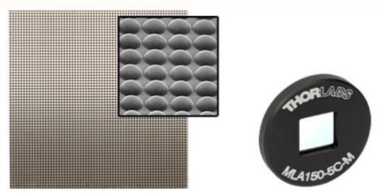
A special case: microlens array for single-shot emittance measurement
The angular distribution of incoherent TR is sensitive to beam divergence: the central minimum is not zero.
Emittance:
IDEA: Microlens array!
?
From spot size
From angular distribution
Notes:
TR is emitted when a charged particle crosses the boundary between two media with different refractive indices. The angular distribution in the far field shows an interesting dependance from beam divergence: the central minimum is different from zero. The first terme of the emittance is measured from the spot size and from the TR angular distribution. Nevertheless, in order to fully measure the beam emittance, we need to retrieve this correlation term.

Slide 19
A special case: microlens array for single-shot emittance measurement
9x9mm array, 300um pitch,
18.5mm focal length
Cianchi, A., Bisesto, F. et al. " Transverse emittance diagnostics for high brightness electron beams." NIMA (2016)
Notes:
This is the sketch of our experimental setup. The TR emitted from a metallic screen follows two different lines: the first one provides the transversal spot size, while the second one is dedicated for the correlation term measurement. In particular, a lens makes an image of the screen on the microlens array, placed in its image plane.

Slide 20
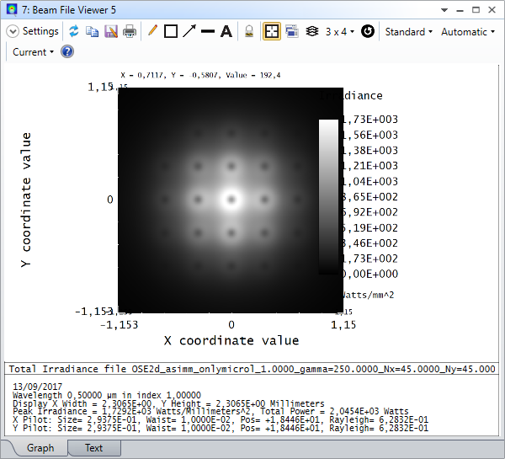
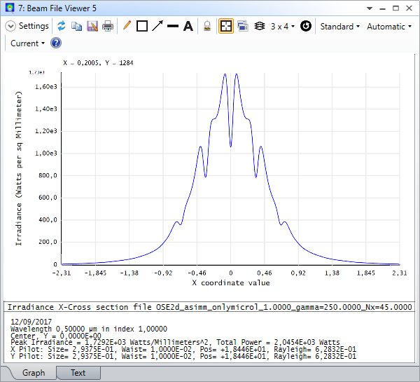
ZEMAX Simulations
Notes:
Indeed, the setup has been simulated by means of Zemax, taking into account all the parameters of the electron beam: transversal size, angular divergence, energy. In particular, a dedicated code with the zemax programming languange has been written for this scope.

Slide 21
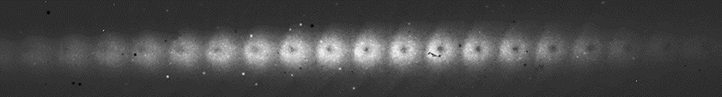
Preliminary results
Measurement with focused beam in one direction.
Experiment performed at SPARC_LAB.
Beam parameters:
Energy = 125 MeV
Spot size = 600 um
Beam divergence = 250 urad
Temporal length = 1 ps
Line profile of central microlens.
Cianchi A., Bisesto F. et al. " Transverse emittance diagnostics for high brightness electron beams." NIMA (2016)
Notes:
Here, you can see a comparison between simulation and measurements, on the top, and a line profile of the central microlens, on the bottom. The visibility of the centra minimum is proportional to electron beam energy. In our case, due to a RF fault, we had not enough electron energy to detect the angular divergence equal to 250urad. By the way, this result represents a proof of principle for this new diagnostics tool. By the way, new experiments are foreseen in the next future, also on electrons from lwfa at flame.

Slide 22
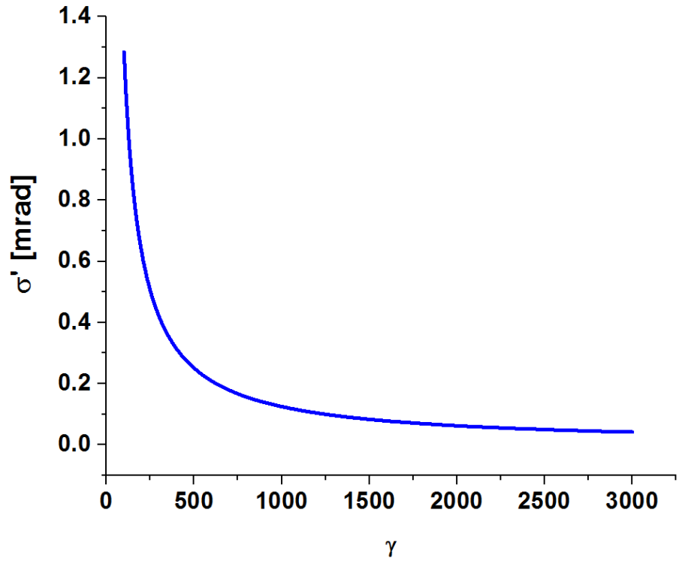
Visibility
Angular divergence was lower than the minimum detectable with good visibility for this energy (500urad).

Slide 23
Conclusions and future perspectives
Zemax features are suitable also for scientific purposes.
Our algorithm can well reproduce the effects due to finite size and non-zero divergence of electron beam on the emitted radiation.
It is a powerful tool to check the feasibility of new ideas.
Further efforts will be done in order to take into account other properties (e.g. temporal profile, energy spread).

Slide 24
Thanks for your attention!
Acknowledgements:
M. Castellano
E. Chiadroni
A. Cianchi
M. Ferrario
…and all the SPARC_LAB group!
fabrizio.giuseppe.bisesto@lnf.infn.it

