Slide 1
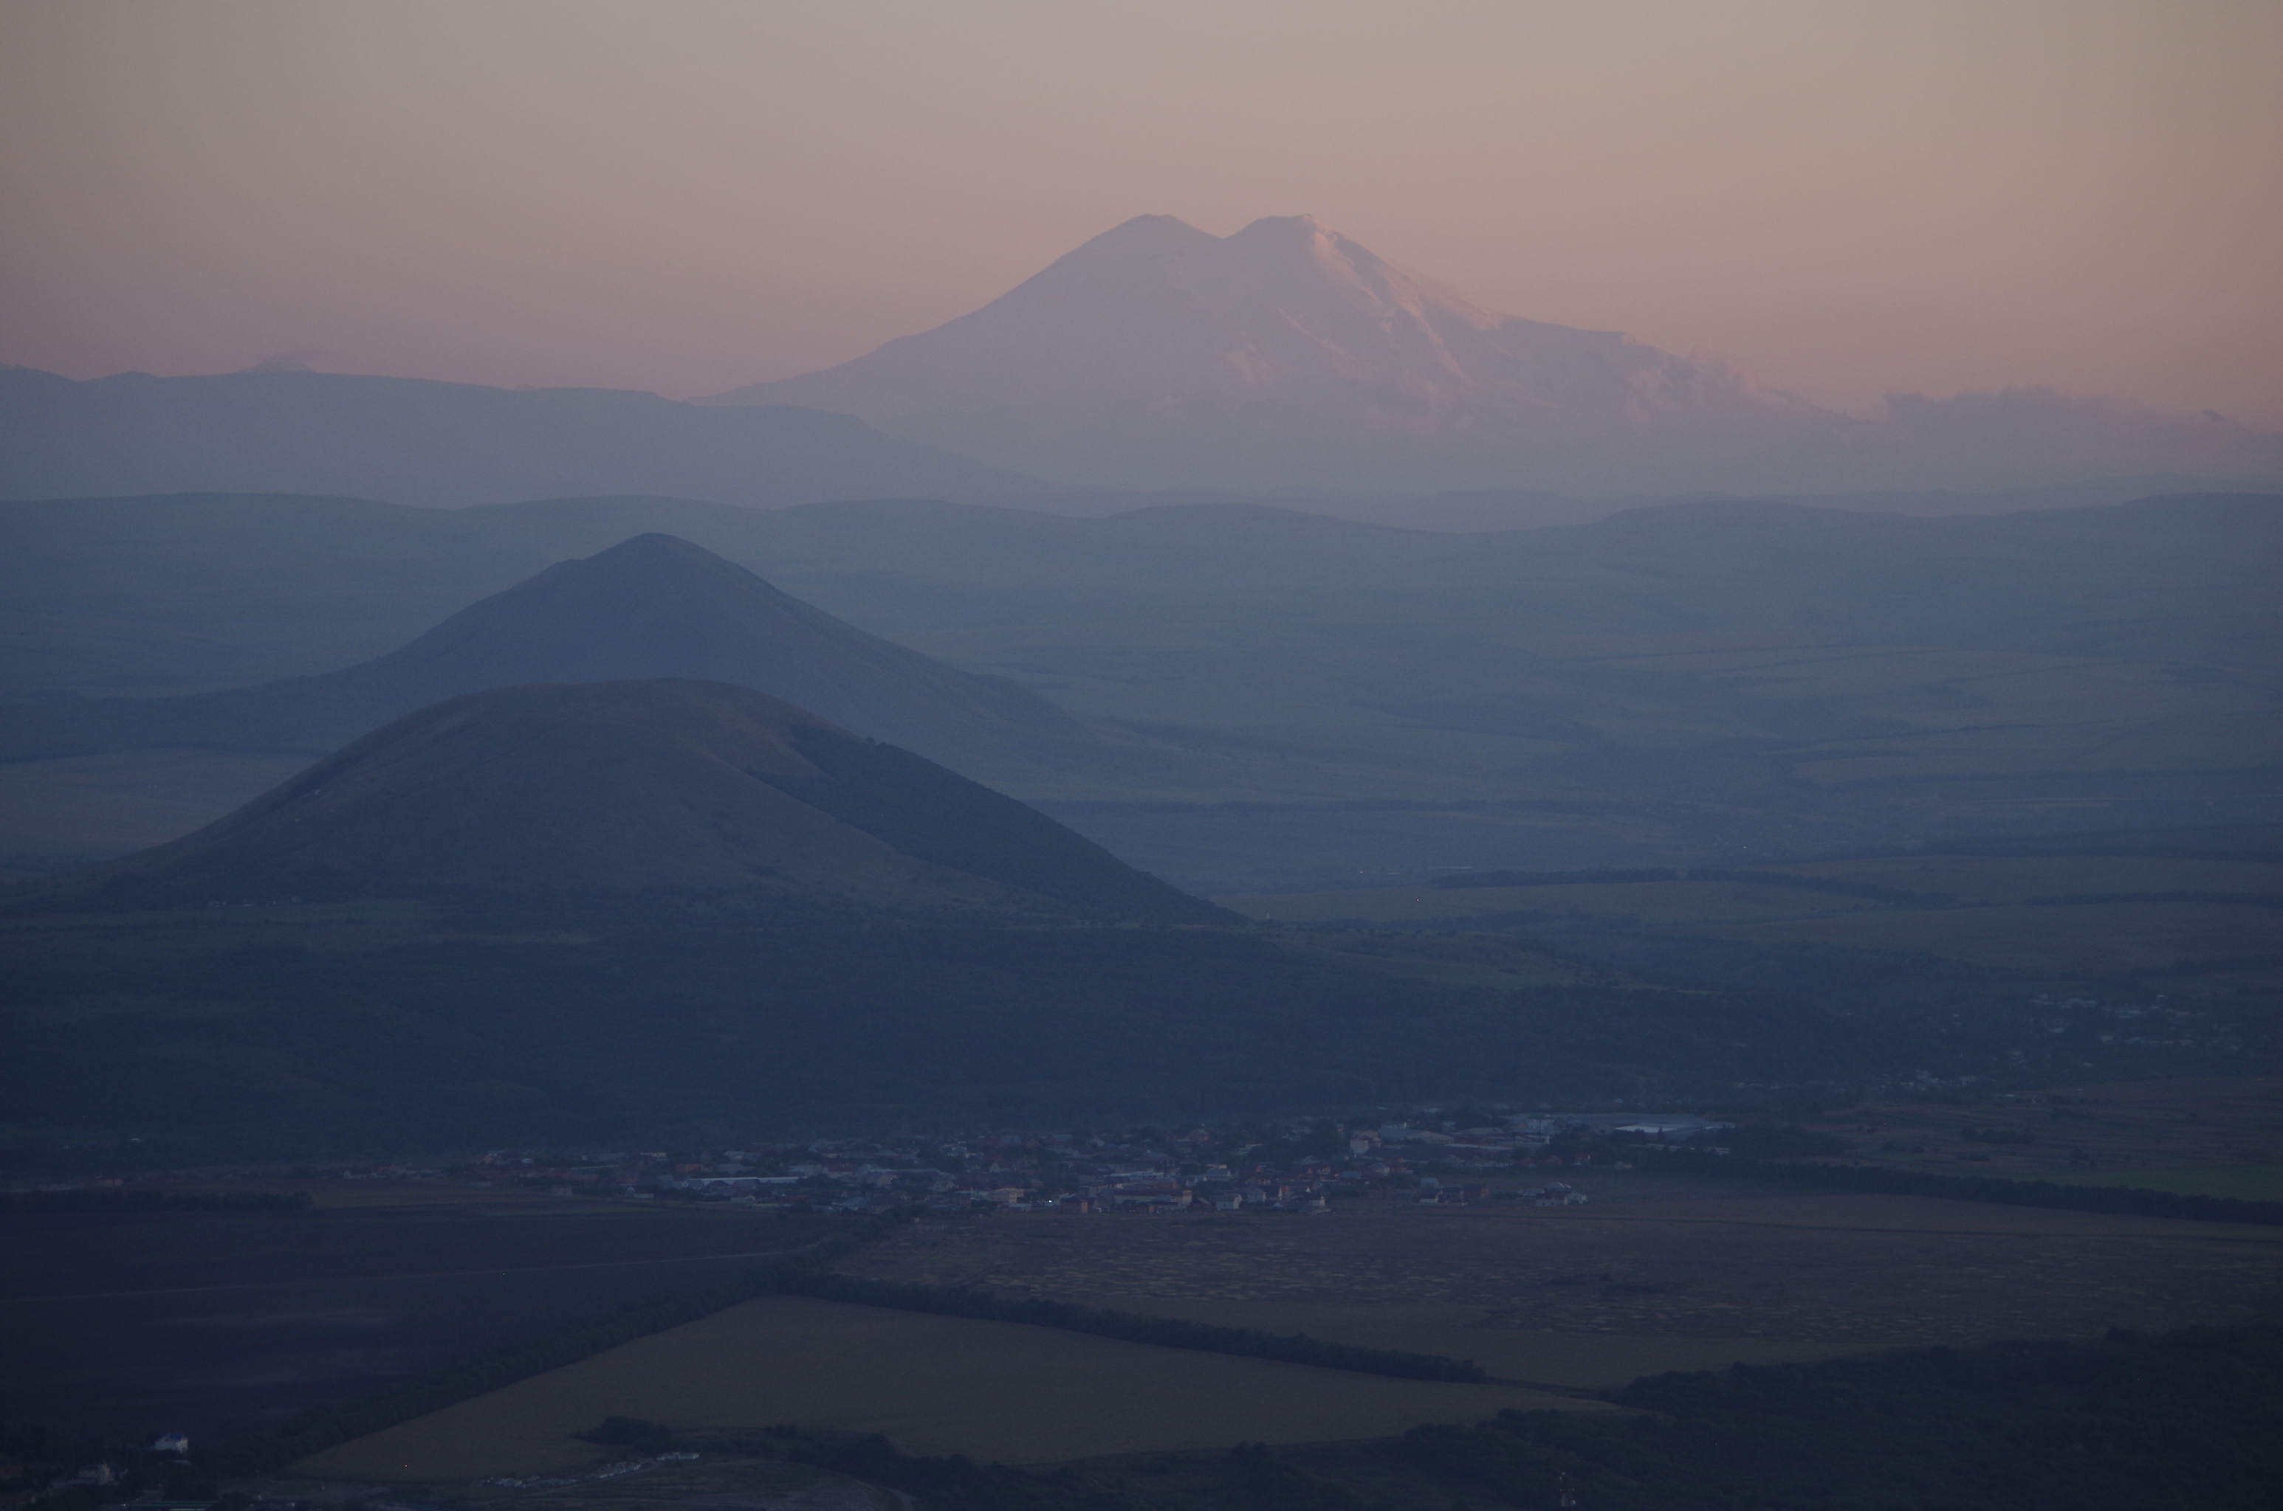
Final Discussion
The Mount Elbrus Conference From Deep Underground up to the Sky
Terskol Pyatigorsk – September 2017

Slide 2
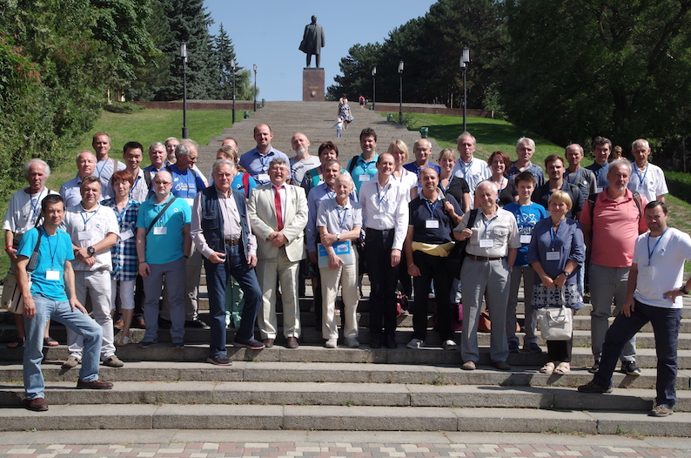

Slide 3
TOPICS of the conference
Astroparticle physics in Deep Underground Laboratories:
Direct Dark Matter searches
Neutrino property measurements
Neutrino astronomy in the low energy regime
Axion searches
Nuclear astronomy in Underground Labs
Multi-messenger aspects related to these topics
Novel ideas and synergies with other fields of science
Upcoming experimental opportunities in Russia, Europe and beyond
Theory and modelling
Many discussions and crosstalks between participants

Slide 4
How to prepare the results of this conference?
Presentations are online available
So far it is not planned to publish proceedings. Do we need proceedings?
We plan to prepare a summary report of the main results of the conference. You are invited to contribute to this report.

Slide 5
Summary & Final discussion, questions
Collaboration agreement between neutrino observatories and astronomical observatories on multi-messenger / alerts suggested by Valery Vlasyuk (SAO)
How to get in touch with more younger scientist and have them participate in our conferences?
Collaboration in upcoming astroparticle projects in Russia
+

Slide 6
Finally, …
A great thank you again to
Yulia, Elena, Anna, Albert, Vladimir, Sergey, Valery, Francesca
all participants
Send us feedback if you like.
Have a save travel back home!
Taxis to the airport are organized. Please ask Yulia when.
No common dinner today

