Slide 1
Calibration Working Group and
Calibration Infrastructure
Jola Sztuk-Dambietz
on behalf of
the European XFEL Calibration Group
May, 16th 2017
22nd Meeting of the XFEL Detector Advisory Committee
European XFEL GmbH, Schenefeld
Notes:
How to edit the title slide
Upper area: Title of your talk, max. 2 rows of the defined size (55 pt)
Lower area (subtitle): Conference/meeting/workshop, location, date,
your name and affiliation,
max. 4 rows of the defined size (32 pt)
Change the partner logos or add others in the last row.

Slide 2
Outline
Calibration status and highlights from the calibration meeting
Infrastructure for detector calibration and tests at the XFEL – status

Slide 3
Calibration activity at XFEL
Development and characterization of laboratory X-ray infrastructure
Development of calibration software tools, simulation → S. Hauf’s presentation
LPD and AGIPD End-to-End tests activity including calibration cross-check
Characterization and calibration of FastCCD detector
Preliminary evaluation of ePix calibration data
Coordination of calibration activity

Slide 4
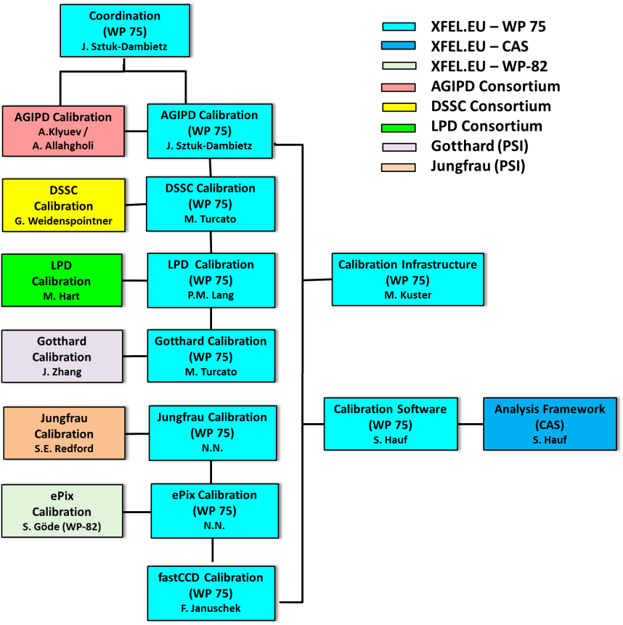


Calibration Working Group
Work done by detector consortia/developers, WP-75, CAS
Experts from consortia available beyond start-up phase of the project
Involvement of beamline scientist → requirement for calibration at beamline during commissioning phase
Involvement of user community through SAC is under discussion
Responsible contact persons:
Indico page with presentations and documents:
https://indico.desy.de/categoryDisplay.py?categId=278
Calibration Working Group site @ Alfresco - https://docs.xfel.eu/share/page/site/calibration/dashboard

Slide 5
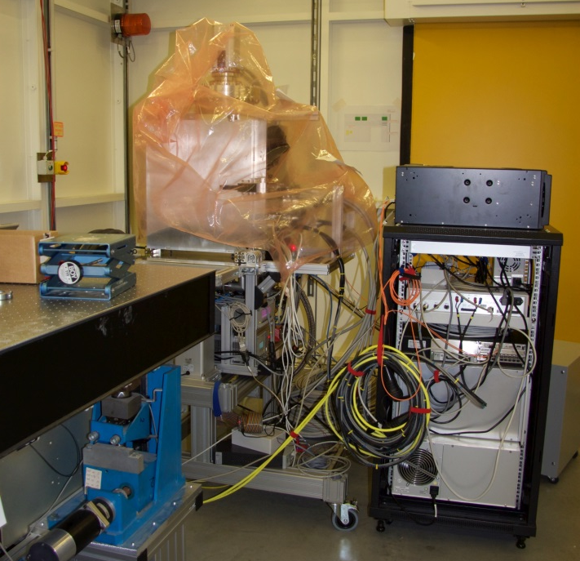
Calibration Activity – DSSC with miniSDD
DSSC – planning for calibration up to operation at beamline (including scheduling for XFEL X-ray calibration infrastructure) exists
Work on optimization of calibration strategy using simulation and existing small prototypes ongoing → to be verified on the full scale devices
Analysis of the data from the beam tests (LaBeC and P04/PETRA III) ongoing
Preparation for the next beam test at PETRA III-P65
  Beamtime scheduled for May 26-29, installation in progress
  Goals for beamtime with miniSDD-F1 ladder:
    Demonstration of suitability of P65 for offset and
    gain calibration (flux level and homogeneity)
    Offset and gain calibration of ladder system
    Demonstration of consistency of DSSC operation
    modes for PETRA III and XFEL

Slide 6
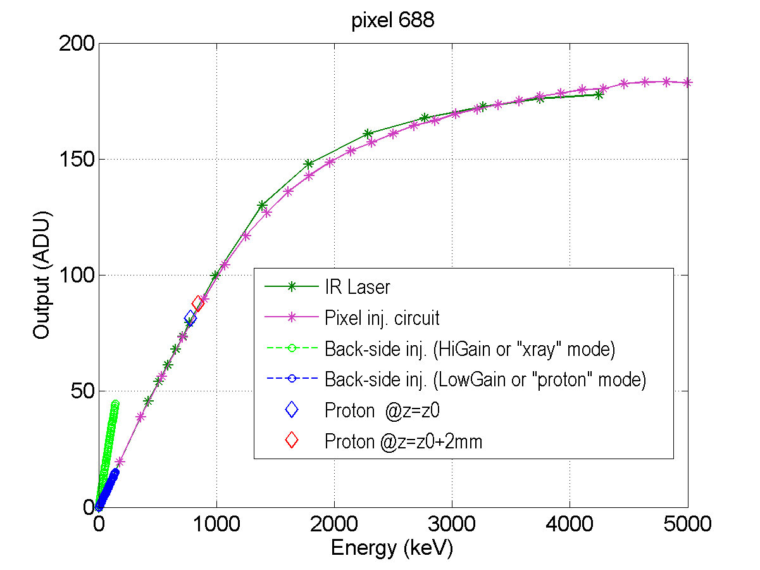
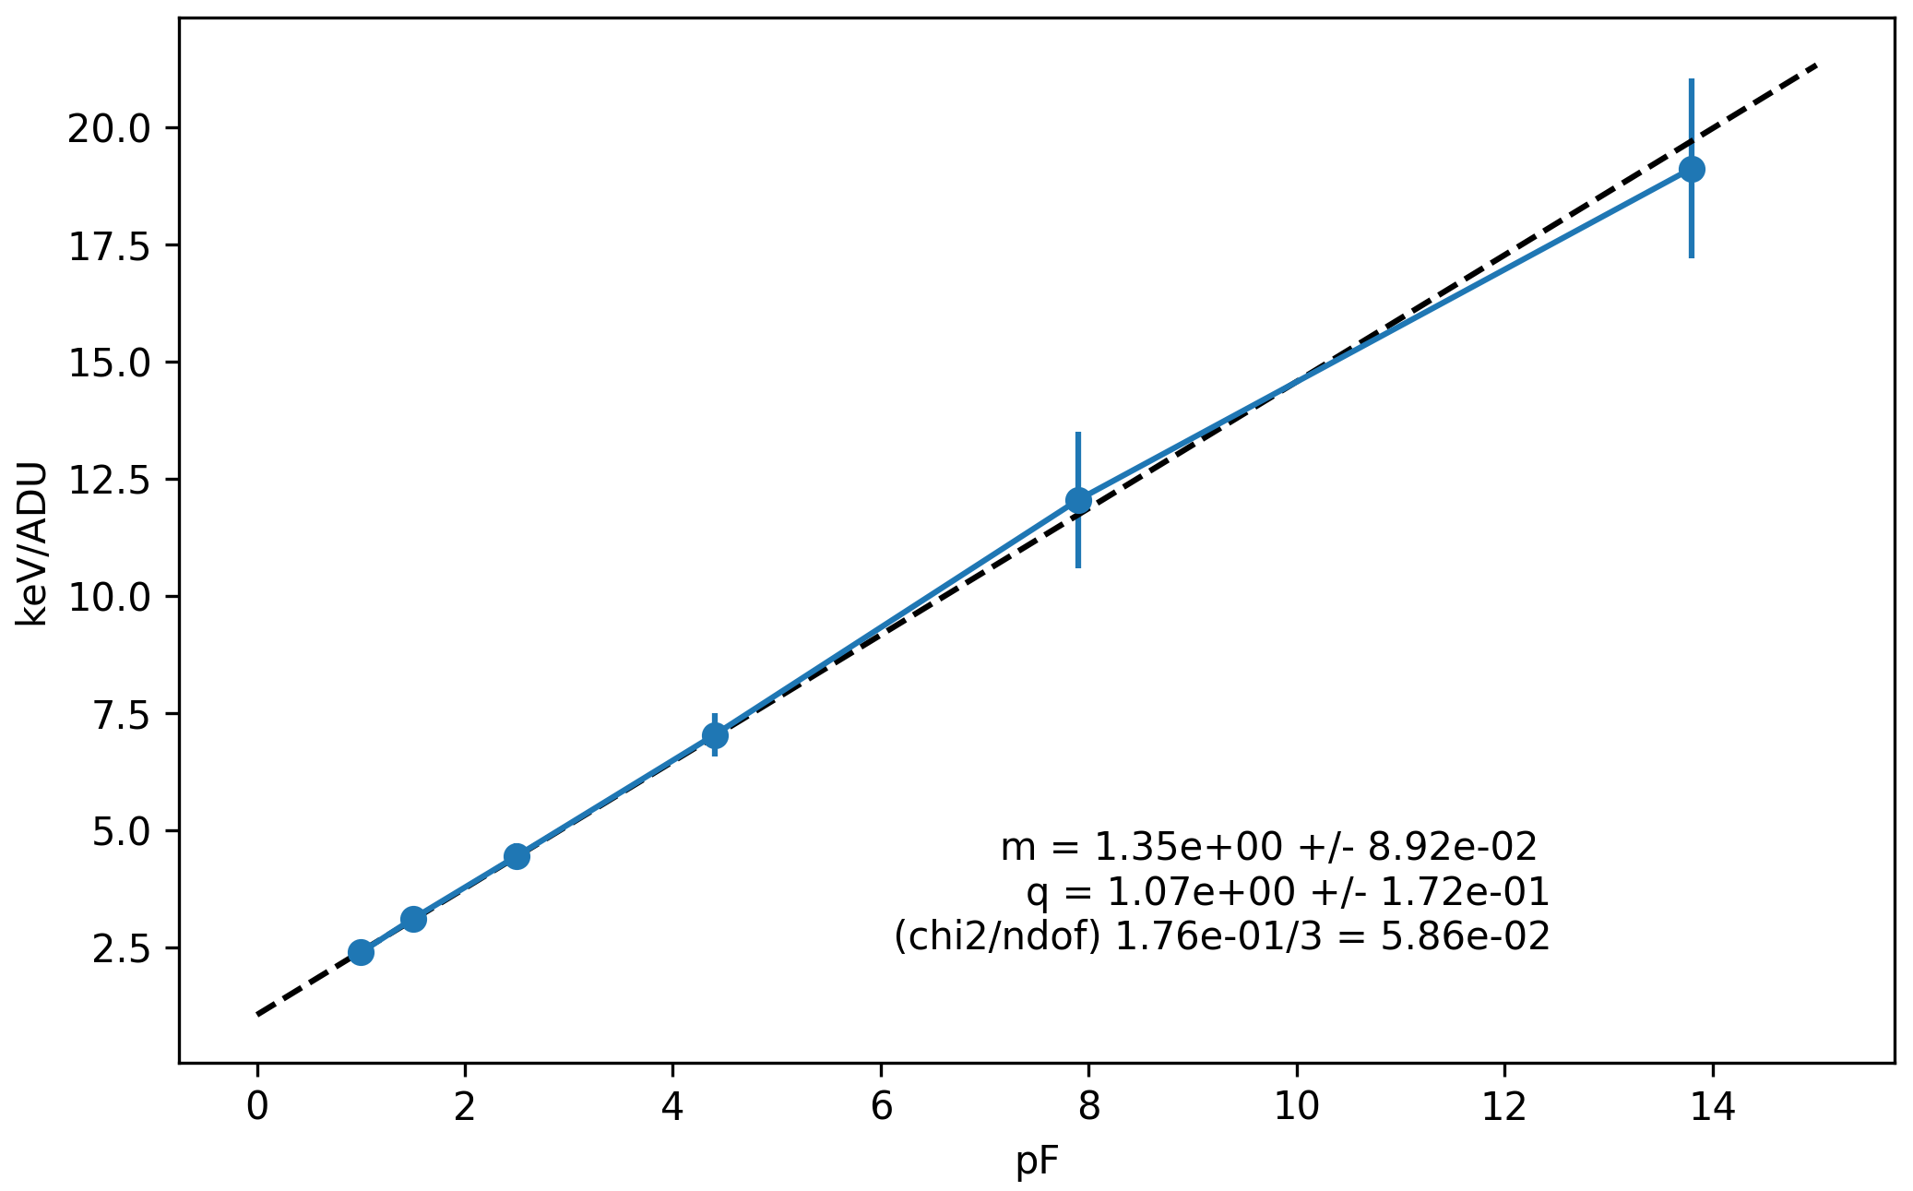
DSSC with miniSDD – Beam tests results
LABEC – single MeV protons
PETRA III – pulsed 1 keV photons
System under test: miniSDD with F1 ASIC (64×64 )
System characteristic calibrated using X-rays, electrical charge injection, and laser
Verification with protons, which provide independent, absolute energy reference
at high energy
System under test: miniSDD-F1 ladder (128×512 pixels)
Successful operation, synchronized to photon pulses
Basic functionalities demonstrated
Measurement of gain and noise in physical units for selected ASIC settings
Measurement of gain dispersion after trimming of ADC gain
Expected linear variation
of physical gain [keV/LSB]
as function of physical C_{f}
Nominal C_{f} [pF]

Slide 7
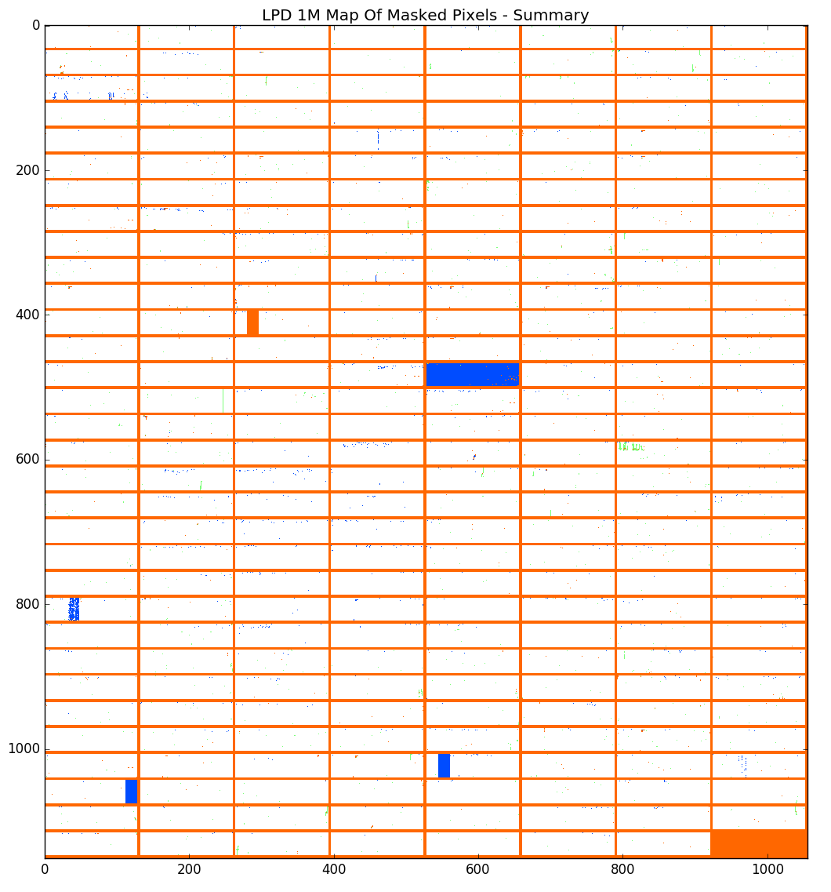
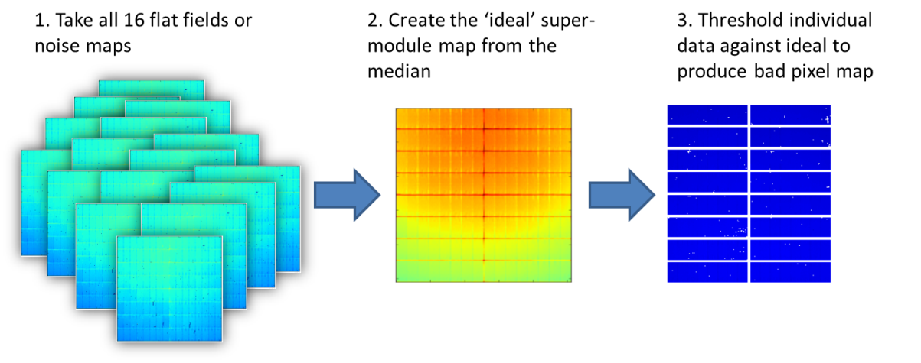
Calibration Activity - LPD at RAL
  LPD super-modules tested standalone and within the 1M system prior to shipping → to be verified during E2E tests at HERA South
  LPD 1M Bad Pixel Maps:
    Out of range signal – Unconnected or shorted pixels.
    Out of range noise – Noisy pixels, coupling to shorted
    pixels, bad power supply units
1Mpix Bad Pixel Map – Categorized map
Pixel Column
Out of range pixel noise
Out of range pixel signal
Both noise and signal out of range
Pixel Row

Slide 8
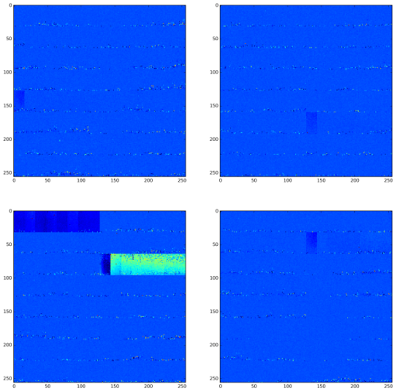
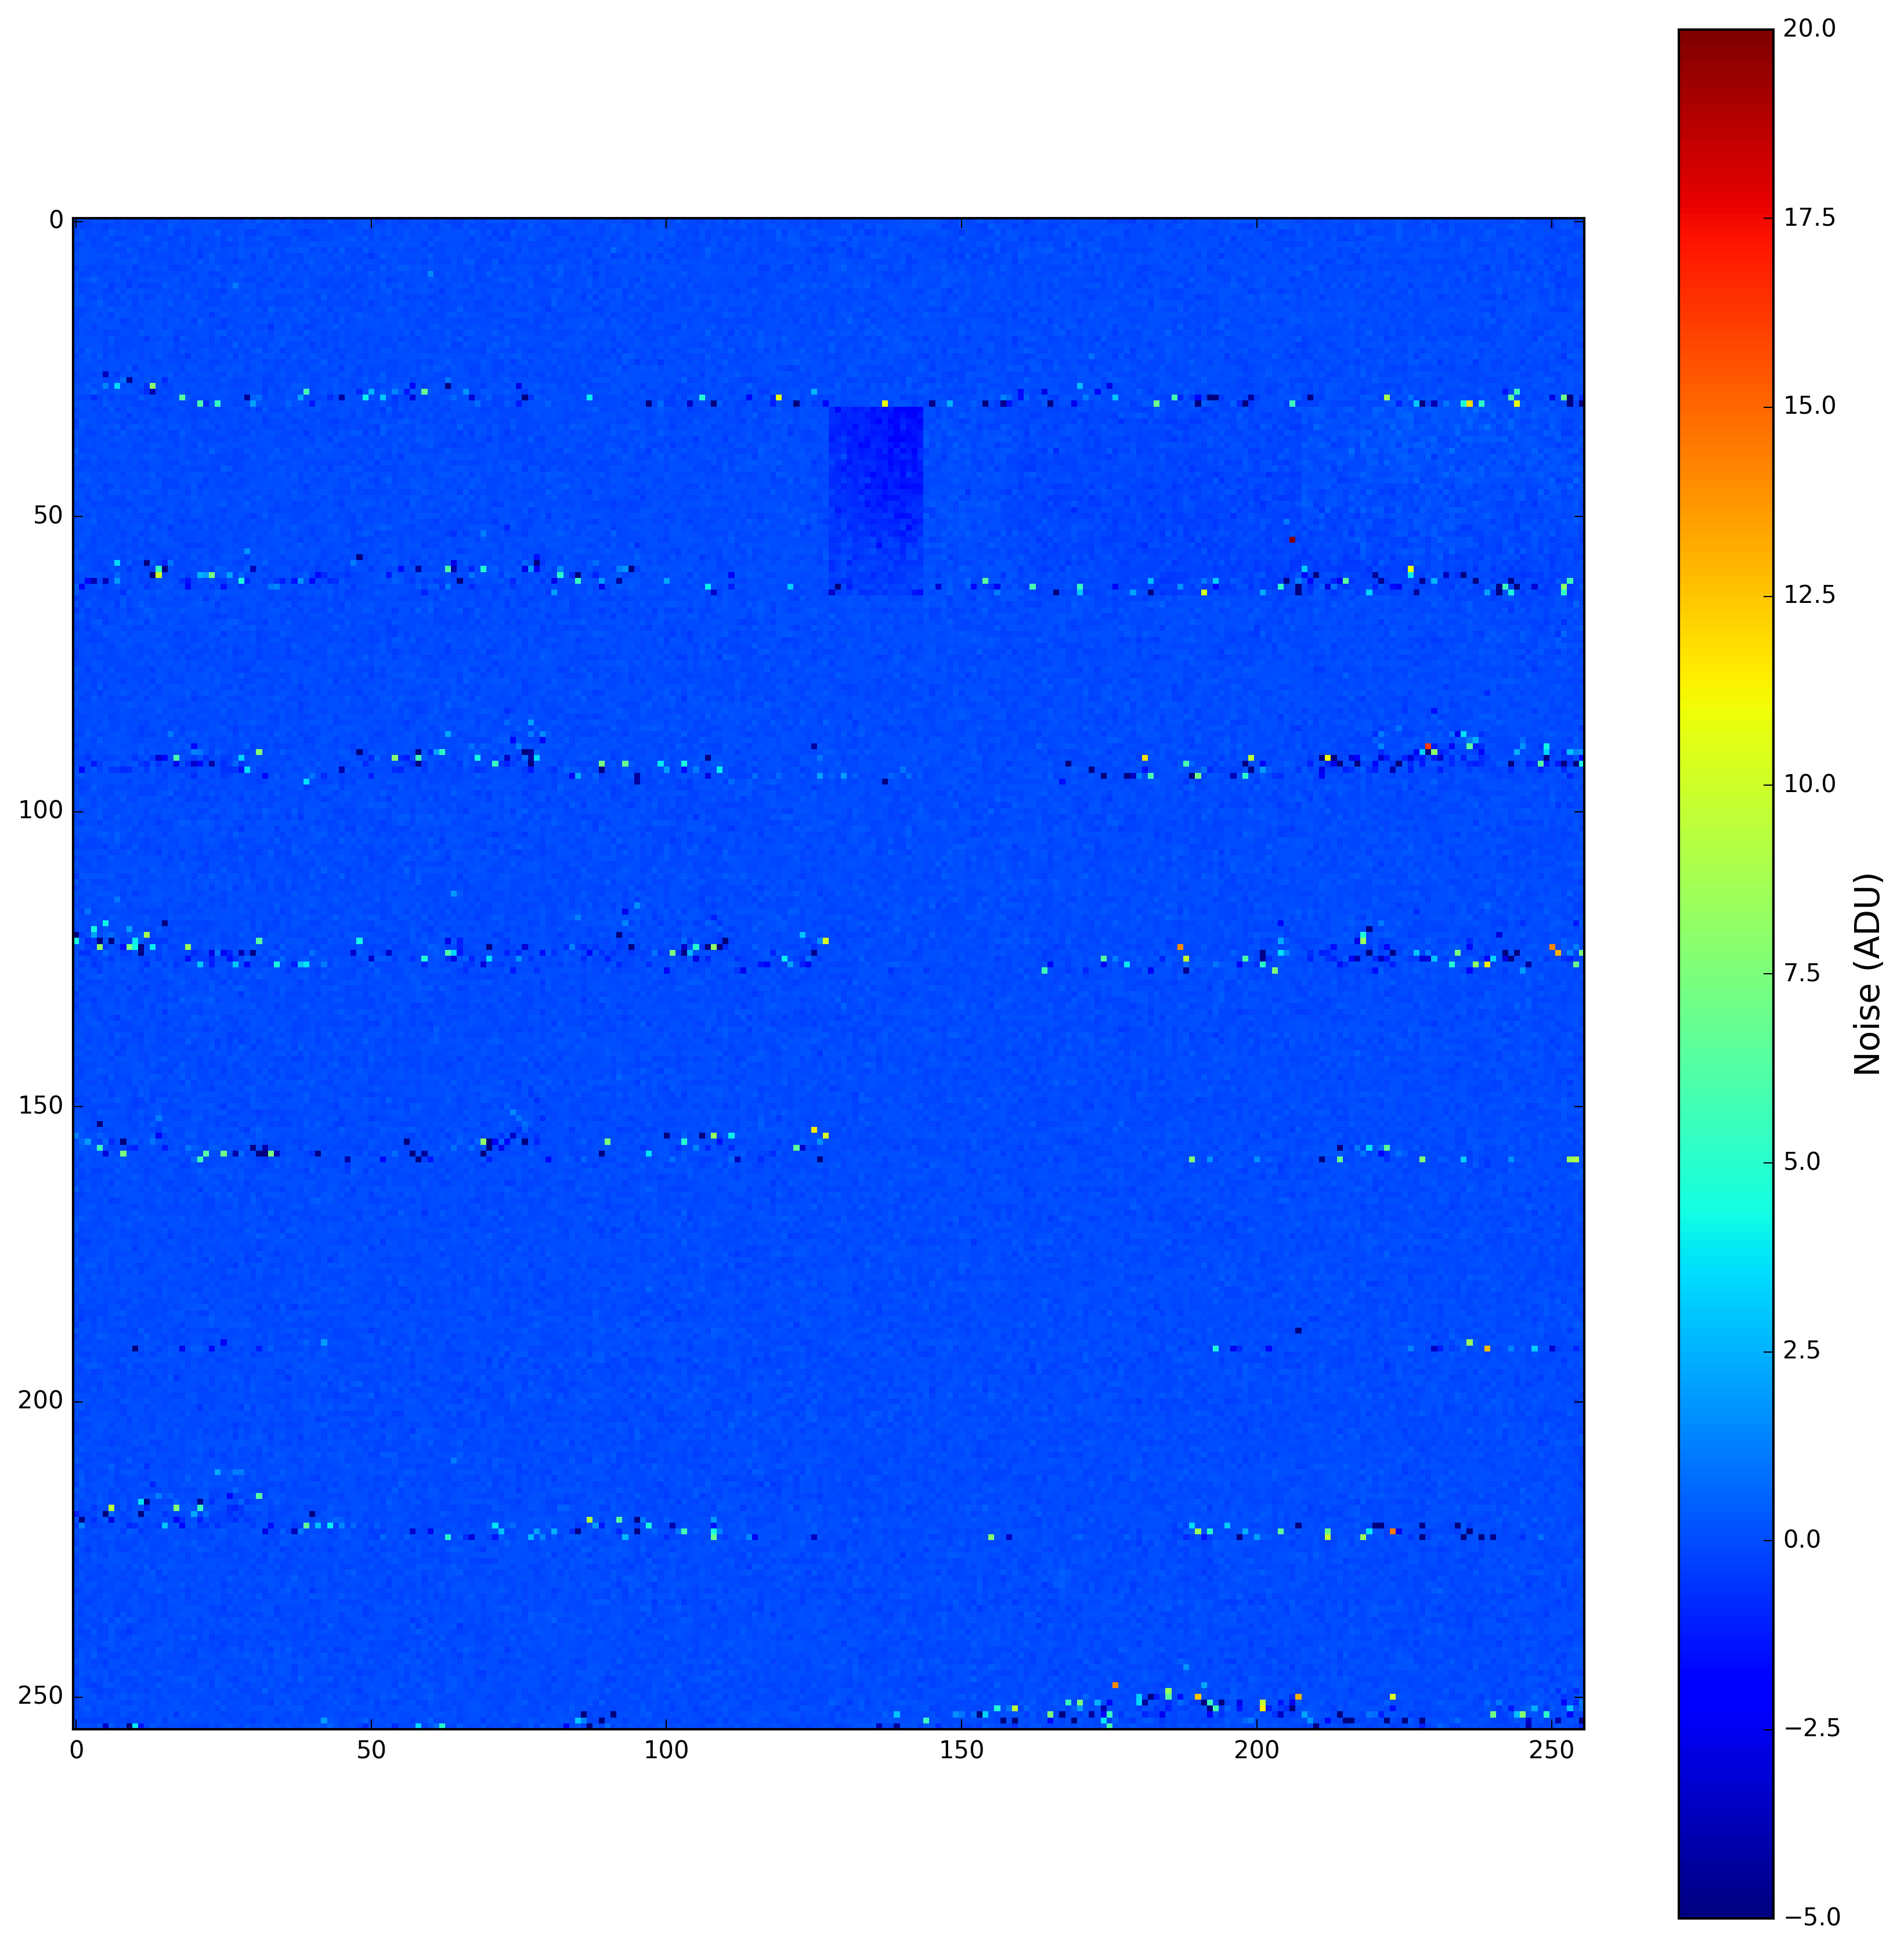
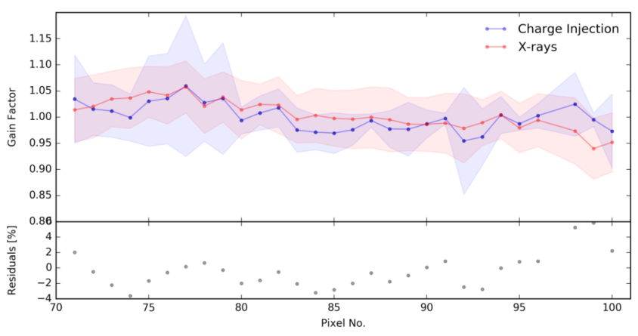
Calibration Activity - LPD at HERA South
  Use charge injection scan to characterize all pixels and cross-check with focused X-ray beam from Seifert tube in Big Amber
  LPD detector delivered to XFEL → integration of the detector ongoing
  First dark data using XFEL DAQ system exists → Next step: Performance of the detector with and w/o X-rays
  First tests of online calibration pipeline successful
Dark frame – offset corrected (Q4)
Charge Injection vs. X-rays
Pixel Column
ADU
Pixel Row

Slide 9
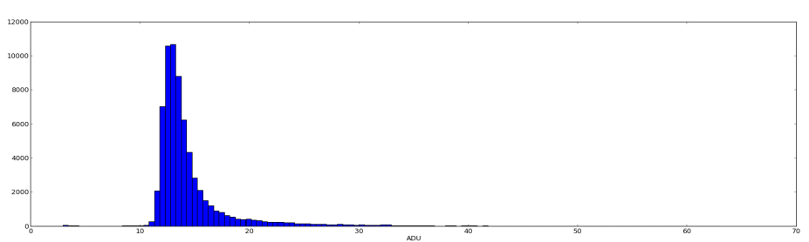
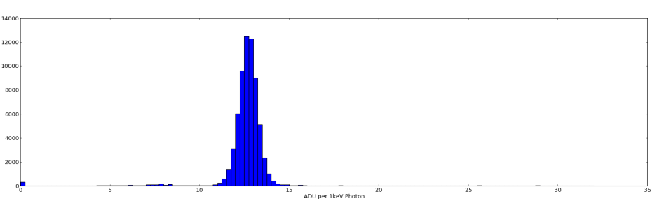
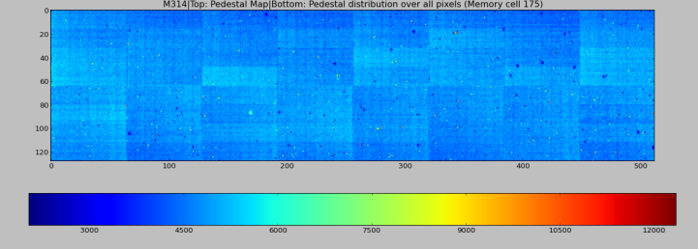
AGIPD Calibration Activity – AGIPD1.1
AGIPD Consortium focuses on calibration of AGIPD1.1
Production of FE modules with AGIPD1.1 ongoing
  10 AGIPD 1.1 modules received in total
  9 tested and show good bump bond yield
  1 used bad sensor (low breakdown voltage)
Communication files (patterns) between FPGA and ASIC adjustment to cope with AGIPD 1.1 ongoing
Characterization/calibration of new AGIPD 1.1 modules ongoing
  Optimization of methods for gain conversion → AGIPD started collaboration with CFEL for calibration routine development
  Kick off meeting for integration of calibration routines into XFEL infrastructure → regular meetings are scheduled
  Fitting routines for AGIPD1.1 current source scan exist
Noise distribution for AGIPD1.1 module
Mean=14.02 ADU
≈ 311 e-
T ≈ 50°C
Counts
ADU
High Gain distribution
<G>=12.5 ADU/keV
Counts
ADU/keV
Pedestal Map

Slide 10
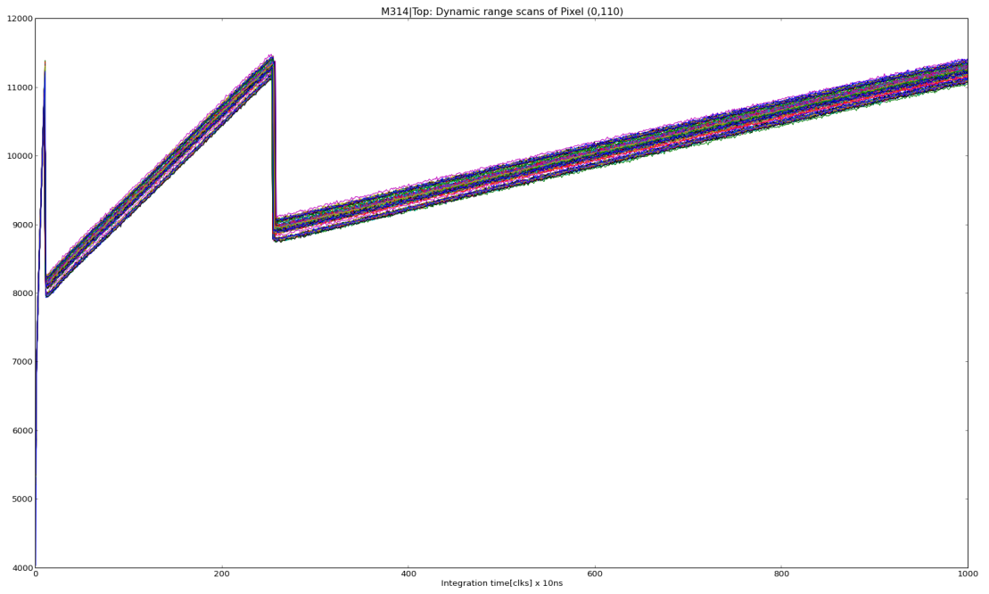
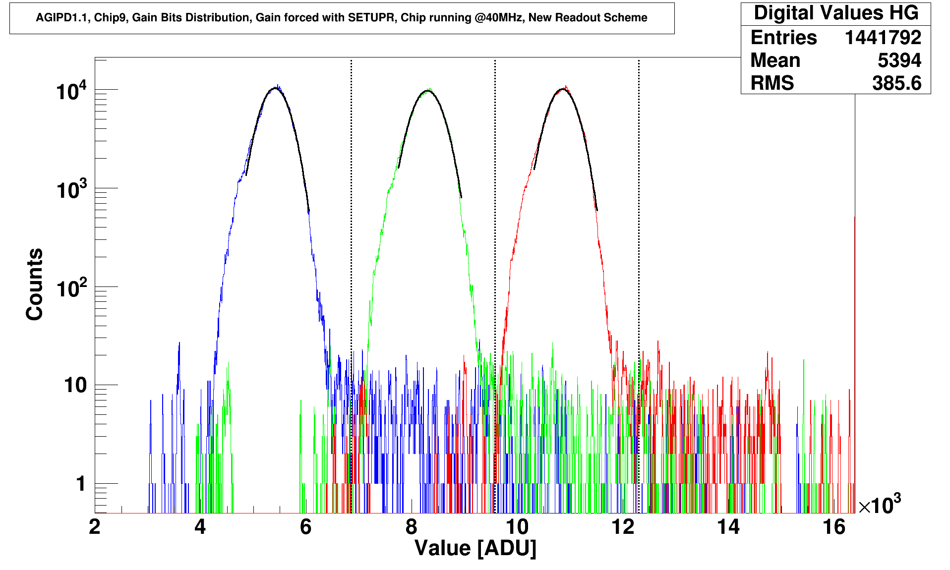
AGIPD Calibration Activity – AGIPD1.1
12000
Current source reaches all gain stages
LG
Dynamic range scan of 352 memory cells of one pixel
ADU
MG
HG
4000
“Double image” day-1 - solution for gain bit decoding: Gain threshold map (2ths x1M pixels x 352 cells) and evaluation logic for gain bit distribution will supplied by AGIPD Consortium → to be integrated in XFEL software
Work on reduction of gain bit threshold map (to be able to use it on FPGA level) ongoing
0
Integration time clk
1000
Gain bit distribution AGIPD1.1 chip

Slide 11
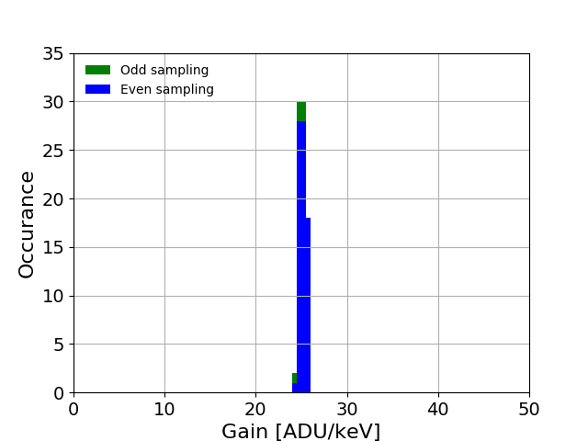
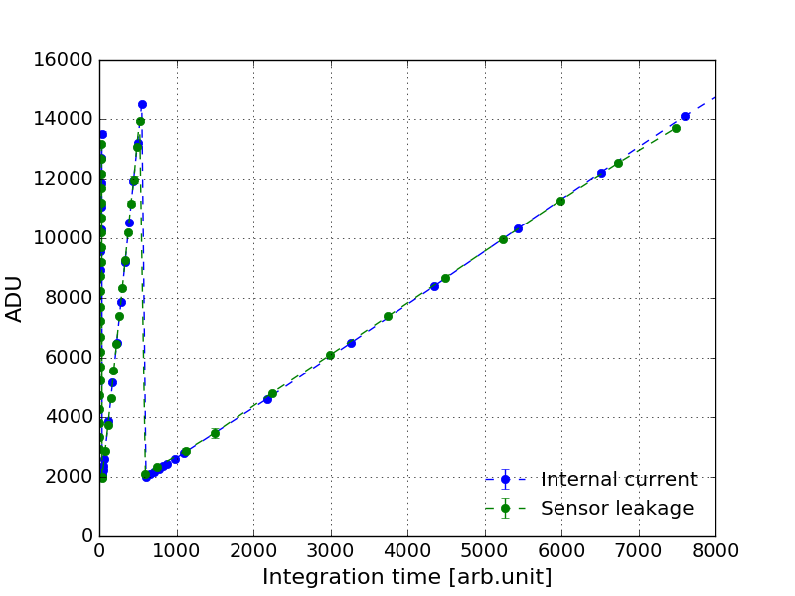
Gotthard detector at PSI
Gain Distribution
Preliminary calibration for Gotthard1.7:
  Conversion gain (HG0):
  X-ray fluorescence → 8.05 keV, 10 μs
  Internal current source:
  2/3 HG0 + full G1 + full G2
  Sensor dark current: entire dynamic
  range
  Relative good overlap between CS
  and DC in G1 and G2
Dynamic Range scan - CS vs DC
Characterization of Gotthard 1.7 → testing/verification of the strategy for calibration of Gotthard II is ongoing
G1
G2

Slide 12
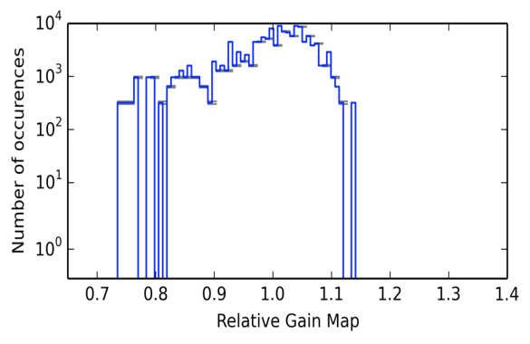
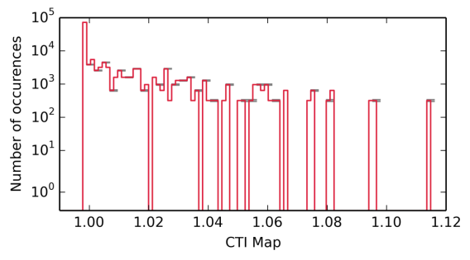
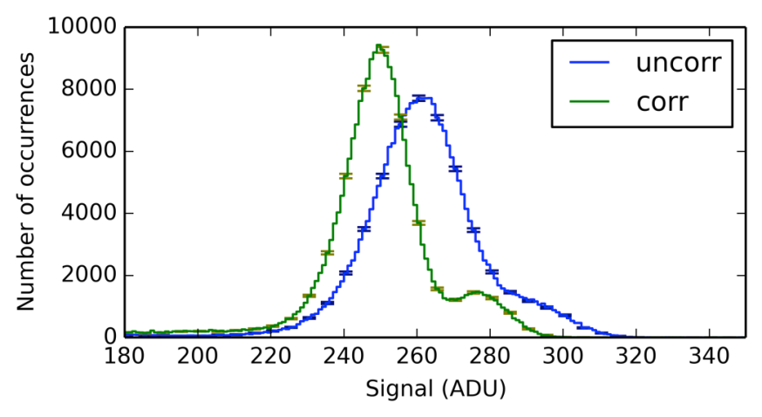
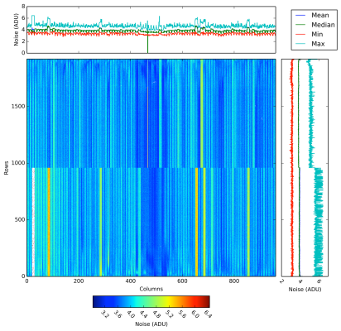
FastCCD
Characterization and calibration of the FastCCD detector using our X-ray infrastructure → several problems were discovered
Detector is currently at LBNL for optimization
After detector is returned, calibration at PHEOBE and PulXar is planned
Full analysis based on the existing and tested CCD calibration pipeline (offset, noise, bad pixels, CTI, relative amplification) → Improvement after CTI and relative amplification correction
Energy resolution: σ≈220 eV @ 6 keV
Conversion gain for highest gain setting: 22.3±0.2 eV/ADU (about 6.1 e-/ADU)
RMS Noise: 24 ± 2 e- (within the specification)
Relative Amplification
Distribution
CTI Distribution
Mn-K_{α} and K_{β} single event spectrum
Noise Map

Slide 13
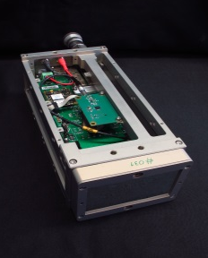
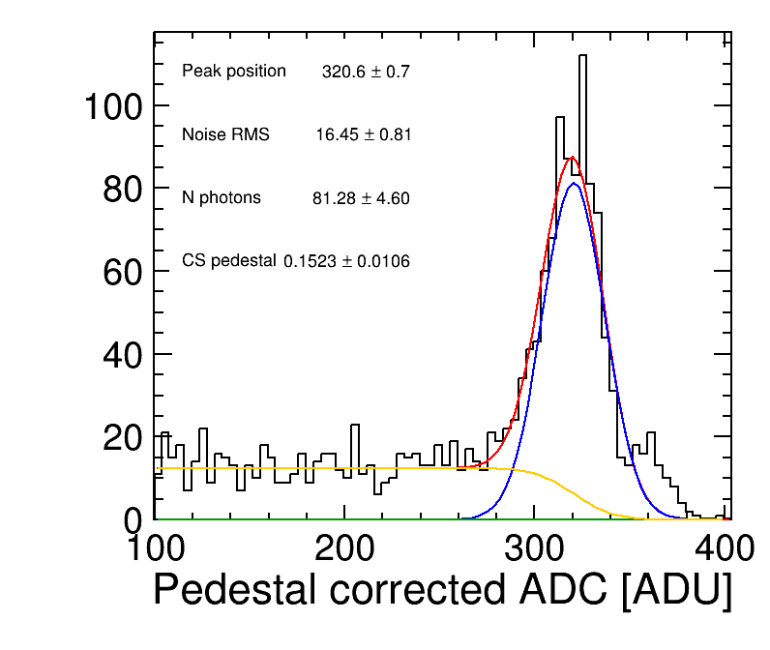
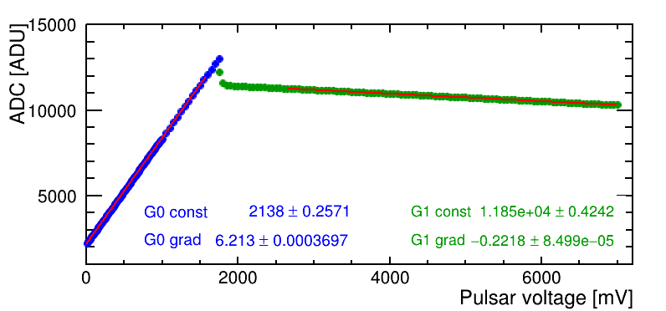
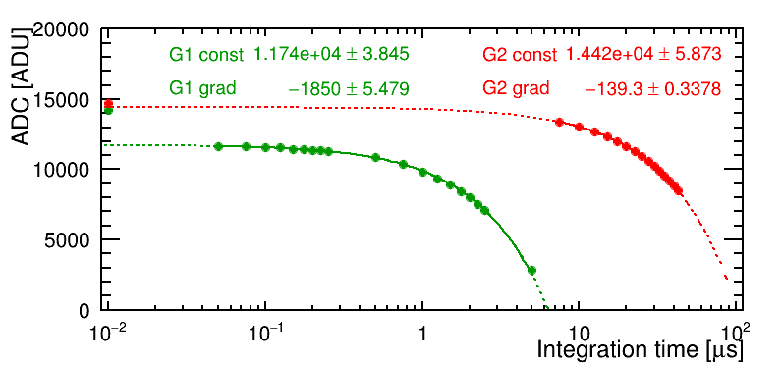
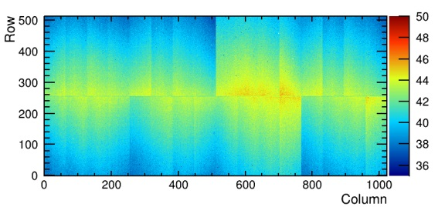
Jungfrau at PSI
Cu fluorescence
Jungfrau module
  2 x 4 chips bump-bonded to a 320 μm silicon sensor
  sensing area ~ 4 cm x 8 cm
  0.5 Mpixels
Full calibration of JUNGFRAU module
  three step process to cover all gains
  data analysis procedures are defined at PSI → not yet integrated in XFEL system
  handful of modules have been fully calibrated to date
  Calibration is valid for kHz operation (to be used at 10 Hz at XFEL.EU)
  Calibration to be verified for MHz operation
Calibration validation at several X-ray sources (ESRF, LCLS, PSI lab X-ray sources) → work on understanding some effects observed at different light sources ongoing
G0/G1: Backplane pulse
G1/G2: Current source
G0 Gain Map

Slide 14
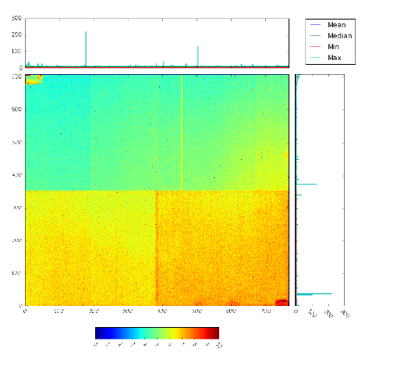
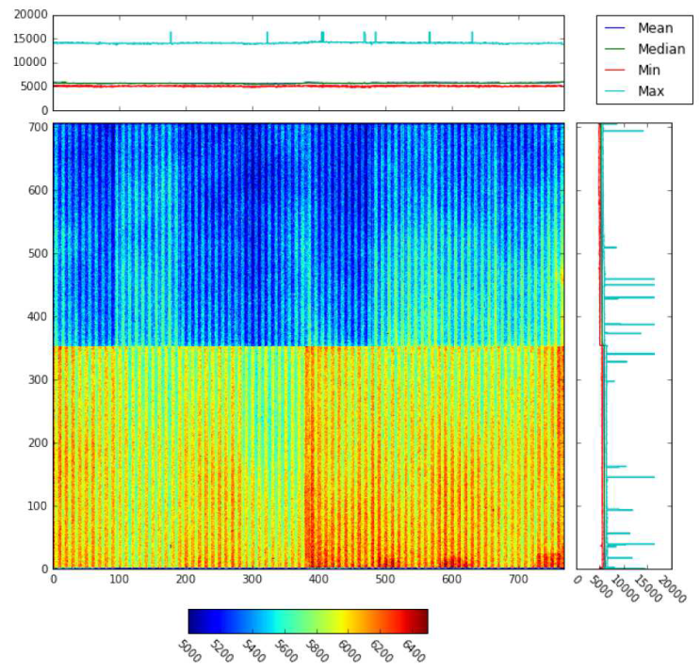
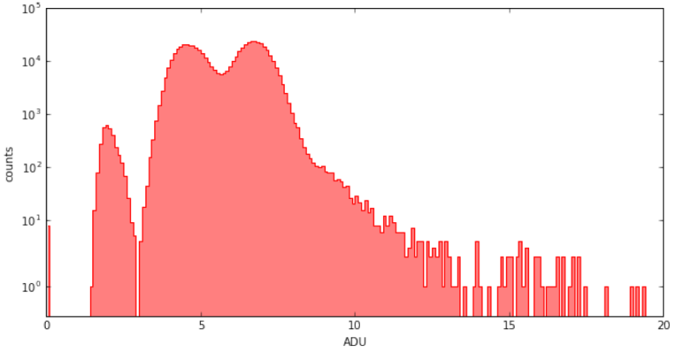
ePix detector for HED and MID
Noise Map
HED instrument ordered ePix detector 100 and 10k → Assembly of ePix100 cameras done
Performance of ePix100 has been demonstrated at LCLS while ePix10k prototype is currently under investigation
Preliminary data analysis at XFEL using calibration pipeline started
Offset Map
ADU
Noise Distribution
ADU

Slide 15
Infrastructure for detector calibration and tests at the XFEL lab - reminder
    Small portable setups Little Amber (for ambient operation) and Pheobe (vacuum operation) → operational, in use (FastCCD, Gotthard, SDDs)
    Big Amber (Ambient X-ray Test Setup for 1 Mpx detectors)
    PulXar (Pulsed Multi-Target X-ray Test Setup)

Slide 16
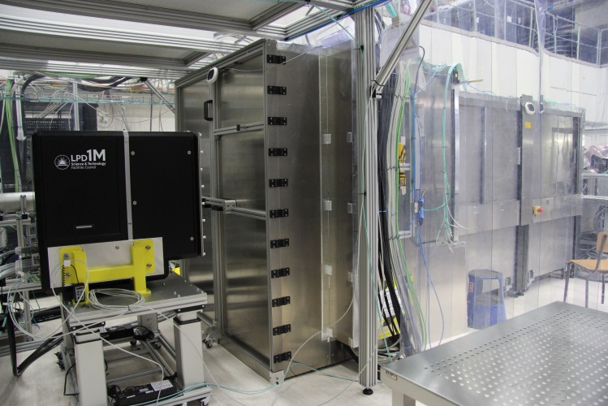
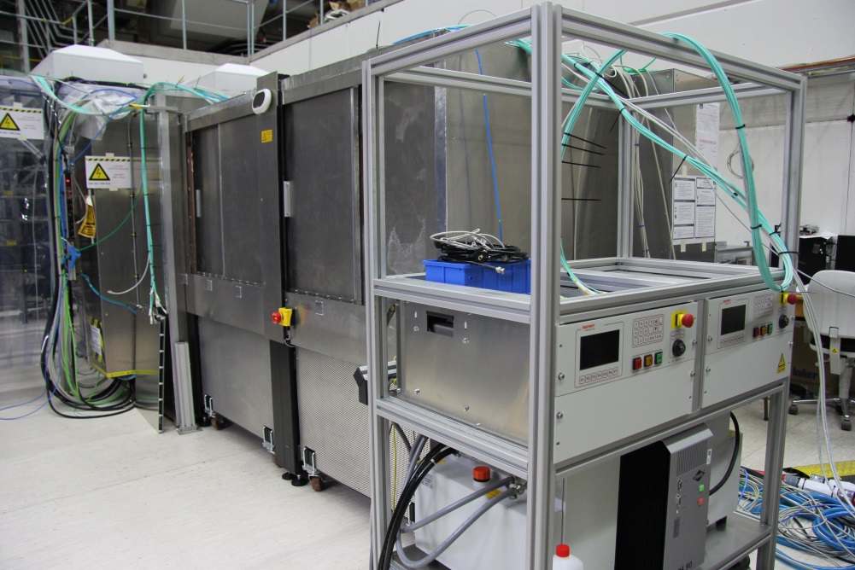
Ambient X-ray test Setup Big Amber: Reminder
Ambient X-ray test setup Big Amber – reminder
Modular setup for large area and small area detectors 3.7 x 1.5 x 1.9 m
X-ray sources:
Commercial high power X-ray tubes: (V < 60 kV and P < 1.6/ 2/3 kW), anodes: Cu (8 keV) and Mo (17 keV)
+ Polycapillary focusing/collimating optics
LPD detector

Slide 17
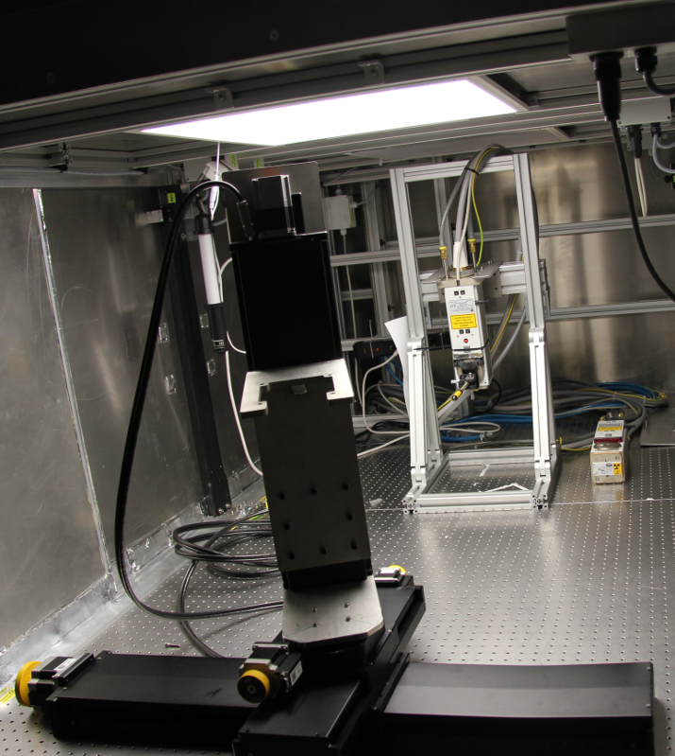
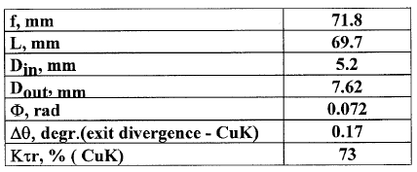
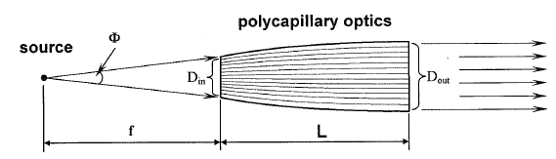
Ambient X-ray test setup Big Amber - status
Status:
Moving stages for movement of the X-ray tube
Second X-ray generator with 3kW Mo tube delivered and installed → high intensity, flat field illumination
Collimating polycapillary optics delivered
Next Steps:
TÜV approval for second X-ray tube/housing
Alignment & commissioning of collimating optics
Exchange optics holder when it is delivered
This will not interfere with the E2E tests for LPD and AGIPD.
Notes:
The concept is to built up infrastructure for XFEL in several steps.
Problem is …
→ go through right part of the slide
What are the specifications, requirements → next slide

Slide 18
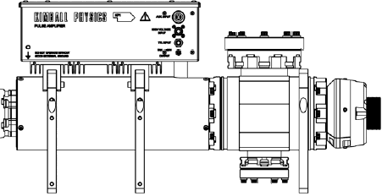
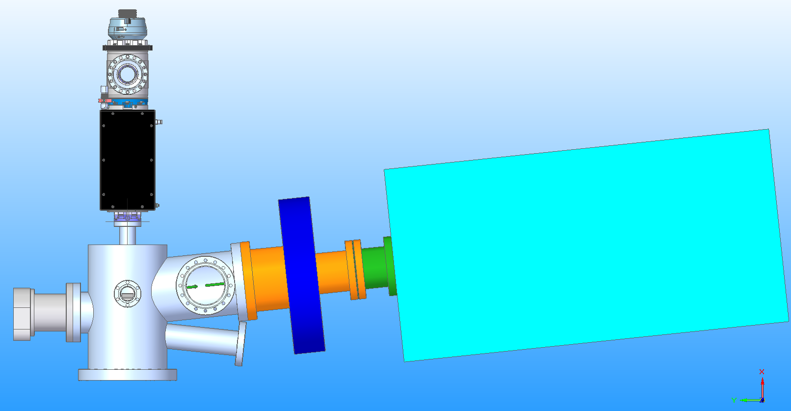
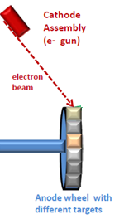
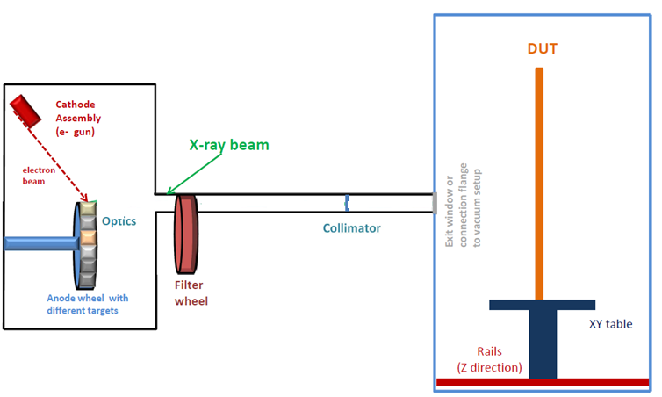
Multi-target pulsed X-ray setup PulXar - reminder
Multi-target X-ray setup with pulsed electron source
First step: PANTER X-ray source* assembled & operated at the XFEL as test bed - done
PulXar v.0.1: Replace the existing electron source with a customized pulsed electron source by Kimball (V < 15 keV, I<1mA) and synchronization - ongoing
PulXar 0.2: design and build new vessel with motorized target, filter wheels and polycapillary optics
e- gun
Filter wheel
Detectors under test
vacuum or ambient conditions
Anode wheel
with different targets
Optics
Parameter of e-gun | Pulsed mode | DC mode
Electron energy | 1 - 50 keV | 1 - 60 keV
Electron beam current | 10 μA - 20 mA | 10μA - 6mA
Beam diameter | 0.15 - 10 mm | 0.1 - 10 mm
Pulsed beam parameters | - Length: τ = 25 -150 ns - XFEL burst mode | n.a.
*Cooperation with PANTER X-ray test facility of the Max-Planck Inst. for extraterrestrial Physics

Slide 19
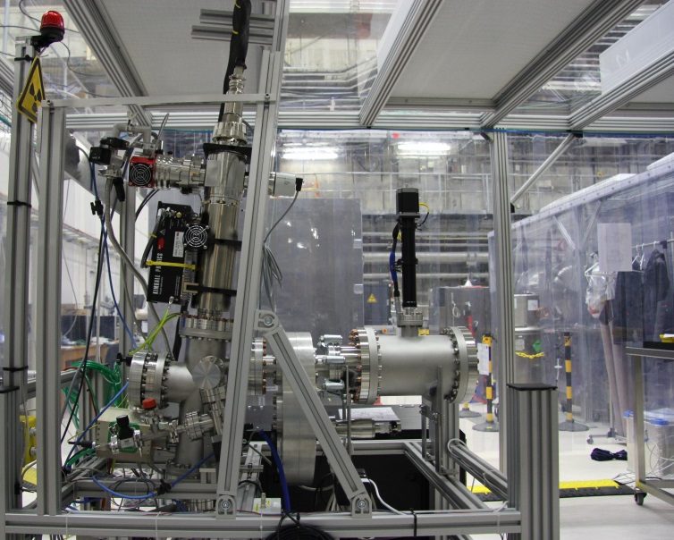
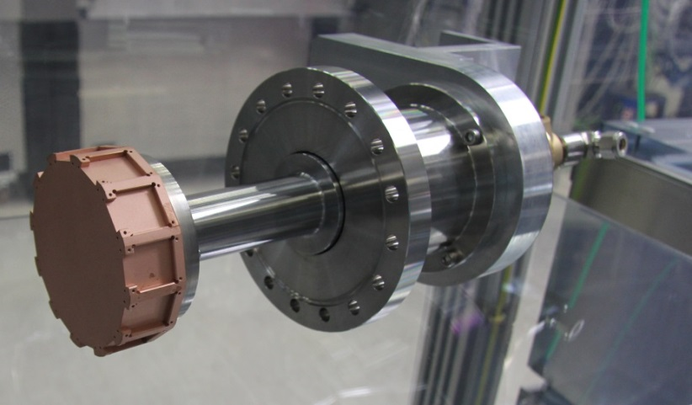
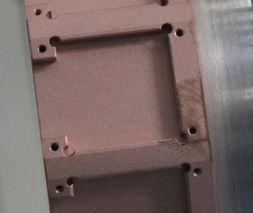
Multi-target (pulsed) X-ray setup PulXar
Status of PulXar v0.1
Up to 1 MHz pulsing observed with reference SDD
(faster pulsing not visible with this detector)
Pulsing for electron gun and clock for a detector can be
provided by XFEL timer board + adapter box →
Train of 1200 pulses of 25 ns length at 4.5 MHz
µTCA crate for stand-alone timing system is ordered
PulXar 0.1
Pulsed e- gun
Filter wheel
Next steps (PulXar v0.1):
Compare count rates for different timing sources
Use for calibration of FastCCD (10 Hz)
DSSC ladder tests in the setup require synchronization
(4.5 MHz) of the DSSC ladder to e- beam from PulXar
SDD
detector
chamber
PulXar 0.2
Status (PulXar v0.2)
Motorized and water-cooled target wheel arrived
Next steps (PulXar v0.2)
Procure targets to be installed on the wheel
Integrate movement system in XFEL control
system
Finish design of X-ray tube new housing

Slide 20
Conclusions
Calibration/characterization strategies exist → verification with small scale prototypes and full scale detector systems ongoing
Calibration work by the detector developers and at the European XFEL is ongoing → a lot of work has been done and still a lot of work is ahead of us
Calibration laboratory X-ray infrastructure
        Portable test setups Pheobe (vacuum) and little Amber (ambient) are operational and in use (for tests with FastCCD, Gotthard, SDDs)
        Permanent ambient X-ray test setup Big Amber:
        3 module version operational and ready for the 1 Mpx AGIPD and LPD
        2nd X-ray tube will be operational soon
        Pulsed Multi-Target X-ray test setup PulXar
        Version 0.1 – commissioning in the final state, work on synchronization ongoing → Q3 2017
        Version 0.2 – design/production ongoing

Slide 21
Backup slides

Slide 23
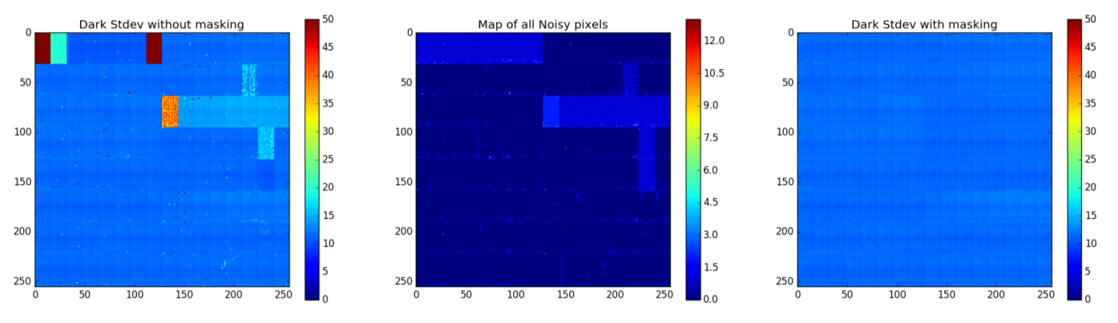
1 Mpix LPD Calibration at RAL
LPD super-modules tested in standalone and within the 1M system prior to shipping → to be verified during E2E tests at HERA South
X-ray set used to capture long exposure flat field data for standalone super-modules.
Average noise of all super-modules with no correction
Bad Pixel Map – summed across all super-modules to look for trends.
Average Nosie of all super-modules with mask applied

Slide 24
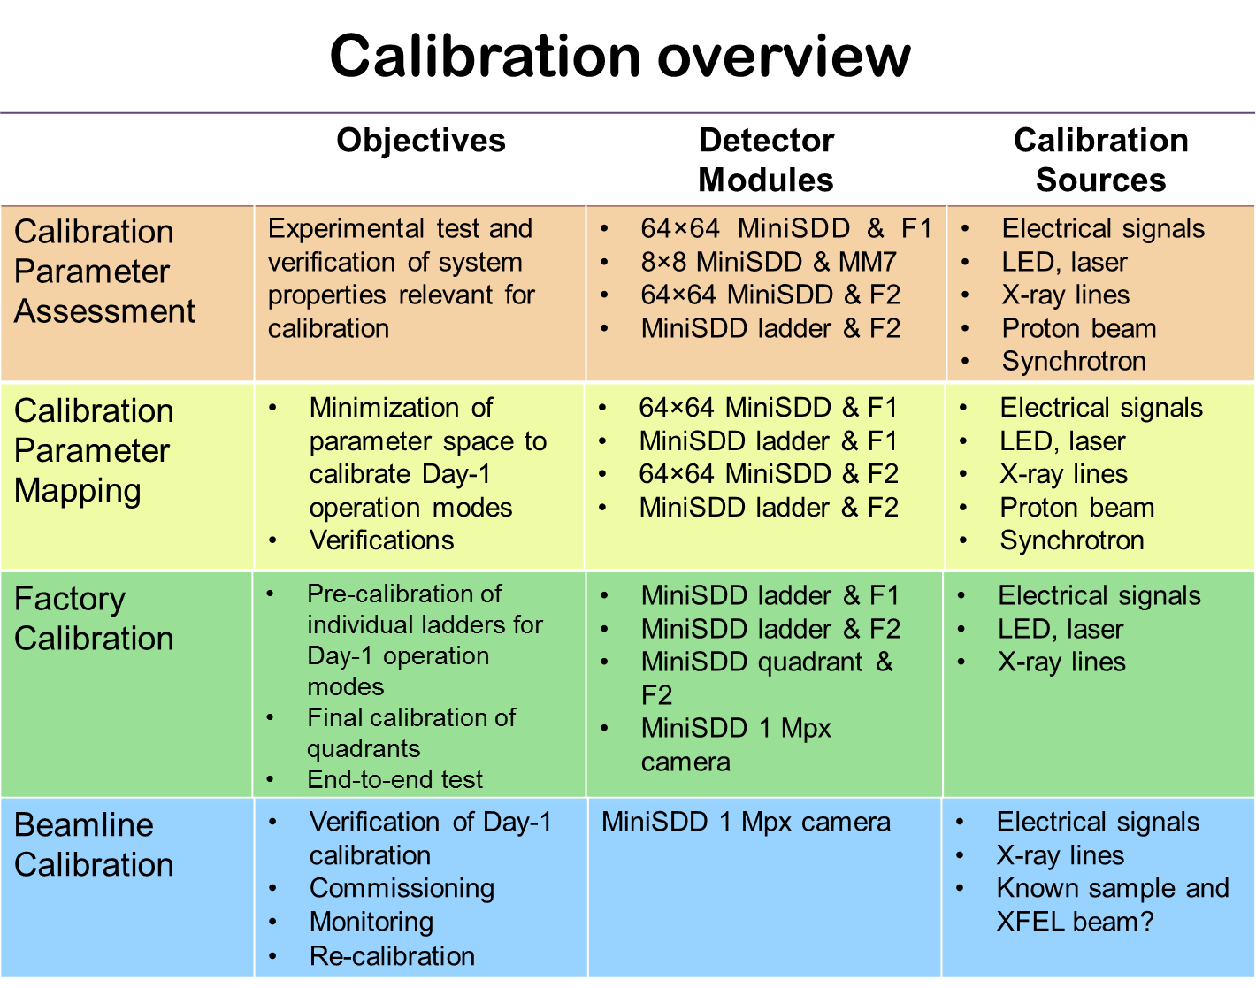
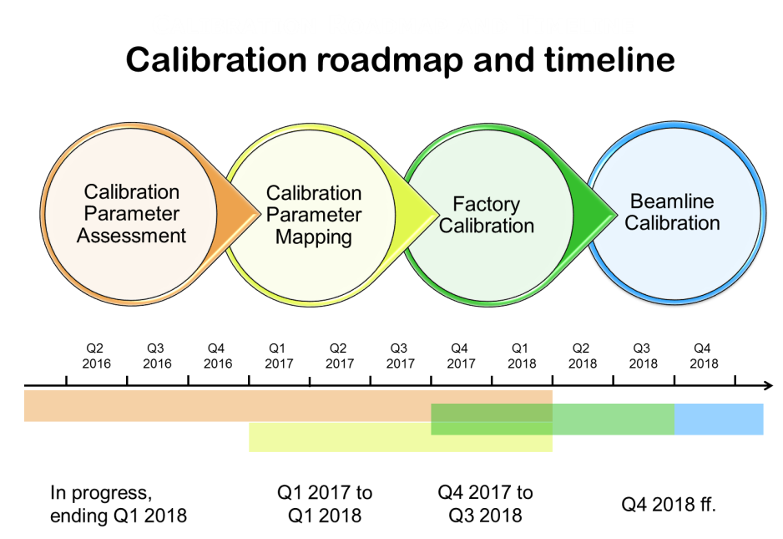
Calibration Activity – DSSC with miniSDD
DSSC – planning for calibration up to operation at beamline (including scheduling for XFEL X-ray calibration infrastructure) , evolving document
Setup for 64x64 mini-SDD with F1 ASIC and available in Munich lab → tests ongoing

Slide 25
Size of Detector Parameter Space
AGIPD
x 352 memory cells
x 1 million pixel
x 3 gain stages
~ 10⁹ parameters
Conclusions
Impossible to calibrate and commission many combinations for first day of operation (finite time) →
Focus on most important operating conditions for day-one
Parameter Dependence
Temperature
Integration time/sampling speed
Irradiated dose
Bias voltage
Day-one operation modes discussed and agreed with instrument scientists

Slide 26
Base Line Detector Operation Modes for Day-one
Non Linear System Response
DSSC
AGIPD
LPD
 | Mode I | Mode II | Mode III
Read Out Frequency | 4.5 MHz
Photon Energy | 1 keV | 1.5 keV | 0.7 keV
Max # of ph/pulse/pixel | 3 x 10³ @1keV (maximum achievable)
Read Out Geometry | Full Frame
Single Photon Sensitivity | No
Alignment Precision | 1/10 of the pixel size (quadrant level)
Veto Capability | Yes&
Memory | 800 Cells (full memory)
Mode I | Mode II | Mode III
4.5 MHz
8.6 keV# | 15 keV | 7 keV
10⁴ @12.4 keV (maximum achievable)
Full Frame
Yes 0.15 ph RMS Noise | Yes 0.084 ph RMS Noise | No
1/10 of the pixel size
Yes&
352 Cells (full memory)
Mode I | Mode II | Mode III
4.5 MHz |  | < 4.5 MHz
12 keV* | 20 keV | 12 keV*
> 10⁴ @12.4 keV (maximum achievable)
Full Frame
Yes 0.35 ph RMS Noise | Yes 0.21 ph RMS Noise | Yes$ < 0.21 ph RMS Noise
1/10 of the pixel size
Yes&
512 Cells (full memory)
&Remove empty frames for different bunch patterns
#Same performance is expected for 7 – 12 keV
*Same performance is expected for 7 – 9 keV
$Feasibility to be confirmed
Notes:
LPD
Operation mode 1
E=12 keV (the same performance is expected at 7-9 keV)
RMS noise = 1200 e- (0.35 ph@12 keV)
Single photon sensitivity at 7-9 keV is not required
Max. nr of ph/pulse/pixel before saturation > 10⁴ photons
Full frame readout
4.5MHz repetition rate (full memory, i.e. 512 memory cells)
Veto/data reduction capability to adjust to the pulse rate
Alignment precision – according to WP-75 definition (see “Detector Alignment at European XFEL: Concepts & Responsibilities” on Alfresco)
Operation mode 2:
E= 20 keV
0.21 ph noise @ 20 keV
Rest stays the same as in the mode 1
Operation mode 3:
E= 12 keV (the same performance expected at 7-9 keV)
Longer readout circle (no 4.5MHz speed) mainly for longer reset (noise reduction) if the feasibility study will show improvement in the detector performance (i.e. lower noise)
Rest stays the same as in the mode 1

Slide 27
Calibration of AGIPD detector
First calibration
Provided by the Consortium (methodology and software tools agreed and compatible with XFEL.EU requirements)
    in the laboratory using lab. X-ray sources and internal calibration circuits
Calibration will be evaluated/tested and improved (if necessary) during AGIPD detector tests first in XFEL detector lab and then during commissioning at SPB instrument
Recalibration at XFEL.EU
Provided by XFEL.EU
    in the experimental hutch using internal calibration circuit, FEL beam and radioactive sources
Calibrated data is the standard data product with which Users will be provided.

Slide 28
Calibration method for each pixel (and memory cell)
Gain stage
Analog data
Saturation
ADU
Low Gain
High Gain
Medium Gain
N of photons (Energy)

Slide 29
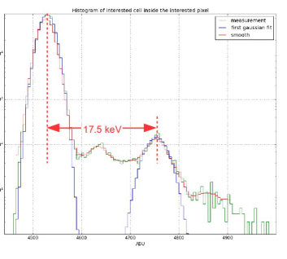
Calibration method for each pixel (and memory cell)
Gain stage
Analog data
Saturation
ADU
High gain extraction with X-ray photons
Extraction of slope, offset and gain bit using internal (electrical) calibration circuits
Low Gain
High Gain
Medium Gain
N of photons (Energy)

Slide 30
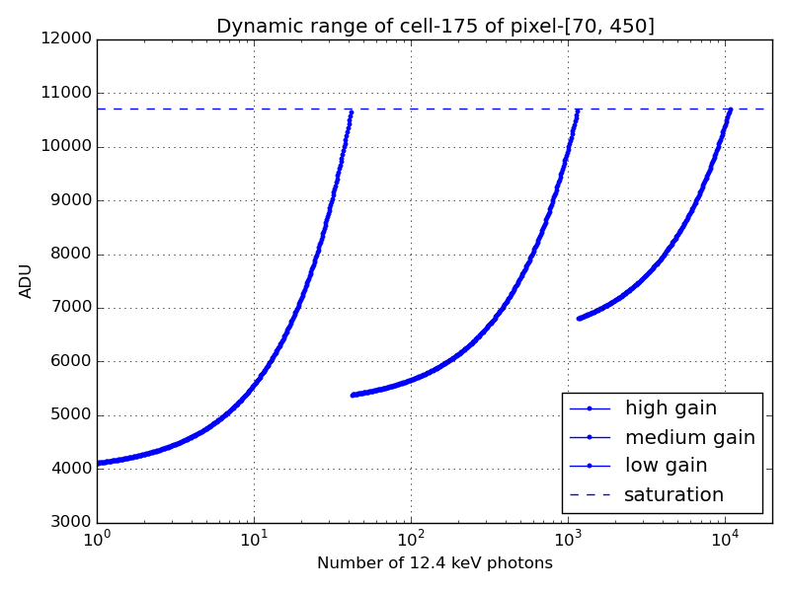
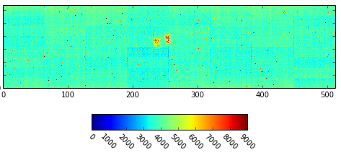
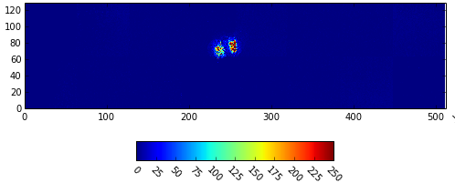
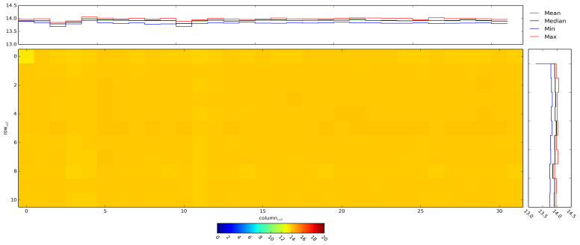
Example – Calibration Constants and Application (single module at HERA South)
Dynamic range of single memory cell in one pixel
Raw data → single image (infrared LED)
ADU
Calibrated data
High gain map for single pixel and all 352 memory cells
keV

Slide 31
Calibration Strategy – where calibration will be done
XFEL.EU Project Phase | Detector Laboratory | FELs/Synchrotrons/ Particle Accelerators
 |  | External Sources | XFEL. EU
 |  |  | Instr. Hutches | Dedicated beam
Start-up | Initial detailed calib. and characterization of det. prototypes, modules | Response of detector vs. either rep. rate or intensity
Commissio-ning | Initial detailed calib. and characterization of full systems | Calibration of 1MPix 2D cameras is NOT feasible due to the demanding infrastructure requirements | Cross-check lab. calibration Characterization of the detector response under real conditions (rep.rate and intensity)
User Operation | Calibration of the full system only if necessary (accident, detailed detector response investigation, etc..) |  | Scientific. exp: Part of regular exp. procedure (shall take a few mins) Maintainance time - Calibration/tests using in-hutch sources | Detailed detector response investigation under real conditions (rep.rate and intensity)

Slide 32
Possible components of correction pipelines – and importance of throughput
granularity
pixel
row/column
image
40%
7%
Droop
correct.
Split
events
7%
40%
7%
Offset
sub.
CM
correct.
CTI correct.
Gain correct.

Slide 33
Calibration and Correction Parameters of XFEL Detectors

