Slide 1
Status of Beckhoff components
Notes:
How to edit the title slide
Upper area: Title of your talk, max. 2 rows of the defined size (55 pt)
Lower area (subtitle): Conference/meeting/workshop, location, date, your name and affiliation, max. 4 rows of the defined size (32 pt)

Slide 2
Production SASE3
Production SASE 3 (acc. to Redmine)
 | OCT | NOV | DEC | JAN | FEB | MARCH | APR | MAY | JUNE | JULY | TOTAL
DONE | 0 | 1 | 0 | 13 | 12 |  |  |  |  |  | 26
INITIAL FORECAST | 0 | 0 | 4 | 17 | 22 | 22 | 20 | 0 | 0 | 85 | 85
FORECAST 01.02.2017 |  |  |  |  | 16 | 18 | 20 | 17 | 0 | 0 | 85
FORECAST 01.03.2017 |  |  |  |  | 16 | 16 | 18 | 20 | 20 | 5 | 105
 |  |  |  | Second supplier
Increase in the number of modules !!
Increase in the number of modules to be produced
9 modules for SQS rescheduled for day 1
4 modules for XTD9
3 modules for SPB new component (SACT)
Modifications temporary being produced in IKC due to lack of resources in AE.

Slide 3
Production SASE3
Production rate below the planning
Lack of CRD approved in January to provide E-plan designs to two suppliers.
Start of production with Beckhoff is being slower than expected.

Slide 4
E-plan design SASE3
E-design SASE3 (acc. to Alfresco folder 3)
 | OCT | NOV | DEC | JAN | FEB | MARCH | APRIL | MAY | TOTAL
DONE | 1 | 10 | 5 | 17 | 21 |  |  |  | 54
INITIAL FORECAST | 1 | 15 | 15 | 20 | 26 | 8 | 0 | 0 | 85
FORECAST 01.02.2017 |  |  |  |  | 20 | 22 | 10 | 0 | 85
FORECAST 01.03.2017 |  |  |  |  | 20 | 22 | 22 | 8 | 105
 |  | 1st person hired | 2nd person hired | 3rd person hired
Increase in the number of modules !!

Slide 5
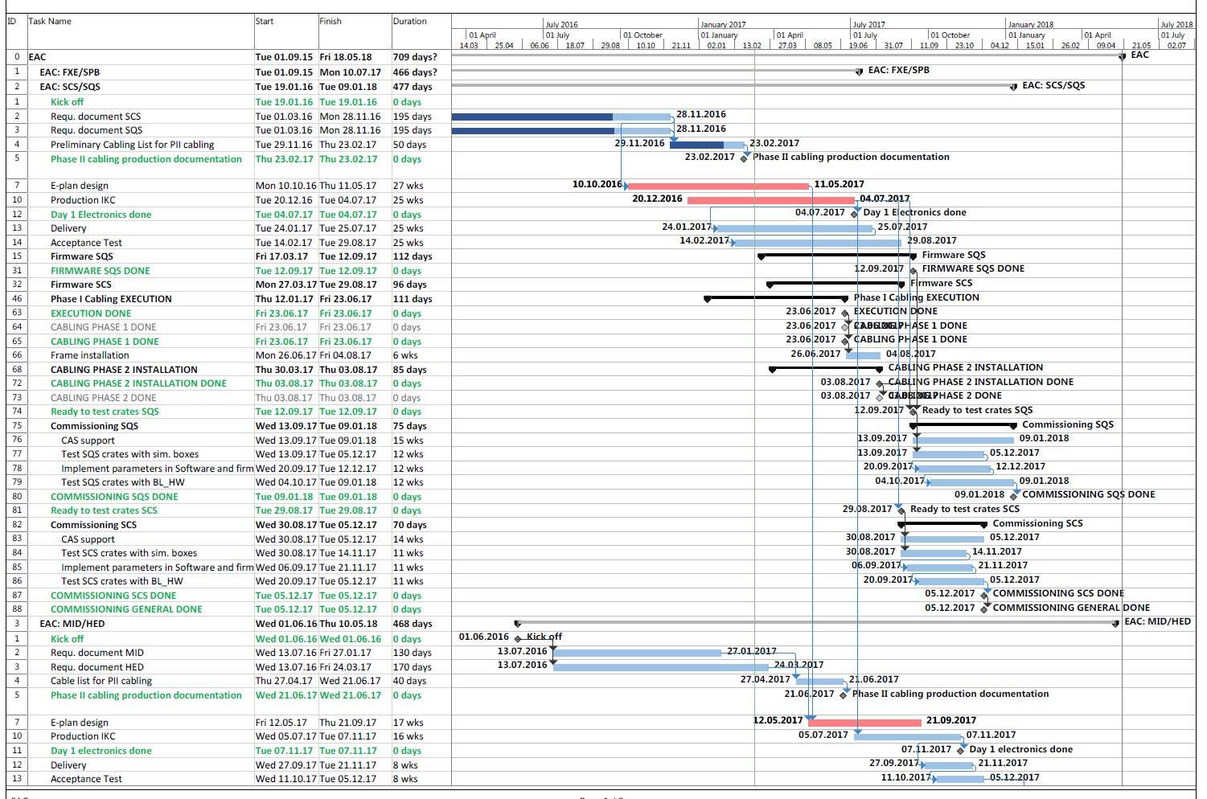
Planning overview

Slide 6
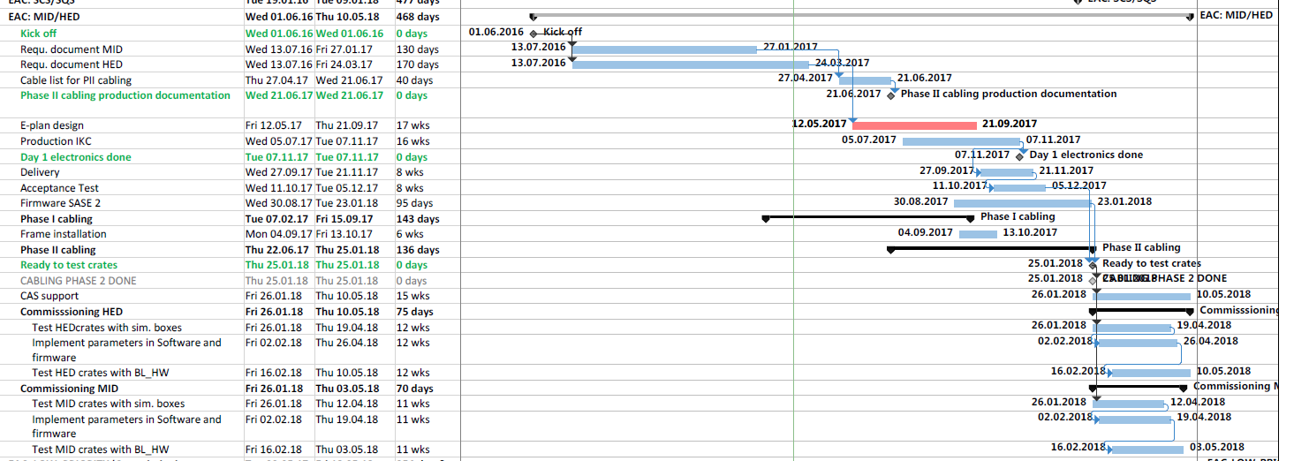
Planning overview

