Slide 1
73th Section Coordination Meeting XHEXP1
A. Violante (PSPO)
10.3.2017

Slide 2
Agenda
SASE1-3 Status Updates
Beckhoff electronics – Status Report (M. Areste)

Slide 3
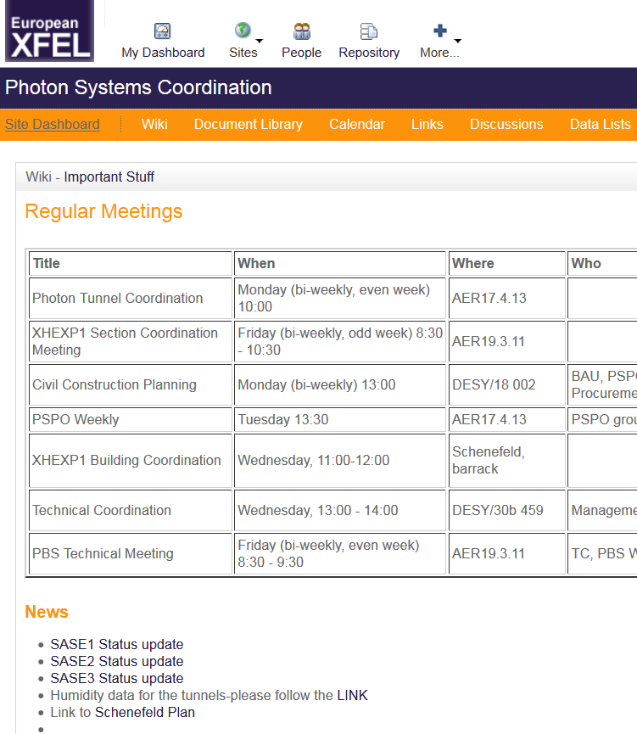
SASE1-3 status update
Summarize most recent and current time-critical tasks / dates for each SASE individually.
At least weekly updated.
In Alfresco: Document Library/Planning
SASE1 Status update
SASE2 Status update
SASE3 Status update

Slide 4
SASE1

Slide 5
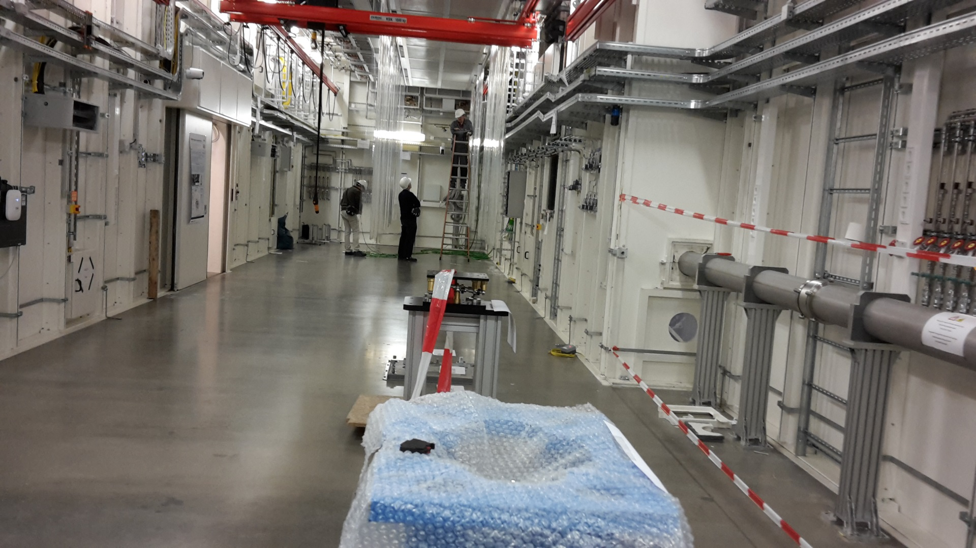
8.2.: SPB-Experiment D.09 with curtains, first cables being pulled.

Slide 6
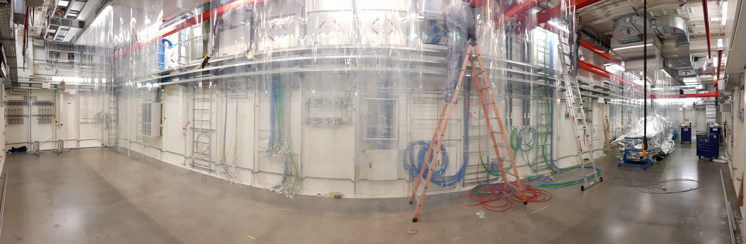
08.3.: SPB EXP D.09 - All the curtains installed, cabling continues, NKB chambers in!

Slide 7
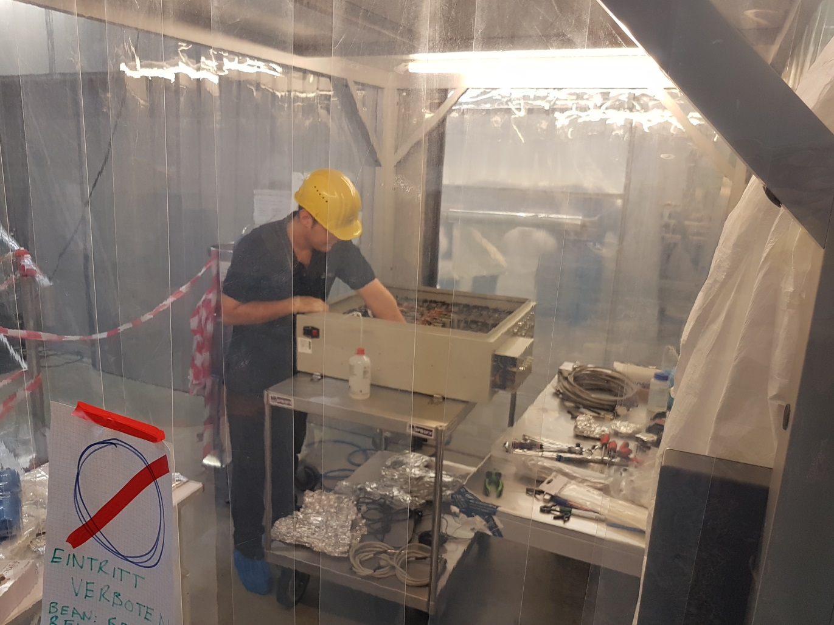
08.3.: SPB OPT D.02- MKB chambers in. Mechanics being mounted in clean room conditions.

Slide 8
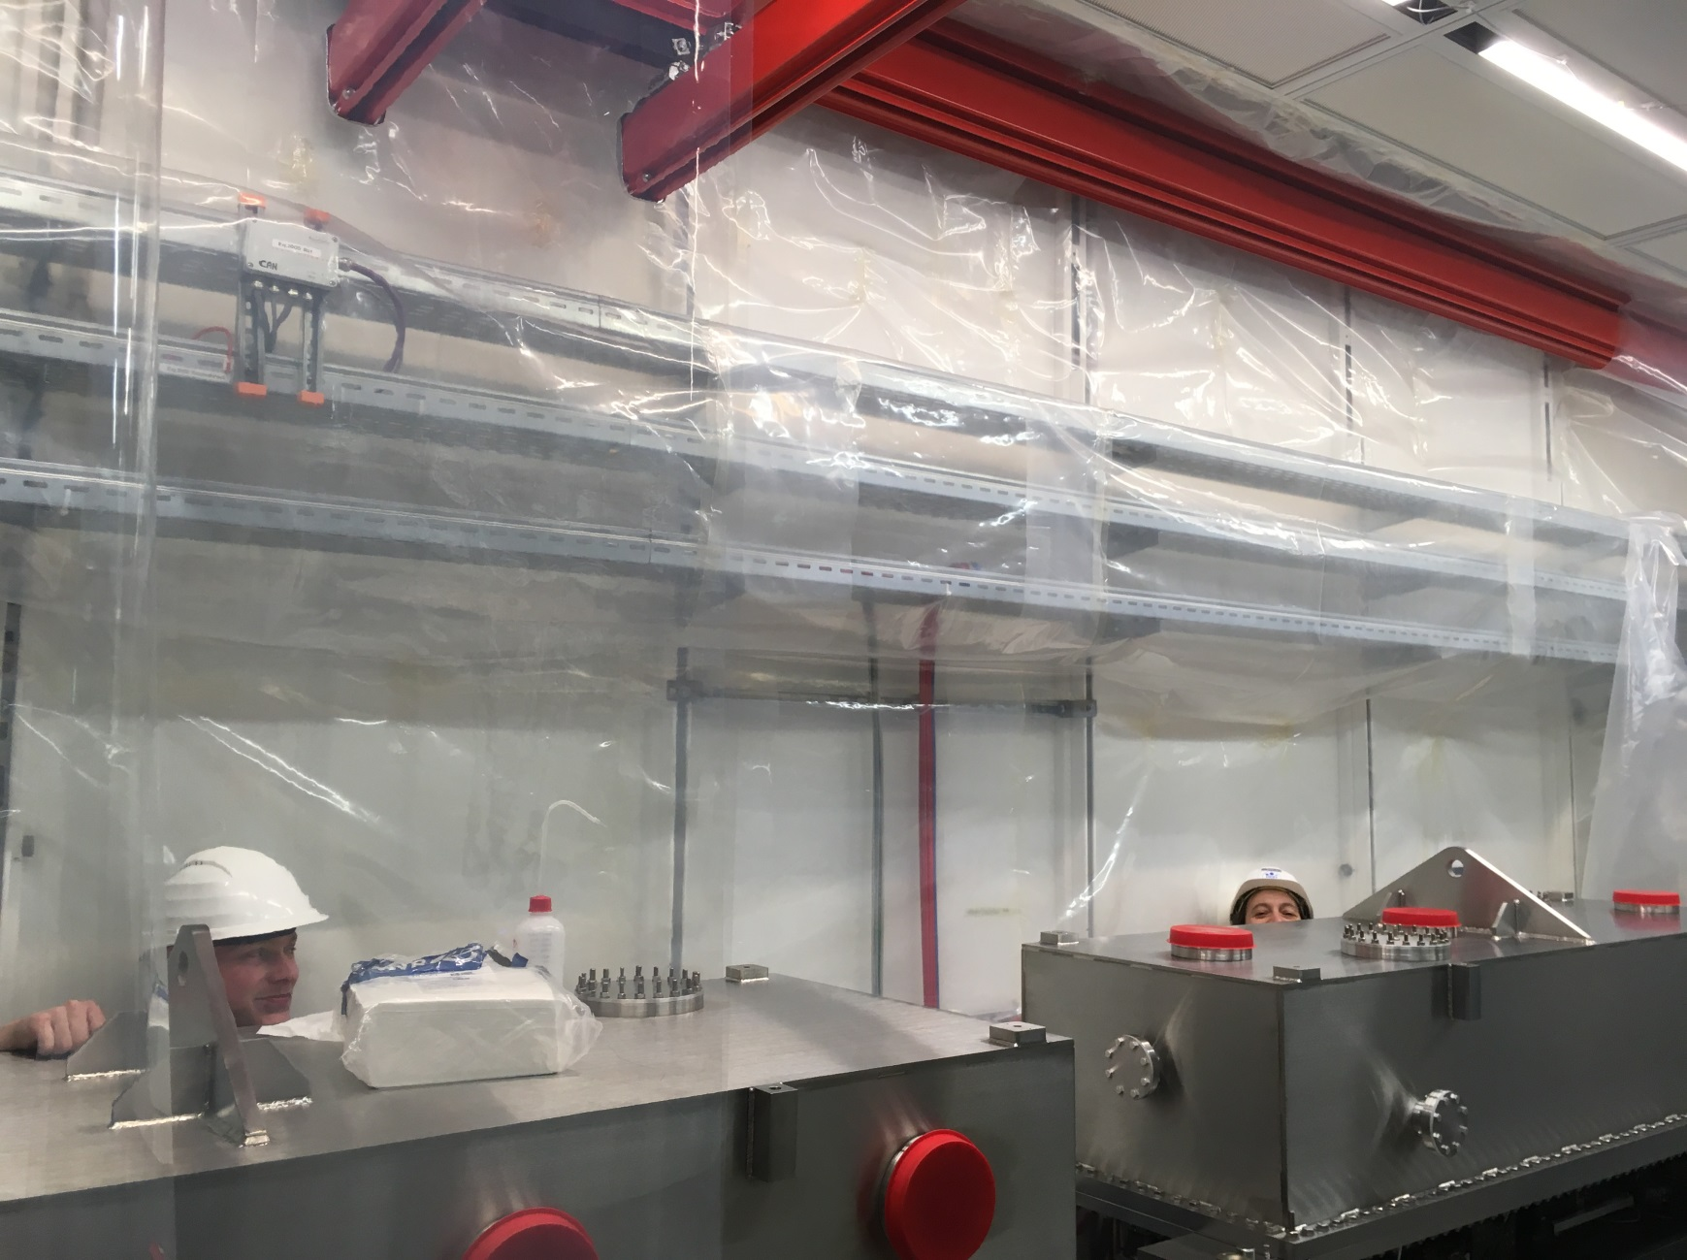
From Inside D.02! Preparation of the clean tent (Courtesy of Richard Bean)

Slide 9
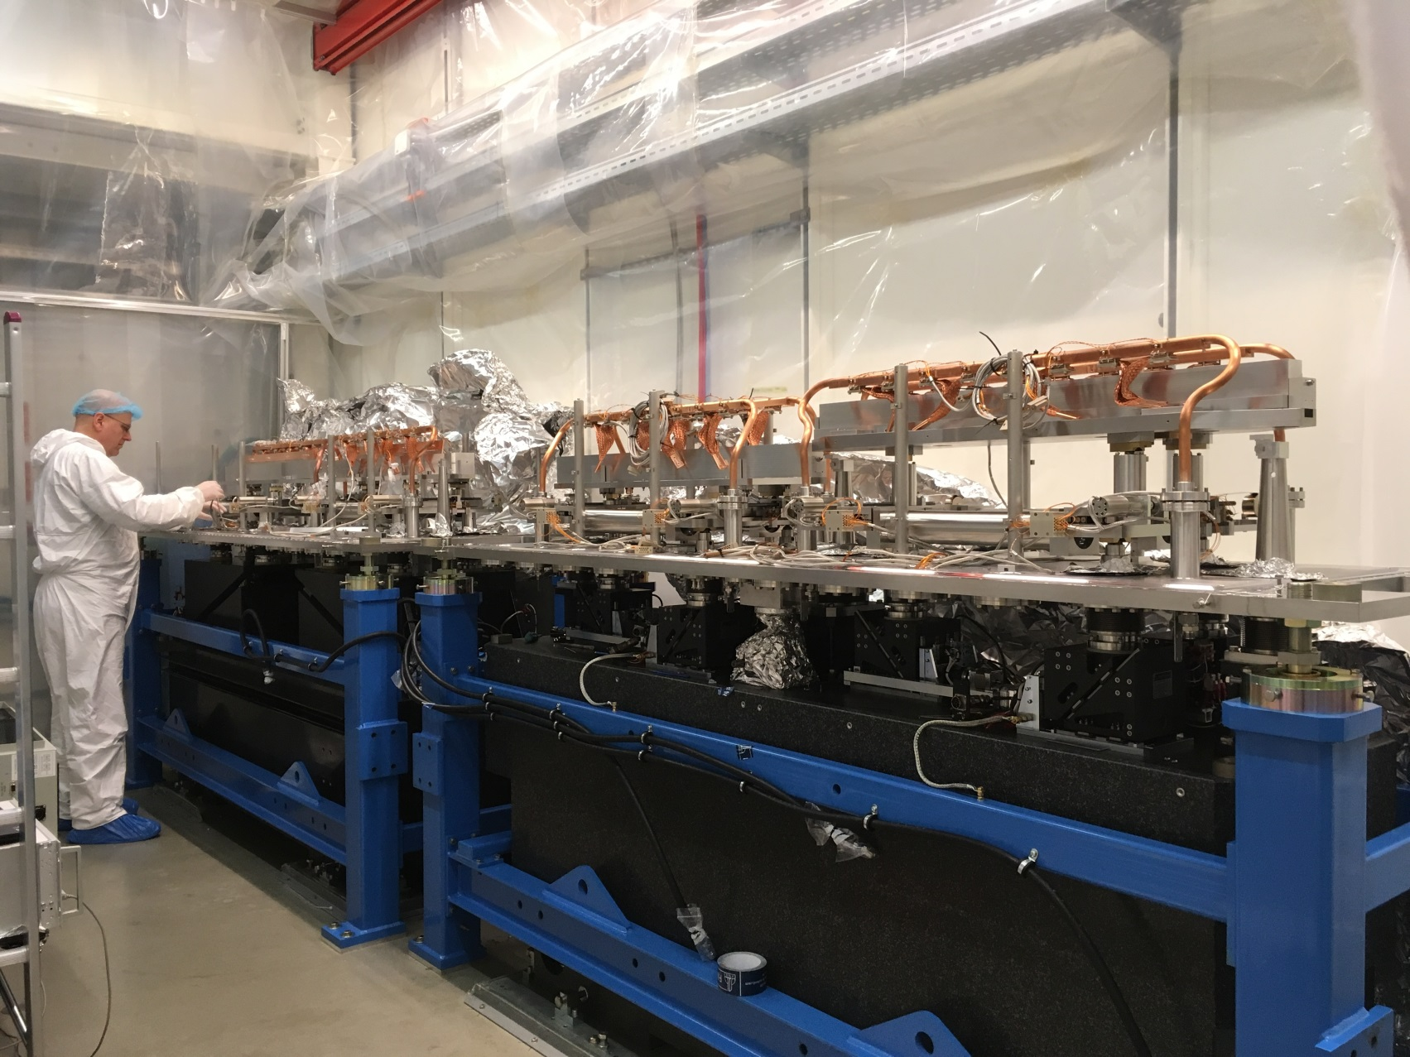
From Inside D.02! Inside the boxes (Courtesy of Richard Bean)

Slide 10
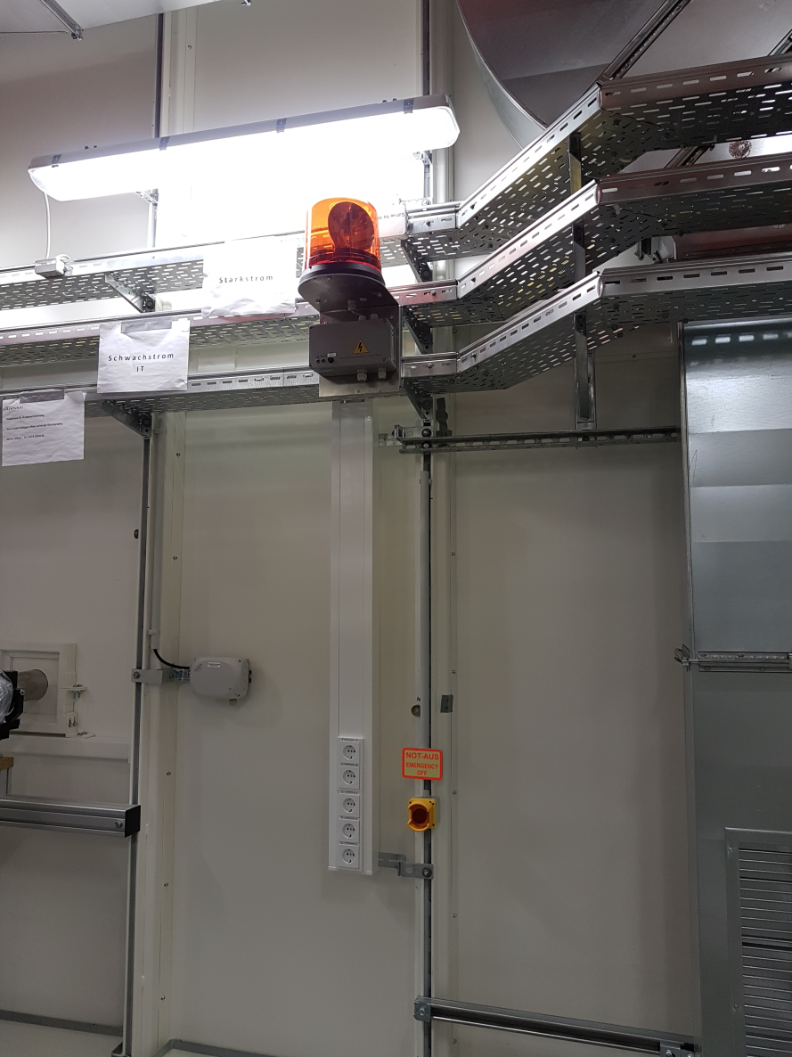
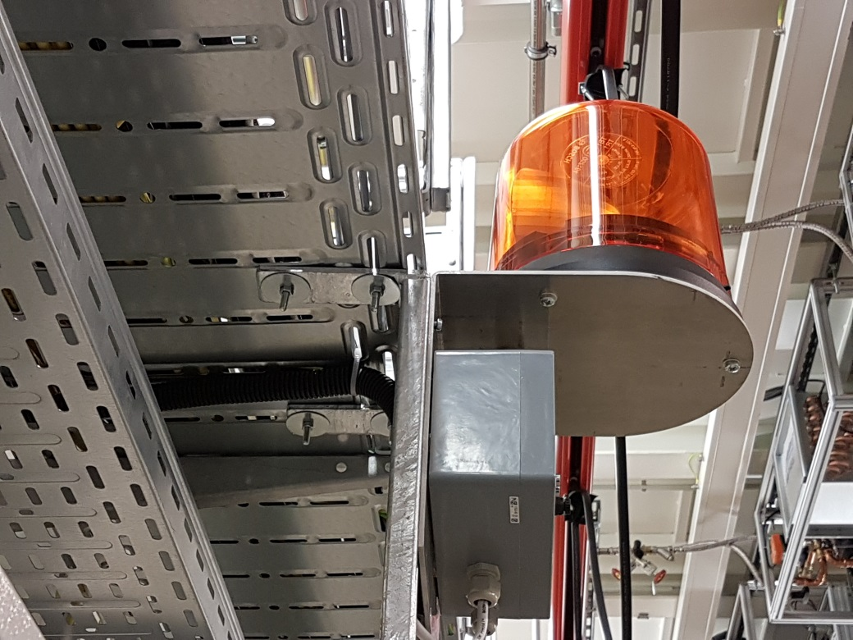
08.03 : Interlock installations being cabled

Slide 11
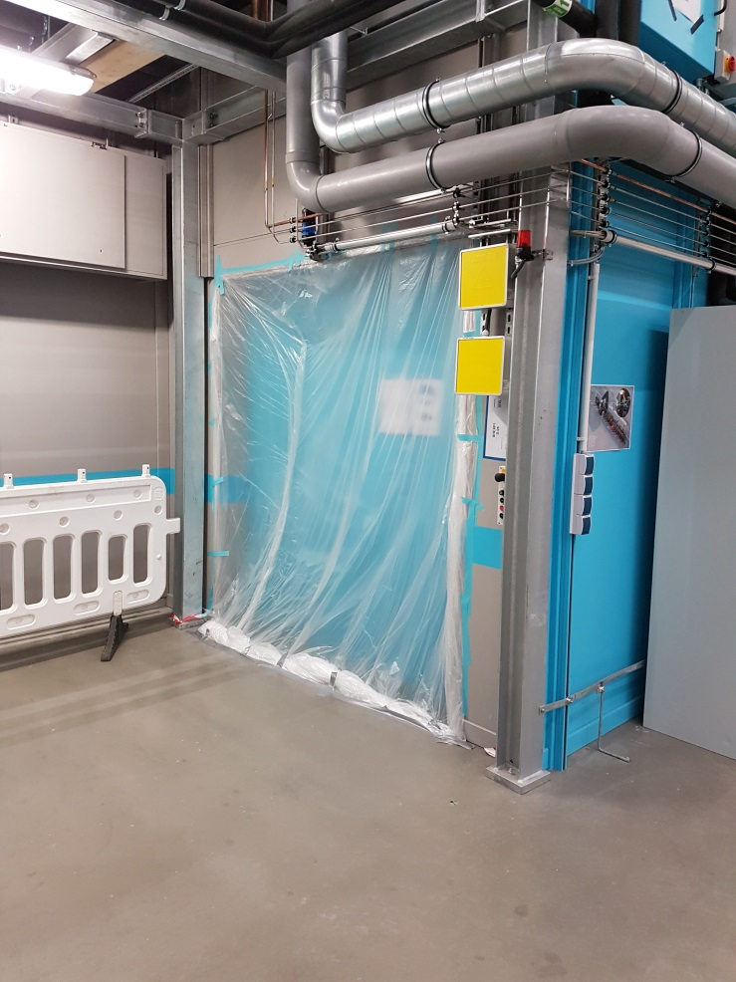
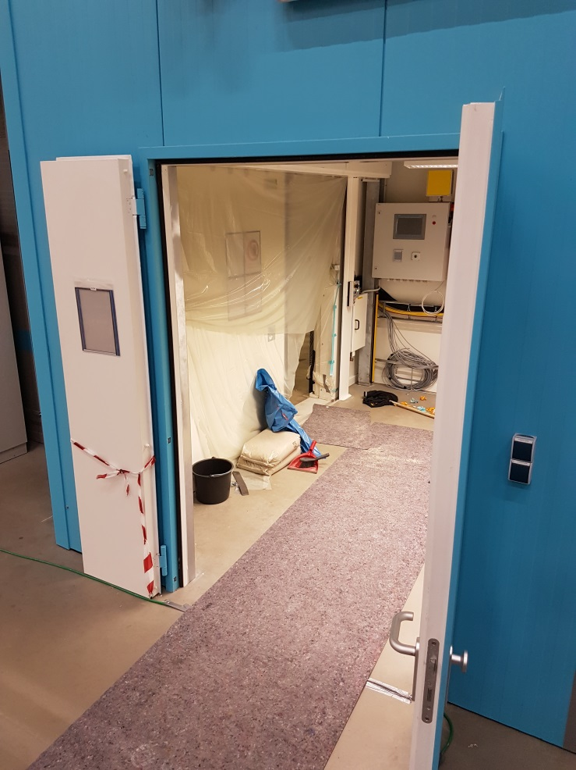
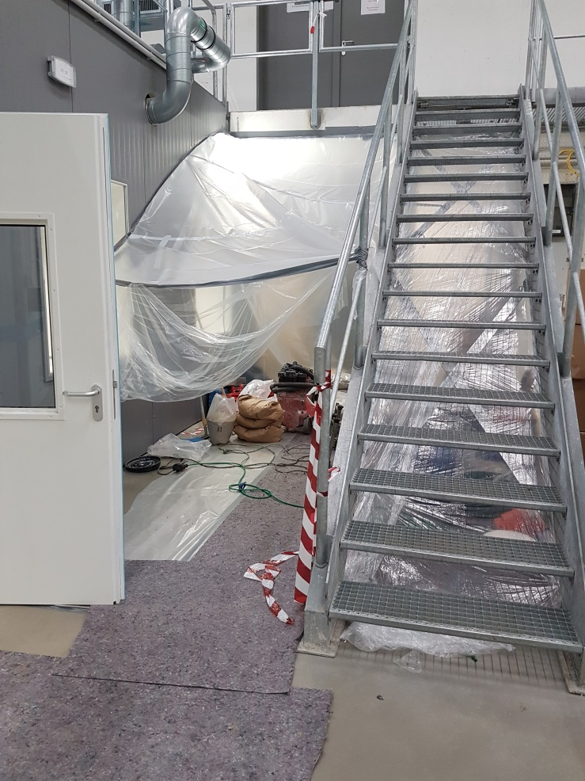
08.03.: FXE floor being grinded – measures against dust

Slide 12
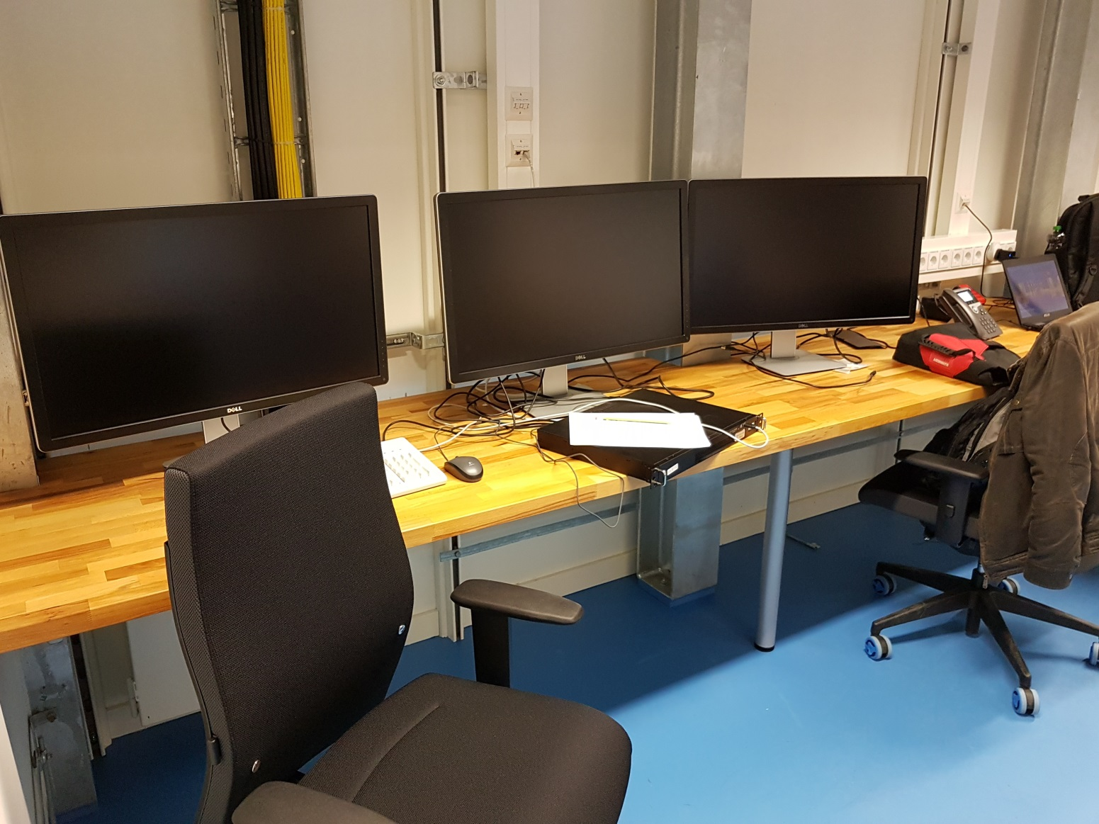
08.03.: SPB control room being set up (FXE as well)

Slide 13


Phase II cabling
D.05 – FXE Exp. “Fertigmeldung„ received
XTD9 – SPB components “Fertigmeldung„ received
D.02 – SPB Opt. Final 22 (250) cables arriving next week
D.13 – SPB Laser Final 16 (130) cables arriving next week
D.09 – SPB/SFX Exp. More than 50% installed, ongoing
Wall connection boxes (D.05, D.09) arriving in KW12
➔ Test of the beckhoff loops by AE in FXE starting.

Slide 14
Final acceptance tests (VOB-Abnahmen)
Dräger (Gases): VOB-Abnahme 15.2.
Jeske (Sanitary): VOB-Abnahme 13.2.
A+S (Fire saf.): Docs received and being checked. ➔ VOB-Abnahme 15.03.
Engie (AC):
Measurements ongoing – Curtains in D.05 to be delivered
➔ VOB-Abnahme ca. end of March

Slide 15
SASE3

Slide 16
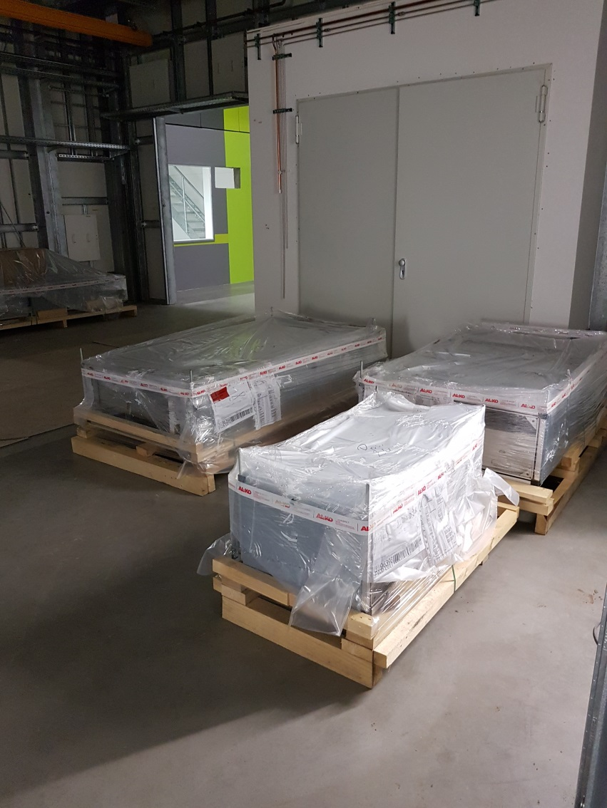
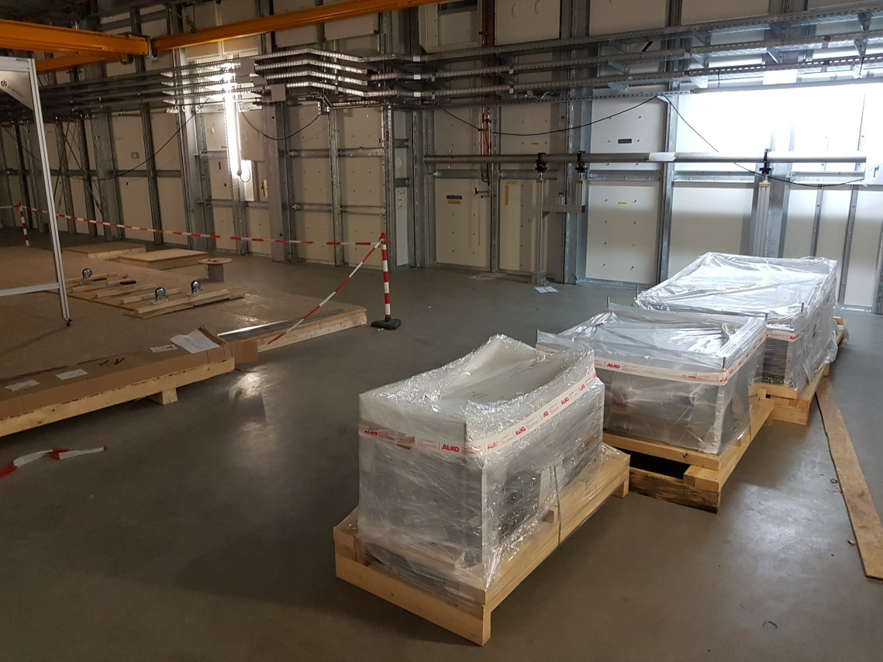
08.3.: SQS/SCS exp hutches - AC devices (Caverion) have arrived!

Slide 17
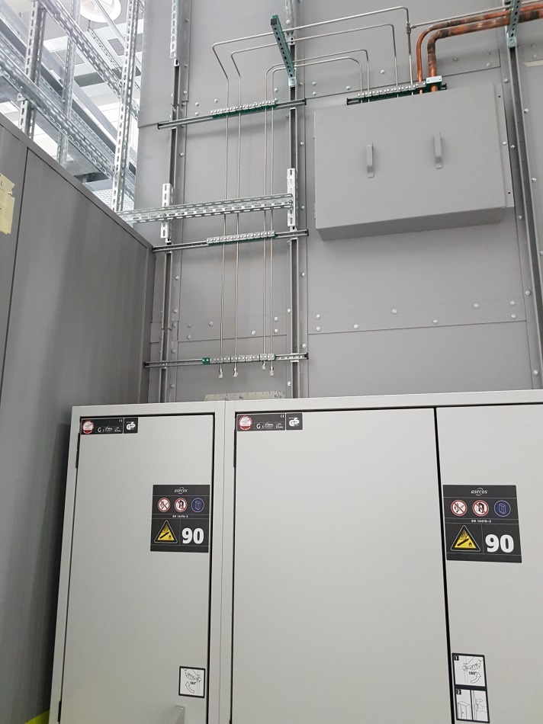
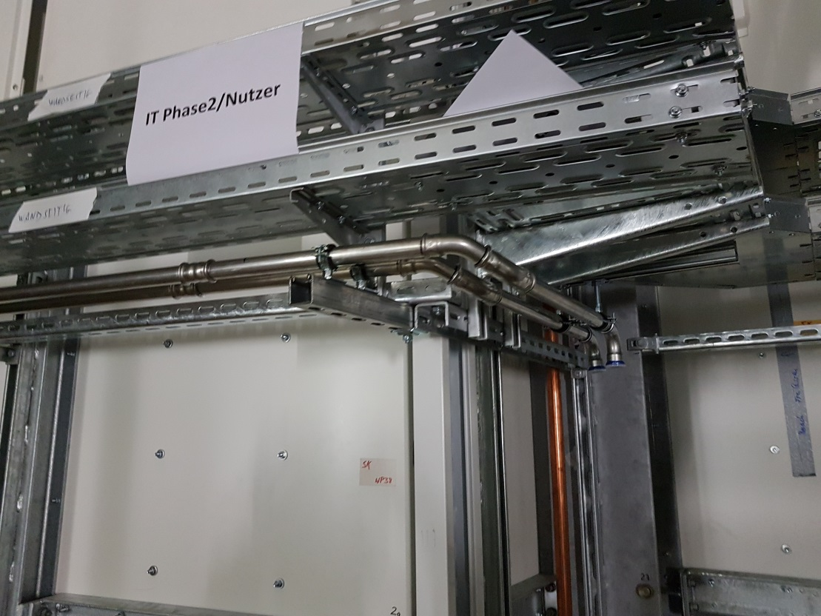
08.3.: Media installation ongoing

Slide 18
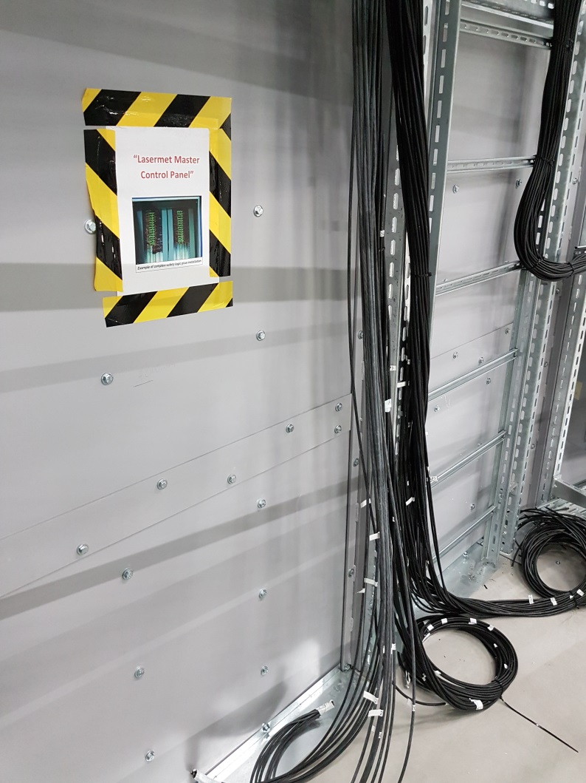
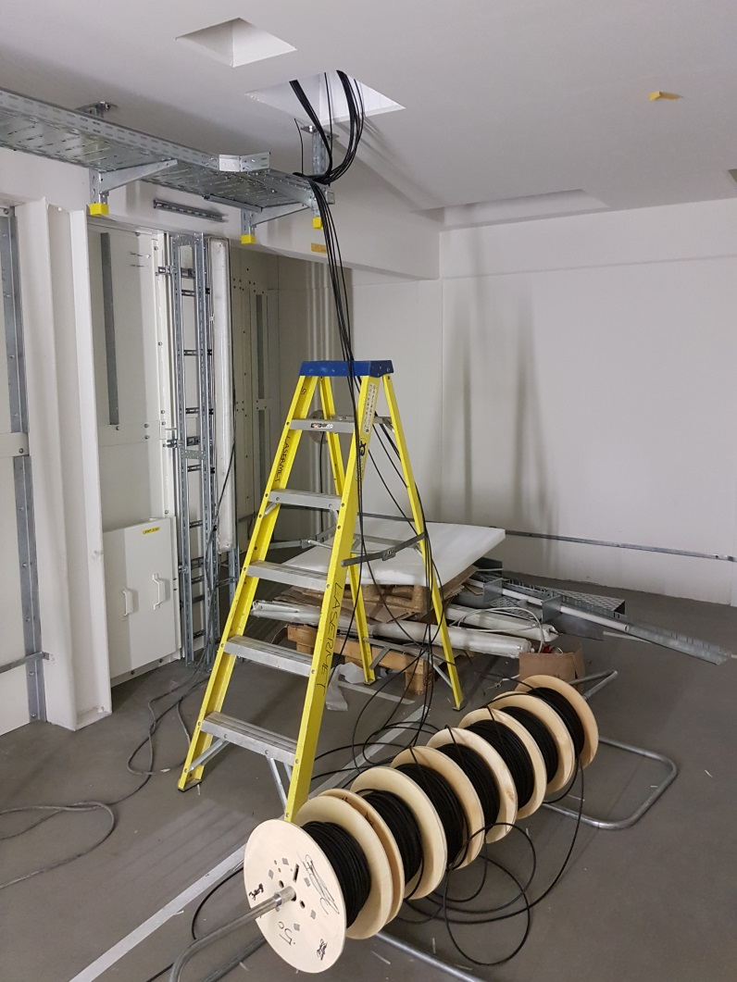
08.03.: LaserMet started pulling the laser Interlock cables in the entire SASE3

Slide 19
SASE2

Slide 20
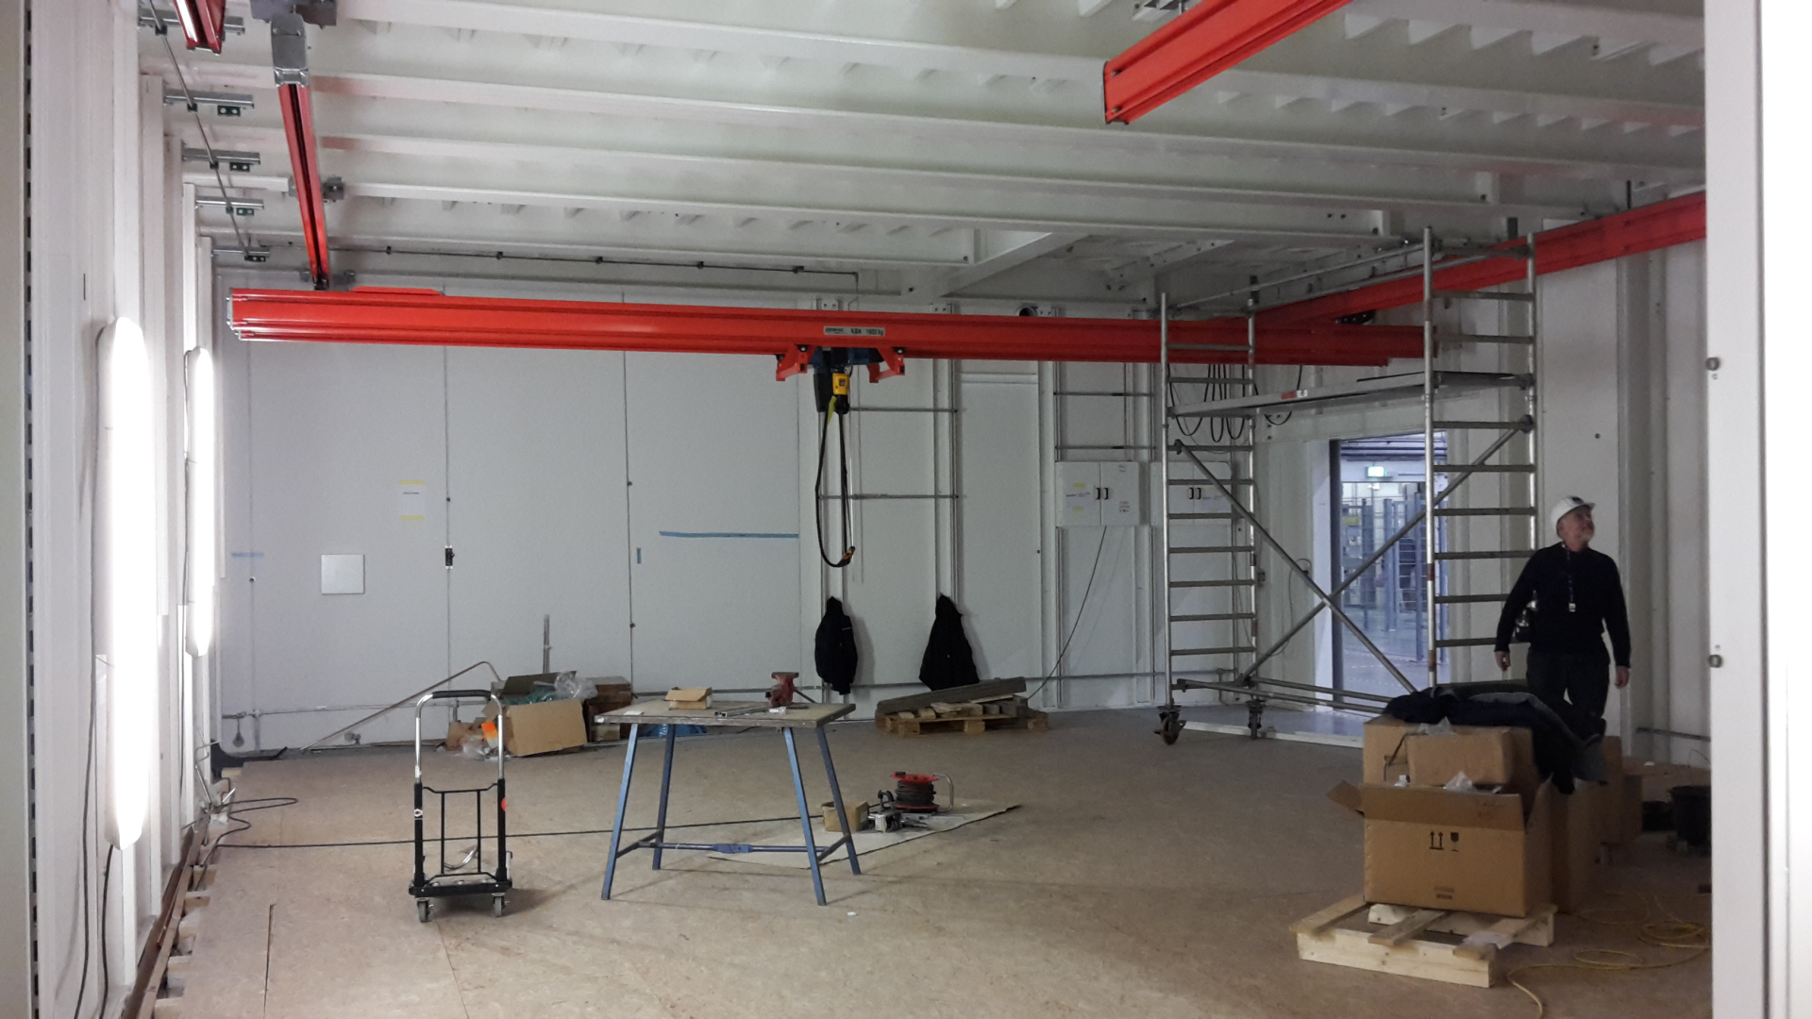
8.2.: 2nd Crane in MID-Experiment has been installed

Slide 21
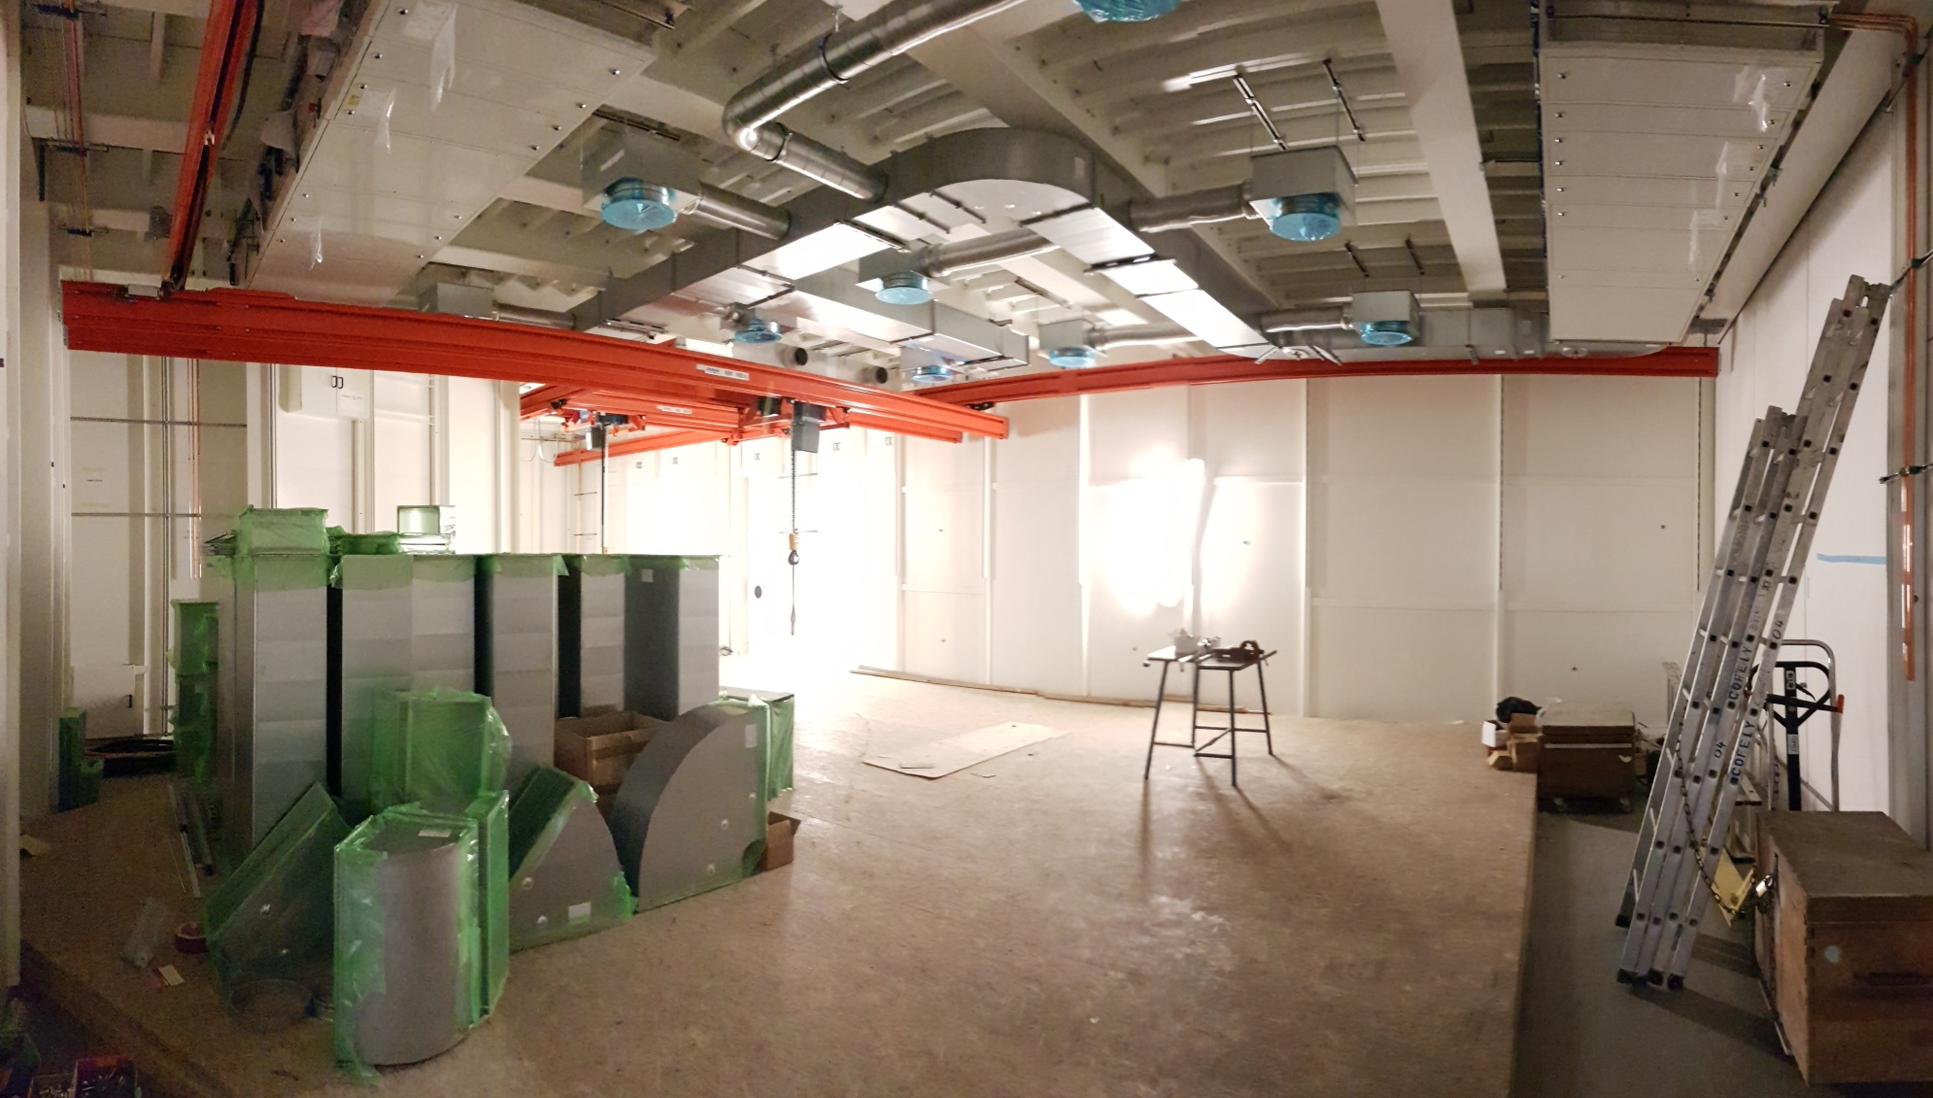
8.3.: Air ducts+AC devices being installed in MID Exp

Slide 22
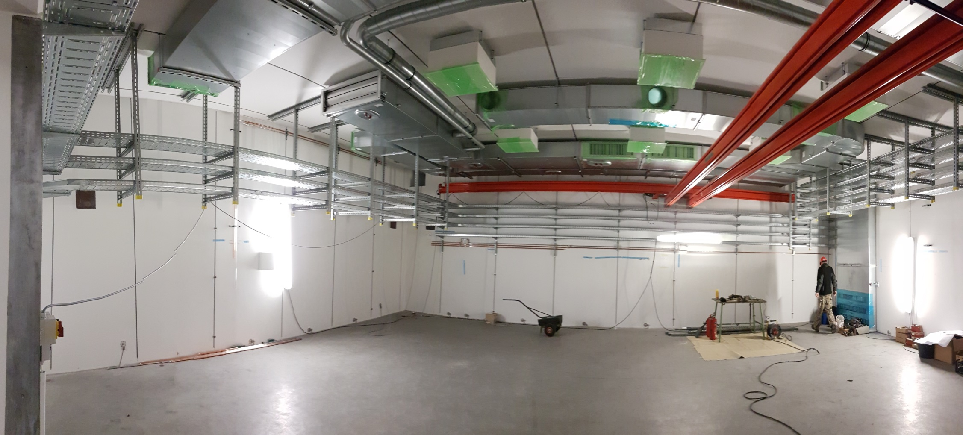
8.3.: Cable trays being installed (HED Enclosure)

Slide 23
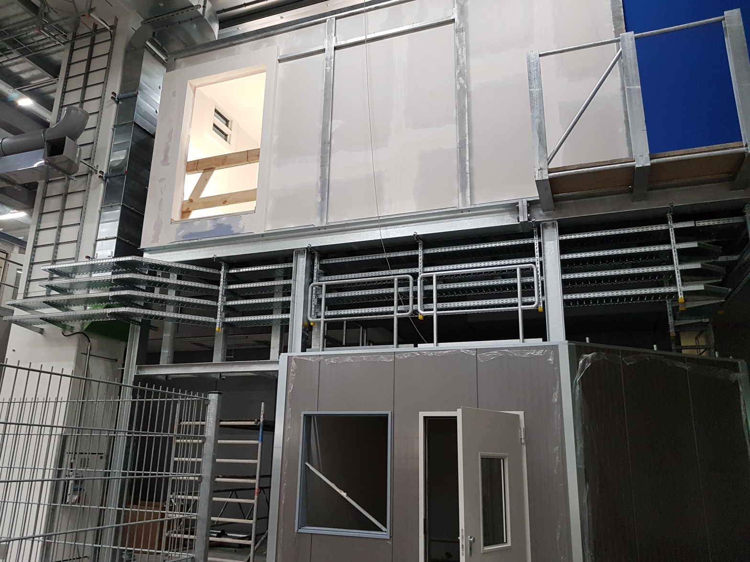
8.3.: Cable trays being installed (outside)

Slide 24
Upcoming Dates & Meetings
Today, 9:00: SASE1 Readiness
17.3., 8:30: Regular TC-Meeting

