Slide 1
XGM – progress week 10 / 2017
Dr. Jan Grünert
X-ray Photon Diagnostics
Group Leader
Hamburg, March 10th, 2017
Contains information from WP74 team
and from K.Tiedtke / F.Jastrow from DESY-FS-FL-D

Slide 2
XGM - Progress (w10)
XGM@XTD2
ADAM&Femto crate installed
XGM@XTD9
ADAM&FEMTO crate installed
Installation of signal cables and local cables on chambers: DONE
Cabling installed for XGM-vacuum-to-Beckhoff (but not yet “plugged in”)
Survey&Alignment: DONE / OK
XGM@XTD10
Electronics crates (MTCA and HV crate) installed and wired to network
Survey&Alignment: DONE / OK
XGM gas supply
Installed bottles in gas cabinet XS3-UG1: B50 N2 200 bar, B50 Ar 200 bar, Kr 100 bar, Xe 6 bar

Slide 3
XGM – Repair Progress Summary (w10)
XGM | Preparation | Resistor exchange | Leak test | HV test | Survey
HERA XGM01 | done | done | done
XTD2 XGM02 | done | done | done | done | done
XTD9 XGM04 | done | done | done | done | done
XTD10 XGM07 | done | done | done |  | done*
XHE3 XGM05
XHE3 XGM06

Slide 4
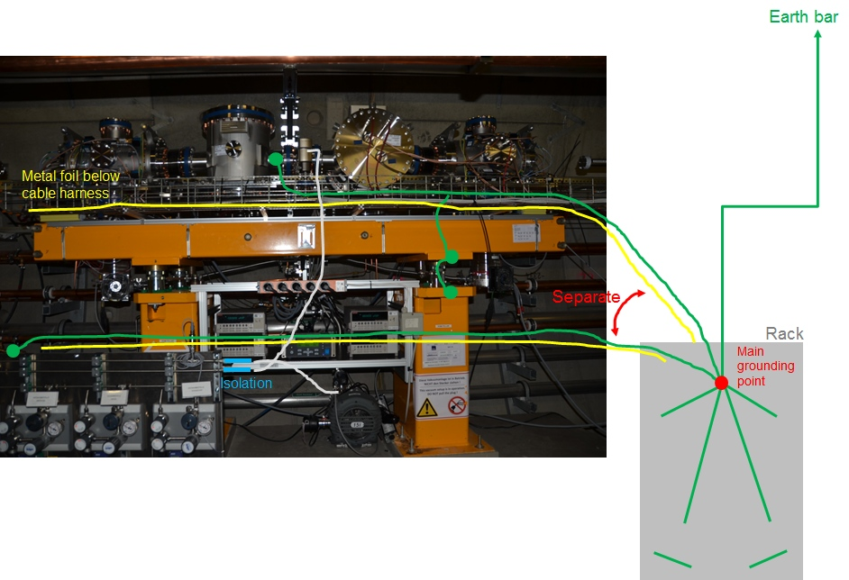
Grounding of XGMs
Grounding recommendations by DESY: Peter Göttlicher, Narcisse Ngada, Fini Jastrow

Slide 5
XGM - Plan week 11
Planning of Next Repairs and Grounding Works
Installation of cable connection Girder ← → ADAM&FEMTO crate in XTD2+9
XGM@XTD9
Finalize XGM-vacuum-to-Beckhoff wiring probably on 9.3.2017
Local VAC Beckhoff test next week (w11)
XGM@XTD2
Commissioning of all slow DOOCS controls (Keithleys, SRG, HV, RVC, ADAMs, FEMTOs)
XGM@XTD10
Start of cabling work
This will mark the end of XGM cabling work in SASE1 !

