Slide 1
Control area in SFX hutch for photon tunnel commissioning
Liubov Samoylova
X-ray Optics Group
Mar 3, 2017
based on info Adrian Mancuso, Marc Messerschmidt, Krzysztof Wrona, Janusz Szuba, Bartosz Poljancewicz
Sandor Brockhauser

Slide 2
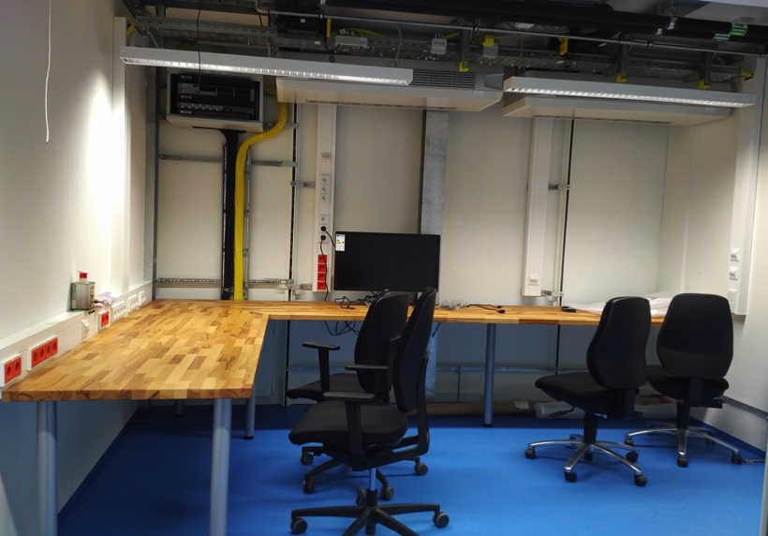
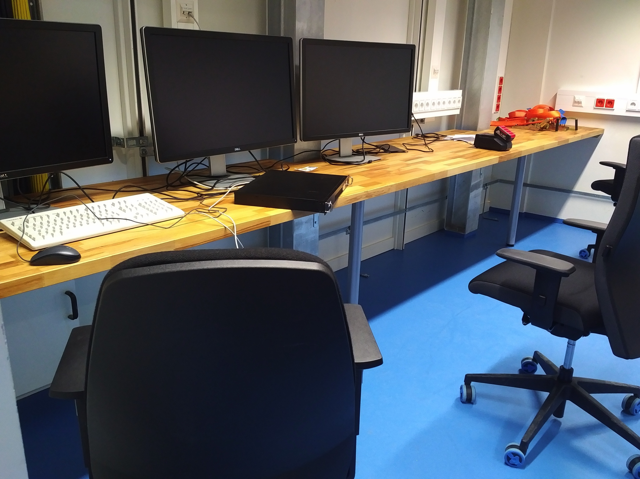
Control area in SFX hutch
This week hardware was available: dedicated PC + 2x 32” monitors + 2-3 regular ‘office’ monitors
Configuration of dedicated PC with Karabo installation on-going
Connection to BKR foreseen via Cisco Meeting at an office PC
For commissioning: a few web cameras to look at optical components
plug into control network
stands for mounting cameras close to critical components (next slide)
By the mid of w10 the first control area installation might be ready.
Who is doing BKR installation?
Control area in SFX hutch
SPB hutch

Slide 3
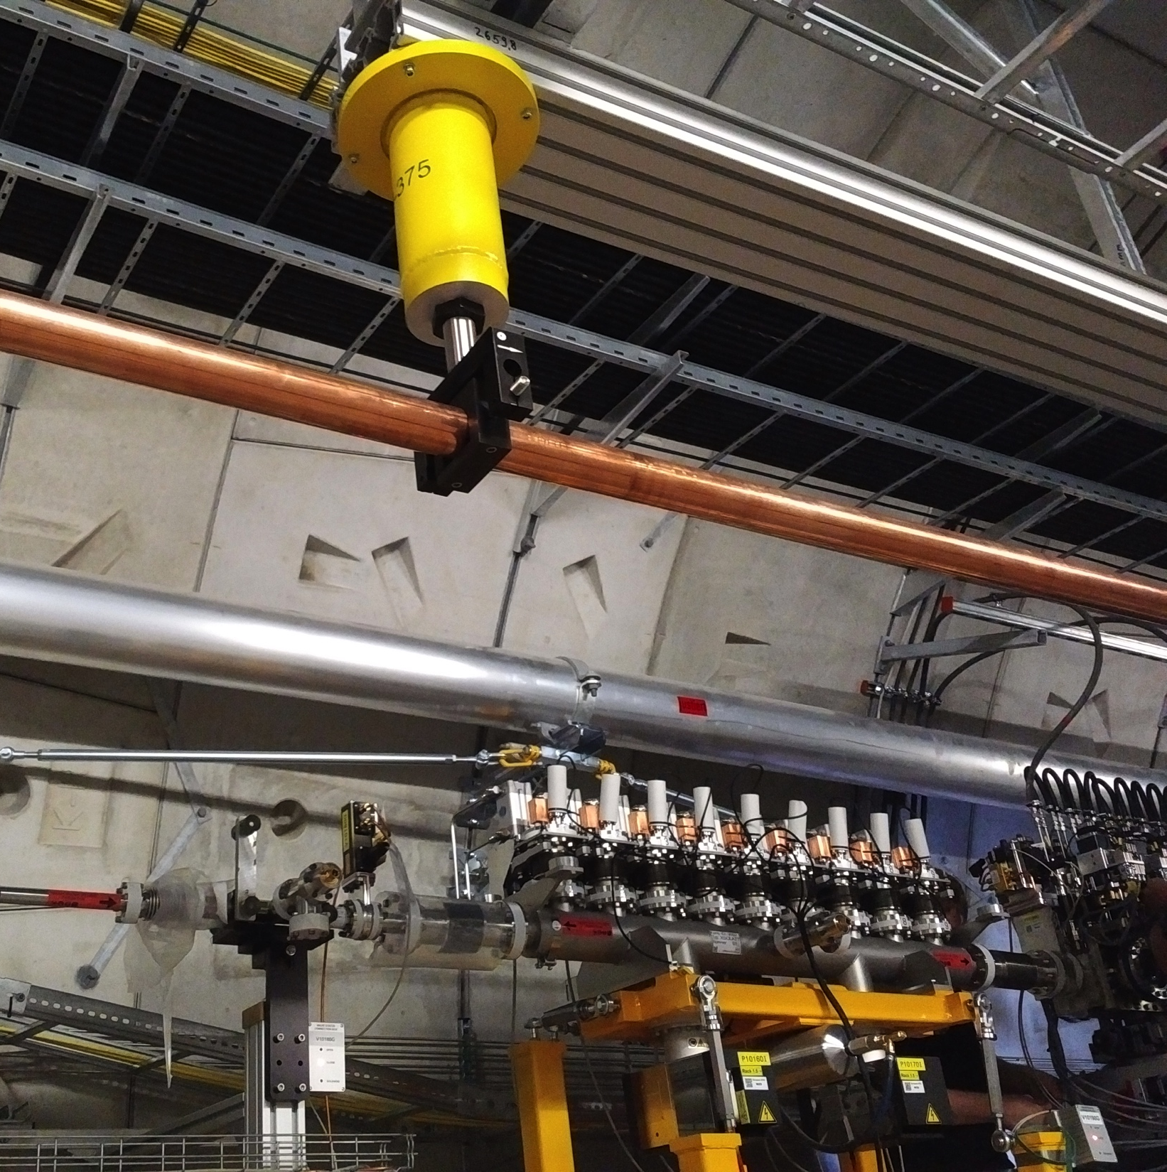
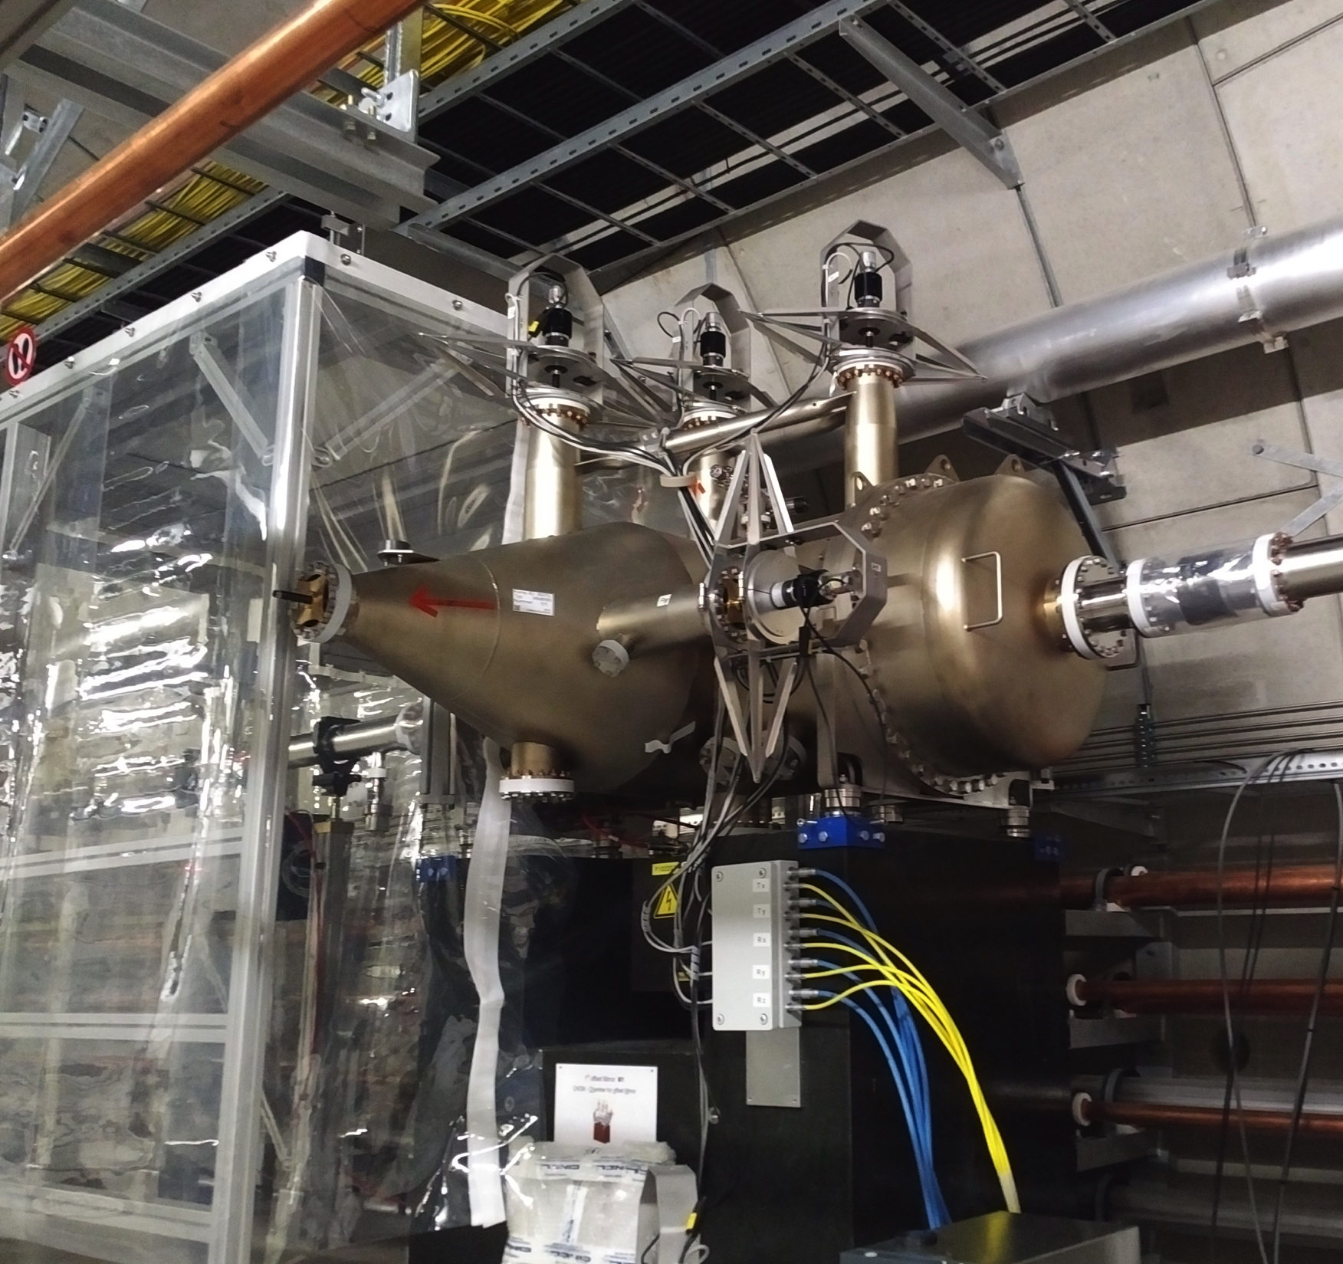
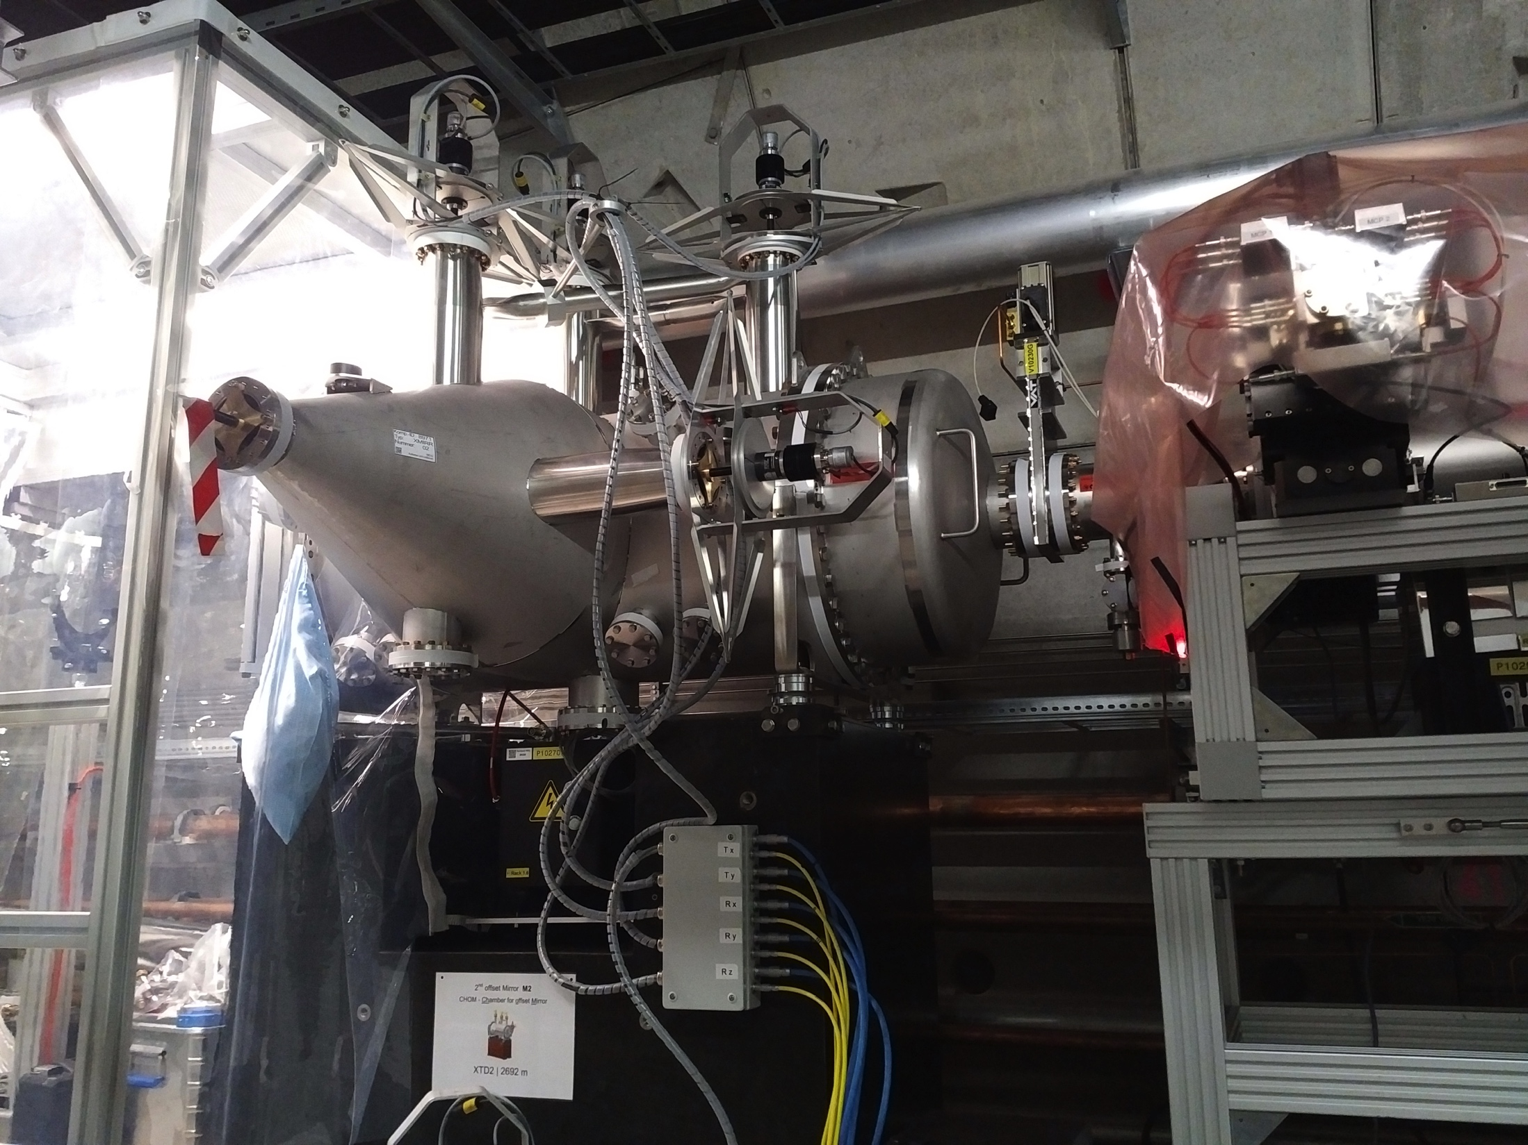
possible views of webcams in XTD2
Solid attenuator
Mirror 1
Mirror 2

Slide 4
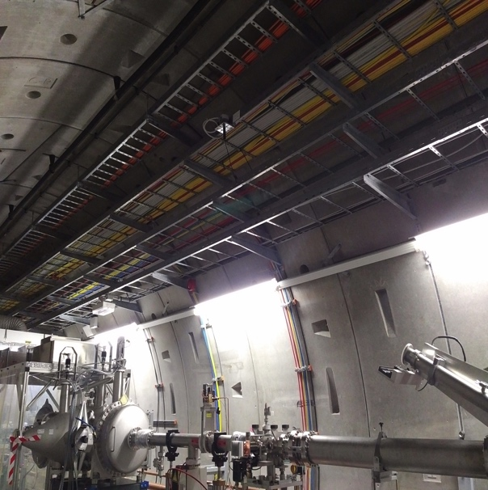
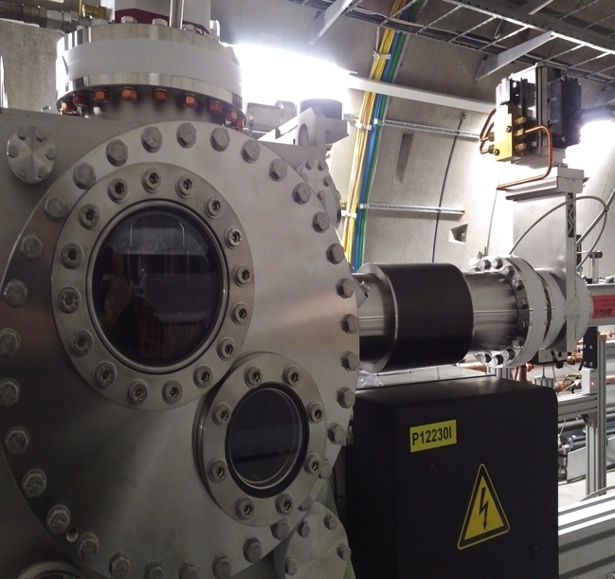
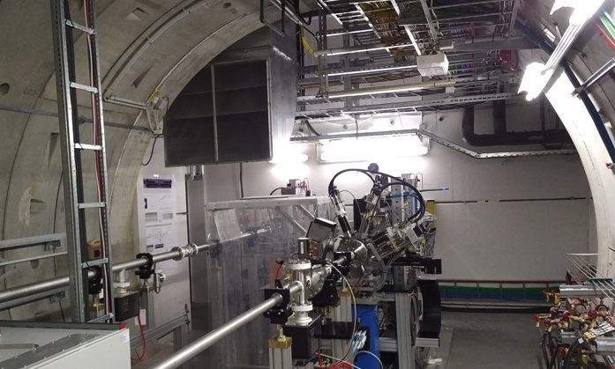
possible views of webcams in XTD9
Distribution mirror
FXE mono
SPB attenuator

